Slide 1

SMART INDIA HACKATHON 2026
AlertX
Team Submission | Smart India Hackathon 2026
Problem Statement ID: 26146
Problem Statement Title: AI-Powered Monitoring & Analysis of Bitcoin Transaction Traffic
B
Theme: Blockchain & Cybersecurity
PS Category: Software
Team ID:
Team Name: AlertX
BLOCKCHAIN | AML | NTRO
@SIH Idea submission- Template
1

Slide 2

₿
Bitcoin AML Surveillance · Air-Gapped · Offline Intelligence Platform
SIH26146
Proposed Solution
THE SYSTEM · SIH26146 — an end-to-end, fully air-gapped platform fusing offline blockchain graph analytics, MaxMind GeoIP/ASN enrichment, and CPU-only deep learning to flag illicit Bitcoin transaction patterns and emit court-admissible forensic dossiers for NTRO cyber-surveillance analysts.
PILLAR 1 · MULTI-LAYER INGESTION & CORRELATION · Bulk CSV / JSON / XML traffic captures flow through FastAPI + Celery (Redis broker), are enriched offline with MaxMind GeoLite2 (City + ASN), and persisted via binary COPY into PostgreSQL 16 and Neo4j 5.26 + GDS 2.13.
PILLAR 2 · GRAPH ANALYTICS & ANOMALY CORE · Neo4j Louvain community detection plus CIOH (Common-Input-Ownership) heuristics cluster multi-input entities; a 7-layer PyTorch Autoencoder and FT-Transformer score 18-feature transactions (F1 = 0.6972, latency 0.0222 ms) on CPU alone.
PILLAR 3 · LAUNDERING PATTERN ENGINE · Deterministic Cypher rules detect peeling chains (97.2 % recall ≥ 5 hops) and CoinJoin mixers (100 % recall ≥ 3-in / ≥ 3-out equal denominations); a Graph Transformer (F1 = 0.9209, AUC = 0.9956) propagates risk from Ransomwhere seed entities across 24,673 wallets.
PILLAR 4 · EXPLAINABLE TACTICAL DASHBOARD · SHAP waterfall plus GNNExplainer subgraphs power a Next.js 16 Tactical Command Center with a master alert grid, D3 force graph, and 1-click JSON / PDF dossier export — running 100 % air-gapped on commodity CPU hardware.
@SIH Idea submission- Template
2

Slide 3
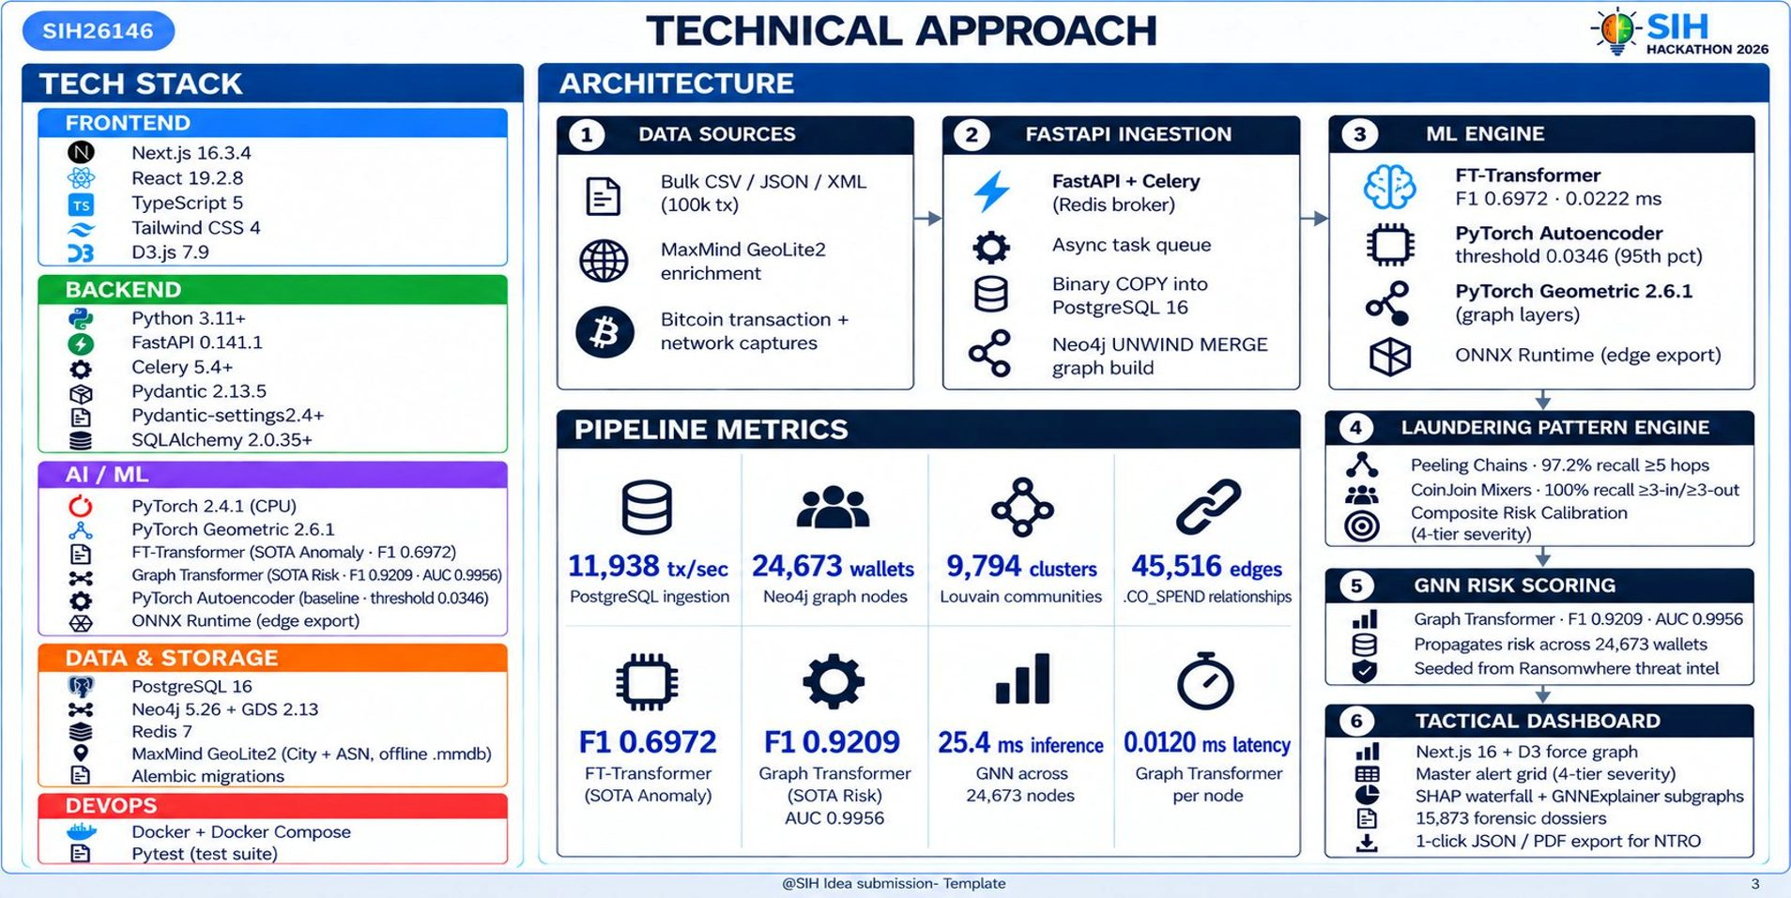
₿
Bitcoin AML Surveillance · Air-Gapped · Offline Intelligence Platform
SIH26146
Technical Approach

Slide 4
₿
Bitcoin AML Surveillance · Air-Gapped · Offline Intelligence Platform
SIH26146
Feasibility and Viability
⚙️ Feasibility
🛡️ Solutions
● Technical: FastAPI 0.141.1 + Next.js 16 + Neo4j 5.26 + PyTorch — fully open-source, no proprietary hardware.
● Air-Gap: CPU-only ONNX-exportable models — no GPU, no internet, no cloud dependency.
● Modular: backend (FastAPI/Celery), graph DB (Neo4j + GDS 2.13), frontend (Next.js) deploy independently.
● Algorithm: Louvain community detection + CIOH heuristics + FT-Transformer — peer-reviewed graph analytics.
● Market: NTRO cyber-surveillance mandate + Interpol + FATF travel-rule; growing demand for BTC AML analytics.
● Economic: commodity-CPU node vs $250K–$500K commercial suites — orders-of-magnitude cheaper.
● Training: class-weighted loss + SMOTE on 18 hand-crafted features — F1 0.6972 anomaly, F1 0.9209 risk.
💰 Viability & Business Potential
👥 Use Cases
● Production Champion: FT-Transformer F1 0.6972, AUC 0.9956, 0.0222 ms / inference.
● NTRO Cyber Analysts: 4-tier severity master alert grid + D3 force-graph drilling on suspect wallets.
● Cost Efficiency: sub-$1K commodity CPU vs $250K–$500K commercial — extends budget 250×.
● Forensic Investigators: SHAP waterfall + GNNExplainer subgraphs for traceable, defensible case files.
● Compliance: court-admissible JSON + PDF dossiers with tamper-evident SHA-256 chain.
● Resilience: 100% air-gapped — immune to network outages, DDoS, sovereign-cloud risk.
● Field Officers / Liaison: 1-click JSON / PDF dossier export for courtroom delivery and chain-of-custody.
🚧 Challenges
⭐ Supporting Facts
● Synthetic Stream Today: demo runs on anonymized ledger traces; live NTRO transaction feed pilot pending.
➤ 11,938 tx/sec sustained PostgreSQL binary-COPY ingest.
● Edge Hardware: ONNX scripts ready; ruggedised Pi-class node procurement + field hardening in progress.
➤ 24,673 wallets / 9,794 Louvain clusters / 45,516 edges scored.
● Multi-Tenant Scale: multi-NTRO-unit isolation + Celery pool tuning at >100k tx/sec not yet benchmarked.
➤ Graph Transformer AUC 0.9956; 0 / 197 missed high-risk wallets on Ransomwhere seed set.
@SIH Idea submission- Template
4

