Slide 1

Data Science Portal Infrastrure & Setup
DekaBank
Markus Schmid,
Dr. Dieter Korus,
Hendrik Devries,
STATWORX
Sebastian Heinz,
Kai Jennissen,
Stephan Emmer

Slide 2
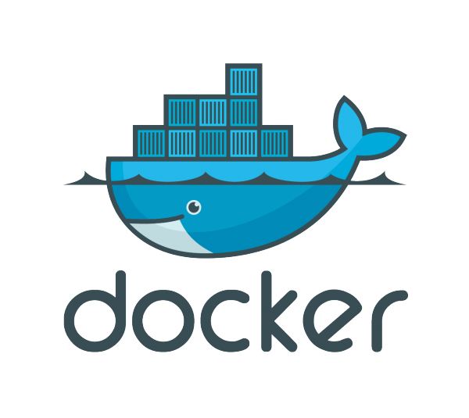








Data Science Portal
Infrastructure
Intranet
On Premise Host Server
Spawn Container
Container
User Login
ShinyProxy
DS-Portal
Pass Through
https://
Mount to Host
Reverse Proxy
Gateway
Backend API
Users
User Login
Spawn Instance
JupyterLab
Instance
JupyterHub
DS-Portal
Individual & Persistent User Directories

Slide 3
Data Science Portal
Setup Guide
1. git clone https://github.com/kaijennissen/docker.git
2. docker pull statworx/deka_data_science_portal:tag
Docker Tags:
nginx
jupyter
mlflow
shinyproxy
rstudio
Alternative:
Navigate to project base folder
Use Makefile: make pull_all
3. Adjust container volume host directory for ShinyProxy application.yml
Navigate to: ./shiny_proxy/source/application.yml
4. Run Setup for jupyter shared libraries
Use Makefile: make run_setup
Alternative:
Navigate to: ./jupyter/docker
Use Makefile: make run_setup
5. Start Docker Container
Use Makefile: make run_all
Alternative:
Navigate to subfolders/docker
Use Makefiles: make run
6. Access the data science portal via the intranet
Rstudio & Mlflow: https://dsp.dk-ningbo.dekager.dekabank.intern:4430/
Jupyterhub: https://dsp.dk-ningbo.dekager.dekabank.intern:4430/jupyter

Slide 4
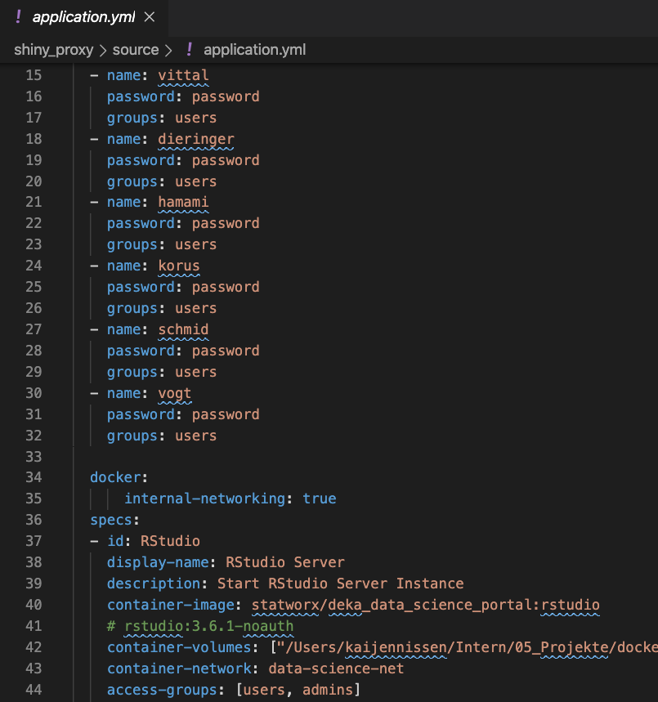
Data Science Portal
Add Users & Passwords – ShinyProxy
1. Navigate to ./shiny_proxy/source
2. Adjust the application.yml
3. Navigate to ./shiny_proxy/docker
4. Use Makefile to reboot ShinyProxy
make rm
make run

Slide 5
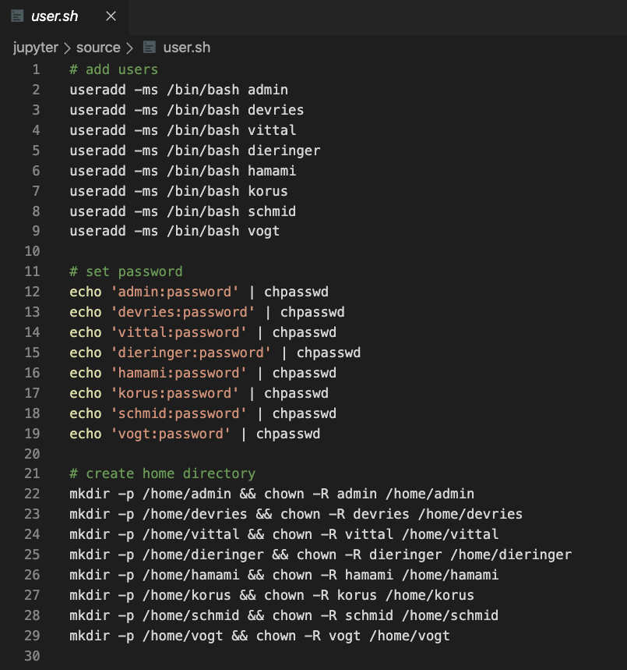
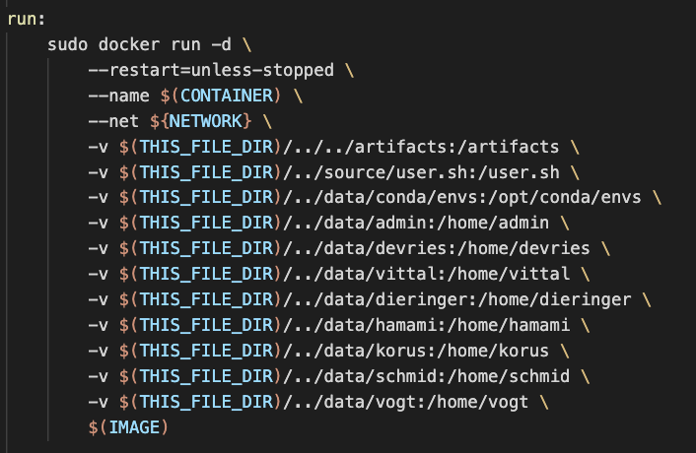
Data Science Portal
Add Users & Passwords – JupyterHub
1. Navigate to ./jupyter/source
2. Adjust the user.sh script
3. Navigate to ./jupyter/docker
4. Adjust the Makefile (make run)
5. Use Makefile to reboot JupyterHub
make rm
make run

