Slide 1
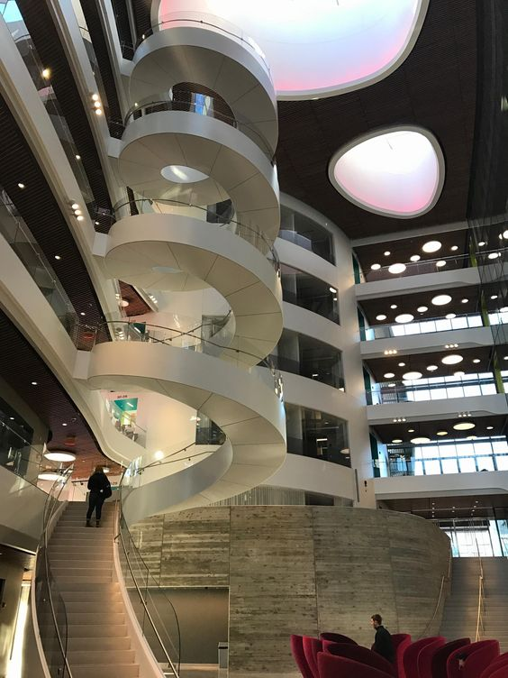
Classification and recognization of RGB images using Pytorch
Kai He
Ruiyue Wang
Jin Dai
Mengyue Duan

Slide 2
Instruction
Dataset CIFAR10
Convolutional Neural Network(CNN)
Gradient Descent
Stochastic Gradient Descent
Final Result

Slide 3
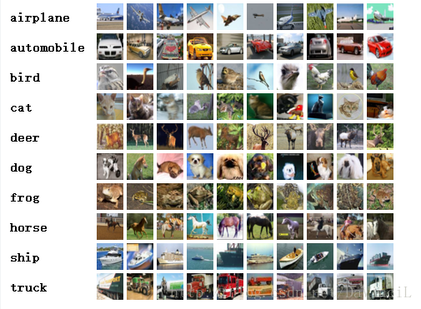
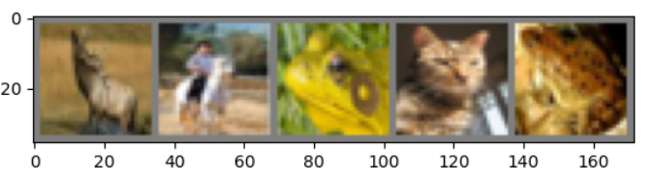
Dataset CIFAR10
The CIFAR-10 dataset consists of 60000 32x32 colour images in 10 classes, with 6000 images per class. There are 50000 training images and 10000 test images.

Slide 4
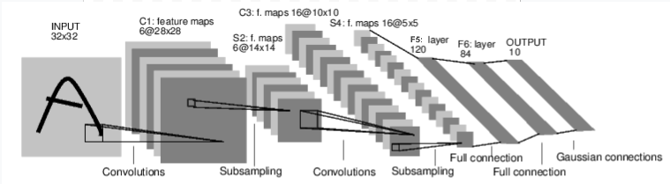
Convolutional Neural Network
The name “convolutional neural network” indicates that the network employs a mathematical operation called convolution. Convolution is a specialized kind of linear operation. Convolutional networks are simply neural networks that use convolution in place of general matrix multiplication in at least one of their layers.

Slide 5
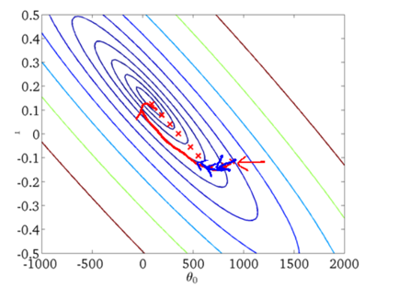
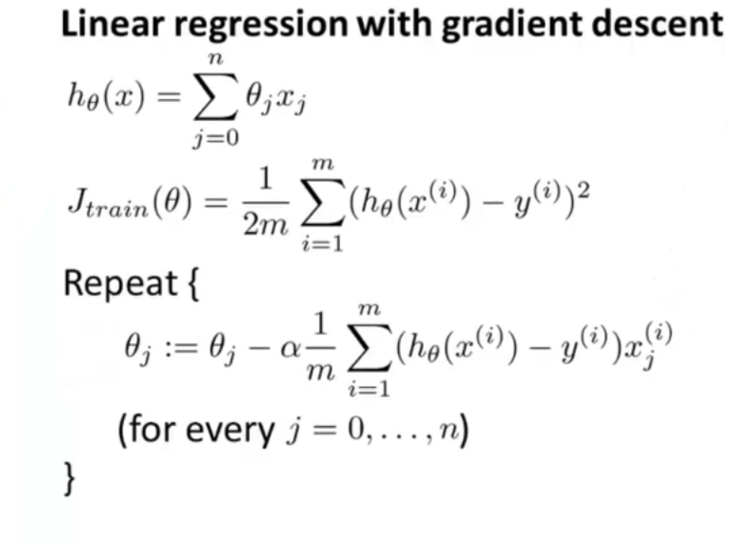
Gradient Descent

Slide 6
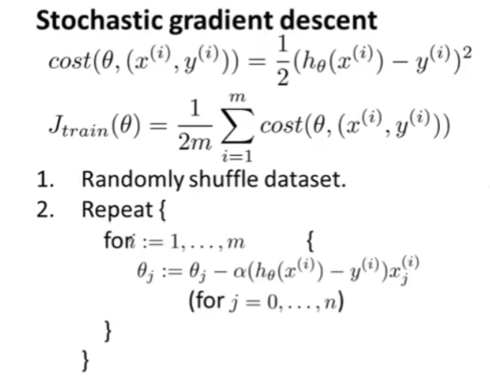
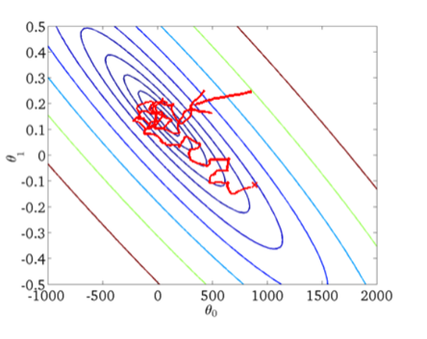
Stochastic Gradient Descent

Slide 7
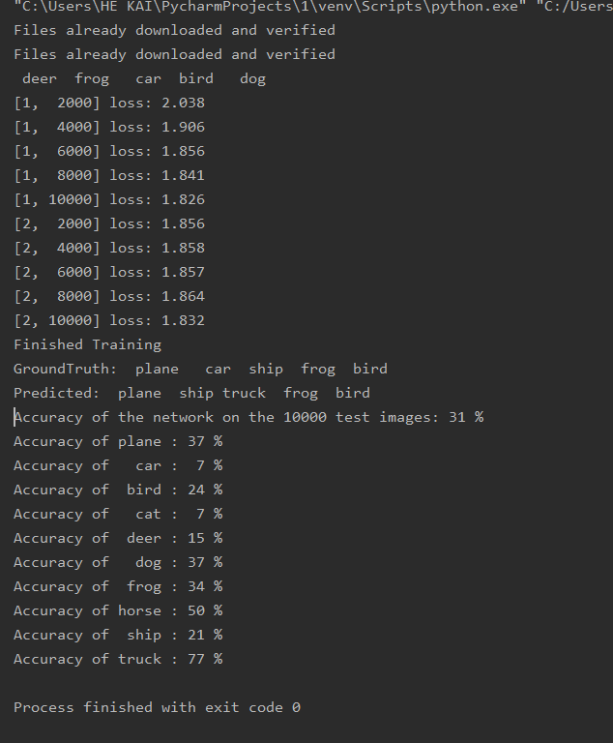
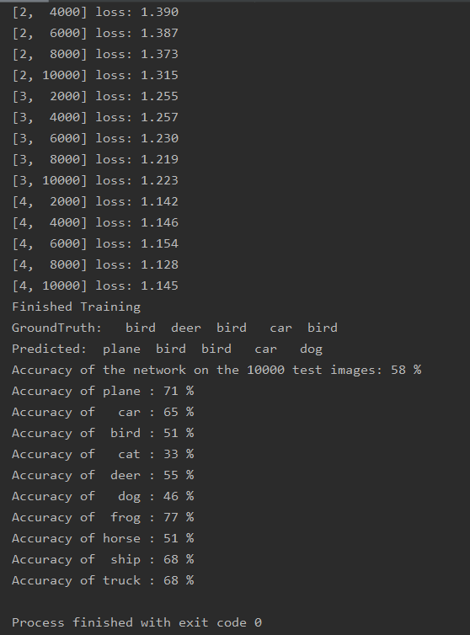
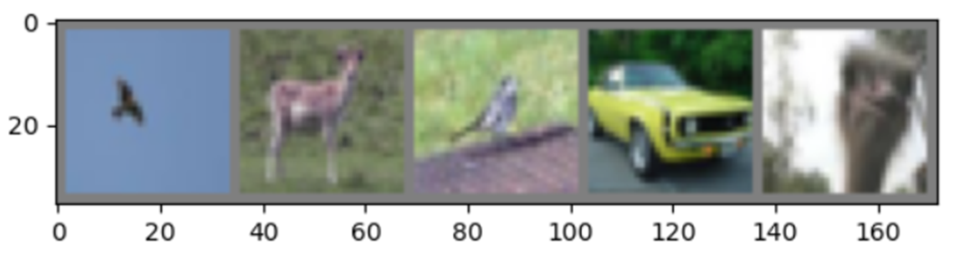
Final Result
Accuracy : 31% Training Times : 2
Lr : 0.01 Momentum : 0.9
Accuracy : 58% Training Times : 4
Lr : 0.001 Momentum : 0.9

Slide 8
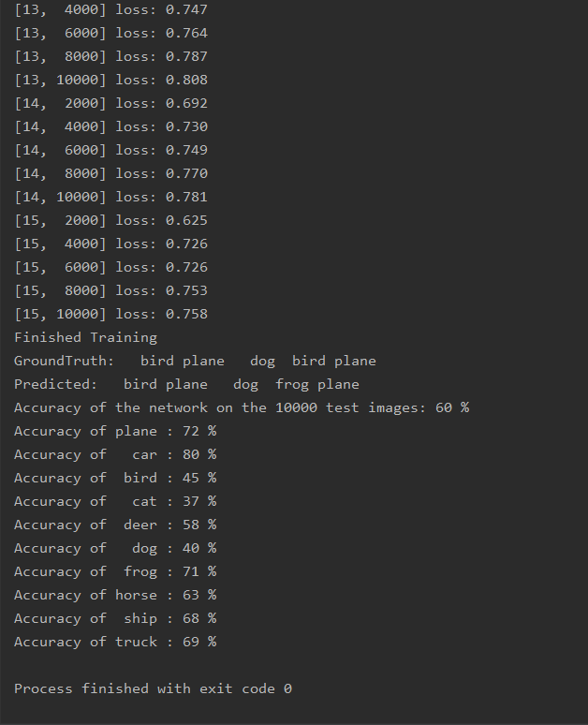
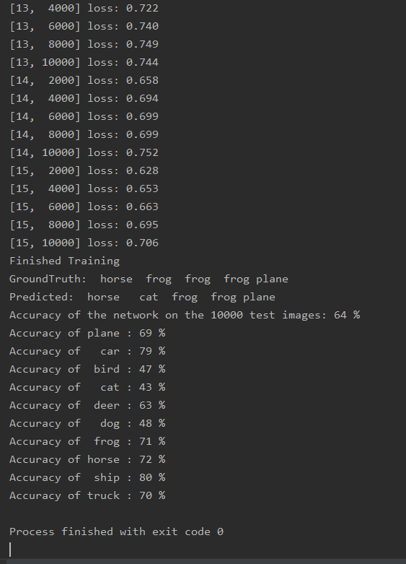
Final Result
Accuracy : 60% Training Times : 15
Lr : 0.001 Momentum : 0.9
Accuracy : 64% Training Times : 15
Lr : 0.0005 Momentum : 0.9

Slide 9
Thanks !

