Slide 1
Thermal photons in A+A collisions at RHIC energies
D.Peressounko
RRC “Kurchatov Institute”

Slide 2
How to calculate thermal photon yield
R – emission rate from the unit 4-volume
at a temperature T(x) and
chemical potential μ(x),
boosted with 4-velocity u(x);
Ω – space-time volume, occupied by the system.
d³N_{γ}
= ∫ R(T,μ,u) d⁴x
dy d²P_{t}
Ω
Key features of calculations:
Emission rates for QGP and RHG
Dynamic model:
  Fireball;
  2+1 Bjorken hydrodynamics;
  3+1 hydro;
  Initial conditions: τ₀ (ε₀ or T₀)
  EoS
Pre-equilibrium contribution:
Neglect it;
Use cascade models;
Model with hydro.

Slide 3
Thermal photon emission rate from QGP
Compton and annihilation (qg→qγ,qq→gγ) processes in HTL framework
J.I. Kapusta, P. Lichard, D. Seibert, Phys. Rev. D44, 2774 (1991); Erratum, ibid D47, 4171 (1993).
R. Baier, H. Nakkagawa, A. Niegawa, K. Redlich, Z. Phys. C53, 433 (1992).
Annihilation with rescattering and bremsstrahlung
P. Aurenche, F. Gelis, R. Kobes, E. Petitgirard, Z. Phys. C75, 315 (1997).
P. Aurenche, F. Gelis, R. Kobes, H. Zaraket, Phys. Rev D58, 085003 (1998).
P. Aurenche, F. Gelis, H. Zaraket, JHEP 0205, 043 (2002).
P. Aurenche, F. Gelis, H. Zaraket, Phys. Rev. D62, 096012 (2000).
Inclusion of the LPM effect
P. Arnold, G.D. Moore, L.G. Yaffe, JHEP 0111, 057 (2001).
P. Arnold, G.D. Moore, L.G. Yaffe, JHEP 0112, 009 (2001).
P. Arnold, G.D. Moore, L.G. Yaffe, JHEP 0206, 030 (2002).
Complete calculations in α and α_{s}

Slide 4
Thermal photon emission rate from hadron gas
Photon emission in reactions in π,ρ,η,ω gas
J. I. Kapusta, P. Lichard, and D. Seibert, Phys. Rev.D 44, 2774 (1991);
Added a₁ as a intermediate state in πρ→a₁→πγ
L. Xiong, E. V. Shuryak, and G.E. Brown, Phys. Rev.D 46, 3798 (1992).
Consistent treatment of contribution of a₁ resonance
C. Song, Phys. Rev. C 47, 2861 (1993).
Exploring effects of hadron mass modifications in hot matter
P. Ko and S. Rudaz, Phys. Rev. D 50, 6877(1996).
J.K. Kim, P. Ko, K. Y. Lee and S. Rudaz, Phys. Rev.D 53, 4787(1996).
S. Sarkar, J. Alam, P. Roy, A. K.Dutt-Mazumder, B. Dutta-Roy and B. Sinha, Nucl. Phys. A 634, 206 (1998);
P. Roy, S. Sarkar, J. Alam and B. Sinha, Nucl. Phys. A 653, 277 (1999).
Y. C. Shin, M. K. Cheoun, K. S. Kim and T. K. Choi, Eur. Phys. J. A 14, 87 (2002).
Inclusion of the contribution of strange mesons, ω in t-channel and baryons
S. Turbide, R. Rapp and C. Gale, hep-ph/0308085.
Jan-e Alam, Pradip Roy and Sourav Sarkar, hep-ph/0310168
Extensive set of reactions involving π,ρ,ω,a₁,K,N

Slide 5
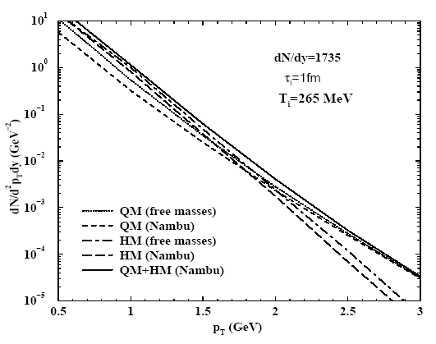
Calcutta group
J. e. Alam, S. Sarkar, T. Hatsuda, T. K. Nayak
and B. Sinha, Phys. Rev. C 63 (2001) 021901.
QGP emission rate:
Two loop, no LPM effect
HG emission rate:
π,ρ,ω,a₁ within different models
Model:
2+1 Bjorken hydrodynamics
In. Cond:
T_{i} = 265 MeV, τ_{i}=1 fm/c
EoS:
Bag model (π,ρ,ω,η,a₁,N in HG)
Evolution is not fitted neither to
hadron multiplicity nor to hadron
spectra.

Slide 6
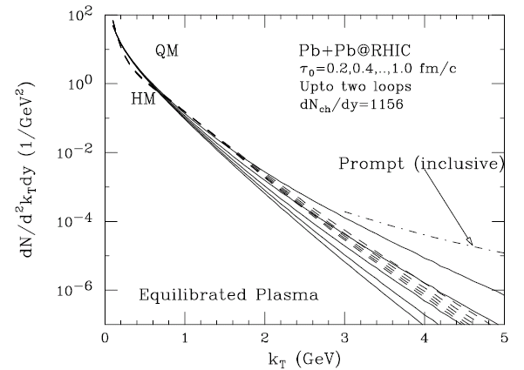
D.K.Srivastava
D. K. Srivastava,
Pramana 57 (2001) 235.
QGP emission rate:
Two loop, no LPM effect
HG emission rate:
emission from π,ρ,a₁ gas
Model:
2+1 Bjorken hydrodynamics
In. Cond:
T_{i} = 670-390 MeV,
τ_{i} = 0.2-1 fm/c
EoS:
Bag model (π,ρ,ω,η,a₁,N in HG)

Slide 7
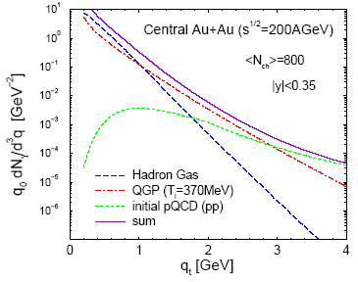
Montreal group
S.Turbide, R.Rapp and C.Gale,
Phys. Rev. C 69, 014903 (2004).
QGP emission rate:
two loop with LPM effect
HG emission rate:
emission from π,ρ,a₁,K,N gas
Model:
Fireball model with fixed
longitudinal and transverse
accelerations.
In.Cond.:
T_{i}~370 MeV
τ_{i}=0.3 fm/c

Slide 8
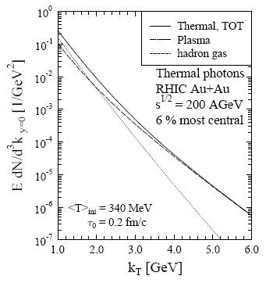
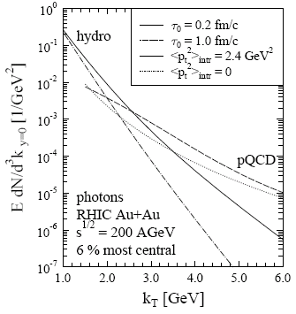
Jyvaskyla group
S.S.Rasanen, Nucl.Phys.A 715 (2003) 717.
F.Gelis, H.Niemi, P.V.Ruuskanen, S.S.Rasanen, J.Phys.G30:S1031-S1036,2004
QGP emission rate: two loop with LPM effect
HG emission rate: emission from π,ρ,a₁ gas
Model: 2+1 Bjorken hydrodynamics
In. Cond: T_{i} = 580 MeV, τ_{i}=0.17 fm/c
EoS: Bag model (rich hadronic gas)
Evolution fit to reproduce
hadron spectra

Slide 9
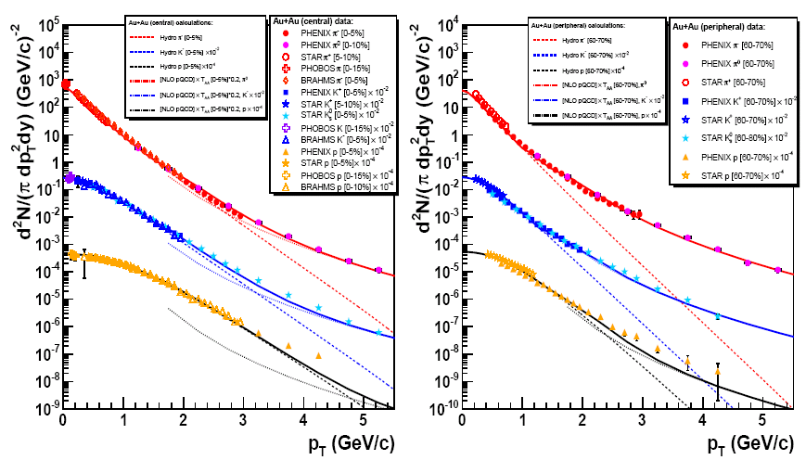
BNL-Moscow group
D.d'Enterria and D.Peressounko,
nucl-th/0503054
QGP emission rate: two-loop with LPM effect
HG emission rate: emission from π,ρ,ω,a₁,K,N gas
Model: 2+1 Bjorken hydrodynamics;
In.Cond: τ_{i}=0.15 fm/c; T_{i}=610 MeV
EoS: Bag model (~400 species in HG)
Evolution is fit to
π,K,p spectra

Slide 10
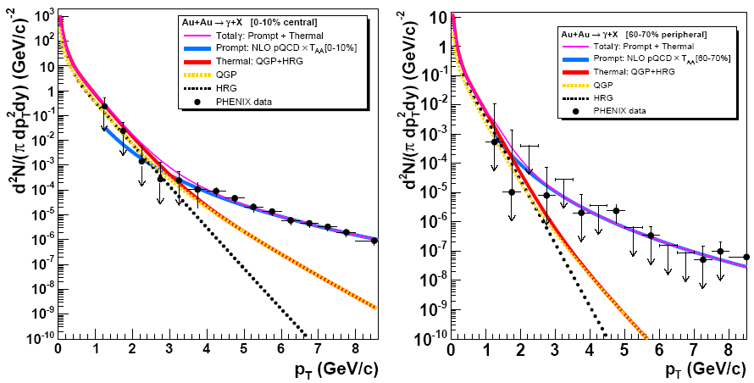
BNL-Moscow group
D.d'Enterria and D.Peressounko,
nucl-th/0503054
pQCD: L.E. Gordon and W. Vogelsang, Phys. Rev. D 48 (1993) 3136;
Phys. Rev. D 50 (1994) 1901.
PHENIX data: S.S.Adler et al., Phys. Rev. Lett. 94, 232301 (2005)

Slide 11
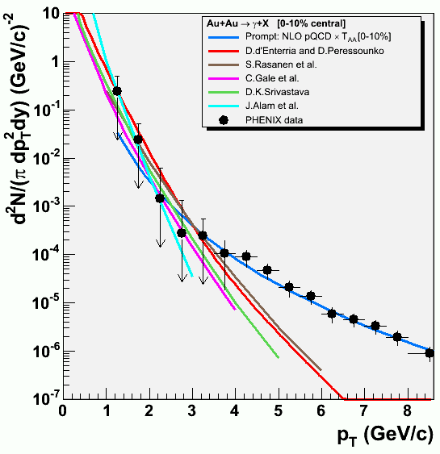
Comparison of predictions to PHENIX data
All calculations predict
considerable thermal
contribution below 3 GeV
All calculations agree with
data within errors.
Calculations with similar
initial time (temperature)
result in similar spectra.
Dependence on used
emission rates and details
of description of evolution
is modest.

Slide 12
What is next?
Calculate centrality dependence of the thermal photon spectrum:
Exploring dependence on the initial energy density.
Can we go further?
Since thermal photons reflect temperature in the medium, can we extract this temperature directly by measuring slope?
Can we extract the number of effective degrees of freedom in hot matter by comparing thermal photon slope and entropy or energy density?

Slide 13
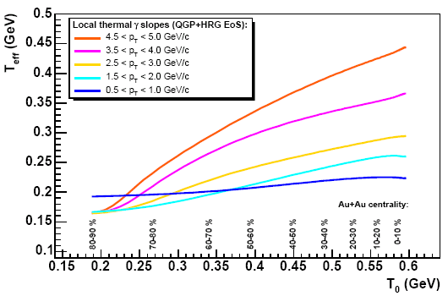
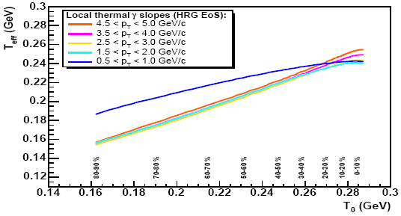
Correlation between apparent and initial temperature
EoS with
phase transition
Smearing of effective temperature:
Final thickness of matter
Temperature gradients T(r)
Collective velocity
Does correlation survive?
EoS without
phase transition
D.d'Enterria and D.Peressounko,
nucl-th/0503054

Slide 14
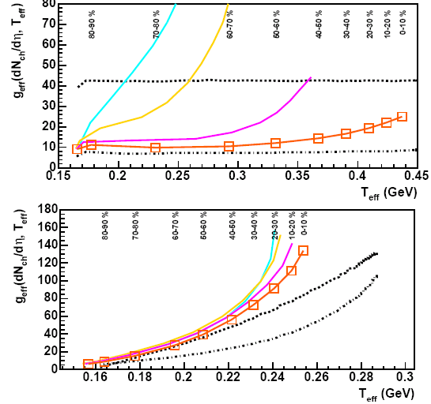

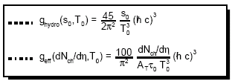
Correlation between apparent temperature and dN_{ch}/dη
Au+Au, 200 AGeV
EoS with
phase transition
EoS without
phase transition
D.d'Enterria and D.Peressounko,
nucl-th/0503054

Slide 15
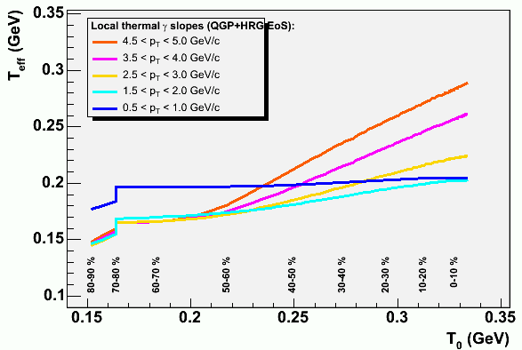
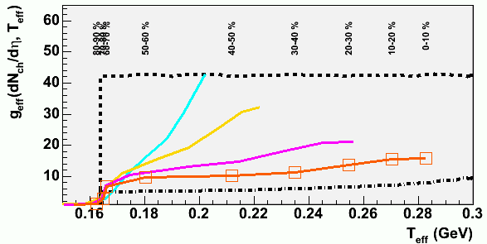
Correlation between apparent temperature and dN_{ch}/dη
Au+Au, 62 AGeV
τ_{i}=4R/γ = 0.45 fm/c
D.d'Enterria and D.Peressounko,
nucl-th/0503054

Slide 16
Conclusions
At top RHIC energy thermal photons contribute to direct photon spectrum at P_{t}<3 GeV: more precise data are necessary to make any conclusion.
Thermal photon spectrum depends mainly on initial temperature and in much smaller extend on details of evolution and emission rates.
Correlation between apparent temperature of thermal photons and maximal initial temperature in the collision is not destroyed by evolution: maximal temperature can be extracted just by measuring inverse slope at as high P_{t} as possible.
One can directly explore phase transition by confronting apparent slope of thermal photons and charged hadron multiplicity.

