Slide 1
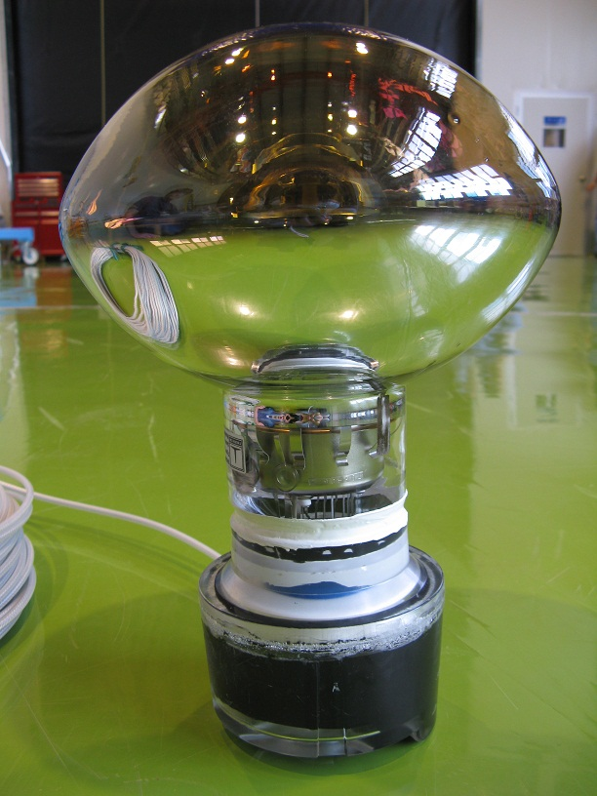
status of MACRO PMT pressure tests at SAB
Shih-Kai Lin, Logan Lebanowski
2010 September 16

Slide 2
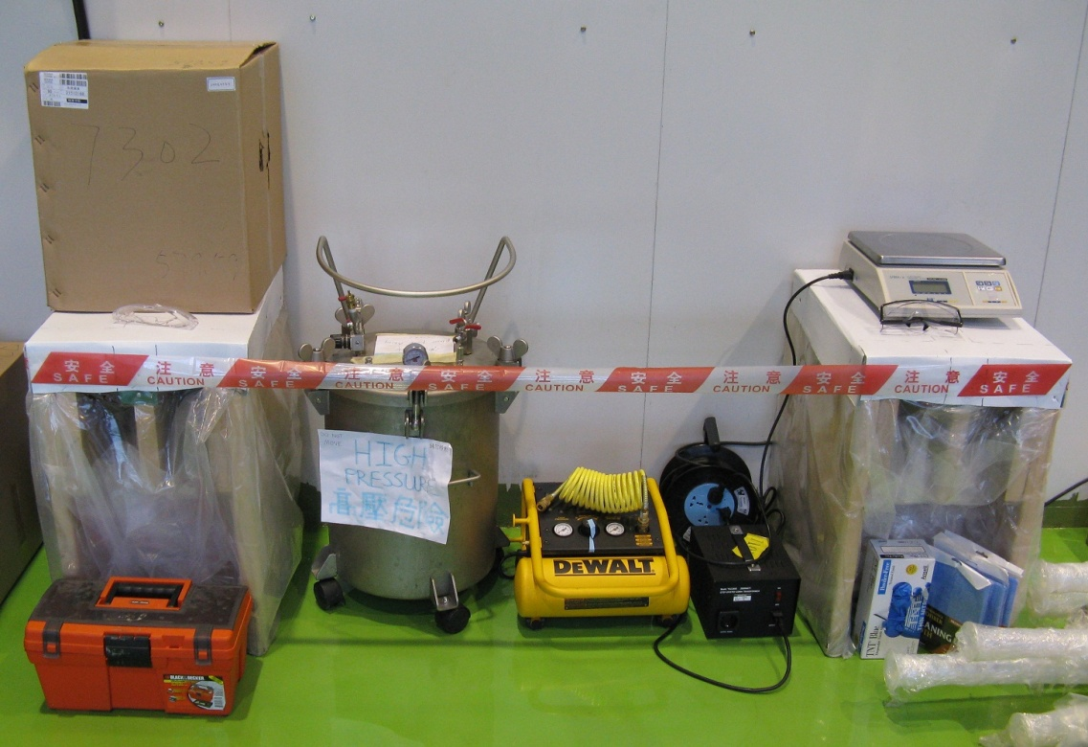
overview
150 waterproof MACRO EMI PMT assemblies need to be pressure tested at the SAB. They have already passed performance tests at DGUT.
We test about 10 PMTs per week (mid-August to December).
For more information, see doc 5373.
As of September 16, we have passed 29 of 29 tested PMTs.

Slide 3
pressure test results
11 PMTs were tested during the past week (September 9 - September 15).
* = PASS. Cable dry. No leaks or cracks.
** = * + Some water penetrated the mastic tape seal of the cable strain relief plug, but did not penetrate the UW cable plug.
! = estimated unpotted mass = potted mass - (3030-540).
SN | Mass (g) | Pressure (psig) | Test time (h:m) | Status
7945 | 608.0! | 12.2 | 14:46 | *
7379 | 508.5! | 6.3 | 8:35 | **
8356 | 524.0! | 6.3 | 15:17 | *
7520 | 589.0! | 12.1 | 8:11 | *
7343 | 600 | 12.2 | 15:22 | FAIL. LEAK into acrylic cap (see photo)
8756 | 590.5 | 12.1 | 47:08 | * {added mastic tape at base}
7692 | 562

Slide 4

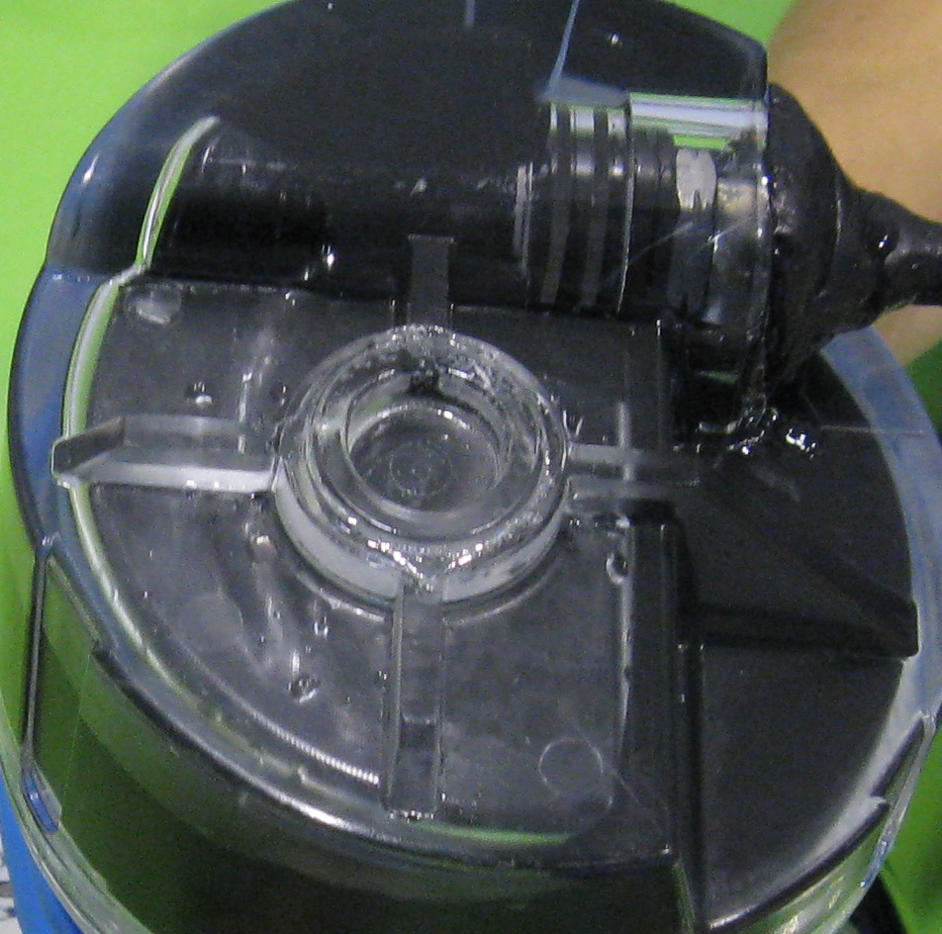
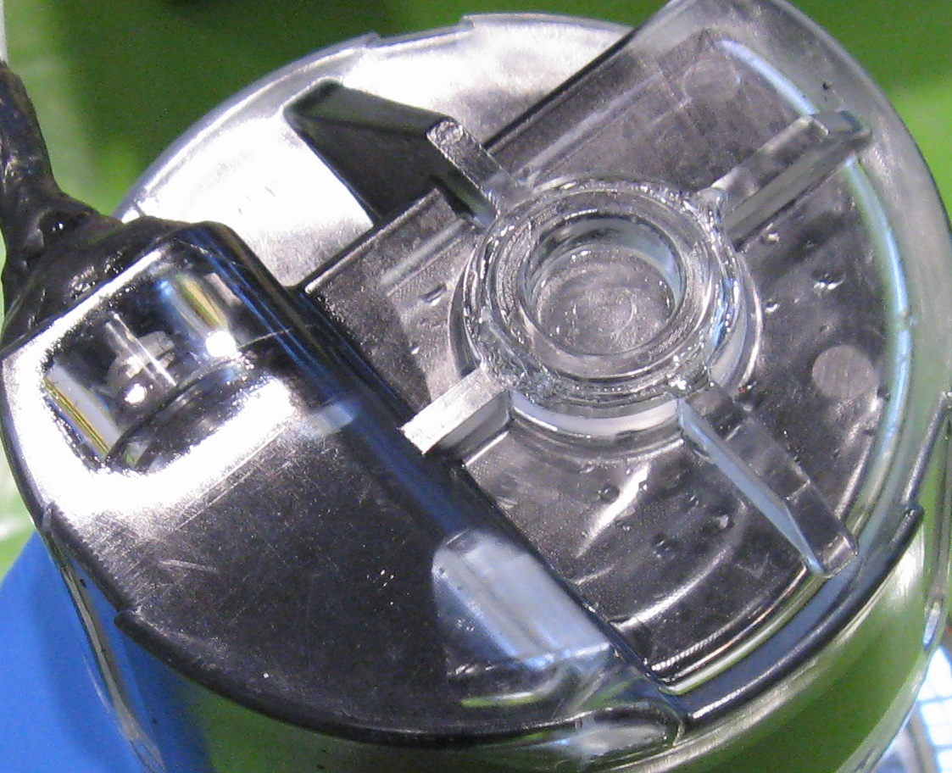
photos
water in acrylic shell cap
water spots
SN7343
SN7343

Slide 5
signal test results
The operational capability of a PMT is verified after pressure testing:
The PMT is placed in a dark box, connected to a single channel decoupler box, and set to its 2E7 gain voltage, as recorded in the DGUT data. After tens of minutes, the count rate, rise time, and pulse height are recorded. We use a threshold of 3.00 mV, which is roughly 1/4 pe.
Run-time longer than 1 day
SN | Rate (kHz) | DGUT rate (kHz) | Rise time (ns) | DGUT rise time (ns)
8140 | 1.2 | 0.64 | 5.3 | 5.2
7750 | 5.0 | 0.61 | 5.1 | 3.9
6297 | 5.5 | 1.47 | 4.7 | 5.1
8656 | 2.5 | 0.6 | 4.7 | 3.4
8459 | 0.8 | 0.32 | 5.7 | 5.6
7772 | 5.5 | 0.44 | 4.7 | 6.5
8932 | 2.3 | 0.34 | 4.1 | 4.2
6863 | ~8 | 0.45 | 4.9 | 5
All rates are less then 10 kHz

Slide 6
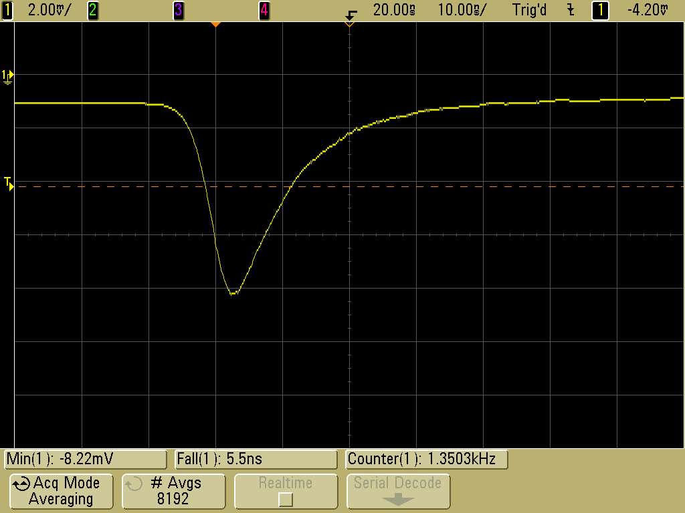
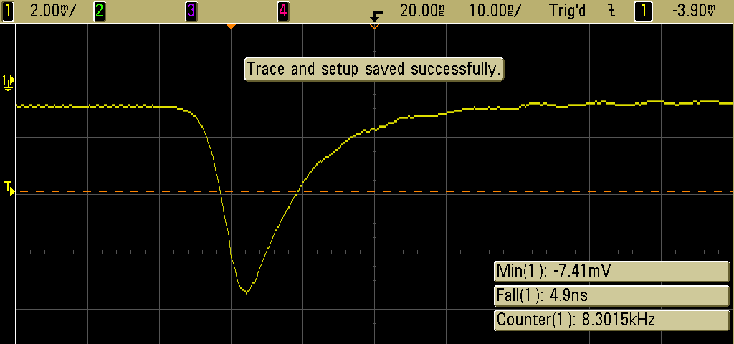
SN8459
SN6863

