Slide 1

Who generated this image?
Image provenance in the AI era: techniques, pitfalls, and future landscape
Kai Yao, PhD Candidate
School of Informatics, The University of Edinburgh
PSML 2026 Spring - Guest Lecture
The University of Edinburgh

Slide 2
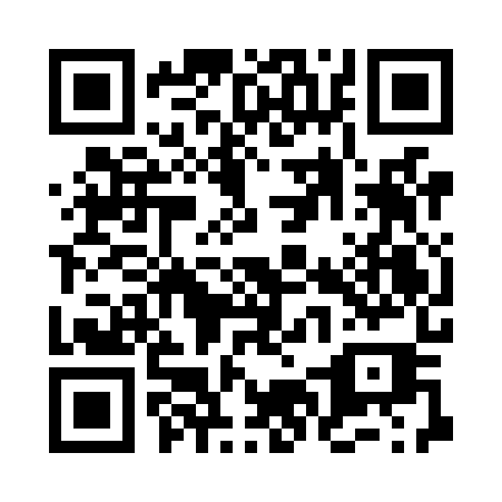
Self-Intro
Who am I?
I’m a final-year PhD student at School of Informatics, supervised by Dr. Marc Juarez.
I study secure and trustworthy machine learning, and my current research projects focus on provenance for image generation models, where we develop novel techniques and conduct robustness evaluations of image fingerprinting and image watermarking.
Experiences:
Fudan University B.Sc. in Theoretical & Applied Mechanics
Johns Hopkins University M.Sc. in Mechanical Engineering
Huawei AI Algorithm Engineer
Intel Senior AI Algorithm Engineer
University of Edinburgh Ph.D. in Cyber Security, Privacy, and Trust
Publications (selected):
Yao K, Juarez M. Smudged Fingerprints: A Systematic Evaluation of the Robustness of AI Image Fingerprints. To appear in the 4th IEEE Secure and Trustworthy Machine Learning Conference, 2026 (Accepted).
Yao K, Juarez M. AuthPrint: Fingerprinting Generative Models Against Malicious Model Providers. arXiv. preprint, 2025.
Yao K, Juarez M. SoK: What Makes Private Learning Unfair? Proceedings of the 3rd IEEE Secure and Trustworthy Machine Learning Conference, 2025.
I hope this lecture is informative enough to guide you through the current landscape of image provenance research.
Privacy and Security with Machine Learning
1

Slide 3
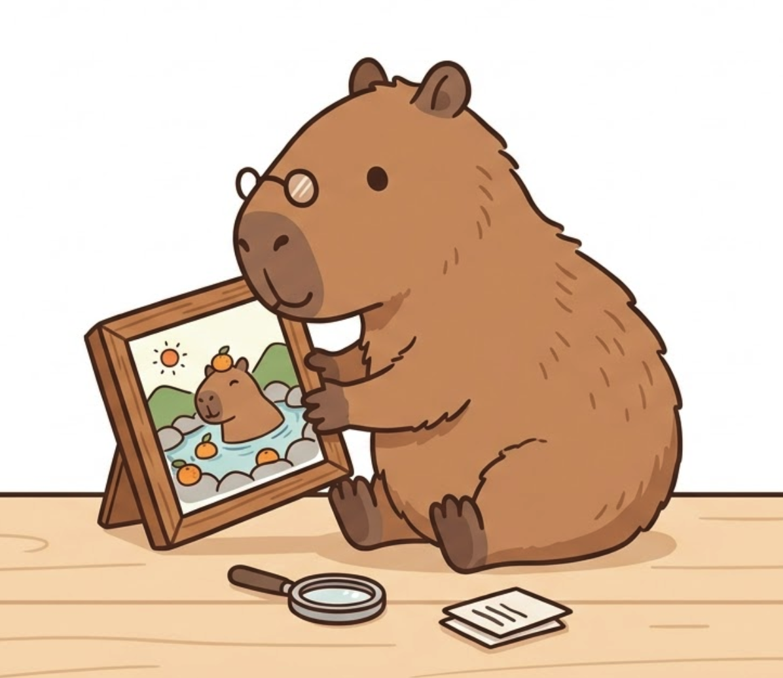


Content table
What do we aim to cover in this lecture?
What is image provenance, and why does it matter?
Approaches to image provenance: taxonomy, examples, and failure cases
Case study: systematic robustness evaluation of image fingerprinting
Let’s begin!
Privacy and Security with Machine Learning
2

Slide 4
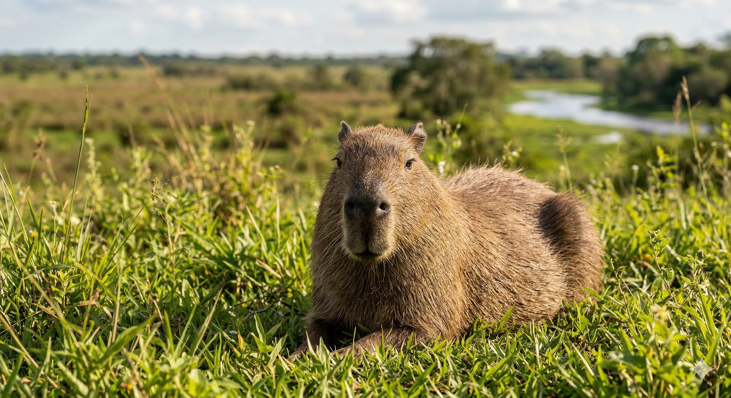
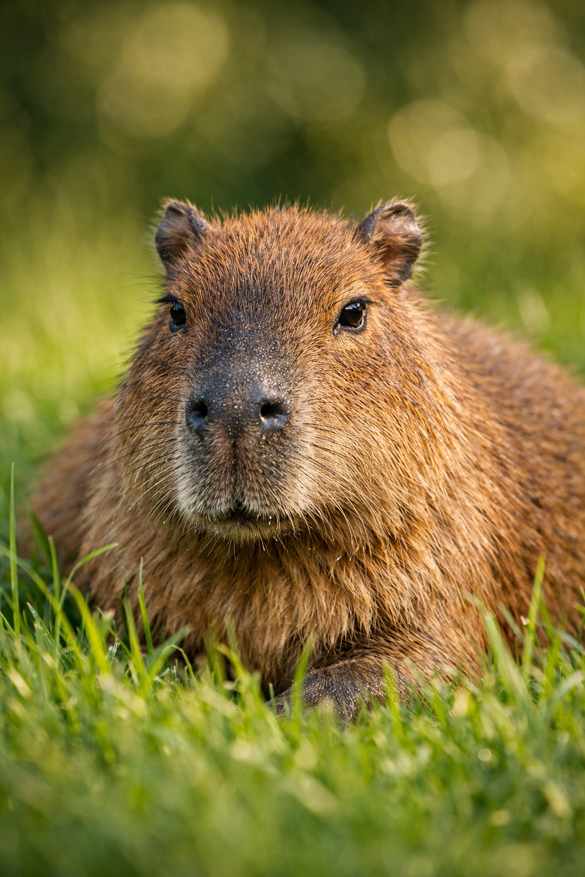
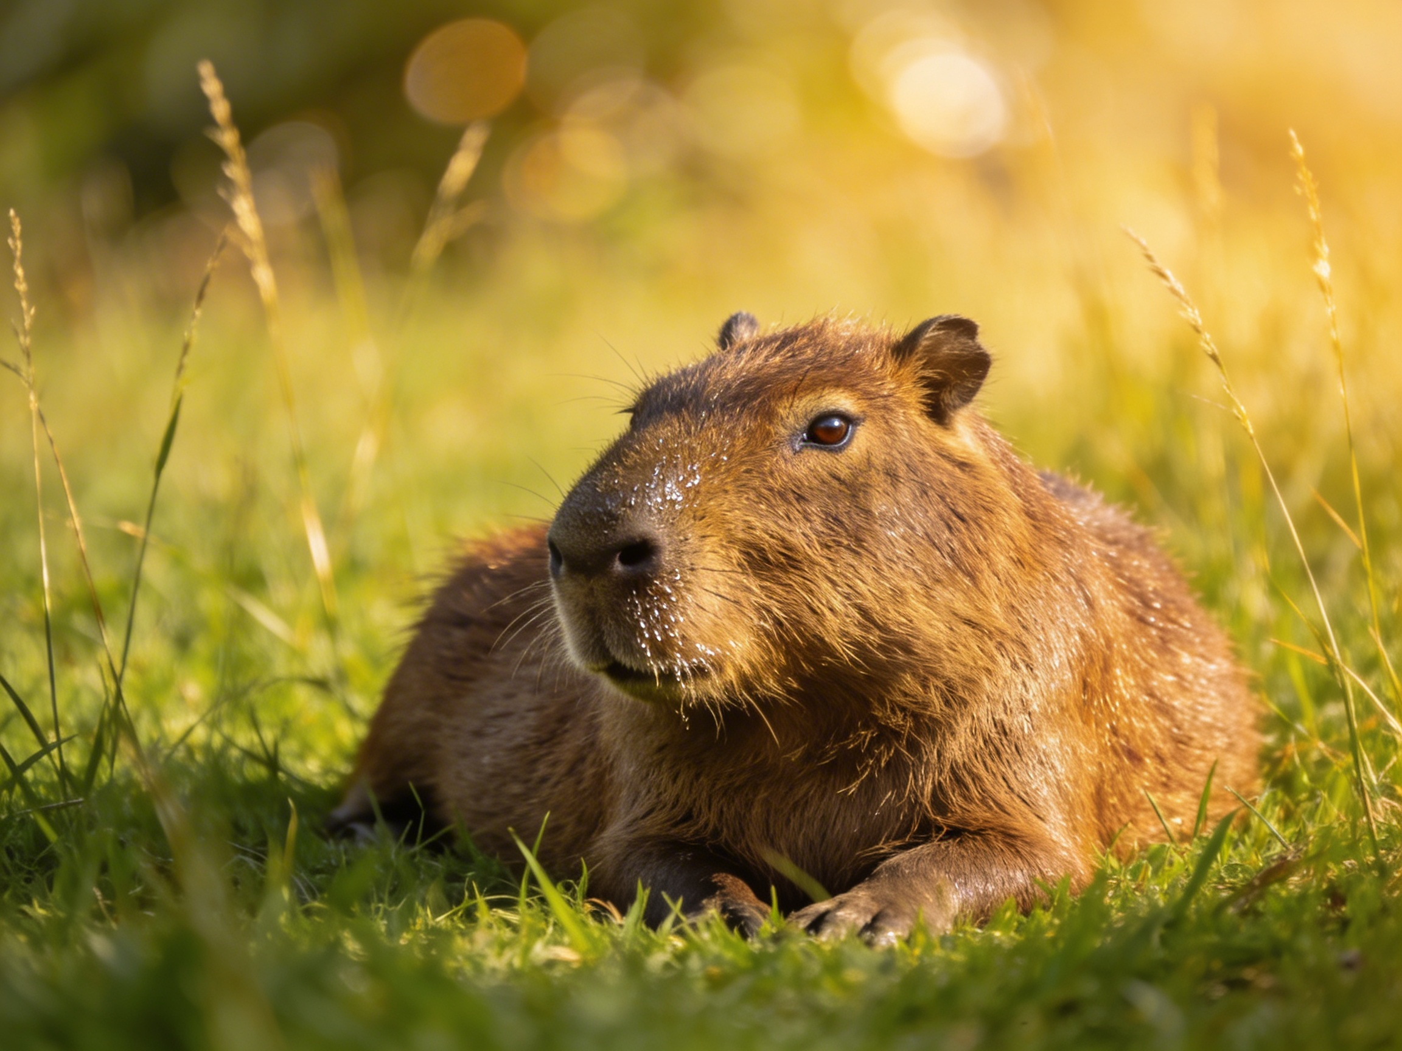
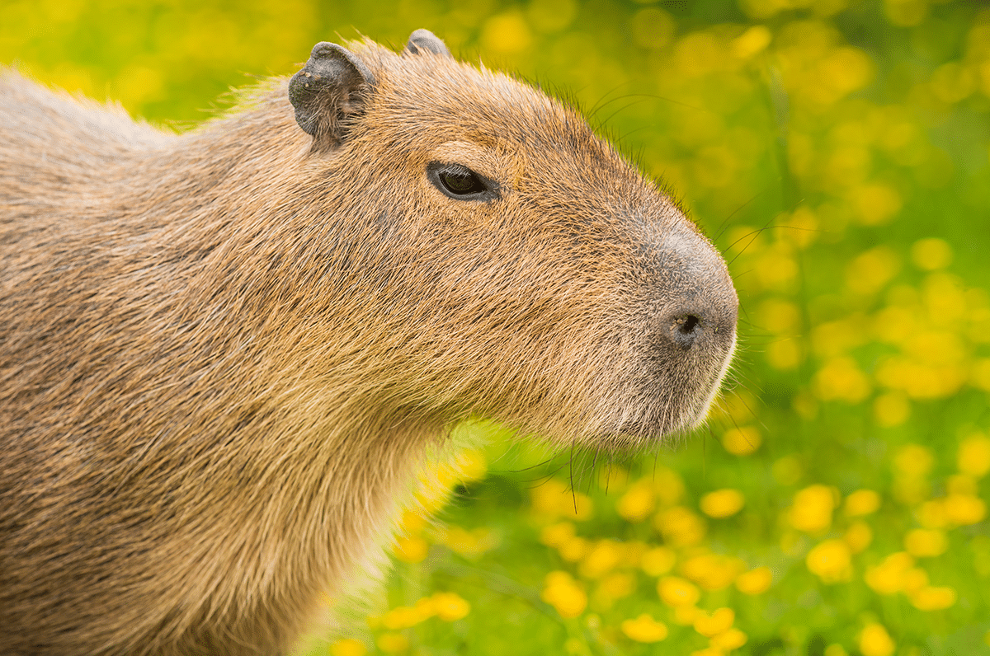
Guess it: which capibara is real?
Q1: Real vs AI ? Q2: GPT vs Gemini vs Claude ?
Gemini 3
Reveal the Answer
Stable Diffusion
Reveal the Answer
GPT 4
Reveal the Answer
Real (zoo capture)
Reveal the Answer
AI has advanced incredibly fast, making photorealistic image and video generation much harder to detect.
Privacy and Security with Machine Learning
3

Slide 5
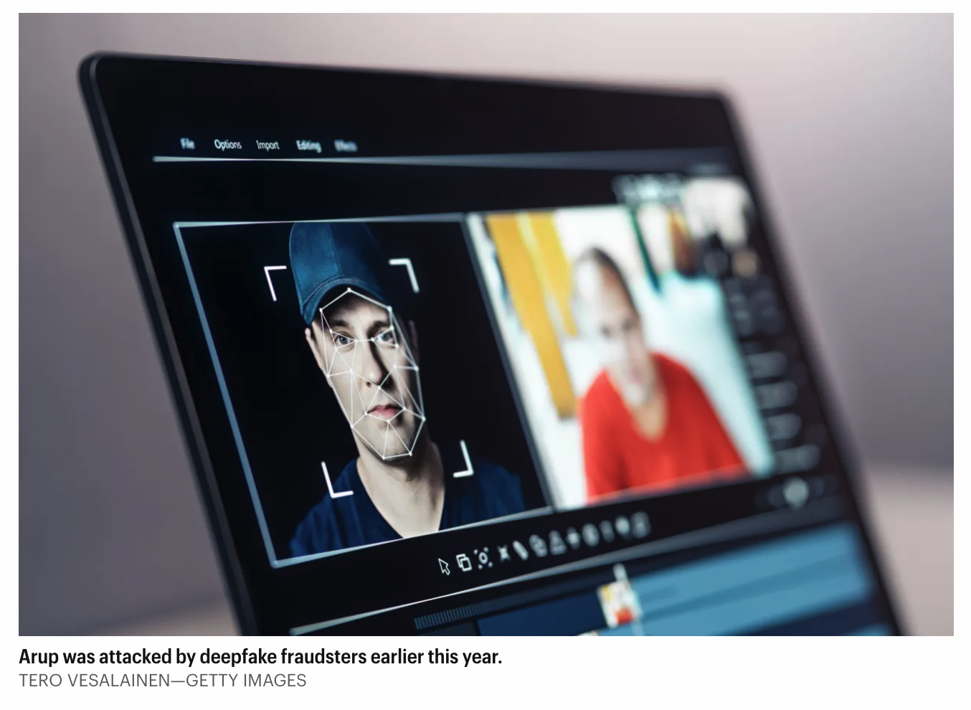

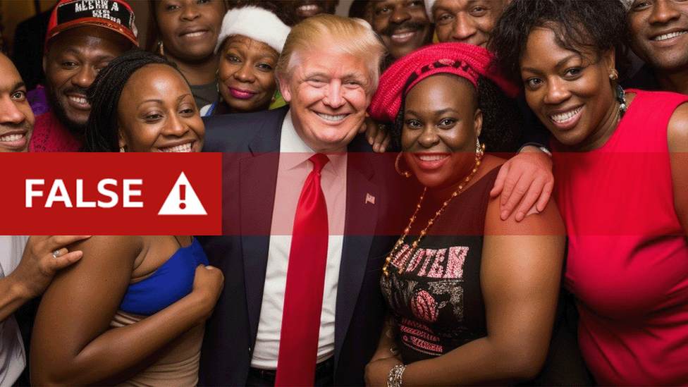
Why image provenance becomes a critical topic in the AI era?
Real security threats are everywhere, not just on the paper. Deepfake incidents occur every 5 minutes globally in 2024.
Financial Fraud
Celebrity Impersonation Scam
Fake Political Campaign
AI-generated images falsely showing Donald Trump with Black supporters were spread on social media during the 2024 U.S. election to fabricate racial grassroots support, deceiving voters and eroding public trust in authentic political imagery.
A deepfake ‘CFO’ tricked a British design firm Arup behind the Sydney Opera House in $25 million scam.
Victims charged a $9.96 'shipping fee' on fraudulent websites for the fake Taylor Swift giving-away post.
Generative AI poses growing real-world harm. Tracing the provenance of images is more urgent than ever.
Privacy and Security with Machine Learning
4

Slide 6
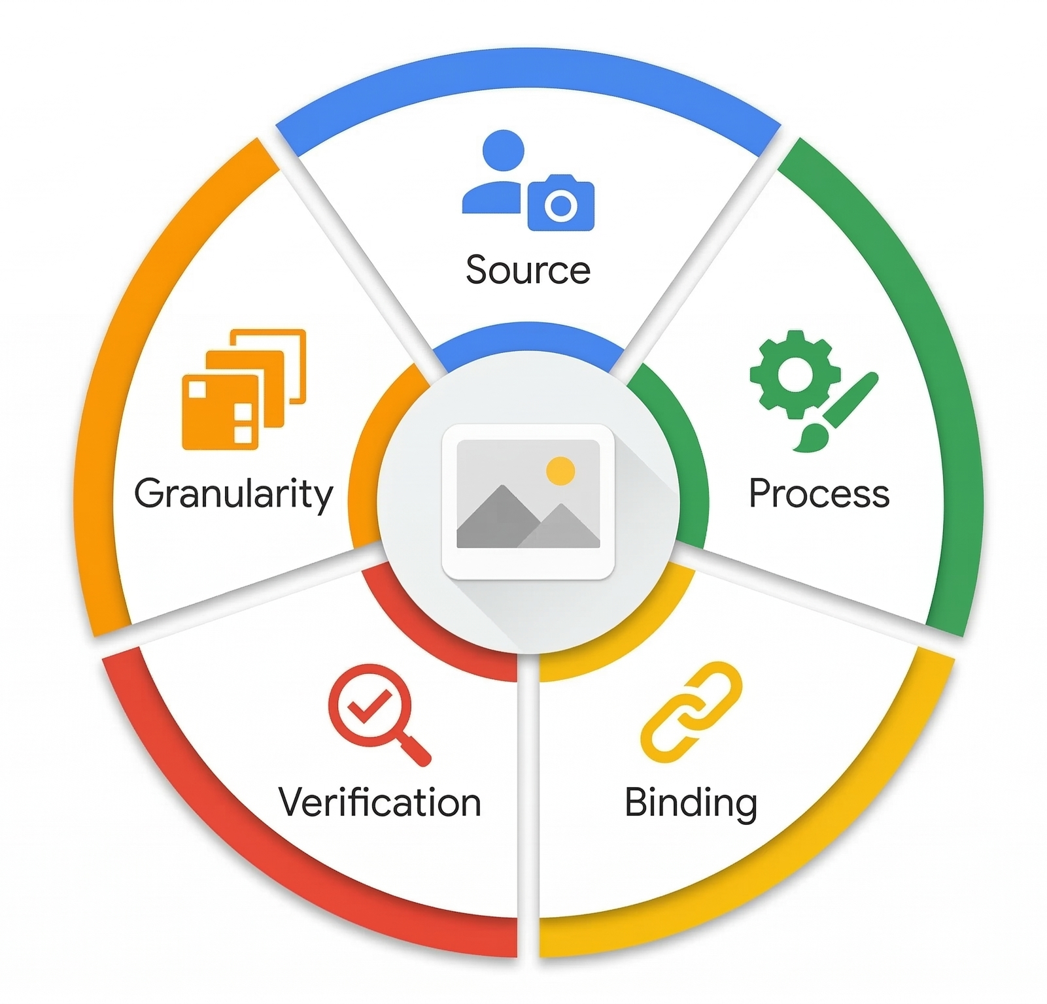
What do we mean by "image provenance"?
An ideal image provenance system should answer those 5 questions credibly.
Source: Who or what model created this image?
Process: What edits have happened to this image?
Binding: How are those claims tied to this image?
Verification: Who can check those claims?
Granularity: AI/non-AI, model, user, device, edit history?
Provenance should be structured evidence about both origin and history.
Privacy and Security with Machine Learning
5

Slide 7
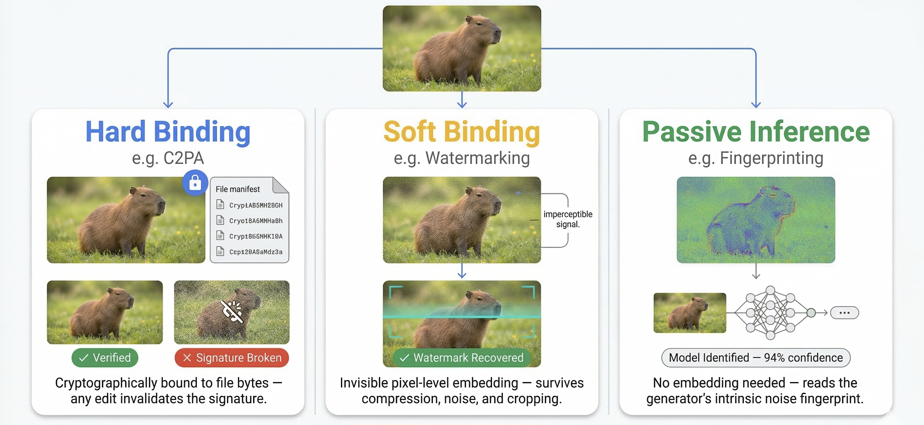
What solutions have been proposed?
A taxonomy on image provenance techniques: hard binding, soft binding, and passive inference.
Hard binding:
A cryptographic lock that ties an image's provenance record to its exact file bytes (e.g., C2PA)
Soft binding:
A content-derived identifier that survives file transformations (e.g., watermarking)
Passive inference: Reading provenance clues the image already left behind, with no active binding (e.g., fingerprinting)
These solutions should be considered as complementary, not as competing substitutes.
Privacy and Security with Machine Learning
6

Slide 8
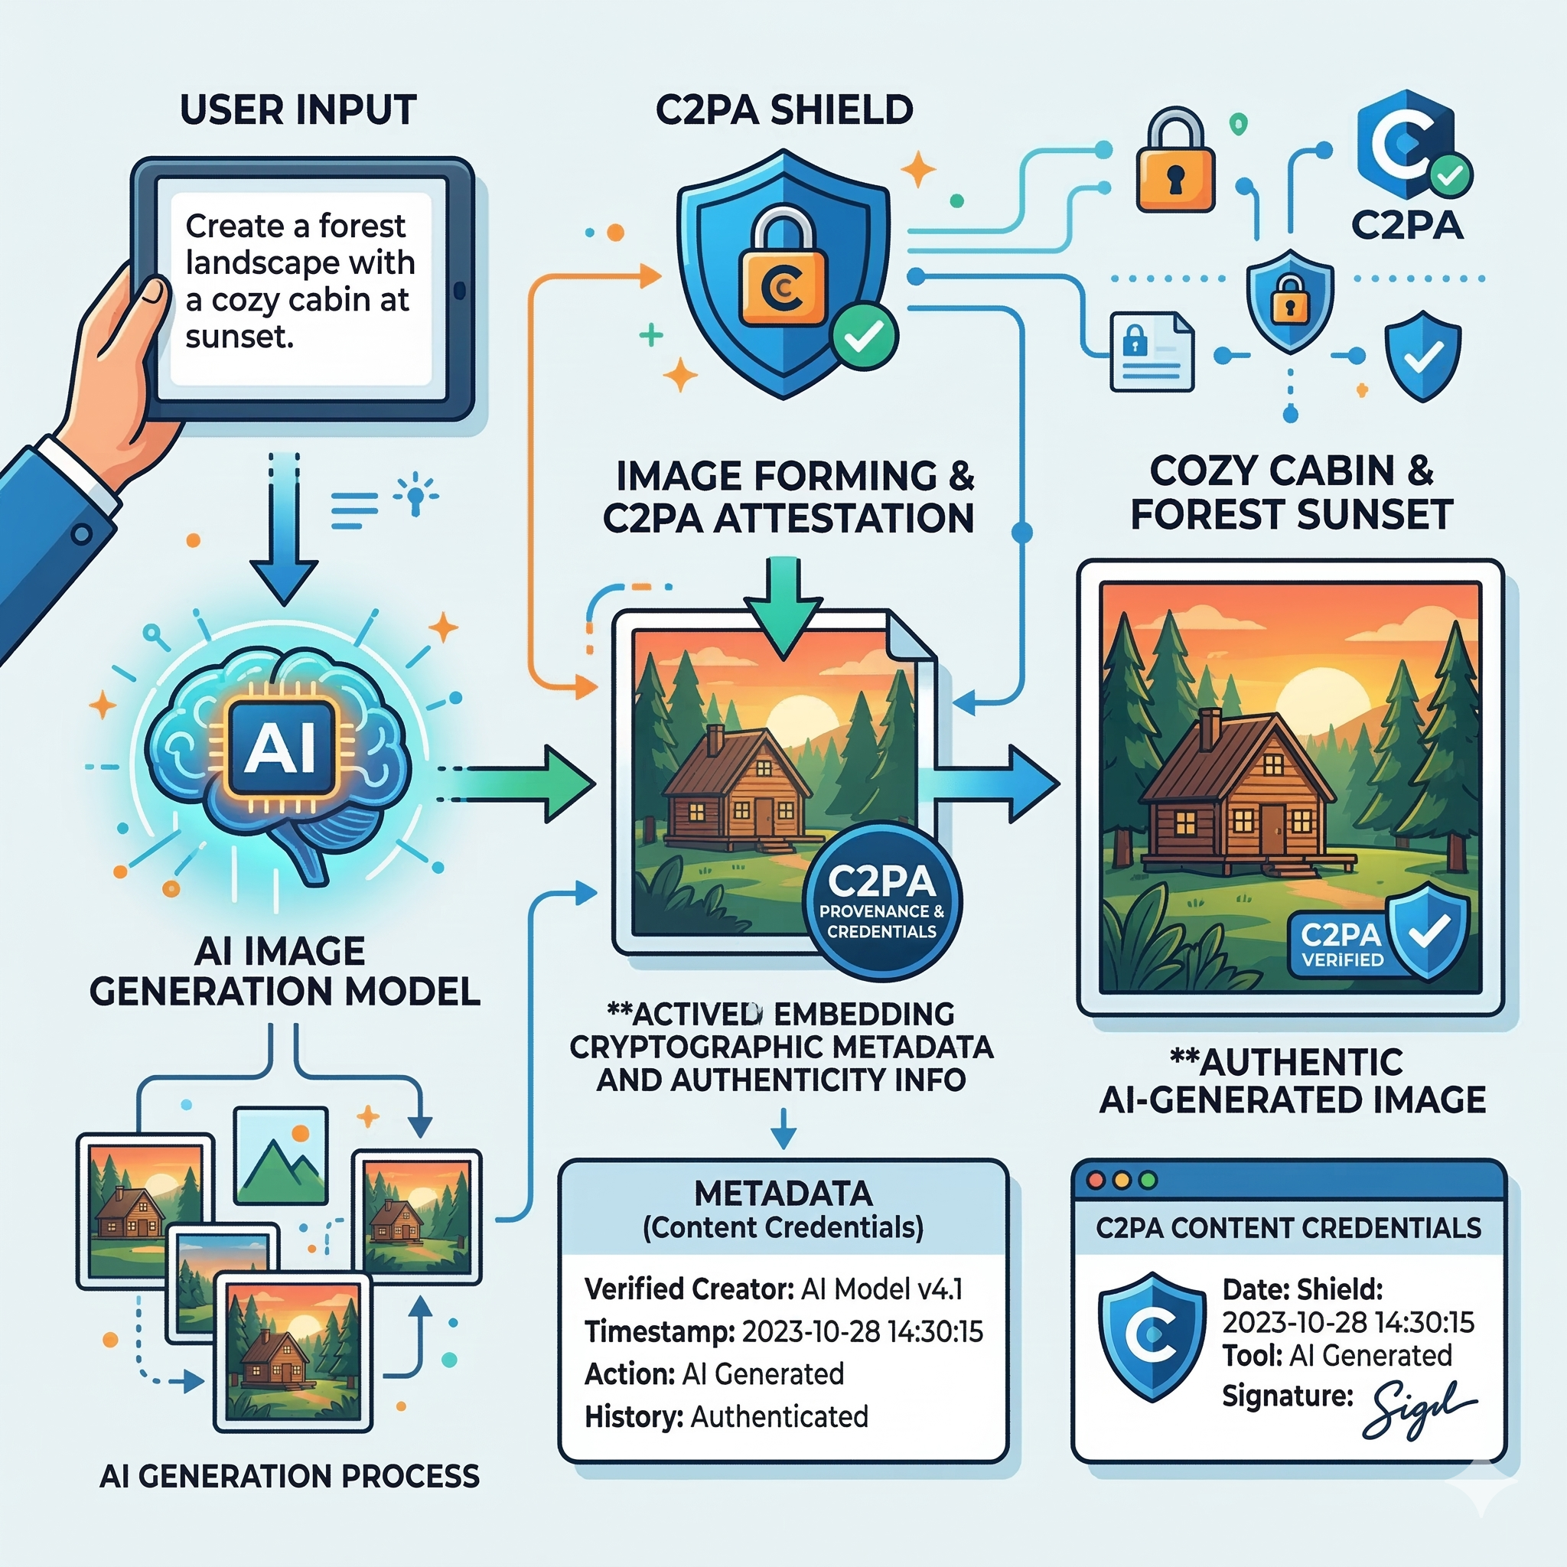
Hard binding: C2PA
C2PA: The Coalition for Content Provenance and Authenticity
C2PA binds "provenance assertions" (who created the file, when, with what tool, what edits were made) into a cryptographically signed manifest embedded in the file. It uses PKI (Public Key Infrastructure) — the same system as HTTPS — with X.509 certificates, content hashing, and digital signatures so that any tampering with the file invalidates the signature. The chain builds up over time: a camera signs the capture, then an editor like Adobe Photoshop signs the edit, then a publisher may add another step. https://help.openai.com/en/articles/8912793-c2pa-in-chatgpt-images
Does it work? https://verify.contentauthenticity.org/
Yes, but …
It works only within a chain of trusted participants. For example, when you want to prove to your business partner that you generated an image by GPT.
Hard binding like C2PA can trace images — but only in trusted environments with no manipulation.
Privacy and Security with Machine Learning
7

Slide 9

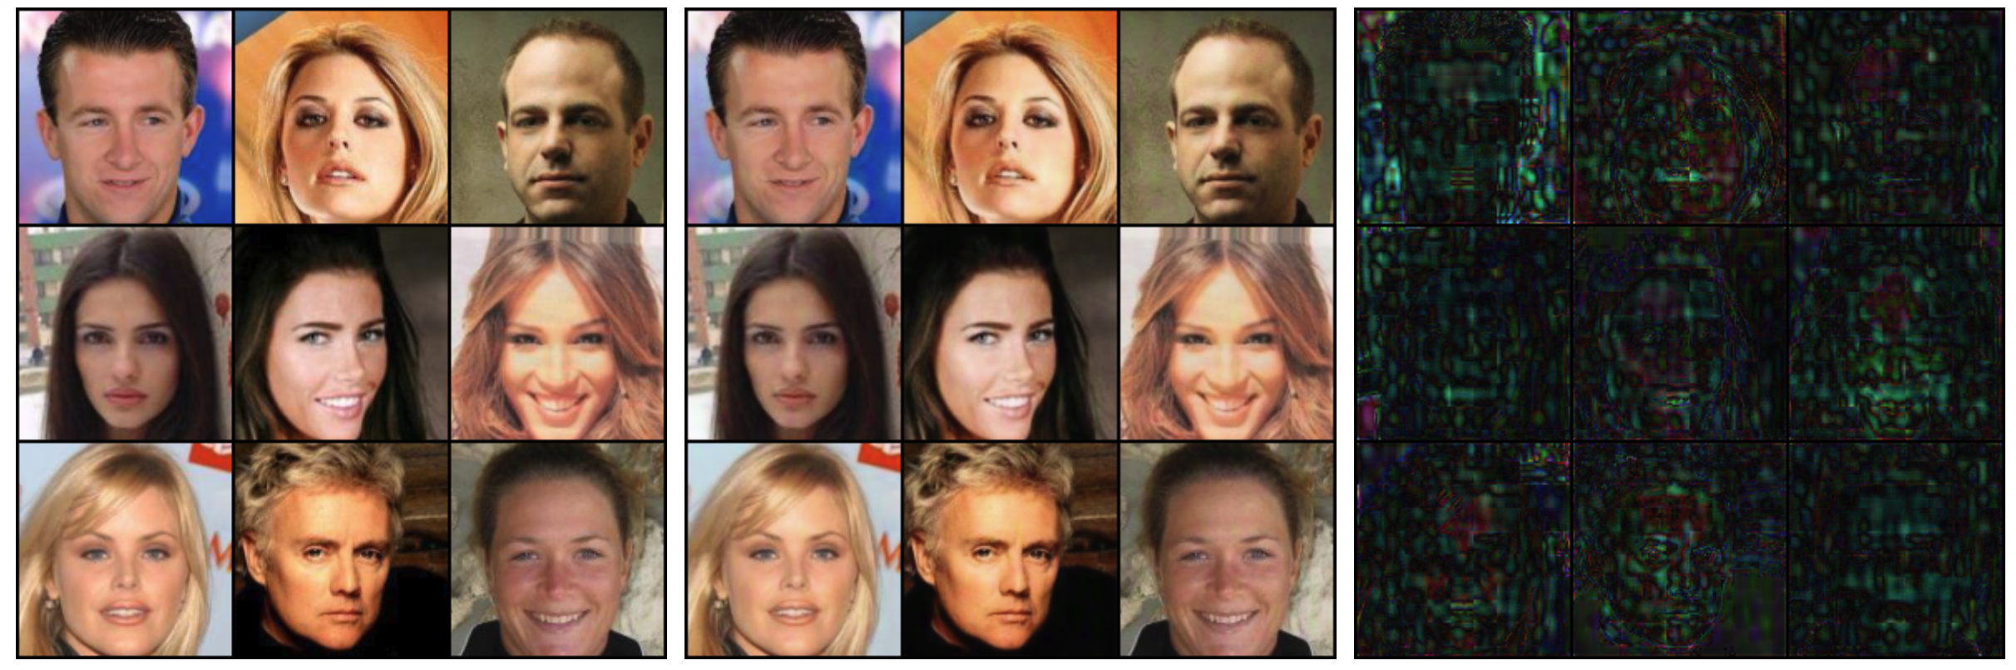
Soft binding: watermarking
To ensure trustworthy image provenance in untrusted environments, "soft binding" techniques like watermarking have been proposed.
Traditional image watermarking embeds a visible signature, but it is easily removed. With advances in AI, deep learning-based methods have become dominant, introducing invisible modifications that require a dedicated "decoder" for verification.
Traditional image watermarking
Image watermarking with Deep Learning
Unlike traditional image watermarks, DL-based image watermarks are often invisible.
Privacy and Security with Machine Learning
8
Notes:
https://arxiv.org/pdf/2007.08457

Slide 10
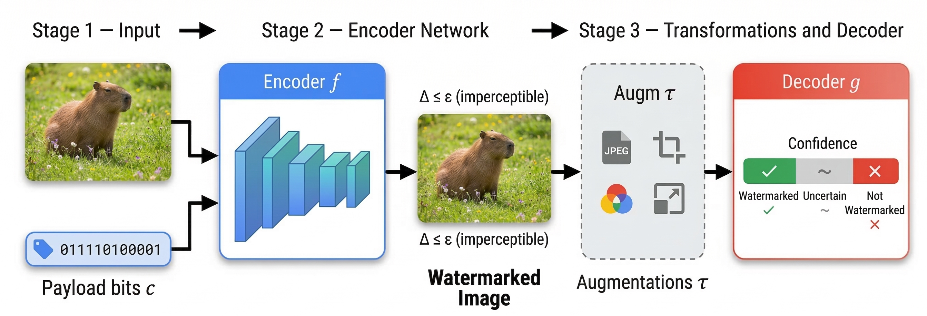
Post-generation (post-hoc) watermarking
For AI-generated images, two types of watermarking exists: post-generation and in-generation.
Example: SynthID-Image by Google DeepMind
https://deepmind.google/models/synthid/
Post-generation watermarking does not interfere with image generation process.
Privacy and Security with Machine Learning
9

Slide 11
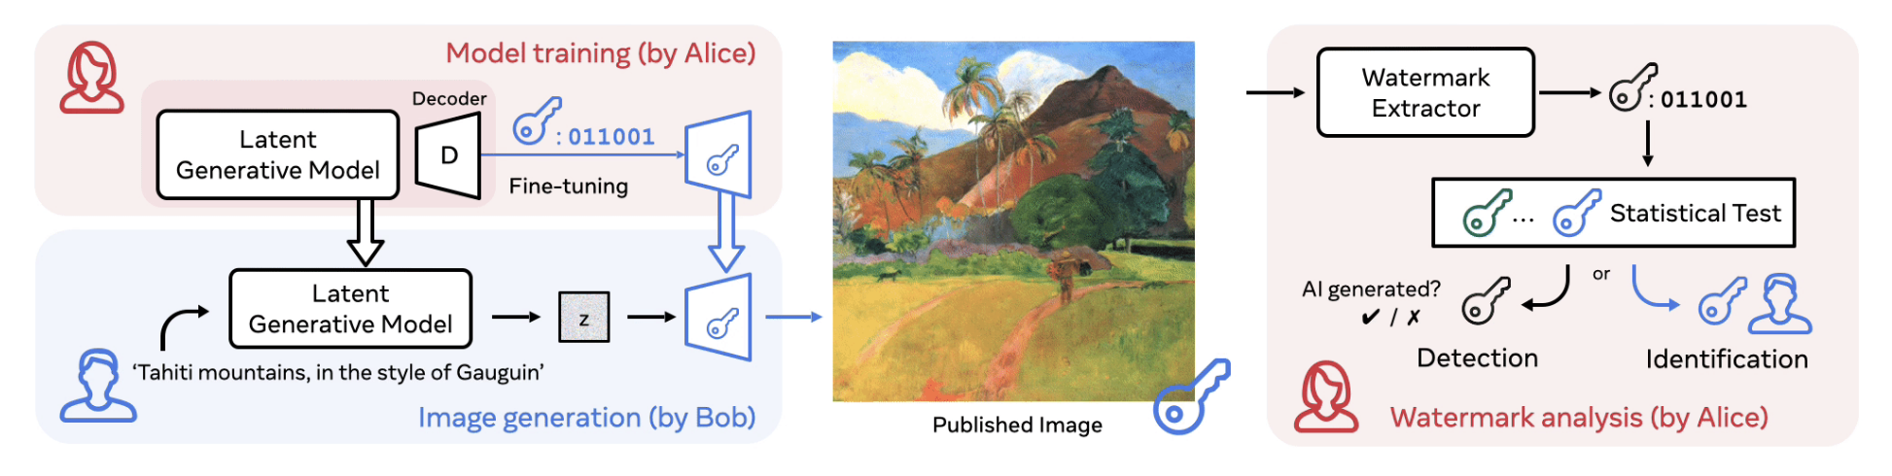
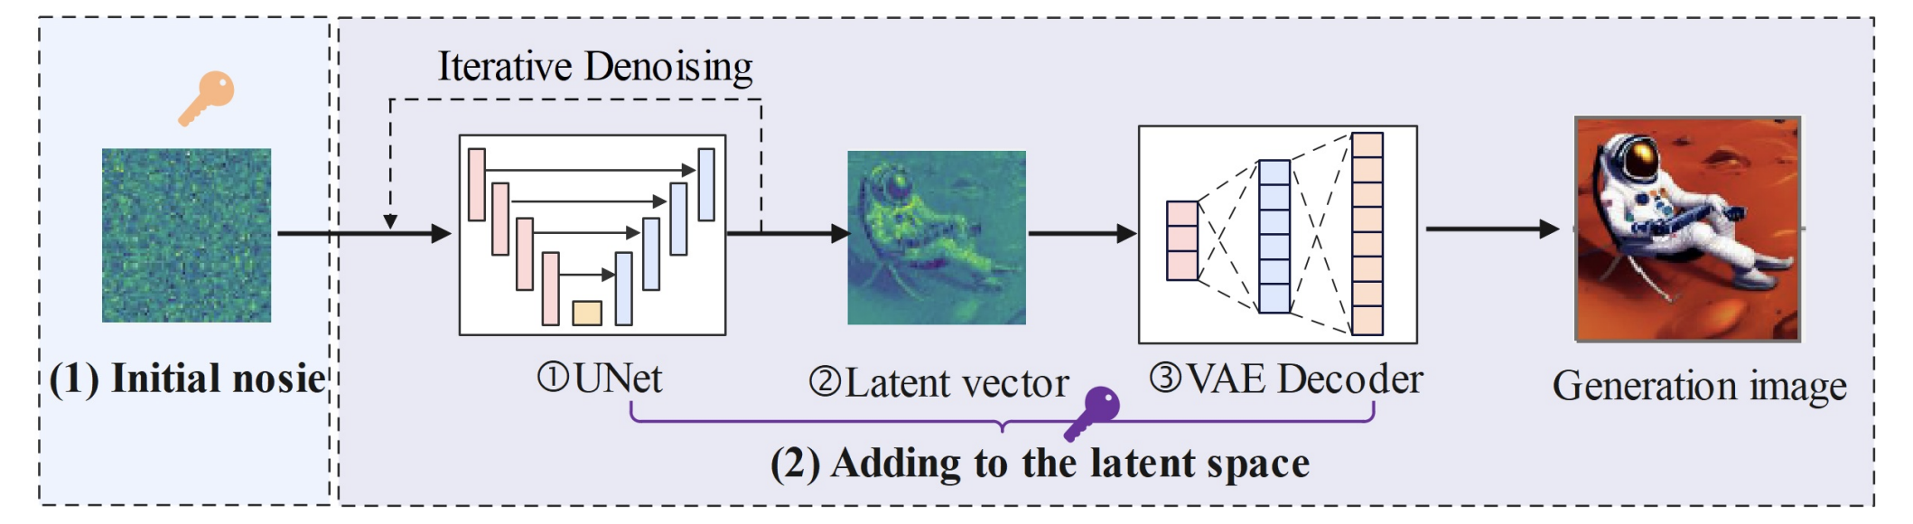
In-generation watermarking
In-generation techniques modifies the generation process itself, instead of embedding a watermark post-hoc.
Decoder-level
(e.g., Stable Signature)
https://pierrefdz.github.io/publications/stablesignature/
Noise & latent-level
(e.g., Tree-Ring, Gaussian Shading)
(Note: requires inversion)
In-generation techniques have dominated watermarking research since 2024.
Privacy and Security with Machine Learning
10

Slide 12
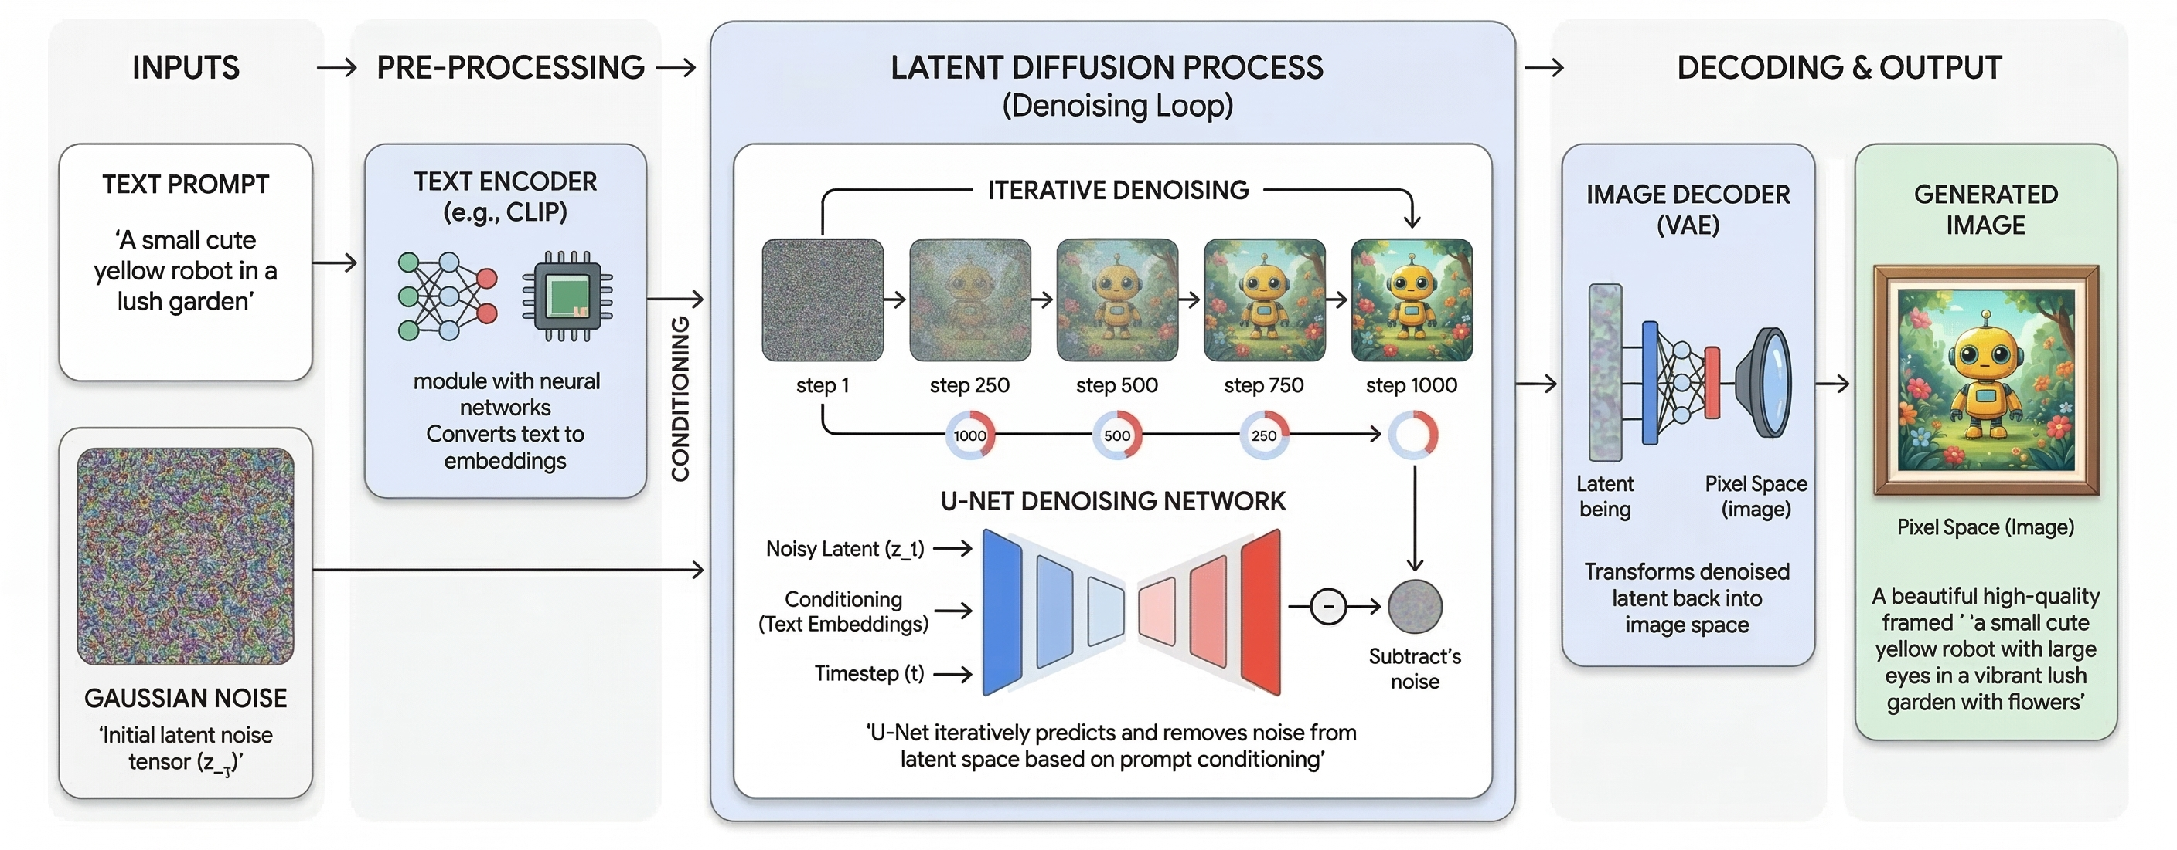

Preliminary: Latent Diffusion Model
The most popular architecture for modern image generation.
How to leverage the generation process to watermark LDM-generated images?
Privacy and Security with Machine Learning
11
Notes:
https://arxiv.org/pdf/2007.08457

Slide 13
Differences?
What are the major differences between post-generation and in-generation watermarking methods?
 | Post-Generation (e.g. SynthID-Image) | In-Generation (e.g. Stable Signature)
When applied | After an image has been generated | During the generation process (noise, latent, decoder)
Model dependency | Model-agnostic | Requires internal access to the model
Deployment flexibility | Works on any existing image | Requires integration into the generator
Robustness | More vulnerable to targeted removal | More robust; intrinsic to content
False positive control | Harder to tune | Highly tuneable (e.g., Stable Signature achieves FPR 1e-10)
Fine-tuning resilience | Unaffected by model changes | May be disrupted if decoder is modified
Computational cost | Lower | Higher (e.g. fine-tuning, inversion)
Both types of watermarking for AI-generated images offer distinct advantages and trade-offs.
Privacy and Security with Machine Learning
12

Slide 14
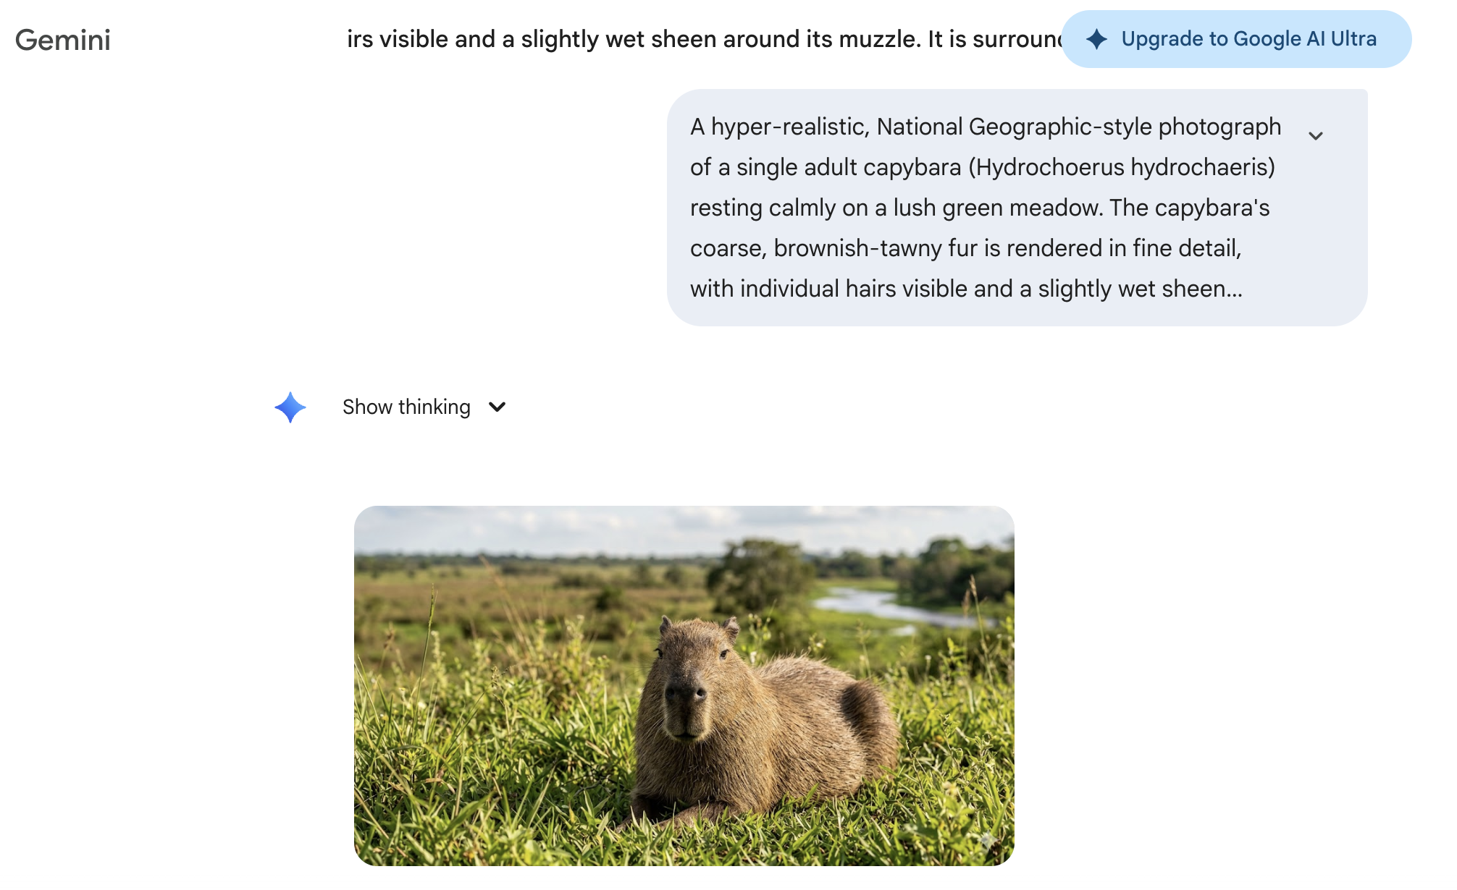
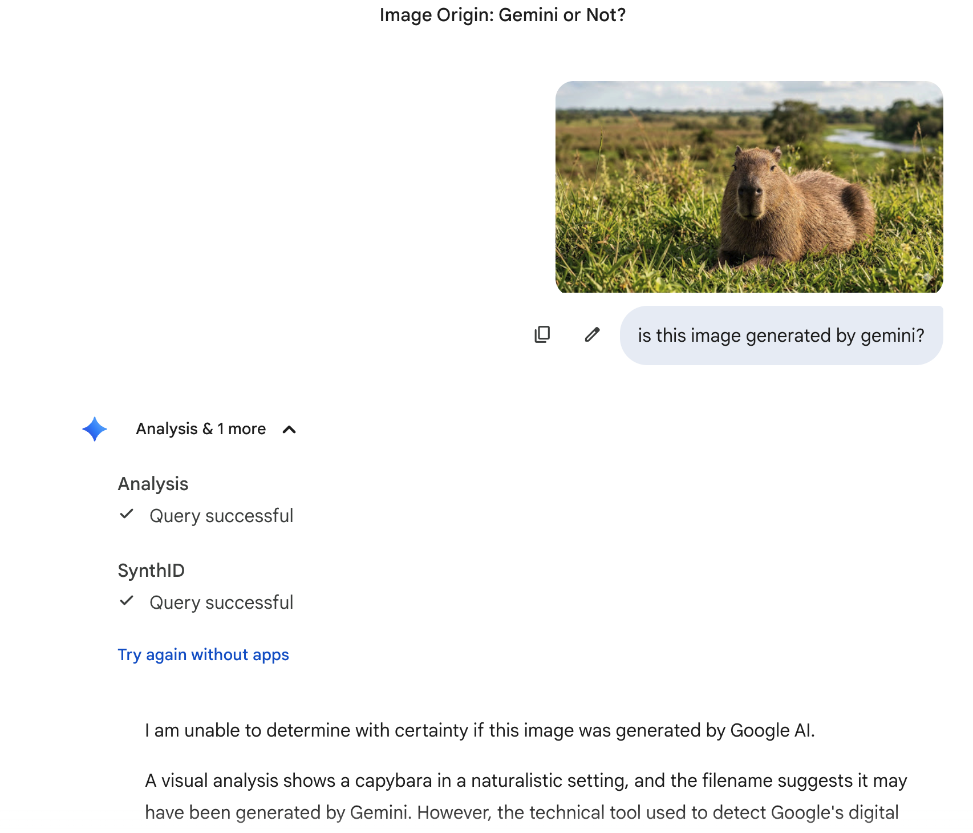
Does watermarking work? Yes, but…
A SynthID-Image example showing false detections are not uncommon.
SynthID-Image cannot always reliably detect images generated with Gemini.
Privacy and Security with Machine Learning
13

Slide 15
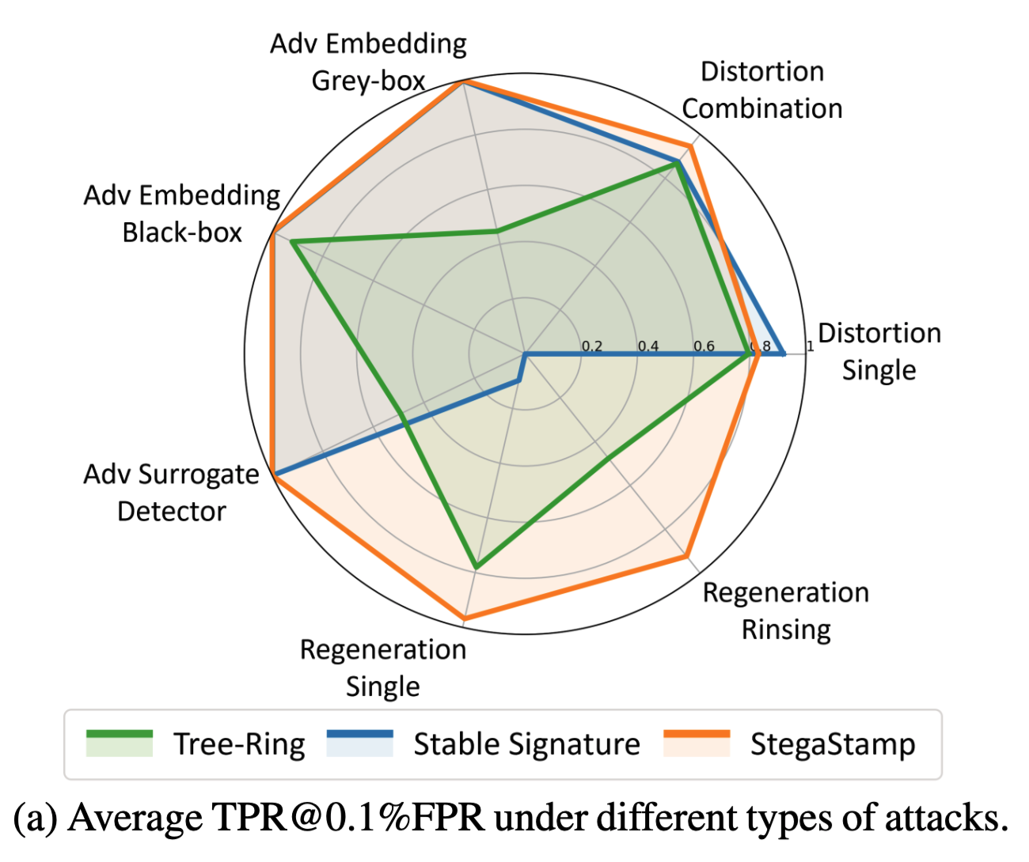
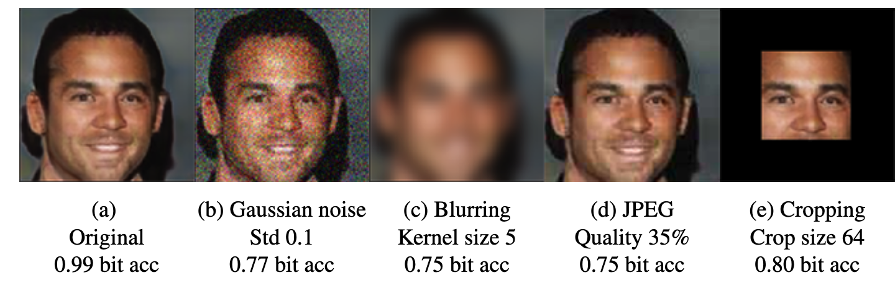
Does watermarking work? Yes, but…
The WAVES benchmark: exposing the vulnerability of watermarking schemes to adversarial attacks.
WAVES benchmark of image watermark robustness: https://arxiv.org/pdf/2401.08573
Various attacks showing watermarks can be removed while image quality is preserved.
Even simple image edits can degrade bit accuracy and hurt provenance credbility.
Watermarks can be more robust against image edits compared to C2PA, but still vulnerable to various types of attacks.
Privacy and Security with Machine Learning
14

Slide 16
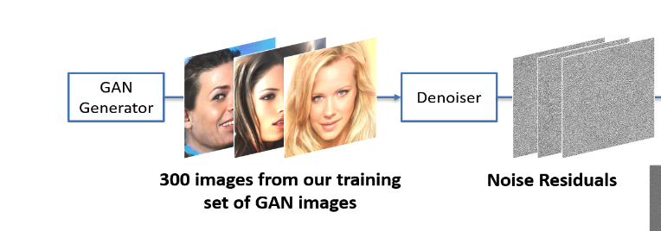
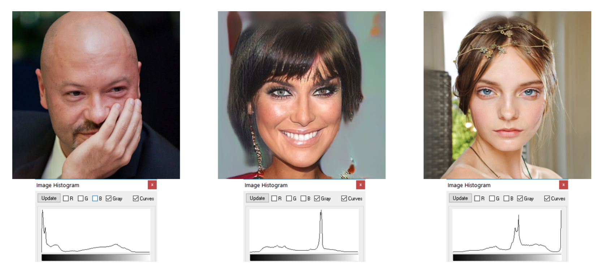
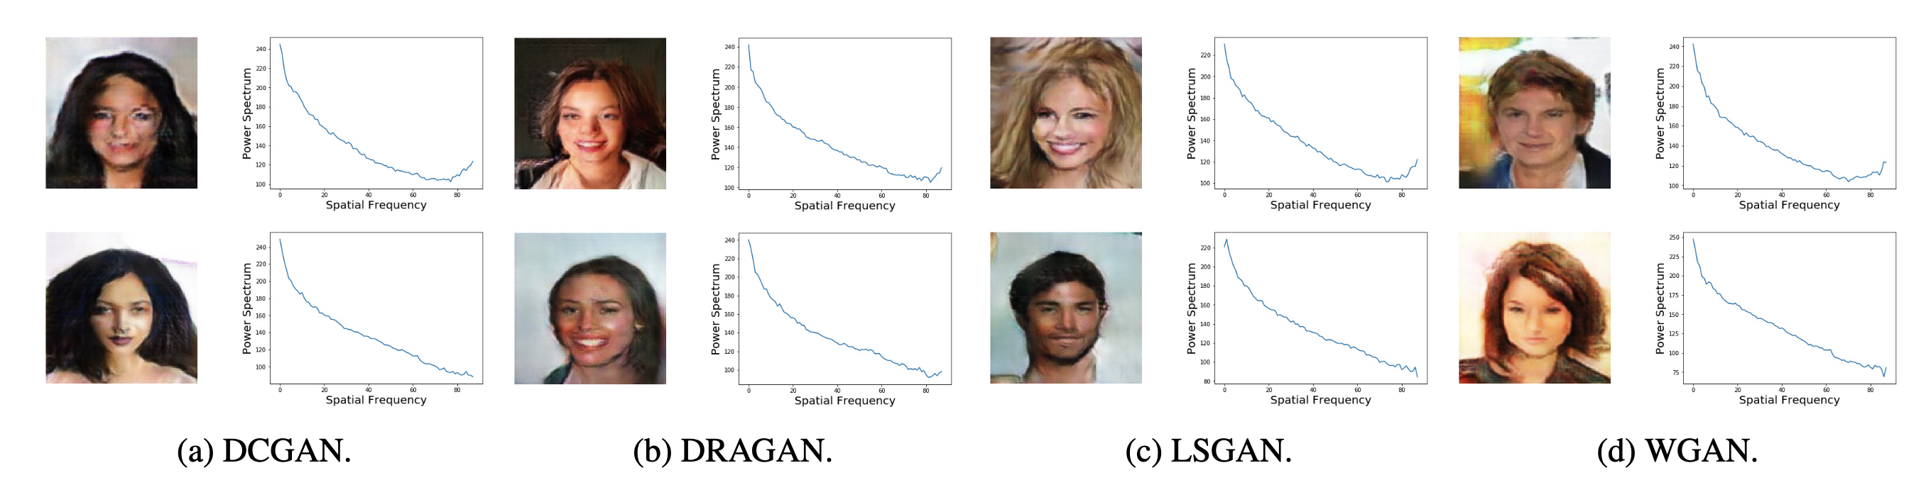

Passive inference: fingerprinting
Another line of research focuses on fingerprinting – the extraction of intrinsic generator-specific traces and artifacts.
Fingerprint $≜$ Noise residuals of an image
Fingerprint $≜$ Pixel intensity histograms of an image
Do GANs leave artificial fingerprints? Marra et al.
Detecting GAN-generated Imagery using Color Cues. McCloskey et al.
Fingerprint $≜$ Power Spectrums of an image
Watch your Up-Convolution: CNN Based Generative Deep Neural Networks are Failing to Reproduce Spectral Distributions. Durall et al.
Fingerprinting leverages intrinsic properties of an image, without actively embed a signal.
Privacy and Security with Machine Learning
15

Slide 17
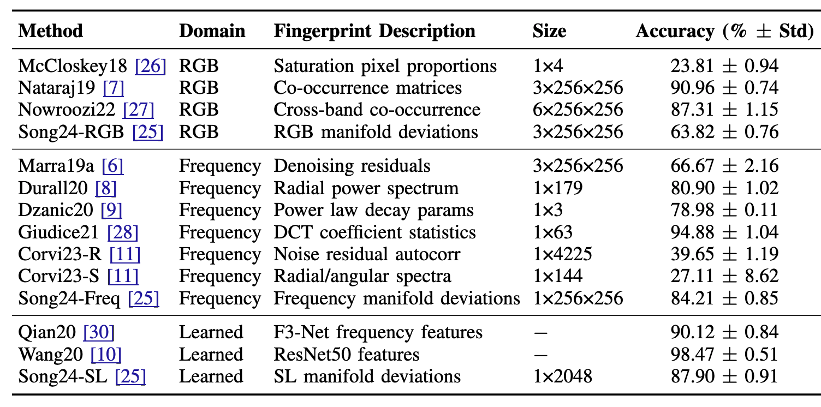
Fingerprinting for model attribution
Fingerprints can also be used for model attribution (which model generated this image?) with high accuracy.
Most fingerprinting techniques achieve >80% attribution accuracy in distinguishing facial images generated by different pre-trained GAN, VAE, and diffusion models trained on the same dataset. Some achieves >95% accuracy.
Model attribution accuracy of 14 different fingerprinting techniques
Smudged Fingerprints: A Systematic Evaluation of the Robustness of AI Image Fingerprints. Yao and Juarez.
Fingerprinting works, but …
Privacy and Security with Machine Learning
16

Slide 18
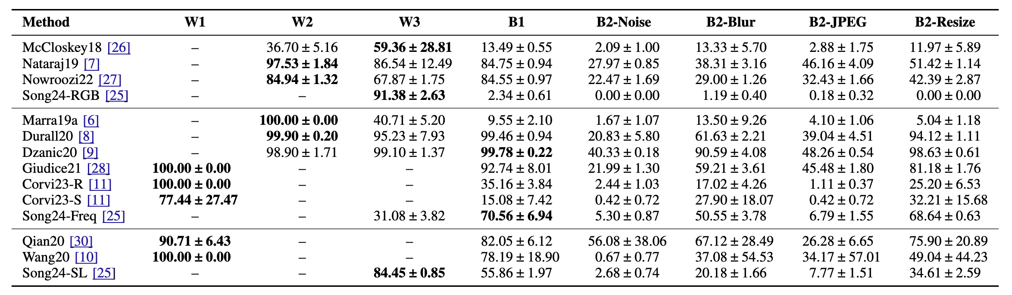
Do fingerprints survive edits and attacks?
However, fingerprints are similarly fragile and offer no more robustness than active watermarks.
Across the 14 fingerprinting methods we benchmarked, the removal success rate is very high under white‑box attacks, where the adversary has access to the fingerprinting mechanism. Even under black‑box editing attacks, such as JPEG compression, the success rate remains non‑negligible.
Attack success rate (in %) of removal attacks against 14 fingerprinting methods
Smudged Fingerprints: A Systematic Evaluation of the Robustness of AI Image Fingerprints. Yao and Juarez.
Fingerprints are also fragile and can be easily manipulated by an active adversary.
Privacy and Security with Machine Learning
17

Slide 19
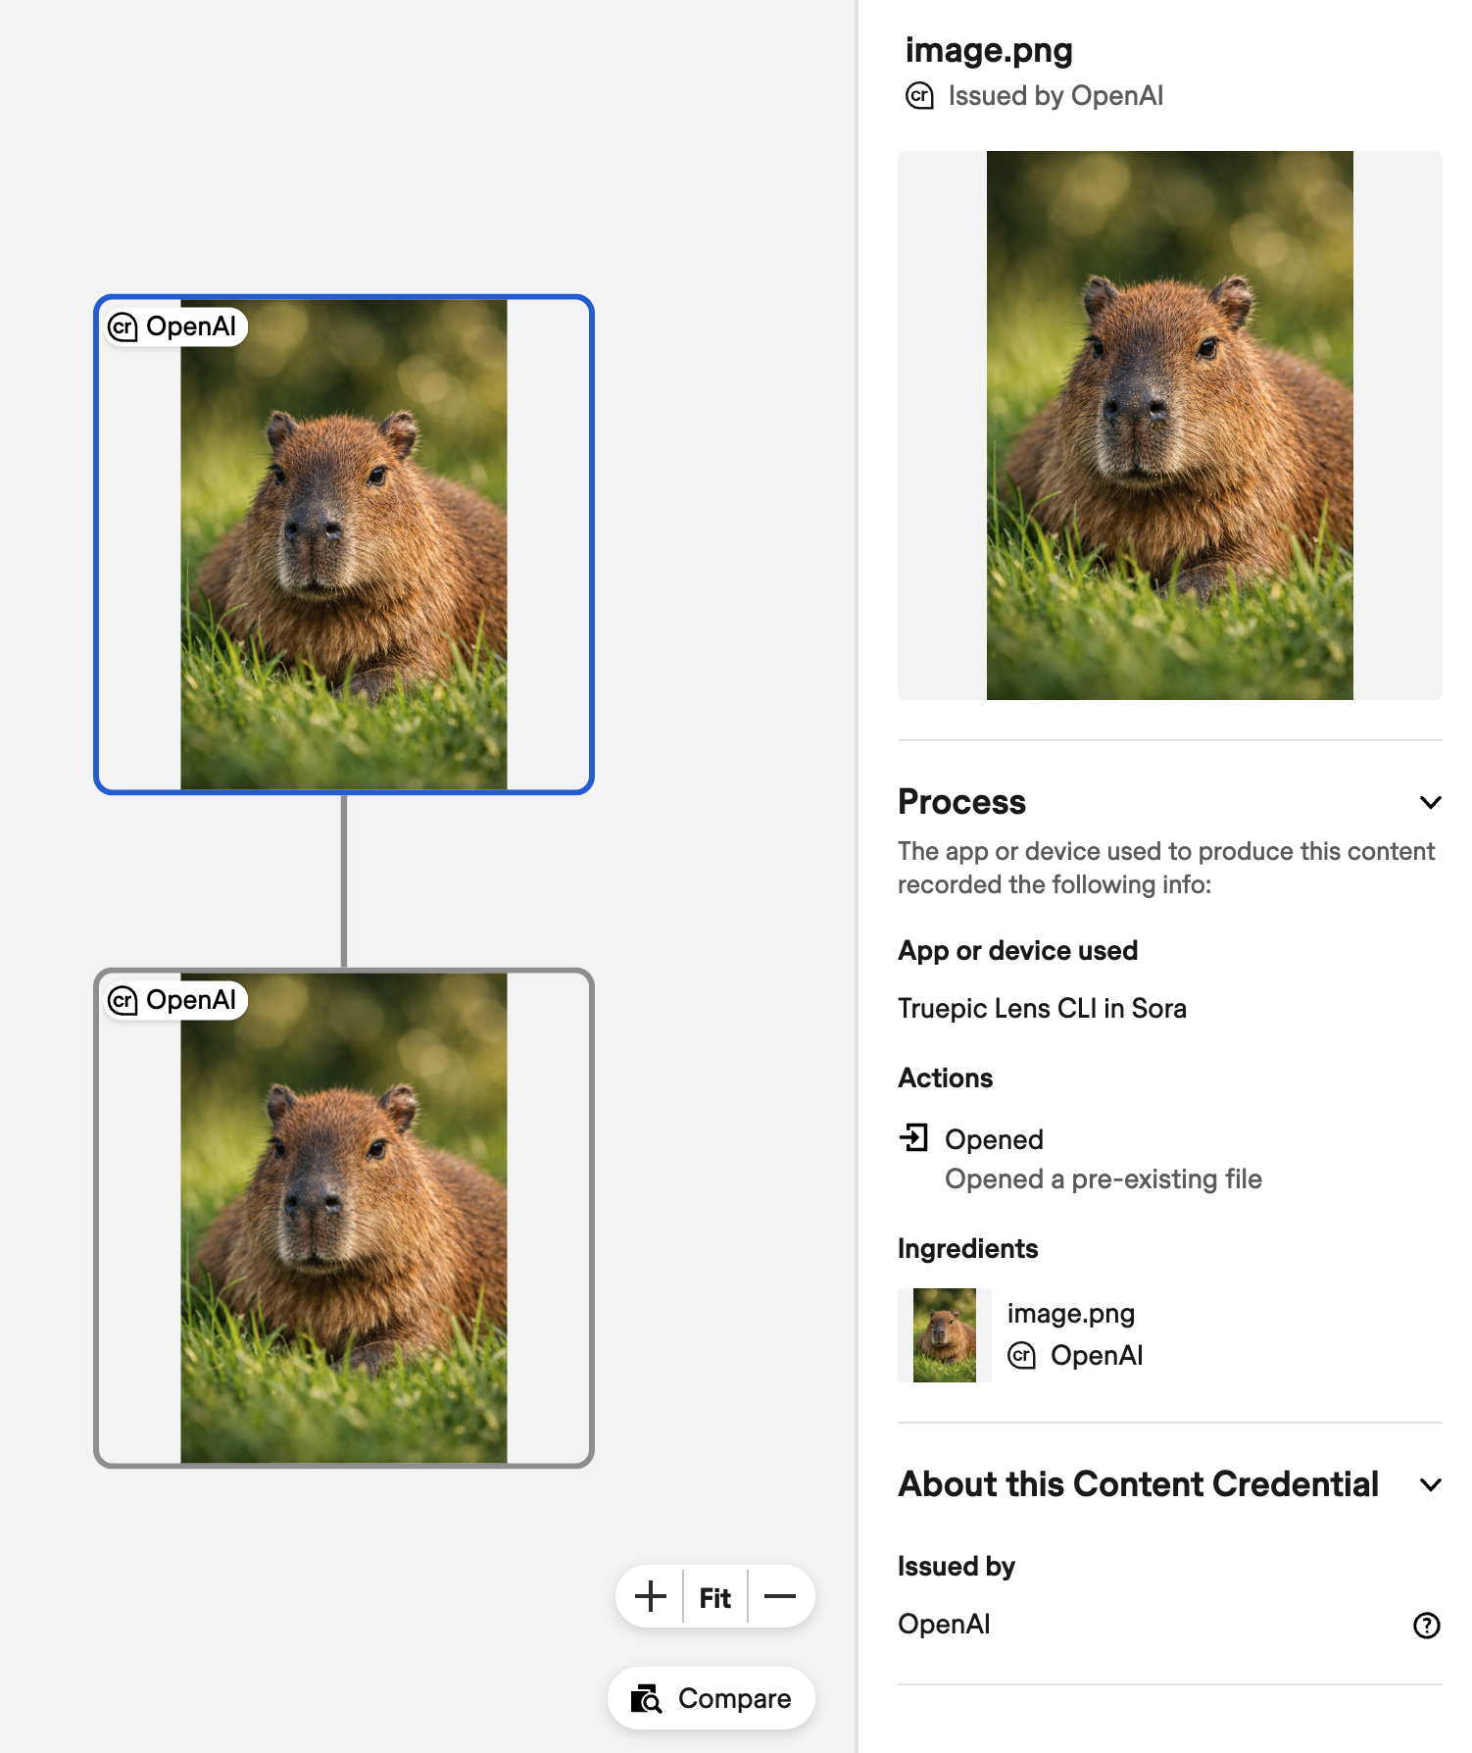
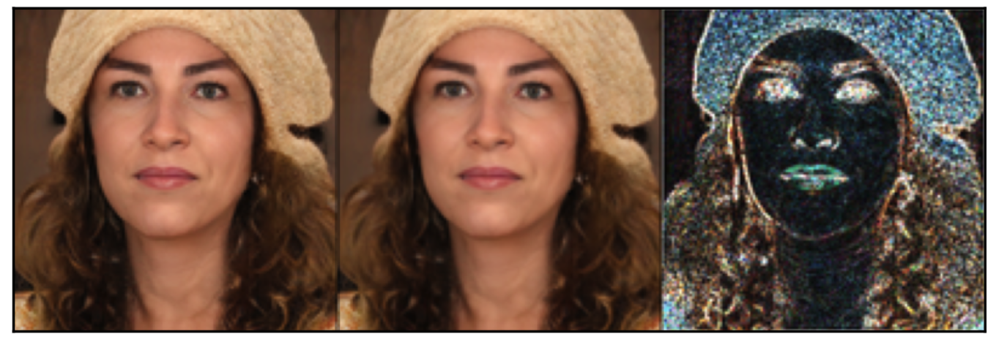
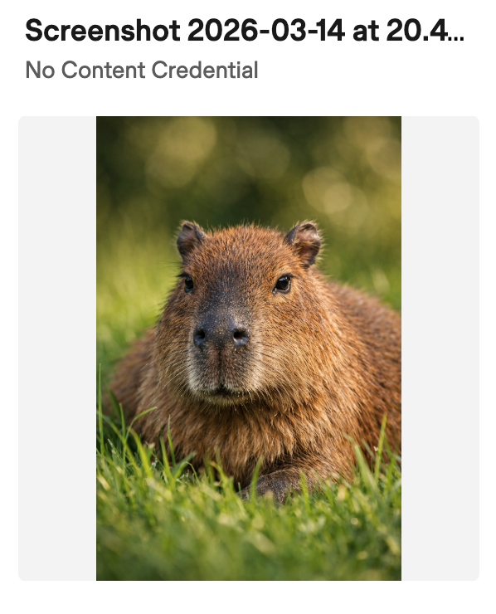
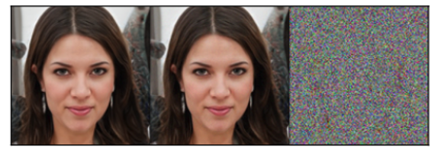
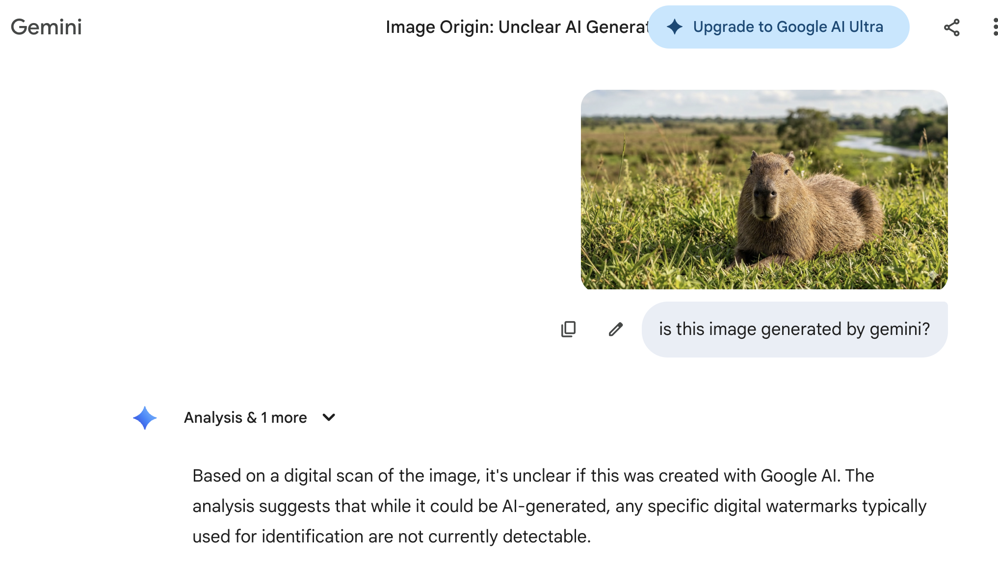
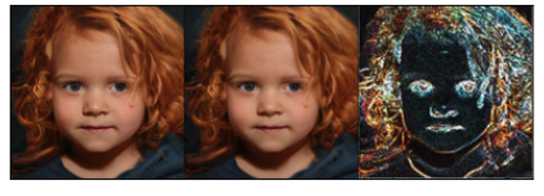
Summary: the “yes, but …”
All current image provenance techniques seem to fall short on robustness.
C2PA doesn’t recognize edits
Watermarks can be unreliable
Fingerprints can be stripped easily
Original
Attacked
Diff.
Most current image provenance signals can be stripped or corrupted by common edits and advanced ML-based attacks.
Privacy and Security with Machine Learning
18

Slide 20
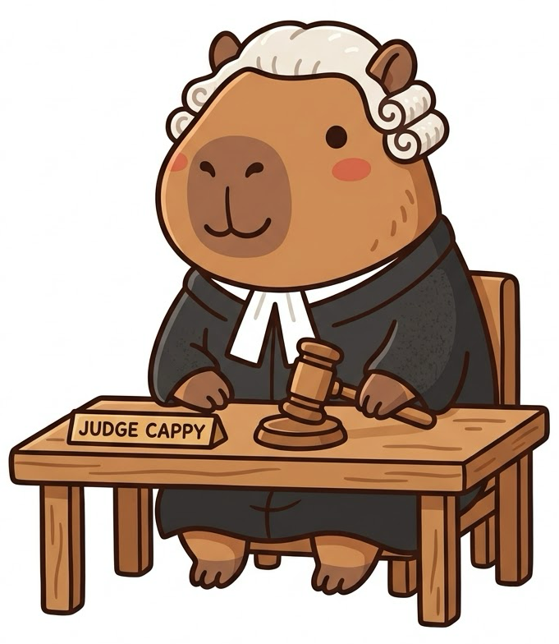
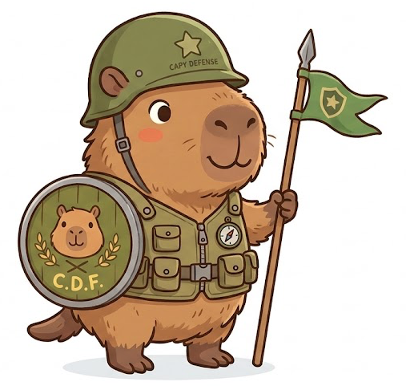

What is the future landscape of AI image provenance?
Going forward, what can we infer about this research field?
Use-Case-Centered Design: Provenance techniques must be tailored to specific threat models—[IP protection] assumes malicious forgers, while [forensics] assumes malicious erasers
Multi-Layer Defense Systems: Combine C2PA hard binding + watermarking + fingerprinting into integrated three-layer provenance architectures for comprehensive attack resistance
Urgent Need for Video Provenance: Recent breakthroughs (e.g., Sora, Seedance 2.0) deliver hyper-realistic video generation—robust video provenance solutions are getting critical
The research in AI image provenance should be more use-case-centered and deployment-facing.
Privacy and Security with Machine Learning
19

