Slide 1





Big 5 Canadian Banks
Descriptive Data Analysis

Slide 2
Project Overview
Comparative Analysis of Big 5 Canadian Banks
Identify the most profitable bank
Choose the most reliable bank for investments

Slide 3
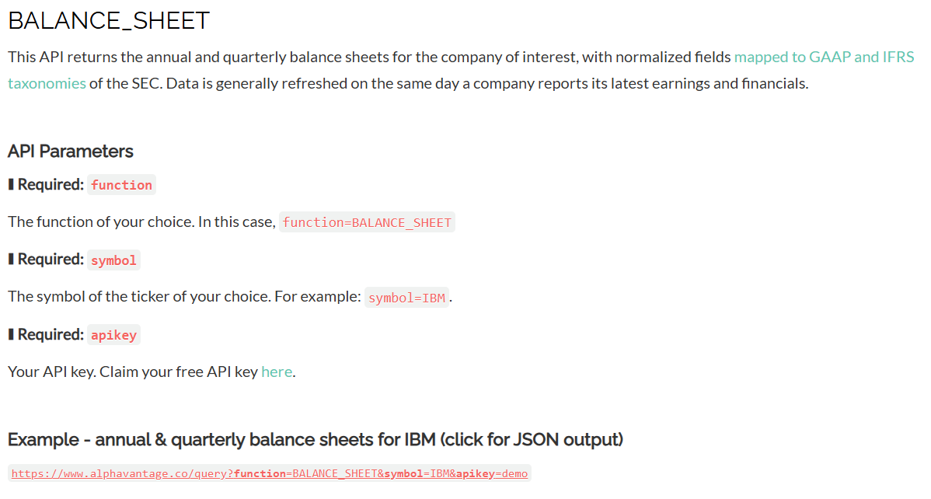
Alpha Vantage API

Slide 4
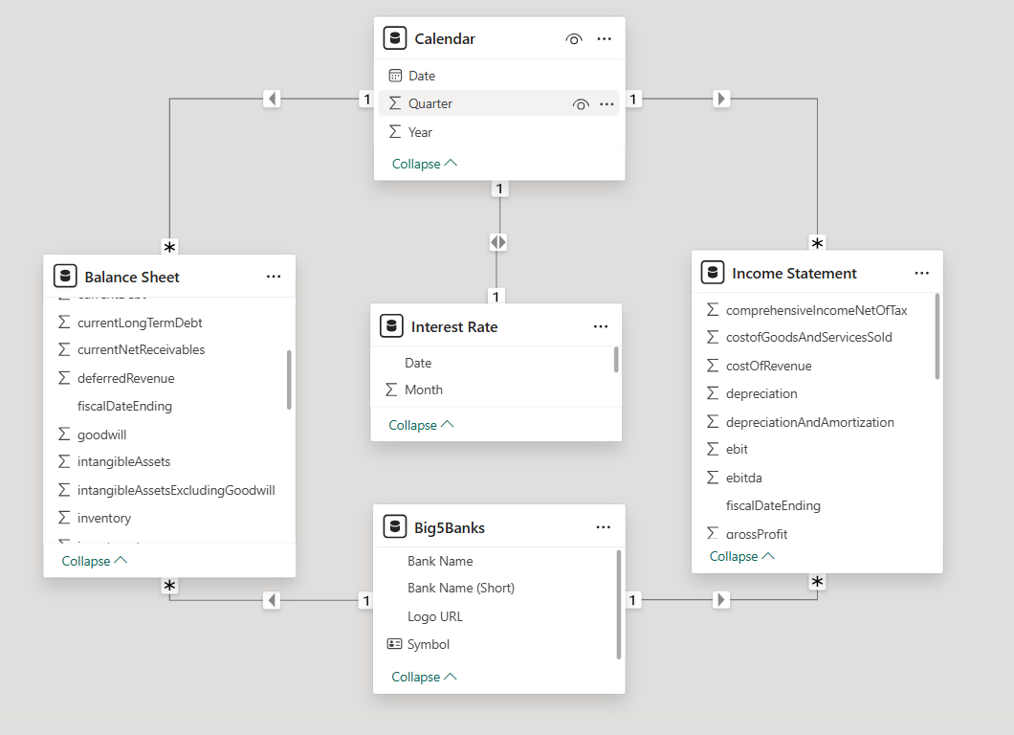
Data Modeling

Slide 5

Notes:
FV rises while IR falls:
The bank is generating value through other means, such as increased transaction fees, investments, or higher loan volume despite lower rates.
This could indicate stronger customer retention or a shift towards non-interest revenue streams.
FV falls while IR rises:
The bank might be losing customers due to high borrowing costs, reducing the total value of deposits and loans.
Could indicate higher loan defaults, affecting the overall future cash flows.

Slide 6
Big 5 Comparison
 | BMO | CIBC | RBC | TD | Scotia Bank
Revenue | 135.0bn | 102.1bn | 236.2bn | 225.6bn | 154.5bn
Net Income | 3.9bn | 5.0bn | 14.8bn | 10.7bn | 7.4bn
Profit Margin | 12.60% | 21.50% | 26.30% | 20.30% | 23.20%
Current Ratio | 1.217 | 1.08 | 2.63 | 1.21 | 1.31
Return on Equity | 2.98% | 3.01% | 3.70% | 3.35% | 2.98%

Slide 7
Future
Opportunities for Improvement
Automating Data Updates
Integrate Real-Time Financial Data
Enhance Visualizations
Notes:
Automating Data Updates: Implement a system that automatically updates visualizations as new financial data becomes available.
Integrate Real-Time Financial Data: Expand data sources to include live market updates for more accurate and timely analysis.
Enhancing Visualizations: dynamic dashboards that adjust to new data in real time for improved decision-making.

Slide 8
Thank You

