Slide 1
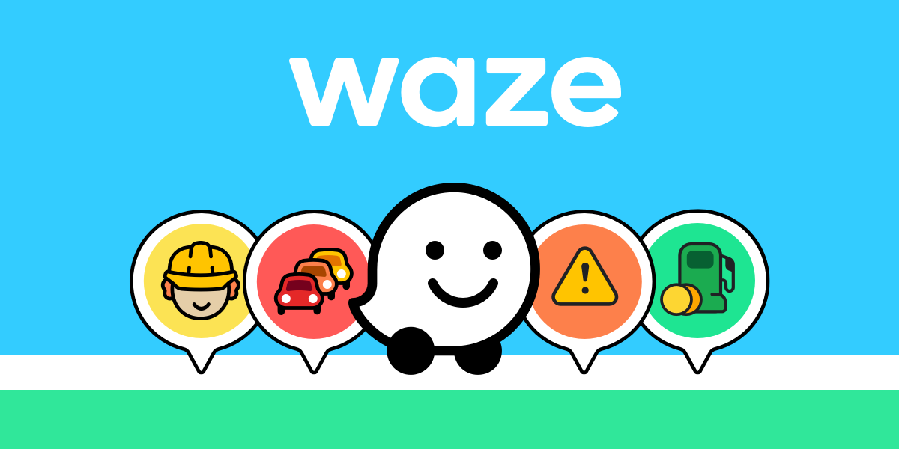
Driving Engagement: Waze User Insights for Marketing Optimization

Slide 2
Timeline
Conception of the FreeMap Israel idea (2006)
Waze is formed to commercialize the idea
(2008)
Renamed to Waze Mobile Ltd
(2009)
Acquired by Google for $1.3B
(2013)
Updated to display real-time and community-curated points of interest
(2011)
Source: https://en.wikipedia.org/wiki/Waze
Notes:
In 2006, Israeli programmer Ehud Shabtai founded a community project known as FreeMap Israel, which aimed to create (with the crowd-sourcing assistance of community users) a free digital mapping database of Israel
In 2008, Shabtai formed a company called Waze to commercialize the initial project;^{[10]}
in 2009, it was renamed to Waze Mobile Ltd.
***In 2010, the company raised US$25 million in the second round of funding;^{[11]} an additional $30 million was raised in financing in the following year.^{[12]}
The application was updated in 2011 to display real-time, community-curated points of interest, including local events such as street fairs and protests.
In June 2013, Waze was acquired by Google for $1.3 billion.^{[5][6][7]} Waze's then-100 employees received about $1.2 million on average: the largest payout to employees in Israeli high tech.^{[20]} As part of the acquisition, the Waze development team continued to operate in Israel as a separate entity from Google.

Slide 3
Overview
Community-Driven Navigation
Real-Time Updates
Crowdsourced Accuracy
User-Centric Features
Notes:
Community-Driven Navigation: Waze is a GPS navigation app powered by a global community of drivers who share real-time traffic and road information to improve routing and travel efficiency.
Real-Time Updates: The app provides live updates on traffic, accidents, hazards, police presence, and road closures to help users navigate the fastest routes.
Crowdsourced Accuracy: Waze leverages crowdsourced data to ensure high accuracy, offering features like ETA adjustments and automatic rerouting based on current conditions.
User-Centric Features: Waze includes personalized features such as fuel price comparisons, voice-guided navigation, and integration with music and podcast apps, enhancing the driving experience.

Slide 4
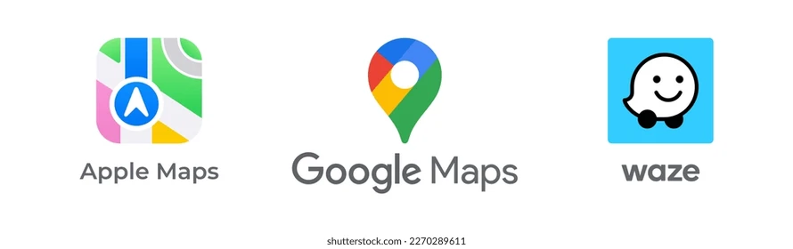
Competitors
Google Inc companies

Slide 5
Specially designed for driving directions
Fastest route, even if it isn't necessarily the most direct
Update the route if a faster option is found
Traffic and other information
Source: https://www.pocket-lint.com/apple-maps-vs-waze/#:~:text=Once%20you've%20chosen%20your,t%20necessarily%20the%20most%20direct
Notes:
Waze is the only and one specially designed for driving directions without any other transportation options available, while the other two were designed as general maps;
Apple Maps tends to generate fairly simple routes that will get you from A to B without any strange detours. In comparison, Waze opts for the fastest route, even if it isn't necessarily the most direct.
Another significant difference is that Waze will update the route if a faster option is found. This can happen fairly frequently if traffic conditions change or if there are accidents or other hazards on the original route.
When you select a route in Waze, you'll see a graphic showing you the issues you will encounter along that route. These include things such as speed cameras, hazards like cars parked at the side of the road, and heavy traffic.

Slide 6
SWOT ANALYSIS
Strengths
Real-time user input
Weaknesses
Heavily rely on active user participation
Threats
Intense rivalry from competitors
Opportunities
Collaborating with car manufacturers
Reroute users to avoid traffic
Continuous location tracking
Developing new features
Potential legal issues
INTERNAL
EXTERNAL
Notes:
Strengths
Crowdsourced Data: Waze leverages real-time user input to provide highly accurate traffic information and road conditions.
Community Engagement: Strong community-driven model where users contribute updates, enhancing the app’s functionality.
Traffic Avoidance: Advanced algorithms that reroute users to avoid traffic congestion, saving time.
Partnerships: Collaborations with governments, municipalities, and event organizers for better traffic management.
User-Friendly Interface: Intuitive design with customizable features, such as vehicle types and voice navigation options.
Advertising Platform: Effective local advertising for businesses through Waze Ads, which target users based on their driving routes.
Weaknesses
Dependence on Active Users: Quality and accuracy heavily rely on active user participation, which may vary regionally.
Battery and Data Usage: High GPS and data usage can drain phone battery and incur costs, especially in areas without unlimited data plans.
Privacy Concerns: Continuous location tracking raises privacy and security issues for users.
Limited Offline Features: Relies on internet connectivity for real-time updates, making it less useful in remote areas.
Opportunities
Expansion into Emerging Markets: Growing smartphone penetration in developing countries provides a significant opportunity.
Integration with Smart Vehicles: Collaborating with car manufacturers to integrate Waze into infotainment systems.
Enhanced Services: Developing features like parking assistance, EV charging stations, and public transportation integration.
AI and Machine Learning: Leveraging AI to predict traffic patterns and improve route suggestions.
Sustainability Initiatives: Promoting carpooling services and partnering with green initiatives.
Threats
Competition: Intense rivalry from competitors like Google Maps (also owned by Google), Apple Maps, and other navigation services.
Regulatory Challenges: Potential legal issues related to user data privacy and sharing traffic information.
Market Saturation: In developed regions, the navigation app market may be nearing saturation.
Technology Disruptions: Advances in autonomous vehicle technology might reduce reliance on navigation apps.

Slide 7
Outline objectives
Improving retention
Driving engagement
and tailoring marketing efforts

Slide 8
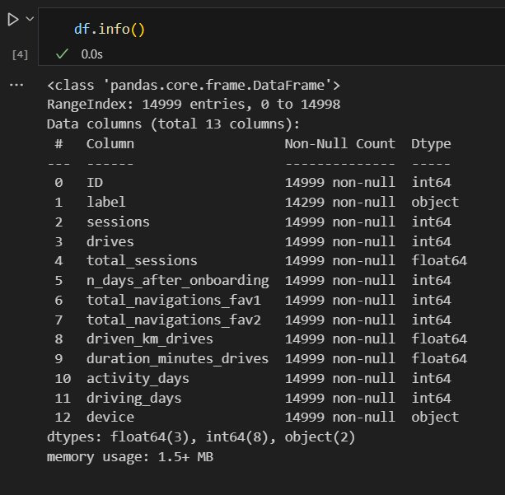

Data Overview
Some key columns include label (churn), drives, n_of_days_onboarding (tenure), and device

Slide 9
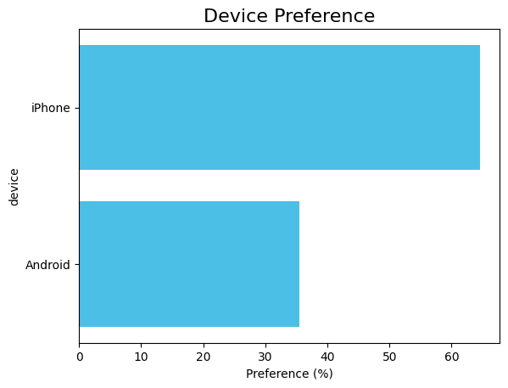

Customer Segmentation
65% users

Slide 10
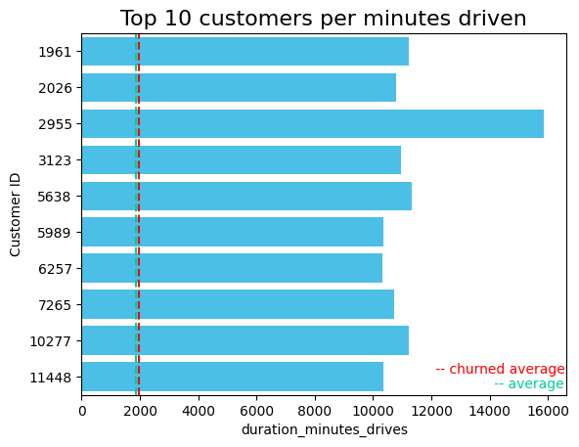
Top 10 customers per minutes driven
Customers who churned, on average, seems to have more minutes driven than the overall average

Slide 11
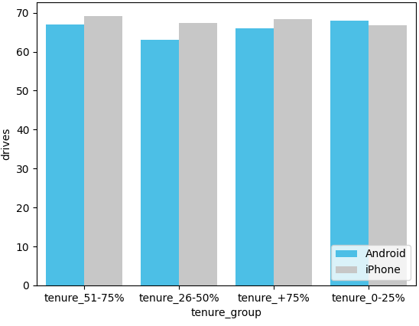
Customer Segmentation by tenure_group, drives, and device
Only the group with the shortest tenure has more drives using Android phones

Slide 12
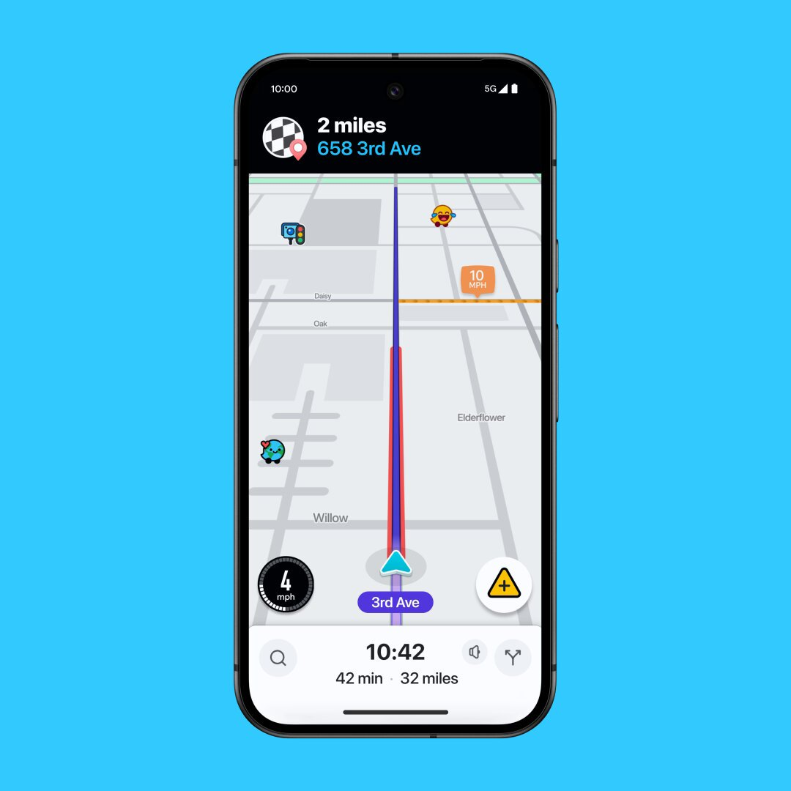
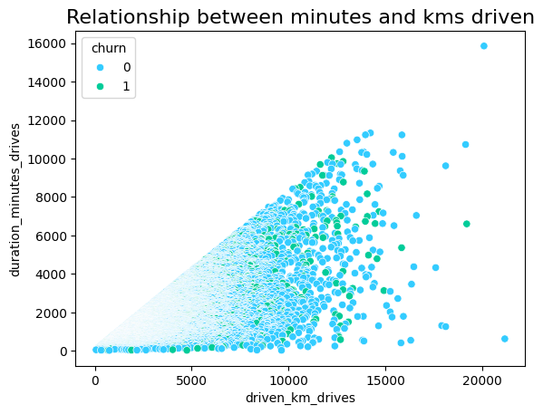
Relationship between minutes and kms driven
Notes:
In this plot, where I relate the drives’ duration in minutes and the driven kms, we can observe that customers who churned have less than 10,000 minutes driven and less than 15,000 kms driven.
OBS: Only 2 customers who have driven more than 15,000 kms churned

Slide 13
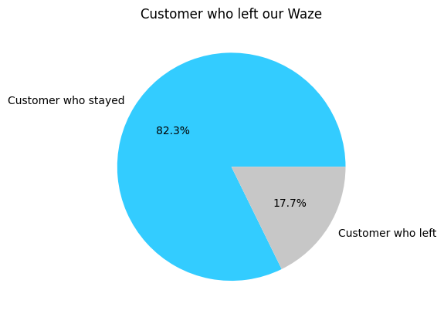
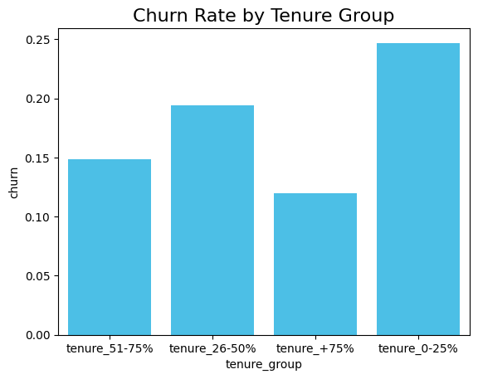
Churn Rate by tenure group

Slide 14

Customer Attrition Profile
Feature | 0-25% | 26-50% | 51-75% | +75%
Sessions | X
Drives |  | X
Total_sessions |  |  |  | X
Tenure |  | X
total_navigations_fav1 | X
total_navigations_fav2 | X
driven_km_drives |  |  |  | X
duration_minutes_drives |  |  |  | X
activity_days | X
driving_days |  |  | X
device | iPhone
Notes:
The customer attrition profile is a way to understand why customers are leaving a company and how to improve retention. This profile typically includes characteristics or behavioral patterns that indicate a higher likelihood of customer churn.
For example, considering everyone, the mode value of drives of the people who churned was between 26 and 50% of the total range of drives,

Slide 15
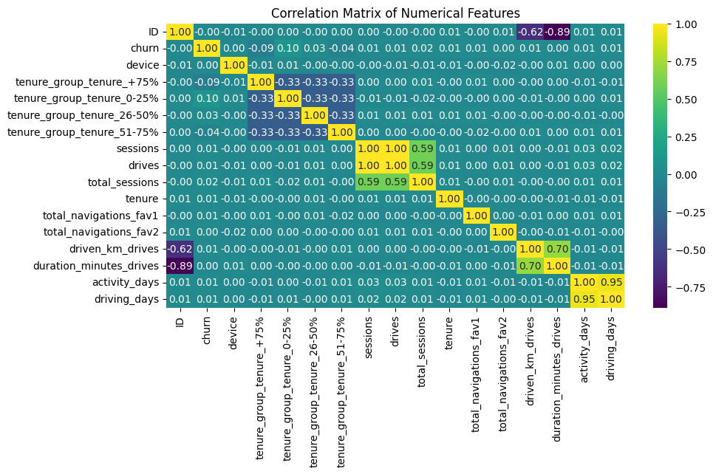
Correlation Matrix of Numerical Features

Slide 16
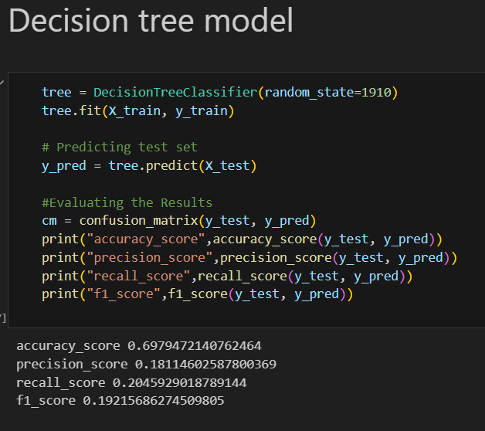
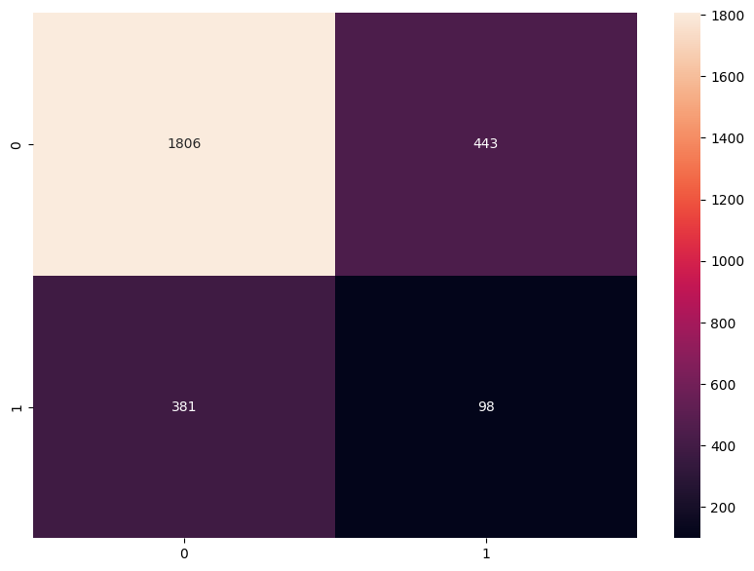
Confusion Matrix of Decision Tree model
Notes:
Why a Decision Tree and not a XGBoost model? In this case, as we are focusing on true churn predictions, we must focus on precision and not accuracy. Given that, the decision tree model had a better precision in terms of prediction than a XGBoost model.

Slide 17
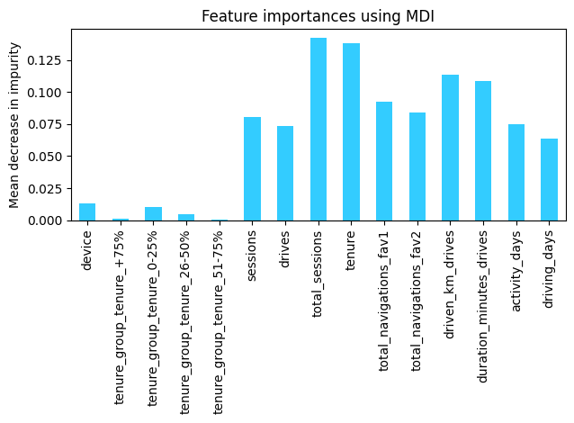
Feature importances using MDI (mean decrease in impurity)

Slide 18

RECOMMENDATIONS
How to improve customer retention?

Slide 19
Personalize Retention Strategies
Insight
Users with higher tenure tend to have better retention rates
Action
Develop personalized engagement campaigns for long-tenure users, such as loyalty rewards, exclusive offers, or personalized notifications based on driving habits.

Slide 20
Re-engage with Churn-Prone users
Insight
Action
Churn likelihood increases when users have lower engagement metrics (e.g., fewer sessions or drives)
Deploy reactivation campaigns targeting low-engagement users with special offers or new feature highlights.
Send personalized emails reminding users of app benefits (e.g., "Avoid traffic with Waze today!").

Slide 21


Targeted Marketing by Device Type
Insight
Action
Engagement and churn rates differ between Android and iPhone users.
Create device-specific marketing campaigns:
Optimize notifications for iOS and Android users separately.
Highlight unique app features tailored to each platform.

Slide 22

Driving Forward: Key Takeaways and Next Steps
Improve data collection
Engagement varies significantly between Android and iPhone users.
Personalize retention strategies for high-value and long-tenure users
Notes:
New features such as Time Since Last Drive calculating inactivity gaps or Engagement Frequency deriving metrics like average sessions or drives per day, could lead to more accurate prediction models;
Deploy device-specific campaigns to improve engagement.
Focus on seasonal campaigns and partnerships with high-value locations to boost usage. Partner with businesses in popular destinations for co-branded promotions.

Slide 23

THANK YOU
Notes:
By putting these strategies into motion, we can drive deeper engagement, retain our users, and ensure Waze remains the go-to navigation app for millions of drivers worldwide.

