Slide 1

Customer Behavior Analysis
Project 3

Slide 2
Project Objective
This project aims to analyze customer behavior patterns using data-driven insights. The primary objective is to understand factors that impact customer engagement, purchase frequency, and churn. By studying behavioral metrics such as sessions, transactions, and engagement with promotions, we seek to identify key drivers of customer satisfaction and areas for improvement.
Project Goals:
Analyze customer interactions across web and app channels.
Identify patterns in customer purchasing, product views, and session behaviors.
Develop actionable insights to boost retention, engagement, and conversion.

Slide 3
Data Preprocessing
Where applicable, numerical columns were converted from int to float types
01
Fields values with commas were replaced by dots
02
Values “yes” and “no” were replaced by Boolean (True or False)\
03
No missing values were identified
04

Slide 4
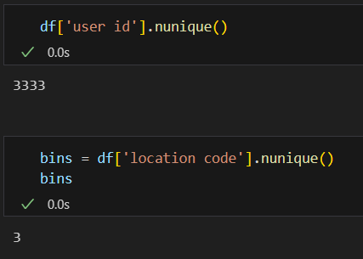
Exploratory Data Analysis
While each row in the dataset represents a different customer (3333)
We found only 3 different location codes in the dataset

Slide 5
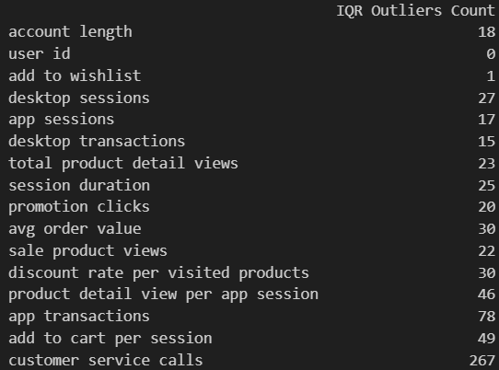
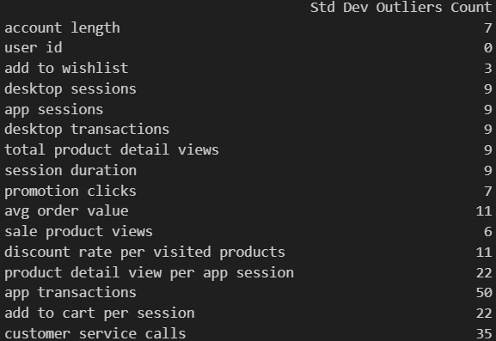
Counting outliers using different methods
Using Interquartile range
Using 3 Standard Deviation
* To achieve these results two different functions were created to individually count the values

Slide 6
Exploratory Data Analysis
50% of the customers have an average order value between $167 and $235.30
The average number of sessions through desktop is almost 6 times more than through app
The average number of transactions through desktop is more than 4 times higher than through app
Each customer check at least 33 sale products
At least half of the customer do not use the wishlist

Slide 7
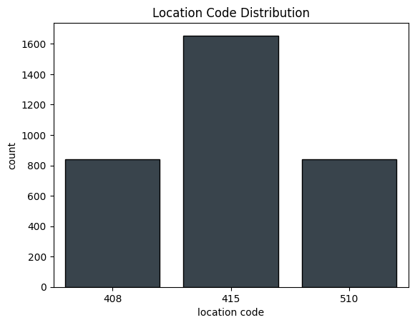
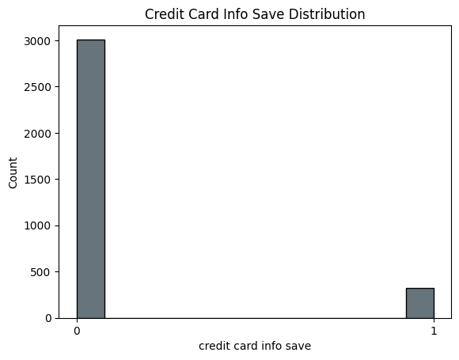
Data Visualization
Approximately 50% of the customer have the location code 415
The other half seems to be equally divided between the other two location codes
Considering 3333 customers, around 3000 do not have their credit card info saved in the platform

Slide 8
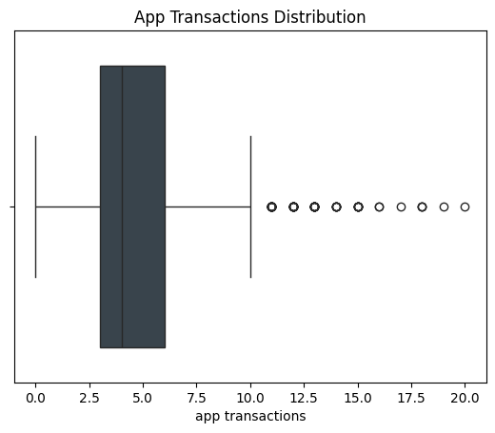
Data Visualization
The App Transactions Distribution is right-skewed, with 75% of the values below 6 transactions
One observation is twice higher than the upper whisker
All the numerical variables in the dataset has outliers from a statistical point of view. What is apparent is that all the outliers represent natural variations as in e-commerce we expect such variations, making the outliers "True outliers"

Slide 9
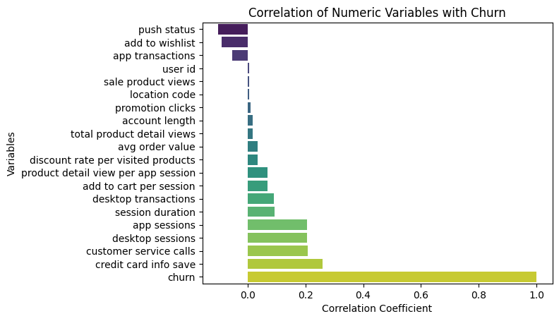
Analysis of the Dependent variable (Churn) vs Independent variables
The numeric variable with the highest correlation with churn is credit card info save, followed by customer service calls, desktop sessions, and app sessions

Slide 10
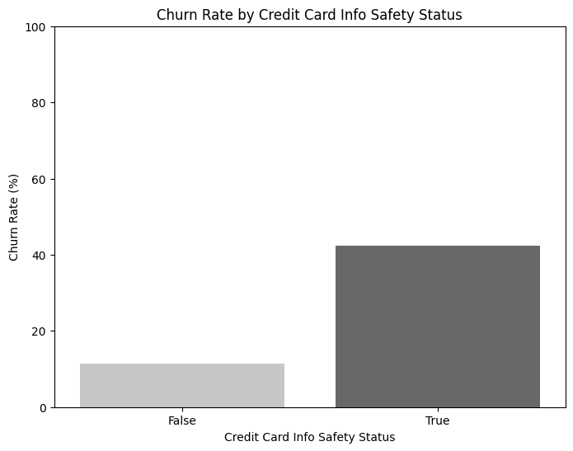
Churn Rate by Credit Card info
This plot suggests that the churn rate between the customers with credit card info saved is higher than between the customers without saving the credit card info

Slide 11
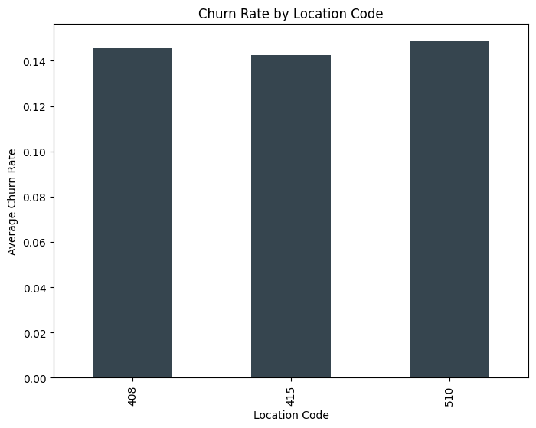
Churn by location
Even though the location code 415 has the biggest share of customers, it presents the lowest average churn rate

Slide 12

Insights & recommendations
Reduce Churn with Customer Service Improvements
Insight: Customers who call customer service are more likely to churn.
Action: Focus on enhancing first-contact resolution and reducing response times to improve customer satisfaction.

Slide 13
Streamline the App experience
Insight: Mobile app sessions are frequent, but transactions per session are lower than on desktop.
Action: Improve app usability and introduce features like in-app product recommendations to encourage purchases within sessions.

Slide 14
Reinforce customers’ personal information
Insight: The reason behind a highest churn rate between customers with credit card info saved, can be linked with an insecurity feature and/ or lack of confidence
Action: Reinforce security systems and trustworthiness when dealing with customers sensitive information, especially credit card info

