Slide 1

Predicting Environmental Waste Violations in New York
Ruohan Li | Juyong Kim
Theophile Gervet | Kaila Gilbert
Notes:
Kaila

Slide 2
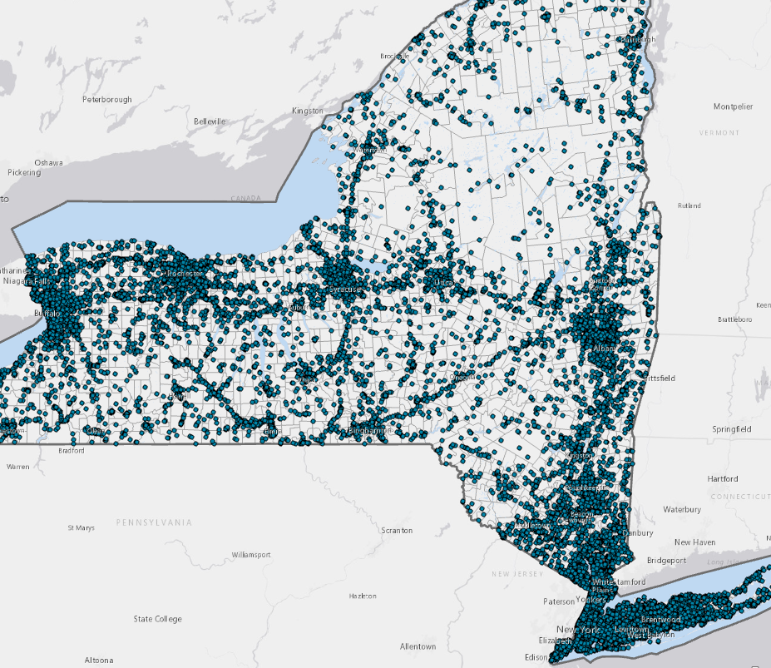
Problem Statement
The Federal Environment Protection Agency (EPA) and the New York State Department of Environmental Conservation (NYSDEC) enforce hazardous waste management regulations in New York.
The EPA and NYSDEC conduct evaluations to detect violations, enforce compliance, and penalize violators.
Notes:
Kaila
New York possesses 7% of waste management facilities and 22% of large waste generators in the United States

Slide 3
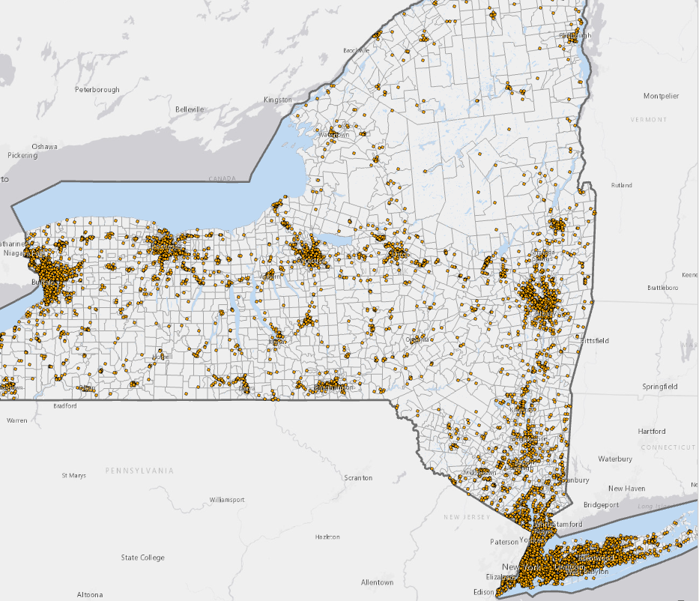
Problem Statement
Few facilities have ever been inspected (14% in NY)
Each year, only 1% - 3% of waste facilities are inspected in NY.
Most common violations are related to administrative issues.
[We Think.]
Notes:
Kaila
New York possesses 7% of waste management facilities and 22% of large waste generators in the United States

Slide 4
Policy Goal
Inform the annual inspection selection process by targeting facilities at highest risk of violating
Efficiency
Minimize waste of public resources
Equity
Consider who will be protected or targeted
Effectiveness
Minimize impacts of violations
Notes:
Kaila

Slide 5
Policy Goal
Inform the annual inspection selection process by targeting facilities at highest risk of violating
Efficiency
Minimize waste of public resources
Equity
Consider who will be protected or targeted
Effectiveness
Minimize impacts of violations
Notes:
Kaila

Slide 6
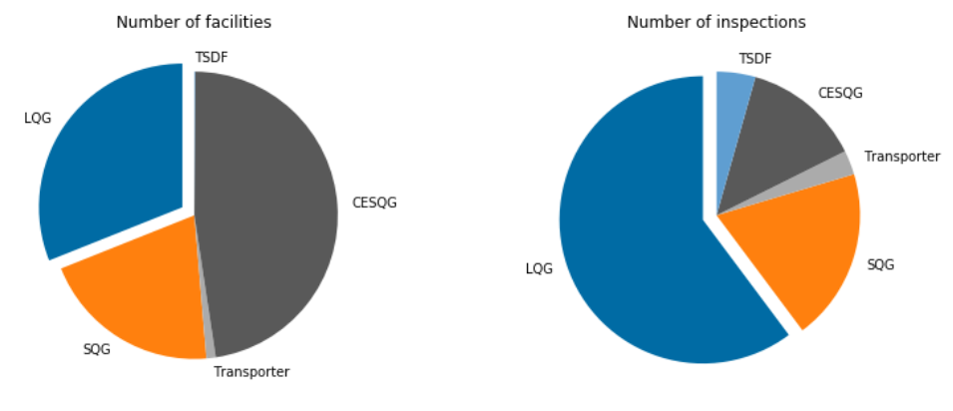
Our Data: Choosing a Facility Type
Our main source of data is inspection/violation records by the EPA to enforce RCRA.
Our project focuses on Large Quantity Generators (LQGs). This reflects perceived prioritization of EPA’s inspection process.
While only a third of facilities, LQGs represent 60% of all inspections, the vast majority of public resources.
31%
31%
60%

Slide 7
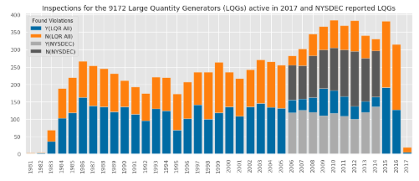
Inspections and Violations (2009-2014)
Our time period of interest coincides with the recording of NYSDEC waste information and available ACS information at the county level.
NYSDEC Waste Reports
Currently Active LQGs
ACS County Data
Notes:
Theo

Slide 8


ML Formulation
Our Cohort (rows):
9,172 LQGs active in 2017
Data includes all activity from 2009-2014
Task (labels): Predict if a facility will commit at least one violation in a given year
Notes:
Theo

Slide 9
Model Features
193 Total Features
Feature Group | Generalizable to never-inspected facilities | Examples
Inspection History | No | Presence of Inspection/violation in the last year, number of inspections/violations in previous k(=5) years
Waste Codes | Yes | Type and quantity of waste generated
NAICS Code | Yes | Industry
ACS Features | Yes | Population density, median income, poverty status, heating and fuel consumption, structure year
Notes:
Theo

Slide 10
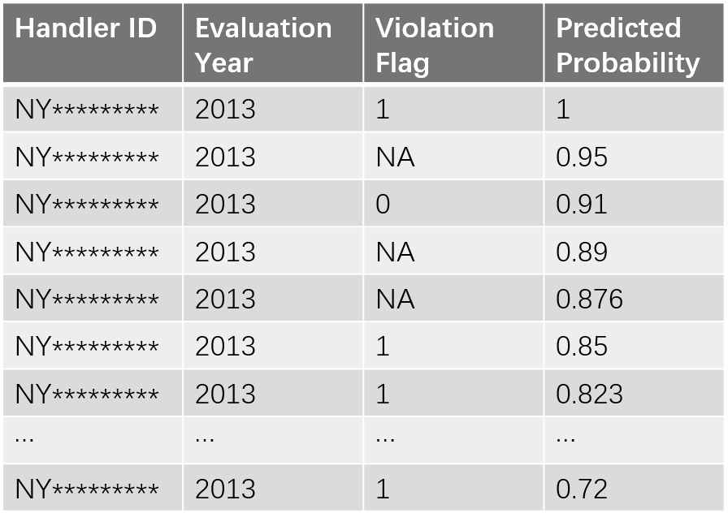
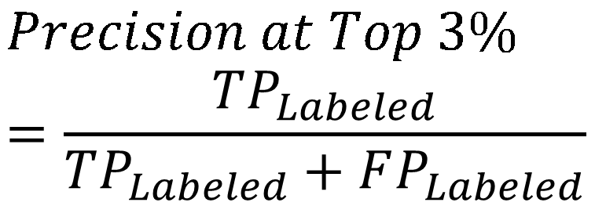
Train / Test Splits (for Technical Readers)
We trained our models based on all the available labeled data
We used this model to test on all active facilities, labeled or not.
Notes:
Ruohan
=> I’ll also quickly present the cohort in the ML formulation slide, it’s nice to have a summary slide of the whole project [Theo]
=> We should mention that although we use labels only from 2009-2014, we extract features from years prior to 2009 if necessary (e.g., for inspections/violations in previous k years) [Theo]

Slide 11
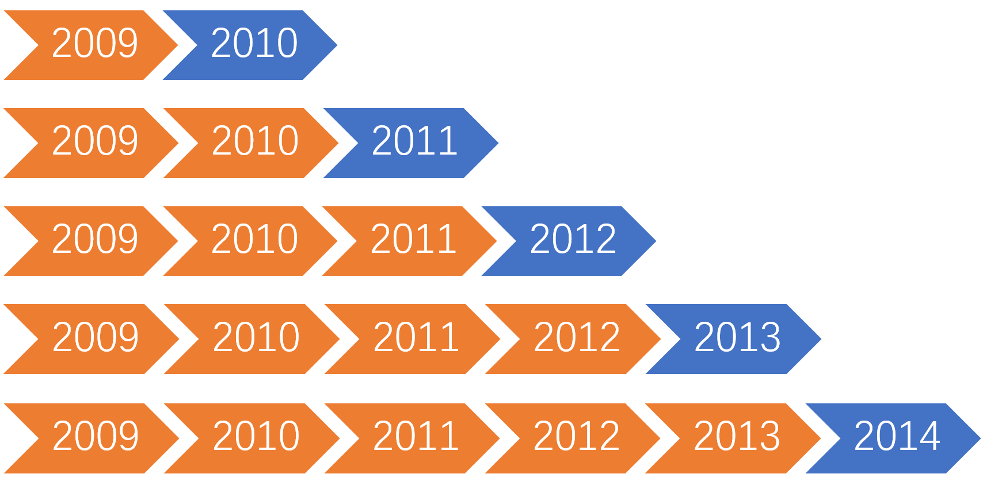
Train / Test Splits
Notes:
Ruohan
=> I’ll also quickly present the cohort in the ML formulation slide, it’s nice to have a summary slide of the whole project [Theo]
=> We should mention that although we use labels only from 2009-2014, we extract features from years prior to 2009 if necessary (e.g., for inspections/violations in previous k years) [Theo]

Slide 12
Machine Learning Models
Types of Models:
Logistic Regression
Random Forest
K Nearest Neighbors
Adaptive Boosting
Feature Groups:
Inspection History, Waste Codes, NAICS Codes, ACS Features
Inspection History, NAICS Codes, ACS Features
Notes:
Ruohan
=> I’ll also quickly present the cohort in the ML formulation slide, it’s nice to have a summary slide of the whole project [Theo]
=> We should mention that although we use labels only from 2009-2014, we extract features from years prior to 2009 if necessary (e.g., for inspections/violations in previous k years) [Theo]

Slide 13
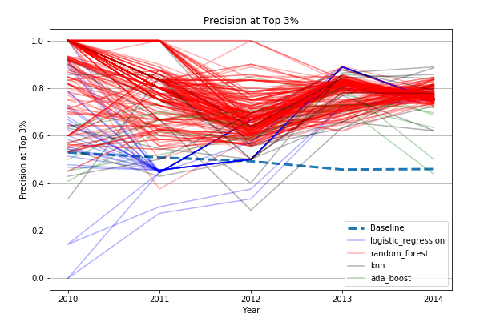
Visualizing Model Effectiveness
Our random forest models (in red) performed higher than all other models, including the baseline (48%)
Notes:
Ruohan
=> color curves by family of estimator as Kai suggested? [Theo]

Slide 14
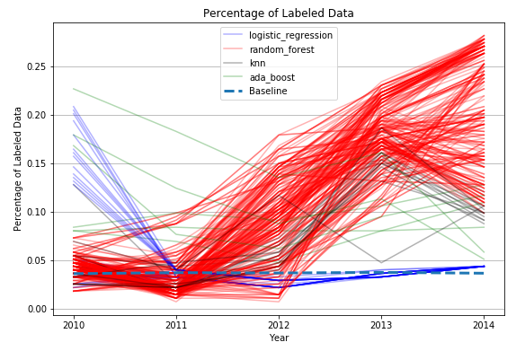
Visualizing the Grid: Labeled or Unlabeled
When applying our predictive model to ALL facilities (inspected or not), random forests outperformed all other models.
Notes:
Ruohan
=> explain why percentage of labeled data increases with time? As suggested by Juyong, our model captures the selection process of the EPA? [Theo]

Slide 15
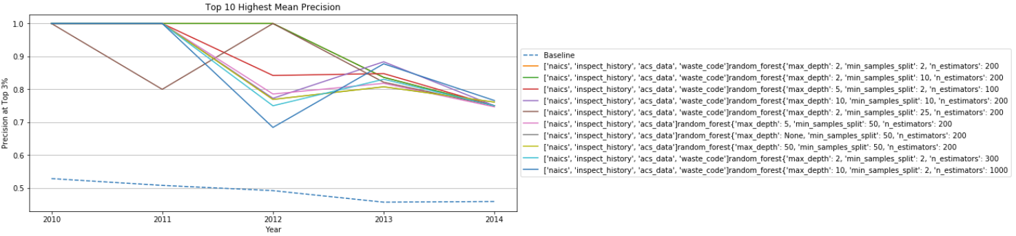
Model Selection: Highest Mean Precision
We selected the model with the Highest Mean Precision: 0.92 for analysis.
Notes:
Ruohan
=> color curves by family of estimator as Kai suggested? [Theo]

Slide 16
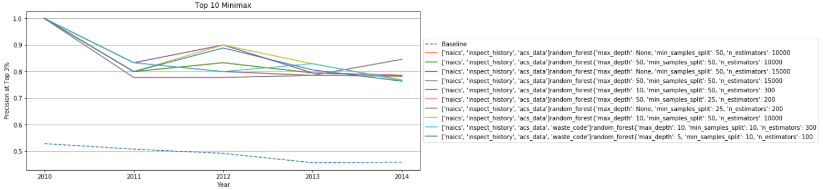
Model Selection: Minimax
We also incorporated the results of another model, with a Minimax rate of 0.79. This model is most least volatile across its predictions, providing stability.
Notes:
Ruohan
=> color curves by family of estimator as Kai suggested? [Theo]

Slide 17
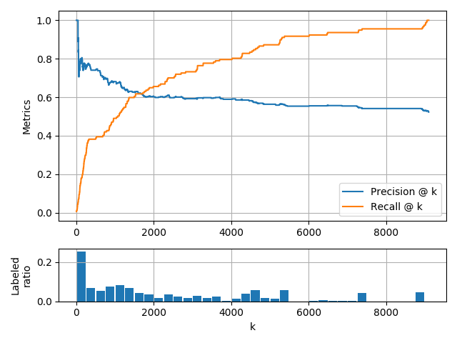
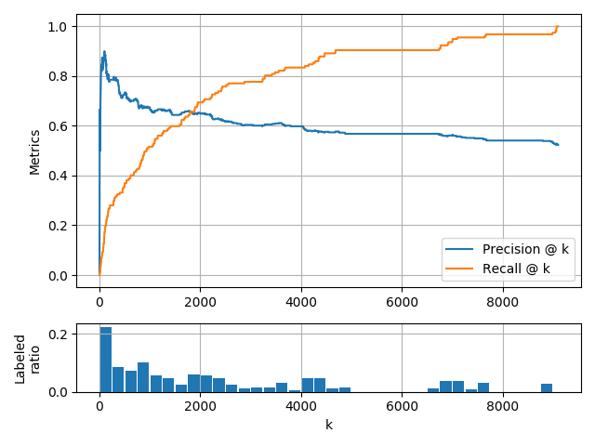
Top Model Performance: Precision-Recall
Model 1: Highest Mean Prec @ 3%
Model 2: Minimax Prec @ 3%
Features: NAICS, inspect history, acs, waste code
Features: NAICS, inspect history, acs
Notes:
[Juyong]
We plotted the precision and recall @ k curve, with the distribution of the percentage of label data, evaluated on the last year (2014).
% The distribution of labeled data is computed by splitting test predictions by 250 from the top, (1~250, 251~500, and so on), and counting the number of labeled examples in each block.
As we can see, both models have high precision @ 3% (~270), and interestingly both models have higher ratio of the labeled data compared than average (3%).
So, the prediction @ 3% is computed on many examples (>50), so the precision @ 3% has statistical significance.

Slide 18
So what are the best predictors of a waste violation?
Even when a facility has never been inspected?

Slide 19
Model Takeaways
In general, the EPA’s data reveals a bit of a loop:
Once any facility has been flagged for violation, it is then inspected more often, and then more likely to show a later violation.
This means the EPA will spend the majority of its time investigating the same facilities, a process which absorbs public resources that could be put towards investigating unknown facilities.
However, we did locate some trends. We share the top indicators on the following slides.

Slide 20
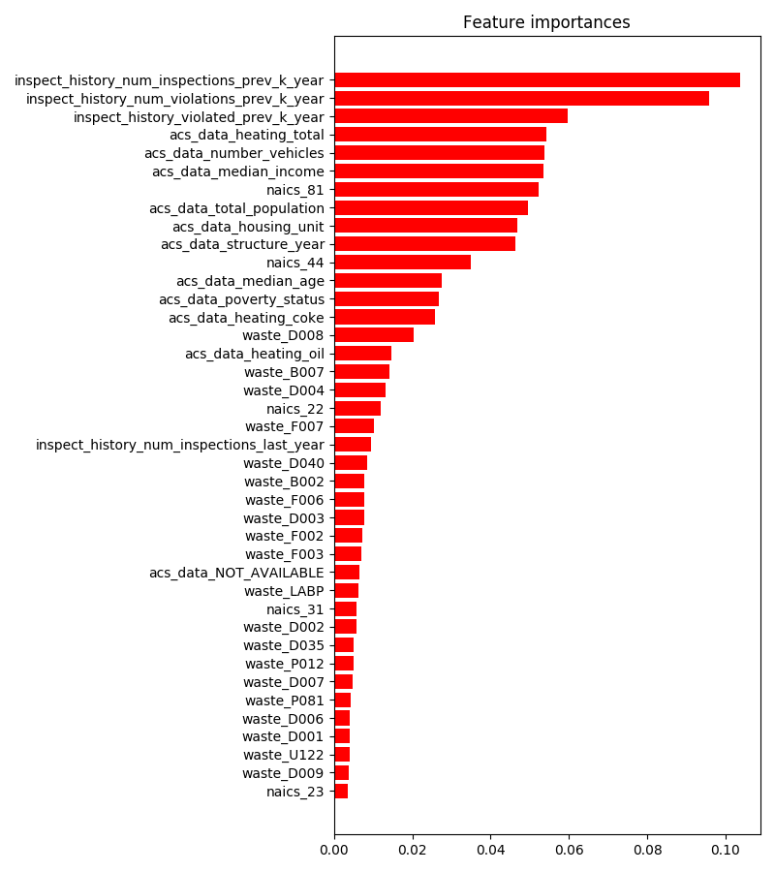
Top Indicators
(ACS) Total Heating Consumption
(ACS) # of Vehicles
(ACS) Median Income
# of Inspections in 5 Years
# of Previous Violations in 5 Years
# Violated in 5 Years
Top Industries
81: Commercial and Industrial Machinery
44: Retail and Trade
22: Utilities
Notes:
[Juyong]
We have visualized feature importance of two best models to see on which features the models focus on.
For the highest mean precision, history of inspection/violation ranked the top features and the ACS features and then waste codes follow.
Also some of NAICS codes are used as a feature.

Slide 21
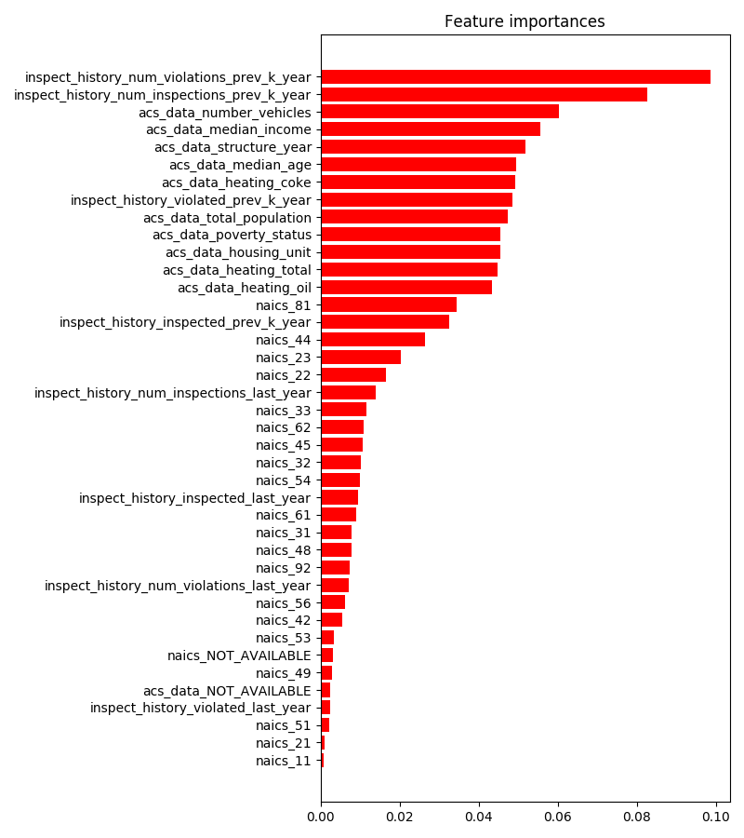
Top Indicators:
Minimax
# of Previous Violations in 5 Years
# of Inspections in 5 Years
(ACS) # of Vehicles
(ACS) Median Income
(ACS) Structure Year
Top Industries
81: Commercial and Industrial Machinery
44: Retail and Trade
23: Construction
Notes:
[Juyong]
This preference is also similar in the minimax model.

Slide 22
Global Interpretability of Two High Performers
Crosstabs: average values on test set at 3% Precision
Model 1: Highest Mean Precision |  |  |  | Model 2: Minimax Precision
Features | Top 3% | Bottom 97% | Rank | Features | Top 3% | Bottom 97%
total inspections in 5 years | 2.613 | 0.103 | 1 | total violations in 5 years | 1.691 | 0.075
total violations in 5 years | 2.588 | 0.047 | 2 | total inspections in 5 years | 1.706 | 0.131
violated in 5 years | 1.480 | 0.041 | 3 | number vehicles (acs) | 309354.0 | 195816.4
heating total (acs) | 352463.2 | 504660.6 | 4 | median income (acs) | 75936.3 | 57577.3
number vehicles (acs) | 306937.9 | 195891.1 | 5 | structure year (acs) | 1944.55 | 1948.38
Notes:
[Juyong]
We also computed the average of the top features used by the best two models.
Overall, if a facility have inspected/violated before, that would be a strong signal for the future violation.
and having less heating, more number of vehicle, more income, and old buildings are signals for the future violation.

Slide 23
Analysis
Our models discovered that the LQGs most likely to experience a violation were located in larger, metropolitan areas.
There was also a general trend towards the policy setting of a specific year; The EPA finds more violations in years it does more inspections in general.
This indicates that violations may hold steady or even increase, but the inspection capacity dictates whether these violations are actually uncovered and investigated.
Wider coverage in general (inspecting random facilities rather than historical abusers) would shed more light on actual underlying indicators.

Slide 24
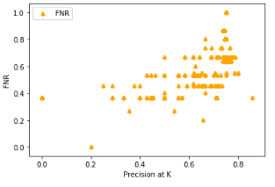
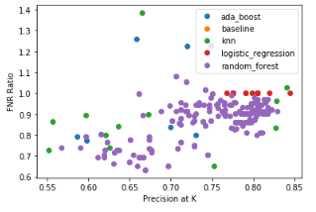
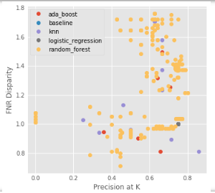
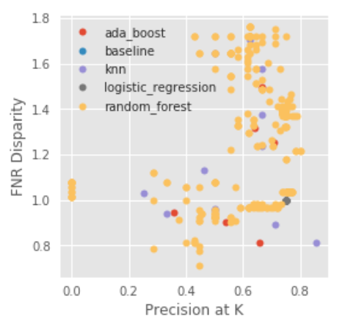
Fairness Audit: FNR
Our group wanted to ensure that our model did not relay bias towards high poverty zip codes, based on pre-existing research into equity and systemic issues in inspections.
Our Protected Groups: High Poverty Zip Codes (> than NY Average)
Our Metric of Interest: False Negative Rate + FNR Disparity
Notes:
Kai

Slide 25
FNR Analysis
Our model did not show the same bias that exists within the baseline status quo. In fact, one model was more likely to overlook violations within high poverty zip codes, with relation to higher income areas. This was seen as problematic, with relation to health quality.
We subsequently selected a new model with a slightly lower performance in accuracy/precision, but a greater degree of trustworthiness and coverage across zip codes and income levels.

Slide 26
Fairness Audit: Top 5 Models on Mean Precision
Model Type | Max Depth | Min Sample Splits | N Estimators | Mean Precision | FNR disparity
random_forest | 50 | 50 | 10000 | 0.895 | 0.928
random_forest | None | 50 | 10000 | 0.895 | 0.928
random_forest | 2 | 50 | 20 | 0.883 | 0.923
random_forest | None | 50 | 1000 | 0.876 | 0.945
random_forest | 50 | 50 | 1000 | 0.876 | 0.945
Notes:
Kai

Slide 27
Fairness Audit: Top 5 Models for FNR
Model Type | Max Depth | Min Sample Splits | N Estimators | Mean Precision | FNR Disparity | FNR
random_forest | 50 | 50 | 10000 | 0.763 | 0.396 | 0.154
random_forest | None | 50 | 10000 | 0.664 | 0.534 | 0.125
random_forest | 2 | 50 | 20 | 0.664 | 0.534 | 0.125
random_forest | None | 50 | 1000 | 0.718 | 0.563 | 0.231
random_forest | 50 | 50 | 1000 | 0.599 | 0.747 | 0.313

Slide 28

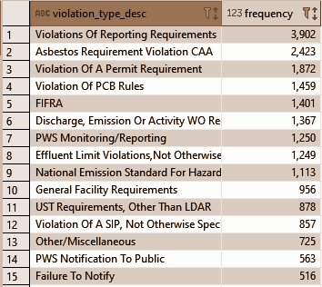
Limitations and Future Work
While we explored violations in general, we recommend an understanding of the “worst impact” violations. Reporting requirements may not have the same impact as discharge and emission offenses.
We want to expand models for different facility types over different time spans
We wish to revisit fairness as an issue which could show health impacts to more marginalized groups.
Notes:
Kai

Slide 29
Other Policy Recommendations
While historical violations remains the stronger indicator of future violation, NY should strategically invest in exploring facilities which have never been inspected, perhaps via random sampling.
Higher income areas are associated with more violations, although this may be correlated with other factors (e.g. the amount of development in an area that could promote large-scale waste generation).
The EPA should run a field trial to validate these findings during the yearly inspection selection process.
Notes:
Kai
=> what do you mean by “increasing the numbers of labeled data, perhaps by random sampling”? [Theo]

Slide 30
Q&A

Slide 31
Image borrowed from <a href="https://www.clipart.email/">clipart.email</a>

Slide 32

Ghani Requirements
Final Project Presentation: Each team will have 10 minutes for their presentation and 3 minutes for questions.
- Timing: Practice your timing before and have a plan for the last 30 seconds. If you're out of time, what do you want to say in the last 30 seconds?
- Content: The presentation should be clear, well-organized, and at appropriate level of depth for the decision makers relevant to your project (as opposed to ML experts)
What problem are you solving and why is it important? Be specific about goals, potential policy impact, and efficiency/equity/effectiveness trade-offs (1-2 minutes)
What data did you use? (1-2 minutes)
Machine Learning Formulation, Analysis, and Evaluation (5 minutes)
formulation of the problem
what are your rows, what are your labels, what are your features
how did you validate - training test splits, evaluation metrics, sensible baseline
results – performance, important features, and bias audit
Caveats: based on the limitations of your data or analysis (1-2 minutes)
Policy Recommendations: concrete recommendations based on your analysis (1-2 minutes)
Future Work < 1 minute

Slide 33
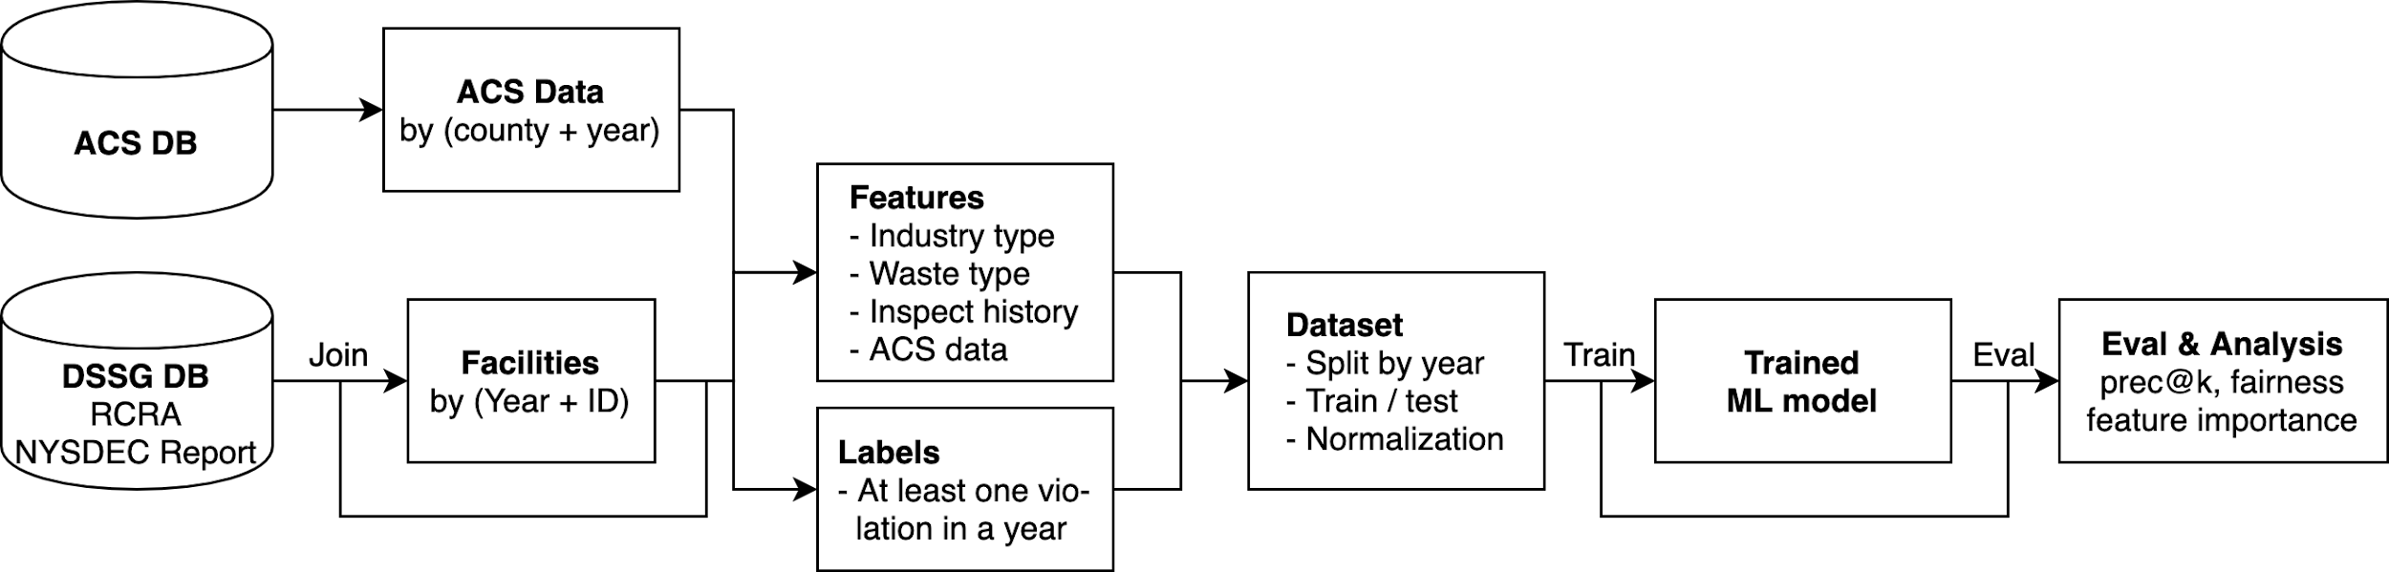
Pipeline

Slide 34
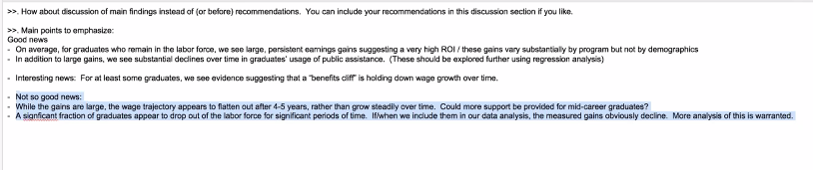
Feature Importances for Opposite FNR
Kaila

