Slide 1
Notify
Notification app for students and faculties
Group 6
Athul V TKM20CS037
Gilu Vijayan TKM20CS059
Gouri P TKM20CS060
Kailas Unni TKM20CS071
27-04-2023

Slide 2
Index
Introduction
Motivation
Problem Statement
Scope
Stakeholder Identification
Features to be enhanced
Requirement Elicitation Methods
Literature Review
Functionalities
Software Requirements
Architectural Overview
Implementation Details: Timeline
Intermediate Result
Conclusion

Slide 3
Introduction
With so much information coming from various sources such as official sites, faculties, and class representatives, it can be overwhelming and time-consuming to sift through everything to find what is most relevant and urgent.
The purpose of a notification system that helps prioritize academic-related notifications is to streamline and manage the flow of information to students in a more effective way.

Slide 4
Motivation
Developing a notification management app for students aims to prevent them from missing important notifications or events related to their academic progress.
This app can help students stay on top of their academic responsibilities and reduce the stress of missing out on crucial information.
Ultimately, it aims to improve the student's academic performance by ensuring they have access to all the information they need to succeed.

Slide 5
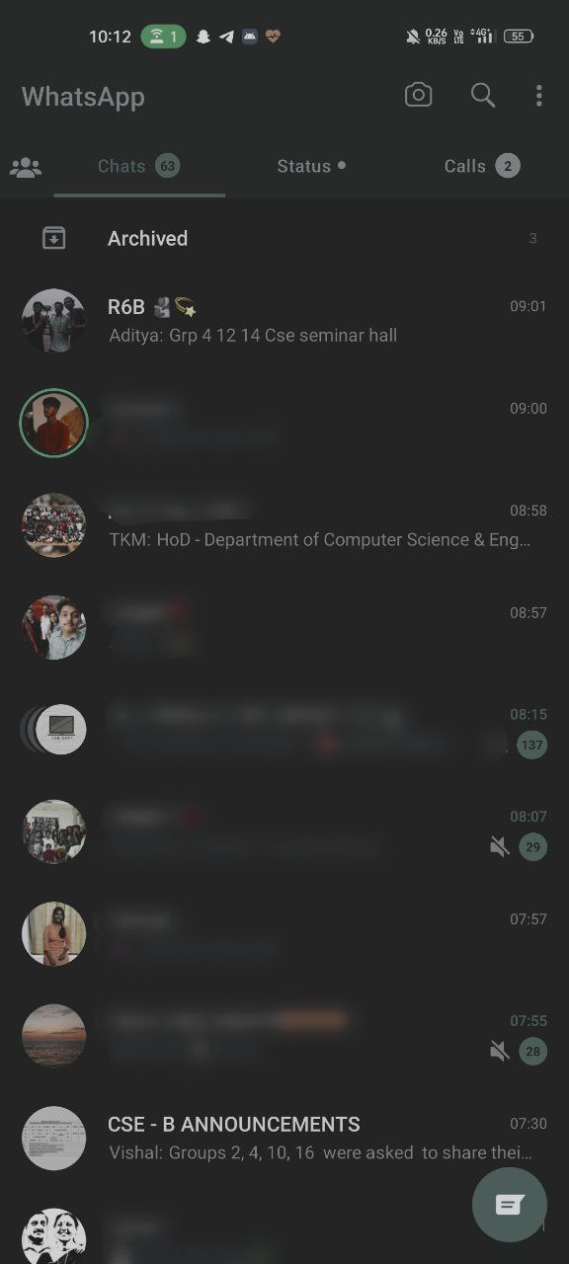
Problem statement
The Problem or Challenge: Most of the students tends to miss many important notifications related to academics due to an inefficient notification delivering system.
The context: Currently most of the notifications are provided through whatsapp groups. As in the current society providing notifications through whatsapp is quite a hassle.
The impact: Missing of notifications and procrastination can cause problems for students.

Slide 6
Problem statement
The proposed solution: Aims to solve this problem by creating an efficient notification delivery and management system.
The expected outcome: We assure that no one misses any more notifications!!!

Slide 7
Scope
Effectively manage the flow of notifications from various sources such as official sites, faculties, and class representatives.
Prioritize Notifications based on Importance.
Filter Notifications according to custom requirements.
Simple yet convenient UI design for hassle free experience.

Slide 8
Stakeholder Identification
Students.
Class Representatives.
Faculties.

Slide 9
Features to be enhanced
Notification Prediction.
Notification Overload.
User Preferences.
Privacy Concerns.
Notification Fatigue.

Slide 10
Requirement Elicitation Methods
Brainstorming.
Survey.
Document Analysis.

Slide 11
Survey Report
75% - More than 75% of students tend to miss notifications.
70% - Felt the need for a notification management app.
64% - Felt the need for auto prioritized notifications.
Survey was conducted between 72 students on and off campus.

Slide 12
Literature Review
College Notification System presented by Department of CSE , BITM, Ballari, India
Comparative Study of Android Native and Flutter App Development presents by Department of Software Engineering, Mehran University of Engineering & Technology, Jamshoro, Pakistan.
Notification System Using Flutter presented by M. H. Saboo Siddik College of Engineering, Mumbai, Maharashtra, India.

Slide 13
Functionalities
For user (student/faculty)
Register
Users can register themselves by typing their credentials.
Login
Users can login by typing their credentials.
Prioritize Notification User can view notifications that require urgent attention.
Filter notification Users can filter notification according to their requirements.

Slide 14
Functionalities
View notification Users can view and take actions for particular notifications.
Notification Log
View entire notification history.
Create custom reminders
Add custom reminders.
Search Notifications
Search for particular keywords.

Slide 15
Functionalities
For Admins
Create notifications Send notifications to students.
Send reminders Send reminders to already sent notifications.

Slide 16
Software Requirements
Flutter Framework.
Backend Framework(FireBase).

Slide 17
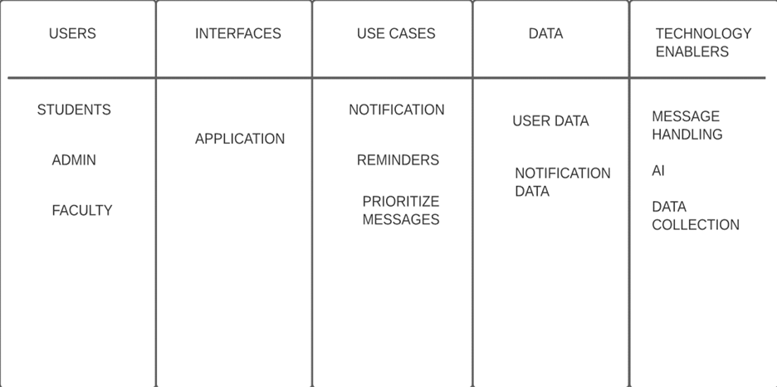
Architectural Overview

Slide 18
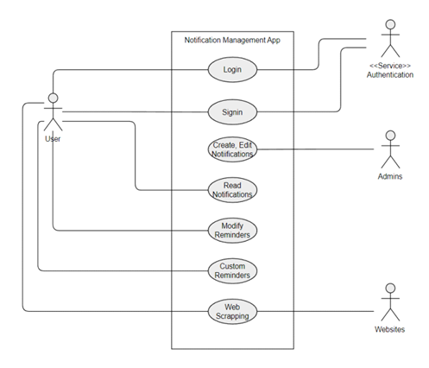
Architectural Overview

Slide 19
Implementation Details: Timeline
WEEK - 1 02/03/2023
Identified functional and non functional requirements for the project. Identified the stake holders. Research papers regarding app development were collected and analysed.
WEEK-2 09/03/2023
Discussed about various softwares assists required for the implementation of the project and created first draft for srs.
WEEK-3 15/03/2023
Circulated google forms for various stakeholders in order to determine the requirements and their concerns.

Slide 20
Implementation Details: Timeline
WEEK-4 23/03/2023
Prepared the final draft of srs and published it.Started discussing about software design and its implementation.
WEEK-5 30/03/2023
Layouts were finalised and created using figma.Prepared the first draft for sdd.
WEEK-6 03/04/2023
Started developing front end using flutter. Research papers were analysed again for the implementation.

Slide 21
Implementation Details: Timeline
WEEK-7 11/04/2023
Prepared final draft of software design document.Various implementation methods in flutter and firebase were discussed.

Slide 22
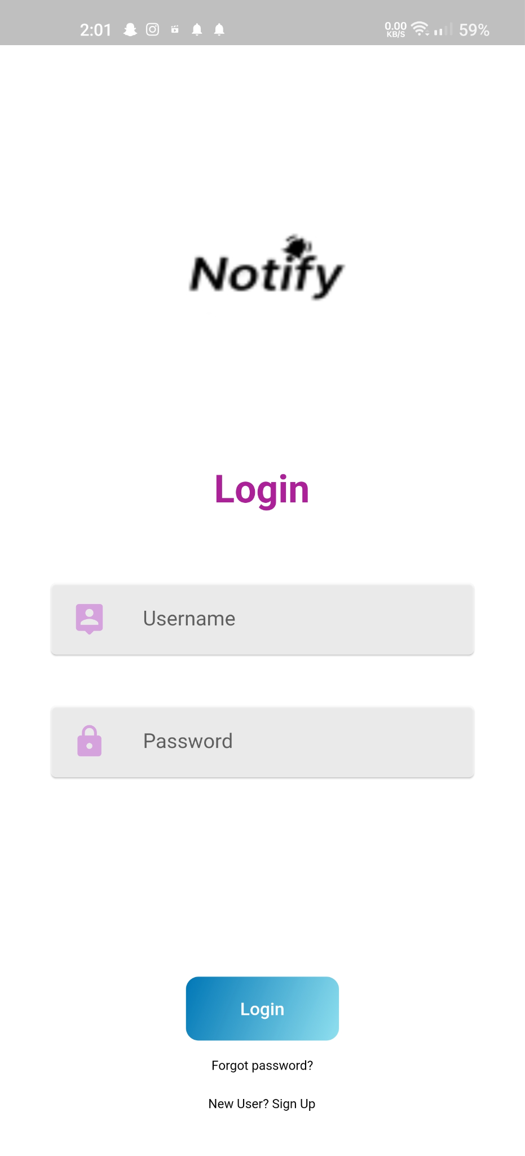
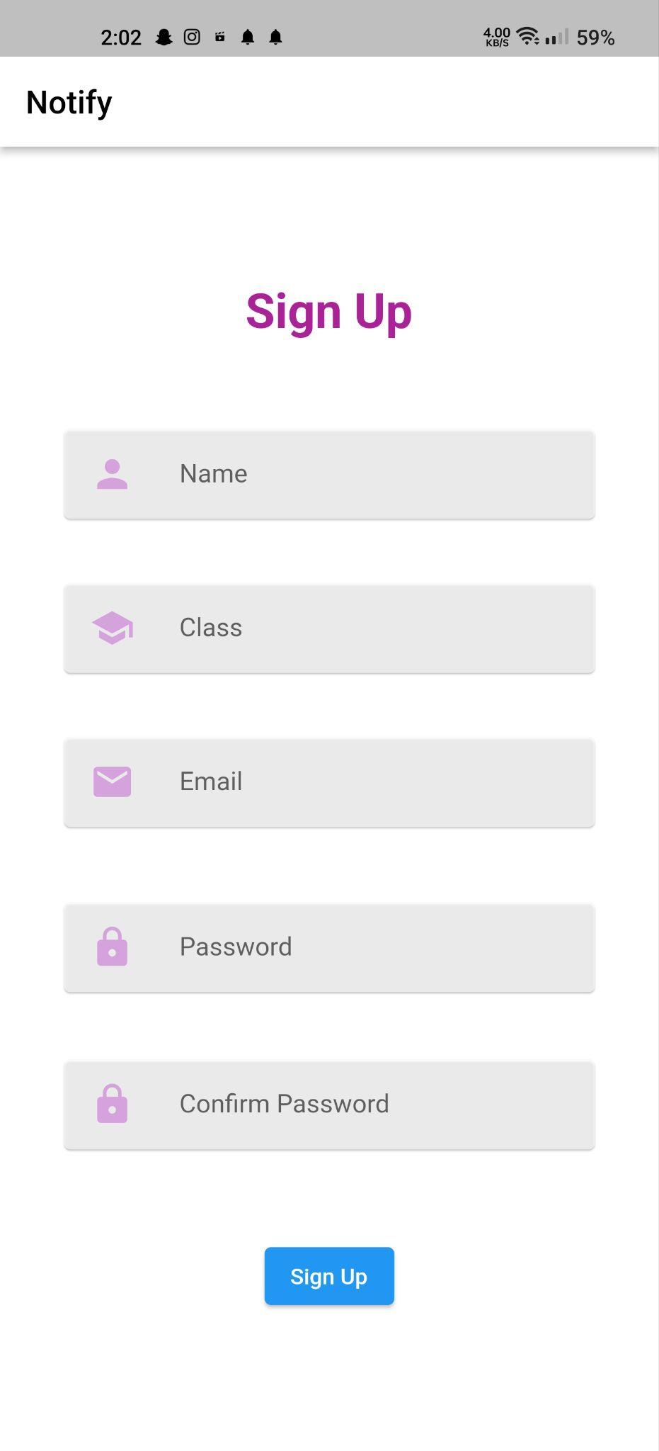
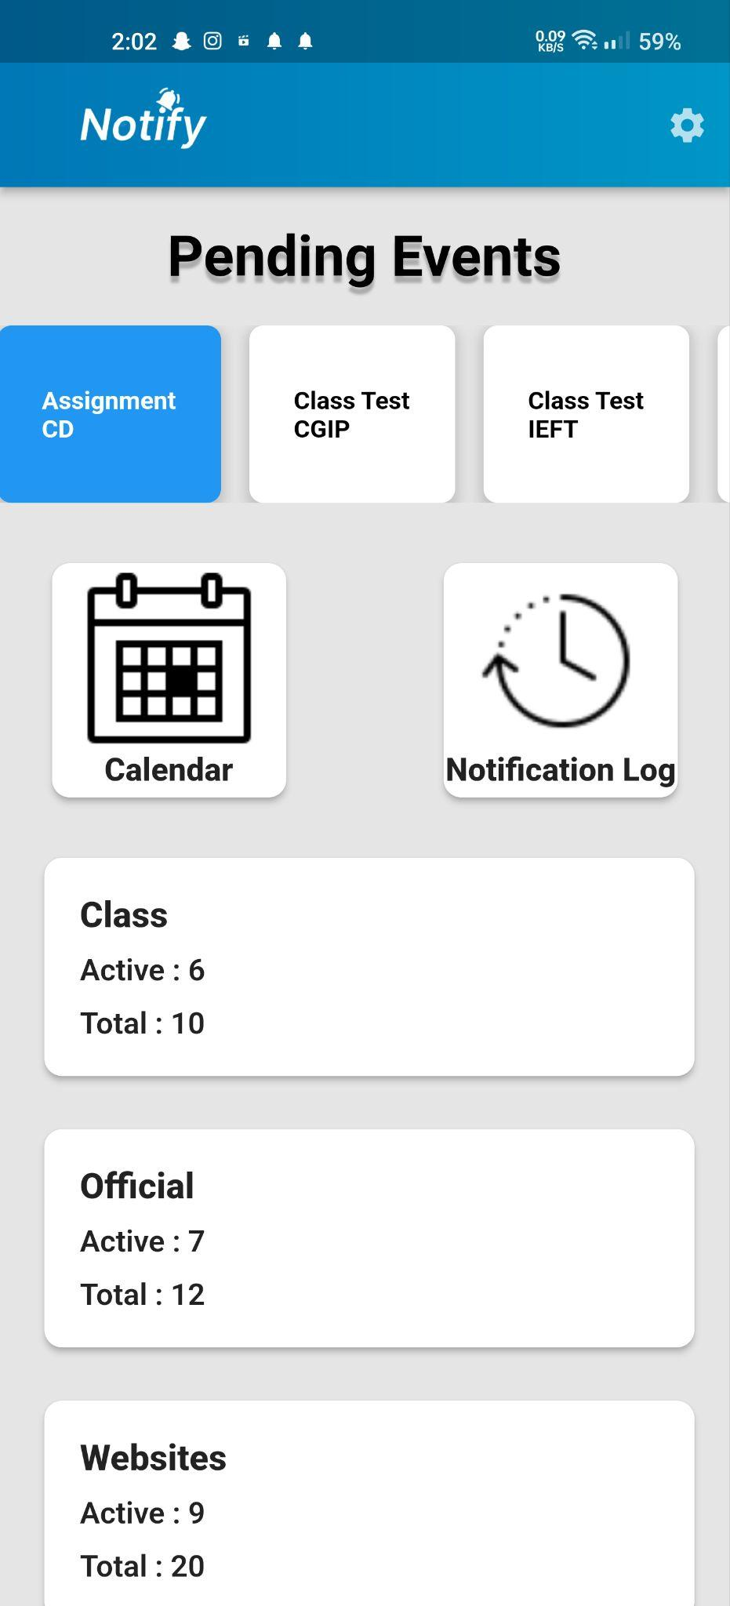
Intermediate Results

Slide 23
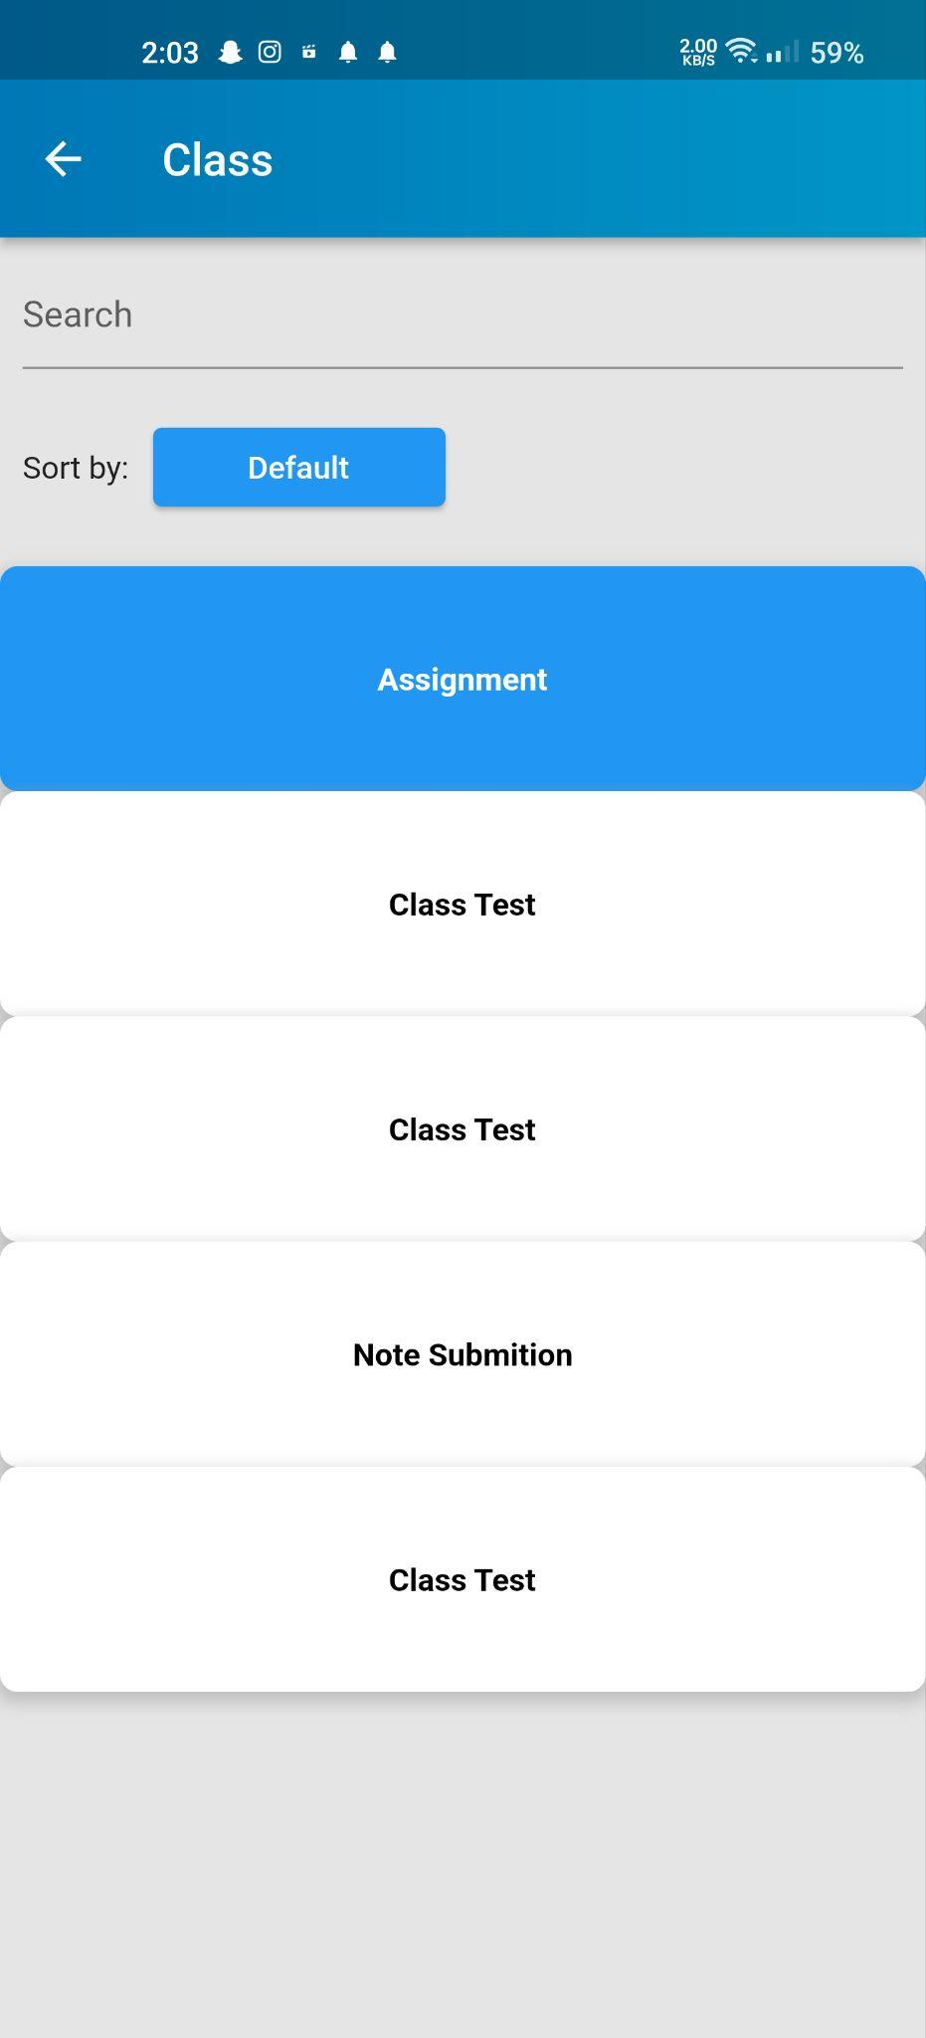
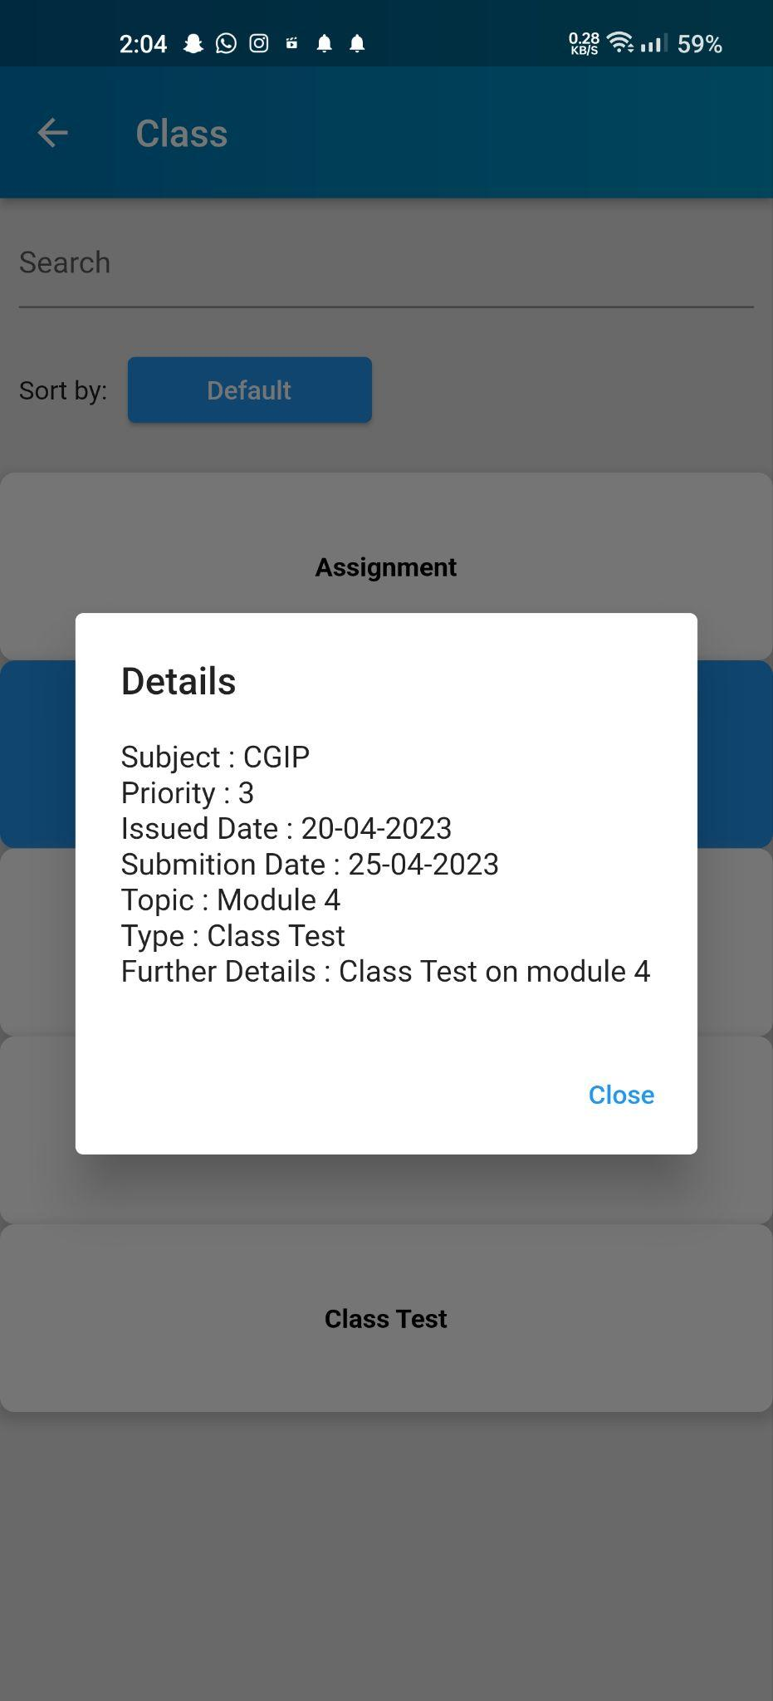
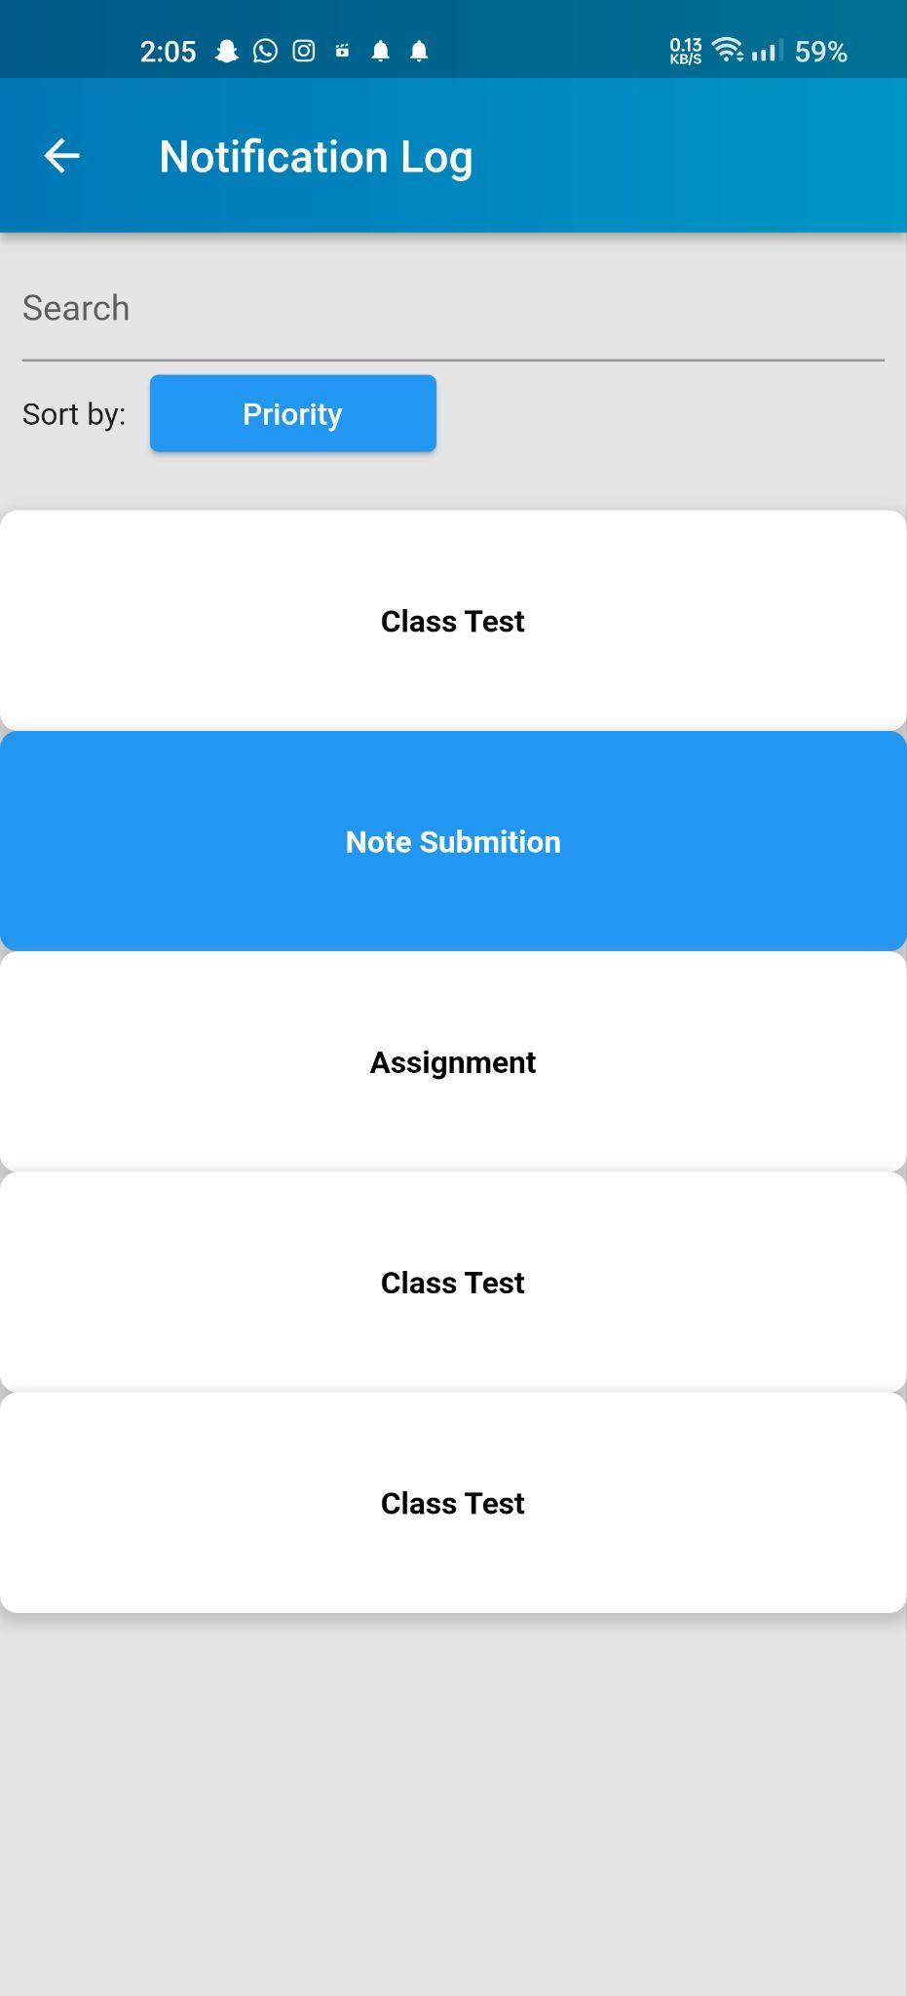
Intermediate Results

Slide 24
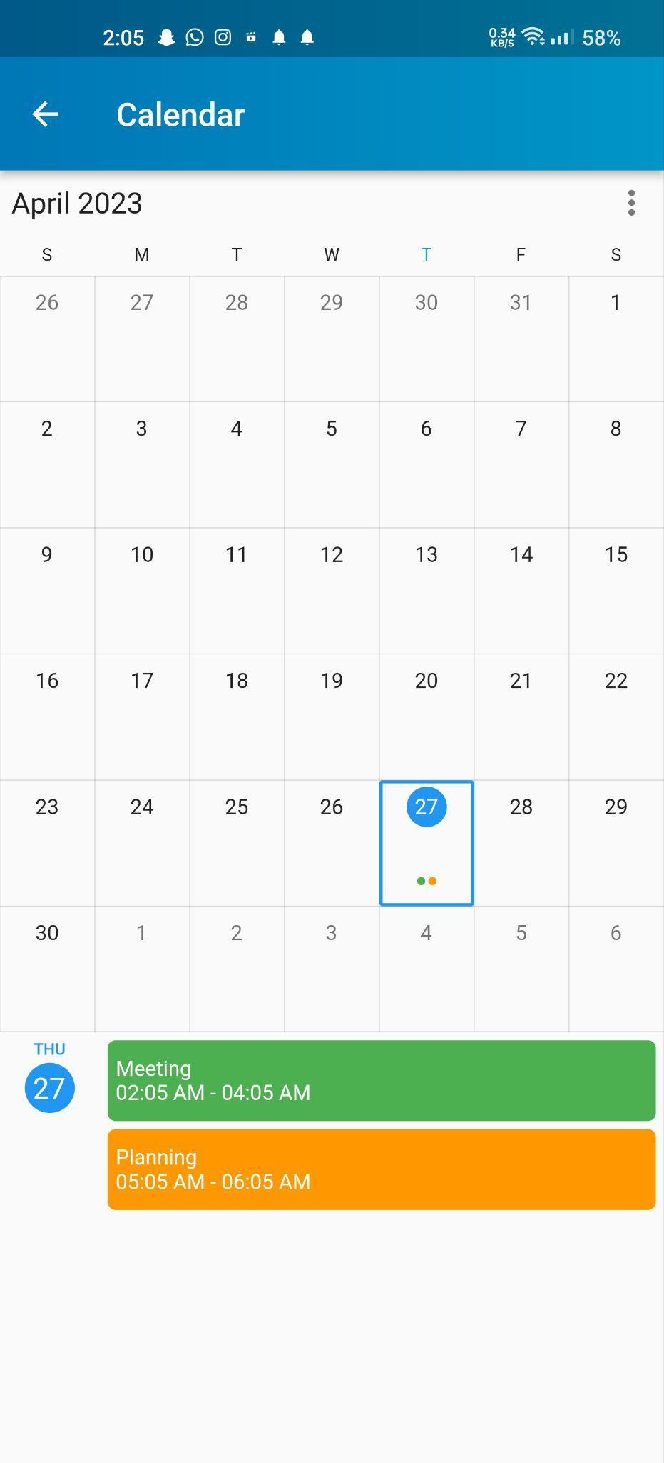
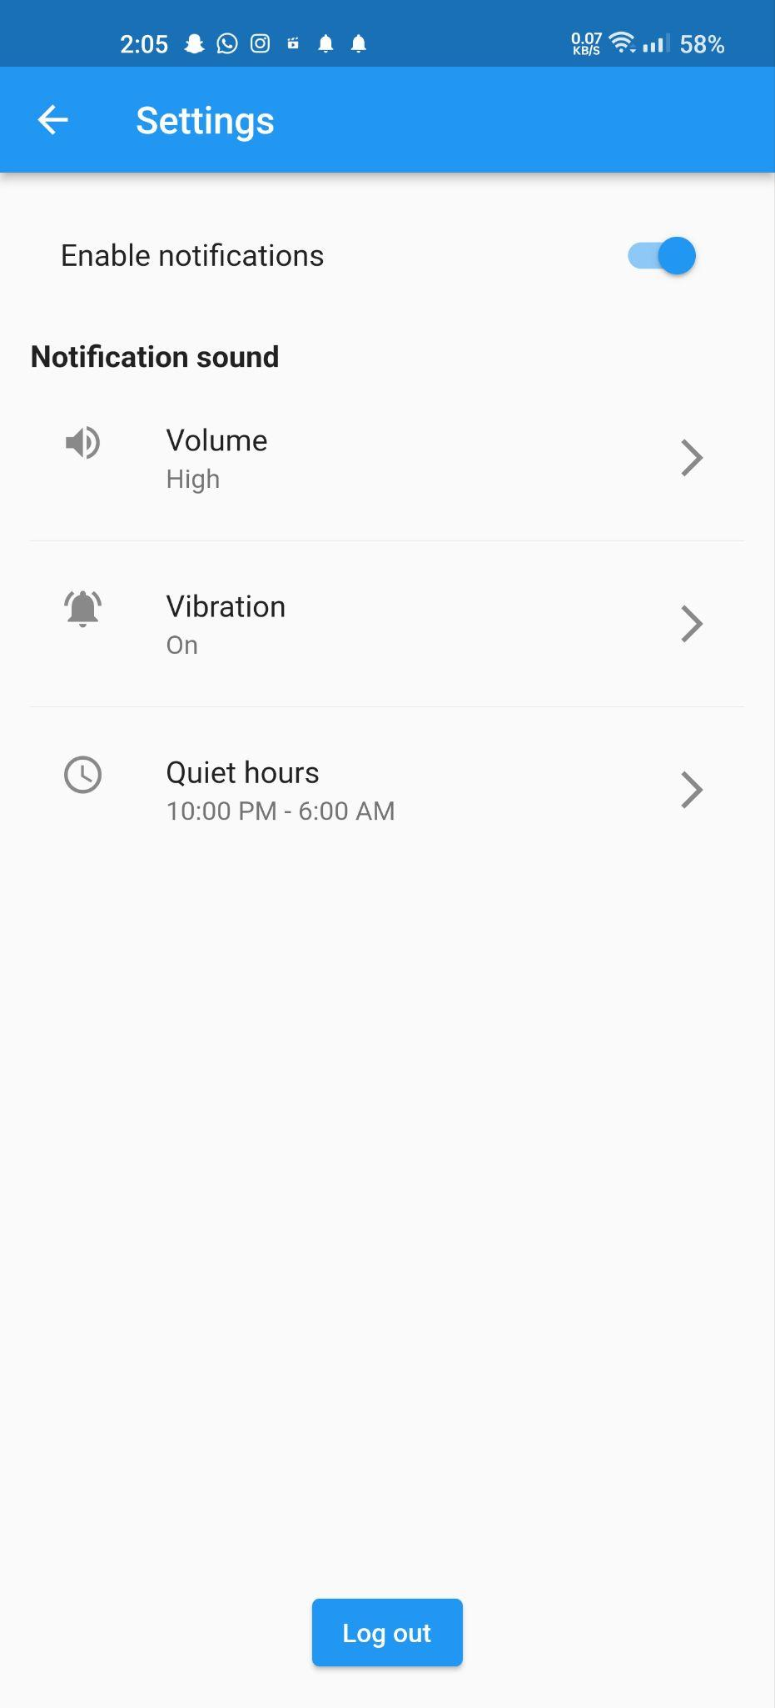
Intermediate Results

Slide 25
Conclusion
A notification app that prioritizes notifications for student faculties presentation can be a valuable tool for enhancing communication and engagement within the academic community.
The app can help to reduce the clutter and noise of less important notifications, allowing users to focus on what matters most.
Overall, a notification app prioritizing student faculty presentations can help to promote a more efficient and effective academic environment.

Slide 26
THANK YOU

