Slide 1
DAB 100 - Introduction to Data Analytics
Final Group Project – Group #5

Slide 2
Table of contents
Team introduction and contribution
Data Cleaning
Data Transformation
Data Visualization
Azure ML model
Conclusion
References

Slide 3
Team introduction and contribution
Kavya - Data cleaning
Kavya - Data cleaning
Kailash - Data Visualization
Kailash - ML
Kailash - Conclusion

Slide 4
Data cleaning
The given Customer churn dataset contains corresponding to various customer properties and subscription.
Checked all columns for null values and found null values in “TotalCharges” variable.
Removed unwanted columns ("Dependents", "OnlineSecurity", "OnlineBackup", "DeviceProtection“) from the data set.

Slide 5
Data transformation
Created a new column for having TotalCharges variable filled.
All the observations with null TotalCharges values had 0 as tenure.
New column named as TotalCharges_clean is created using the below formula
If ( TotalCharges > 0 & tenure > 0 ) then TotalCharges else MonthlyCharges

Slide 6
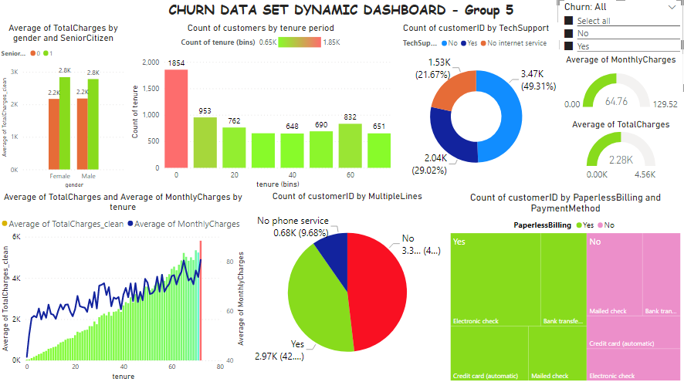
Data Visualization – All customers

Slide 7
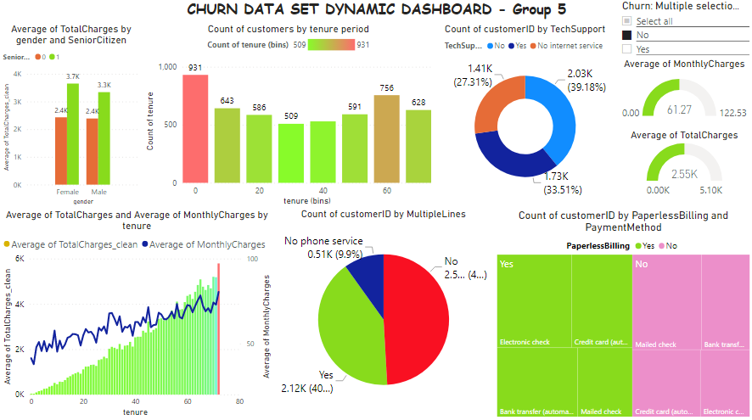
Data Visualization – Non-churned customers

Slide 8
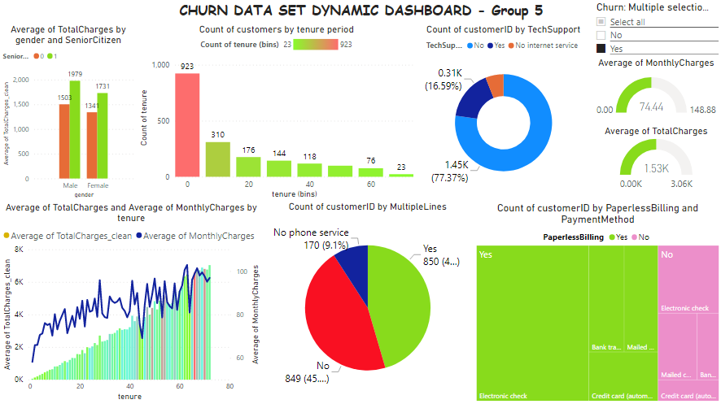
Data Visualization – Churned customers

Slide 9
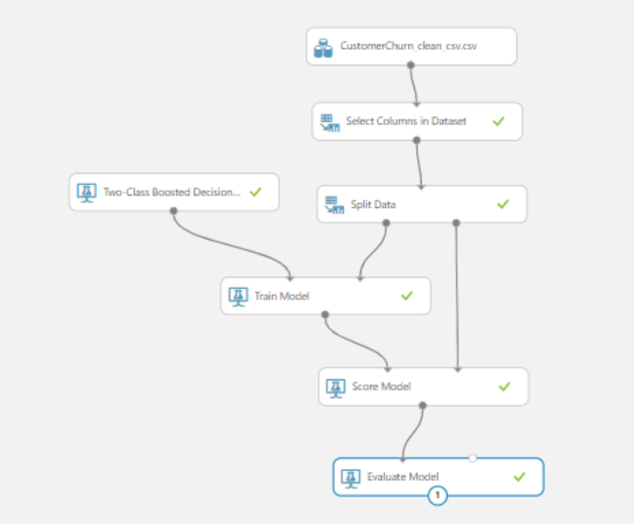
Azure – Two Class Booster Decision Tree

Slide 10
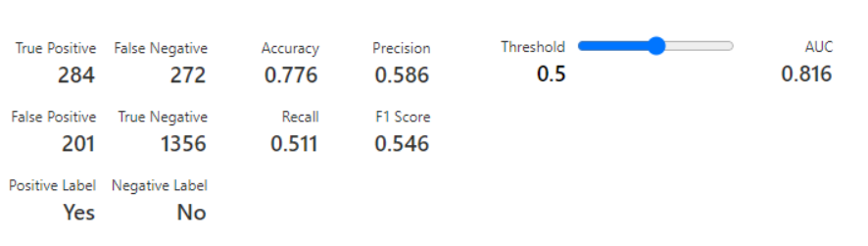
Azure – Two Class Booster Decision Tree
Observation from the Two Class Booster Decision tree with threshold value of 0.5.
The model is with 77.6% accuracy.

Slide 11
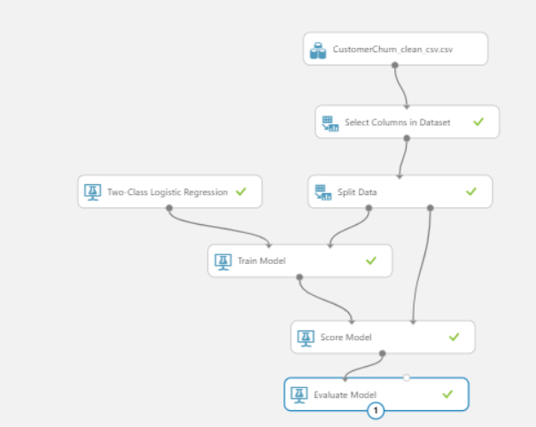
Azure – Logistic Regression model

Slide 12
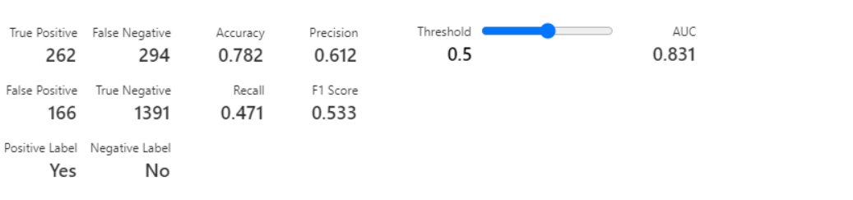
Azure – Logistic Regression model
Observation from Logistic Regression model with threshold 0.5.
The accuracy is 78.2% in predicting the churn in this model.

Slide 13
Conclusion
We have created the plot between True Positive rate and False Positive rate at varying thresholds
The area under the curve is 0.812 and as we know that higher AUC leads to a better model because it's able to distinguish the positive values from the negative values.
A threshold value of 0.5 implies that if the probability is more than 0.5, it is considered as likely, i.e. Positive.
From this we're able to conclude that Logistic accuracy is more than the decision tree model.

Slide 14
Conclusion
From the data and the visualizations we could conclude that most of the churned customers are the new/customers within 1 year of service tenure.
Tech support facility has not been used by most of the customers who has churned.
Most of the customers who churned use the electronic payment method.
To reduce the churn the telecom service provider can provide exiting offers to increase their tenure period thereby reducing the overall churn.
Also proper awareness is to be created among the customers to make use of tech-support effectively.

Slide 15
References
https://www.tutorialgateway.org/create-bins-in-power-bi/

