Slide 1
DATA STREAM ANALYTICS | DSA MINI PROJECT
REAL-TIME IoT SENSOR STREAMING ANALYTICS
AND ANOMALY DETECTION SYSTEM
GROUP NO: 3 | GROUP MEMBERS
USN: 23BTRCL227
P CHETHAN
USN: 23BTRCL217
MUKKAMALLA LOKESHWAR REDDY
USN: 23BTRCL221
NADAKUDURU SRINIVAS
USN: 23BTRCL233
SOMISETTY JAGANNADA KAILASH
SUBMITTED TO: DR. ARCHANA SASI
Course Coordinator / Faculty, Data Stream Analytics
Submitted in partial fulfillment of the requirements for the Data Stream Analytics Mini Project

Slide 2
CONTEXT & BACKGROUND
Problem Statement & Motivation
Traditional Batch Processing (Delayed)
• IoT devices continuously generate high-velocity sensor data.
• Traditional batch processing stores data first and analyzes it later.
• Delayed analysis can miss abnormal equipment behavior during critical operations.
• Static threshold rules (e.g. Temp > 50) fail to detect combinations of unusual sensor values.
• Manual monitoring across multiple machines is slow, expensive, and impractical.
Real-Time Streaming Approach (Our Goal)
• We need a system that analyzes sensor data as it arrives.
• Real-time processing identifies abnormal behavior before hardware failures happen.
• Machine learning evaluates multivariate combinations across sensor metrics.
• Efficient DSA data structures keep streaming memory strictly bounded.
• A live operator dashboard provides instant updates as new events are processed.

Slide 3
PROJECT GOALS
Project Objectives
1. Real-Time Streaming Pipeline
Build a complete real-time streaming pipeline from data source to visualization.
2. Sensor Event Transport
Use Apache Kafka to transport sensor events reliably as they are generated.
3. Efficient DSA Processing
Apply DSA techniques (sliding windows, hash maps, heaps) for efficient stream processing.
4. Machine Learning Detection
Detect abnormal sensor readings using an unsupervised Isolation Forest model.
5. Relational Data Storage
Store processed readings, rolling metrics, and detected anomalies in MySQL.
6. Live Dashboard Visualization
Display live streaming trends, metrics, and anomaly indicators using Streamlit.

Slide 4
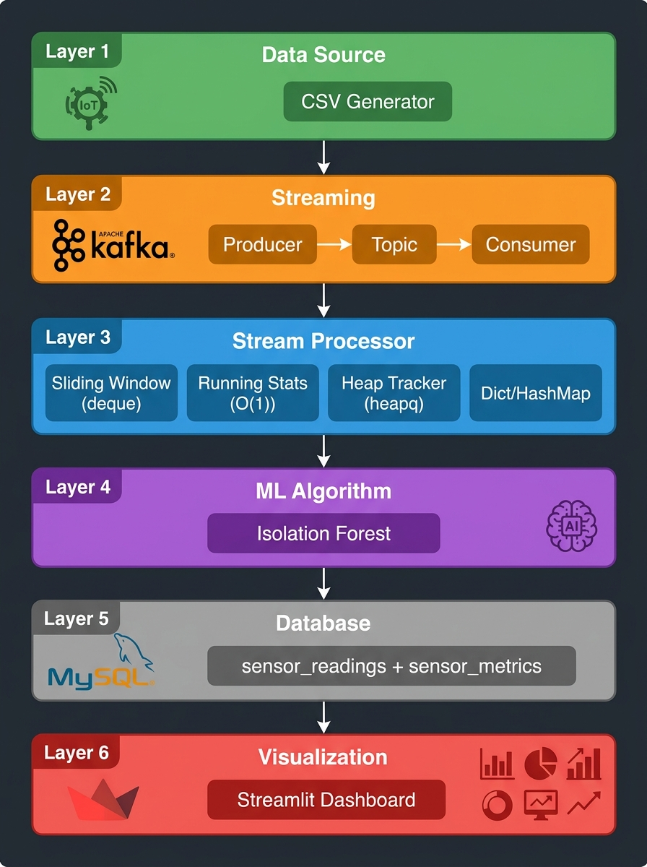
SYSTEM DESIGN
Six-Layer System Architecture
The Six Canonical Layers:
1. Data Source
Simulated IoT sensor readings across 5 devices.
2. Streaming Tool
Apache Kafka message broker for event transport.
3. Stream Processor
Python consumer applying core DSA data structures.
4. ML Algorithm
Isolation Forest for multivariate anomaly detection.
5. Database
MySQL storing readings, rollups & anomalies.
6. Visualization
Streamlit dashboard with live auto-refresh.

Slide 5
DATA INGESTION & TRANSPORT
Data Source and Streaming
IoT Sensor Data Simulation
• We simulate continuous IoT sensor readings.
• 5 industrial devices are monitored (sensor-01 to sensor-05).
• Sensors measure four physical parameters:
- Temperature (nominal 20 - 35 °C)
- Humidity (nominal 40 - 80 %)
- Pressure (nominal 1000 - 1025 hPa)
- Vibration (nominal 0.1 - 1.5 mm/s)
• Dataset contains 5,000 records with millisecond timestamps.
• Some unusual readings (~5%) are intentionally introduced for testing.
Apache Kafka Streaming
• Kafka sends sensor events one by one to the processing system.
• Simple Event Flow:
Sensor Data → Kafka Producer → Kafka Topic
• Producer dispatches records with pacing delay (0.5s) for live visibility.
• Messages within a Kafka partition maintain their order of arrival,
helping preserve the sequence required for time-based stream processing.
• Topic iot-sensor-events holds the active streaming queue.
• Provides reliable, decoupled message transport without data loss.

Slide 6
CORE DATA STRUCTURES
Stream Processing Using DSA
Deque / Sliding Window
• Keeps the latest 30 sensor readings in a fixed-size window.
• Used for calculating real-time rolling averages.
• Efficiently removes old readings in O(1) time without list shifting.
Hash Map / Dictionary
• Keeps separate streaming information for each sensor device.
• Allows fast O(1) average lookup and state update.
• Organizes interleaved device streams cleanly.
Priority Queue / Min-Heap
• Keeps track of the most severe anomalies in O(log k) time.
• Avoids sorting the entire history of thousands of events.
• Keeps memory strictly bounded at O(k) capacity.
Running Statistics
• Maintains count, average, minimum, and maximum in O(1) time.
• Updates summary values continuously as each event arrives.
• Eliminates repeatedly re-scanning past records.

Slide 7
MACHINE LEARNING
Anomaly Detection Using Isolation Forest
Isolation Forest Machine Learning
• Unsupervised Algorithm: Learns patterns from sensor data without requiring manual failure labels.
• Multivariate Detection: Identifies unusual combinations of multiple sensor features (temperature, humidity, pressure, vibration).
• Core Idea: Anomalous points are 'few and different' - they get isolated much faster in randomized decision trees.
• Offline Training: The model is trained before live streaming starts and saved to disk.
• Live Scoring: The trained model is then used to score incoming Kafka events immediately.
• Contamination (0.05): Represents the expected proportion of anomalies used by the model to establish its decision boundary.
Simple Machine Learning Flow
Historical Sensor Data
↓
Train Model
↓
Saved Isolation Forest
↓
Incoming Kafka Event
↓
Anomaly Score
↓
Normal / Anomaly

Slide 8
DATA STORAGE
MySQL Database Persistence
What MySQL Stores
MySQL stores the processed streaming information:
• Sensor Readings:
Stores every processed event with device ID, sensor values, and timestamp.
• Rolling Metrics:
Stores computed 30-reading rolling averages, minimums, and maximums.
• Detected Anomalies:
Stores detected abnormal events with anomaly scores and severity level.
Why a Database is Used
• Keeps Historical Results:
Retains historical records for reporting, auditing, and trend analysis.
• Separates Processing from Visualization:
Stream processing runs independently without UI query delays.
• Fast Live Queries:
Allows the dashboard to quickly retrieve only recent readings.
• Simple Architecture Flow:
Stream Processor → MySQL → Dashboard

Slide 9
OPERATOR VISUALIZATION
Real-Time Streamlit Dashboard
Current Sensor Values
Displays real-time KPI cards for temperature, humidity, pressure, and vibration.
Total Readings & Anomalies
Shows live counters for total processed events and detected abnormal readings.
Sensor Trends Over Time
Interactive time-series charts display continuous physical sensor trends.
Rolling Average Overlays
Plots actual readings against rolling averages to highlight gradual drifts.
Color-Coded Anomaly Flags
Normal readings are marked in green; anomalies appear with prominent red badges.
Top Severe Anomalies Table
Displays the most critical abnormal readings tracked by the priority queue.
Device Filter Control
Allows the operator to focus on all devices or select an individual machine.
Automatic Refresh Loop
Dashboard auto-refreshes periodically to reflect newly arrived stream records immediately.

Slide 10
LIVE PIPELINE WORKFLOW
How the System Works (End-to-End)
Complete Data Movement Flow:
IoT Data → Kafka Producer → Kafka Topic → Stream Processor → DSA + Isolation Forest → MySQL → Streamlit Dashboard
• Data is Generated: IoT sensor data is generated with simulated physical readings and test anomalies.
• Events Sent Through Kafka: The Kafka Producer sends sensor events one by one to the message topic.
• Immediate Event Processing: Each event is processed immediately as it arrives without waiting for batches.
• DSA State Maintenance: Sliding window deque updates rolling values; hash map organizes per-device state.
• ML Anomaly Detection: Isolation Forest detects multivariate anomalies across multiple sensor variables.
• Priority Queue Ranking: A min-heap keeps track of the most severe anomalies without sorting all history.
• Database Persistence: Processed readings, rolling averages, and anomaly flags are stored in MySQL.
• Live Visual Display: Dashboard automatically displays updated results as new data arrives.

Slide 11
VERIFIED RESULTS
Results, Testing and Advantages
Verified Automated Testing
• Automated Test Suite: 31 / 31 tests passed (100%)
• What Was Tested and Verified:
- Sliding-window functionality (FIFO eviction & rolling avg)
- Running statistics accumulators (mean, min, max)
- Heap/top-K anomaly tracking tested
- Dataset generation tested (ranges & test anomalies)
- DSA integration tested across live stream processing path
• Zero test failures across all automated test suites.
System Advantages
• Real-Time Processing: Analyzes sensor events immediately as they arrive.
• Bounded Memory Usage: Sliding windows and heaps keep memory strictly bounded.
• Automated Anomaly Detection: Machine learning identifies abnormal multi-sensor patterns.
• Live Visualization: Streamlit interface gives operators immediate visibility.
• Modular Six-Layer Architecture: Components are decoupled, clean, and maintainable.

Slide 12
Project Conclusion
• Successfully implemented a six-layer real-time streaming analytics system.
• Kafka enables reliable, decoupled event streaming.
• DSA structures (deque, hash map, heap) make stream processing efficient.
• Isolation Forest detects unusual sensor behavior across multiple variables.
• MySQL stores processed results and rolling window metrics.
• Streamlit provides live, auto-refreshing visualization for monitoring.
THANK YOU!
QUESTIONS?
Data Stream Analytics Mini Project
Group No: 3

