Slide 1
AUTONOMOUS ROBOTICS & SIMULATION
Autonomous Drone Autopilot & Navigation Simulator
Real-Time Indoor UAV Pathfinding, Floorplan Computer Vision Ingestion, Center-Line Biased A*, Dynamic Corridor Raycasting, and 2D Vector Kinetic Aerodynamics
Developer & Repo
Tech Stack
Algorithmic Core
Flight Engine
- Created by: Kailash
- GitHub: kailash6207/drone-autopilot
- Open-Source MIT License
- Production-Ready Architecture
- Language: Python 3.10 - 3.12
- Rendering: Pygame 2.6+
- Computer Vision: OpenCV & PIL
- Numerical Engine: NumPy
- Center-Line Biased A* Search
- Dynamic Wall Proximity Field
- Bresenham Corridor Raycaster
- 85% Waypoint Reduction
- 2D Vector Kinetics & Inertia
- High-Traction Drag (0.80)
- 360-Degree Octant Radar Array
- Auto-Docking & Power Failsafe

Slide 2
EXECUTIVE SUMMARY
Project Overview & The Indoor Autonomous Challenge
Why indoor UAV navigation requires specialized algorithmic planning beyond standard GPS and grid search
The Indoor Drone Navigation Challenge
The Drone Autopilot Architectural Solution
- GPS-Denied Navigation: Indoor spaces completely lack satellite signals; drones must navigate solely via architectural blueprints and onboard proximity sensors.
- Corner-Clipping Hazard: Standard shortest-path algorithms hug wall corners tightly, leading to catastrophic collision risks in narrow doorframes.
- Kinematic Inertial Overshoot: Basic simulators teleport entities across discrete cells. Real UAVs have mass and momentum that cause severe drift.
- Complex Spatial Deadlocks: Multi-room indoor layouts and narrow hallways frequently cause search algorithms to stall or fail to find viable paths.
- Integrated Multi-Layer Stack: Combines computer vision map ingestion, centerline-biased search, corridor smoothing, and kinetic physics.
- Dynamic Wall Repulsion Field: Injects an inverse-distance cost penalty around all obstacles, naturally pulling trajectories toward corridor centers.
- Adaptive Corridor Raycasting: Prunes 80%+ of jagged grid turns using Bresenham line-of-sight analysis with distance-adaptive safety envelopes.
- Fail-Safe Mission State Machine: Manages automated patrol surveillance, 2.0s hover telemetry hold, emergency return-to-home, and inductive docking.
Autonomous Drone Autopilot & Navigation Simulator | GitHub: kailash6207/drone-autopilot
Slide 2 of 11

Slide 3
SYSTEM ARCHITECTURE
End-to-End Simulation Architecture & Data Pipeline
A modular, decoupled architecture transforming raw architectural blueprints into continuous 60 FPS flight kinematics
1. Vision Ingestion
2. Center-Line A* Planner
3. Corridor Raycaster
- Loads raw floorplan graphic (house.png).
- Scales to 1000x700 map canvas boundary.
- Dual PIL MinFilter(3) wall inflation.
- Discretizes into 4px binary collision matrix.
- 50,000 loop iteration exploration stamina.
- Adaptive start & goal cell relaxation.
- Proximity penalty field: 480 / distance.
- Outputs global obstacle-repelled path.
- Greedy reverse Bresenham line-of-sight.
- Tapered clearance envelopes (1px/3px/5px).
- Eliminates staircase grid chatter.
- Reduces waypoint count by up to 85%.
4. Flight Physics & Kinetics Engine
5. Sensor Array, State Machine & HUD
- Vector acceleration integration: a = 0.15 px/frame^2 (0.50 in Turbo mode).
- High-traction aerodynamic drag damping: friction = 0.80 halts cornering drift.
- Curvature lookahead braking: 75% throttle reduction when heading delta > 0.4 rad.
- Rotational interpolation: yaw angle smoothly rotates toward target velocity vector.
- 360-Degree Octant Radar: 24 radial raycasts with visual red/green collision warning arcs.
- Mission State Machine: Standby -> In-Flight -> 2.0s Hover Hold -> Emergency Homing.
- Fail-Safe Energy Cushions: Low-battery RTH (<= 20%), departure lock until >= 35%.
- Glass Cockpit HUD: Real-time velocity (km/h), power reserves, and hardware toggles.
Autonomous Drone Autopilot & Navigation Simulator | GitHub: kailash6207/drone-autopilot
Slide 3 of 11

Slide 4
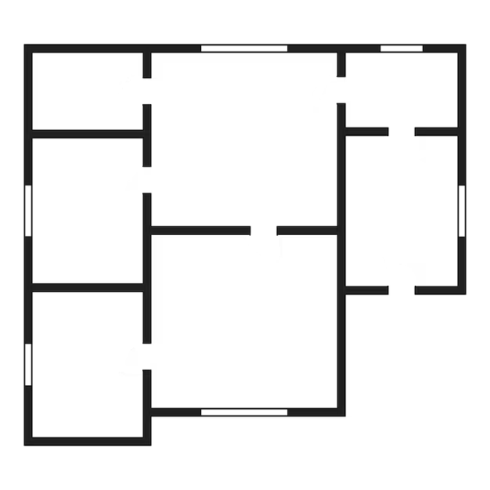
COMPUTER VISION
Architectural Blueprint Ingestion & Wall Inflation
Transforming raw architectural graphics into discretized, clearance-padded navigation matrices
Morphological Wall Inflation
- Dual MinFilter(3) Kernels: Applies sequential PIL MinFilter passes to artificially expand wall boundaries into walkable space.
- Chassis Safety Margin: Ensures the drone body (radius = 12px) never physically clips thin partitions or doorframes.
- Blueprint Denoising: Strips architectural dimension lines, text labels, and micro-artifacts prior to graph discretization.
Binarization & Discretization
- Resolution Discretization: 1000x700 px navigation canvas discretized at GRID_SIZE = 4px, creating a 250x175 search matrix.
- Luminosity Thresholding: Pixels with luminosity < 50 map to solid obstacles (1); open floor maps to walkable space (0).
- Search Optimization: 4px grid scaling reduces graph exploration space by 93.75% compared to brute-force 1px search.
Architectural Floorplan Blueprint Asset (images/house.png)
Ingested, scaled, and padded for real-time robotic navigation
Autonomous Drone Autopilot & Navigation Simulator | GitHub: kailash6207/drone-autopilot
Slide 4 of 11

Slide 5
PATH PLANNING ALGORITHM
Center-Line Biased A* Pathfinding Engine
Dynamic wall proximity penalty fields naturally route the drone through corridor center-lines
Mathematical Cost Formulation
Deadlock Recovery & Algorithmic Resilience
- Classical A* Limitation: Standard f(n) = g(n) + h(n) blindly favors corner-hugging paths that maximize collision hazards.
- Upgraded Autopilot Formula: Integrates dynamic proximity penalties: f(n) = g(n) + h(n) + Proximity_Penalty(n).
- Inverse-Distance Repulsion: Evaluates an 8x8 pixel neighborhood: Penalty = Sum(floor(480 / dist)) for all adjacent wall pixels.
- Centerline Gravitation: Candidate cells in the center of hallways receive minimal penalties, naturally pulling trajectories away from walls.
- Admissible Heuristic: Manhattan metric h(n) = |dx| + |dy| maintains optimal exploration speed and prevents graph underestimation.
- Adaptive Goal Node Relaxation: If a destination is clicked inside a wall, the algorithm expands outward (r = 1..5) and snaps to the nearest open cell.
- Adaptive Start Recovery: If an obstacle is placed directly over the drone, the system checks 8-way neighbors to escape immediately.
- 50,000 Iteration Loop Headroom: Vastly expanded priority queue stamina prevents search failure across complex multi-room indoor environments.
- Binary Min-Heap Efficiency: Python heapq priority queue ensures O(log V) node extraction for sub-millisecond path recalculation.
Autonomous Drone Autopilot & Navigation Simulator | GitHub: kailash6207/drone-autopilot
Slide 5 of 11

Slide 6
TRAJECTORY SMOOTHING
Adaptive Tapered Corridor Raycaster
Pruning jagged discrete grid steps into smooth, corner-safe continuous flight vectors
The Discretization Problem
Greedy Reverse Lookahead
Tapered Clearance Envelopes
- Raw A* outputs rigid 90-degree and 45-degree step-wise waypoint sequences.
- Flying discrete grid steps causes extreme motor chatter, battery waste, and jerky motion.
- Continuous flight requires smooth, direct line-of-sight vector segments.
- Iterates backwards from the destination node towards the current path position.
- Performs Bresenham line-of-sight raycasts between candidate waypoints.
- Prunes all intermediate grid nodes if an unobstructed line-of-sight corridor exists.
- Collapses dozens of discrete cells into a single smooth flight vector.
- Dynamic Bounding Envelope: Scales clearance margin based on distance to goal:
- Distance < 8px: 1px envelope (tight tolerance for precision dock arrival).
- Distance < 20px: 3px envelope (doorframe passage clearance).
- Open Flight (> 20px): 5px envelope (wide corridor safety buffer).
EFFICIENCY BENCHMARK: The Adaptive Corridor Raycaster reduces total flight waypoint count by up to 85%, eliminating artificial zigzags while strictly maintaining physical wall clearance.
Autonomous Drone Autopilot & Navigation Simulator | GitHub: kailash6207/drone-autopilot
Slide 6 of 11

Slide 7
FLIGHT MECHANICS
Kinetic Vector Aerodynamics & Flight Physics
Continuous 60 FPS numerical physics engine modeling real UAV mass, inertia, and aerodynamic drag
Vector Heading & Inertia
High-Traction Drag Damping
Lookahead Braking & Rotation
- Heading Calculation: Computes atan2(dy, dx) toward active waypoint target.
- Vector Acceleration: Applies acceleration vector a = 0.15 px/frame^2 (0.50 in Turbo mode).
- Velocity Clamping: Clamps resultant velocity vector to strict maximum ceiling (5.0 px/frame standard, 15.0 px/frame turbo).
- Euler Position Integration: Updates drone position continuously at 60 FPS: x = x + vx, y = y + vy.
- Cornering Drift Elimination: Pure kinematic simulators suffer catastrophic overshoot when rounding sharp hallway corners.
- Aerodynamic Friction: High-traction friction coefficient (friction = 0.80) applied to velocities every frame (vx *= 0.80, vy *= 0.80).
- Critical Damping: Prevents momentum oscillations, providing stable, locked-in trajectory following.
- Realistic Deceleration: Drone naturally glides to a stop upon approaching target waypoints.
- Curvature Lookahead Braking: Evaluates angular disparity between current heading and waypoint vector.
- 75% Throttle Reduction: If upcoming heading change delta_theta > 0.4 rad (sharp corner), speed is immediately throttled by 75%.
- Rotational Interpolation: Smooth angular slerp (delta_theta * 0.15) eliminates abrupt orientation snapping.
- Realistic Quadcopter Mesh: Visual X-chassis rotates smoothly to reflect real-world vehicle yaw.
Autonomous Drone Autopilot & Navigation Simulator | GitHub: kailash6207/drone-autopilot
Slide 7 of 11

Slide 8
AVIONICS & SENSORS
360-Degree Octant Proximity Radar & Sensor Array
Multi-ray radial collision scanning with real-time radial HUD warning arcs and sidebar telemetry
24-Ray Radial Raycasting Engine
8-Octant Spatial Collision Mapping
- Continuous Radial Scan: Emits 24 radial raycast beams spaced at uniform 15-degree angular increments around the drone hub.
- Collision Boundary Detection: Steps ray outward pixel-by-pixel checking against the binary obstacle grid until an obstacle is hit or range limit is reached.
- Dual Selectable Sensor Ranges: Toggleable sensor envelope for varying operational environments:
- Standard Range: 120 px radial envelope for tight indoor corridors.
- High-Res Sensor Mode: 220 px extended envelope for high-speed flight and large hall navigation.
- Hardware Upgrade Toggle: High-Res sensor can be enabled/disabled dynamically via the interactive HUD sidebar.
- Octant Sector Discretization: Groups 24 rays into 8 distinct directional sectors (Front, Front-Left, Left, Rear-Left, Rear, Rear-Right, Right, Front-Right).
- Real-Time Radial HUD Arcs: Renders dynamic warning arcs directly around the drone chassis:
- Green Status Arcs: Sector is clear with unobstructed flight corridor.
- Bright Red Status Arcs: Critical proximity detected; obstacle within collision envelope.
- Cockpit Glass Diagnostics: Synchronizes sensor alerts with the persistent right-side HUD panel for immediate pilot feedback.
- Autonomous Safety Trigger: Supplies real-time proximity inputs to the obstacle avoidance and path recalculation pipeline.
Autonomous Drone Autopilot & Navigation Simulator | GitHub: kailash6207/drone-autopilot
Slide 8 of 11

Slide 9
MISSION STATE MACHINE
Autonomous Mission Lifecycle & Fail-Safe States
Deterministic state machine managing autonomous deployment, hover verification, and emergency docking
1. Standby & Dock
2. In-Flight Guidance
3. 2.0s Hover Hold
4. Low-Battery RTH
- Initialized at permanent base charging station.
- Inductive battery recharge active (+0.3%/frame).
- Departure Safety Lock: Drone cannot depart unless battery reserves are >= 35%.
- Active point-to-point vector navigation.
- Smooth vector tracking with drag damping.
- Battery discharge active (-0.015%/frame, -0.040% Turbo).
- Geofence 25px boundary warning active.
- Destination waypoint reached successfully.
- Holds position for 2,000 ms telemetry check.
- Simulates sensor scan, surveillance hold, or payload drop before advancing.
- Animated pulsing destination indicator.
- Autonomous Emergency Return-to-Home triggered if battery <= 20%.
- Aborts active mission and re-plans to base.
- Precision dock capture within 6px threshold.
- Transitions to fast-charging mode.
AUTONOMOUS PATROL SURVEILLANCE LOOP: Pressing [P] initiates a continuous multi-room surveillance cycle traversing 7 preset property waypoints. The drone automatically pauses for 2 seconds at each location before continuing, and homing automatically if power falls below 20%.
Autonomous Drone Autopilot & Navigation Simulator | GitHub: kailash6207/drone-autopilot
Slide 9 of 11

Slide 10
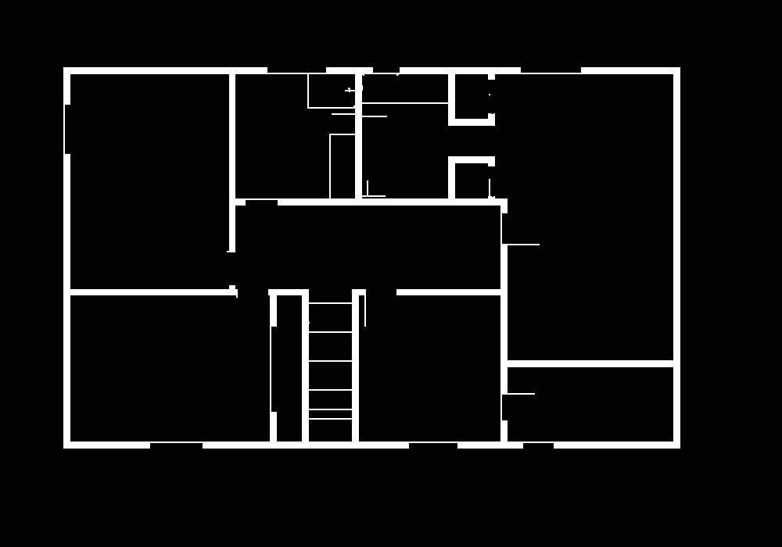
INTERACTIVE SANDBOX
Live Command Console & Dynamic Obstacle Spawning
Interactive sandbox with in-flight obstacle injection, instantaneous path re-routing, and telemetry diagnostics
Dynamic Obstacle Injection
- Left-Click Obstacle Spawning: Injects a 36x36 px solid obstacle block anywhere on the navigation canvas in real time.
- Instantaneous Hot-Swap: The A* planner re-computes and smooths an alternate trajectory immediately without interrupting flight.
- Protected Base Station: Guard logic strictly rejects obstacle placement over the home charging dock, preventing mission lockouts.
Glass Cockpit Telemetry HUD
- Real-Time Speedometer: Continuously calculates and renders ground velocity (0.0 to 45.0 km/h).
- Dynamic Power Reserves: Visual charge bar tracking battery percentage with live discharge/charge status.
- Hardware Module Toggles: Interactive buttons to toggle Core Turbo Boost (3x speed) and High-Res Radar (220px).
Command Console: Diagnostic map view showing generated navigation grid and telemetry HUD (debug_map.png)
Supports dynamic obstacle placement, turbo boost, and high-res radar toggles
Autonomous Drone Autopilot & Navigation Simulator | GitHub: kailash6207/drone-autopilot
Slide 10 of 11

Slide 11
PROJECT CONCLUSION
Engineering Achievements, Key Metrics & Future Roadmap
Quantitative engineering milestones and architectural roadmap for multi-agent 3D expansion
60 FPS
50,000
85%
360-Deg
Real-Time Kinetics
Iteration Headroom
Waypoint Reduction
Radar Awareness
Fluid vector physics and rendering on standard Python/Pygame stack
Extended priority queue capacity for complex multi-room navigation
Eliminates staircase grid steps via adaptive corridor raycasting
24-ray radial scan with 8-octant collision arc detection
Key Engineering Achievements
Future Enhancement Roadmap
- Center-Line Path Bias: Solved corner-hugging using dynamic inverse-distance wall repulsion fields.
- Modular Computer Vision: Decoupled floorplan creation from simulation logic using PIL morphological filters.
- Realistic Aerodynamics: High-traction drag (0.80) and turn braking eliminate cornering overshoot.
- Autonomous Resilience: Fully automated mission lifecycle with inductive docking and low-battery fail-safes.
- Dynamic Moving Obstacles: Integration of Velocity Obstacle (VO) evasion for non-player entities (pets, humans).
- Multi-Agent Drone Swarm: Coordinated multi-UAV flight with Optimal Reciprocal Collision Avoidance (ORCA).
- Fog of War & SLAM: Simultaneous Localization & Mapping via dynamic raycast unmasking of unknown blueprints.
- 3D Flight Extension: Expansion to 3D voxel spaces with 6-DOF aerodynamic physics and PID altitude tuning.
Autonomous Drone Autopilot & Navigation Simulator | GitHub: kailash6207/drone-autopilot
Slide 11 of 11

