Slide 1


Communication Protocol Customization: FTP
Dialects as fingerpints to authenticate client and server systems.

Slide 2
Outline
Background of FTP protocol
Objective
Security issues
Protocol Dialects
Pseudocode - modified protocol work flow
System design
Neural network & decision tree modules.
Appendix

Slide 3
Background : FTP
The FTP protocol defines how FTP programs should work together when sharing files. It uses the client/server model in its implementation.
File Transfer Protocol is still widely used for fast file sharing. Biggest file sharing companies such as ExaVault, Box.com, BrickFTP, Sharefile and SmartFile are using FTP for their services.
FTP was not built to be secure. It is considered to be an insecure protocol because it relies on clear-text usernames and passwords for authentication and does not use encryption. Data sent via FTP is vulnerable to sniffing, spoofing, and brute force attacks, among other basic attack methods.

Slide 4
Is FTP still a viable option for sending file transfers?
While organizations across all industries have started shifting to secure FTP protocols like SFTP and FTPS, a surprising number of businesses still use FTP to transfer sensitive documents across internal and external networks. The search "how to use FTP" comes up with over 163 million results on Google, for example, versus only 29 million for the more secure "how to use secure FTP" search.
Why? People are always on the lookout for free or open-source software that will help them do their job quickly and efficiently, and FTP is no exception.
Why FTP is still used when there are other options with greater security on the market?
First, it has been around for 25+ years now and it is therefore compatible with many, many systems.
Second, companies or their employees may just not be aware of the risks of non-secure data sharing. Many underestimate the abilities of hackers, or they have a false sense of invincibility

Slide 5
Objective:
The aim of this work is to utilize protocol dialects¹ as an authentication mechanism to verify the identities of client-server systems.
Note: The objective of this protocol dialect is to add authentication to FTP in addition to the existing authentication performed by TLS. The security mechanisms and protocol dialect provided here is not designed as a replacement to TLS.
1.Protocol dialects: A protocol dialect is a variation of an existing protocol at the binary level to incorporate additional security measures, mutating message packets, generate different request-response transactions while maintaining the core functionality of the protocol.
Examples of dialects:- mutating the message packets, cross-graft numerous implementation of FTP, generating unconventional request-response pairs.

Slide 6
Security issues:
FTP being an insecure protocol only has default username and password as the authentication mechanism.
For instance, assume the password is stolen, then the idea of the extra authentication layer helps the client-server systems to use these dialects as fingerprints as an authentication mechanism for the whole handshake process. For each request, a particular sequence of handshakes will be used the dialect to communicate.
We also present few CVE vulnerabilities of the FTP protocol which can be resolved by our mechanism.

Slide 7
Security issues:
CVE-2019-9760: FTPGetter Standard v.5.97.0.177 allows remote code execution when a user initiates an FTP connection to an attacker-controlled machine that sends crafted responses. Long responses can also crash the FTP client with memory corruption.
Assumption for the vulnerability: When a client sends a request “X” server. We assume an MITM attaacker sits between the client and server to manipulate the request destination address and send to an attacker controlled machine. Then the attacker controlled machine can send malicious responses. But, with the help of dialects, and also the NN_model which only the genuine client and server have makes it difficult for the attacker to guess the dialect. The client when receives the response it verifies if the response matches to that particular dialect structure. If not, then the connection is closed.
Notes:
Note: The technical details are unknown and an exploit is not available. The structure of the vulnerability defines a possible price range of USD $0-$5k at the moment (estimation calculated on 05/16/2020)

Slide 8
Dialects - 1
Mutating the message packets: Mutating the information application level layer packets, this technique encourages us to split the information of one packet into several subpackets.
The lower level layers headers will be attached to each sub packet. For each sub packet sent “send” from server, there will be a “recv” to receive the information and send a response back.
This mechanism, therefore, helps us to change the default handhskake into an unconventional handshake with a customized design yet remain intact with the core functionality of the protocol.

Slide 9
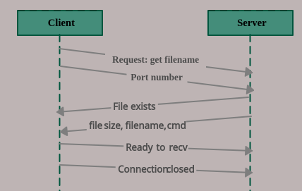
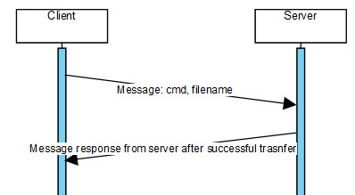
Mutating message packets : Example
FTP default handshake
FTP - handshake (mutating the messgae packets)
The response from server is sent as 2 packets with 1st packet saying file exists and the 2nd packet provides some details about the filename in 3 different fields seprated by a “,”
Client: Request
Server: Response

Slide 10
Dialects - 2
Cross-grafting the handshakes: We adopted different sequences of handshakes (request-response pairs) from numerous implementations of the FTP protocol.
Each protocol dialect is defined as different sequence of handshake which helps to transform the original protocol implementation into a valid variant that accomplishes successful client-server communication.
For each session, a particular sequence of handshakes will be used as dialects. So, given the context, rather than establishing one time username and password, we use the dialects as an authentication mechanism throughout the session.

Slide 11
Cross-grafting the handshakes: Example
Class D1:
def do_get():
Client: Request (get file.txt)
Server: Response (File exists)
Server: Response (Filename, size of file)
Server: Response (length of filename)
Class D2:
def do_get():
Client: Request (get file.txt)
Server: Response (File exists)
Server: Response (Filename, size of file, command)
Class D3:
def do_get():
Client: Request (get file.txt)
Server: Response (File exists)
Server: Response (Length of filename)
Server: Response (length of command)
.....
.....
Class D15:
def do_get():
def do_get():
Client: Request (get file.txt)
Server: Response (File exists)
Server: Response (Filename, size of file)
Server: Response (length of filename)
X1:
def do_get():
Client: Request (get file.txt)
Server: Response (File exists)
Server: Response (Filename, size of file, command)
X2:
def do_get():
Client: Request (get file.txt)
Server: Response (File exists)
Server: Response (Length of filename)
Server: Response (length of command)
X3:
Notes:
X1, X2, X3 are implementations collected from FTP protocols github. We just include the basic structure from the github implmentations and we also mutate the message according to our requirements.

Slide 12
Pseudocode - 1
Server listens on the port 21 and waits for the client to connect.
Client initiates the connection.
Client generates a request --> “get file.txt” (R₁)
R₁ is passed onto the neural network model and a dialect number “n” is predicted for the request R₁.
Note: Dialect number is depenadent on each request R_{n}.
If D_{n} = n (n is the dialect number predicted and is in the range of dialects 1 to 15)
then Class_D_{n} is used to send the R₁ to server.
Note: Even if the “R₁” is sent from Class_D_{n}, the R₁ is an undialected version of the request. The first request which is sent from client to server is undialected and all the 15 requests are in same format: “command arg”
else
then the connection gets closed, as the dialect number is not present in the range of dialects

Slide 13
Pseudocode - 2
Server receives the “R₁” and again passes the same request to server's neural network model to predict the dialect number “n”.
Note: Even if the “R₁” is sent from Class_D_{n}, the R₁ is an undialected version of the request. The first request which is sent from client to server is undialected and all the 15 requests are in same format: “command arg”
If D_{n} = n (n is the dialect number predicted and is in the range of dialects 1 to 15)
then “R₁” is sent to Class_D_{n}, the response “X₁” is sent from server to client
else
then the connection gets closed, as the dialect number is not present in the range of dialects
Once, the client receives the “X₁”, the “X₁” is sent to the decision tree to check for the dialect overlapping.
Note: Each dialects body differs in the response “X₁”. A decision tree is used to check is there is any overlap amongst the body of the dialects.
If the response “X₁” is not overlapped, then the client verifies the packet is from genuine server and generates the response “X₂” to be sent to server.

Slide 14
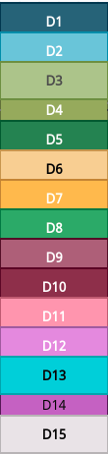
System design:
Request: get file.txt
Even if the request R = “get file.txt” is sent from D4, the R is an undialected version of the request. The first request which is sent from client to server is undialected for all the 15 requests & are in the same format:
“command arg” format
Client
Server
Request: get file.txt, received from D4 is forwarded to NN model
Request: get file.txt, is forwarded to NN model
Request: get file.txt is sent from D4
Dialect 4
Dialect 4
Neural network model
Neural network model
Server sends a response to D4

Slide 15
Neural Network model - 1
We use similar neural network model on both client-server systems. The idea of using neural network helps in incorporating a customized design to predict the dialects.
Similar to any classification problem in machine learning, we need a set of datasets and their corresponding categories (labels) to train the network. Here, every request (ex: get file.txt) is an instance of the dataset and the dialect number (ex: 1 or 2 or 3...15) is its label.
After training the network with a set of requests and the labels (categories) that they belong to, we expect the network to analyze unseen and new requests and find what kind of label (dialect number) they are inclined to. In this regard, we need a model to map every request to the label of the dataset.
For mapping, the request to dialect, we first assign 15 to all the requests and then we compare the starting request with other requests to find the distance between them. For example, if there are two strings x = abc and y = abcd, then the output distance will be 1. Then if the dialect for x is mapped as dialect 7, we give dialect 15 for y). In this way, the diffusion property is ensured.

Slide 16
Neural Network model -2
The properties which we propose through our deep neural network are the following:
Diffusion property, this is defined as even if there is a single character change, the prediction of dialect should be far away.
Example: (get file.txt --> D15 and get hile.txt--> D7)
Each dialect having a cost x (minimizing the cost), we define a cost “x” to each dialect (1 to 15) based on it's handshake structure.
Cost of each dialect is calculated as follows: No.of packets exchanged for a dialect + pkt 1*no.of fields in pkt1 + pkt 2*no.of fields in pkt2 + ....
Maximizing the entropy, we use the mean square error loss function to maximize the distribution of output labels (dialects). For instance, when we look at the output (if there are 15000 labels), all the 15 dialects should be spread uniformly in a random manner. That results in, entropy should be log(n) if there are n outcomes.

Slide 17
Decision tree: to avoid overlapping of dialects
We use the decision tree to avoid overlapping between the dialects. The idea to implement this decision tree is to avoid the dialects which are similar in their handshake structure.
We again train the decision tree using the server's response to predict the dialect. For instance, if the server replies as X = “P1: file exists/ P2: filename, command”. Then X is sent as the input to the decision tree model to make sure that this type of response belong dialect 11.
We take 150000 data points as the input and use 70% data as the training data and 30% data as the testing data. CART, Classification And Regression Trees algorithm in sk learn library helps us to constructs the tree based on a numerical splitting criterion recursively applied to the data.

Slide 18
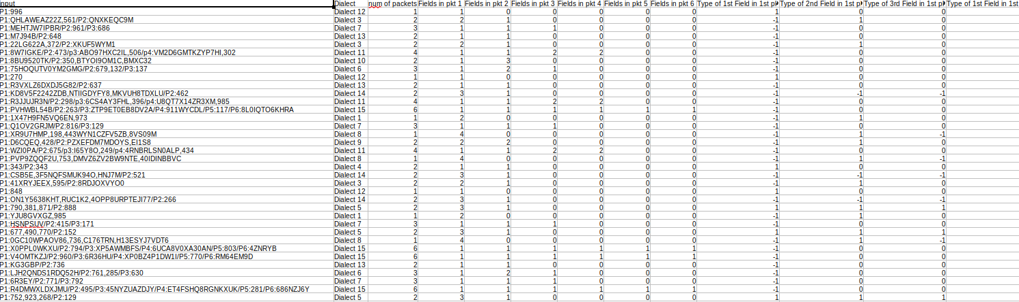
Decision tree - Dataset details
We use a python to create the features, output, input of the dataset.
The features used for the decision tree used for the decision tree are no.of packets, no.of fields in the respective packets and also the type of field in the packets (string or an int)
Dataset:

Slide 19
Verification of Server identity: (by client)
Example:
Server receives a request “get file.txt” from client
Server sends the request to NN model and obtains the key (dialect number) to respond from that Class(Dialect_number) (ex: Class(D4)) and sends a response like Packet 1: File exists
Packet 2: Length of filename (8), Length of command (3)
Packet 3: Size of the file (ex: 40 bytes)
Client receives the response from Class(D4),
First, checks if the response from Dialect 4 is not overlapping with any other dialects using a decision tree
Checks if there are three separate packets as response?
In the packet 1 - checks if packet content is “file exists” (using an if statement)
In the packet 2-1st field, since client already has the length of filename (just compares it again using if statement). In the 2nd field, since client knows the command too, it can just compare the length of command.
In the 2nd field, the client expects an integer number in the 1st field, since the file size changes dynamically and also the size is calcualted and sent by the server.

Slide 20

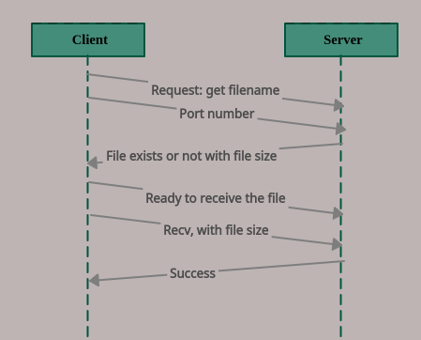
Appendix: Dialect 1

Slide 21
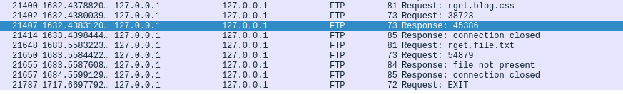
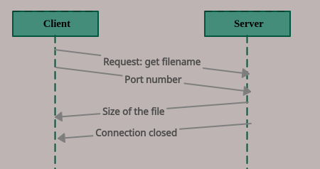
Dialect 2

Slide 22
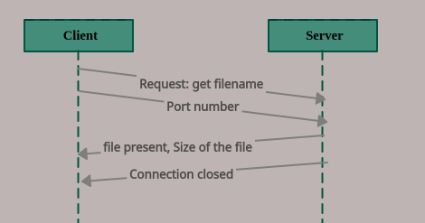
Dialect 3

Slide 23
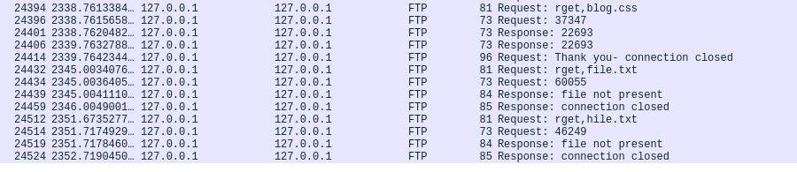
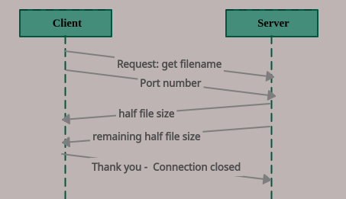
Dialect 4

Slide 24
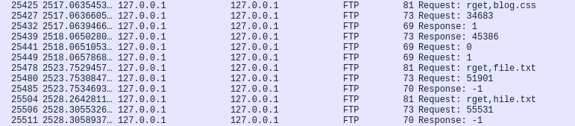
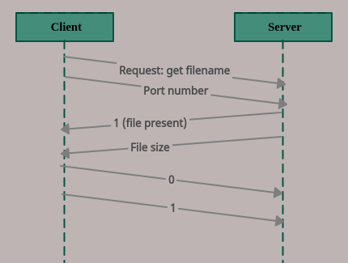
Dialect 5

Slide 25
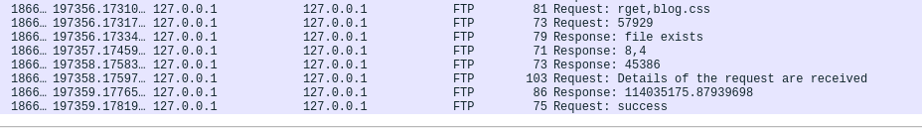
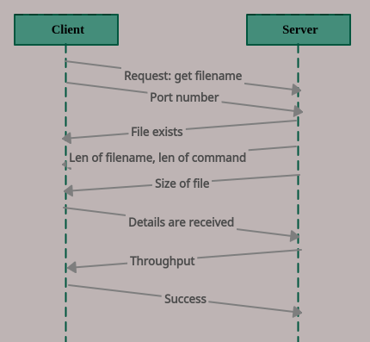
Dialect 6

Slide 26
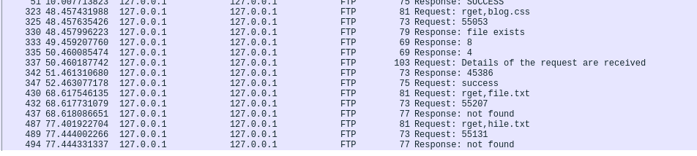
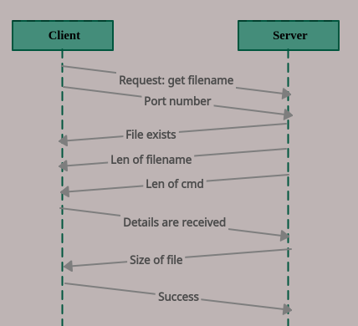
Dialect 7

Slide 27
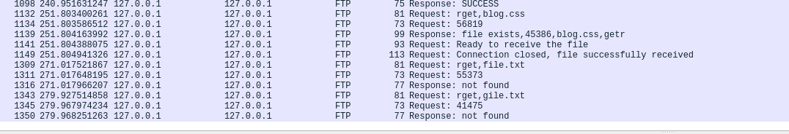
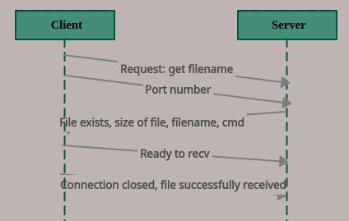
Dialect 8

Slide 28
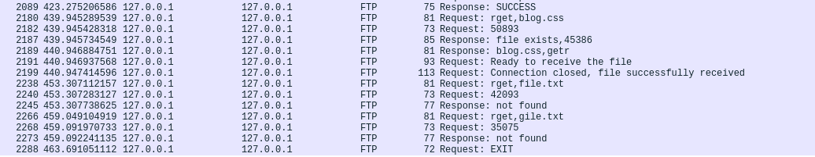
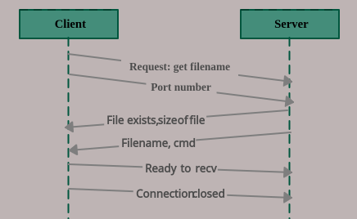
Dialect 9

Slide 29
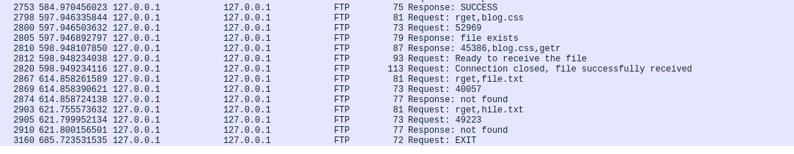

Dialect 10

Slide 30
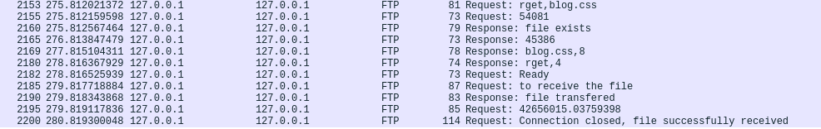
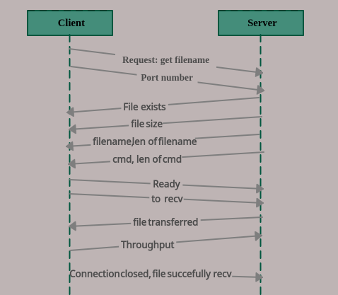
Dialect 11

Slide 31
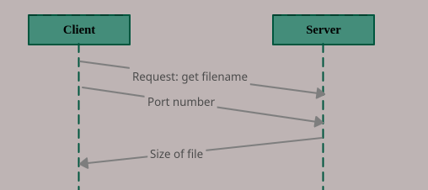
Dialect 12

Slide 32
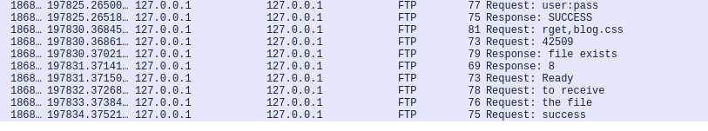
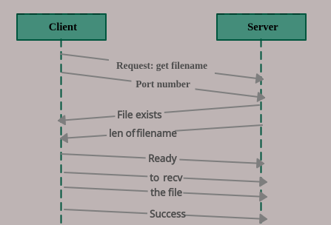
Dialect 13

Slide 33
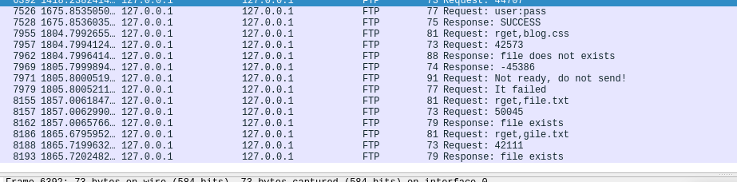
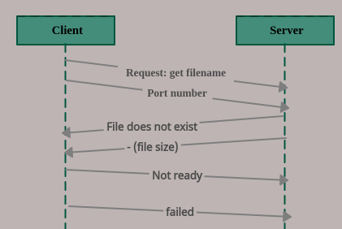
Dialect 14

Slide 34
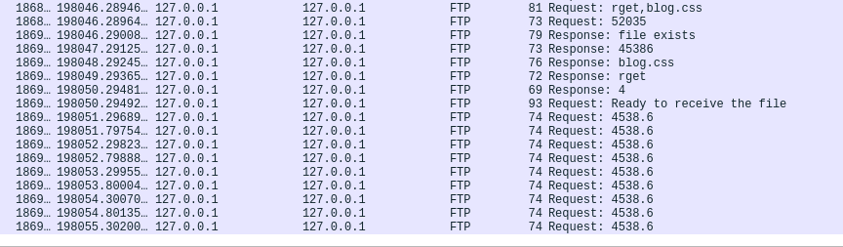
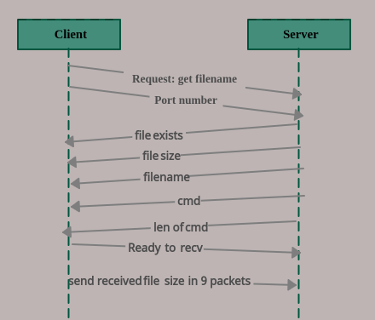
Dialect 15

