Slide 1
EcoSplice
Local DNA splice boundary analysis
Real predictions and measured algorithm comparisons
Final application demonstration 9 October 2026
Notes:
EcoSplice predicts possible canonical boundaries from DNA context. It runs locally with React, FastAPI, NumPy and SQLite. This presentation describes the implemented system and its frozen results. Use docs/submission/DEMO_SCRIPT.md for the four-minute live flow.

Slide 2
Input and prediction scope
Paste DNA or upload one FASTA record
A/C/G/T/N, at least 20 called bases, up to 100,000 bases
50 bases
GT or AG
50 bases
Complete A/C/G/T context
Two-base canonical motif
Complete A/C/G/T context
One-based motif starts in the supplied orientation
Incomplete or N-containing contexts remain visible with no score.
Outputs identify possible boundaries. Complete intron pairing and sequence removal remain outside this version.
Notes:
Source: docs/DATASET_AND_COORDINATES.md and backend/ecosplice/sequence.py. Canonical GT donor and AG acceptor candidates only. Input is supplied in the direction to analyse. Minus-strand bundled demos are already oriented. Donor boundary is before GT and acceptor boundary after AG. Scores require 102 ACGT bases.

Slide 3
Local application architecture
React dashboard
FastAPI service
DNA input and results
Validation and run APIs
Predictions and measurements save to SQLite.
Analysis engine
Saved models and three methods
SQLite history
Saved scientific snapshots
Shared report renderer
CSV, JSON and printable HTML
One localhost address serves the interface and API. Normal inference uses no cloud service or internet.
Notes:
Sources: backend/ecosplice/local_app.py, api.py, algorithms.py, storage.py, reports.py and frontend/src/useWorkspace.js. One loopback process serves built React and the API. Scientific snapshots persist locally. Training and source downloads are development-only utilities.

Slide 4
Real data and isolated partitions
GENCODE v49 with GRCh38 primary chromosome 22 DNA
Partition | Donor | Acceptor | Non-site | Total
Train | 3,654 | 3,811 | 85,766 | 93,231
Validation | 858 | 821 | 18,474 | 20,153
Test | 900 | 918 | 19,401 | 21,219
400 genes form 304 groups and 134,603 unique contexts.
Overlap groups stay in one split. Global deduplication includes reverse complements. Unannotated negatives may include unknown activity.
Notes:
Sources: data/processed/manifest.json and split_membership.json; https://www.gencodegenes.org/human/release_49.html ; https://hgdownload.soe.ucsc.edu/goldenPath/hg38/chromosomes/ . GENCODE open-access source terms and scientific attribution remain with samples. Seed 20261006. Full groups stay in one partition.

Slide 5
Saved prediction models
Scorer | Context | Features | Donor | Acceptor
Preliminary | 22 bases | Single bases | 0.36 | 0.31
Detailed | 102 bases | Bases and pairs | 0.41 | 0.44
Thresholds and adaptive settings freeze on validation.
Opening EcoSplice loads saved numeric coefficients.
Training is a separate development step.
Scores are model scores under sampled class balance. A score is not an established biological probability.
Notes:
Sources: results/model-evaluation.json, results/algorithm-verification.json, models/ecosplice-v1/manifest.json. Frozen development artifacts, not live timings. Detailed logistic regression uses base and adjacent-pair position features. Preliminary uses bases only. Training fits train, validation selects thresholds and routes. Softmax reflects sampled balance. No probability calibration transform was fit.

Slide 6
Three implemented algorithms
Method | Processing | Detailed calls | Preliminary calls
Exhaustive | Every eligible position | e | 0
Filtered | Eligible GT/AG only | q | 0
Adaptive | Cheap first, escalate uncertain | m | q
All three remain O(n) for a fixed context and model.
Filtering reduces expensive evaluations while preserving canonical results.
Notes:
Sources: results/model-evaluation.json, results/algorithm-verification.json, models/ecosplice-v1/manifest.json. Frozen development artifacts, not live timings. Sources: backend/ecosplice/algorithms.py and docs/MODELS_AND_ALGORITHMS.md. e is all eligible contexts, q eligible canonical contexts and m uncertain canonical contexts. Baseline really evaluates ordinary positions. All use bounded batches.

Slide 7
Adaptive routing performs less detailed work
Eligible canonical candidate
Complete 102-base context
Preliminary scorer
Reads the central 22 bases
Decisive score
Uncertain score
Fast final result
Detailed final result
Uses preliminary score and threshold
Evaluates the 102-base context
The saved result records the actual final scorer and route. Adaptive predictions can differ from the detailed reference.
Notes:
Sources: results/model-evaluation.json, results/algorithm-verification.json, models/ecosplice-v1/manifest.json. Frozen development artifacts, not live timings. Frozen donor decisive range <=0.18 or >=0.52. Acceptor <=0.0775 or >=0.655. Use the applicable final scorer threshold, not the route threshold, for the final decision. Detailed scorer is called only for uncertain contexts.

Slide 8
Held-out prediction quality
80.77% fewer detailed test evaluations
Adaptive donor F1 falls from 0.7987 to 0.7858. Acceptor F1 rises from 0.7173 to 0.7238. Sampled chr22 results.
Notes:
Sources: results/model-evaluation.json, results/algorithm-verification.json, models/ecosplice-v1/manifest.json. Frozen development artifacts, not live timings. Canonical donor domain 7497, support900; acceptor domain7523, support918. Detailed confusion donor TP712 FP171 FN188 TN6426; acceptor TP637 FP221 FN281 TN6384. Rounded display values from full-precision JSON. Adaptive avoids12132/15020 detailed evaluations, 80.77 percent. Donor F1 drop0.0129 exceeds the validation tolerance0.005. No test tuning.

Slide 9
Measured runtime on real held-out regions
Five fresh repeats per method after warm-up. Same input and settings. Hardware and background load affect timings.
Notes:
Sources: results/model-evaluation.json, results/algorithm-verification.json, models/ecosplice-v1/manifest.json. Frozen development artifacts, not live timings. Five repeats, shuffled method order, one excluded warm-up per method, batch512. Windows11 AMD64 Family25 Model68 Stepping1,16logicalCPUs Python3.12.10 NumPy2.2.6. Runtime excludes startup/HTTP/UI/serialization/SQLite writes. Raw totals and IQR are in source artifact.

Slide 10
Maximum input and estimated energy
Estimated joules = assumed watts × milliseconds / 1000
100,000-base synthetic inputs have no accuracy labels. The 15 W example gives 12.024 / 6.755 / 3.069 J on motif-rich DNA. Power is assumed.
Notes:
Sources: results/model-evaluation.json, results/algorithm-verification.json, models/ecosplice-v1/manifest.json. Frozen development artifacts, not live timings. These100000-base inputs are synthetic stress controls without biological truth. Motif-rich eligible49950 and edges50,baseline detailed99899. Estimated energy assumes15W for illustration. Frozen rich medians801.6242,450.3357,204.6002ms. Equal power makes reduction follow runtime.

Slide 11
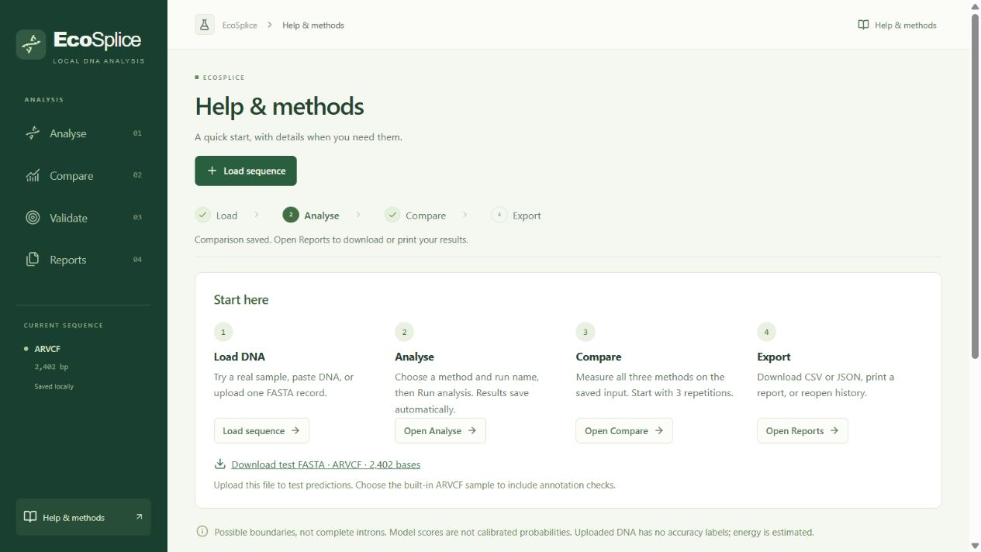
Guided local dashboard
Analyse and compare
Real scores, routes and repeated measurements
Validate and reports
Held-out metrics and SQLite history with consistent exports
Notes:
Source image: qa/screenshots/part5-help-desktop.png, actual final browser QA on9October2026. The four-step path follows actual input, saved analysis and saved comparison. The interface uses short text and expandable details; its sample link downloads genuine ARVCF DNA.

Slide 12
One local launch after setup
One-time setup
setup-ecosplice.cmd
Everyday launch
start-ecosplice.cmd
Open http://127.0.0.1:8765
The built frontend and API share one loopback Python process. Saved models, real demos and evaluation ship with the application.
Notes:
Source: scripts/setup_local.py, scripts/start_local.py and docs/LOCAL_RELEASE.md. Python3.12 is the tested runtime. Source setup needsNode20.19+ or22.12+,ZIP hasprebuiltfrontendandrequiresnoNode. Internetfor dependency preparation once. Normalinference/labels/history/exportoffline. Occupiedport --port8766.

Slide 13
Scientific limits and future work
Current evidence
Future extensions
Sampled chromosome 22 data
Canonical GT and AG boundaries
Adaptive quality can change
Energy uses assumed power
Broader independent evaluation
Calibrated probabilities
Intron pairing and variant effects
Measured power and acceleration
Uploaded FASTA has no known answers. Results identify possible boundaries and require broader biological validation.
Notes:
Sources: results/model-evaluation.json, results/algorithm-verification.json, models/ecosplice-v1/manifest.json. Frozen development artifacts, not live timings. Future proposals only: variants,cryptic sites,intron pairing,calibration,broader datasets,quantization,Jetson/NPU,cloudoffload,federatedlearning. Current model canonical sampled chr22, scoresnotprobabilities, annotatednegativesnotproveninactive, homologyindependencenotestablished. UploadedFASTAhasnolabels.

