Slide 1
Digital Portfolio
STUDENT NAME: Kailash kunwar jodha
REGISTER NO AND NMID: BD13728B5DAB2B58E0F409CC268D0C84
DEPARTMENT: BSc computer science with data analytics
COLLEGE: A.V.P college of arts and science in bharathiar university

Slide 2
PROJECT TITLE
STUDENT PORTFOLIO

Slide 3


AGENDA
Problem Statement
Project Overview
End Users
Tools and Technologies
Portfolio design and Layout
Features and Functionality
Results and Screenshots
Conclusion
Github Link
3/21/2024 Annual Review

Slide 4

PROBLEM STATEMENT
In today’s highly competitive digital era, students and professionals need a dynamic online presence to effectively showcase their skills, achievements, and projects. Traditional resumes are static, limited in scope, and often fail to highlight creativity, technical expertise, or individuality, making it difficult to stand out in the modern job market.

Slide 5

PROJECT OVERVIEW
This project is a personal portfolio website developed by Kailash kunwar jodha, a Computer Science student specializing in Data Analytics. The website presents personal details, educational background, skills, services, and projects in an engaging and user-friendly format. It functions as a digital resume to showcase creativity and frontend development expertise using HTML, CSS, and JavaScript.

Slide 6

WHO ARE THE END USERS?
Recruiters / Employers → To evaluate the student’s skills, experience, and suitability for jobs or internships. Clients → To review design and development capabilities for freelance or project-based work. Peers / Educators → To explore academic projects, assignments, and the overall learning journey. General Visitors → Anyone interested in viewing the student’s profile, services, or getting in touch.

Slide 7

TOOLS AND TECHNIQUES
Frontend Languages: HTML → For structuring and organizing web content. CSS → For styling, layout design, and ensuring responsiveness. JavaScript → For adding interactivity and dynamic functionality.

Slide 8
POTFOLIO DESIGN AND LAYOUT
Navigation Bar → Home, About, Services, Portfolio, Contact Hero Section → Introduction, role (Frontend Developer), and “Download CV” button About Me → Educational background, skills, and personal introduction Services → Web Development, Poster Design, Digital Marketing Portfolio (Projects) → Showcase of projects with images and descriptions Contact Section → Options to connect via email or social media links Footer → Copyright and credits
8

Slide 9
FEATURES AND FUNCTIONALITY
Responsive Layout → Optimized for mobile, tablet, and desktop devices Smooth Scrolling → Seamless navigation between sections Download CV → Quick access to resume with a single click Service Section → Icons for clear and quick understanding Project Showcase → Space for project details with GitHub/live links integration Contact Section → Easy communication via email and social platforms

Slide 10
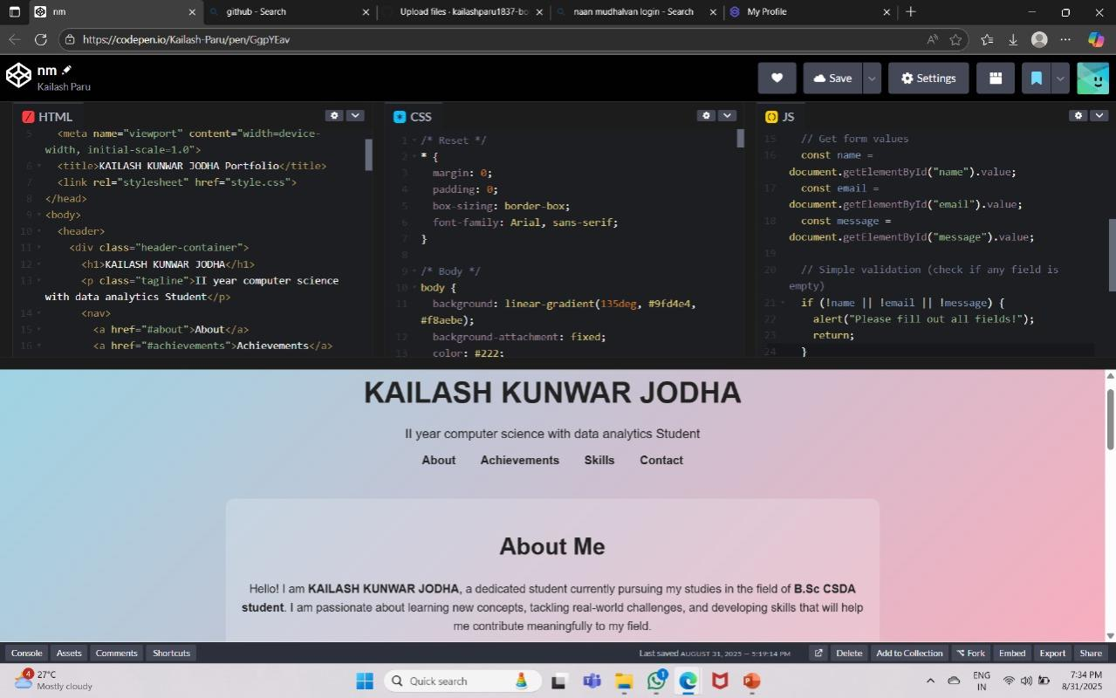

RESULTS AND SCREENSHOTS
3/21/2024 Annual Review
10

Slide 11
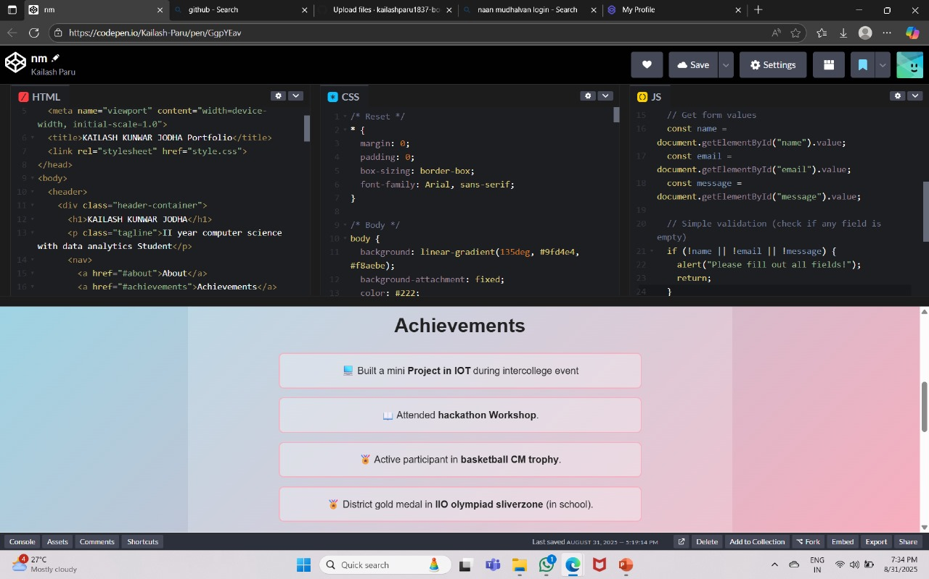

Slide 12
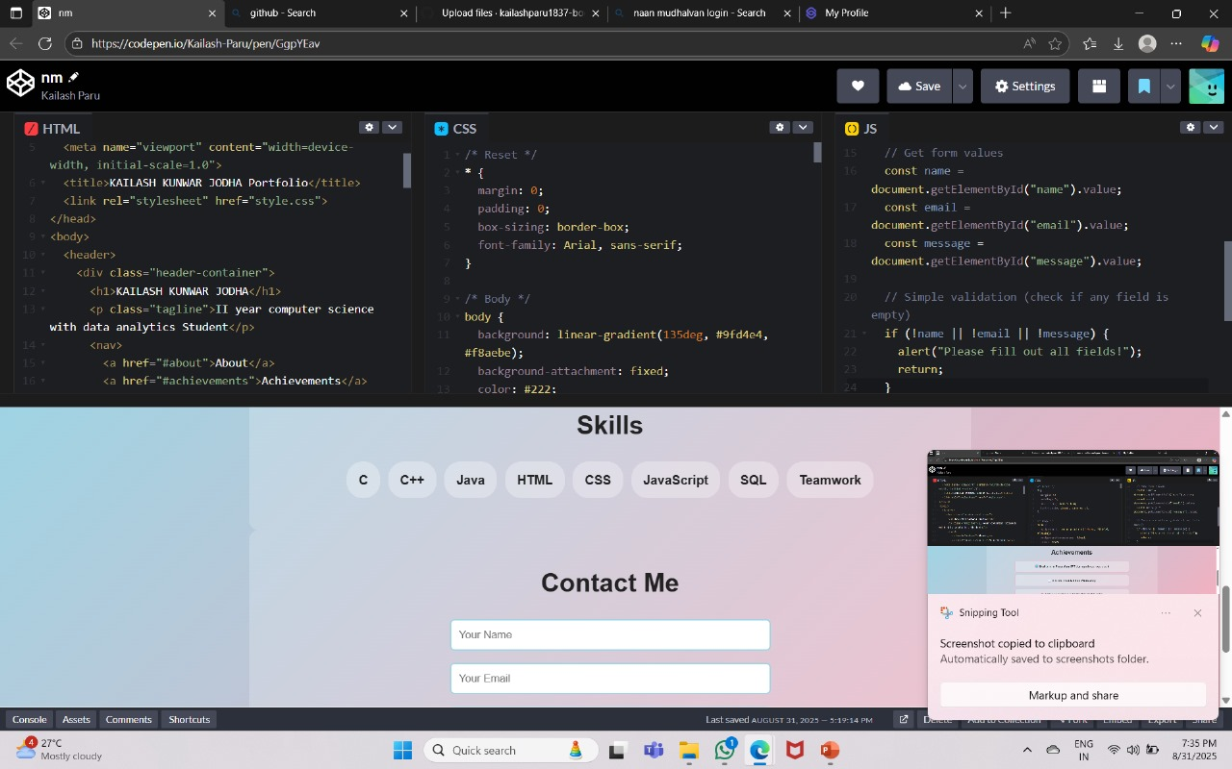

Slide 13
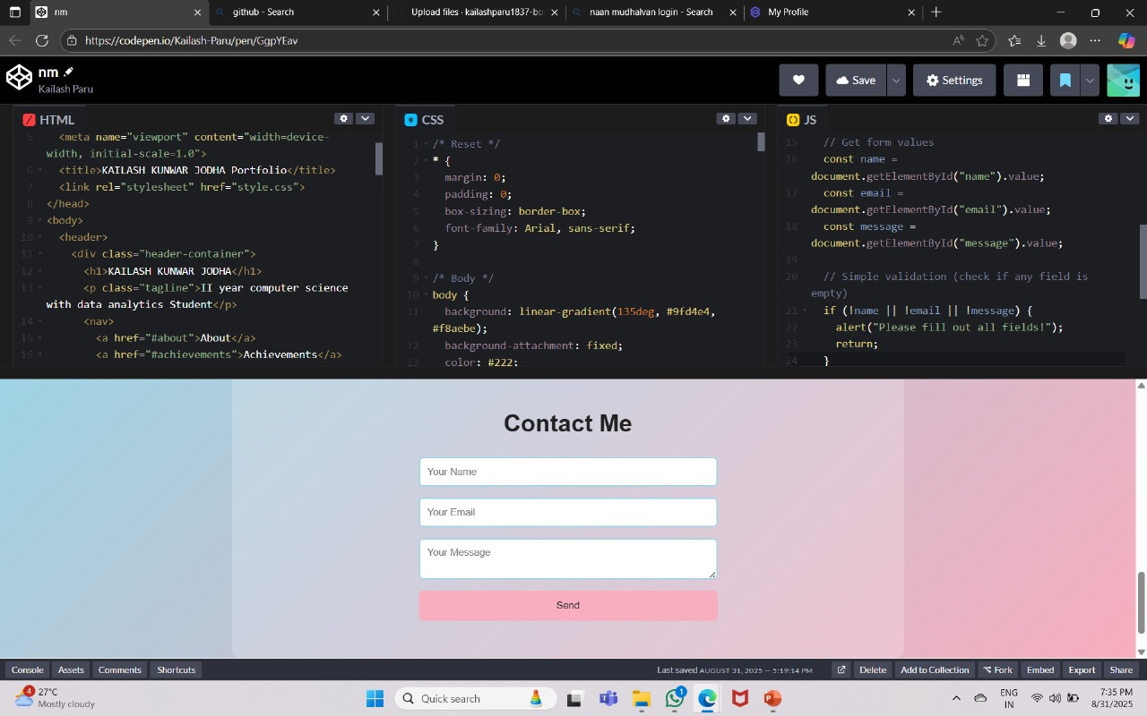

Slide 14
CONCLUSION
The personal portfolio website serves as an effective digital platform to showcase skills, creativity, and achievements in a structured and professional way. It functions as an online resume, enhancing visibility in academic and professional networks. This project highlights the practical application of frontend technologies and builds a strong foundation for future improvements such as adding a blog, integrating a contact form, and showcasing real-time projects.
14

Slide 15
Thank you

