Slide 1
Video Link
https://drive.google.com/file/d/1NonRQ-B0AgK0IFOQ7kfap40n-xVFL6km/view?usp=sharing

Slide 2
Task 1: Identifying the Top Branch by Sales Growth Rate (6 Marks) Walmart wants to identify which branch has exhibited the highest sales growth over time. Analyze the total sales for each branch and compare the growth rate across months to find the top performer.
Code:-
WITH Sales_Month AS
(SELECT Branch,DATE_FORMAT(Date, '%Y-%m') AS Month_Sales,SUM(Total) AS Total_SalesFROM walmart.walmartsales
GROUP BY Branch, Month_Sales),
GrowthRate AS (SELECT Branch, Month_Sales,Total_Sales,LAG(Total_Sales) OVER (PARTITION BY Branch ORDER BY Month_Sales) AS Prev_Month_Sales,
((Total_Sales - LAG(Total_Sales) OVER (PARTITION BY Branch ORDER BY Month_Sales)) / LAG(Total_Sales) OVER (PARTITION BY Branch ORDER BY Month_Sales)) * 100 AS Growth_Percentage
FROM Sales_Month)
SELECT Branch, ROUND(AVG(Growth_Percentage),2) AS Avg_Growth
FROM GrowthRate
WHERE Growth_Percentage IS NOT NULL
GROUP BY Branch
ORDER BY Avg_Growth DESC
LIMIT 1;

Slide 3


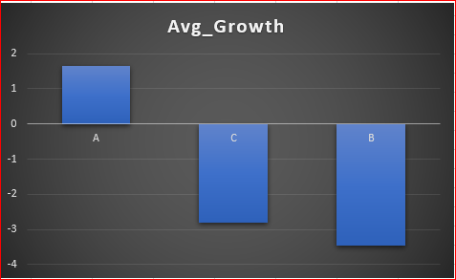
Result(TASK1)
TOP PERFORMER

Slide 4
Task 2: Finding the Most Profitable Product Line for Each Branch (6 Marks) Walmart needs to determine which product line contributes the highest profit to each branch.The profit margin should be calculated based on the difference between the gross income and cost of goods sold.
Code:
WITH Profit_Margin AS( SELECT Branch,Product_line,sum(cogs-gross_income) AS total_profit
FROM walmart.walmartsales
GROUP BY Branch,Product_line),
Profit_rank AS(SELECT Branch,Product_line,total_profit,
RANK() OVER(PARTITION BY Branch ORDER BY total_profit DESC) AS Rnk
FROM Profit_Margin)
SELECT Branch,Product_line,round(total_profit,2) AS ttl_prft
FROM Profit_rank
WHERE Rnk=1;

Slide 5
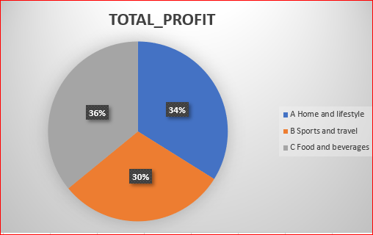

Result(TASK2)

Slide 6
Task 3: Analyzing Customer Segmentation Based on Spending (6 Marks) Walmart wants to segment customers based on their average spending behavior. Classify customers into three tiers: High, Medium, and Low spenders based on their total purchase amounts.
Code:
SELECT Customer_ID, ROUND(SUM(Total),2) AS Total_Spending,
CASE WHEN SUM(Total) >= 21500 THEN "High Spender" -- SET MY OWN CONDITION—
WHEN SUM(Total) BETWEEN 19500 AND 21500 THEN "Medium Spender" -- SET MY OWN CONDITION—
ELSE "Low Spender"END AS Spending_Div
FROM walmart.walmartsales
GROUP BY Customer_ID
ORDER BY Customer_ID ASC;

Slide 7
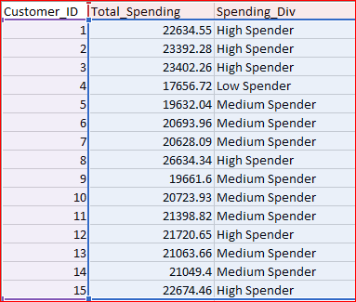
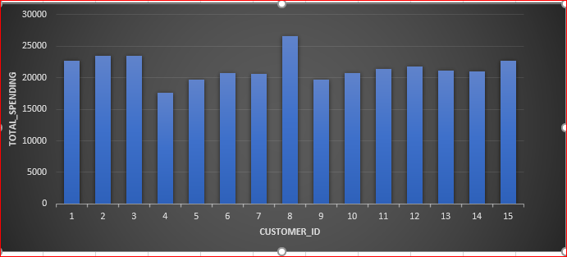
Result(TASK3):-
Spending Division According to Total Spending

Slide 8
Task 4: Detecting Anomalies in Sales Transactions (6 Marks) Walmart suspects that some transactions have unusually high or low sales compared to the average for the product line. Identify these anomalies.
Code:
SELECT Customer_ID, Product_line, Total AS Total_Sales,
CASE WHEN Total > (SELECT AVG(Total) FROM walmart.walmartsales) * 2 THEN "High Anomaly"
WHEN Total < (SELECT AVG(Total) FROM walmart.walmartsales) / 2 THEN "High Anomaly"
ELSE "No Anomaly" END AS Type_of_Anomaly
FROM walmart.walmartsales
WHERE Total > (SELECT AVG(Total) FROM walmart.walmartsales) * 2
OR Total < (SELECT AVG(Total) FROM walmart.walmartsales) / 2

Slide 9
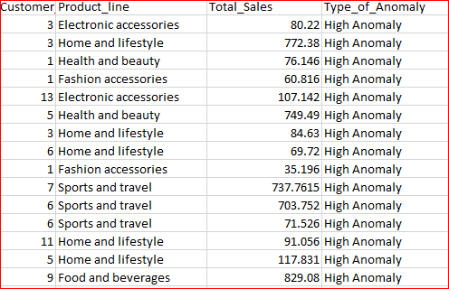
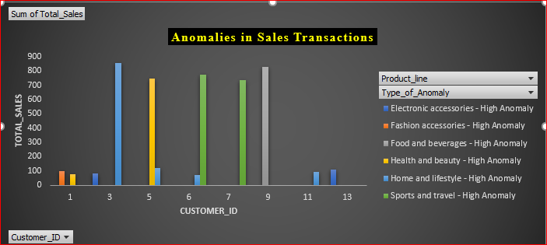
Result(TASK4)
Detecting Anomalies in Sales Transactions(Showing the result of 1st 15 Row only)

Slide 10
Task 5: Most Popular Payment Method by City (6 Marks) Walmart needs to determine the most popular payment method in each city to tailor marketing strategies.
Code:
WITH PaymentCounts AS
( SELECT City, Payment, COUNT(*) AS payment_count,
RANK() OVER (PARTITION BY City ORDER BY COUNT(*) DESC) AS rnk
FROM walmart.walmartsales
GROUP BY City, Payment)
SELECT City, Payment, payment_count
FROM PaymentCounts
WHERE rnk = 1;

Slide 11
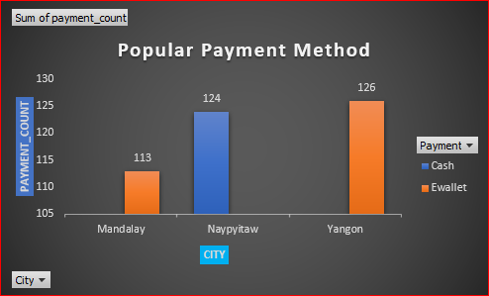

Result(TASK5):
Popular Payment Method BY CITY

Slide 12
Task 6: Monthly Sales Distribution by Gender (6 Marks) Walmart wants to understand the sales distribution between male and female customers on a monthly basis.
Code:
SELECT
DATE_FORMAT(Date, '%m-%y') AS Month,
Gender,
Round(SUM(Total),2) AS Total_Sales
FROM walmart.walmartsales
GROUP BY Month, Gender
ORDER BY Month, Gender;

Slide 13
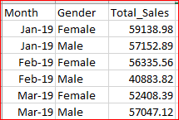
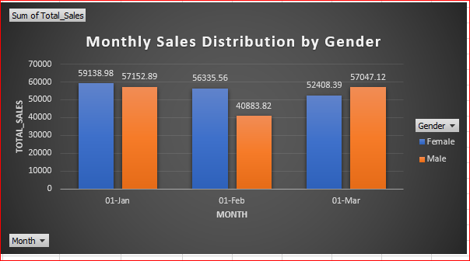
Result(TASK6):
Monthly Sales Distribution by Gender

Slide 14
Task 7: Best Product Line by Customer Type (6 Marks) Walmart wants to know which product lines are preferred by different customer types(Member vs. Normal).
Code:
SELECT Customer_type, Product_line,
COUNT(Invoice_ID) AS Purchase_Count
FROM walmart.walmartsales
GROUP BY Customer_type, Product_line
ORDER BY Customer_type, Purchase_Count DESC;

Slide 15
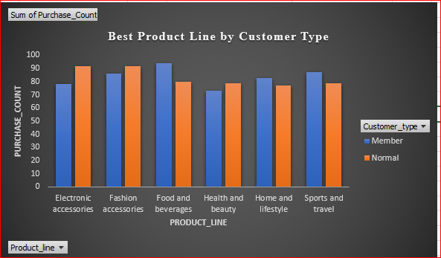
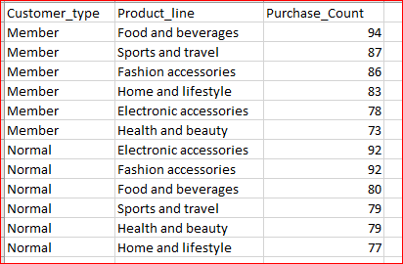
Result(TASK7):
Best Product Line by Customer Type

Slide 16
Task 8: Identifying Repeat Customers (6 Marks) Walmart needs to identify customers who made repeat purchases within a specific time frame (e.g., within 30 days).
Code:
WITH Purchase AS (
SELECT Customer_ID,Date,
LAG(Date) OVER (PARTITION BY Customer_ID ORDER BY Date) AS Last_Purchase_Date
FROM walmart.walmartsales)
SELECT DISTINCT Customer_ID
FROM Purchase
WHERE DATEDIFF(Date, Last_Purchase_Date) <= 30;

Slide 17
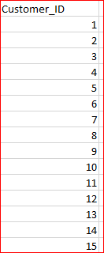
Result:
Repeat Customers (e.g., within 30 days)

Slide 18
Task 9: Finding Top 5 Customers by Sales Volume (6 Marks) Walmart wants to reward its top 5 customers who have generated the most sales Revenue.
Code:
SELECT Customer_ID,Round(SUM(Total),2) AS Total_Rev
FROM walmart.walmartsales
GROUP BY Customer_ID
ORDER BY SUM(Total) DESC
LIMIT 5;

Slide 19
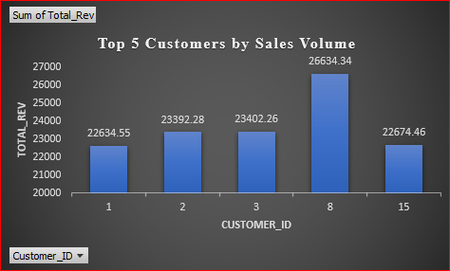
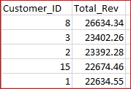
Result(TASK9):
Top 5 Customers by Sales Volume

Slide 20
Task 10: Analyzing Sales Trends by Day of the Week (6 Marks) Walmart wants to analyze the sales patterns to determine which day of the week brings the highest sales.
Code:
SELECT
DAYNAME(Date) AS Day_Of_Week,
Round(SUM(Total),2) AS Total_Sales
FROM walmart.walmartsales
GROUP BY Day_Of_Week
ORDER BY Total_Sales DESC;

Slide 21
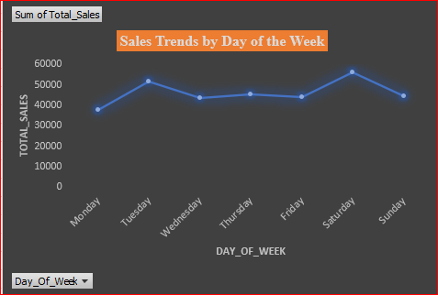
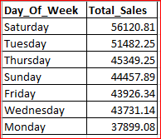
Result(TASK10)
Sales Trends by Day of the Week

