Slide 1

NEXT-GENERATION TRAVEL
Flight Route Planner
PRESENTED BY: ANIKETH HEMANT KAILASH SAMPATH
Notes:
Introduce Flight Route Planner as a new standard for flight discovery and booking decisions.

Slide 2
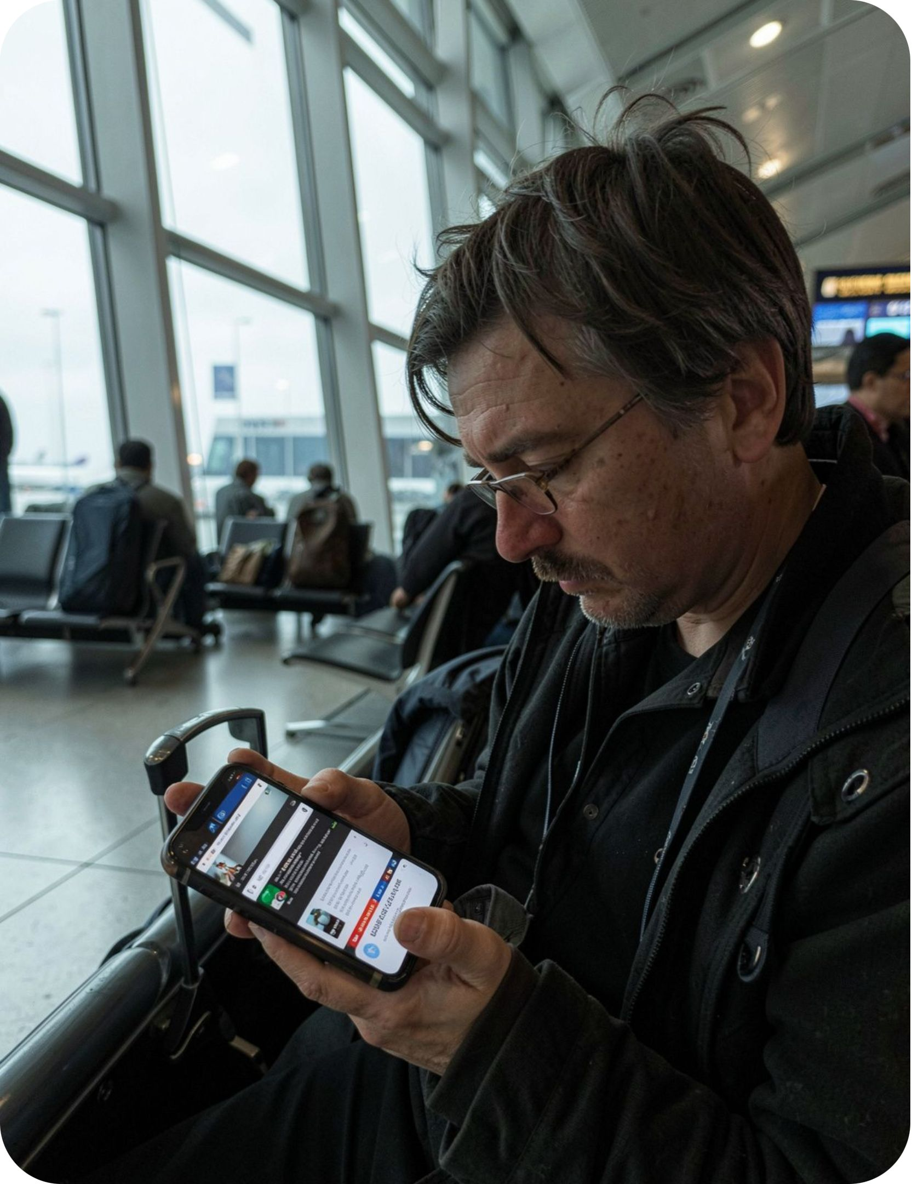
The Problem
Industry Friction
Travel planning is still too fragmented.
Modern flight shoppers juggle a dozen browser tabs just to evaluate one journey. Critical details like terminal transfers, self-transfers, and total transit time stay hidden behind disparate search engines.
12+
43min
Tabs opened per booking
Spent reconciling hidden fees
Flight Route Planner
2
Notes:
Frame the problem: consumers face cognitive overload when comparing multi-airport hubs and layovers.

Slide 3
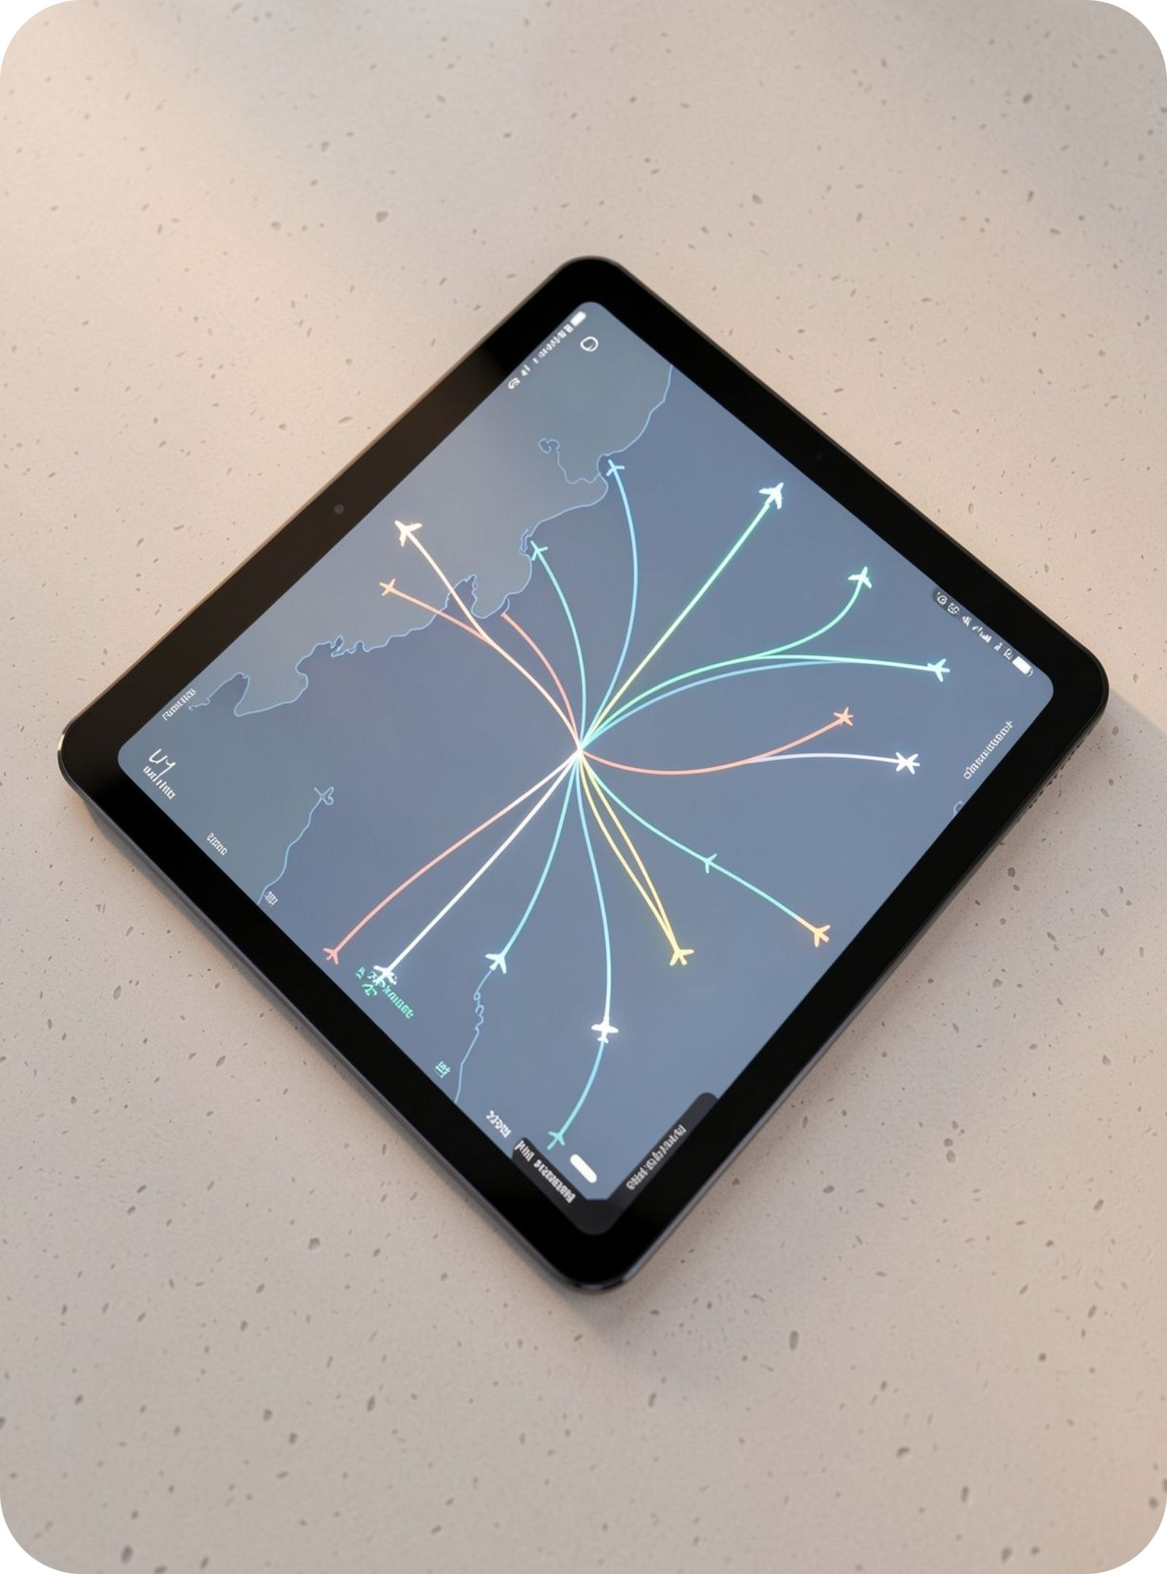
The Solution
All-In-One Canvas
One calm workspace for every journey.
Replace scattered tabs with a single interactive flight surface. Origin, alternate airports, layover corridors, and live price signals converge on one coherent visual timeline.
Smart Input
Route Map
Clear Delta
Multi-city & nearby airport pairing
Visual transit paths with layover bars
Transparent trade-offs in seconds
Flight Route Planner
3
Notes:
Demonstrate how the calm workspace aggregates disparate data streams into a single high-fidelity interface.

Slide 4
Customization
Priority Weighting
Plan the route around what matters most.
Every passenger evaluates value differently. Tune ranking parameters instantly without reloading queries or restarting search workflows.
BUDGET
SPEED
COMFORT
ACCESS
Lowest Fare
Shortest Transit
Fewer Stops
Preferred Hubs
Prioritizes raw cost efficiency and secondary airport savings without compromise on reliability.
Filters for direct routes and hyper-efficient layovers to protect productive business hours.
Minimizes transfer friction, terminal changes, and self-transfer baggage rechecks.
Locks selections to preferred airline alliances and preferred metropolitan departure airports.
Flight Route Planner
4
Notes:
Highlight the real-time dynamic re-ranking capability that saves users from resetting query filters.

Slide 5
User Journey
End-To-End Reliability
From search results to a trip you can trust.
A three-stage guided pipeline turns high-dimensional flight data into confidence.
01
02
03
Set Preferences
Evaluate Options
Save & Monitor
Input origin cities, date ranges, and personal travel constraints on an interactive map canvas.
Compare algorithmically scored flight corridors detailing duration, risk index, and fare history.
Lock your itinerary with real-time schedule tracking, gate changes, and automated price drop alerts.
Flight Route Planner
5
Notes:
Walk through the three intuitive stages from query initiation to ongoing itinerary monitoring.

Slide 6

Decision Matrix
Visible Trade-offs
A better decision, made visible.
Side-by-side transparency reveals why our recommended flight balances total cost and passenger well-being.
Option | Price | Duration | Stops & Airport
Recommended Smart balance | $680 | 9h 45m | 1 stop (1h 20m, LHR)
Fastest Direct non-stop | $1,140 | 8h 15m | Direct (JFK → CDG)
Economy Ultra-budget | $520 | 15h 30m | 2 stops (Airport change)
Flight Route Planner
6
Notes:
Present the side-by-side comparison matrix demonstrating the value of our decision intelligence.

Slide 7
Thank You
Let’s make every flight easier to plan.
Notes:
Conclude with contact information and an invitation for questions or investment discussion.

