Slide 1
IPC With SOCKETS

Slide 2
Introduction to IPC
Inter-process communication (IPC) is a set of
techniques for the exchange of data among
multiple threads in one or more processes.
Why “Inter Process Communication”?
Information sharing
Computation speedup
Modularity
Convenience

Slide 3
Types of IPC
Pipes(Half-duplex)
FIFOs (named pipes)
STREAM pipes (Full-duplex pipes)
Named STREAM pipes
Message queues
Semaphore sets
Shared memory segments
Sockets
Streams

Slide 4
Types of IPC
Pipes(Half-duplex)
FIFOs (named pipes)
STREAM pipes (Full-duplex pipes)
Named STREAM pipes
Message queues
Semaphore sets
Shared memory segments
Sockets
Streams
processes on the same machine were able to communicate

Slide 5
Types of IPC
Pipes(Half-duplex)
FIFOs (named pipes)
STREAM pipes (Full-duplex pipes)
Named STREAM pipes
Message queues
Semaphore sets
Shared memory segments
Sockets
Streams
processes on the same machine were able to communicate
Include communication between processes on different machines
Notes:
<number>

Slide 6
motivation: why sockets?
UNIX-Operating systems at first only supported using pipes for IPC
only related processes on the same machine were able to communicate
only one-way communication
networking was difficult since there were no standards for network interfaces
developing applications for network jobs was difficult (each network interface had to be implemented separately)

Slide 7
What is a socket?
A socket is a communication endpoint — an object through which an application sends or receives packets of data across a network.
A data structure that can be created, manipulated and used for communication using system calls.
sockets are an abstraction of the network interface and the network protocol. Socket facility layered on top of networking.
socket layer
Stream Socket
network protocols
TCP/IP Protocol
network interfaces
10 MBit/s Ethernet

Slide 8
>> Communicating processes each create a socket and connect them together
>> Data is sent from a source socket to a destination socket
>> Can be used for local (same machine) or remote communication
process 1
process 2
KERNEL
socket
socket

Slide 9
general properties of sockets
connection-based
can have an address bound to them
use packets for data transmission
allow checking for errors
UNIX_STREAM and TCP
allow IPC in a network environment
“all-rounder”
many protocols such as IPX, AX_25 and AppleTalk are supported

Slide 10
Creating a socket….
Created using the socket() system call
#include <sys/types.h> #include <sys/socket.h>
fd = socket(PF_INET,SOCK_STREAM,0)
File descriptor
protocol
domain
socket type

Slide 11
Creating a socket….
Created using the socket() system call
#include <sys/types.h> #include <sys/socket.h>
fd = socket(PF_INET,SOCK_STREAM,0)
File descriptor
protocol
domain
Unix-Domain PF_UNIX
Internet PF_INET
socket type
stream SOCK_STREAM
datagram SOCK_DGRAM
UNIX_STREAM, UNIX_DGRAM
TCP, UDP(normally 0 )

Slide 12
Types of sockets
UNIX Domain sockets
realized in memory
can be bound to an address which appears in the local file system
if client and server are on the same machine, twice as fast as INET-sockets
Internet (INET) sockets
implemented through the network
using a combination of 32-bit numbers and a port-number as address (e.g. 192.168.0.1:8088)
both types have in common: once they are bound to an address they can be reached by other sockets

Slide 13
Types of sockets

Slide 14
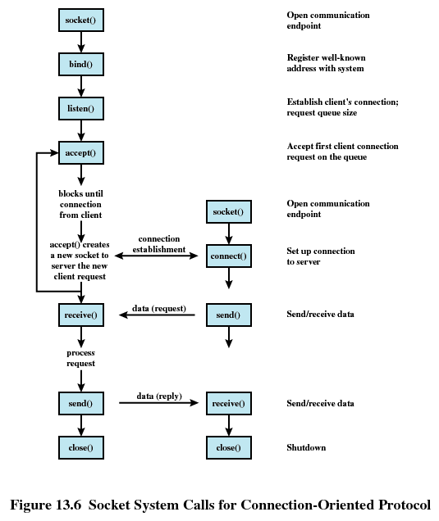
Client-server communication using sockets

Slide 15
Socket connections(server)
step-1:Creating a socket
Created using the socket() system call
fd = socket(PF_INET,SOCK_STREAM,0)
File descriptor
protocol
domain
socket type
A server application creates a socket, which like a file descriptor is a resource assigned to the server process and that process alone.
The server creates it using the system call socket, and it can’t be shared with other processes.

Slide 16
step-2:naming/addressing a socket
the server process gives the socket a name.
Local sockets are given a filename in the Linux file system, often to be found in /tmp or /usr/tmp.
For network sockets, the filename will be a service identifier (port number/access point) relevant to the particular network to which the clients can connect.
This identifier allows Linux to route incoming connections specifying a particular port number to the correct server process.
A socket is named using the system call bind.
#include <sys/socket.h>
bind(int fd, struct sockaddr *umyaddr, int addrlen);
On successful completion, bind returns 0. If it fails, it returns -1

Slide 17
The server process then waits for a client to connect to the named socket.
Step-3:The system call, listen, creates a queue for incoming connections.
#include <sys/socket.h>
listen(int fd, int backlog);
The listen function will return 0 on success or -1 on error
Step-4:The server can accept incoming connections using the system call accept.
#include <sys/socket.h>
accept(int fd, struct sockaddr *upeer_sockaddr, int upeer_addrlen);
The accept function returns a new socket file descriptor when there is a client connection pending or -1 on error.
When the server calls accept, a new socket is created that is distinct from the named socket.
This new socket is used solely for communication with this particular client.
The named socket remains for further connections from other clients.
A server can take multiple connections. Further clients wait on the listen queue until the server is ready again.

Slide 18
Socket connections (server)
socket(int family, int type, int protocol)
creates a socket file descriptor
binds the socket to an address
bind(int fd, struct sockaddr *umyaddr, int addrlen);
tells the kernel that the socket
is now ready to accept
connections
listen(int fd, int backlog);
on an incoming connection:
accept(int fd, struct sockaddr *upeer_sockaddr, int upeer_addrlen);

Slide 19
Socket connections(client)
Step-1:The client creates an unnamed socket by calling socket.
socket(int family, int type, int protocol)
Step-2:It then calls connect to establish a connection with the server by using the server’s named socket as an address.
#include <sys/socket.h>
connect(int fd, struct sockaddr *uservaddr, int addrlen);
If it succeeds, connect returns 0, and -1 is returned on error
Once a connection was established, sockets can be used like
low-level file descriptors, providing two-way data
communications.

Slide 20
Client-server communication using sockets

Slide 21
A Simple Local Server
1. Make the necessary includes and set up the variables.
#include <sys/types.h>
#include <sys/socket.h>
#include <stdio.h>
#include <sys/un.h>
#include <unistd.h>
int main()
{
int server_sockfd, client_sockfd;
int server_len, client_len;
struct sockaddr_un server_address;
struct sockaddr_un client_address;
2. Remove any old sockets and create an unnamed socket for the server.
unlink(“server_socket”);
server_sockfd = socket(AF_UNIX, SOCK_STREAM, 0);
3. Name the socket.
server_address.sun_family = AF_UNIX;
strcpy(server_address.sun_path, “server_socket”);
server_len = sizeof(server_address);
bind(server_sockfd, (struct sockaddr *)&server_address, server_len);

Slide 22
A Simple Local Server
4. Create a connection queue and wait for clients.
listen(server_sockfd, 5);
while(1) {
char ch;
printf(“server waiting\n”);
5. Accept a connection.
client_len = sizeof(client_address);
client_sockfd = accept(server_sockfd,
(struct sockaddr *)&client_address, &client_len);
6. Read and write to client on client_sockfd.
read(client_sockfd, &ch, 1);
ch++;
write(client_sockfd, &ch, 1);
close(client_sockfd);
}
}

Slide 23
A Simple Local Client
1. Make the necessary includes and set up the variables.
#include <sys/types.h>
#include <sys/socket.h>
#include <stdio.h>
#include <sys/un.h>
#include <unistd.h>
int main()
{
int sockfd;
int len;
struct sockaddr_un address;
int result;
char ch = ‘A’;
2. Create a socket for the client.
sockfd = socket(AF_UNIX, SOCK_STREAM, 0);
3. Name the socket as agreed with the server.
address.sun_family = AF_UNIX;
strcpy(address.sun_path, “server_socket”);
len = sizeof(address);

Slide 24
A Simple Local Client
4. Connect our socket to the server’s socket.
result = connect(sockfd, (struct sockaddr *)&address, len);
if(result == -1) {
perror(“oops: client1”);
exit(1);
}
5. You can now read and write via sockfd.
write(sockfd, &ch, 1);
read(sockfd, &ch, 1);
printf(“char from server = %c\n”, ch);
close(sockfd);
exit(0);
}

Slide 25
output
The server program in this example can serve only one client at a time. It just reads a character from the client, increments it, and writes it back.
When you run the server program, it creates a socket and waits for connections. If you start it in the background so that it runs independently, you can then start clients in the foreground.
$ server1 &
[1] 1094
$ server waiting
Now, when you run the client program, you are successful in connecting to the server. Since the server socket exists, you can connect to it and communicate with the server.
$ ./client1
server waiting
char from server = B
$
the server has
received a character from the client, incremented it, and returned it. The server then continues and waits
for the next client.

Slide 26
applications
Linux functions such as printing and network utilities such as rlogin(remote login) and ftp(file transfer protocol) usually use sockets to communicate.
Client/Server models
Peer-to-peer scenarios, such as chat applications
Making remote procedure calls (RPC) by having the receiving application interpret a message as a function call.

