Slide 1
Digital Portfolio
STUDENT NAME: kailas nadh
REGISTER NO AND NMID: 222407629
DEPARTMENT: computer science
COLLEGE: veltech Ranga Sanku Arts College

Slide 2
PROJECT TITLE
Digital portfolio

Slide 3


AGENDA
Problem Statement
Project Overview
End Users
Tools and Technologies
Portfolio design and Layout
Features and Functionality
Results and Screenshots
Conclusion
Github Link
3/21/2024 Annual Review

Slide 4

PROBLEM STATEMENT
★Lack of a professional online identity for students. ★Traditional resumes are static and less engaging. ★Need for a digital portfolio that highlights projects, skills, and achievements effectively.

Slide 5

PROJECT OVERVIEW
★A Personal Portfolio Website built using HTML, CSS, and JavaScript.
★Provides structured sections: About, Skills, Certificates, Projects, and Contact.
★Designed to be responsive, interactive, and user-friendly.

Slide 6

WHO ARE THE END USERS?
★Students who want to showcase their academic and project work.
★Recruiters/HR professionals searching for talent.
★Teachers and mentors evaluating project submissions.
★General qudience interested in portfolioreference designs

Slide 7

TOOLS AND TECHNIQUES
HTML – Structure CSS – Styling &amp; Layout JavaScript – Functionality VS Code – IDE GitHub – Version Control &amp; Hosting

Slide 8
POTFOLIO DESIGN AND LAYOUT
★Header &amp; Navbar → Quick navigation
★Hero Section → Introduction + Tagline
★About Section → Bio + Image
★Skills Section → Progress bars
★Certificates Section → Achievements list
★Projects Section → Showcase with cards
★Contact Section → Form + Social links
★Footer → GitHub &amp; LinkedIn
8

Slide 9
FEATURES AND FUNCTIONALITY
★ Responsive navigation bar mobile and desktop view). Dark mode toggle Interactive skill progress bars. ★Contact form with validation &amp; success message Project showcase using cards with hover effects.Social links for networking (GitHubLI &amp; Linkedln)

Slide 10
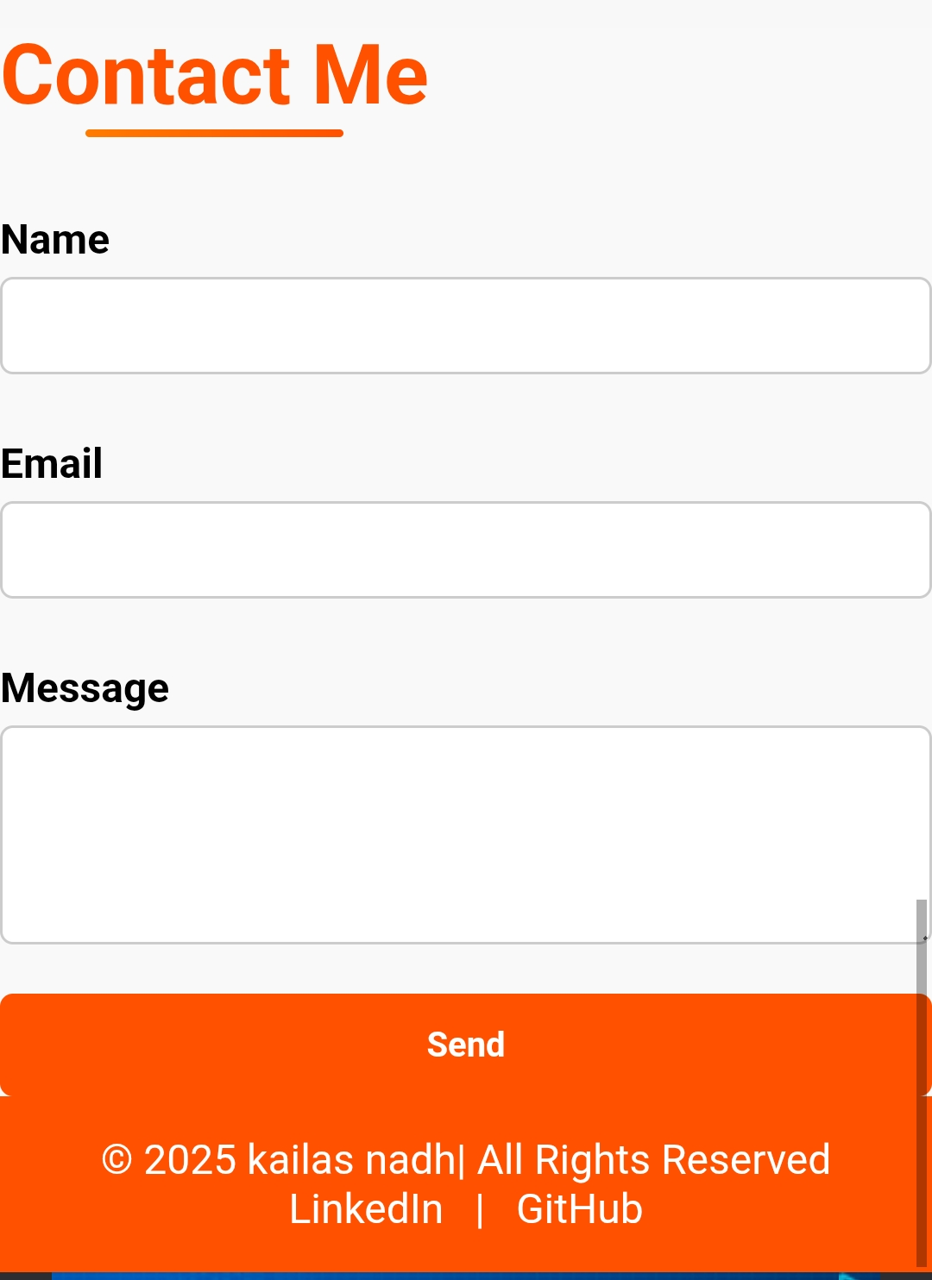
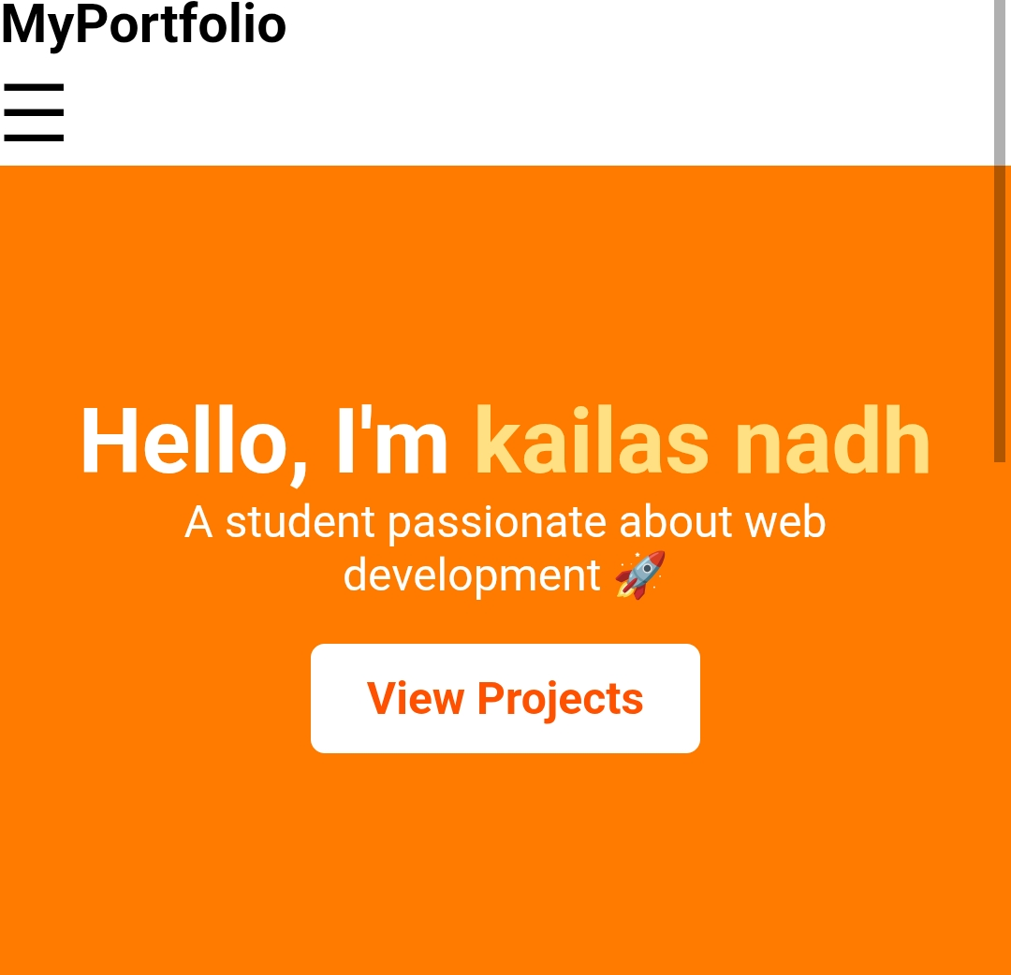
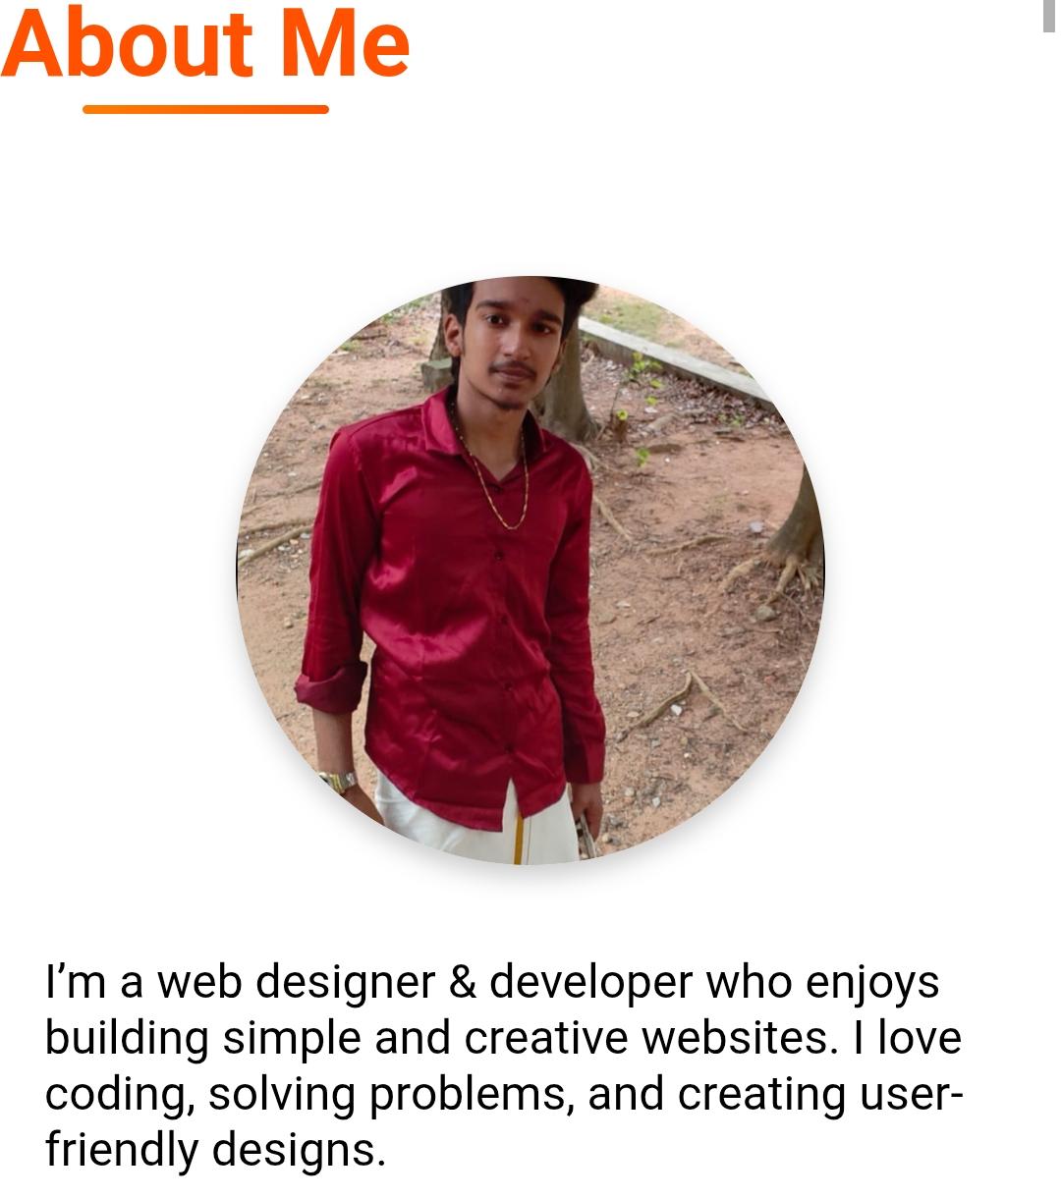
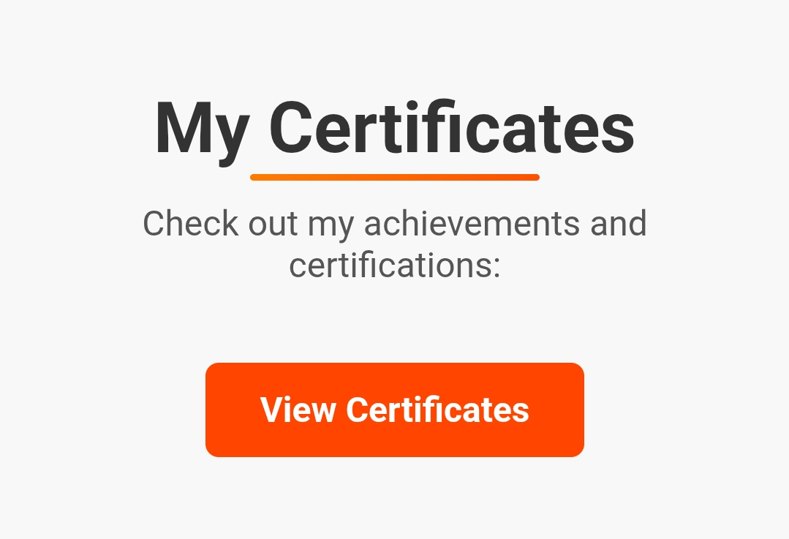
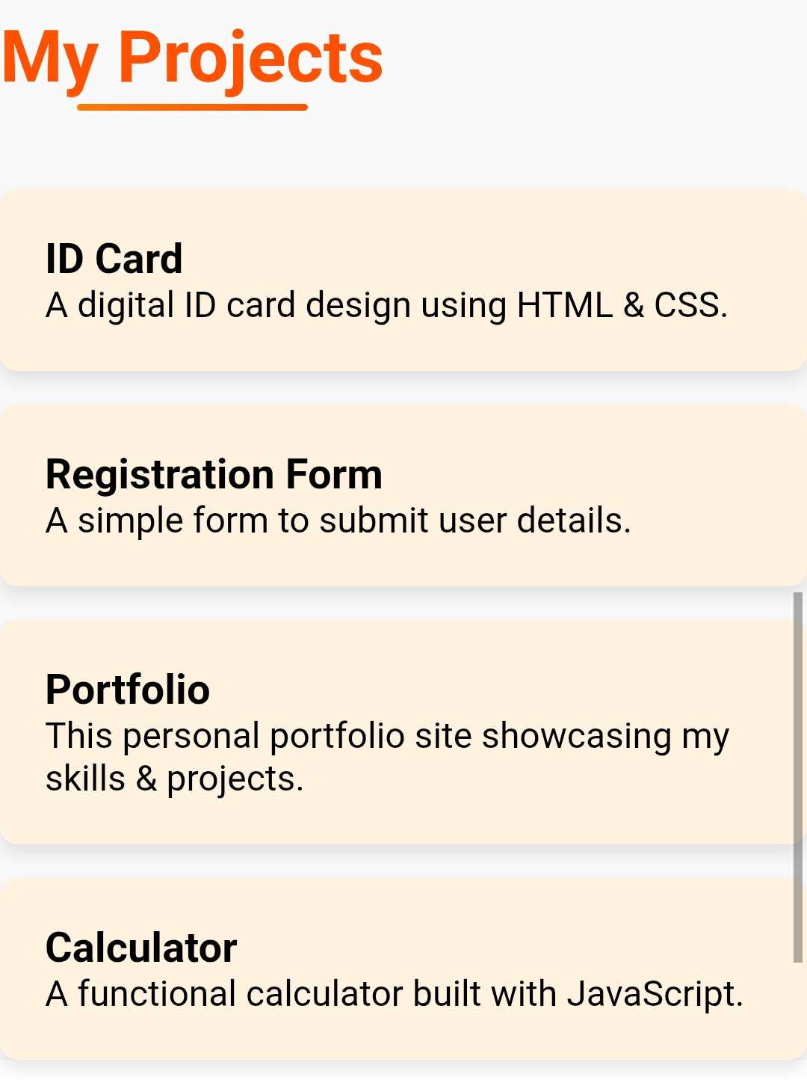
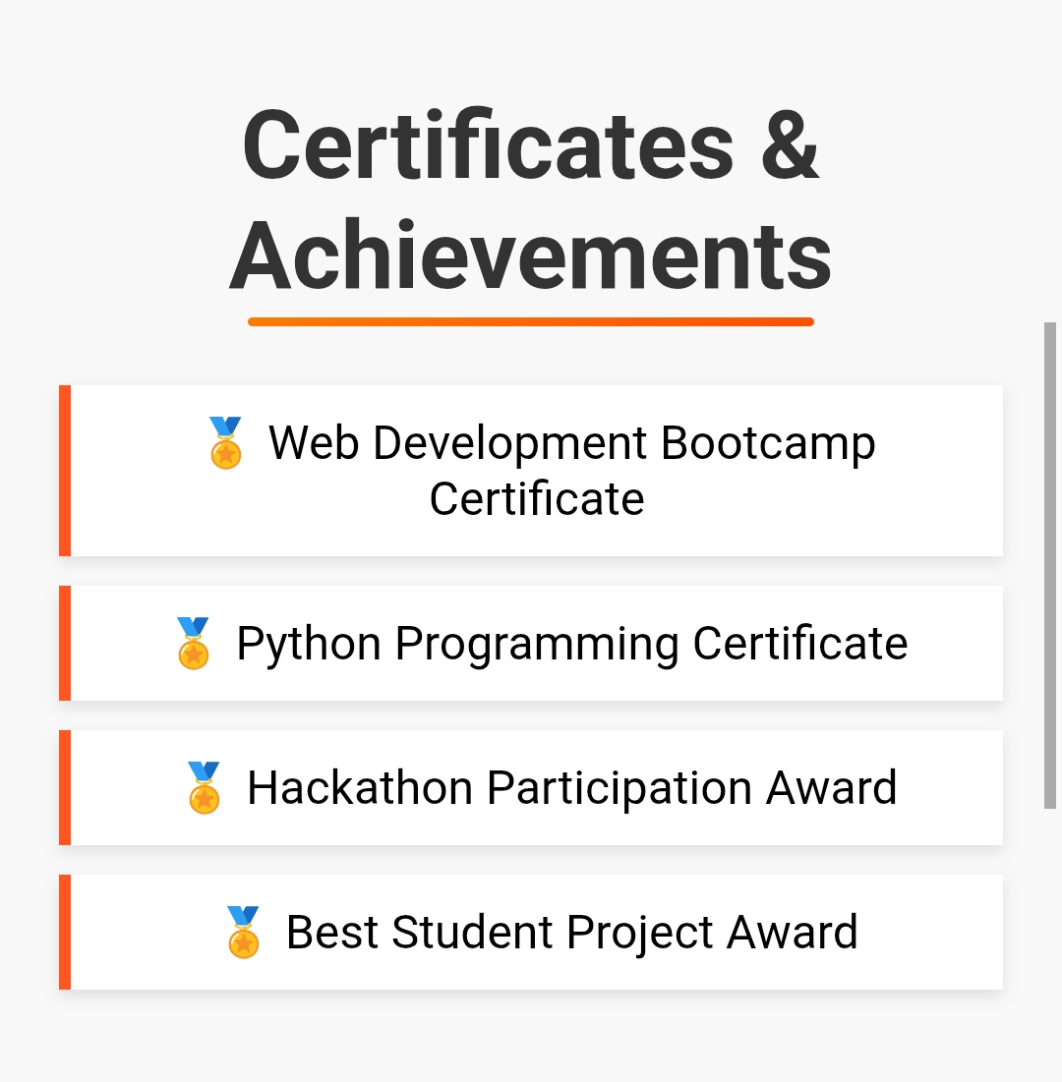

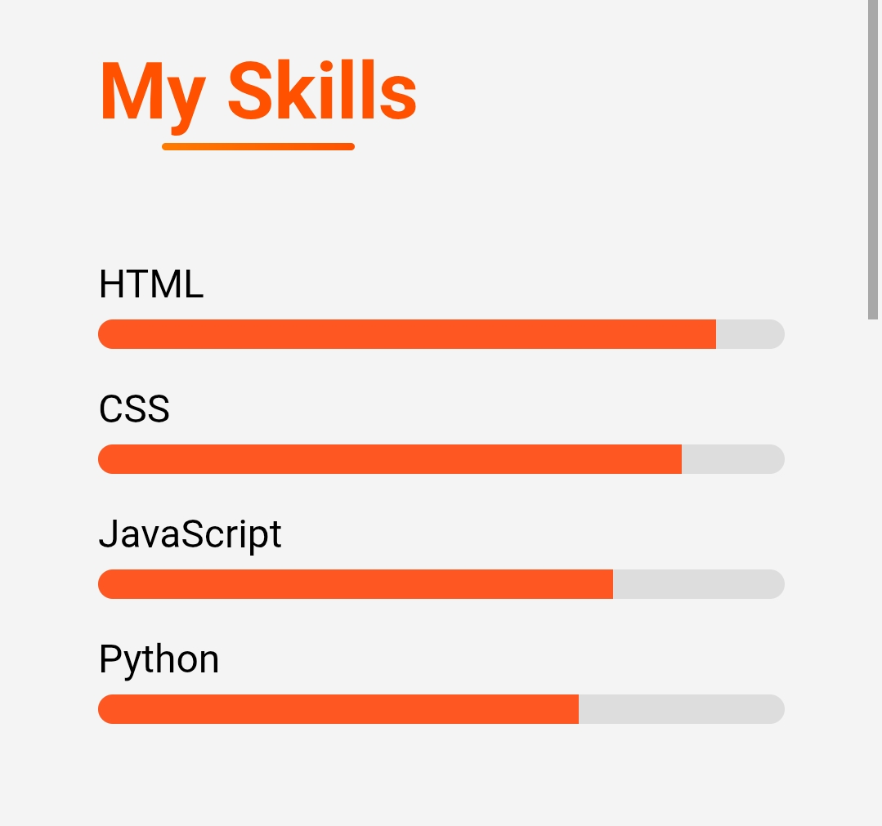
RESULTS AND SCREENSHOTS
3/21/2024 Annual Review
10

Slide 11
CONCLUSION
★The project demonstrates web development skills. ★Provides a digital resume for better professional visibility. ★Increases chances of internships and job opportunities.
11

