Slide 1
H-126 Recitation 4: Executive Function

Slide 2


’s Section
Logistics (10 minutes)
Exam 1 goes out today
Lecture review (25 minutes)
Small group activities (20 minutes)
Questions (5 minutes)

Slide 3
Executive Function (EF)
Definition
Notes:
EF is higher-order, self-regulatory, and cognitive processes that underlie goal-directed thought and behavior.

Slide 4
Executive Function (EF)
Definition
Subdomains of EF
Notes:
3 factors:
Inhibition
interference control: prevent interference; Stroop, flanker, priming; ACC->DLPFC->premotor->basal ganglia
cognitive: suppress irrelevant info to protect attention; ratings of intrusive thoughts, effortful directed ignoring; ACC->Prefrontal->Association cortex
behavioral: suppress a cued but inappropriate response; stop signal task; lateral and orbital prefrontal ->premotor
occulomotor: suppress reflexive saccade; antisaccade task, occulomotor tasks; frontal eye fields, orbitofrontal cortex
Working memory (holding info in the mind while working with it-verbal and non-verbal)
Backward digits tasks, self-ordered pointing; DLPFC
Cognitive flexibility (ability to switch between thinking about 2 diff. concepts/think about both multiple concepts at once).
Task/set-shifting (e.g., trails task); neural correlates not included in lecture

Slide 5
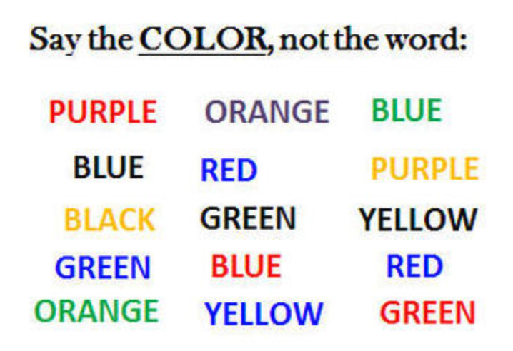
Executive Function (EF)
Definition
Subdomains of EF
How are these tested/ what are their neural correlates?
Example of Stroop task
Notes:
What category is Stroop? (inhibition)

Slide 6
Executive Function (EF)
Definition
Subdomains of EF
How are these tested/ what are their neural correlates?
Example of Stroop task
Hot vs. cool EF
Notes:
Hot EF: Top-down influences that operate in motivationally and emotionally significant situations (marshmallow task)
Cool EF: Top-down influences that operate in more neutral contexts (most lab tasks)

Slide 7
Executive Function (EF)
Definition
Subdomains of EF
How are these tested/ what are their neural correlates?
Example of Stroop task
Hot vs. cool EF
Development of EF
Notes:
Development is a protracted process: emerges in infancy, develops throughout childhood and adolescence and reaches maturity in young adulthood.
EF is thought to be unitary in young children (preschool: Wiebe et al., 2008; 2011)
but 3 factors in middle childhood through adulthood
although some evidence that it’s just two factors: WM and cognitive flexibility from 7-21 years old (e.g., Miyake & Friedman, 2012)

Slide 8
Executive Function (EF)
Definition
Subdomains of EF
How are these tested/ what are their neural correlates?
Example of Stroop task
Hot vs. cool EF
Development of EF
Correlates/contributing factors to EF
Notes:
Correlates/contributing factors: sleep, mental/physical health, SES, language, culture, stress, sadness, loneliness, among others
EF predicts math, school readiness, grades, high school/college completion, and theory of mind, associated with better life outcomes overall

Slide 9
Executive Function (EF)
Definition
Subdomains of EF
How are these tested/ what are their neural correlates?
Example of Stroop task
Hot vs. cool EF
Development of EF
Correlates/contributing factors to EF
EF Training
Notes:
Some evidence that aspects of EF can be trained in certain populations
CogMed, Taekwondo, PATHS – Promoting Alternative Thinking Strategies CSRP Chicago School Readiness Project
Benefits children with the worst EF
EF demands must increase incrementally to be effective
Does transfer, but the broader the training, the broader the transfer
Greater effects with more practice/effect of training best detected on most challenging tasks/conditions

Slide 10
Executive Function (EF)
Definition
Subdomains of EF
How are these tested/ what are their neural correlates?
Example of Stroop task
Hot vs. cool EF
Development of EF
Correlates/contributing factors to EF
EF Training
Educational implications of EF research

Slide 11
EF and ASD
performance on…
Shifting?
Inhibition?
Working Memory?
Planning?
(Delay of Gratification?)
Notes:
EF in ASD
Shifting: consistent difficulties, particularly when rules are unpredictable
Inhibition: sometimes impaired, particularly of distracting info
WM: sometimes impaired, especially visual-spatial
Planning: consistent difficulties, including with executing tasks and monitoring progress
Delay of gratification: impaired
Older preschoolers: ⬇ flexibility, WM & inhibition, compared with typical & DD

Slide 12
EF and ADHD
performance on…
Shifting?
Inhibition?
Working Memory?
Planning?
(Delay of Gratification?)
Notes:
EF in ADHD
Shifting: some have difficulty
Inhibitions: large observed difficulties in response inhibition and interference control
WM: some have difficulty
Planning: some have difficulty
Delay of Gratification: trouble
in general, EF impaired in comparison to controls, but doesn’t fully account for all symptoms (may account for a subset)

Slide 13
ADHD
Prevalence
Notes:
Prevalence: 3-5% of the population of school age children meet criteria for ADHD

Slide 14

ADHD
Prevalence
Two clusters of symptoms
Hyperactivity/impulsivity
Inattention
Notes:
2 clusters of symptoms: Hyperactivity/Impulsivity (e.g., talks excessively, interrupts, runs or climbs inappropriately) and inattention (e.g., trouble listening, forgetful, poor organization skills)

Slide 15
ADHD
Prevalence
Two clusters of symptoms
Hyperactivity/impulsivity
Inattention
Treatments
Notes:
Often treated with stimulant (and some non-stimulant) medications as well as behavioral interventions and school accommodations

Slide 16
ADHD
Prevalence
Two clusters of symptoms
Hyperactivity/impulsivity
Inattention
Treatments
Comorbidity
Notes:
Comorbid with oppositional defiant disorder, conduct disorder, mood disorders, anxiety disorders, learning disorders in children; mood disorders, anxiety disorders, and drug/alcohol dependency in adults

Slide 17
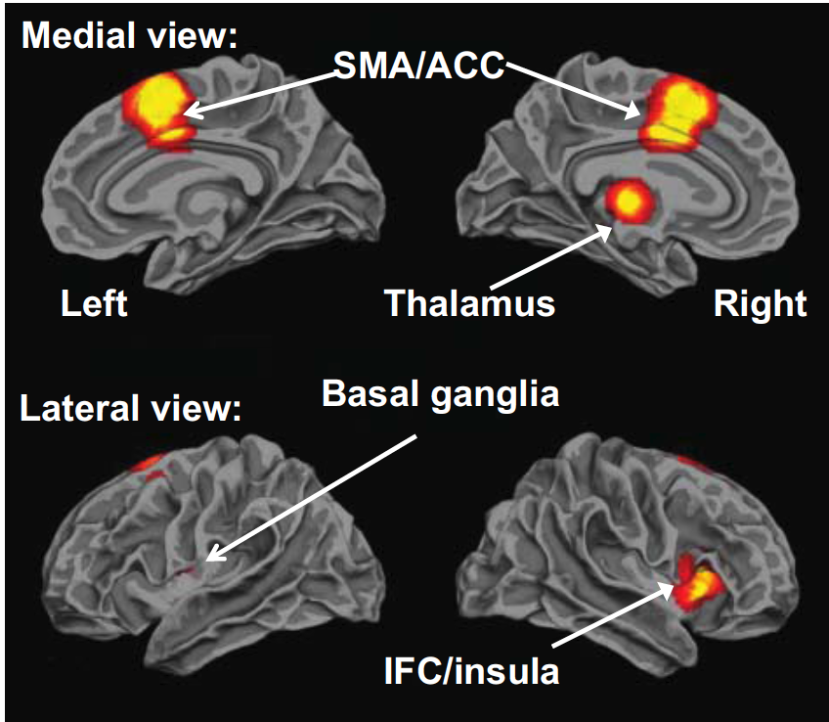
ADHD
Prevalence
Two clusters of symptoms
Hyperactivity/impulsivity
Inattention
Treatments
Comorbidity
Neurobiology
Hart, Radua, Nakao, Mataix-Cols, & Rubia, 2013
Notes:
Neurobiology:
Structural diffs: Children with ADHD have a smaller prefrontal cortex, basal ganglia, and cerebellum
weaker pathways between BG, striatum, and PFC
Functional diffs:
Less activation for inhibition in RIFG, SMA, ACC, striato-thalamic areas;
Less activation for attention in RDLPFC, posterior basal ganglia, and thalamic & parietal regions (Hart at al., 2013)
Less ventral striatum activation in anticipation of reward
Neural pathways are prefrontal-basal ganglia
So: inhibition, motor control, and modulation of reward central
Functional & structural differences in these structures correlate with severity of EF impairments in ADHD (Casey et al., 1997; Schulz et al., 2004; Schulz et al., 2005; Semrud-Clikeman et al., 2000; Vaidya et al., 2005) and ratings of ADHD behavioral severity

Slide 18
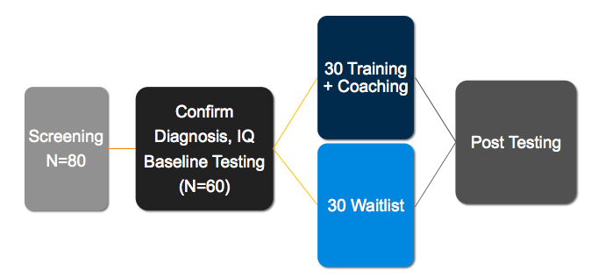
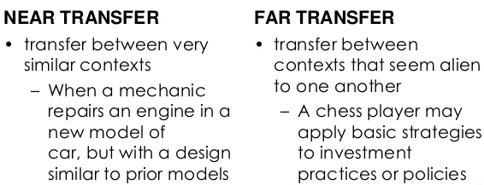
Design an intervention study
A good intervention study involves:
Selecting a population of interest
Randomly sampling from that population
Obtaining baseline measures
Randomly assigning subjects to a treatment or a control condition
Obtaining post-test measures
An intervention study might find no effect (or a negative effect) of the intervention, improvement on the task of interest (but no other tasks), improvement on the task of interest and similar tasks (near transfer), or improvement on those tasks as well as less closely-related tasks (far transfer).
Example from Susan Faja’s GAMES project
Notes:
Before directly applying our findings from neuroimaging studies to the classroom, we should implement rigorous studies “on the ground” in order to determine the efficacy of the intervention.

Slide 19
ADHD Case Studies
Arrange yourselves into small groups (3-4 people in each)
Navigate to this website and read through your assigned case.
Discuss the following questions as a group:
What interventions are being implemented for this student, and why?
What role does SES, heritability, and/or exposure to adversity implicitly play in this case study (if at all)?
Do you know someone similar to this student? Would you implement a similar intervention for them? Why or why not?
What does your response to the last question tell you about the nature of applying a single intervention to all? How does this relate to the problem of applying cog neuro findings directly to the classroom?
Share out to the class!

Slide 20

Questions?

Slide 21
Design an intervention study
In small groups (of 3-4), your task is to design a (behavioral) intervention study aimed at helping students improve their EF skills
You should:
Select a population of interest
Choose aspect(s) of EF that your study plans to improve
Discuss how you would select your sample
Discuss any pre-testing/post-testing measures
Describe the nature of the intervention
Describe how subjects would be assigned to treatment vs. control groups
Explain how you would determine whether or not the study is a success/who the results can be generalized to
Your intervention doesn’t have to be completely original. We just want you to be thinking about how to evaluate an intervention.
You will be asked to present your intervention to the class after 10 minutes.
Notes:
Population: age; whether they are typically developing, have ASD, and/or have ADHD
Examples of EF tasks: Stroop task, Flanker task

