Slide 1
H-126 Recitation 6: Reading Development & Dyslexia

Slide 2


Today’s Section
Final Paper info
Review of the readings/content ~20 mins
Dyslexia case study ~15 mins
Briefly review case study
Practice assessment with partner
Report back about your assessment, why it was used, and what it tells us about the subject
Questions ~5 mins

Slide 3
Final Paper
Select a topic of interest to you!
Topic must be related to the course in some way! i.e., developmental cognitive neuroscience
Due Monday, 11/27 by 5pm
20% of final grade
Opportunity to gain a deeper understanding of a topic of interest to you, through:
Literature review
Grant/study proposal
Policy memo
We strongly encourage you to submit/discuss your topic idea to your TF by Monday, 11/6, to ensure it is appropriate

Slide 4
Developmental Dyslexia
About how many students in the U.S. have dyslexia?
~ 5-17% of children (Dehaene, 2009)
How is dyslexia defined?
“…failure to acquire reading skills despite adequate intelligence, education, and social background” (Ramus, 2003)
What are some common misconceptions about dyslexia?
e.g., social construction, children confuse letters - d vs. b, low IQ
Is dyslexia considered to be a visual deficit?
Originally considered to by visual deficit (“congenital word blindness”), but now considered by many to be due to a phonological deficit (Dehaene, 2009)
What are some theories of dyslexia?
Phonological deficit theory, magnocellular theory, cerebellar theory, double deficit hypothesis (Ramus, 2003)
How is dyslexia thought to arise?
Certain genes → errors in neuronal migration → disorganization of the cortex (Galaburda et al., 2006)
Notes:
phonological theory: difficulties with phonological processing and representation; why might this occur?
magnocellular theory: visual stream that processes low spatial frequency and high temporal frequency; fundamental problem with domain-general fast sensory processing
cerebellar theory: deficit in performing skills automatically and/or fluidly, cerebellar manages motor skills, its dysfunction causes actual problem motor skill of the eye so that the it is hard to process visual info, e.g. u cannot read the word as whole word, need to read it per syllable and it is hard to match syllable with sound
double-deficit theory: deficits in either phonological or rapid naming; children with both have “double deficit”
most are well-supported in literature, but we haven’t figured out the one cause – dyslexia is very heterogeneous

Slide 5
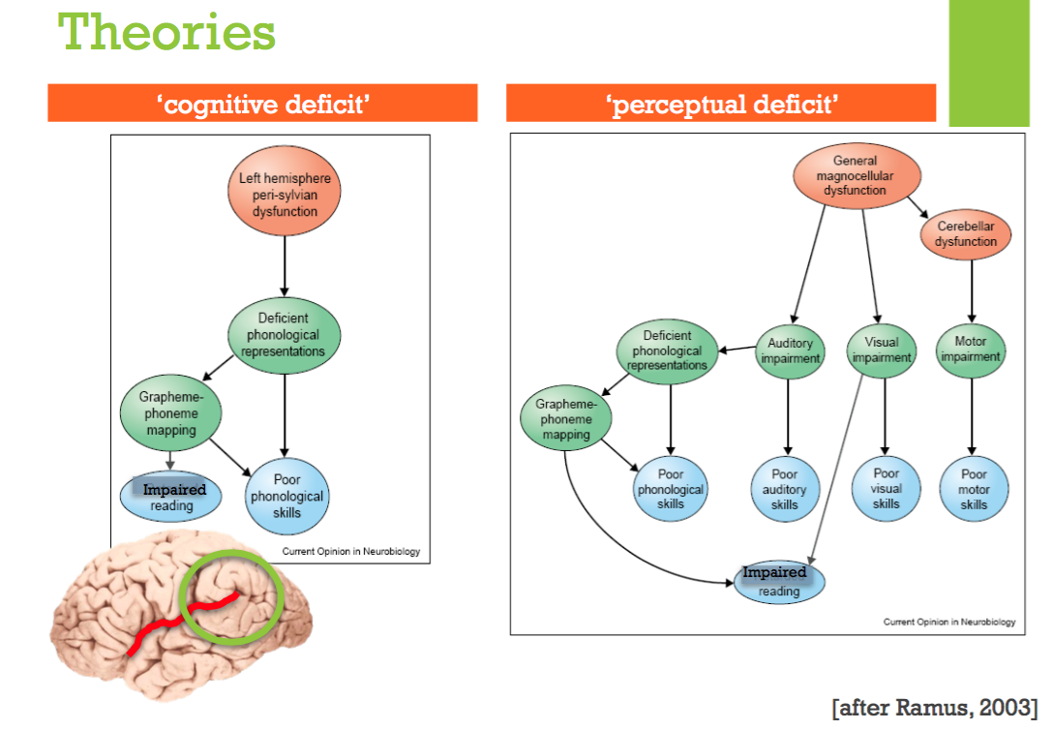
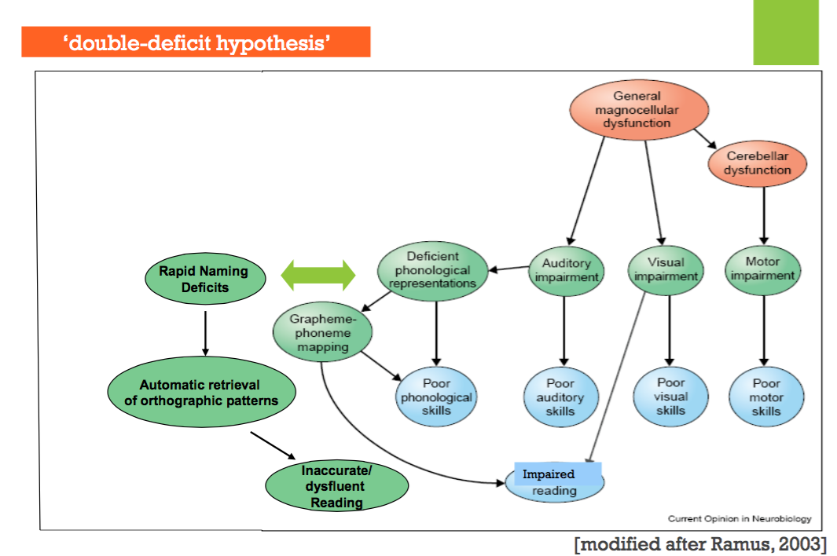
Notes:
cognitive would now be supporting phonological theory

Slide 6
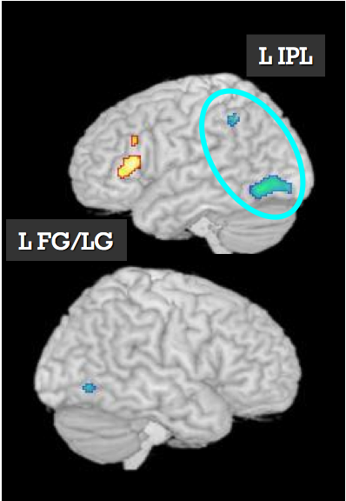
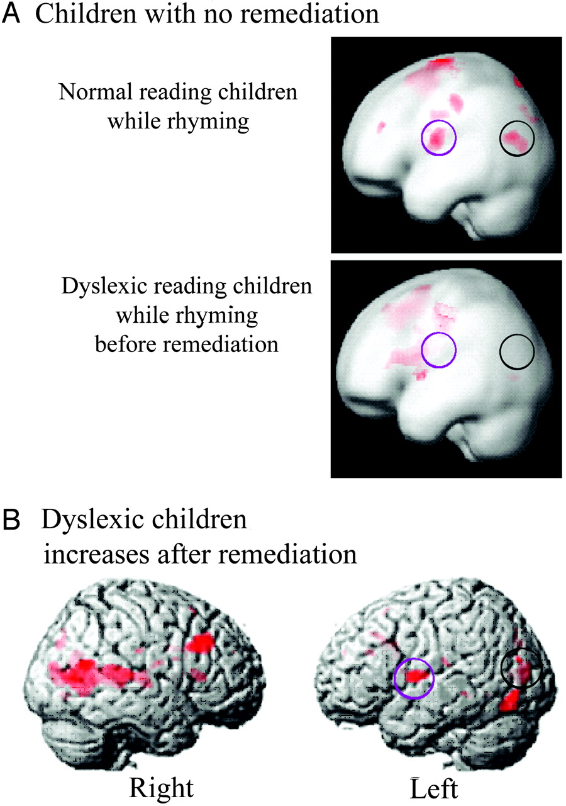
Developmental Dyslexia
Imaging studies in Dyslexia have found…
Hypoactivation in left temporo-parietal regions (involved in speech processing) and VWFA (e.g., Hoeft et al., 2007)
Hyperactivation in IFG (Broca’s) during reading & reading-related tasks
Reduced left-hemispheric white matter connectivity (Yeatman & Wandell, 2011)
Increases in activation after remediation (Temple et al., 2003)
(Hoeft et al., 2007)
(Temple et al., 2003)
Notes:
Hoeft: neurobio underlying dyslexia is unique to children with dyslexia (not reading-age-matched controls, so not just lagging behind)
- distinct, characteristic altered function in children with dyslexia (less activity in L temporo-parietal regions)
Temple: FastForWord intervention
no active control group (they should have done a reading group with other intervention, like doing more reading at night. Other wise you can only say that the effects are due to more reading, but not necessarily FastForWord)
more activity in IFG (compensatory? overuse of the wrong region?)

Slide 7
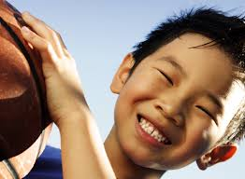
Case Study: Dennis
Dennis is a bright, boisterous 7th grader with dyslexia who has been taking part in a study at the Gaab lab
Your job is to…
Find a partner / small group to work with
Quickly read through the case study while I pass out one assessment to each pair
Look over your assigned assessment with your partner
Discuss what the construct is, why you think the Gaab lab measured it, how Dennis’s scores changed over time, and how he ranks compared to other children his age
You will briefly report your findings back to the larger group after 7 minutes
Notes:
Profile on the first page – summary of info you might find about a child as a researcher, on the back – standardized assessments of language and literacy
I have examples of the assessments that are highlighted.
Each small group looks at one assessment, and then we’ll come together to discuss what we learned.
Look at how Dennis’s score changes over time (using the bell curve on the next slide)
CTOPP:
phonological processing
starts with compound words; if they’re doing well it becomes harder (phoneme)
RAN/RAS:
rapid automatized naming (automatic rapid recall of familiar objects)
first need to be sure child knows all objects (i.e. knows all letters)
tester keeps track of errors and whether they self-corrected or kept going
colors included to see whether naming deficit it unique to symbols vs. general
TOWRE:
word reading efficiency and automaticity
read as fast as they can
sight words = familiar words (direct route), shouldn’t need to decode
phonemic decoding = pseudoword; efficiency of phonological decoding
scoring sheet included
WRMT:
Letter ID, Word ID, word attack
reading comprehension GORT-5
Reading Fluency, Reading comprehension
Overall profile: Looks like RAN is his weakness that is holding him back in his reading (timing issue), but he is also showing issues with phonemic decoding
doesn’t appear to have a phonological processing deficit, but does seem to have a timing deficit
looks like his early reading intervention was effective for phonological processing

Slide 8
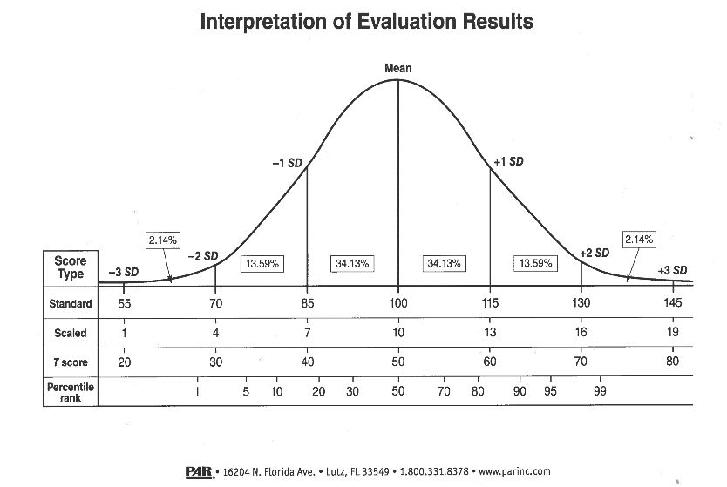
Standardization & Evaluation
Notes:
Within 1 SD is “average,” but at or below is concerning

Slide 10

Questions?

Slide 11
References
Galaburda, A. M., LoTurco, J., Ramus, F., Fitch, R.H., & Rosen, G. D. (2006). From genes to behavior in developmental dyslexia. Nature Neuroscience, (9)10, 1213-1217.
Ramus, F. (2003). Developmental dyslexia: specific phonological deficit or general sensorimotor dysfunction? Current Opinion in Neurobiology, 13(2), 212-218.

