Slide 1
Day 01 - The Internet

Slide 2
Chapter 1
Introduction
A note on the use of these ppt slides:
We’re making these slides freely available to all (faculty, students, readers). They’re in PowerPoint form so you can add, modify, and delete slides (including this one) and slide content to suit your needs. They obviously represent a lot of work on our part. In return for use, we only ask the following:
If you use these slides (e.g., in a class) in substantially unaltered form, that you mention their source (after all, we’d like people to use our book!)
If you post any slides in substantially unaltered form on a www site, that you note that they are adapted from (or perhaps identical to) our slides, and note our copyright of this material.
Thanks and enjoy! JFK/KWR
All material copyright 1996-2010
J.F Kurose and K.W. Ross, All Rights Reserved
Computer Networking: A Top Down Approach Featuring the Internet,
5rd edition.
Jim Kurose, Keith Ross
Addison-Wesley, July 2010.

Slide 3
Outline
  1.1 What is the Internet?
  1.2 Network edge
  1.3 Network core

Slide 4





What’s the Internet: “nuts and bolts” view
billions of connected computing devices: hosts, end-systems
  PCs, workstations, servers
  PDAs, phones, toasters
  running network apps
communication links
  fiber, copper, radio, satellite
  transmission rate = bandwidth
routers: forward packets (chunks of data)
router
workstation
server
mobile
local ISP
regional ISP
company
network

Slide 5

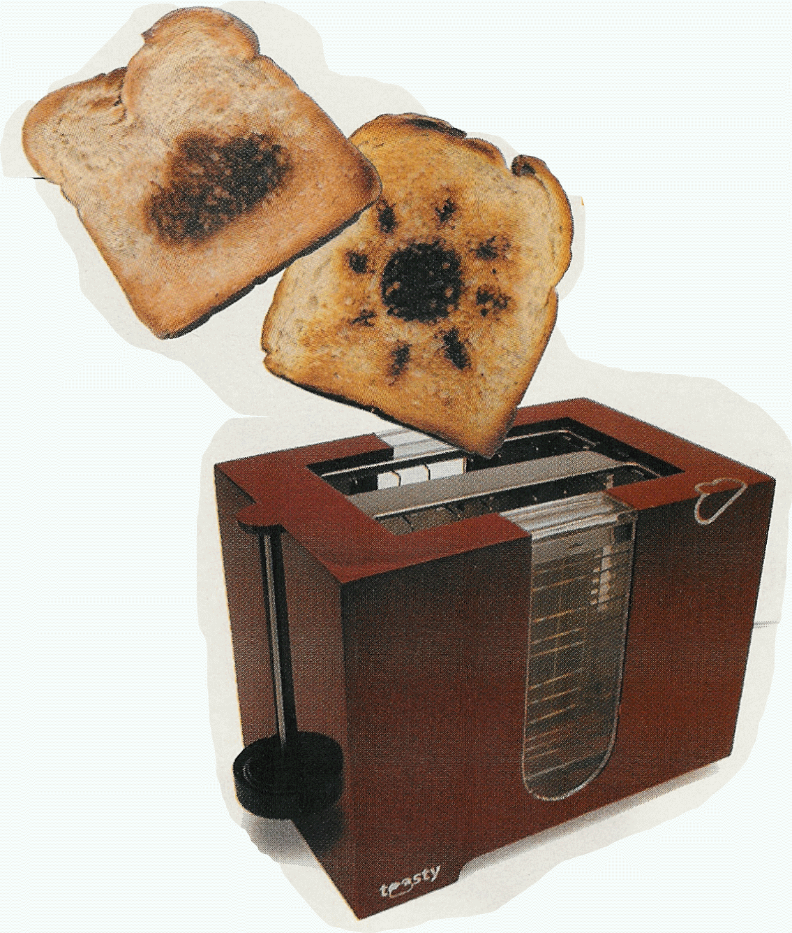
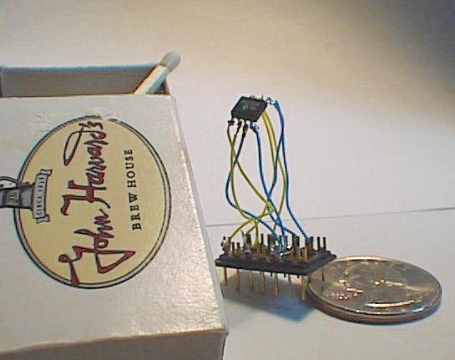
“Cool” internet appliances
IP picture frame
http://www.ceiva.com/
Web-enabled toaster+weather forecaster
http://www.theregister.co.uk/2001/03/30/java_toaster_prints_weather_forecast/
http://www.theregister.co.uk/2001/06/04/bread_as_a_display_device/
World’s smallest web server
http://www-ccs.cs.umass.edu/~shri/iPic.html

Slide 6
What’s the Internet: “nuts and bolts” view
Internet: “network of networks”
  loosely hierarchical
  public Internet versus private intranet
protocols control sending, receiving of msgs
  e.g., TCP, IP, HTTP, FTP, PPP
Internet standards
  RFC: Request For Comments
  IETF: Internet Engineering Task Force
router
workstation
server
mobile
local ISP
regional ISP
company
network

Slide 7
What’s the Internet: a service view
communication infrastructure enables distributed applications:
  Web, email, games, e-commerce, database, voting, file (MP3) sharing
communication services provided to apps:
  connectionless
  connection-oriented
Notes:
Connectionless – no prior handshake
Connection-oriented – make an end-to-end connection.

Slide 8


What’s a protocol?
a human protocol and a computer network protocol:
Hi
TCP connection
req
Hi
TCP connection
response
Got the
time?
Get http://www.awl.com/kurose-ross
2:00
<file>
time

Slide 9
What’s a protocol?
network protocols:
all communication activity in Internet governed by protocols
protocols define:
  format
  order of msgs sent, received
  actions taken on msg transmission, receipt

Slide 10
A closer look at network structure:
network edge: applications and hosts
network core:
  routers
  network of networks

Slide 11
Outline
  1.1 What is the Internet?
  1.2 Network edge
  1.3 Network core

Slide 12
The network edge:
end systems (hosts):
  run application programs
  e.g. Web, email
  at “edge of network”
client/server model
  e.g. Web browser/server; email client/server
  Distributed applications
peer-peer model:
  minimal (or no) use of dedicated servers
  e.g. Skype, KaZaA
Notes:
ATA – analog telephone adaptor

Slide 13
Network edge: connection-oriented service
Goal: data transfer between end systems
handshaking: setup a connection for data transfer ahead of time
TCP - Transmission Control Protocol
  Internet’s connection-oriented service
TCP service [RFC 793]
reliable, in-order byte-stream data transfer
  loss: acknowledgements and retransmissions
flow control:
  sender won’t overwhelm receiver
congestion control:
  senders “slow down sending rate” when network congested
Notes:
ATM and Frame Relay are connection-oriented but unreliable networks.
Connection-oriented is modeled on the telephone network.

Slide 14
Network edge: connectionless service
Goal: data transfer between end systems
UDP - User Datagram Protocol [RFC 768]:
  No handshaking – less work!
  Less delay
  Internet’s connectionless service
    unreliable data transfer
    no flow control
    no congestion control
Notes:
Connection-less service is modeled on the post office service.
ICMP – error messages
IP

Slide 15
TCP vs. UDP
App’s using TCP:
HTTP (Web), FTP (file transfer), Telnet (remote login), SMTP (email)
App’s using UDP:
streaming media, teleconferencing, DNS, Internet telephony, network games

