Slide 1
10-Congestion control
Transport Layer
3-<number>

Slide 2
Approaches towards congestion control
Two broad approaches towards congestion control:
End-to-end congestion control:
no explicit feedback from network
congestion inferred from end-system observed loss, delay
approach taken by TCP
Network-assisted congestion control:
routers provide feedback to end systems
  bits indicating congestion
  explicit rate sender should send at
Transport Layer
3-<number>

Slide 3
Case study: ATM ABR congestion control
ABR: available bit rate:
“elastic service”
if sender’s path “underloaded”:
  sender should use available bandwidth
if sender’s path congested:
  sender throttled to minimum guaranteed rate
RM (resource management) cells:
sent by sender, interspersed with data cells
bits in RM cell set by switches (“network-assisted”)
RM cells returned to sender by receiver, with bits intact
Transport Layer
3-<number>
Notes:
ATM is a high-speed networking standard designed to support both voice and data communications. ATM is normally utilized by Internet service providers on their private long-distance networks. ATM operates at the data link layer (Layer 2 in the OSI model) over either fiber or twisted-pair cable.
Since there is a virtual ckt, it is possible to priortize the cells and allow some cells to go ahead of others and thus ensure some level of QoS.

Slide 4

Case study: ATM ABR congestion control
EFCI (explicit forward congestion indication) bit in data cells: set to 1 in congested switch
  if data cell preceding RM cell has EFCI set, sender sets CI bit in returned RM cell
CI(congestion indication) and NI(no increase) bits in RM cells
  Switch sets NI to 1 (mild congestions) CI bit to 1(severe congestion)
two-byte ER (explicit rate) field in RM cell
  congested switch may lower ER value in cell
  sender’s send rate thus minimum supportable rate on path
3-<number>

Slide 5
TCP Congestion Control
end-end control (no network assistance)
How does sender limit the rate?
CongWin (congestion window) is dynamic, function of perceived network congestion
LastByteSent-LastByteAcked
≤ CongWin
How does sender perceive congestion?
loss event = timeout or 3 duplicate acks
Three mechanisms to adapt CongWin:
  AIMD
  slow start
  conservative after timeout events
Transport Layer
3-<number>

Slide 6

TCP AIMD
multiplicative decrease: cut CongWin in half after loss event
additive increase: increase CongWin by 1 MSS every RTT in the absence of loss events
Long-lived TCP connection
Transport Layer
3-<number>

Slide 7
TCP Slow Start
When connection begins, CongWin = 1 MSS
available bandwidth may be >> MSS/RTT
  desirable to quickly ramp up to respectable rate
When connection begins, increase rate exponentially fast until first loss event
  For every successful ACK, send two packets.
Transport Layer
3-<number>

Slide 8

TCP Slow Start (more)
When connection begins, increase rate exponentially until first loss event:
  double CongWin every RTT
  done by incrementing CongWin for every ACK received
Summary: initial rate is slow but ramps up exponentially fast
Host A
Host B
one segment
RTT
two segments
four segments
time
Transport Layer
3-<number>

Slide 9
Refinement
Philosophy:
3 dup ACKs indicates
network capable of
delivering some segments
timeout before 3 dup
ACKs is “more alarming”
After 3 dup ACKs: (AIMD)
  CongWin is cut in half
  window then grows linearly
But after timeout event:
  CongWin instead set to 1 MSS;
  window then grows exponentially to a threshold, then grows linearly
Transport Layer
3-<number>

Slide 10
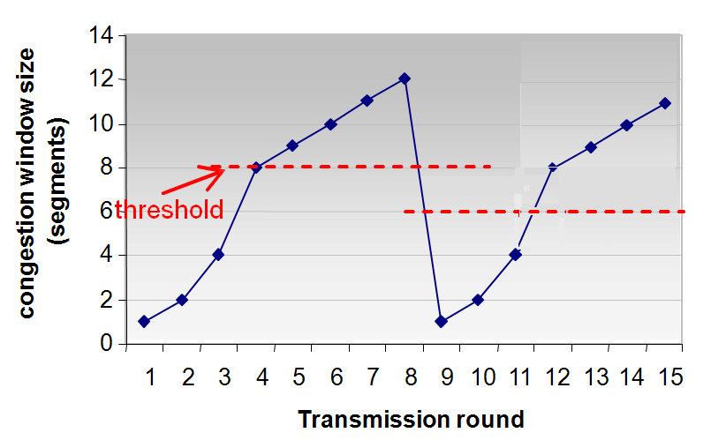
Refinement (more)
Q: When should the exponential increase switch to linear?
A: When CongWin gets to 1/2 of its value before timeout.
14
12
10
8
congestion window size
(segments)
6
threshold
4
2
0
1
2
3
4
5
6
7
8
9
10
11
12
13
14
15
Implementation:
Variable Threshold
At loss event, Threshold is set to 1/2 of CongWin just before loss event
Transmission round
Transport Layer
3-<number>

Slide 11
Summary: TCP Congestion Control
When CongWin is below Threshold, sender in slow-start phase, window grows exponentially.
When CongWin is above Threshold, sender is in congestion-avoidance phase, window grows linearly.
When a triple duplicate ACK occurs, Threshold set to CongWin/2 and CongWin set to Threshold.
When timeout occurs, Threshold set to CongWin/2 and CongWin is set to 1 MSS.
Transport Layer
3-<number>

