Slide 1

Link Layer: Introduction
Terminology:
hosts and routers are nodes
communication channels that connect adjacent nodes along communication path are links
wired links
wireless links
LANs
layer-2 packet is a frame, encapsulates datagram
data-link layer has responsibility of
transferring datagram from one node
to physically adjacent node over a link
Notes:
EMPHASIZE

Slide 2
Link layer: context
datagram transferred by different link protocols over different links:
e.g., Ethernet on first link, frame relay on intermediate links, 802.11 on last link
each link protocol provides different services
e.g., may or may not provide reliable data transport over link
transportation analogy
trip from Rose to Crete
limo: Rose to IND
plane: IND to Athens
boat: Athens to Crete
tourist = datagram
transport segment = communication link
transportation mode = link layer protocol
travel agent = routing algorithm

Slide 3
Link Layer Services
framing, link access:
encapsulate datagram into frame, adding header, trailer
channel access if shared medium
“MAC” addresses used in frame headers to identify source, dest
different from IP address!
reliable delivery between adjacent nodes
we learned how to do this already (chapter 3)!
seldom used on low bit-error link (fiber, some twisted pair)
wireless links: high error rates
Q: why both link-level and end-end reliability?
Notes:
EMPHASIZE

Slide 4
Link Layer Services (more)
flow control:
pacing between adjacent sending and receiving nodes
error detection:
errors caused by signal attenuation, noise.
receiver detects presence of errors:
signals sender for retransmission or drops frame
error correction:
receiver identifies and corrects bit error(s) without resorting to retransmission
half-duplex and full-duplex
with half duplex, nodes at both ends of link can transmit, but not at same time
Notes:
EMPHASIZE

Slide 5
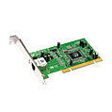
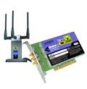
Where is the link layer implemented?
in each and every host
link layer implemented in “adaptor” (aka network interface card NIC)
Ethernet card, PCMCI card, 802.11 card
implements link, physical layer
attaches into host’s system buses
combination of hardware, software, firmware
host schematic
application
transport
network
link
cpu
memory
link
physical
host
bus
(e.g., PCI)
controller
physical
transmission
network adapter
card
Notes:
EMPHASIZE

Slide 6
Adaptors Communicating
datagram
datagram
controller
controller
sending host
receiving host
datagram
frame
sending side:
encapsulates datagram in frame
adds error checking bits, rdt, flow control, etc.
receiving side
looks for errors, rdt, flow control, etc
extracts datagram, passes to upper layer at receiving side
Notes:
Controller: single special purpose chip.
Some may provide reliable data transfer.

Slide 7
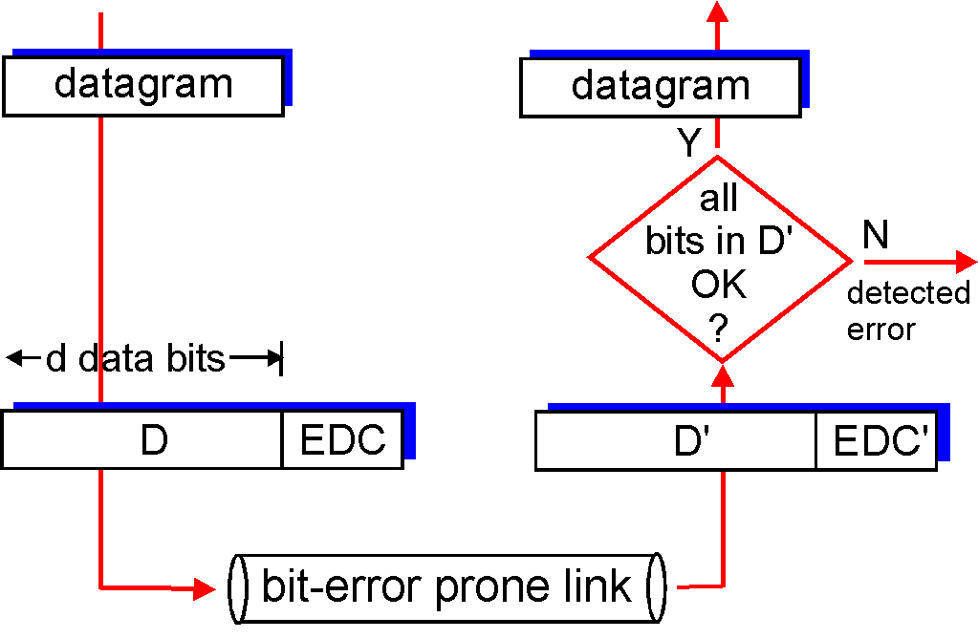
Error Detection
EDC= Error Detection and Correction bits (redundancy)
D = Data protected by error checking, may include header fields
Error detection not 100% reliable!
protocol may miss some errors, but rarely
larger EDC field yields better detection and correction
otherwise

Slide 8
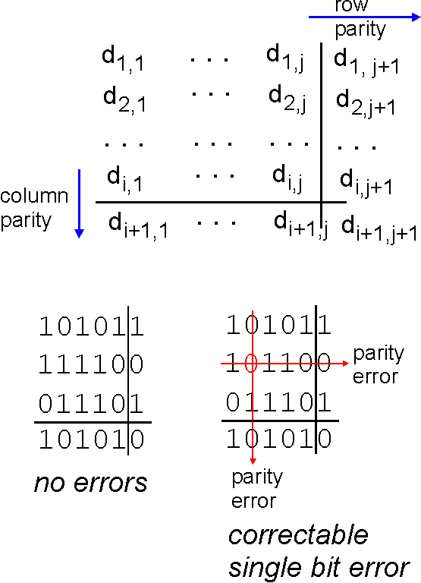
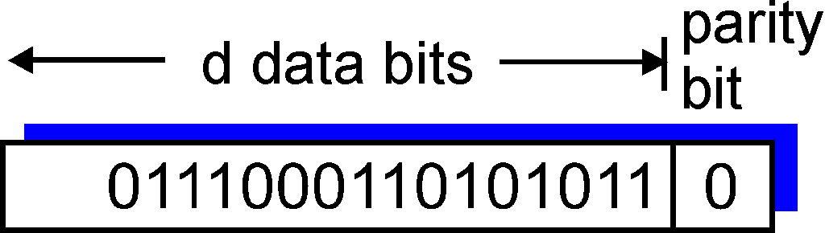
Parity Checking
Single Bit Parity:
Detect single bit errors
Two Dimensional Bit Parity:
Detect and correct single bit errors
0
0
Notes:
EMPHASIZE
There is even parity and odd parity, single bit parity and two dimensional bit parity.
The idea is to add extra bit(s) to the data bits so that there are an even/odd number of 1’s in the data sent. The receiver looks at the bits and can determine whether any bit was changed during transmission and correct it.
FEC – forward error correction – the ability of the receiver to detect and correct errors
May not always work. Why?
In the two examples, which is an odd parity and which one is even?

Slide 9
Internet checksum (review)
Goal: detect “errors” (e.g., flipped bits) in transmitted packet (note: used at transport layer only)
Sender:
treat segment contents as sequence of 16-bit integers
checksum: addition (1’s complement sum) of segment contents
sender puts checksum value into UDP checksum field
Receiver:
compute checksum of received segment
check if computed checksum equals checksum field value:
NO - error detected
YES - no error detected. But maybe errors nonetheless?

Slide 10
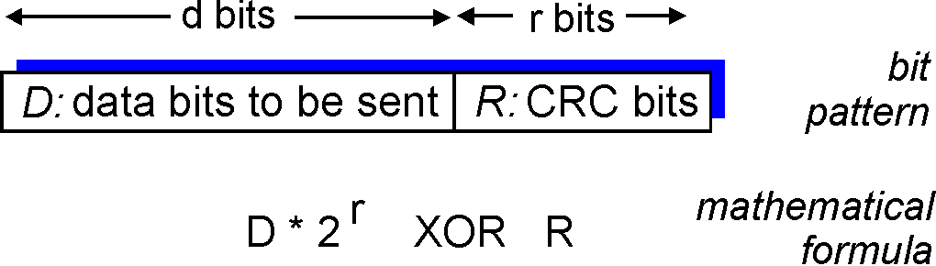
Checksumming: Cyclic Redundancy Check
view data bits, D, as a binary number
choose r+1 bit pattern (generator), G
goal: choose r CRC bits, R, such that
<D,R> exactly divisible by G (modulo 2)
receiver knows G, divides <D,R> by G. If non-zero remainder: error detected!
can detect all burst errors less than r+1 bits
widely used in practice (Ethernet, 802.11 WiFi, ATM)
Notes:
Consider data bits, D as a binary number => 101110
Choose r+1 bit pattern (generator) and agree on that number => 1001
There are standard generators for CRC-8, CRC-12, CRC-16 and CRC-32
Problem in WEP protocol used in wireless – user can regenerate the CRC
The mathematical formula expression == nG

Slide 11

Multiple Access Links and Protocols
Two types of “links”:
point-to-point
PPP for dial-up access
point-to-point link between Ethernet switch and host
broadcast (shared wire or medium)
old-fashioned Ethernet
upstream HFC
802.11 wireless LAN
humans at a
cocktail party
(shared air, acoustical)
shared wire (e.g.,
cabled Ethernet)
shared RF
(e.g., 802.11 WiFi)
shared RF
(satellite)
Notes:
If A sends packets using broadcast, then B and C will receive the packets and pass them up the stack. If A sends the packet specifically addressed to B, C may receive it but it won’t pass it up the network stack.

Slide 12
Multiple Access protocols
single shared broadcast channel
two or more simultaneous transmissions by nodes: interference
collision if node receives two or more signals at the same time
multiple access protocol
distributed algorithm that determines how nodes share channel, i.e., determine when node can transmit
communication about channel sharing must use channel itself!
no out-of-band channel for coordination
Notes:
EMPHASIZE

Slide 13
Ideal Multiple Access Protocol
Broadcast channel of rate R bps
1. when one node wants to transmit, it can send at rate R.
2. when M nodes want to transmit, each can send at average rate R/M
3. fully decentralized:
no special node to coordinate transmissions
no synchronization of clocks, slots
4. simple

Slide 14
MAC Protocols: a taxonomy
Three broad classes:
Channel Partitioning
divide channel into smaller “pieces” (time slots, frequency, code)
allocate piece to node for exclusive use
Random Access
channel not divided, allow collisions
“recover” from collisions
“Taking turns”
nodes take turns, but nodes with more to send can take longer turns

Slide 15
Channel Partitioning MAC protocols: TDMA
TDMA: time division multiple access
access to channel in "rounds"
each station gets fixed length slot (length = pkt trans time) in each round
unused slots go idle
example: 6-station LAN, 1,3,4 have pkt, slots 2,5,6 idle
6-slot
frame
1
3
4
1
3
4

Slide 16
Channel Partitioning MAC protocols: FDMA
FDMA: frequency division multiple access
channel spectrum divided into frequency bands
each station assigned fixed frequency band
unused transmission time in frequency bands go idle
example: 6-station LAN, 1,3,4 have pkt, frequency bands 2,5,6 idle
time
frequency bands
FDM cable

Slide 17
Random Access Protocols
When node has packet to send
transmit at full channel data rate R.
no a priori coordination among nodes
two or more transmitting nodes ➜ “collision”,
random access MAC protocol specifies:
how to detect collisions
how to recover from collisions (e.g., via delayed retransmissions)
Examples of random access MAC protocols:
slotted ALOHA
ALOHA
CSMA, CSMA/CD, CSMA/CA

Slide 18
CSMA (Carrier Sense Multiple Access)
CSMA: listen before transmit:
If channel sensed idle: transmit entire frame
If channel sensed busy, defer transmission
human analogy: don’t interrupt others!
Notes:
EMPHASIZE

Slide 19
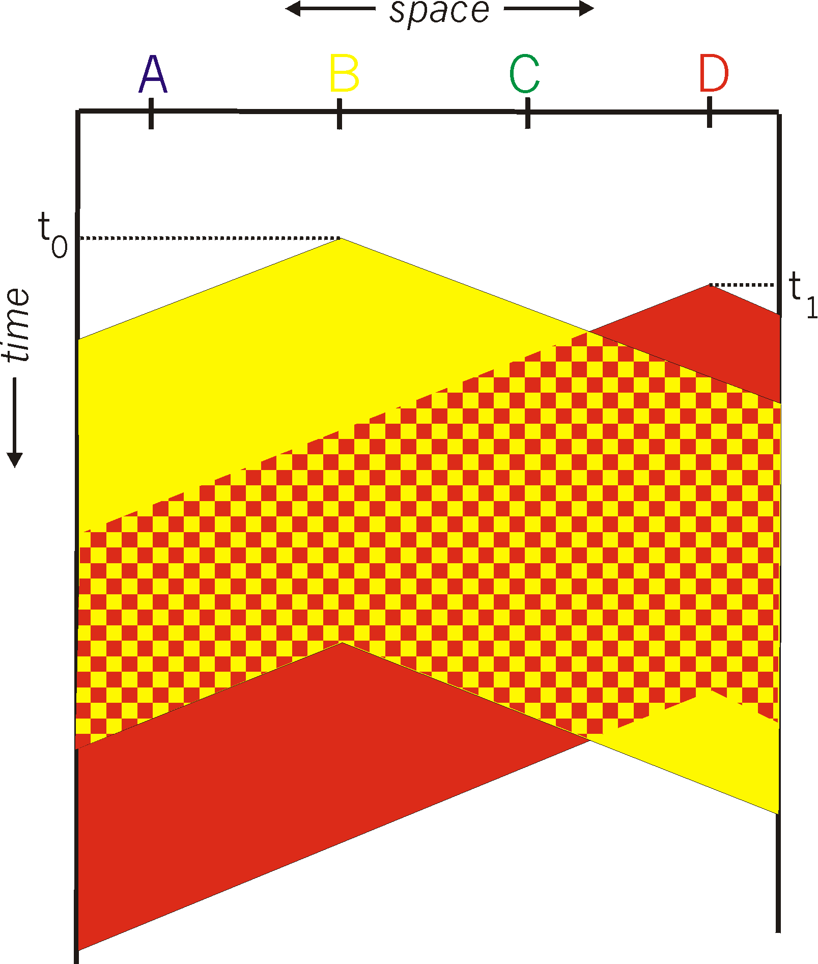
CSMA collisions
spatial layout of nodes
collisions can still occur:
propagation delay means
two nodes may not hear
each other’s transmission
collision:
entire packet transmission
time wasted
note:
role of distance & propagation delay in determining collision probability

Slide 20
CSMA/CD (Collision Detection)
CSMA/CD: carrier sensing, deferral as in CSMA
collisions detected within short time
colliding transmissions aborted, reducing channel wastage
collision detection:
easy in wired LANs: measure signal strengths, compare transmitted, received signals
difficult in wireless LANs: received signal strength overwhelmed by local transmission strength
human analogy: the polite conversationalist

Slide 21
“Taking Turns” MAC protocols
channel partitioning MAC protocols:
share channel efficiently and fairly at high load
inefficient at low load: delay in channel access, 1/N bandwidth allocated even if only 1 active node!
random access MAC protocols
efficient at low load: single node can fully utilize channel
high load: collision overhead
“taking turns” protocols
look for best of both worlds!

Slide 22
“Taking Turns” MAC protocols
Polling:
master node “invites” slave nodes to transmit in turn
typically used with “dumb” slave devices
concerns:
polling overhead
latency
single point of failure (master)
data
poll
master
data
slaves

Slide 23
“Taking Turns” MAC protocols
Token passing:
control token passed from one node to next sequentially.
token message
concerns:
token overhead
latency
single point of failure (token)
T
(nothing
to send)
T
data
Notes:
EMPHASIZE

Slide 24
MAC Addresses and ARP
32-bit IP address:
network-layer address
used to get datagram to destination IP subnet
MAC (or LAN or physical or Ethernet) address:
function: get frame from one interface to another physically-connected interface (same network)
48 bit MAC address (for most LANs)
burned in NIC ROM, also sometimes software settable
Notes:
EMPHASIZE

Slide 25
LAN Addresses and ARP
Each adapter on LAN has unique LAN address
1A-2F-BB-76-09-AD
Broadcast address =
FF-FF-FF-FF-FF-FF
LAN
(wired or
wireless)
= adapter
71-65-F7-2B-08-53
58-23-D7-FA-20-B0
0C-C4-11-6F-E3-98

Slide 26
LAN Address (more)
MAC address allocation administered by IEEE
manufacturer buys portion of MAC address space (to assure uniqueness)
analogy:
(a) MAC address: like Social Security Number
(b) IP address: like postal address
MAC flat address ➜ portability
can move LAN card from one LAN to another
IP hierarchical address NOT portable
address depends on IP subnet to which node is attached

Slide 27
ARP: Address Resolution Protocol
Question: how to determine
MAC address of B
knowing B’s IP address?
Each IP node (host, router) on LAN has ARP table
ARP table: IP/MAC address mappings for some LAN nodes
< IP address; MAC address; TTL>
TTL (Time To Live): time after which address mapping will be forgotten (typically 20 min)
137.196.7.78
1A-2F-BB-76-09-AD
137.196.7.23
137.196.7.14
LAN
71-65-F7-2B-08-53
58-23-D7-FA-20-B0
0C-C4-11-6F-E3-98
137.196.7.88

Slide 28
ARP protocol: Same LAN (network)
A wants to send datagram to B, and B’s MAC address not in A’s ARP table.
A broadcasts ARP query packet, containing B's IP address
dest MAC address = FF-FF-FF-FF-FF-FF
all machines on LAN receive ARP query
B receives ARP packet, replies to A with its (B's) MAC address
frame sent to A’s MAC address (unicast)
A caches (saves) IP-to-MAC address pair in its ARP table until information becomes old (times out)
soft state: information that times out (goes away) unless refreshed
ARP is “plug-and-play”:
nodes create their ARP tables without intervention from net administrator

Slide 29
Addressing: routing to another LAN
walkthrough: send datagram from A to B via R.
focus on addressing - at both IP (datagram) and MAC layer (frame)
assume A knows B’s IP address
assume A knows B’s MAC address (how?)
assume A knows IP address of first hop router, R (how?)
assume A knows MAC address of first hop router interface (how?)
A
B
R
111.111.111.111
222.222.222.222
74-29-9C-E8-FF-55
49-BD-D2-C7-56-2A
222.222.222.220
1A-23-F9-CD-06-9B
111.111.111.112
111.111.111.110
222.222.222.221
CC-49-DE-D0-AB-7D
E6-E9-00-17-BB-4B
88-B2-2F-54-1A-0F

Slide 30
Addressing: routing to another LAN
A creates IP datagram with IP source A, destination B
A creates link-layer frame with R's MAC address as dest, frame contains A-to-B IP datagram
MAC src: 74-29-9C-E8-FF-55
MAC dest: E6-E9-00-17-BB-4B
IP
Eth
Phy
IP src: 111.111.111.111
IP dest: 222.222.222.222
A
B
R
111.111.111.111
222.222.222.222
74-29-9C-E8-FF-55
49-BD-D2-C7-56-2A
222.222.222.220
1A-23-F9-CD-06-9B
111.111.111.112
111.111.111.110
222.222.222.221
CC-49-DE-D0-AB-7D
E6-E9-00-17-BB-4B
88-B2-2F-54-1A-0F

Slide 31
Addressing: routing to another LAN
frame sent from A to R
frame received at R, datagram removed, passed up to IP
MAC src: 74-29-9C-E8-FF-55
MAC dest: E6-E9-00-17-BB-4B
IP
Eth
Phy
IP src: 111.111.111.111
IP dest: 222.222.222.222
IP
Eth
Phy
A
B
R
111.111.111.111
222.222.222.222
74-29-9C-E8-FF-55
49-BD-D2-C7-56-2A
222.222.222.220
1A-23-F9-CD-06-9B
111.111.111.112
111.111.111.110
222.222.222.221
CC-49-DE-D0-AB-7D
E6-E9-00-17-BB-4B
88-B2-2F-54-1A-0F

Slide 32
Addressing: routing to another LAN
R forwards datagram with IP source A, destination B
R creates link-layer frame with B's MAC address as dest, frame contains A-to-B IP datagram
MAC src: 1A-23-F9-CD-06-9B
MAC dest: 49-BD-D2-C7-56-2A
IP
Eth
Phy
IP
Eth
Phy
IP src: 111.111.111.111
IP dest: 222.222.222.222
A
B
R
111.111.111.111
222.222.222.222
74-29-9C-E8-FF-55
49-BD-D2-C7-56-2A
222.222.222.220
1A-23-F9-CD-06-9B
111.111.111.112
111.111.111.110
222.222.222.221
CC-49-DE-D0-AB-7D
E6-E9-00-17-BB-4B
88-B2-2F-54-1A-0F

Slide 33
Addressing: routing to another LAN
R forwards datagram with IP source A, destination B
R creates link-layer frame with B's MAC address as dest, frame contains A-to-B IP datagram
MAC src: 1A-23-F9-CD-06-9B
MAC dest: 49-BD-D2-C7-56-2A
IP
Eth
Phy
IP
Eth
Phy
IP src: 111.111.111.111
IP dest: 222.222.222.222
A
B
R
111.111.111.111
222.222.222.222
74-29-9C-E8-FF-55
49-BD-D2-C7-56-2A
222.222.222.220
1A-23-F9-CD-06-9B
111.111.111.112
111.111.111.110
222.222.222.221
CC-49-DE-D0-AB-7D
E6-E9-00-17-BB-4B
88-B2-2F-54-1A-0F

Slide 34
Addressing: routing to another LAN
R forwards datagram with IP source A, destination B
R creates link-layer frame with B's MAC address as dest, frame contains A-to-B IP datagram
MAC src: 1A-23-F9-CD-06-9B
MAC dest: 49-BD-D2-C7-56-2A
IP src: 111.111.111.111
IP dest: 222.222.222.222
IP
Eth
Phy
A
B
R
111.111.111.111
222.222.222.222
74-29-9C-E8-FF-55
49-BD-D2-C7-56-2A
222.222.222.220
1A-23-F9-CD-06-9B
111.111.111.112
111.111.111.110
222.222.222.221
CC-49-DE-D0-AB-7D
E6-E9-00-17-BB-4B
88-B2-2F-54-1A-0F

