Slide 1
Review of MAC protocols
channel partitioning, by time, frequency or code
Time Division, Frequency Division
random access (dynamic),
ALOHA, S-ALOHA, CSMA, CSMA/CD
carrier sensing: easy in some technologies (wire), hard in others (wireless)
CSMA/CD used in Ethernet
CSMA/CA used in 802.11
taking turns
polling from central site, token passing
Bluetooth, FDDI, IBM Token Ring
Notes:
FDDI → Fiber-distributed data interface

Slide 2
Slotted ALOHA
Assumptions:
all frames same size
time divided into equal size slots (time to transmit 1 frame)
nodes start to transmit only slot beginning
nodes are synchronized
if 2 or more nodes transmit in slot, all nodes detect collision
Operation:
when node obtains fresh frame, transmits in next slot
if no collision: node can send new frame in next slot
if collision: node retransmits frame in each subsequent slot with prob. p until success

Slide 3
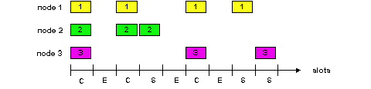
Slotted ALOHA
Pros
single active node can continuously transmit at full rate of channel
highly decentralized: only slots in nodes need to be in sync
simple
Cons
collisions, wasting slots
idle slots
nodes may be able to detect collision in less than time to transmit packet
clock synchronization
Notes:
EMPHASIZE

Slide 4
Slotted Aloha efficiency
Efficiency : long-run fraction of successful slots (many nodes, all with many frames to send)
max efficiency: find p* that maximizes Np(1-p)^{N-1}
for many nodes, take limit of Np*(1-p*)^{N-1} as N goes to infinity, gives:
Max efficiency = 1/e = .37
suppose: N nodes with many frames to send, each transmits in slot with probability p
prob that given node has success in a slot = p(1-p)^{N-1}
prob that any node has a success = Np(1-p)^{N-1}
At best: channel
used for useful
transmissions 37%
of time!
!

Slide 5
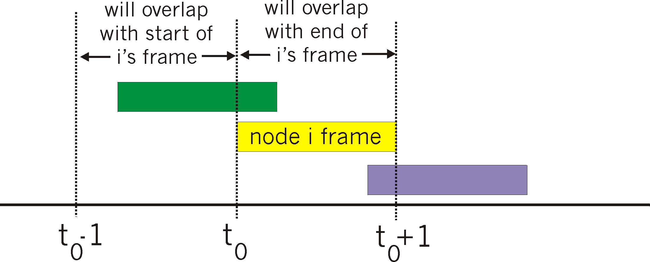
Pure (unslotted) ALOHA
unslotted Aloha: simpler, no synchronization
when frame first arrives
transmit immediately
collision probability increases:
frame sent at t₀ collides with other frames sent in [t₀-1,t₀+1]

Slide 6
Pure Aloha efficiency
P(success by given node) = P(node transmits) .
P(no other node transmits in [p₀-1,p₀] .
P(no other node transmits in [p₀-1,p₀]
= p . (1-p)^{N-1 .} (1-p)^{N-1}
= p . (1-p)^{2(N-1)}
… choosing optimum p and then letting n -> infty ...
^{= 1/(2e) = .18}
even worse than slotted Aloha!

Slide 7
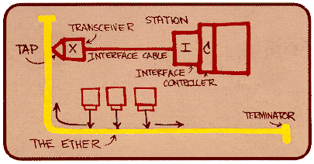
Ethernet
“dominant” wired LAN technology:
cheap $20 for NIC
first widely used LAN technology
simpler, cheaper than token LANs and ATM
kept up with speed race: 10 Mbps – 10 Gbps
Metcalfe’s Ethernet
sketch

Slide 8
Star topology
bus topology popular through mid 90s
all nodes in same collision domain (can collide with each other)
today: star topology prevails
active switch in center
each “spoke” runs a (separate) Ethernet protocol (nodes do not collide with each other)
switch
bus: coaxial cable
star

Slide 9

Ethernet Frame Structure
Sending adapter encapsulates IP datagram (or other network layer protocol packet) in Ethernet frame
Preamble:
7 bytes with pattern 10101010 followed by one byte with pattern 10101011
used to synchronize receiver, sender clock rates
Notes:
EMPHASIZE

Slide 10
Ethernet Frame Structure (more)
Addresses: 6 bytes
if adapter receives frame with matching destination address, or with broadcast address (e.g. ARP packet), it passes data in frame to network layer protocol
otherwise, adapter discards frame
Type: indicates higher layer protocol (mostly IP but others possible, e.g., Novell IPX, AppleTalk)
CRC: checked at receiver, if error is detected, frame is dropped
Notes:
EMPHASIZE

Slide 11
Ethernet: Unreliable, connectionless
connectionless: No handshaking between sending and receiving NICs
unreliable: receiving NIC doesn’t send acks or nacks to sending NIC
stream of datagrams passed to network layer can have gaps (missing datagrams)
gaps will be filled if app is using TCP
otherwise, app will see gaps
Ethernet’s MAC protocol: unslotted CSMA/CD
Notes:
EMPHASIZE

Slide 12
Ethernet CSMA/CD algorithm
1. NIC receives datagram from network layer, creates frame
2. If NIC senses channel idle, starts frame transmission If NIC senses channel busy, waits until channel idle, then transmits
3. If NIC transmits entire frame without detecting another transmission, NIC is done with frame !
4. If NIC detects another transmission while transmitting, aborts and sends jam signal
5. After aborting, NIC enters exponential backoff: after mth collision, NIC chooses K at random from {0,1,2,…,2^{m}-1}. NIC waits K·512 bit times, returns to Step 2
Notes:
EMPHASIZE

Slide 13
Ethernet’s CSMA/CD (more)
Jam Signal: make sure all other transmitters are aware of collision; 48 bits
Bit time: .1 microsec for 10 Mbps Ethernet ; for K=1023, wait time is about 50 msec
Exponential Backoff:
Goal: adapt retransmission attempts to estimated current load
heavy load: random wait will be longer
first collision: choose K from {0,1}; delay is K· 512 bit transmission times
after second collision: choose K from {0,1,2,3}…
after ten collisions, choose K from {0,1,2,3,4,…,1023}
See/interact with Java
applet on AWL Web site:
highly recommended !
Notes:
EMPHASIZE

Slide 14
CSMA/CD efficiency
T_{prop} = max propagation delay for signal energy between 2 nodes in LAN
t_{trans} = time to transmit max-size frame
efficiency goes to 1
as t_{prop} goes to 0
as t_{trans} goes to infinity
better performance than ALOHA: and simple, cheap, decentralized!

Slide 15
802.3 Ethernet Standards: Link & Physical Layers
many different Ethernet standards
common MAC protocol and frame format
different speeds: 2 Mbps, 10 Mbps, 100 Mbps, 1Gbps, 10G bps
different physical layer media: fiber, cable
application
transport
network
link
physical
MAC protocol
and frame format
100BASE-TX
100BASE-T2
100BASE-FX
100BASE-T4
100BASE-SX
100BASE-BX
copper (twister
pair) physical layer
fiber physical layer

Slide 16
Hubs
… physical-layer (“dumb”) repeaters:
bits coming in one link go out all other links at same rate
all nodes connected to hub can collide with one another
no frame buffering
no CSMA/CD at hub: host NICs detect collisions
twisted pair
hub

Slide 17
Switch
link-layer device: smarter than hubs, take active role
store, forward Ethernet frames
examine incoming frame’s MAC address, selectively forward frame to one-or-more outgoing links when frame is to be forwarded on segment, uses CSMA/CD to access segment
transparent
hosts are unaware of presence of switches
plug-and-play, self-learning
switches do not need to be configured
Notes:
EMPHASIZE
A switch is a store-and-forward device

Slide 18
Switch: allows multiple simultaneous transmissions
A
hosts have dedicated, direct connection to switch
switches buffer packets
Ethernet protocol used on each incoming link, but no collisions; full duplex
each link is its own collision domain
switching: A-to-A’ and B-to-B’ simultaneously, without collisions
not possible with dumb hub
C’
B
1
2
6
3
5
4
C
B’
A’
switch with six interfaces
(1,2,3,4,5,6)

Slide 19
Switch Table
A
Q: how does switch know that A’ reachable via interface 4, B’ reachable via interface 5?
A: each switch has a switch table, each entry:
(MAC address of host, interface to reach host, time stamp)
looks like a routing table!
Q: how are entries created, maintained in switch table?
something like a routing protocol?
C’
B
1
2
6
3
5
4
C
B’
A’
switch with six interfaces
(1,2,3,4,5,6)

Slide 20
Switch: self-learning
Source: A
Dest: A’
A
A A’
switch learns which hosts can be reached through which interfaces
when frame received, switch “learns” location of sender: incoming LAN segment
records sender/location pair in switch table
C’
B
1
2
6
3
5
4
C
B’
A’
MAC addr interface TTL
A
1
60
Switch table
(initially empty)

Slide 21
Switch: frame filtering/forwarding
When frame received:
1. record link associated with sending host
2. index switch table using MAC dest address
3. if entry found for destination then {
if dest on segment from which frame arrived then drop the frame
else forward the frame on interface indicated
}
else flood
forward on all but the interface
on which the frame arrived

Slide 22
Self-learning, forwarding: example
Source: A
Dest: A’
A
A A’
C’
B
frame destination unknown:
1
2
flood
6
3
A A’
A A’
A A’
A A’
A A’
5
4
destination A location known:
C
selective send
A’ A
B’
A’
MAC addr interface TTL
A
1
60
Switch table
(initially empty)
A’
4
60

Slide 23
Switches vs. Routers
application
transport
network
link
physical
both store-and-forward devices
routers: network-layer devices (examine network-layer headers)
switches are link-layer devices (examine link-layer headers)
routers maintain routing tables, implement routing algorithms
switches maintain switch tables, implement filtering, learning algorithms
datagram
frame
link
physical
frame
switch
network
link
physical
datagram
frame
application
transport
network
link
physical
Notes:
EMPHASIZE

Slide 24
Point to Point Data Link Control
one sender, one receiver, one link: easier than broadcast link:
no Media Access Control
no need for explicit MAC addressing
e.g., dialup link, ISDN line
popular point-to-point DLC protocols:
PPP (point-to-point protocol)
HDLC: High level data link control (Data link used to be considered “high layer” in protocol stack!)
Notes:
EMPHASIZE

Slide 25
PPP Design Requirements [RFC 1557]
packet framing: encapsulation of network-layer datagram in data link frame
carry network layer data of any network layer protocol (not just IP) at same time
ability to demultiplex upwards
bit transparency: must carry any bit pattern in the data field
error detection (no correction)
connection liveness: detect, signal link failure to network layer
network layer address negotiation: endpoint can learn/configure each other’s network address

Slide 26
PPP non-requirements
no error correction/recovery
no flow control
out of order delivery OK
no need to support multipoint links (e.g., polling)
Error recovery, flow control, data re-ordering
all relegated to higher layers!

Slide 27
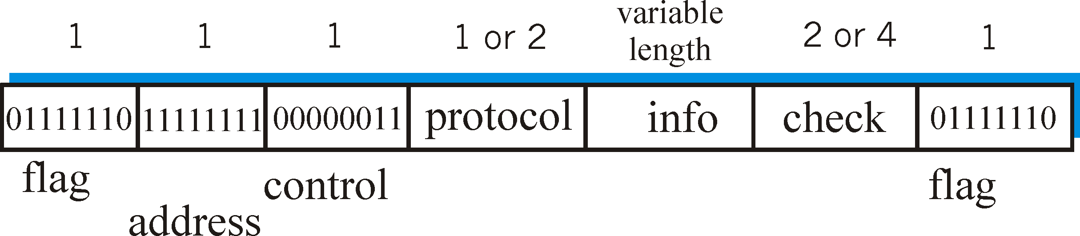
PPP Data Frame
Flag: delimiter (framing)
Address: does nothing (only one option)
Control: does nothing; in the future possible multiple control fields
Protocol: upper layer protocol to which frame delivered (e.g., PPP-LCP, IP, IPCP, etc)

Slide 28
PPP Data Frame
info: upper layer data being carried
check: cyclic redundancy check for error detection

Slide 29
Asynchronous Transfer Mode: ATM
1990’s/00 standard for high-speed (155Mbps to 622 Mbps and higher) Broadband Integrated Service Digital Network architecture
Goal: integrated, end-end transport of carry voice, video, data
meeting timing/QoS requirements of voice, video (versus Internet best-effort model)
“next generation” telephony: technical roots in telephone world
packet-switching (fixed length packets, called “cells”) using virtual circuits

Slide 30
Multiprotocol label switching (MPLS)
initial goal: speed up IP forwarding by using fixed length label (instead of IP address) to do forwarding
borrowing ideas from Virtual Circuit (VC) approach
but IP datagram still keeps IP address!
PPP or Ethernet
header
IP header
remainder of link-layer frame
MPLS header
label
Exp
S
TTL
20
3
1
5

Slide 31
MPLS capable routers
a.k.a. label-switched router
forwards packets to outgoing interface based only on label value (don’t inspect IP address)
MPLS forwarding table distinct from IP forwarding tables
signaling protocol needed to set up forwarding
RSVP-TE
forwarding possible along paths that IP alone would not allow (e.g., source-specific routing) !!
use MPLS for traffic engineering
must co-exist with IP-only routers

Slide 32
MPLS forwarding tables
in out out
label label dest interface
10 A 0
in out out
label label dest interface
12 D 0
8 A 1
10 6 A 1
12 9 D 0
R6
0
0
D
1
1
R4
R3
R5
0
0
A
R2
in out out
label label dest interface
R1
in out out
label label dest interface
6 - A 0
8 6 A 0

Slide 33
Synthesis: a day in the life of a web request
journey down protocol stack complete!
application, transport, network, link
putting-it-all-together: synthesis!
goal: identify, review, understand protocols (at all layers) involved in seemingly simple scenario: requesting www page
scenario: student attaches laptop to campus network, requests/receives www.google.com

Slide 34
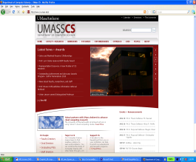

A day in the life: scenario
browser
DNS server
Comcast network
68.80.0.0/13
school network
68.80.2.0/24
web page
web server
Google’s network
64.233.160.0/19
64.233.169.105
Notes:
EMPHASIZE

Slide 35
A day in the life… connecting to the Internet
DHCP
DHCP
UDP
IP
Eth
Phy
connecting laptop needs to get its own IP address, addr of first-hop router, addr of DNS server: use DHCP
DHCP
DHCP
DHCP
DHCP
DHCP request encapsulated in UDP, encapsulated in IP, encapsulated in 802.1 Ethernet
DHCP
DHCP
UDP
IP
Eth
Phy
DHCP
DHCP
DHCP
DHCP
router
(runs DHCP)
Ethernet frame broadcast (dest: FFFFFFFFFFFF) on LAN, received at router running DHCP server
Ethernet demuxed to IP demuxed, UDP demuxed to DHCP

Slide 36
A day in the life… connecting to the Internet
DHCP
DHCP
UDP
IP
Eth
Phy
DHCP server formulates DHCP ACK containing client’s IP address, IP address of first-hop router for client, name & IP address of DNS server
DHCP
DHCP
DHCP
encapsulation at DHCP server, frame forwarded (switch learning) through LAN, demultiplexing at client
DHCP
DHCP
UDP
IP
Eth
Phy
DHCP
DHCP
DHCP
router
(runs DHCP)
DHCP client receives DHCP ACK reply
DHCP
Client now has IP address, knows name & addr of DNS
server, IP address of its first-hop router

Slide 37
A day in the life… ARP (before DNS, before HTTP)
DNS
UDP
IP
Eth
Phy
before sending HTTP request, need IP address of www.google.com: DNS
DNS
DNS
DNS
ARP
ARP query
DNS query created, encapsulated in UDP, encapsulated in IP, encapsulated in Eth. In order to send frame to router, need MAC address of router interface: ARP
ARP
ARP reply
Eth
Phy
ARP query broadcast, received by router, which replies with ARP reply giving MAC address of router interface
client now knows MAC address of first hop router, so can now send frame containing DNS query

Slide 38
A day in the life… using DNS
DNS
UDP
IP
Eth
Phy
DNS
DNS server
DNS
UDP
IP
Eth
Phy
DNS
DNS
DNS
DNS
DNS
DNS
DNS
DNS
Comcast network
68.80.0.0/13
IP datagram forwarded from campus network into comcast network, routed (tables created by RIP, OSPF, IS-IS and/or BGP routing protocols) to DNS server
IP datagram containing DNS query forwarded via LAN switch from client to 1st hop router
demuxed to DNS server
DNS server replies to client with IP address of www.google.com

Slide 39
A day in the life… TCP connection carrying HTTP
HTTP
HTTP
TCP
IP
Eth
Phy
SYNACK
SYN
SYNACK
SYN
SYNACK
SYN
SYN
to send HTTP request, client first opens TCP socket to web server
TCP SYN segment (step 1 in 3-way handshake) inter-domain routed to web server
TCP
IP
Eth
Phy
SYNACK
SYN
SYNACK
SYN
SYNACK
SYNACK
SYN
web server responds with TCP SYNACK (step 2 in 3-way handshake)
web server
64.233.169.105
TCP connection established!

Slide 40
A day in the life… HTTP request/reply
web page finally (!!!) displayed
HTTP
HTTP
TCP
IP
Eth
Phy
HTTP
HTTP
HTTP
HTTP
HTTP
HTTP
HTTP
HTTP
HTTP request sent into TCP socket
IP datagram containing HTTP request routed to www.google.com
HTTP
HTTP
TCP
IP
Eth
Phy
HTTP
HTTP
HTTP
web server responds with HTTP reply (containing web page)
HTTP
web server
64.233.169.105
IP datagram containing HTTP reply routed back to client

