Slide 1
19 – Multimedia Networking

Slide 2


Multimedia and Quality of Service: What is it?
multimedia applications: network audio and video
(“continuous media”)
QoS
network provides application with level of performance needed for application to function.

Slide 3
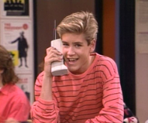
MM Networking Applications
Classes of MM applications:
1) stored streaming
2) live streaming
3) interactive, real-time
Fundamental characteristics:
typically delay sensitive
end-to-end delay
delay jitter
loss tolerant: infrequent losses cause minor glitches
antithesis of data, which are loss intolerant but delay tolerant.
Jitter is the variability
of packet delays within
the same packet stream

Slide 4

Streaming Stored Multimedia
Stored streaming:
media stored at source
transmitted to client
streaming: client playout begins before all data has arrived
timing constraint for still-to-be transmitted data: in time for playout

Slide 5
Streaming Stored Multimedia: What is it?
Cumulative data
2. video
sent
1. video
recorded
3. video received,
played out at client
network
delay
time
streaming: at this time, client
playing out early part of video,
while server still sending later
part of video

Slide 6
Streaming Live Multimedia
Examples:
Internet radio talk show
live sporting event
Streaming (as with streaming stored multimedia)
playback buffer
playback can lag tens of seconds after transmission
still have timing constraint
Interactivity
fast forward impossible
rewind, pause possible!

Slide 7
Real-Time Interactive Multimedia
applications: IP telephony, video conference, distributed interactive worlds
end-end delay requirements:
audio: < 150 msec good, < 400 msec OK
includes application-level (packetization) and network delays
higher delays noticeable, impair interactivity

Slide 8
Multimedia Over Today’s Internet
TCP/UDP/IP: “best-effort service”
no guarantees on delay, loss
?
?
?
?
?
?
But you said multimedia apps requires
QoS and level of performance to be
effective!
?
?
?
?
?
Today’s Internet multimedia applications
use application-level techniques to mitigate
(as best possible) effects of delay, loss

Slide 9
Streaming Stored Multimedia
application-level streaming techniques for making the best out of best effort service:
client-side buffering
use of UDP versus TCP
multiple encodings of multimedia
Media Player
jitter removal
decompression
error concealment
graphical user interface w/ controls for interactivity

Slide 10
User Control of Streaming Media: RTSP
What it doesn’t do:
doesn’t define how audio/video is encapsulated for streaming over network
doesn’t restrict how streamed media is transported (UDP or TCP possible)
doesn’t specify how media player buffers audio/video
HTTP
does not target multimedia content
no commands for fast forward, etc.
RTSP: RFC 2326
client-server application layer protocol
user control: rewind, fast forward, pause, resume, repositioning, etc…

Slide 11
RTSP: out of band control
FTP uses an “out-of-band” control channel:
file transferred over one TCP connection.
control info (directory changes, file deletion, rename) sent over separate TCP connection
“out-of-band”, “in-band” channels use different port numbers
RTSP messages also sent out-of-band:
RTSP control messages use different port numbers than media stream: out-of-band.
port 554
media stream is considered “in-band”.

Slide 12
RTSP Example
Scenario:
metafile communicated to web browser
browser launches player
player sets up an RTSP control connection, data connection to streaming server

Slide 13
Metafile Example
<title>Twister</title>
<session>
<group language=en lipsync>
<switch>
<track type=audio
e="PCMU/8000/1"
src = "rtsp://audio.example.com/twister/audio.en/lofi">
<track type=audio
e="DVI4/16000/2" pt="90 DVI4/8000/1"
src="rtsp://audio.example.com/twister/audio.en/hifi">
</switch>
<track type="video/jpeg"
src="rtsp://video.example.com/twister/video">
</group>
</session>

Slide 14
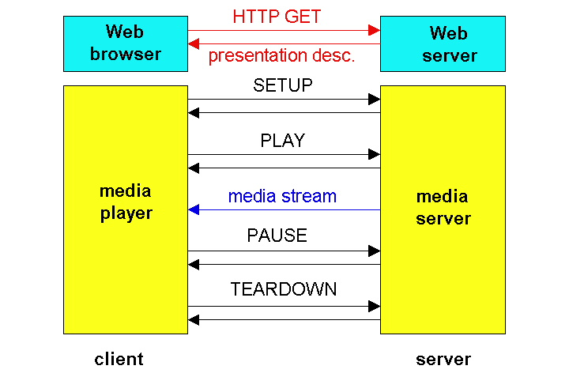
RTSP Operation

Slide 15
Content distribution networks (CDNs)
Content replication
challenging to stream large files (e.g., video) from single origin server in real time
solution: replicate content at hundreds of servers throughout Internet
content downloaded to CDN servers ahead of time
placing content “close” to user avoids impairments (loss, delay) of sending content over long paths
CDN server typically in edge/access network
origin server
in North America
CDN distribution node
CDN server
in S. America
CDN server
in Asia
CDN server
in Europe

Slide 16
Content distribution networks (CDNs)
Content replication
CDN (e.g., Akamai) customer is the content provider (e.g., CNN)
CDN replicates customers’ content in CDN servers.
when provider updates content, CDN updates servers
origin server
in North America
CDN distribution node
CDN server
in S. America
CDN server
in Asia
CDN server
in Europe

Slide 17
CDN example
HTTP request for
www.foo.com/sports/sports.html
origin server
1
2
DNS query for www.cdn.com
client
CDN’s authoritative
DNS server
3
HTTP request for
www.cdn.com/www.foo.com/sports/ruth.gif
CDN server near client
origin server (www.foo.com)
distributes HTML
replaces:
http://www.foo.com/sports.ruth.gif
with http://www.cdn.com/www.foo.com/sports/ruth.gif
CDN company (cdn.com)
distributes gif files
uses its authoritative DNS server to route redirect requests

Slide 18
More about CDNs
routing requests
CDN creates a “map”, indicating distances from leaf ISPs and CDN nodes
when query arrives at authoritative DNS server:
server determines ISP from which query originates
uses “map” to determine best CDN server
CDN nodes create application-layer overlay network

Slide 19
Summary: Internet Multimedia: bag of tricks
use UDP to avoid TCP congestion control (delays) for time-sensitive traffic
client-side adaptive playout delay: to compensate for delay
server side matches stream bandwidth to available client-to-server path bandwidth
chose among pre-encoded stream rates
dynamic server encoding rate
error recovery (on top of UDP)
FEC, interleaving, error concealment
retransmissions, time permitting
CDN: bring content closer to clients

