Slide 1
Security in the layers

Slide 2
Secure sockets layer (SSL)
Transport layer security to any TCP-based app using SSL services.
Used between Web browsers, servers for e-commerce (https).
Security services:
server authentication
data encryption
client authentication (optional)
Server authentication:
SSL-enabled browser includes public keys for trusted CAs.
Browser requests server certificate, issued by trusted CA.
Browser uses CA’s public key to extract server’s public key from certificate.
Notes:
https ➔ HTTP Secure
CA ➔ Certification authority

Slide 3
SSL (continued)
Encrypted SSL session:
Browser generates symmetric session key, encrypts it with server’s public key, sends encrypted key to server.
Using private key, server decrypts session key.
Browser, server know session key
All data sent into TCP socket (by client or server) encrypted with session key.
SSL: basis of IETF Transport Layer Security (TLS).
SSL can be used for non-Web applications, e.g., IMAP.
Client authentication can be done with client certificates.
Notes:
The Internet Engineering Task Force (IETF) develops and promotes Internet standards.
Internet message access protocol (IMAP) is one of the two most prevalent Internet standard protocols for e-mail retrieval, the other being the Post Office Protocol (POP)

Slide 4
IPsec: Network Layer Security
Network-layer secrecy:
sending host encrypts the data in IP datagram
TCP and UDP segments; ICMP and SNMP messages.
Network-layer authentication
destination host can authenticate source IP address
Two principal protocols:
authentication header (AH) protocol
encapsulation security payload (ESP) protocol
For both AH and ESP, source, destination handshake:
create network-layer logical channel called a security association (SA)
Designed for IPv6
Backward compatible with IPv4
Notes:
IPsec supports 2 Modes
Transport mode
Only payload encrypted/authenticated
Tunnel mode
(used to create Virtual Private Networks (VPNs)
Everything encrypted/authenticated
Mostly used to create VPN connections.

Slide 5
IEEE 802.11 security
War-driving: drive around Bay area, see what 802.11 networks available?
More than 9000 accessible from public roadways
85% use no encryption/authentication
packet-sniffing and various attacks easy!
Securing 802.11
encryption, authentication
first attempt at 802.11 security:
Wired Equivalent Privacy (WEP): a failure
current attempt: 802.11i

Slide 6
Wired Equivalent Privacy (WEP):
authentication as in a weak protoocol
host requests authentication from access point
access point sends 128 bit nonce
host encrypts nonce using shared symmetric key
access point decrypts nonce, authenticates host
no key distribution mechanism
authentication: knowing the shared key is enough

Slide 7
WEP data encryption
Host/AP share 40 bit symmetric key
Host appends 24-bit Initialization Vector (IV) to create 64-bit key
64 bit key used to generate stream of keys, k_{i}^{IV}
k_{i}^{IV} used to encrypt ith byte, d_{i}, in frame:
c_{i} = d_{i} XOR k_{i}^{IV}
IV and encrypted bytes, c_{i} sent in frame

Slide 8
802.11 WEP encryption
Sender-side WEP encryption

Slide 9
Breaking 802.11 WEP encryption
Security hole:
24-bit IV, one IV per frame, -> IV’s eventually reused
IV transmitted in plaintext -> IV reuse detected
Attack:
Trudy causes Alice to encrypt known plaintext d₁ d₂ d₃ d₄ …
Trudy sees: c_{i} = d_{i} XOR k_{i}^{IV}
Trudy knows c_{i} d_{i}, so can compute k_{i}^{IV}
Trudy knows encrypting key sequence k₁^{IV} k₂^{IV} k₃^{IV} …
Next time IV is used, Trudy can decrypt!

Slide 10
802.11i: improved security
numerous (stronger) forms of encryption possible
provides key distribution
uses authentication server separate from access point

Slide 11
WPA - Wi-Fi Protected Access
Implements 802.11i
128-bit key, 48-bit IV
Uses TKIP (Temporary Key Integrity Protocol)
Hash of IV (not sent in plaintext)
Ensures each frame is sent with a unique key

Slide 12
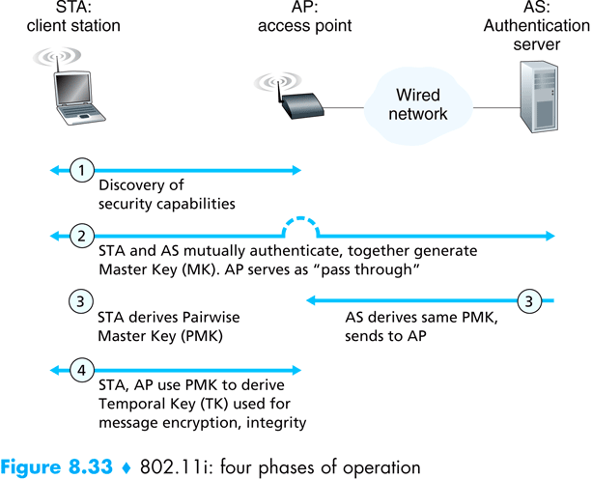
Notes:
Phase 1:
AP advertises presence & security capabilities to wireless client.
Client requests desired security needs. Several more steps required for proper authentication.

Slide 13
Firewalls
firewall
isolates organization’s internal net from larger Internet, allowing some packets to pass, blocking others.
administered
network
public
Internet
firewall

Slide 14
Firewalls: Why
prevent denial of service attacks:
SYN flooding: attacker establishes many bogus TCP connections, no resources left for “real” connections.
prevent illegal modification/access of internal data.
e.g., attacker replaces CIA’s homepage with something else
allow only authorized access to inside network (set of authenticated users/hosts)
two types of firewalls:
application-level
packet-filtering

Slide 15
Packet Filtering
Should arriving packet be allowed in? Departing packet let out?
internal network connected to Internet via router firewall
router filters packet-by-packet, decision to forward/drop packet based on:
source IP address, destination IP address
TCP/UDP source and destination port numbers
ICMP message type
TCP SYN and ACK bits
Notes:
A network admin can configure firewall based on the policies or the organization.
Different filter settings can be used for different policies.

Slide 16
Packet Filtering
Example 1: block incoming and outgoing datagrams with IP protocol field = 17 and with either source or dest port = 23.
All incoming and outgoing UDP flows and telnet connections are blocked.
Example 2: Block inbound TCP segments with ACK=0.
Prevents external clients from making TCP connections with internal clients, but allows internal clients to connect to outside.
Notes:
Filter setting is given in red font.
Policy is given in black font.

Slide 17
Application gateways
gateway-to-remote
host telnet session
host-to-gateway
telnet session
Filters packets on application data as well as on IP/TCP/UDP fields.
Example: allow select internal users to telnet outside.
application
gateway
router and filter
1. Require all telnet users to telnet through gateway.
2. For authorized users, gateway sets up telnet connection to dest host. Gateway relays data between 2 connections
3. Router filter blocks all telnet connections not originating from gateway.

Slide 18
Limitations of firewalls and gateways
IP spoofing: router can’t know if data “really” comes from claimed source
if multiple app’s. need special treatment, each has own app. gateway.
client software must know how to contact gateway.
e.g., must set IP address of proxy in Web browser
filters often use all or nothing policy for UDP.
tradeoff: degree of communication with outside world, level of security
many highly protected sites still suffer from attacks.
http://darkreading.com/security/intrusion-prevention/showArticle.jhtml?articleID=217300227

Slide 19
Network Security (summary)
Basic techniques…...
cryptography (symmetric and public)
authentication
message integrity
key distribution
…. used in many different security scenarios
secure email
secure transport (SSL)
IP sec
802.11
Firewall

