Slide 1
ITDO7013: Infrastructure Security
Module 2 : Software Security
By: Prof. Prasad Padalkar

Slide 2
Topics
Software Vulnerability
Buffer overflow
Format String
Cross-Site Scripting,
SQL Injection
Malware: Viruses, Worms, Trojans, Logic Bomb, Bots, Rootkits

Slide 3
What is a Software Vulnerability?
A software vulnerability is a weakness or flaw in a software application that can be exploited by attackers to cause harm.
These vulnerabilities can arise from various issues, such as coding errors, design flaws, or misconfigurations.

Slide 4
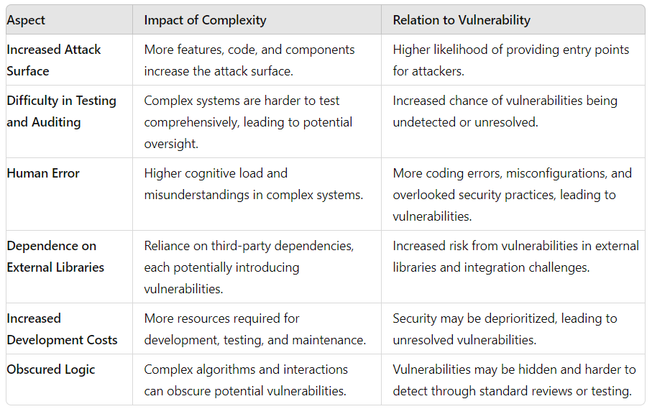
What is relation between Software complexity and Software vulnerability ?
As software complexity increases, the likelihood of introducing vulnerabilities tends to rise.

Slide 5
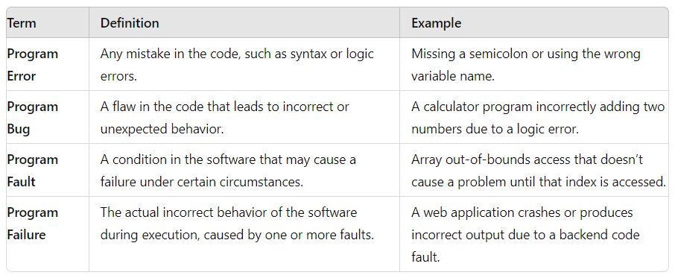
Program Error, Program Bug, Program Fault, Program Failure

Slide 6
Buffer Overflow
A buffer overflow is a type of software vulnerability that occurs when a program writes more data to a fixed-length block of memory, or buffer, than it can hold. When this happens, the extra data can overwrite adjacent memory locations, which can lead to unexpected behavior, including crashes, data corruption, or even the execution of malicious code.

Slide 7
Buffer Overflow
Example:
#include <stdio.h>
#include <string.h>
int main() {
char buffer[10]; // Buffer can hold 10 characters
printf("Enter some text: ");
gets(buffer); // Reads input into buffer without checking the length
printf("You entered: %s\n", buffer);
return 0;
}

Slide 8
Types of Buffer Overflows
#include <stdio.h>
#include <string.h>
int main() {
char buffer[10]; // Buffer can hold 10 characters
printf("Enter some text: ");
gets(buffer); // Reads input into buffer without checking the length
printf("You entered: %s\n", buffer);
return 0;
}
Stack-based Buffer Overflow
Writing more data than the buffer can hold, attackers overwrite critical stack data, such as the return address of a function. This can redirect the program's execution flow to malicious code.

Slide 9
Types of Buffer Overflows
Heap-based Buffer Overflow
Overflows in heap-allocated buffers can overwrite adjacent heap memory structures, such as metadata or other objects. This can corrupt data, alter program behavior, or overwrite function pointers.

Slide 10
Types of Buffer Overflows
#include <string.h>
typedef struct {
char data[10];
void (*func_ptr)();
} heap_object;
void malicious_function() {
printf("Malicious function executed!\n");
}
int main() {
heap_object *obj = malloc(sizeof(heap_object));
strcpy(obj->data, "ThisIsWayTooLongForTheBuffer"); // Overflow
obj->func_ptr(); // Overwritten function pointer may point to malicious_function
free(obj);
return 0;
}

Slide 11
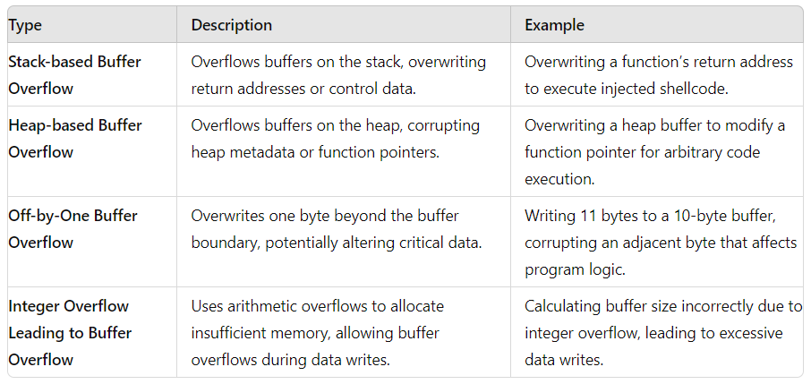
Types of Buffer Overflows

Slide 12
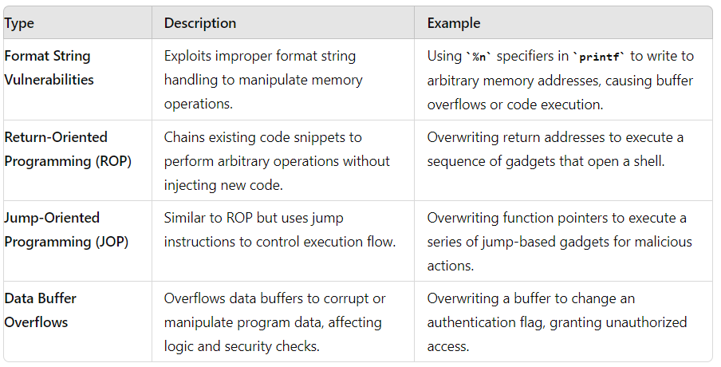
Types of Buffer Overflows

Slide 13
Format String Vulnerability
The Format String exploit occurs when the submitted data of an input string is evaluated as a command by the application. In this way, the attacker could execute code, read the stack, or cause a segmentation fault in the running application, causing new behaviors that could compromise the security or the stability of the system.

Slide 14
Format String Vulnerability
For example: #include <stdio.h>
void main(int argc, char **argv)
{
// This line is safe
printf("%s\n", argv[1]);
// This line is vulnerable
printf(argv[1]);
}

Slide 15
Format String Vulnerability
Safe Code
The line printf("%s", argv[1]); in the example is safe, if you compile the program and run it:
./example "Hello World %s%s%s%s%s%s"
The printf in the first line will not interpret the “%s%s%s%s%s%s” in the input string, and the output will be: “Hello World %s%s%s%s%s%s”

Slide 16
Format String Vulnerability
Vulnerable Code
The line printf(argv[1]); in the example is vulnerable, if you compile the program and run it:
./example "Hello World %s%s%s%s%s%s"
The printf in the second line will interpret the %s%s%s%s%s%s in the input string as a reference to string pointers, so it will try to interpret every %s as a pointer to a string, starting from the location of the buffer . At some point, it will get to an invalid address, and attempting to access it will cause the program to crash.

Slide 17
Format String Vulnerability
An attacker can also use this to get information, not just crash the software. For example, running:
./example "Hello World %p %p %p %p %p %p"
Will print the lines:
Hello World %p %p %p %p %p %p
Hello World 000E133E 000E133E 0057F000 CCCCCCCC CCCCCCCC CCCCCCCC

Slide 18
Cross site Scripting
Cross-Site Scripting (XSS) is a web application vulnerability which allows attackers to inject malicious scripts (usually JavaScript) into webpages viewed by other users. When a user visits a compromised page, the injected script is executed in their browser, potentially leading to various malicious outcomes, such as stealing cookies, session tokens, or other sensitive data, defacing the website, or redirecting users to malicious sites.

Slide 19
Cross site Scripting
For example : Consider a web application with a comment section where users can post comments:
HTML Form
<form action="/submit_comment" method="post">
<input type="text" name="comment" placeholder="Enter your comment">
<input type="submit" value="Submit">
</form>

Slide 20
Cross site Scripting
Server-side Vulnerable code:
<?php
if ($_SERVER['REQUEST_METHOD'] == 'POST') {
$comment = $_POST['comment'];
// No input sanitization
echo "<p>User comment: $comment</p>";
}
?>

Slide 21
Cross site Scripting
Attack Scenario:
An attacker submits the following comment:
<script>alert('XSS Attack!');</script>

Slide 22
Cross site Scripting
Result: When the server processes this comment and displays it back to users, it directly embeds the attacker’s script in the HTML:
<p>User comment: <script>alert('XSS Attack!');</script></p>
Impact: Every user who visits the page sees an alert box with "XSS Attack!".

Slide 23
Method to prevent XSS
Input Validation: Ensure that all input is validated and sanitized. Strip out or encode any potentially dangerous characters or scripts.
Output Encoding: Encode data before displaying it on the page to ensure it is treated as text rather than executable code.
Use Secure APIs: Prefer secure APIs that automatically handle output encoding (e.g., template engines that escape HTML).
Content Security Policy (CSP): Implement CSP headers to restrict the sources from which scripts can be loaded and executed.
Sanitize HTML: If your application allows HTML input, use libraries to sanitize it and remove any potentially harmful tags or attributes.

Slide 24
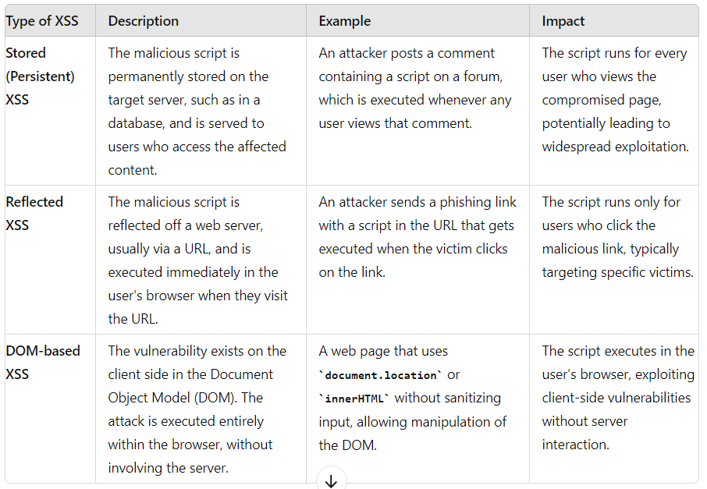
Types of XSS

Slide 25


