Slide 1
Formulation of a Micro Demand Model for Freight Transport in Berlin
Lei Zhang

Slide 2
Overview
Background
Objectives
Commodity Generation
Tour Distribution
Further Research

Slide 3
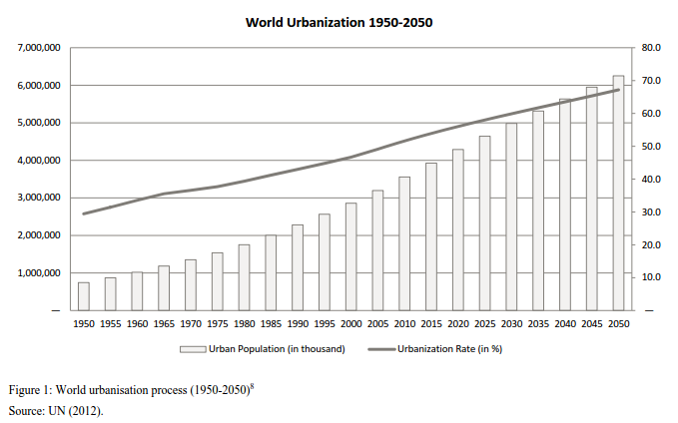
Background
Cities provide attractive opportunities

Slide 4
Background
Freight transport problems:
Public infrastructure
Safety
Energy consumption
Air pollution
Other negative social effects
…
Most operational models do not have sufficient behavioral detail to simulate in a representative and satisfying manner.
Freight movement involves complicated linkages among many freight agents interacting in supply chain.
Finding sufficient empirical data behind the models remains challenging.

Slide 5
Objectives
City as a whole: help to achieve the sustainability of urban economic and freight transport growth
Private sector: maximize the utilization of all logistical resources to satisfy a city’s demand for high-qualified logistics services; reduce the total logistics cost; and ensure a sustainable goods supply for citizens
Public sector: minimize the negative effects caused by the logistical activities within urban areas to improve the city living environment
To contribute to the development of a freight demand model based on a microscopic modeling approach, which reflects the real mechanism of freight movement, describes its behavior in a quantitative way and allows for high sensitivity towards policy changes.

Slide 6
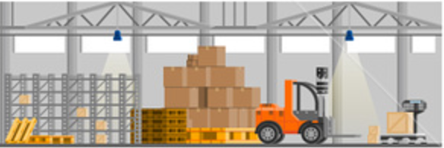

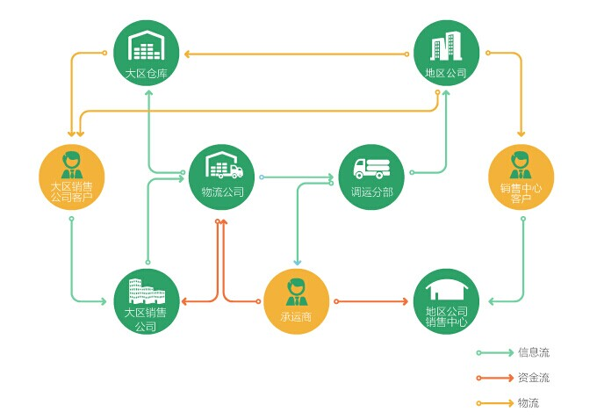



Commodity Generation
Cities are growing more and more into pure consumption centers of goods.
The movement of vehicles is the result of the intention to move commodities, and consumption demand regulates commodity flows.
The commodity consumption of a shop is caused by individual consumers.

Slide 7

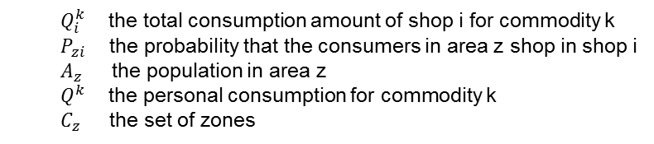
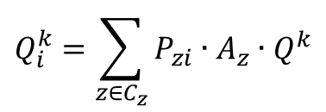
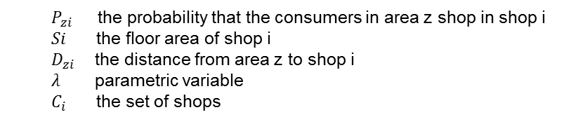
Commodity Generation
Consumers are more willing to go to shops with high consumer appeal.
$$P_{zi}=\frac{\frac{Si}{D_{zi}^{λ}}}{\sum_{i∈C_{i}}{\frac{Si}{D_{zi}^{λ}}}}$$
$P_{zi}$ the probability that the consumers in area z shop in shop i
$Si$ the floor area of shop i
$D_{zi}$ the distance from area z to shop i
$λ$ parametric variable
$C_{i}$ the set of shops
$$Q_{i}^{k}=\sum_{z∈C_{z}}{P_{zi}∙A_{z}∙Q^{k}}$$
$Q_{i}^{k}$ the total consumption amount of shop i for commodity k
$P_{zi}$ the probability that the consumers in area z shop in shop i
$A_{z}$ the population in area z
$Q^{k}$ the personal consumption for commodity k
$C_{z}$ the set of zones

Slide 8
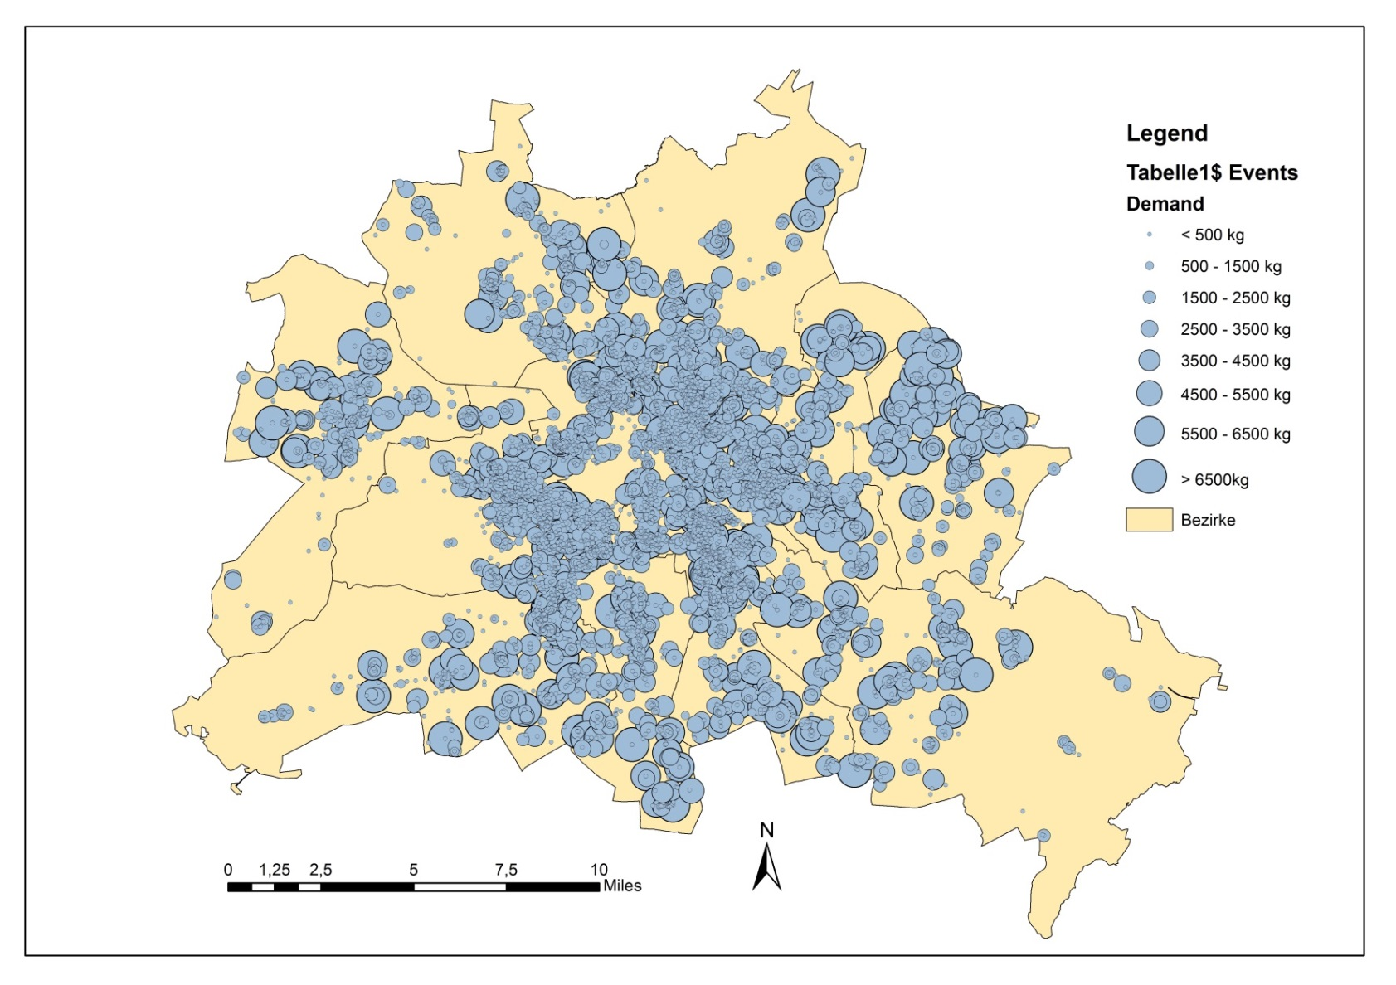
Commodity Generation
Average daily consumption amount of food for the shops in Berlin

Slide 9
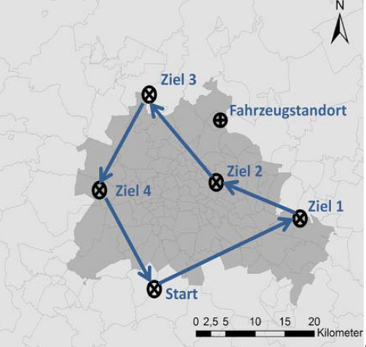
Tour Distribution
Trip chain data from KID (Kraftfahrzeugverkehr in Deutschland)
2230 freight travel records in Berlin and surrounding areas

Slide 10
Tour Distribution
Trip chain data from KID (Kraftfahrzeugverkehr in Deutschland)
2230 freight travel records in Berlin and surrounding areas
(Food Retail)
(Food Retail)

Slide 11
Tour Distribution
Distance frequency for food retail
90%
63%

Slide 12
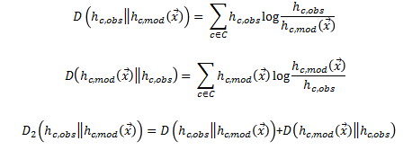
Tour Distribution
Assumption and Constraints for the simple problem:
One shop can be assigned to exactly one distribution center
Any shop can be assigned to any distribution center
All of the shops must assign to a distribution center
Each distribution center has a capacity which can not be exceeded
Objective function
Minimize the difference between observed distance distribution and modeled distance distribution
Formal: Symmetric Kullback-Leibler-Divergence

Slide 13
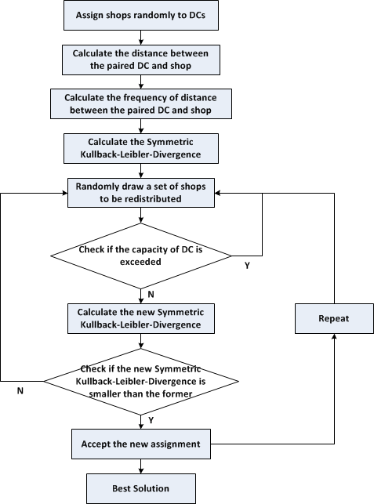
Tour Distribution
Solution method for simple problem

Slide 14
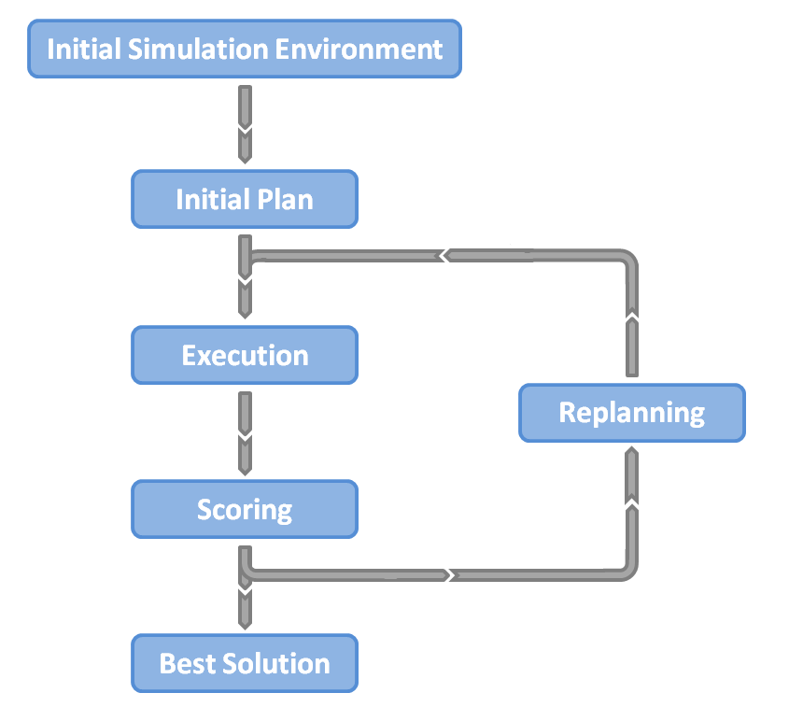
Tour Distribution

Slide 15
Tour Distribution

Slide 16
Further Research
Extension case: insert previous knowledge and observations
Shops can be labeled according to their characteristics
Type of goods sold
Retail chain
Assignment rules do not change
Each store can still be assigned to every DC
DCs
Shops
DCs
Shops
Preference
Mandatory

Slide 17
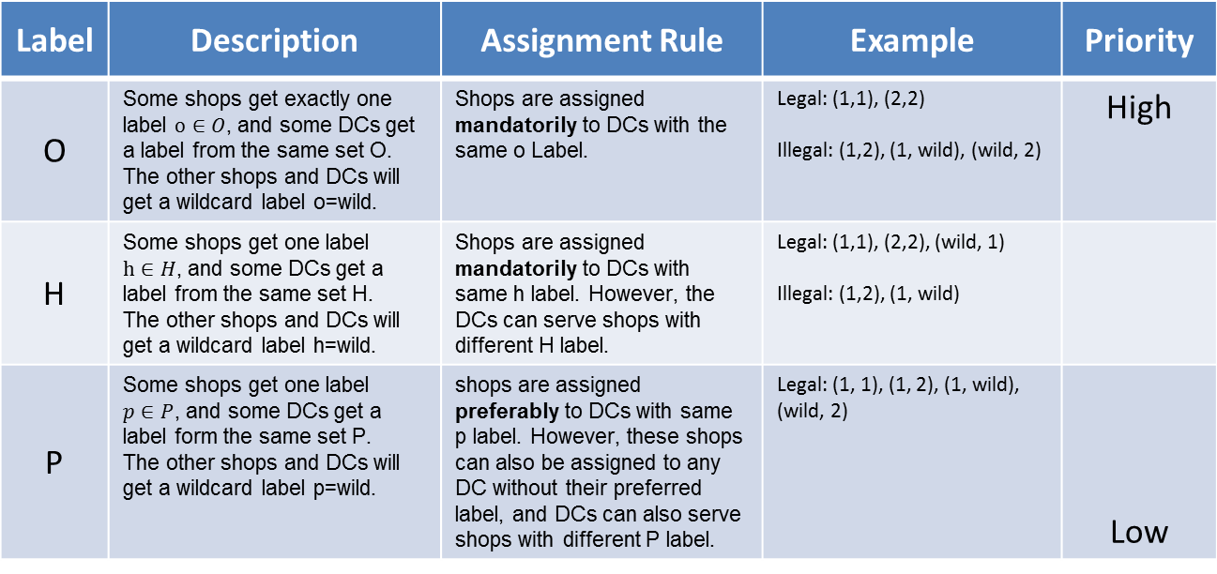
Assignment Algorithm
For the most simple case: we know nothing about the reality.
For the extension case: insert previous knowledge and observations
Label | Description | Assignment Rule | Example | Priority
O | Some shops get exactly one label $o∈O$, and some DCs get a label from the same set O. The other shops and DCs will get a wildcard label o=wild. | Shops are assigned mandatorily to DCs with the same o Label. | Legal: (1,1), (2,2) Illegal: (1,2), (1, wild), (wild, 2) | High
H | Some shops get one label $h∈H$, and some DCs get a label from the same set H. The other shops and DCs will get a wildcard label h=wild. | Shops are assigned mandatorily to DCs with same h label. However, the DCs can serve shops with different H label. | Legal: (1,1), (2,2), (wild, 1) Illegal: (1,2), (1, wild)
P | Some shops get one label $p∈P$, and some DCs get a label form the same set P. The other shops and DCs will get a wildcard label p=wild. | shops are assigned preferably to DCs with same p label. However, these shops can also be assigned to any DC without their preferred label, and DCs can also serve shops with different P label. | Legal: (1, 1), (1, 2), (1, wild), (wild, 2) | Low

Slide 18
Retail Chain | Number of DCs | Number of shops
Aldi | 4 | 143
DM | 2 | 70
Edeka | 2 | 180
Euro Gida | 1 | 15
Getränke Hoffmann | 1 | 120
Kaisers | 1 | 133
Kaufland | 1 | 30
Lidl | 2 | 140
Metro | 1 | 7
Netto | 2 | 202
Norma | 1 | 31
Rewe | 2 | 208
Rossmann | 1 | 85
Label O

Slide 19
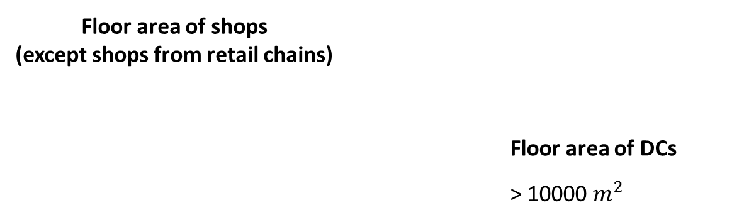
Label P
Floor area of shops (except shops from retail chains)
 |  | Floor area of DCs
 |  | > 10000 $m^{2}$

Slide 20
Other assumptions and constraints:
One shop can be assigned to exactly one distribution center
All of the shops must assign to a distribution center with the corresponding label
Each distribution center has a capacity which can not be exceeded
Objective function
Minimize the difference between observed distance distribution and modeled distance distribution
Formal: Symmetric Kullback-Leibler-Divergence

Slide 21
Assign shops to the nearest DC according to the labels

Slide 22
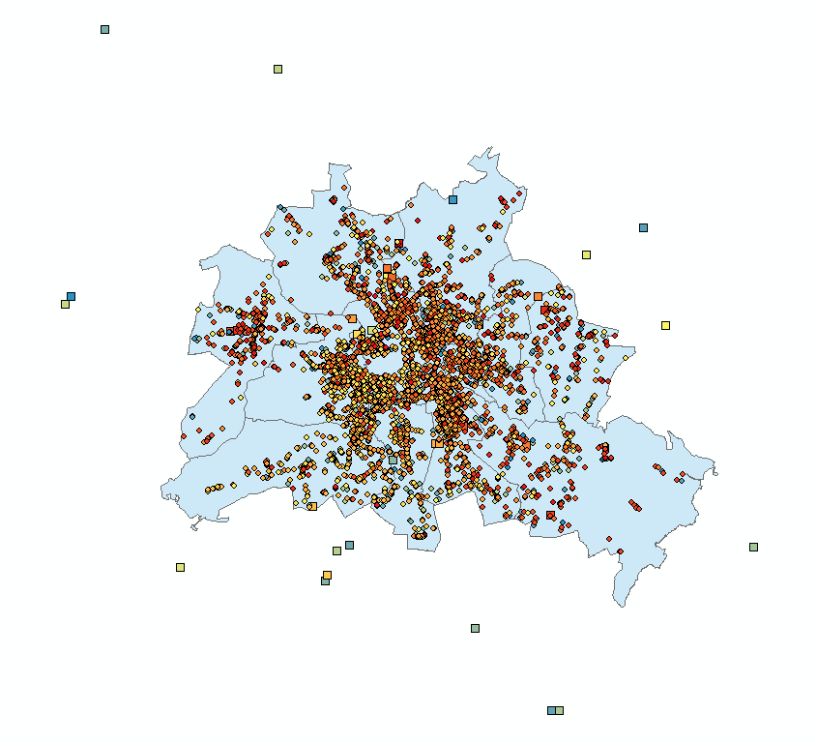
Assignment Result
40 Distribution Centers
6817 Shops

Slide 23
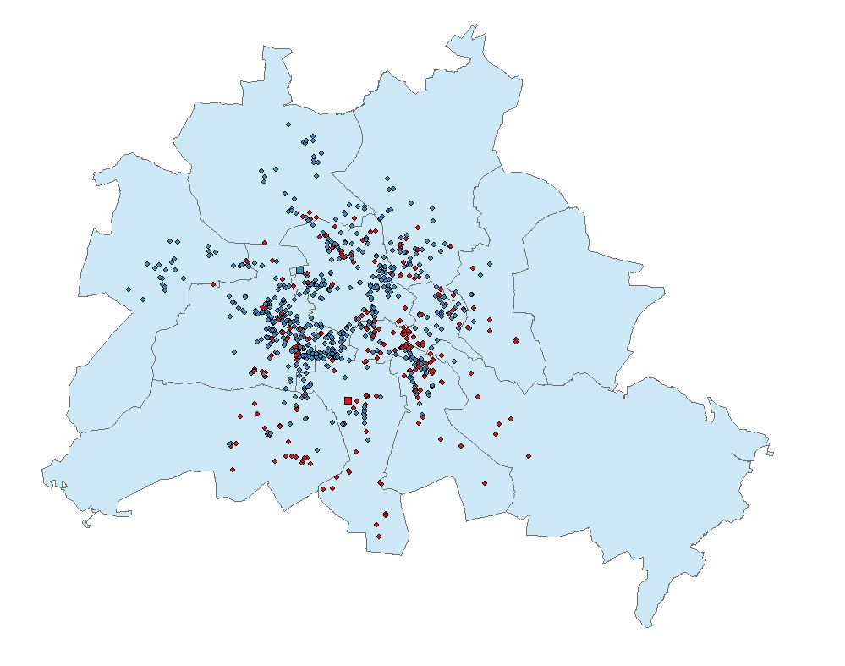
Assignment Result

Slide 24
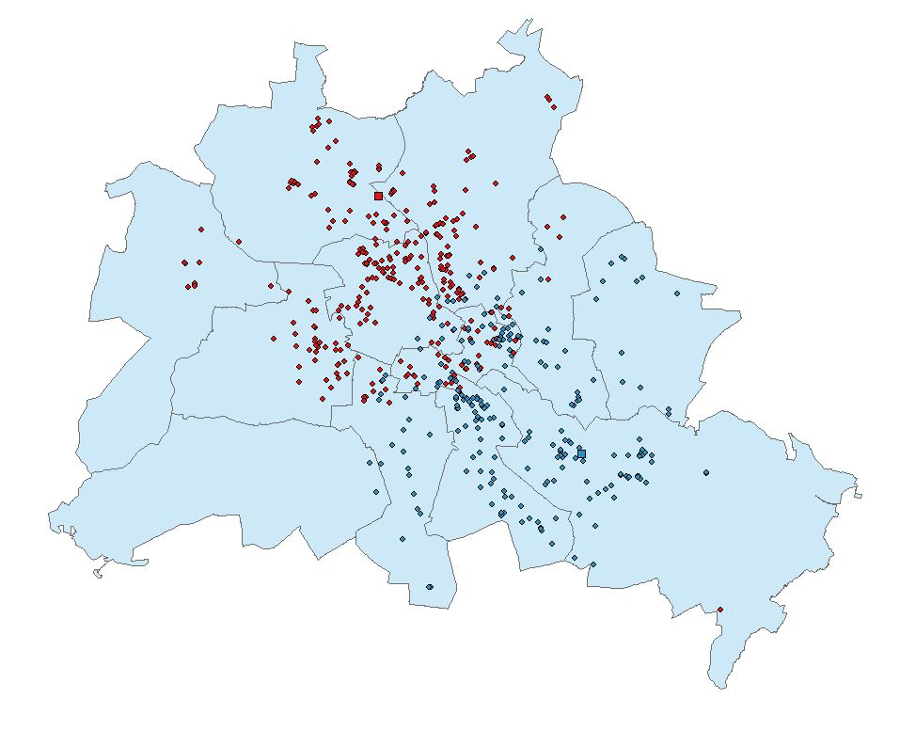
Assignment Result

Slide 25
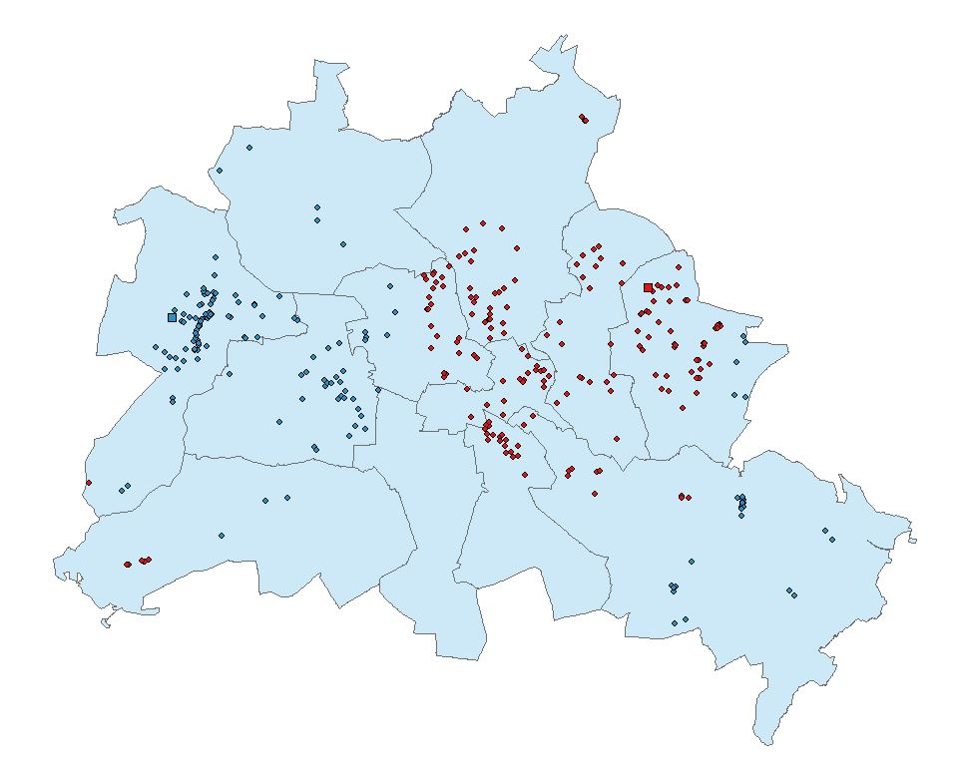
Assignment Result

Slide 26
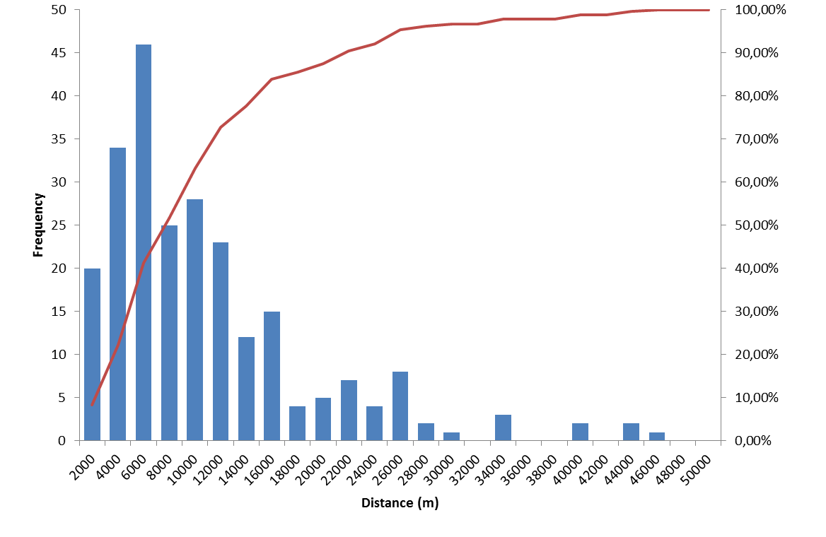
Distance frequency for food retail

Slide 27
Formulation of a Micro Freight Demand Model for Berlin
Lei Zhang

