Slide 1
MECH 151
Technical Design
Unit Reference Guide
A student quick-reference for every unit — Design Fundamentals through Design for Manufacturing — for portfolio work, quizzes, and the final prototype.
Foundations
Unit 1
Unit 2
Unit 3
Unit 4
Final Exam

Slide 2
COURSE MAP
Semester Roadmap, Weeks 4–17
One project-based portfolio module per week; a short foundations unit precedes Unit 1.
Foundations
Weeks 4–7 · Quiz Wk 7
Weeks 7–10 · Quiz Wk 10
Weeks 11–13 · Quiz Wk 13
Weeks 14–16 · Quiz Wk 16
Week 17
Design Fundamentals
Unit 1 — CAD Fundamentals
Unit 2 — CAD Advanced
Unit 3 — Design for Assembly
Unit 4 — Design for Manufacturing
Final Exam — Prototype Project
How grading lines up: each unit maps to a graded portfolio module and closes with a unit quiz; the Design Portfolio (50% of the course grade) and the Prototype + Final Exam (30%) are graded separately — see the syllabus for the remaining weighting.
MECH 151 · Technical Design — Unit Reference Guide

Slide 3
COURSE NOTE
This Course Is CAD-Program-Agnostic
The field of CAD software is too broad to teach every package — so this course teaches the operations that transfer between all of them.
Dozens of parametric CAD packages — are used across industry — SolidWorks, Fusion 360, Onshape, Inventor, Creo, NX, CATIA, and more
It's impractical to teach all of them in one course — and mastering only one would leave you stuck the moment a job, internship, or team uses something else
So this course teaches the operations every one of them shares — the specific menu names are yours to look up in whatever software you're using
The Operation
Sometimes Called
Push/pull a 2D profile into a solid
Extrude · Pad · Boss / Cut
Spin a profile around an axis
Revolve · Rotate
Lock a sketch so it can't drift
Relations · Constraints
The running history of modeling steps
Feature Tree · Timeline · Model Tree
Position parts relative to each other
Mates · Joints · Assembly Constraints
Round over or angle-cut a sharp edge
Fillet / Chamfer · Round / Bevel
Why it matters: everything in this deck — sketching, feature trees, mates, GD&T — describes the operation, not a specific menu path. Whatever software you're using in class, an internship, or a job, look for the tool that does the same job.
MECH 151 · Technical Design — Unit Reference Guide

Slide 4
00
FOUNDATIONS
Design Fundamentals
Step back from the software: what a CAD model is for, before Unit 1's sketches and features begin.
BEFORE UNIT 1

Slide 5
FOUNDATIONS
The Design Process Is a Cycle
Every design loops — the first prototype is expected to be wrong, and that's the process working.
Define
Design
Build
Test
Evaluate
↺ then back to Design (or Define), carrying what you learned
Define — state what the part must do, fit, withstand, and cost — before any geometry exists
Design — concept options, then the parametric models and drawings that pin down every dimension
Build — make a prototype — a print, a machined part, a mock-up
Test — measure it, fit it, load it, use it the way it will really be used
Evaluate — compare what happened against the requirements; loop back with what you learned
Why it matters: if you assume the first version is final, you build a model that's painful to change. If you assume you'll revise it, you build for iteration — clean sketches, captured intent, a readable feature tree.
MECH 151 · Technical Design — Unit Reference Guide

Slide 6
FOUNDATIONS
Define the Problem Before You Design
The step skipped most often — and the one that wastes the most time when skipped.
S
M
A
R
T
Specific
Measurable
Achievable
Relevant
Time-bound
says exactly what, for whom
has a number you can check
possible with your time & tools
actually serves the need
due by a defined point
SMART in practice: "hold a phone at a comfortable viewing angle" is a direction. "Hold a 600 g phone at 55–70° without tipping, printable in under 4 hours, done by Week 12" is something you can design to and test against.
Requirements, objectives, and constraints get lumped together as "the spec" — but they filter and rank designs differently (next: how each one works).
MECH 151 · Technical Design — Unit Reference Guide

Slide 7
FOUNDATIONS
Requirements, Objectives, Constraints
Requirements and constraints filter designs to the acceptable ones; objectives rank the acceptable ones to find the best.
Requirements
Objectives
Constraints
What the design must do — pass/fail
What you're optimizing — directions of "better"
Fixed limits on the solution space
"Supports 5 kg without permanent deflection"
Either met or not; missing one disqualifies a design
Verified by test or inspection
"As light as possible," "minimize cost"
Not pass/fail — compared by degree
Often trade against each other
"Fits a 150 mm cube," "$25 budget," "due Week 12"
Not about function — about what's allowed
Violating one disqualifies the design
Why it matters: mix them up and you either reject a good design for missing a "nice to have," or ship one that fails a real must-have.
Evaluating success — turn objectives into weighted, measurable criteria and score concepts with a decision matrix — screen pass/fail items first, then rank.
MECH 151 · Technical Design — Unit Reference Guide

Slide 8
FOUNDATIONS
Knowing When to Stop: The 80/20 Rule
No design is ever perfect — chasing perfection is its own failure mode.
80/20
Move forward once requirements are met — even if you can see ways it could be nicer
Perpetual designing is a cost — every revision delays the prototype, the test, and everything you'd learn from them
"Good enough" is a decision — judge against written requirements, not an imagined ideal
~80% of a design's useful performance comes from the first 20% of the effort — chasing the rest costs far more than it returns.
Hold both ideas at once: expect the first version to be wrong, and resist the urge to perfect it. The cycle moves forward when a design is good enough to learn from — not when it's flawless, and not before it meets its requirements.
MECH 151 · Technical Design — Unit Reference Guide

Slide 9
FOUNDATIONS
Design Intent
The reasoning a model should capture — what you expect to stay true when a dimension changes.
Same result, different intent — dimension a hole two ways:
Sketch relations — symmetric, equal, concentric, collinear say why geometry is where it is, so it stays right when dimensions change
Which dimensions you choose — dimension from the reference that actually matters — a mounting face, a mating edge — not whatever's convenient
Feature order & references — build later features off stable geometry, not faces that may move or disappear in an edit
Equations & linked values — when two dimensions must always match or follow a rule, drive one from the other instead of typing both
Dimensioned from the left edge:
widen
→ widen the block and the hole drifts off-center
Tied to center by a symmetric relation:
widen
→ widen the block and the hole stays centered
Why it matters: both models look identical until the block changes size — only the second one captures what you actually meant, not just a position that happened to look right.
1
Editability
2
Communication
3
Downstream reuse
a well-built model updates the way you intend
the next person can read the tree and see the logic
assemblies, drawings & manufacturing files inherit it
MECH 151 · Technical Design — Unit Reference Guide

Slide 10
FOUNDATIONS
Organizing a Design
When a design has more than one part, where do the controlling dimensions live?
Bottom-Up
Top-Down
Design each part alone, then assemble
Start from the assembly's shared geometry
Parts are independent — editing one doesn't ripple
Simple to manage; easy to reuse parts
Good for well-understood or off-the-shelf parts
Weak when parts must share dimensions
Shared dimensions live in one place and propagate
Keeps mating parts fitting as the design evolves
Good for new designs with moving interfaces
More setup; unmanaged references get fragile
Tools for top-down — layout sketch (fixes key sizes before parts exist), skeleton/master model (shared reference geometry), in-context references (shape one part against another directly).
Rule of thumb: use the simplest structure that captures the intent — reach for top-down only where parts genuinely must share dimensions.
MECH 151 · Technical Design — Unit Reference Guide

Slide 11
FOUNDATIONS
Practices That Keep a Design Robust
1
Fully define every sketch
2
Reference stable geometry
3
Keep sketches simple
an under-defined sketch can drift on an unrelated edit
the origin and default planes never move; a filleted edge might vanish
one idea per feature — complexity goes in the feature tree
4
Name & organize features
5
Minimize dependency chains
6
Model the design, not just the shape
a tree of "Extrude7, Cut12" tells the next person nothing
fewer things a feature relies on means fewer ways it breaks
if a rule governs the part, build the rule in
MECH 151 · Technical Design — Unit Reference Guide

Slide 12
01
UNIT 1 · WEEKS 4–7
CAD Fundamentals
Sketching, views, and the first parametric model — the foundation every later unit depends on.
QUIZ IN WEEK 7

Slide 13
UNIT 1
There Is No Single "Right" Model
The same shape can be built from a different base feature, sketch set, or feature order — with effectively infinite valid combinations.
What actually separates good from poor: two classmates can hand in completely different feature trees and both be correct. What separates a good model from a poor one is whether it captures design intent, rebuilds without errors, and stays easy to edit — not whether it matches a canonical answer.
Focus on — making deliberate choices you can explain, not on guessing the "expected" answer.
This unit builds — the drawing and modeling foundation every later unit depends on — a controlled sketch, standard views, and a parametric solid that updates when you change it.
MECH 151 · Technical Design — Unit Reference Guide

Slide 14
UNIT 1
The Origin: Where Every Model Begins
Every coordinate, sketch, and feature ultimately measures from one fixed point in space.
The three default planes meet here
The origin (0, 0, 0) — the one point in the file that never moves, no matter how the model is edited
Three default planes — Front, Top, and Right all pass through the origin and split space along the X, Y, and Z axes
Everything is measured from it — directly or indirectly — a sketch plane, a mate, even a drawing's projected views all trace back to this fixed reference
Why it matters — reference the origin (or geometry built from it) instead of an edge that might move, get filleted away, or get deleted in a later edit
Y
Z
X
Origin (0, 0, 0)
Why it matters: the exact pairing of planes to axes (which plane is "Front") varies by CAD program — but every parametric system anchors its geometry to an origin and a set of default planes the same way.
MECH 151 · Technical Design — Unit Reference Guide

Slide 15
UNIT 1
From Point to Solid: Building Up in Dimensions
Every model is a stack of dimensions — each one built from the last.
0D
1D
2D
3D
Point
Line / Curve
Polygon (Profile)
Solid (Volume)
a location in space — no length, area, or volume. A sketch point, a vertex, the origin itself.
connects two points — has length only. Lines, arcs, and splines: what you actually sketch.
a closed loop of 1D entities that encloses an area. A triangle, rectangle, circle — any closed profile.
push, spin, or sweep a profile through space and it gains volume. Extrude, revolve, sweep, loft.
Coming up: the next several slides walk through sketching (0D → 1D → 2D) and solid modeling (2D → 3D) in detail — this is the map for where each one fits.
MECH 151 · Technical Design — Unit Reference Guide

Slide 16
UNIT 1
Creating a Body: The Feature Loop
Every solid feature repeats the same four steps — the feature tree is just this loop, run again and again.
Pick a Plane
Define a Profile
Create a Volume
Dress It Up
↺ repeat, starting the next loop from a face this feature just created
1 · Pick a plane — one of the three default planes, a flat face of the solid so far, or an offset/angled reference plane
2 · Define a profile — sketch a closed, fully-defined 2D profile on that plane — points and lines built into a polygon
3 · Create a volume — extrude, revolve, sweep, or loft the profile into a solid, then add, cut, or intersect it with what's already there
4 · Dress it up — apply fillets, chamfers, shells, drafts, or patterns — operations on the solid, not a new sketched volume
Why it matters: step 1 of the next loop is usually a face the previous loop just created, not a default plane — that dependency is exactly what builds the feature tree, one branch at a time.
MECH 151 · Technical Design — Unit Reference Guide

Slide 17
UNIT 1
Sketching Fundamentals
A sketch is a 2D profile on a plane or face — the input to a 3D feature like an extrude or revolve.
1
Sketch entities
2
Reference geometry
3
Closed vs. open profiles
lines, arcs, circles, rectangles, slots, splines, and points
the origin, the three default planes (front, top, right), and construction lines that guide without becoming part of the profile
a closed loop can be extruded into a solid; an open profile makes thin features, surfaces, or paths
Why it matters: keep sketches simple — draw only the geometry the feature needs, keep profiles closed, and put complexity into separate features rather than one crowded sketch.
MECH 151 · Technical Design — Unit Reference Guide

Slide 18
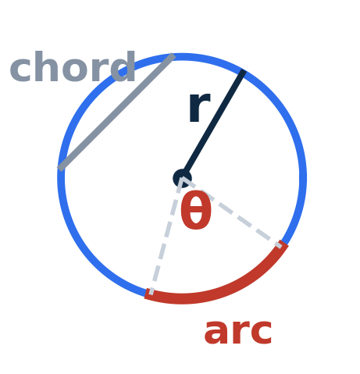
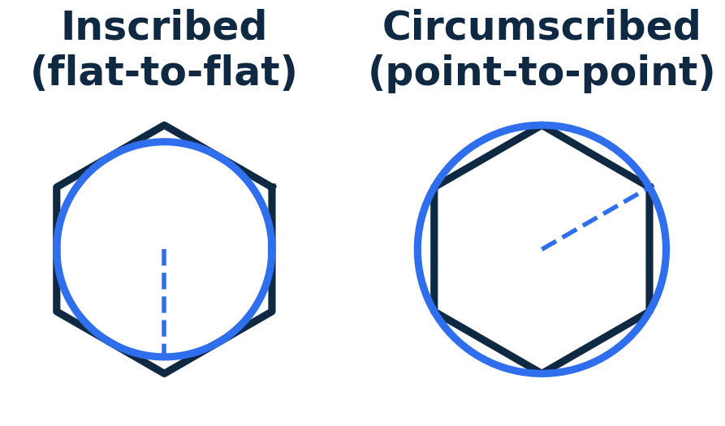
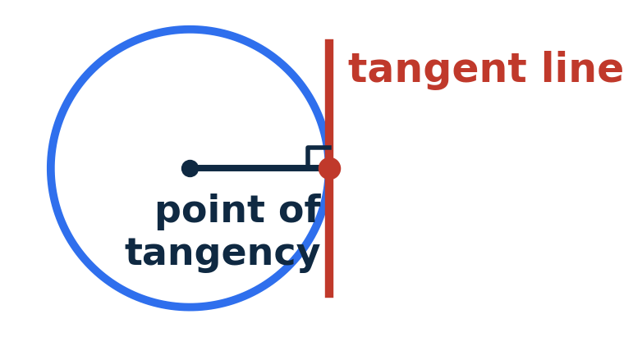
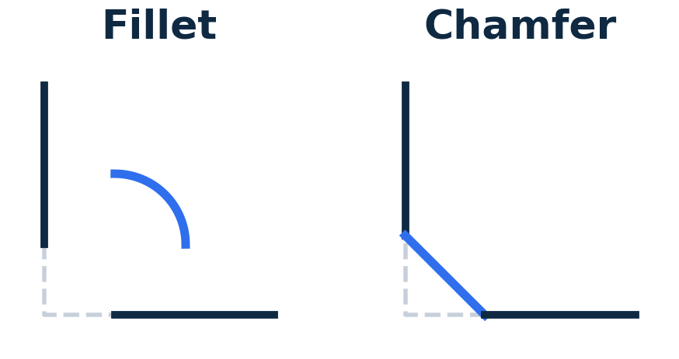
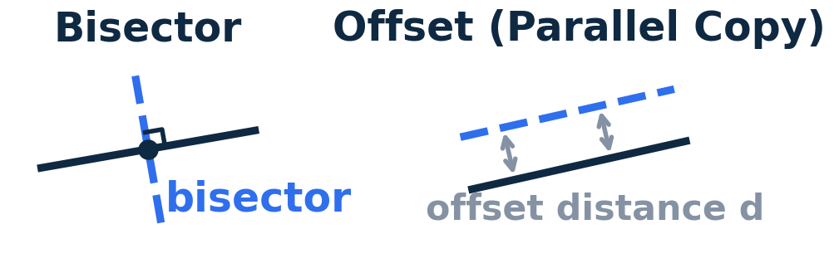
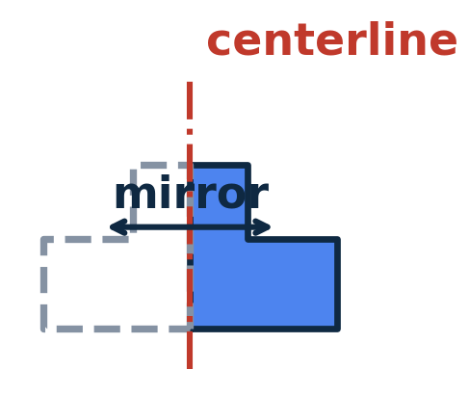
UNIT 1
Geometry of Shapes: 2D Construction
Before a shape is a sketch, it's plane geometry — points, lines, and curves in defined relationships.
Circle & Arc Geometry
Polygons
Tangency
center + radius/diameter; a chord connects two points, a central angle subtends an arc.
inscribed (flat-to-flat) vs. circumscribed (point-to-point) — matters for hex features and bolt heads.
a line/arc touches a circle at exactly one point, perpendicular to the radius there.
Fillets & Chamfers
Constructions
Symmetry & Centerlines
a fillet is a tangent arc replacing a sharp corner; a chamfer is a straight cut across it.
perpendicular bisector and offset — classic constructions, now done by relations.
build half a shape about a construction line and mirror it to guarantee identical halves.
MECH 151 · Technical Design — Unit Reference Guide

Slide 19
UNIT 1
Sketch Constraints & Relations
Constraints lock down where sketch geometry can move, removing degrees of freedom until the sketch is fully defined.
Under-defined
Fully defined
Over-defined
Geometry can still be dragged
The sketch is not fully controlled
Every entity fixed by relations + dimensions
The target state before finishing a sketch
Conflicting or redundant constraints
Must be resolved, not ignored
Geometric relations — coincident, collinear, parallel, perpendicular, tangent, concentric, equal, horizontal, vertical, symmetric
Dimensions — linear, radial, diameter, angular
Why it matters: add relations before dimensions — relations capture intent (this hole stays centered) so changing one dimension updates the model predictably instead of distorting it.
MECH 151 · Technical Design — Unit Reference Guide

Slide 20
UNIT 1
Orthographic Projection & Multiview Theory
Imagine the part inside a glass box — each face of the box catches one view; unfolding it gives the standard view arrangement.
TOP
Third-angle projection — the U.S. standard — top view sits above front, right-side view sits to its right
Line conventions — visible edges solid, hidden edges dashed, centerlines for holes and symmetry axes
View selection — choose the front view with the most shape and fewest hidden lines; add only the views needed
Descriptive geometry — true length appears only when a line is parallel to the viewing plane; true shape only in a view perpendicular to that plane
Primary vs. secondary views — a primary view projects from a principal view; a secondary view projects from a primary view to reveal a feature still not true-size
FRONT
RIGHT
MECH 151 · Technical Design — Unit Reference Guide

Slide 21
UNIT 1
Basic Dimensioning Standards
Dimensions tell the reader how big the part is and how precisely each feature must be made (ASME Y14.5 in the U.S.).
1
Anatomy
2
Placement
extension lines, dimension lines, arrowheads, and the value — kept off the outline and out of the view
dimension to visible outlines, not hidden lines; group related dimensions; smallest closest to the view
3
Don't over-dimension
4
Feature callouts
each feature is located once — a redundant dimension creates conflict on the shop floor
diameter, radius, counterbore, countersink, and depth symbols for holes
MECH 151 · Technical Design — Unit Reference Guide

Slide 22
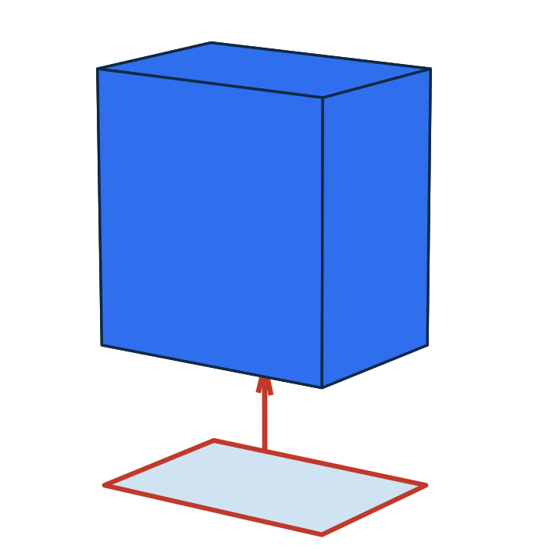
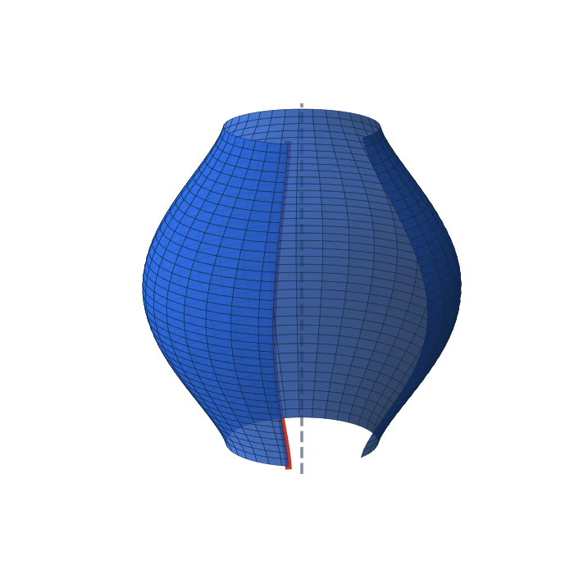
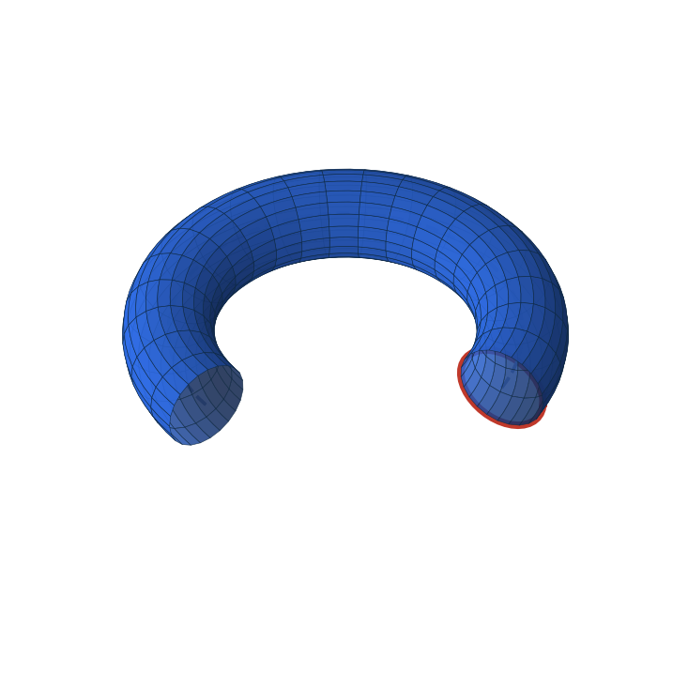
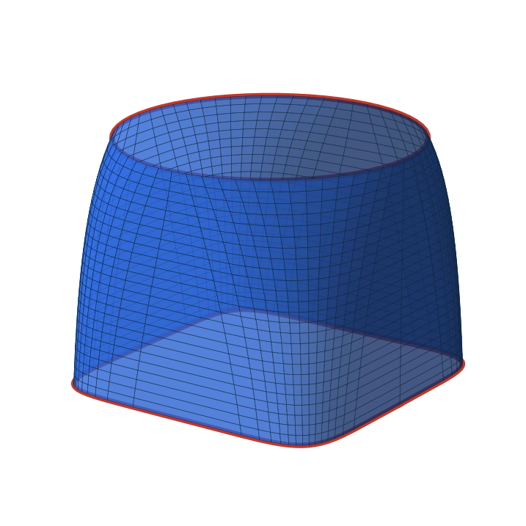
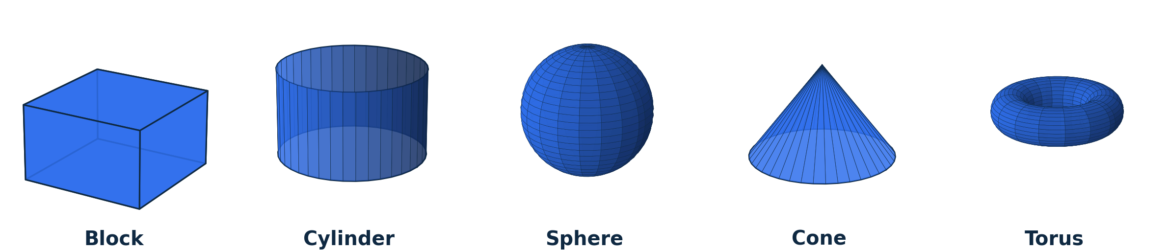
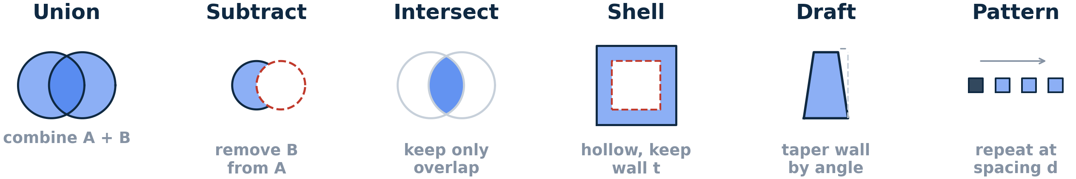
UNIT 1
Geometry of Shapes: Building 3D Solids
Every solid model is a running total: start with a volume, add more, and cut some away.
Extrude
Revolve
Sweep
Loft
push a profile along an axis
spin a profile around an axis
run a profile along a path
blend between different profiles
Primitives
Booleans & Dress-Up
Fillet & chamfer are shown on the sketching slide (2D construction).
MECH 151 · Technical Design — Unit Reference Guide

Slide 23
UNIT 1
Introduction to Parametric Part Modeling
A parametric model is a history of features, each driven by dimensions and relations — change a dimension and the model rebuilds.
Base feature — the first solid, usually an extrude or revolve of a fully defined sketch
Added features — extrude, cut, revolve, fillet, chamfer, hole, shell, pattern — each added in order on the feature tree
Sketch planes & references — choosing where each feature's sketch lives so edits stay stable
Practice — editing driving dimensions, reordering/suppressing features, fixing rebuild errors — reading a feature tree and predicting what an edit will do
Why it matters: this is what makes CAD editable rather than something you redraw from scratch.
MECH 151 · Technical Design — Unit Reference Guide

Slide 24
UNIT 1
Geometry of Shapes: Measurable Properties
Every shape carries numbers that follow from its geometry — the values a design is checked against.
Of a 2D profile
Of a 3D solid
Area, perimeter, centroid
Second moment of area (I) — resistance to bending
Section modulus (I ÷ distance to extreme fiber)
Volume, surface area
Mass (volume × density), center of gravity
Mass moment of inertia — resistance to angular acceleration
Garbage in, garbage out: the numbers are only right if the material density is set correctly and the model is a single watertight solid — an open or multi-body model gives a meaningless mass.
MECH 151 · Technical Design — Unit Reference Guide

Slide 25
UNIT 1
Unit 1 Wrap-Up
1
Controlled sketches
2
Multiview drawing
3
First parametric model
fully defined, with relations that capture intent
correct projection, line types, and dimensions
a clean, editable feature tree
✓
You'll produce: controlled sketches, a multiview drawing, and a first fully parametric part model.
Assessed by: Unit 1 Quiz (Week 7) and the corresponding portfolio modules.
MECH 151 · Technical Design — Unit Reference Guide

Slide 26
02
UNIT 2 · WEEKS 7–10
CAD Advanced
Detailed views, fasteners, and production drawings — turning a model into a document a shop can build from.
QUIZ IN WEEK 10

Slide 27
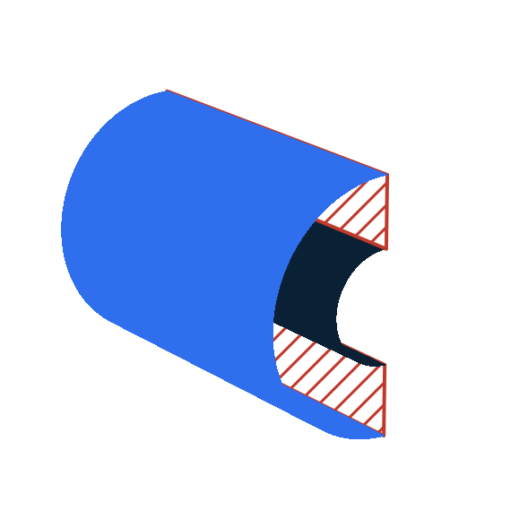

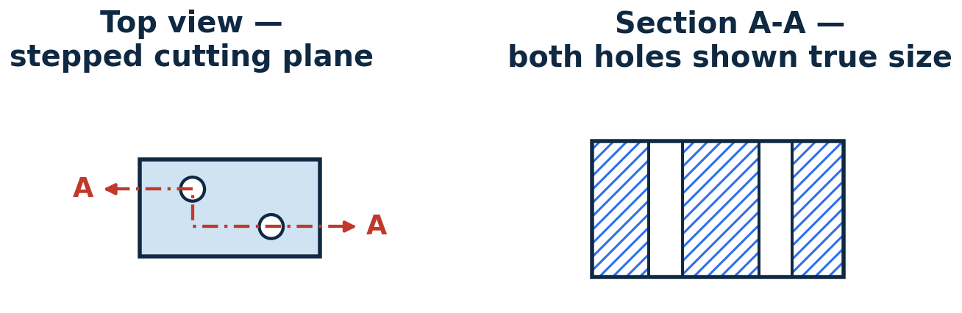
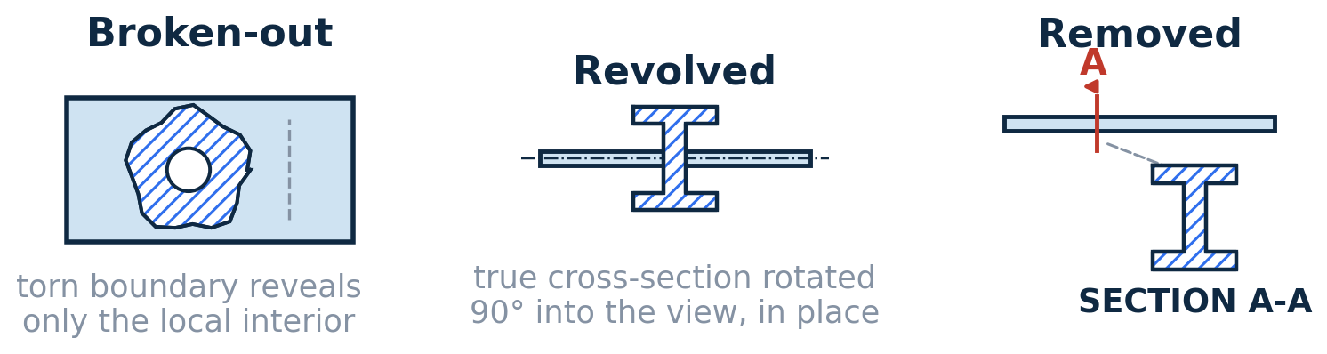
UNIT 2
Section Views
An imaginary cutting plane slices the part to show what's inside, replacing hidden-line tangles with a clear cut face.
Full Section
Half Section
The cutting plane passes entirely through the part, exposing the interior along its whole length.
Only one quarter is removed — the exterior and the interior appear together in a single view. Best for symmetric parts.
Offset Section
Local Sections
The plane is stepped (jogged) so it passes through features that aren't in line — each still appears true size.
Broken-out, revolved, and removed — used to show one local feature without a full cut.
Convention: section lining marks the cut face — but ribs, webs, fasteners, shafts, and pins are never hatched, even when the cutting plane passes through them.
MECH 151 · Technical Design — Unit Reference Guide

Slide 28
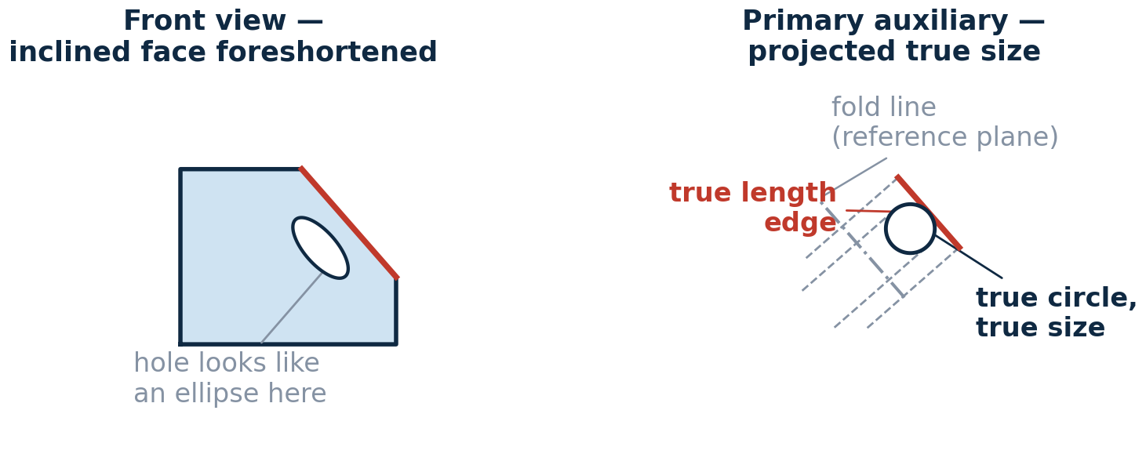
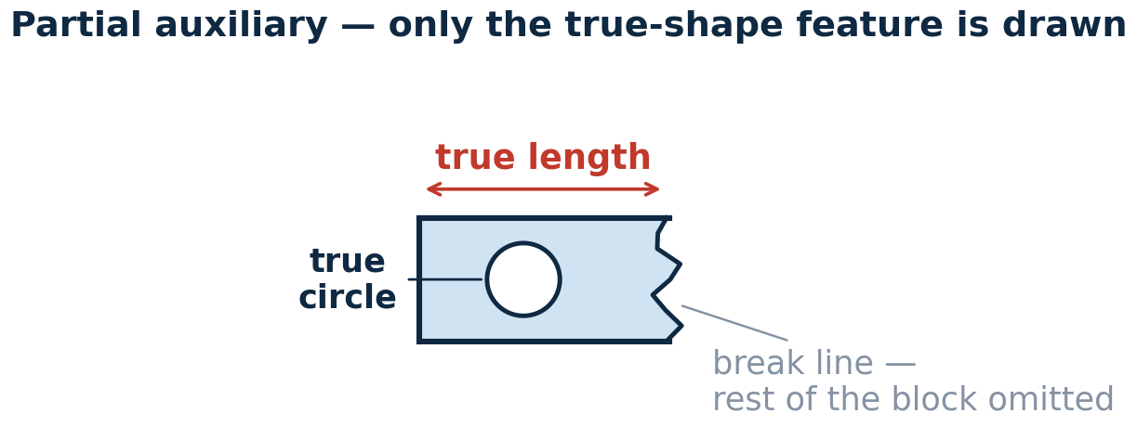
UNIT 2
Auxiliary Views
An inclined face looks foreshortened in every principal view — an auxiliary view is projected perpendicular to it so it appears true-size.
Primary auxiliary — projected from one principal view to show an inclined surface true-shape
Partial auxiliary — only the inclined feature is drawn — the rest is omitted to avoid distortion and clutter
Reference-plane method — measurements are transferred across the fold line along projection lines
MECH 151 · Technical Design — Unit Reference Guide

Slide 29
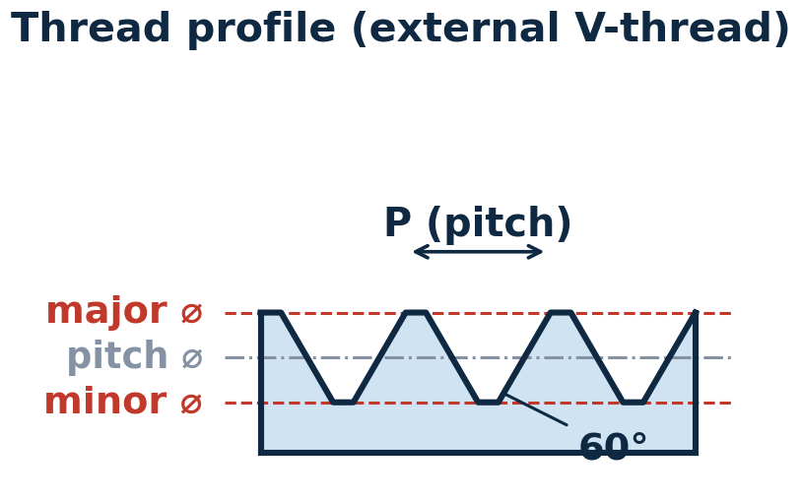
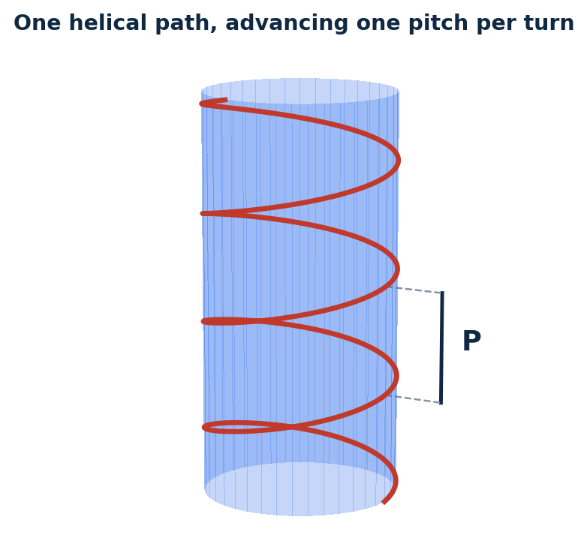
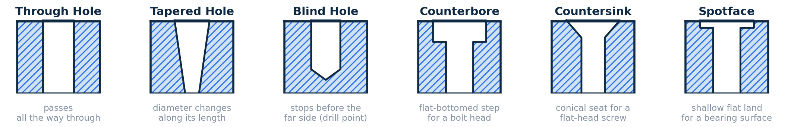
UNIT 2
Threads & Fastener Representation
Threads are almost never drawn in full detail — a standardized representation plus a note carries the information a shop needs.
Thread Profile
How a Thread Is Cut
Thread terms — major/minor diameter, pitch, lead, external vs. internal, right- vs. left-hand, class of fit
Representation — detailed, schematic, simplified — simplified is most common on production drawings
Fasteners — bolts, screws, nuts, washers, inserts — clearance and tap-drill holes are sized to fit them
Thread notes — 1/4-20 UNC-2A (inch) or M6 × 1 (metric) — diameter, pitch, and class in one callout
Common Hole Types
MECH 151 · Technical Design — Unit Reference Guide

Slide 30
UNIT 2
Production & Detail Drawings
A detail drawing is a controlled document — its format carries information that isn't in the geometry.
8
7
6
5
4
3
2
1
DRAWING VIEWS & GEOMETRY
A
(front, top, right-side views — dimensions and GD&T applied directly on the geometry)
B
GENERAL NOTES
PARTS LIST (assemblies only)
(tolerance defaults, finish, material, heat-treat)
ITEM
QTY
DESCRIPTION
MATERIAL
1.
REV
DESCRIPTION
DATE
APPR.
C
2.
3.
TITLE / PART NAME
4.
DRAWN BY / DATE
MATERIAL
SCALE
DWG NO. / SHEET
D
A blank sheet layout — every real drawing fills these same zones with the part's views, dimensions, and notes.
MECH 151 · Technical Design — Unit Reference Guide

Slide 31
UNIT 2
Introduction to Tolerancing
No part is made to an exact dimension — tolerancing states how much variation is acceptable so parts still fit and function.
⌀
R
±
SQ
SR
°
25
( )
Diameter
Radius
Plus/Minus
Square
Spherical Radius
Degrees
Basic Dimension
Reference Dim.
⌀25
R5
±0.01
SQ20
SR10
45°
[25]
(25)
Limit Dimensions
Plus/Minus Tolerance
GD&T Callout
1.253
⌀0.10 Ⓜ
A
1.247
1.250 ±0.003
high limit over low limit — no math on the shop floor
bilateral shown; unilateral: +0.005 / −0.000
position, ⌀0.10 at MMC, to datum A
Close Fit
Loose Fit
Surface Finish
Ra 1.6
⌀25 H7/p6
⌀25 H11/c11
near-zero gap — press or light-tap assembly (interference)
visible gap — free-running clearance, easy to assemble
roughness average (µin/µm) — smaller number = smoother surface
MECH 151 · Technical Design — Unit Reference Guide

Slide 32
UNIT 2
CAD Software Configuration
Consistent output comes from configured software, not from fixing every file by hand.
1
Templates
2
Document properties
part, assembly, drawing templates with the right units, standard, title block
units, dimensioning standard (ASME/ISO), grid, layers
3
Custom properties
4
File management
file metadata that auto-populates the title block and BOM
naming, folder structure, keeping references intact
MECH 151 · Technical Design — Unit Reference Guide

Slide 33
UNIT 2
CAD/CAM Data Translation
Moving a model between systems means exporting to a neutral format — each keeps some information and loses the rest.
Solid exchange
Kernel formats
Mesh formats
STEP (AP203/214/242), IGES
Parasolid, ACIS
STL, 3MF
Geometry preserved
Parametric feature history is not
Used between packages sharing a modeling kernel
Faceted surface, no true curves
Resolution set at export
Why it matters: lost or corrupted faces, gaps requiring geometry healing, and unit-scale errors are the common translation issues.
MECH 151 · Technical Design — Unit Reference Guide

Slide 34
UNIT 2
Unit 2 Wrap-Up
Freedom in modeling, discipline in documentation — how you build the part stays open-ended; the drawing follows shared conventions (ASME Y14.5, ISO) so anyone can read it.
1
Documentation-ready drawing
2
Thread & fastener callouts
3
Configured templates
section & auxiliary views, complete title block
with dimensional tolerances applied
and a clean, translated model export
✓
You'll produce: a fully detailed production drawing with section & auxiliary views, fastener callouts, tolerances, plus a correctly configured template and clean export.
Assessed by: Unit 2 Quiz (Week 10) and the corresponding portfolio modules.
MECH 151 · Technical Design — Unit Reference Guide

Slide 35
03
UNIT 3 · WEEKS 11–13
Design for Assembly
Combine part models into working assemblies, document them, and design them to be quick and cheap to put together.
QUIZ IN WEEK 13

Slide 36
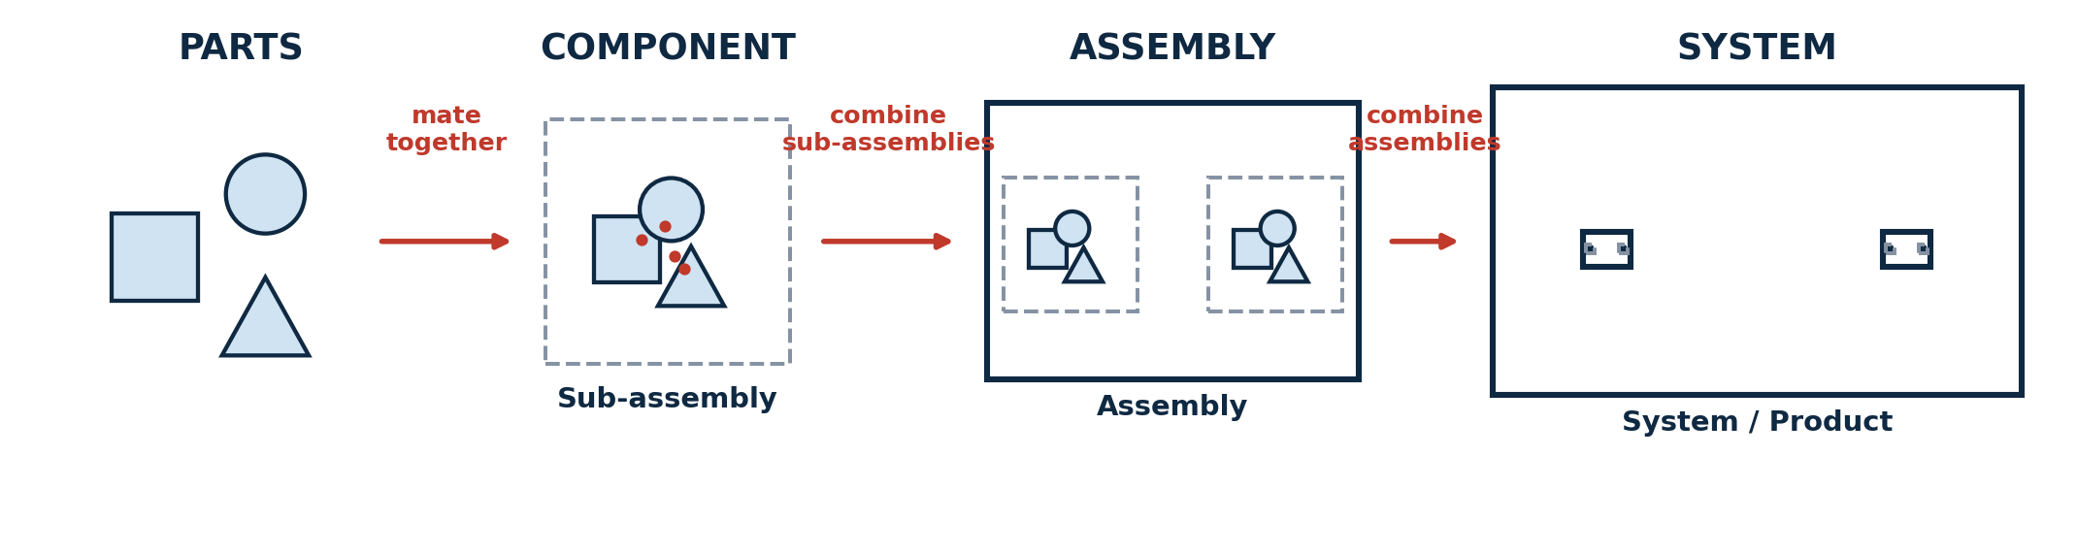
UNIT 3
From Parts to Systems
The same relationship repeats at every scale: individual parts mate into a component, components combine into an assembly, and assemblies combine into a complete system.
Why break it down: this is how large, complicated systems stay manageable — a vehicle or an instrument is never modeled as one flat list of thousands of parts. It's a tree of assemblies, each one a self-contained, testable unit.
MECH 151 · Technical Design — Unit Reference Guide

Slide 37
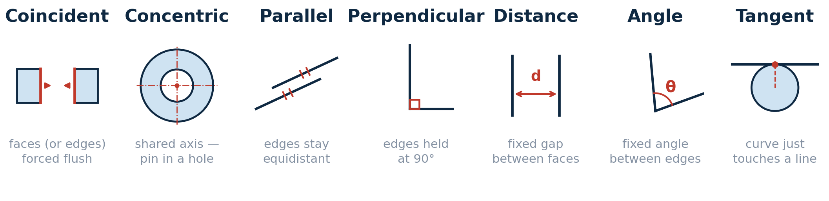
UNIT 3
Assembly Modeling: Mates & Constraints
An assembly positions components relative to one another using mates — each removes degrees of freedom.
6
First component — the first part placed is fixed and becomes the ground the rest is built against
Motion — leaving rotational or linear freedom on purpose so a mechanism can be moved and checked
degrees of freedom a free rigid body has — mates remove them one axis at a time.
MECH 151 · Technical Design — Unit Reference Guide

Slide 38
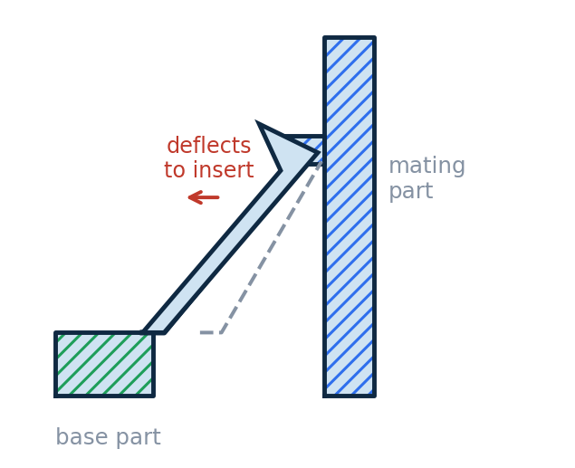
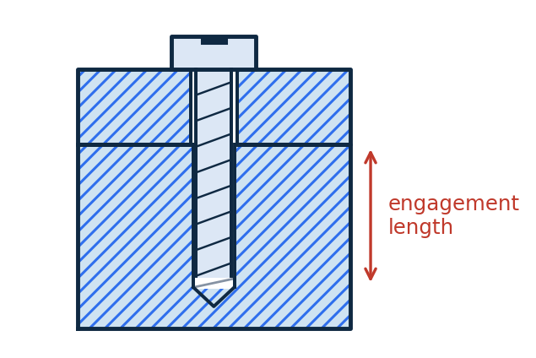
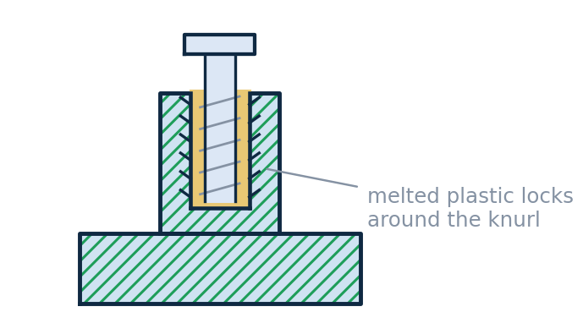
UNIT 3
Methods of Joining, Part 1
How two parts are held together is a design decision — choose deliberately, then design both parts to suit it.
Threaded Fasteners
Heat-Set Inserts
Snap-Fit Joints
Into tapped holes
For plastic / 3D-printed parts
No hardware, no tools
Default for metal-to-metal joints — strong, standard, and removable. Needs ~1.5–2× screw diameter of thread engagement plus tool access.
A brass insert is pressed into a boss with a soldering iron — melted plastic locks into its knurls, far more reusable than threading into plastic directly.
Cantilever, annular, and torsion snaps release or lock permanently depending on retention angle — design for allowable strain and a lead-in angle.
MECH 151 · Technical Design — Unit Reference Guide

Slide 39
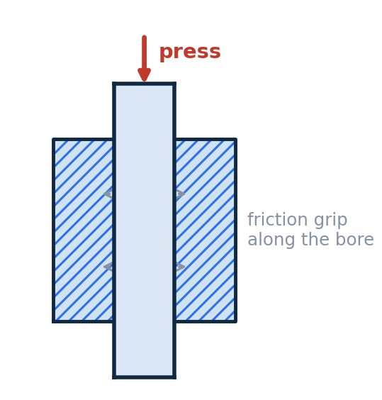
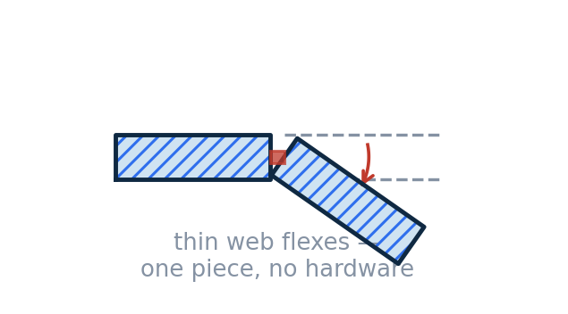
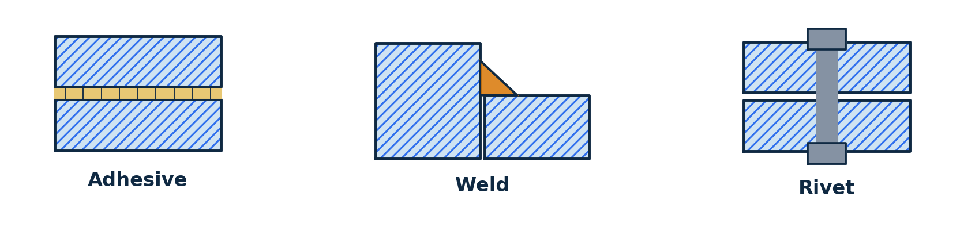
UNIT 3
Methods of Joining, Part 2
Press / Interference Fits
Compliant Mechanisms
Hold by friction from a slight size mismatch between mating diameters — dowel pins, bushings, bearings. Cheap and precise, but hard to disassemble and tolerance-sensitive.
Motion or retention comes from the material's own flexibility — living hinges, flexure pivots, one-piece clips. Cuts part count to the extreme; limited travel and fatigue life.
Permanent Joints
Adhesives, solvent/ultrasonic welding, and riveting — used only where the joint never needs to separate.
The DFA trade-off: hardware is universal and serviceable but adds parts, tools, and assembly time; snap-fits and compliant features add almost nothing to the parts list but must be designed carefully and are harder to revise once tooling is dialed in.
MECH 151 · Technical Design — Unit Reference Guide

Slide 40
UNIT 3
Using Online Component Repositories
You should not model a part you can download — this is normal professional practice, not a shortcut.
Where models come from — McMaster-Carr (download STEP/native from almost any product page), manufacturer sites, TraceParts, GrabCAD, 3D ContentCentral
Why it matters for DFA — a downloaded model is the real catalog part — correct dimensions and thread, a real part number for the BOM, at the price and lead time listed
Bring them in cleanly — keep in a dedicated library folder, don't edit their geometry, mate to them like any other component
Check before you trust — confirm units/scale on import, simplify heavy models, verify the part number matches what you intend to buy
MECH 151 · Technical Design — Unit Reference Guide

Slide 41
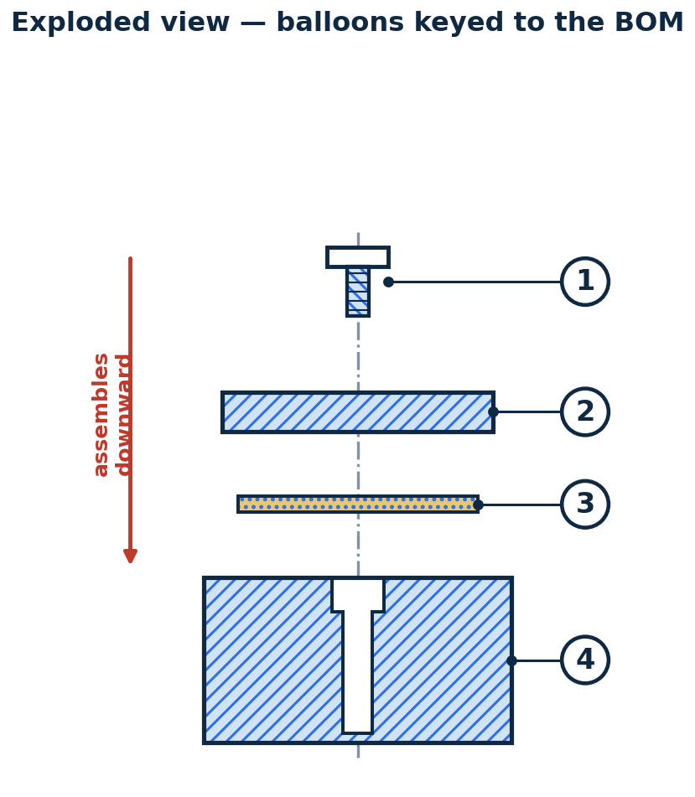
UNIT 3
Assembly Drawings
An assembly drawing shows how parts go together — exploded, numbered, and tied to a parts list.
Bill of Materials
ITEM
PART NO.
DESCRIPTION
QTY
1
HW-0425
Socket head cap screw, M4 × 12
4
2
100-002
Cover plate
1
3
100-003
Gasket, silicone
1
4
100-001
Housing (base)
1
In CAD, this table is generated directly from the assembly and stays linked — edit the model and the parts list updates automatically.
Balloon numbers are assigned in assembly order and match the item numbers in the parts list at right.
MECH 151 · Technical Design — Unit Reference Guide

Slide 42
UNIT 3
Design for Assembly (DFA) Principles
Fewer parts, easier insertion, less to get wrong on the line — DFA turns assembly time into a design variable.
1
Minimize part count
2
Prefer off-the-shelf parts
a part is a candidate for elimination unless it moves, needs a different material, or must be removable
cheaper, faster, and more reliable than custom-fabricated — see the online repositories slide
3
Easy insertion & no reorientation
4
Standardize fasteners & use symmetry
chamfers and self-locating features, assembling from one direction
fewer unique sizes to stock and pick; make orientation obvious or irrelevant
Design review & iteration: the unit ends with a design review workshop — present an assembly, take feedback against the DFA principles, and produce a documented revision with a measurable improvement.
MECH 151 · Technical Design — Unit Reference Guide

Slide 43
UNIT 3
Unit 3 Wrap-Up
1
Multi-part assembly
2
Exploded drawing + BOM
3
Documented revision
correct mates, sub-assemblies, and library hardware
balloons keyed to a linked bill of materials
a design review turned into a measurable DFA improvement
✓
You'll produce: a multi-part assembly model with correct mates, an exploded drawing with balloons and a linked BOM, plus a documented design revision.
Assessed by: Unit 3 Quiz (Week 13) and the corresponding portfolio modules.
MECH 151 · Technical Design — Unit Reference Guide

Slide 44
04
UNIT 4 · WEEKS 14–16
Design for Manufacturing
Close the loop from CAD model to physical part — manufacturing-ready files, process limits, and shop safety.
QUIZ IN WEEK 16

Slide 45
UNIT 4
Why Standards Carry the Design Intent
Once a design leaves your screen, the maker builds exactly what the documentation says.
The maker is not the designer — standard conventions (ASME Y14.5, GD&T, thread/finish callouts) let them read your intent without a phone call
Critical dimensions must be stated — a tolerance callout tells the shop where to spend effort and where a loose result is fine
Standard formats preserve meaning — STEP carries clean geometry between systems; a sloppy export arrives with gaps, wrong units, or lost features
Ambiguity is expensive and slow — on a graded prototype, it comes back as a part you can't use and no time to redo
Why it matters: capture the design intent, then communicate it in the form everyone downstream already knows how to read.
MECH 151 · Technical Design — Unit Reference Guide

Slide 46
UNIT 4
GD&T: The Building Blocks
A symbolic language (ASME Y14.5 / ISO GPS) for functional relationships — design intent written in symbols instead of prose.
Feature of size — a feature with an axis or centerplane — a hole, pin, slot, width
Datums (A, B, C) — reference surfaces chosen to match how the part actually seats in use
Datum reference frame — primary + secondary + tertiary datums lock all six degrees of freedom
Tolerance zone — the geometric space the feature must lie within — a gap, a cylinder, a band
Symbol families — the standard's ~14 geometric characteristic symbols sort into five families — form, orientation, location, profile, and runout (next slide)
Feature control frame — read left to right
⌀0.2 M
A B C
Symbol (position)
Tolerance value
Datums referenced
Why it beats plain ±: a ± box on four hole dimensions creates a small square zone and over-constrains the part; a position callout defines a round zone tied to the surfaces that matter, letting more good parts through.
MECH 151 · Technical Design — Unit Reference Guide

Slide 47
UNIT 4
GD&T Symbol Categories
The standard's ~14 geometric characteristic symbols sort into five families by what they control and whether they need a datum.
Form
Orientation
Location
Profile & Runout
No datum needed
Needs a datum
Needs datums
Profile: no/some datums · Runout: datum axis
Straightness
Perpendicularity
Position
Profile of a line
Flatness
Parallelism
Concentricity
Profile of a surface
Circularity
Angularity
Symmetry
Circular runout
Cylindricity
Total runout
Material condition modifiers: MMC (maximum material condition) and LMC (least material condition) let a position tolerance earn bonus tolerance as the hole moves away from its worst-case size — matching how a bolted clearance-hole joint really behaves.
MECH 151 · Technical Design — Unit Reference Guide

Slide 48
UNIT 4
Manufacturing-Ready Files
Each process consumes a different file — a good part starts with exporting the right one at the right settings.
Additive
Laser Cutting
CNC Machining
Watertight mesh: STL or 3MF
Fine enough to hide facets, not so fine the file is unwieldy
2D vector profile (DXF)
Cut and engrave lines on separate layers
Solid model (STEP) + dimensioned drawing
Drawing tells the machinist which dimensions are critical
CAM basics — stock setup, toolpath generation, simulation, and the post-processor that turns toolpaths into machine G-code.
MECH 151 · Technical Design — Unit Reference Guide

Slide 49
UNIT 4
Machine Safety, PPE & Operation
Students are checked out on safe setup and operation before running any shop equipment.
Baseline PPE — ANSI Z87.1 safety glasses, closed-toe shoes, no loose clothing/jewelry/unrestrained hair
Rotating machinery — never wear gloves near a spindle, chuck, or bit — a caught glove pulls the hand in
Laser cutter — never run unattended; keep a view of the cut; know the extraction and fire response
3D printers — hot nozzle and bed — let them cool, don't reach into an active machine
Before starting — know the location of the e-stop, fire extinguisher, and first-aid kit
PPE is not optional: per the syllabus, a participant without proper PPE during machine use will be asked to leave the class for that session.
MECH 151 · Technical Design — Unit Reference Guide

Slide 50
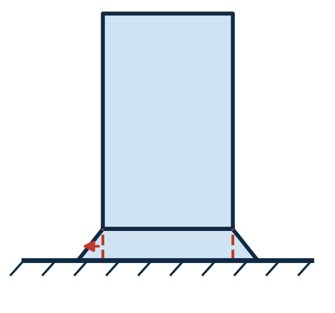
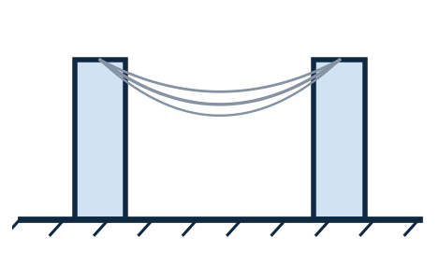
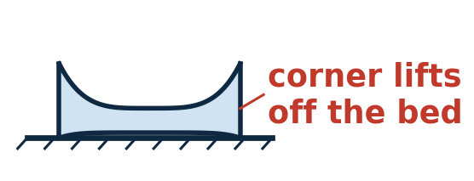
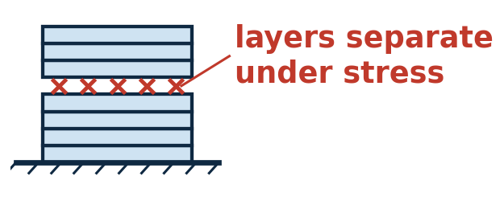
UNIT 4
Additive Manufacturing (3D Printing)
The course uses material-extrusion printing (FDM/FFF), building one deposited layer at a time.
Materials — PLA, PETG, ABS — printability, strength, and temperature trade-offs
Orientation — layers are weakest in the build (Z) direction — a strength decision, not just fit-on-bed
Supports & overhangs — the roughly 45° rule, bridging limits, designing to avoid support
Settings that matter — layer height, wall count, infill density and pattern
Tolerances — holes print undersize, first layers spread — allow for it or drill/ream after
Common Print Issues & Fixes
Elephant Footing
Stringing
Warping
Layer Separation
the first layer over-extrudes and squishes outward under the nozzle
molten filament oozes from the nozzle while traveling between features
outer edges cool and shrink faster than the center, curling corners up
layers don't fully fuse — often too cold, or cooled by a draft
Fix — add a brim, or reduce first-layer horizontal expansion
Fix — dry the filament; tighten retraction distance/speed
Fix — add a brim/raft; enclose the printer or use a heated bed
Fix — raise nozzle temp slightly; shield the print from drafts
MECH 151 · Technical Design — Unit Reference Guide

Slide 51
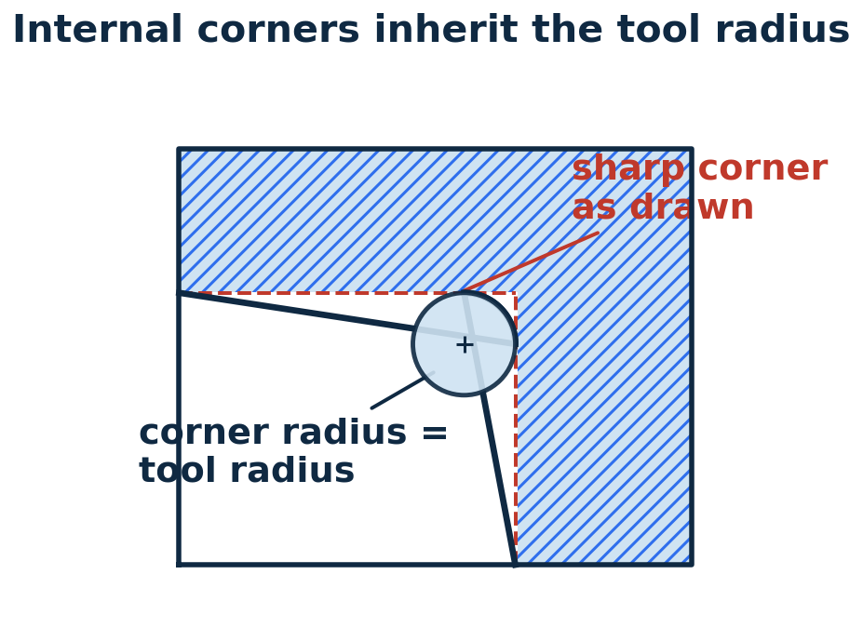
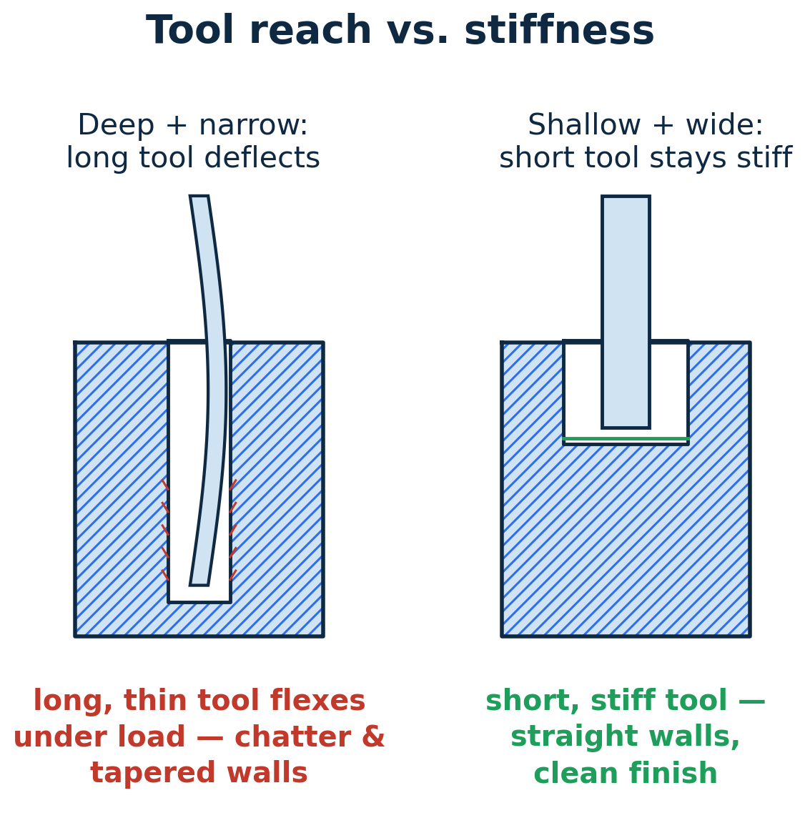
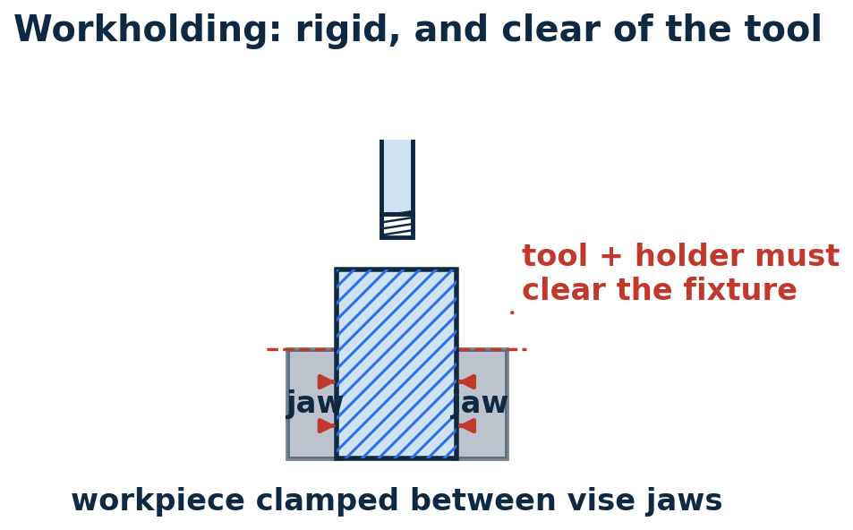
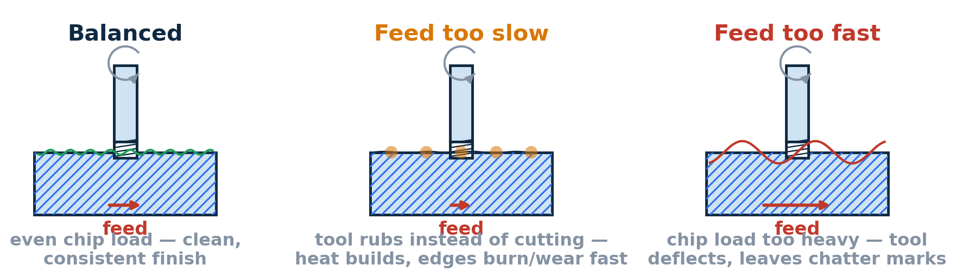
UNIT 4
Subtractive Manufacturing (CNC)
Starts with solid stock and cuts material away — design constraints come from the tool and how the part is held.
Feeds & Speeds
MECH 151 · Technical Design — Unit Reference Guide

Slide 52
UNIT 4
An Introduction to G-code
A plain-text list of moves the machine runs one line at a time — the shared language of CNC mills, 3D-printer slicers, and laser cutters.
What it is — a text file a controller runs top to bottom; G words set motion and modes, M words switch machine functions
A line is a block — a list of words, each an address letter plus a value: X25.0 is address X, value 25.0
Modal settings stick — units, positioning, feed and speed stay in effect until a later line changes them
Where it comes from — CAM or a slicer writes it; a post-processor tailors it to your exact machine — then you set the part zero and dry-run before cutting
One block, broken down
G01 X25.0 Y10.0 F150
linear feed move
(modal)
target coordinates
feed rate, mm/min
(modal)
Modal words hold: this F150 and G01 keep acting on every line below until one is changed.
Codes you'll actually see
G20 / G21 inch / millimetre
G90 / G91 absolute / incremental
G17 work in the XY plane
G00 rapid — non-cutting move
G01 linear move at feed rate
G02 / G03 clockwise / CCW arc
G54–G59 work offset (part zero)
G28 return to machine home
G04 dwell — timed pause
M00 pause for the operator
M03 / M05 spindle on CW / off
M06 tool change
M08 / M09 coolant on / off
M30 end of program
S / F / T speed / feed / tool no.
MECH 151 · Technical Design — Unit Reference Guide

Slide 53
UNIT 4
Working with G-code
Small edits at the edges of a program are routine — editing the geometry in the middle is CAM's job.
A short program, annotated
(SLOT — 6MM 2-FLUTE ENDMILL)
G21 G90 G17 mm, absolute, XY plane
G54 work offset = part zero
G0 Z5.0 rapid to safe height
M3 S10600 spindle on CW, 10600 rpm
G0 X0 Y0 rapid above the start
G1 Z-2.0 F300 feed down to depth
G1 X50.0 F640 cut the slot at feed
G0 Z5.0 retract
M5 spindle off
M30 end of program
Safe to edit by hand
Feed (F) and spindle speed (S) — ease off for chatter or burning
Safe / clearance Z heights — after checking nothing is taller
Work offset (G54→G55); add a pause (M00) or dwell (G04)
Trim header/footer lines your machine doesn't use; drop an unused tool section
Regenerate from CAM — don't hand-edit
Individual X / Y / Z cutting values, or arc I / J centres
Switching units (G20 ↔ G21) partway through
Cutter compensation (G41 / G42) offsets
Prove it before it cuts: re-simulate the whole program, then run it once as an air pass with a hand on the feed-hold — a G-code error is found by the machine at full speed.
MECH 151 · Technical Design — Unit Reference Guide

Slide 54
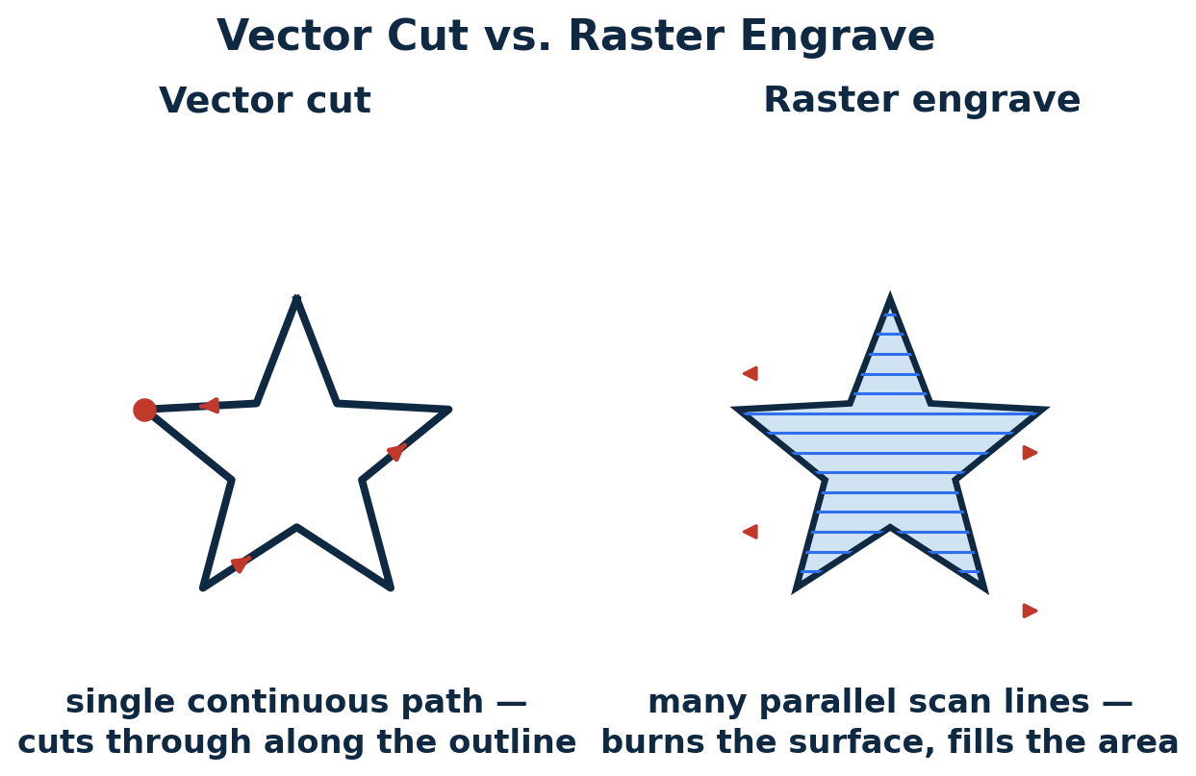
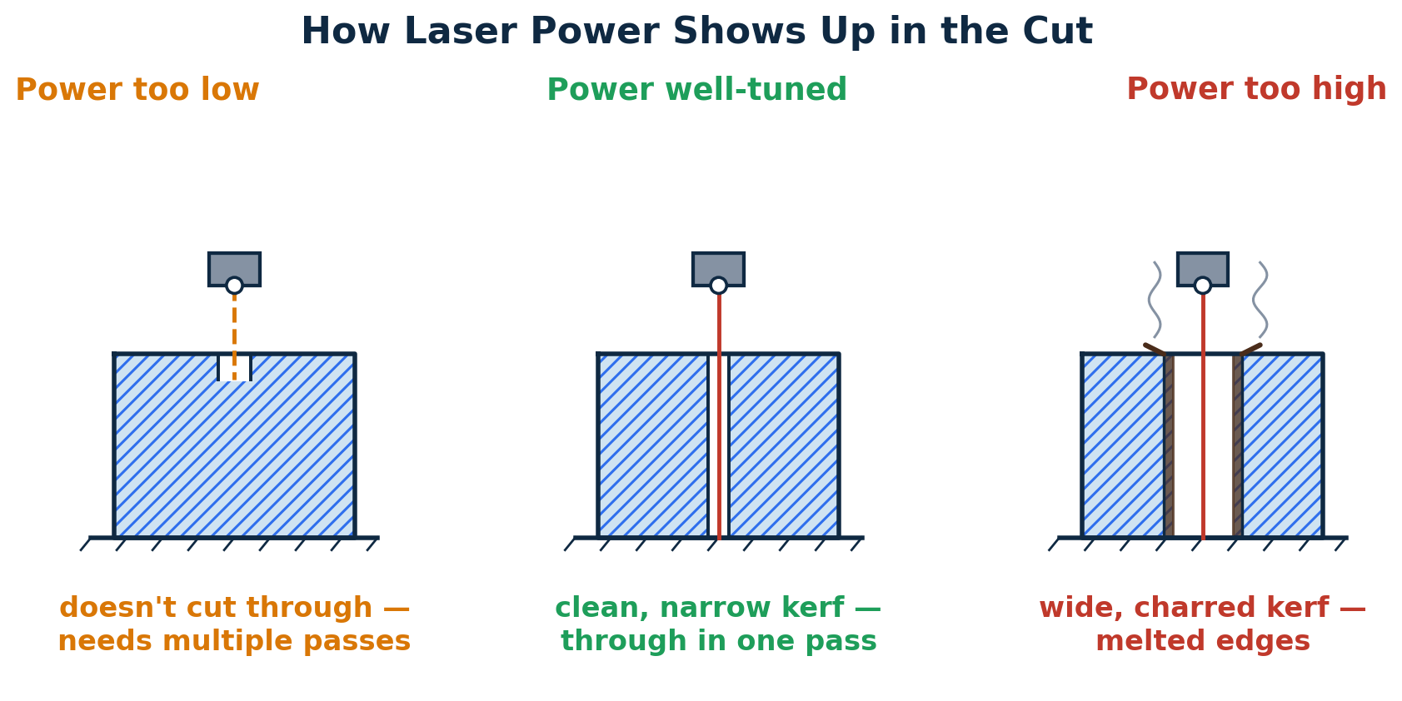
UNIT 4
Laser Cutting
Cuts flat sheet by burning or vaporizing a narrow line through it — fast and precise in 2D, with its own rules.
Kerf — the cut removes a finite width of material — account for it on tight-fitting parts
Material limits — wood, acrylic, paper, and cloth cut well
Small-feature limits — minimum hole size and spacing relative to material thickness
Never cut: PVC and other chlorinated plastics must never be cut on a laser — they release chlorine gas.
MECH 151 · Technical Design — Unit Reference Guide

Slide 55
UNIT 4
DFM Design Considerations
Shape the part so the chosen process can make it well, at reasonable cost, without special effort.
1
Match design to process
2
Minimize setups
3
Tolerance only what matters
uniform walls for printing/casting, generous radii for machining, flat unfolded geometry for laser
features on one face are cheaper than features needing re-fixturing
tight tolerances drive cost — apply to mating/functional features
4
Use standard stock & tooling
5
Design for prototype AND product
standard sizes and drill/tool radii cost less, arrive faster
what's fine for a one-off print may not survive production
MECH 151 · Technical Design — Unit Reference Guide

Slide 56
UNIT 4
Unit 4 Wrap-Up
1
Manufacturing-ready files
2
GD&T documentation
3
A DFM-reviewed design
correctly exported for the chosen process
for at least one process, showing what you'd control and why
ready to hand off to a shop process
✓
You'll produce: manufacturing-ready files and GD&T documentation demonstrating your design-for-manufacturing reasoning, plus reading and safely editing a G-code file.
Assessed by: Unit 4 Quiz (Week 16). The physical prototype build & presentation is graded separately as the course Final Exam.
MECH 151 · Technical Design — Unit Reference Guide

Slide 57
QUICK REFERENCE
All Units at a Glance
Keep this page open while you work — every unit's timing, focus, and assessment in one place.
Foundations
Before Unit 1
Define the problem, design intent, top-down vs. bottom-up
—
Unit 1 — CAD Fundamentals
Weeks 4–7
Controlled sketches, multiview drawing, first parametric model
Quiz, Wk 7
Unit 2 — CAD Advanced
Weeks 7–10
Section/auxiliary views, threads, tolerancing, production drawing
Quiz, Wk 10
Unit 3 — Design for Assembly
Weeks 11–13
Mates, joining methods, exploded drawing + BOM, DFA principles
Quiz, Wk 13
Unit 4 — Design for Manufacturing
Weeks 14–16
GD&T, manufacturing files, G-code, additive/subtractive/laser, DFM, safety
Quiz, Wk 16
Final Exam — Prototype Project
Week 17
Team-built physical prototype, manufacturing docs, presentation
30% (w/ prototype)
MECH 151 · Technical Design — Unit Reference Guide

