Slide 1
COMSATS University Islamabad Abbottabad Campus Computer Science Department Mobile Application Development Introduction to android
Prepared by: Muhammad Ibtisam Gul
Reviewed by: Mukhtiar Zamin

Slide 2
Topics
The History
What is Android
Features of Android
Android Versions / API Levels
Market Analysis
Android Development Environments

Slide 3
Mobile App
A software application
fit to run on mobile devices – phones, tablets and various other devices.
Made for popular operating systems – iOS and Android

Slide 4
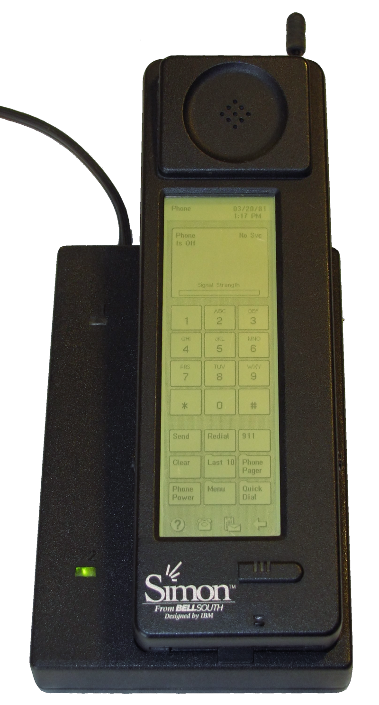
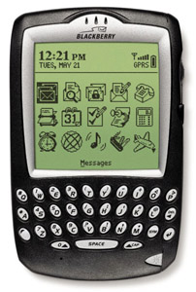
The History (First smartphones)
First smartphone (PDA) was IBM Simon (1993)
Apps like contact book, calendar, world clock and calculator.
The Blackberry 5810 (2002)
One of the early Java-based devices
2G network

Slide 5
The History (Operating Systems)
1994 – Palm OS
1997 – Symbian OS
2002 – J2ME
2005 – Windows mobile 5.0
2007 – Apple iOS
2008 – Android 1.0
2010 – Windows Phone

Slide 6
Android
Based on Linux kernel
Developed by Google
Base system is free and open-source
Largest installed base worldwide
Installed software is proprietary and closed-source

Slide 7
Features of Android OS
General Features
Messaging
Telephony
Auto Correction and dictionary
Web browser
Voice-based features
Multi-touch
Multitasking
Screen Capture
TV recording
Video calling
Multiple language support
Accessibility

Slide 8
Features of Android OS
Connectivity Features
GSM-2G, CDMA, W-CDMA, 3G, 4G-LTE, 5G
Bluetooth
Tethering
Media Features
Streaming media support
Media support
External storage
Other Features
Hardware support
Java support
Handset layout
Storage
Native APIs
Instant App

Slide 9
Top 10 features of Android 10 (Q)
Dark mode
Smart reply for all messaging apps
Better sharing menu
Focus mode
Quicker access to settings
Standard depth format
Improved files app
Overhauled permissions
WIFI sharing via QR codes
Improved gestures navigation
Google assistant handles
Hearing aids gets streaming support
Security updates via play store
Wet, overheating USB warnings

Slide 10
Android Versions
Codename | Version | API level/NDK release
Android10 | 10 | API level 29
Pie | 9 | API level 28
Oreo | 8.1.0 | API level 27
Oreo | 8.0.0 | API level 26
Nougat | 7.1 | API level 25
Nougat | 7.0 | API level 24
Marshmallow | 6.0 | API level 23
Lollipop | 5.1 | API level 22
Lollipop | 5.0 | API level 21
KitKat | 4.4 - 4.4.4 | API level 19
Jelly Bean | 4.3.x | API level 18
Jelly Bean | 4.2.x | API level 17
Jelly Bean | 4.1.x | API level 16
Ice Cream Sandwich | 4.0.3 - 4.0.4 | API level 15, NDK 8
Ice Cream Sandwich | 4.0.1 - 4.0.2 | API level 14, NDK 7
Honeycomb | 3.2.x | API level 13
Honeycomb | 3.1 | API level 12, NDK 6
Honeycomb | 3.0 | API level 11
Gingerbread | 2.3.3 - 2.3.7 | API level 10
Gingerbread | 2.3 - 2.3.2 | API level 9, NDK 5
Froyo | 2.2.x | API level 8, NDK 4
Eclair | 2.1 | API level 7, NDK 3
Eclair | 2.0.1 | API level 6
Eclair | 2.0 | API level 5
Donut | 1.6 | API level 4, NDK 2
Cupcake | 1.5 | API level 3, NDK 1
(no codename) | 1.1 | API level 2
(no codename) | 1.0 | API level 1

Slide 11
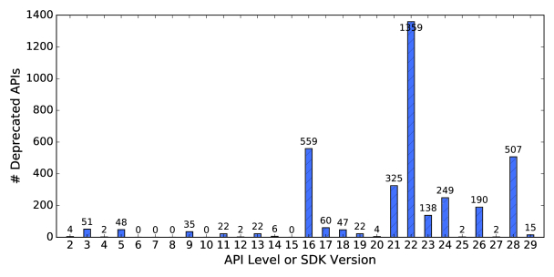
Deprecated APIs

Slide 12
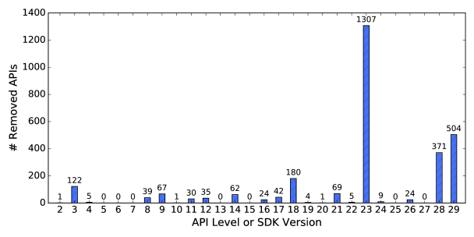
Removed APIs

Slide 13
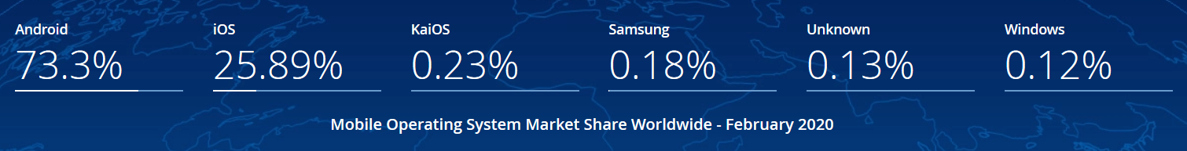
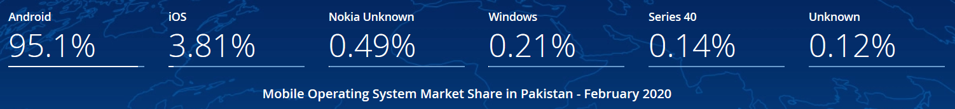
Market Analysis

Slide 14
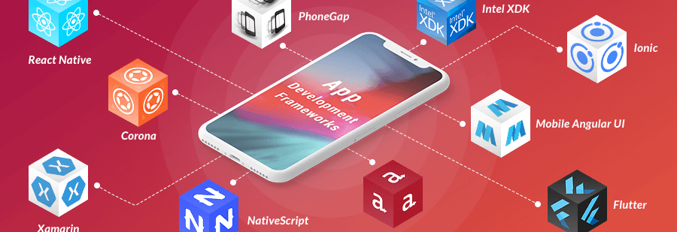
App Development Frameworks

Slide 15
The Android Development Environment
Android Studio
Your workbench for writing Android applications
Hardware Requirements for Windows OS
4 GB RAM minimum, 8 GB RAM recommended
2 GB of available disk space minimum, 4 GB Recommended (500 MB for IDE + 1.5 GB for Android SDK and emulator system image)
1280 x 800 minimum screen resolution

Slide 16
Android Studio
JDK (Java Development Kit)
Basic Java library
Android SDK (Software Development Kit)
Android libraries
NDK (Native Development Kit)
Calling native C/C++ functions
IntelliJ IDEA (Java IDE)
Features rich Java IDE adopted for android development
Gradle Build Tools
Open-source build automation system
XML (eXtensible Markup Language)
Used in layout files, manifest and settings
AVD (Android Virtual device)
Create and manage virtual devices

Slide 17
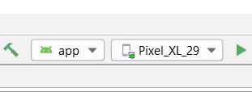
The Android Emulator
We will be using Emulators provided by Android SDK
Press run button
Running Emulator from command prompt
Direct command prompt to:
C:\Users\YourUName\AppData\Local\Android\Sdk\emulator
emulator -list-avds
emulator @(name of your emu) -gpu host

Slide 18
Emulator Pros & Cons
Pros
Doesn’t require an actual phone
Hardware is reconfigurable
Changes are non-destructive
Cons
Can be slow
Some features unavailable e.g., no support for bluetooth or USB connections
Performance / user experience can be misleading

Slide 19
Device Monitoring Tools
Tool for examining the internal state of a running application.
Android Profiler
profile your app's CPU, memory, and network usage.
Hierarchy Viewer
If you want to inspect your app's view hierarchy at runtime, use Tools > Layout Inspector.
Debugger

Slide 20
Installing Android Studio Tutorial
https://www.javaworld.com/article/3095406/android-studio-for-beginners-part-1-installation-and-setup.html
https://www.javaworld.com/article/3104621/android-studio-for-beginners-part-2-explore-and-code-the-app.html
https://www.javaworld.com/article/3104621/android-studio-for-beginners-part-2-explore-and-code-the-app.html?page=2
https://www.javaworld.com/article/3104622/android-studio-for-beginners-part-3-build-and-run-the-app.html

