Slide 1
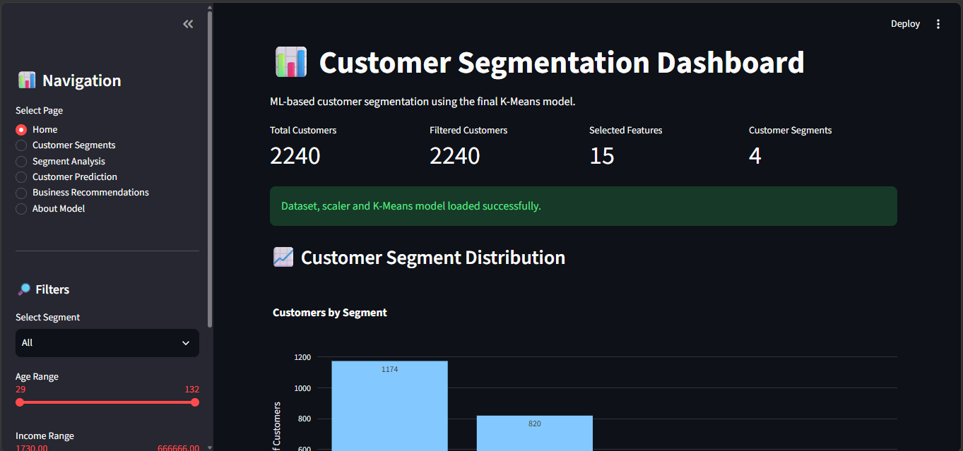
Customer Personality Analysis & Customer Segmentation Dashboard
Machine Learning / Data Science Internship Project
Prepared by: Kainat Fatima
Customer Personality Analysis & Customer Segmentation Dashboard
1

Slide 2
Project Overview
End-to-end customer segmentation and decision-support dashboard
CUSTOMERS
2,240
Final cleaned records
FEATURES
15
Selected / engineered features
SEGMENTS
4
Business-oriented customer groups
MODEL
K=4
K-Means + StandardScaler
Built an unsupervised learning workflow for behavioral customer segmentation.
Converted numerical clusters into interpretable business personas.
Integrated the trained model into a six-page Streamlit dashboard.
Added interactive analytics, prediction, recommendations, and QA testing.
Customer Personality Analysis & Customer Segmentation Dashboard
2

Slide 3
Problem Statement & Objectives
Why automated customer segmentation was needed
PROBLEM
Large customer datasets contain demographic, spending, channel, and campaign-response patterns that are difficult to interpret manually.
OBJECTIVES
Develop a practical ML-to-dashboard pipeline.
Generic marketing can waste budget and reduce campaign effectiveness.
High-value and at-risk customers may remain unidentified.
Static analysis does not easily reveal multi-attribute behavioral groups.
Clean and prepare the Customer Personality Analysis dataset.
Select meaningful features and standardize them.
Train K-Means with four final clusters.
Profile clusters and assign business-oriented names.
Deploy an interactive dashboard with model-backed prediction.
Customer Personality Analysis & Customer Segmentation Dashboard
3

Slide 4
Dataset & Selected Features
Customer Personality Analysis dataset
DATASET
2,240 records
cleaned_final.csv
FEATURE SPACE
15 features
demographic + behavioral + channel + campaign
FINAL MODEL
K-Means
4 clusters
SCALING
StandardScaler
mean 0, std 1
Demographic: Income, Age, Children
Behavioral: Total_Spend, Recency, NumDealsPurchases
Channels: NumWebPurchases, NumStorePurchases, NumCatalogPurchases, NumWebVisitsMonth
Campaign response: AcceptedCmp1–AcceptedCmp5
Customer Personality Analysis & Customer Segmentation Dashboard
4

Slide 5
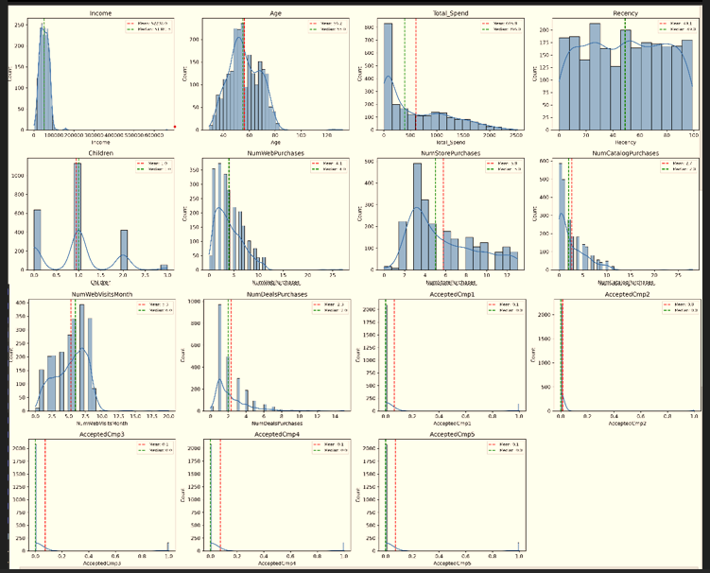
Data Preprocessing & Feature Engineering
Preparing a consistent numerical feature matrix for distance-based clustering
DATA CLEANING
Missing-value handling and validation
FEATURE ENGINEERING
Age and Total_Spend derived for segmentation
STANDARDIZATION
z = (x − μ) / σ
WHY SCALE?
Prevents high-magnitude features from dominating distance calculations.
Customer Personality Analysis & Customer Segmentation Dashboard
5

Slide 6
Machine Learning Methodology
Unsupervised K-Means workflow
1
2
3
4
5
6
Prepare
15 selected features
Scale
StandardScaler
Evaluate
Elbow + Silhouette + DB
Cluster
K-Means, K=4
Profile
Compare cluster behavior
Interpret
Business personas
K-Means was selected because the dataset has no predefined target segment.
Cluster quality was assessed using WCSS/Elbow, Silhouette, and Davies–Bouldin analysis.
The final application uses K=4 for operationally simple, interpretable segmentation.
Customer Personality Analysis & Customer Segmentation Dashboard
6

Slide 7
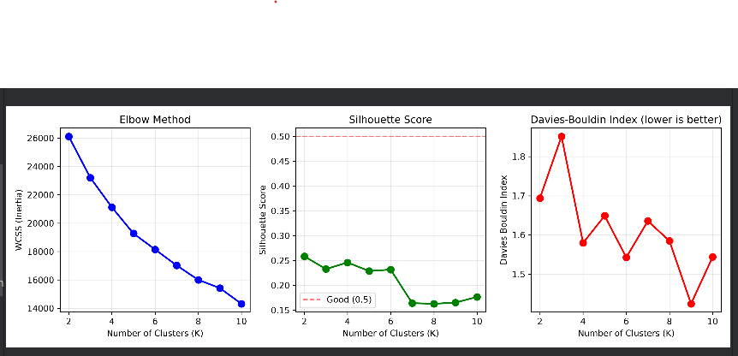
Cluster Evaluation
Elbow Method, Silhouette Score, and Davies–Bouldin Index
Combined evaluation view used to support the final clustering workflow.
Customer Personality Analysis & Customer Segmentation Dashboard
7

Slide 8
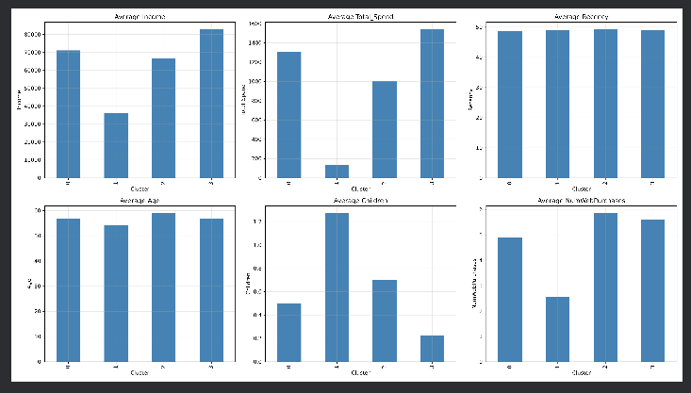
Customer Segment Profiles
Four business-oriented personas derived from cluster characteristics
Premium Buyers
High income • high spending | Catalog / Store
High-Value Customers
Solid income • consistent spending | Web / Store
Discount Seekers
Price-sensitive • deal-focused | Web / Deals
At-Risk Customers
High recency • lower engagement | Minimal / Dormant
Customer Personality Analysis & Customer Segmentation Dashboard
8

Slide 9
Interactive Dashboard
Streamlit + Plotly decision-support interface
Home / Overview with KPI summaries
Customer Segments distribution and comparison
Segment Analysis with behavioral insights
Customer Prediction for individual inference
Business Recommendations
About Model and artifact information
Customer Personality Analysis & Customer Segmentation Dashboard
9

Slide 10
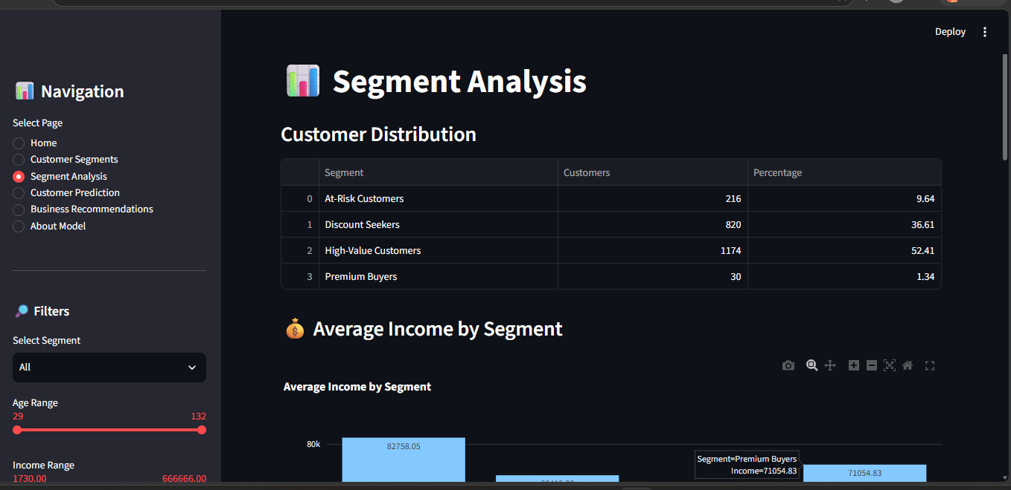
Segment Analysis
Interactive comparison of customer distribution and segment insights
INTERACTIVE FILTERS
Age, income, and segment filters
VISUAL ANALYTICS
Segment distribution and average income comparisons
DATA ACCESS
Customer search and filtered CSV export
Customer Personality Analysis & Customer Segmentation Dashboard
10

Slide 11
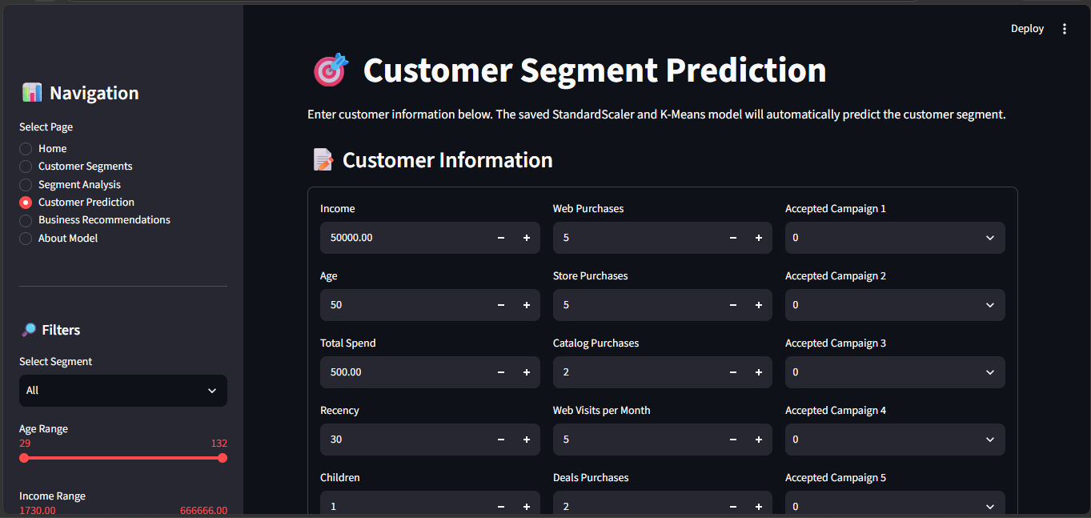
Model Integration & Customer Prediction
Saved ML artifacts connected directly to the Streamlit application
Customer Input
Feature Order
StandardScaler
K-Means
Cluster ID
Segment Name
Recommendation
selected_features.txt keeps inference feature order consistent.
Saved scaler and K-Means artifacts are loaded by the application.
Prediction returns a cluster and maps it to a human-readable business persona.
Customer Personality Analysis & Customer Segmentation Dashboard
11

Slide 12
Strategic Business Recommendations
Turning segmentation into actionable marketing decisions
Premium Buyers
Business Focus
VIP retention & value maximization
Recommended Actions
Exclusive loyalty, early product access, premium catalog/store service
High-Value Customers
Business Focus
Cross-selling & loyalty growth
Recommended Actions
Personalized campaigns, tiered rewards, complementary recommendations
Discount Seekers
Business Focus
Volume incentivization
Recommended Actions
Targeted discount codes, value bundles, promotional web campaigns
At-Risk Customers
Business Focus
Churn mitigation & win-back
Recommended Actions
Re-engagement emails, win-back incentives, feedback surveys
Customer Personality Analysis & Customer Segmentation Dashboard
12

Slide 13
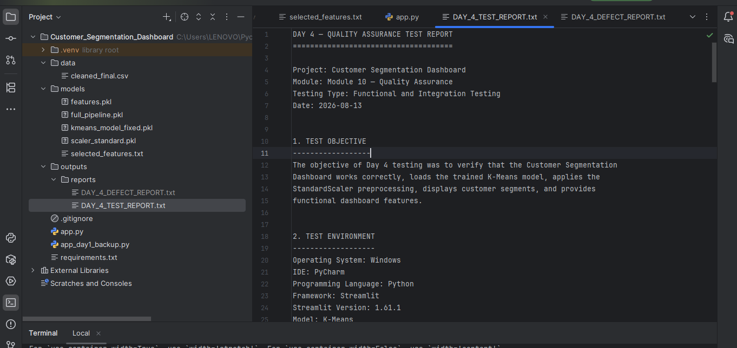
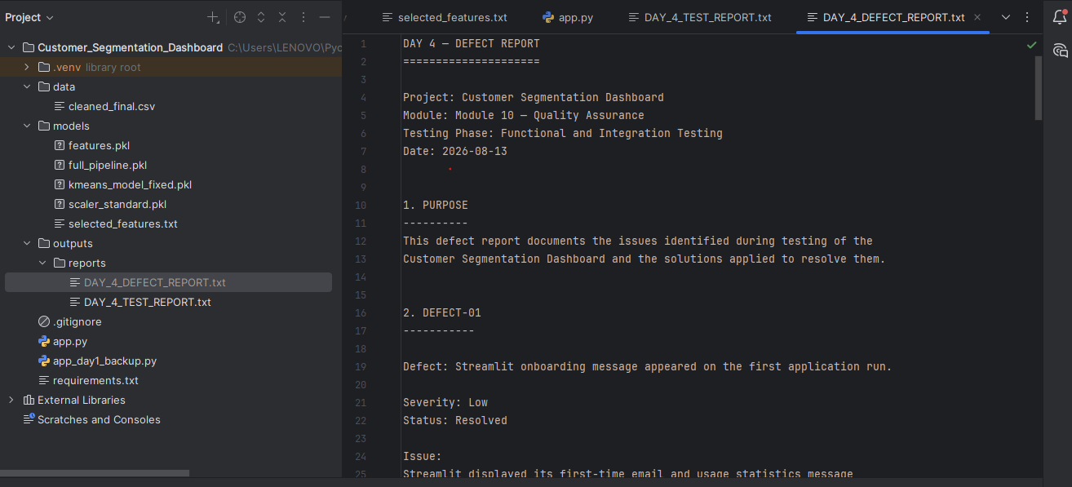
Quality Assurance & Defect Resolution
Day 4 functional, interface, filtering, visualization, and model-inference testing
TEST RESULTS
PASS
Model initialization, filtering, Plotly rendering, search, CSV export, and prediction
DEFECT 01
Resolved
Feature-order mismatch fixed using selected_features.txt
DEFECT 02
Resolved
Chart redraw latency reduced using suitable Streamlit caching
Customer Personality Analysis & Customer Segmentation Dashboard
13

Slide 14
Project Outcomes & Future Enhancements
Final deliverables and next steps
DATA
2,240 records
processed through final workflow
SEGMENTS
4 personas
business-oriented customer groups
DASHBOARD
6 pages
interactive Streamlit application
QA
Completed
test + defect reports
Deploy the Streamlit dashboard to a cloud environment.
Connect the application to a live database.
Introduce periodic re-clustering as new customer data becomes available.
Compare additional clustering approaches and extend analysis with RFM.
Integrate segmentation with CRM or marketing automation systems.
Customer Personality Analysis & Customer Segmentation Dashboard
14

Slide 15
Conclusion
The project demonstrates an end-to-end machine learning workflow—from data preparation and K-Means clustering to model integration, interactive visualization, business recommendations, and quality assurance.
Thank You
Kainat Fatima • Customer Personality Analysis & Customer Segmentation Dashboard
Customer Personality Analysis & Customer Segmentation Dashboard
15

