Slide 1
17기 정규세션
ToBig’s 16기 강의자
김건우
Optimization

Slide 2
Unit 01 ㅣ Introduction
Unit 02 ㅣ MLE, MAP
Contents
Unit 03 ㅣ Gradient Descent Algorithm
Unit 04 ㅣ Hyperparameter Optimization

Slide 3
Unit 01 ㅣIntroduction
Unit 01 - Introduction

Slide 4
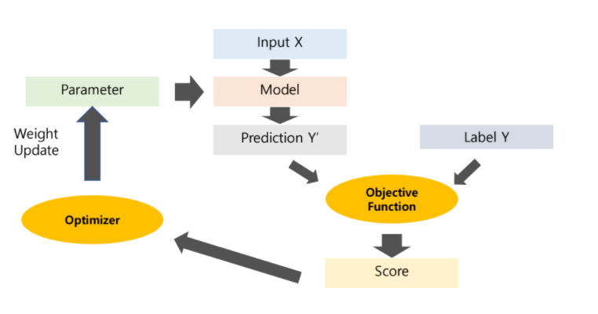
Unit 01 ㅣIntroduction
Machine Learning Workflow
How it works?

Slide 5
Unit 01 ㅣIntroduction
Machine Learning is the process of finding optimal parameters through
OPTIMIZATION to have the best performance

Slide 6
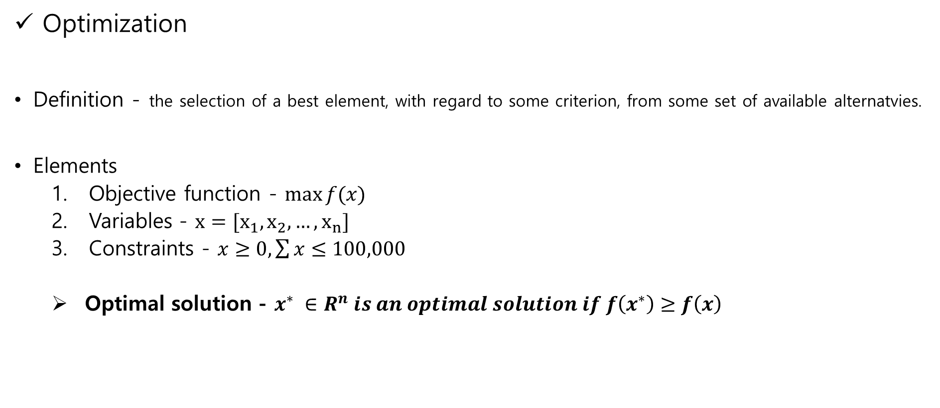
Unit 01 ㅣ Introduction
Optimization
Definition - the selection of a best element, with regard to some criterion, from some set of available alternatvies.
Elements
Objective function - $\max{f(x)}$
Variables - $x=[x_{1},x_{2},…, x_{n}]$
Constraints - $x≥0, \sum{x}≤100,000$
Optimal solution - $x^{∗} ∈R^{n} is an optimal solution if f\left(x^{∗}\right)≥f\left(x\right)$
Linear Programming, Quadratic Programming etc.

Slide 7
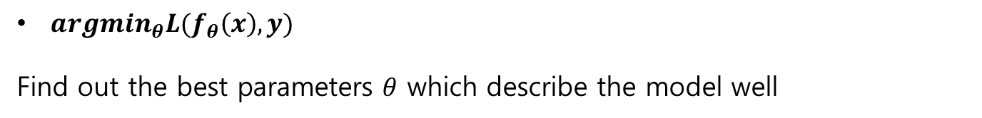





Unit 01 ㅣ Introduction
Optimization
Input
$$x$$
SVM,RF
$$f_{θ }$$
Output
$$\hat{y}=f_{θ }(x)$$
Loss function
$$L(f_{θ }\left(x\right),y)$$
$$update θ$$
$argmin_{θ}L(f_{θ}\left(x\right),y)$
Find out the best parameters $θ$ which describe the model well

Slide 8
Unit 02 ㅣMLE, MAP
Unit 02
Maximum Likelihood Estimation (MLE)
Maximum a Posteriori Estimation (MAP)

Slide 9

Unit 02 ㅣMLE MAP
Bayes Rule :$P\left(A | B\right)=\frac{P\left(B | A\right)P(A)}{P(B)}=\frac{P\left(B | A\right)P(A)}{\sum_{A}{P\left(B | A\right)P(A)}}$
$P\left(A | B\right)$ : Posterior Probability
$P\left(B | A\right)$ : Likelihood
$P(A)$ : Prior
$P(B)$ : Evidence Probability / Marginal

Slide 10
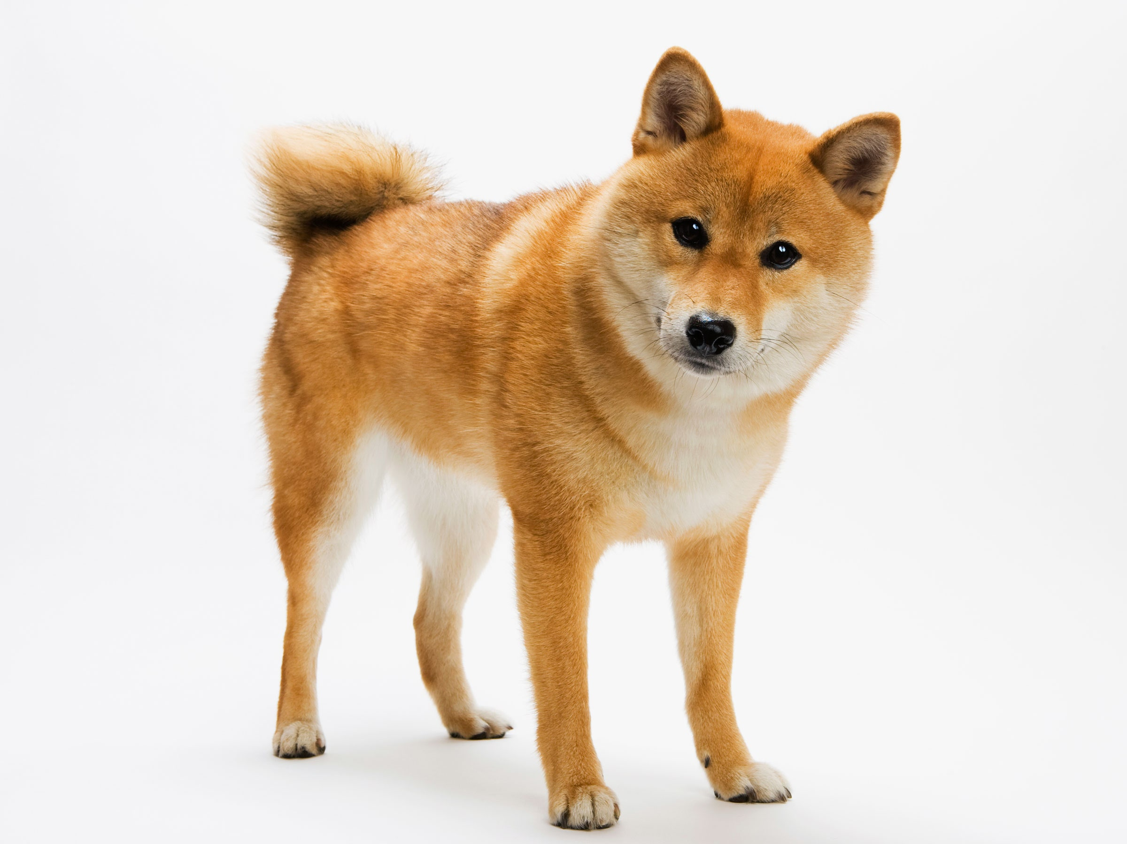
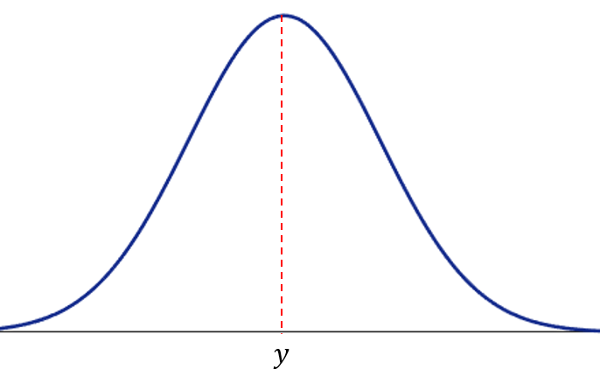
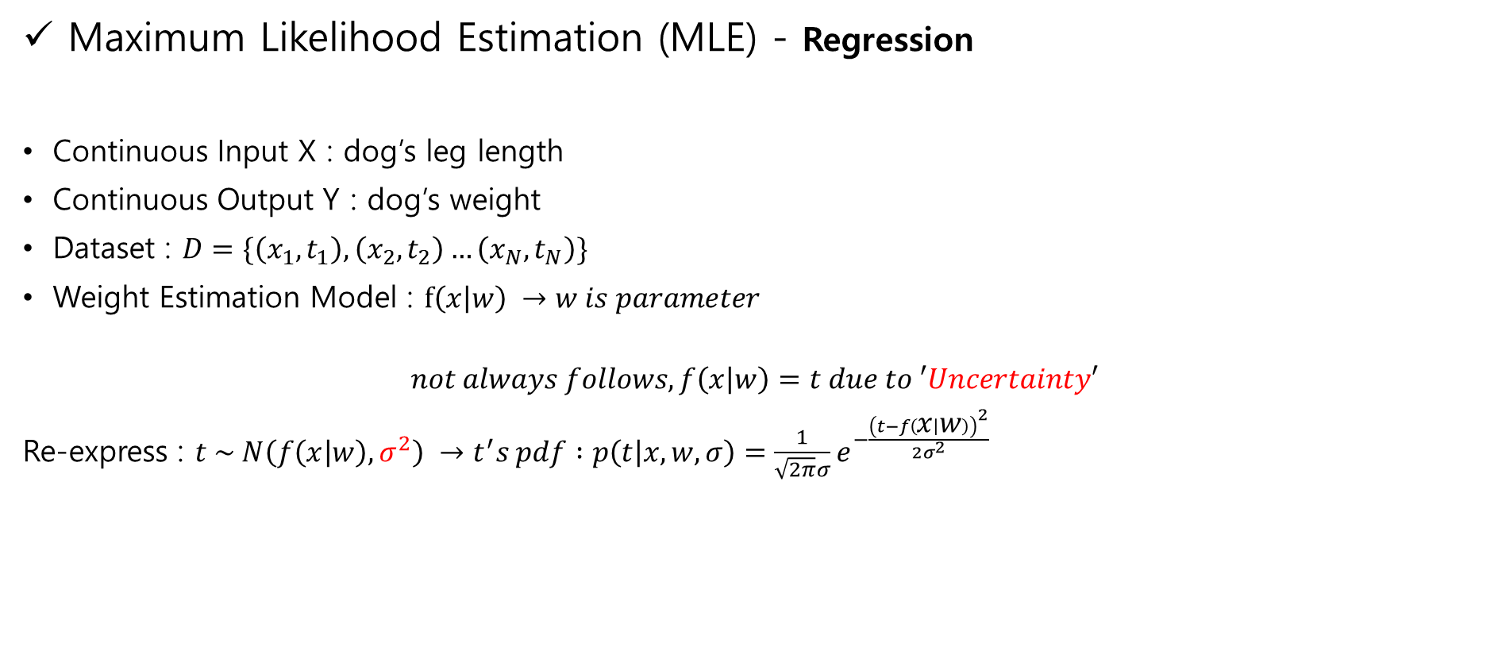
Unit 02 ㅣMLE, MAP
Maximum Likelihood Estimation (MLE) - Regression
Continuous Input X : dog’s leg length
Continuous Output Y : dog’s weight
Dataset : $D=\{\left(x_{1},t_{1}\right),\left(x_{2},t_{2}\right)…\left(x_{N},t_{N}\right)\}$
Weight Estimation Model : $f\left(x | w\right) →w is parameter$
$$not always follows, f\left(x | w\right)=t due to ′Uncertainty′$$
Re-express : $t \sim N\left(f\left(x | w\right),σ^{2}\right) →t^{′}s pdf :p\left(t | x,w,σ\right)=\frac{1}{\sqrt{2π}σ}e^{−\frac{{\left(t−f\left(x | w\right)\right)}^{2}}{2σ^{2}}}$
Weight : 20kg
Leg length : 10cm
Gaussian Distribution

Slide 11
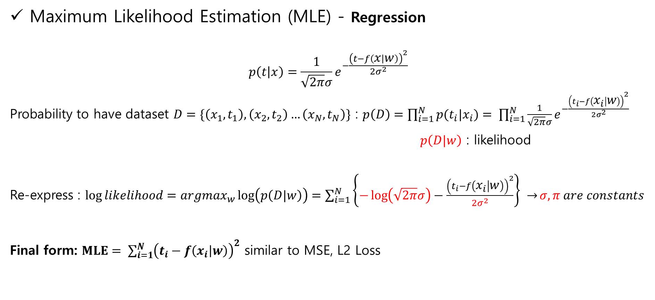
Unit 02 ㅣMLE, MAP
Maximum Likelihood Estimation (MLE) - Regression
$$p\left(t | x\right)=\frac{1}{\sqrt{2π}σ}e^{−\frac{{\left(t−f\left(x | w\right)\right)}^{2}}{2σ^{2}}}$$
Probability to have dataset $D=\{\left(x_{1},t_{1}\right),\left(x_{2},t_{2}\right)…\left(x_{N},t_{N}\right)\}$ : $p\left(D\right)=\prod_{i=1}^{N}{p(t_{i}|x_{i})}= \prod_{i=1}^{N}{\frac{1}{\sqrt{2π}σ}e^{−\frac{{\left(t_{i}−f\left(x_{i} | w\right)\right)}^{2}}{2σ^{2}}}}$
$p\left(D|w\right)$ : likelihood
Re-express : $\log{likelihood}=argmax_{w}\log\left(p\left(D|w\right)\right)=\sum_{i=1}^{N}{\left\{−\log\left(\sqrt{2π}σ\right)−\frac{{\left(t_{i}−f\left(x_{i} | w\right)\right)}^{2}}{2σ^{2}}\right\} →}σ,π are constants$
Final form: $MLE= \sum_{i=1}^{N}{{\left(t_{i}−f\left(x_{i} | w\right)\right)}^{2}}$ similar to MSE, L2 Loss

Slide 12

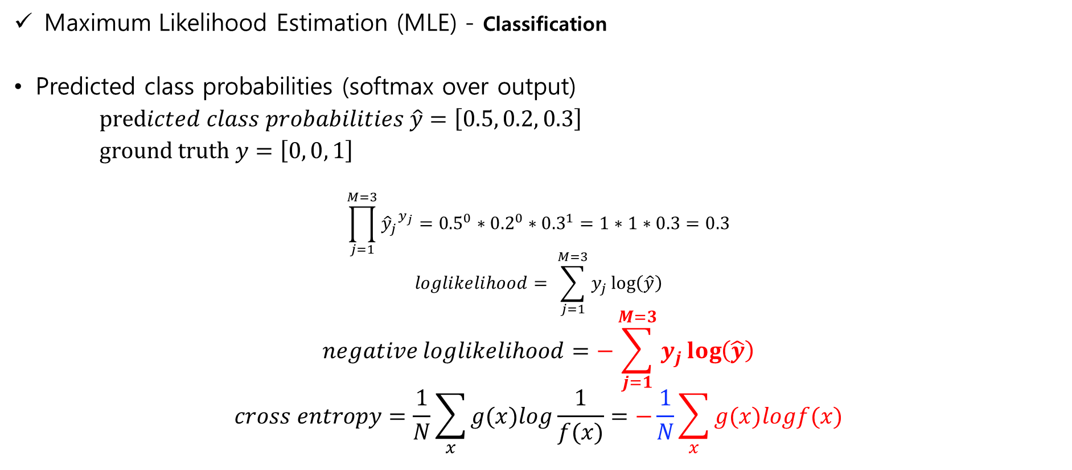
Unit 02 ㅣMLE, MAP
Maximum Likelihood Estimation (MLE) - Classification
Predicted class probabilities (softmax over output)
$predicted class probabilities \hat{y}=\left[0.5, 0.2, 0.3\right]$
$ground truth y=\left[0, 0, 1\right]$
$$\prod_{j=1}^{M=3}{{{\hat{y}}_{j}}^{y_{j}}}={0.5}^{0}∗{0.2}^{0}∗{0.3}^{1}=1∗1∗0.3=0.3$$
$$loglikelihood= \sum_{j=1}^{M=3}{y_{j}\log\left(\hat{y}\right)}$$
$$negative loglikelihood=−\sum_{j=1}^{M=3}{y_{j}\log\left(\hat{y}\right)}$$
$$cross entropy=\frac{1}{N}\sum_{x}{g(x)log\frac{1}{f(x)}}=−\frac{1}{N}\sum_{x}{g(x)logf(x)}$$

Slide 13

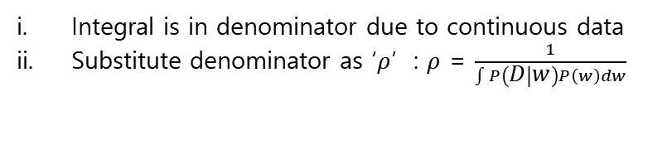
Unit 02 ㅣMLE, MAP
Maximum A Posterior (MAP)
Find out parameters only using ‘data’ – MLE
Find out parameters using ‘data’ and ‘prior’ – MAP
Posterior : $P\left(w | D\right)=\frac{P\left(D | w\right)P(w)}{\int{P\left(D | w\right)P\left(w\right)}dw}$
Re-express: $P\left(w | D\right)=ρP\left(D | w\right)P(w)$
Integral is in denominator due to continuous data
Substitute denominator as ‘$ρ$’ : $ρ$ = $\frac{1}{\int{P\left(D | w\right)P\left(w\right)}dw}$

Slide 14
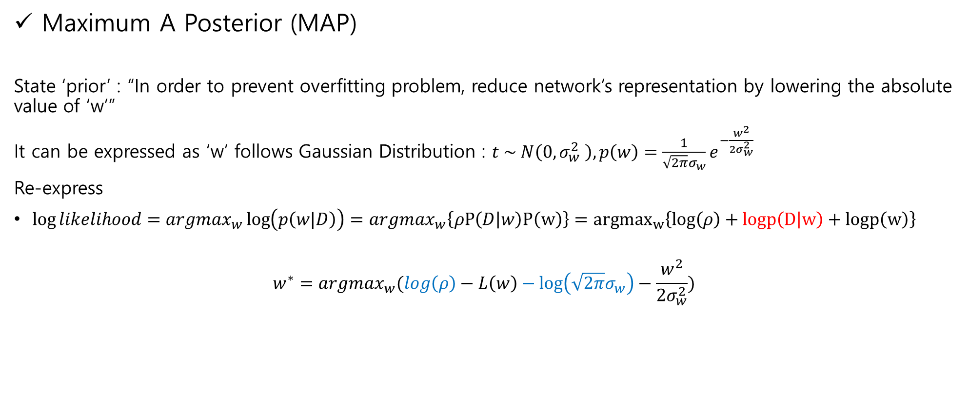
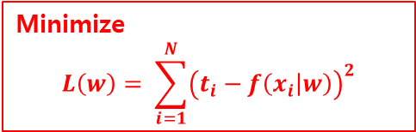
Unit 02 ㅣMLE, MAP
Maximum A Posterior (MAP)
State ‘prior’ : “In order to prevent overfitting problem, reduce network’s representation by lowering the absolute value of ‘w’”
It can be expressed as ‘w’ follows Gaussian Distribution : $t \sim N\left(0,σ_{w}^{2} \right), p\left(w\right)=\frac{1}{\sqrt{2π}σ_{w}}e^{−\frac{w^{2}}{2σ_{w}^{2}}}$
Re-express
$\log{likelihood}=argmax_{w}\log\left(p\left(w|D\right)\right)=argmax_{w}\left\{ρP\left(D | w\right)P\left(w\right)\right\}={argmax}_{w}\left\{log\left(ρ\right)+logp\left(D | w\right)+logp\left(w\right)\right\}$
$$w^{∗}=argmax_{w}(log\left(ρ\right)−L\left(w\right)−\log\left(\sqrt{2π}σ_{w}\right)−\frac{w^{2}}{2σ_{w}^{2}})$$
Minimize
$$L\left(w\right)= \sum_{i=1}^{N}{{\left(t_{i}−f\left(x_{i} | w\right)\right)}^{2}}$$
Final form: $MAP=L\left(W\right)+\frac{w^{2}}{2σ_{w}^{2}}=\sum_{i=1}^{N}{{\left(t_{i}−f\left(x_{i} | w\right)\right)}^{2}}+\frac{w^{2}}{2σ_{w}^{2}}$similar to weight decay, L2 Regularization

Slide 15
Unit 03 ㅣGradient Descent Algorithm
Unit 03 – Gradient Descent Algorithm

Slide 16
Unit 03 ㅣGradient Descent Algorithm
MLE, MAP are general approach to estimating parameters in statistical models
specify objective function
Gradient Descent Algorithm is an optimization algorithm
finds the optimal solution to a problem which MLE specified
other methods (exhaustive search, genetic search) but GD is the best one

Slide 17
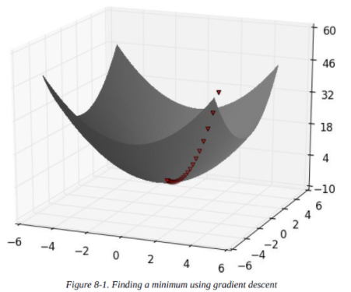
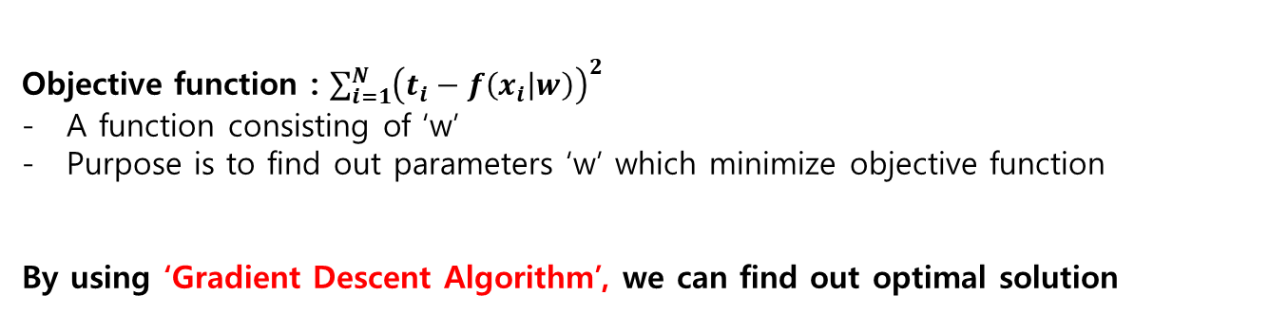
Unit 03 ㅣGradient Descent Algorithm
Gradient Descent Algorithm
Objective function : $\sum_{i=1}^{N}{{\left(t_{i}−f\left(x_{i} | w\right)\right)}^{2}}$
A function consisting of ‘w’
Purpose is to find out parameters ‘w’ which minimize objective function
By using ‘Gradient Descent Algorithm’, we can find out optimal solution

Slide 18
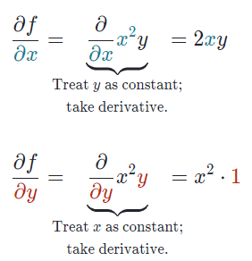
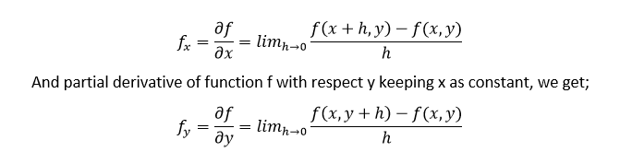

Unit 03 ㅣGradient Descent Algorithm
Partial Derivative : pretend other variables as constant
- $f\left(x,y\right)=x^{2}y$

Slide 19
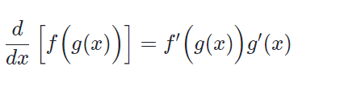
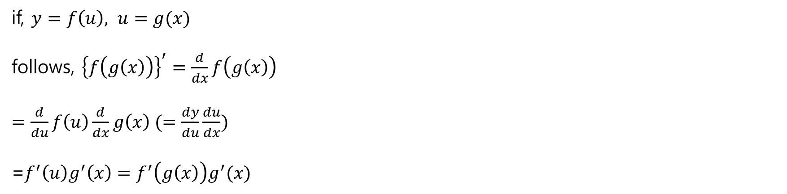
Unit 03 ㅣGradient Descent Algorithm
Chain Rule : a method to find the derivative of a composite function
if, $y=f\left(u\right), u=g(x)$
follows, ${\left\{f\left(g\left(x\right)\right)\right\}}^{′}=\frac{d}{dx}f\left(g\left(x\right)\right)$
$=\frac{d}{du}f\left(u\right)\frac{d}{dx}g\left(x\right) (=\frac{dy}{du}\frac{du}{dx})$
=$f^{′}\left(u\right)g^{′}\left(x\right)=f^{′}\left(g\left(x\right)\right)g^{′}(x)$

Slide 20
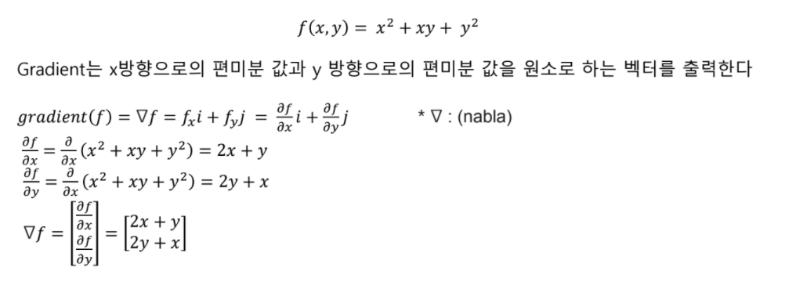
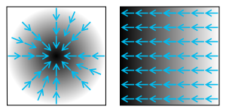
Unit 03 ㅣGradient Descent Algorithm
Gradient : the vector field whose value at a point ‘p’ is the vector whose components are the partial derivatives of ‘f’ at ‘p’. It can be interpreted as the “direction and rate of fastest increase”

Slide 21

Unit 03 ㅣGradient Descent Algorithm
Gradient Descent

Slide 22
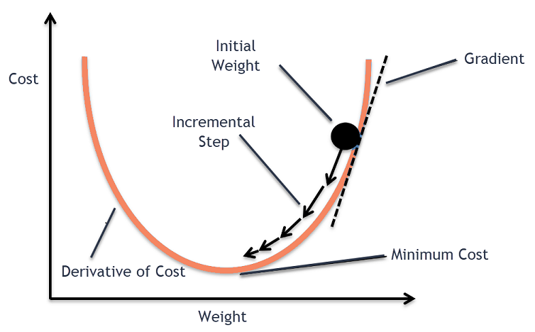

Unit 03 ㅣGradient Descent Algorithm
Gradient Descent : an iterative optimization algorithm for finding the local minimum of a function
Take steps proportional to the negative of the gradient
Repeat until convergence
: $θ_{j}≔θ_{j}−α\frac{∂}{∂θ_{j}}J(θ)$
Gradient Ascent
Take steps proportional to the positive of the gradient
-> find the local maximum

Slide 23
Unit 03 ㅣGradient Descent Algorithm
Gradient Descent
Gradient : steep scale
Learning Rate : step scale
Local Minimum : convergence point
Global Minimum : optimal convergence point

Slide 24
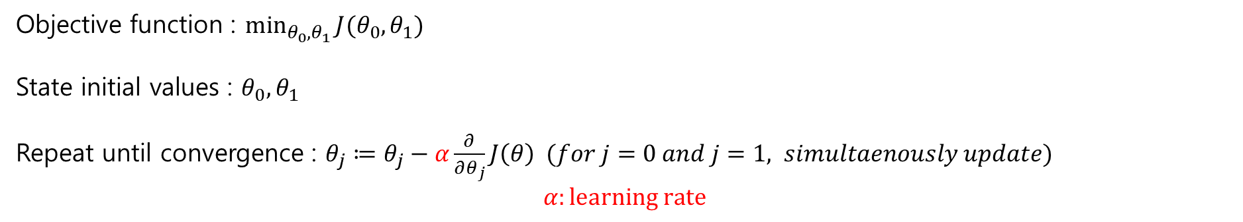
Unit 03 ㅣGradient Descent Algorithm
Gradient Descent Algorithm
Objective function : $\min_{θ_{0},θ_{1}}{J(θ_{0},θ_{1})}$
State initial values : $θ_{0}, θ_{1}$
Repeat until convergence : $θ_{j}≔θ_{j}−α\frac{∂}{∂θ_{j}}J\left(θ\right) (for j=0 and j=1, simultaenously update)$
$$α:learning rate$$

Slide 25
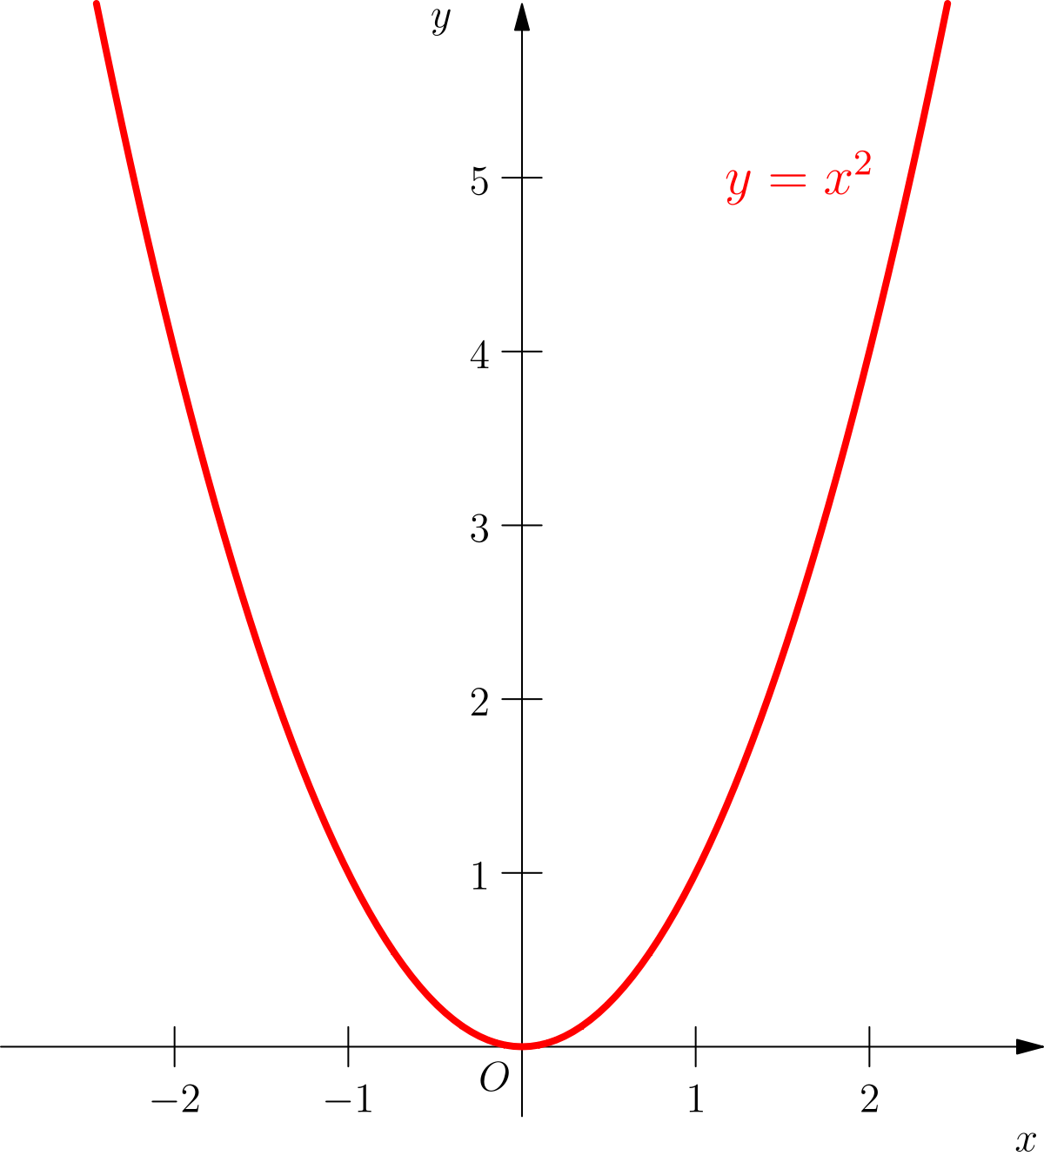
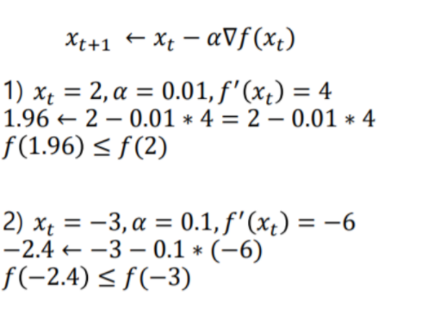
Unit 03 ㅣGradient Descent Algorithm
Gradient Descent Algorithm
Example : $f\left(x\right)=x^{2}$

Slide 26
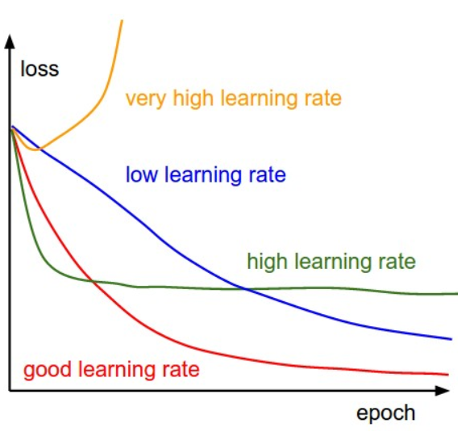
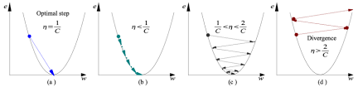
Unit 03 ㅣGradient Descent Algorithm
Learning Rate
Learning rate is optimal, model converges to the minimum
Learning rate is too small, it takes more time but converges to the minimum
Learning rate is higher than the optimal value, it overshoots but converges
Learning rate is very large, it overshoots and diverges

Slide 27
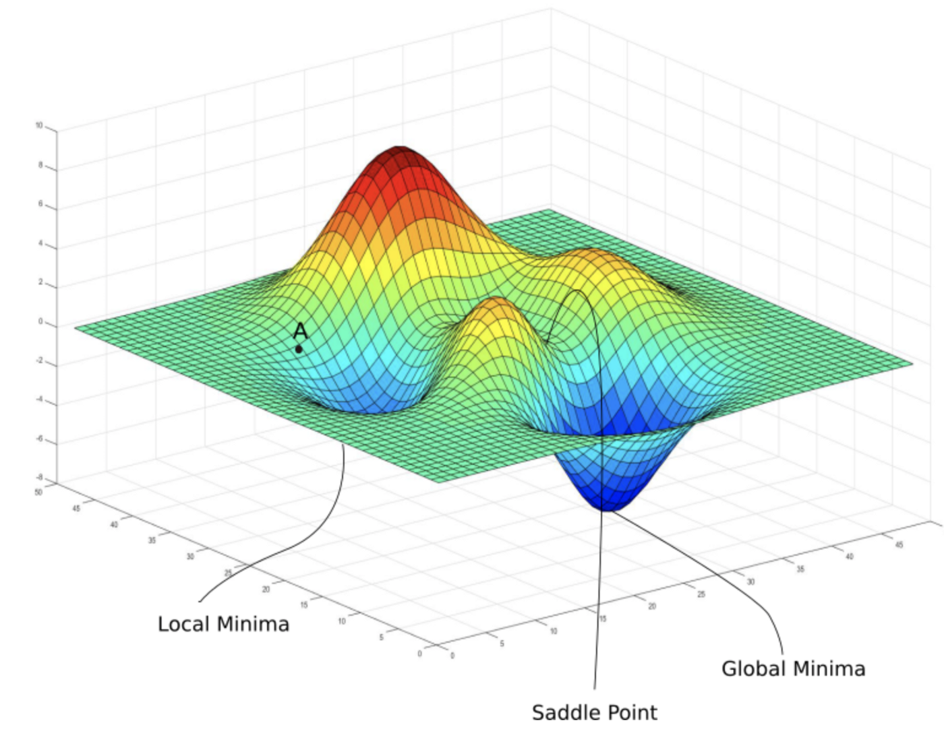
Unit 03 ㅣGradient Descent Algorithm
Initial Point

Slide 28
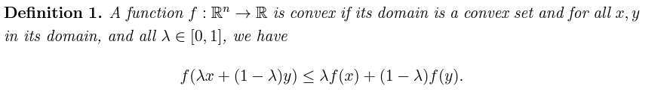
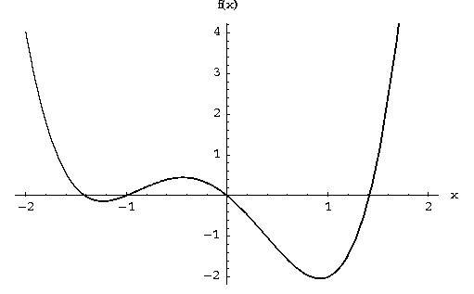
Unit 03 ㅣGradient Descent Algorithm
Initial Point
Convex function : doesn’t matter where to start
Non-convex function : does matter where to start a lot. It can converge to local minima or saddle point.

Slide 29
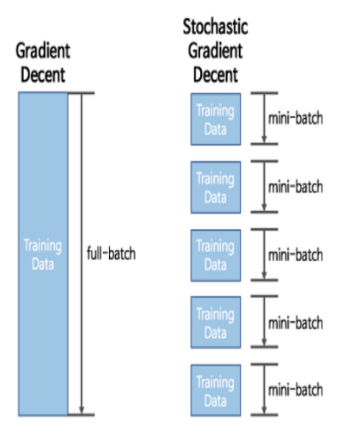
Unit 03 ㅣGradient Descent Algorithm
Batch Learning
Batch Gradient Descent – BGD
Calculate the gradient for all datasets at once
Stochastic Gradient Descent – SGD
Calculate the gradient for only one arbitrary dataset at a time of learning
Mini Batch Gradient Descent - MGD
Calculate the gradient for only a part of dataset at a time of learning

Slide 30
Unit 03 ㅣGradient Descent Algorithm
Batch Learning
 | BGD | SGD
Pros | - Stable learning - Parallel processing | Fast optimization Solve out local minima
Cons | Local minima Need large memory | No parallel processing Not stable learning
BGD pros + SGD pros = MGD (Mini Batch Gradient Descent)

Slide 31
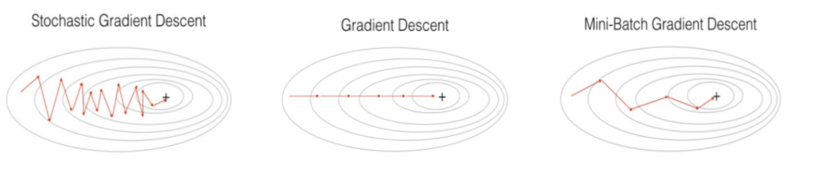
Unit 03 ㅣGradient Descent Algorithm
Batch Learning

Slide 32


Unit 03 ㅣGradient Descent Algorithm
Gradient Descent in Logistic Regression
$$p\left(X_{i}\right)=\frac{1}{1+e^{−X_{i}θ}}$$
$$L\left(X\right)= \prod{p{\left(X_{i}\right)}^{y_{i}}{\left(1−p\left(X_{i}\right)\right)}^{1−y_{i}}}$$
$$l\left(X\right)=−logL\left(x\right)=−\sum{[y_{i}logp\left(X_{i}\right)+\left(1−y_{i}\right)\log\left(1−p\left(X_{i}\right)\right)]}$$
$$θ=argmin_{θ}l(x)$$

Slide 33

Unit 03 ㅣGradient Descent Algorithm
Gradient Descent in Logistic Regression
$$l\left(X\right)=−logL\left(x\right)=−\sum{[y_{i}logp\left(X_{i}\right)+\left(1−y_{i}\right)\log\left(1−p\left(X_{i}\right)\right)]}$$
$$=−\sum{[y_{i}log\frac{p\left(X_{i}\right)}{1−p(X_{i})}+\log\left(1−p\left(X_{i}\right)\right)]}$$
$$=−\sum{[y_{i}log\frac{1}{e^{−X_{i}θ}}−\log\left(\frac{1+e^{−X_{i}θ}}{e^{−X_{i}θ}}\right)]}$$
$$=−\sum{[y_{i}X_{i}θ−\log\left(e^{X_{i}θ}+1\right)]}$$

Slide 34
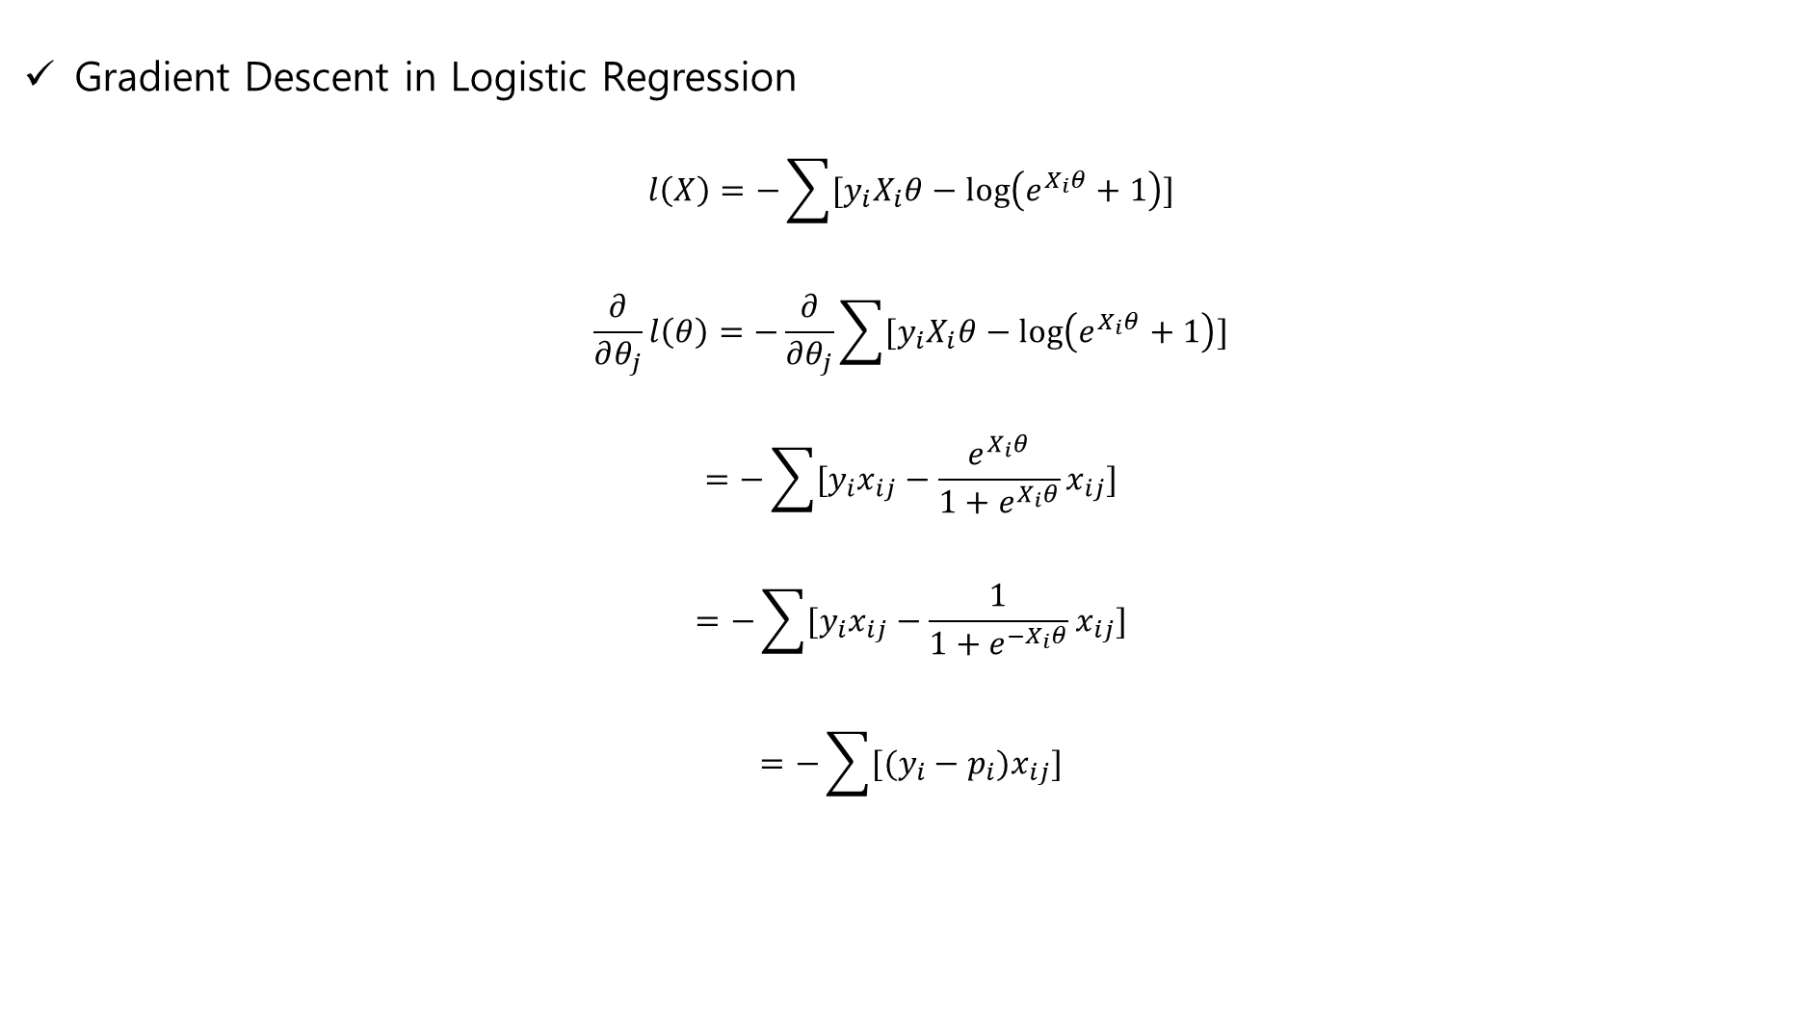
Unit 03 ㅣGradient Descent Algorithm
Gradient Descent in Logistic Regression
$$l\left(X\right)=−\sum{[y_{i}X_{i}θ−\log\left(e^{X_{i}θ}+1\right)]}$$
$$\frac{∂}{∂θ_{j}}l\left(θ\right)=−\frac{∂}{∂θ_{j}}\sum{[y_{i}X_{i}θ−\log\left(e^{X_{i}θ}+1\right)]}$$
$$=−\sum{[y_{i}x_{ij}−\frac{e^{X_{i}θ}}{1+e^{X_{i}θ}}x_{ij}]}$$
$$=−\sum{[y_{i}x_{ij}−\frac{1}{1+e^{−X_{i}θ}}x_{ij}]}$$
$$=−\sum{[(y_{i}−p_{i})x_{ij}]}$$

Slide 35

Unit 03 ㅣGradient Descent Algorithm
Gradient Descent in Logistic Regression
$$after calculating gradient, update parameters$$
$$θ_{j}^{t+1}←θ_{j}^{t}−α\frac{1}{N}\frac{∂}{∂θ_{j}^{t}}l\left(θ^{t}\right)$$
$$θ_{j}^{t+1}←θ_{j}^{t}−α\frac{1}{N}\sum{[(y_{i}−p_{i})x_{ij}]}$$
Consider number of data

Slide 36
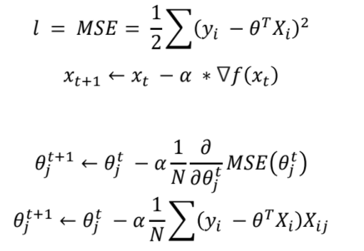
Unit 03 ㅣGradient Descent Algorithm
Gradient Descent in Linear Regression

Slide 37
Unit 04 ㅣHyperparameter Optimization
Unit 04 – Hyperparameter Optimization

Slide 38
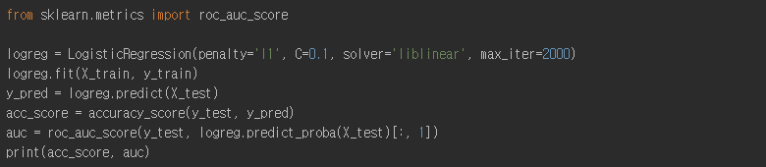
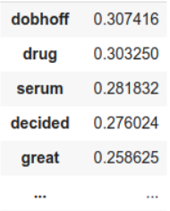
Unit 04 ㅣHyperparameter Optimization
Hyperparameter : a parameter whose value is used to control the learning process
Parameter : the values of parameters (weights) are learned

Slide 39
Unit 04 ㅣHyperparameter Optimization
Hyperparameter optimization : black-box optimization
We don’t know Objective Function
Cannot solve gradient
High cost
Manual Search – the idea is to first take big jumps in values and then small jumps to focus around a specific value which performed better
Grid Search – try all the ‘exhaustive’ combinations of parameter values and choose the best out of it
Random Search – try only ‘random’ combinations out of all the available combinations
Bayesian Optimization – take an intelligent guess about the next combination to be tried by looking at the results of previous combinations

Slide 40

Unit 04 ㅣHyperparameter Optimization
Manual Search

Slide 41
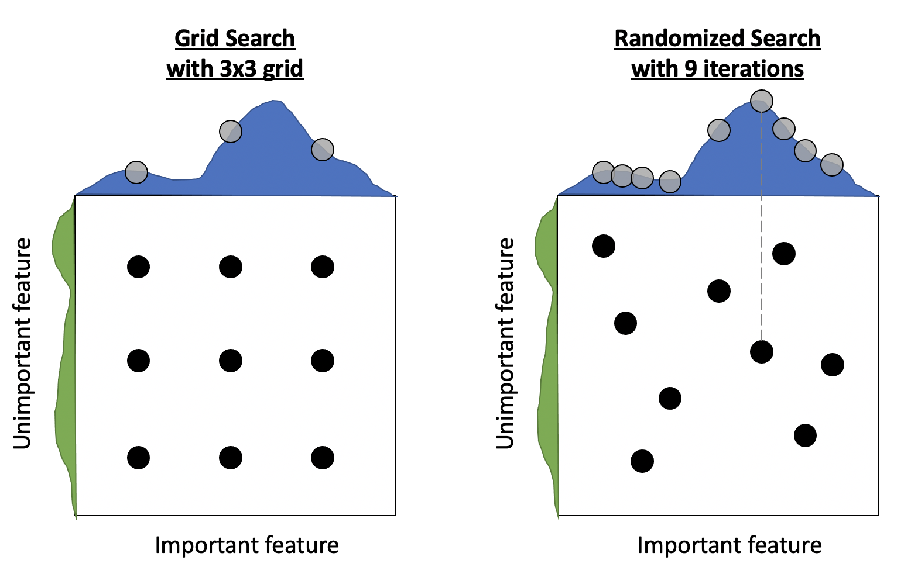
Unit 04 ㅣHyperparameter Optimization
Grid Search, Random Search

Slide 42
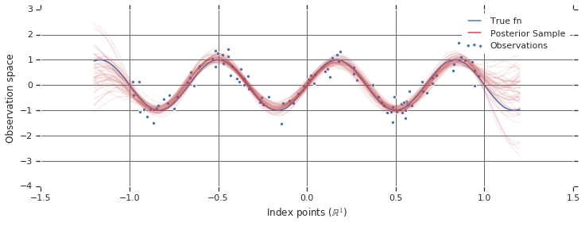

Unit 04 ㅣHyperparameter Optimization
Bayesian Optimization : the basic idea is to estimate f(x) based on observed data and choose following parameters based on the estimated model f(x)
When estimating, f(x) use bayes theorm - $P(f|D)∝P\left(D | f\right)P(f)$
$$x^{∗}=argmin_{x}f(x)$$
Assume f(x) follows Gaussian Process

Slide 43
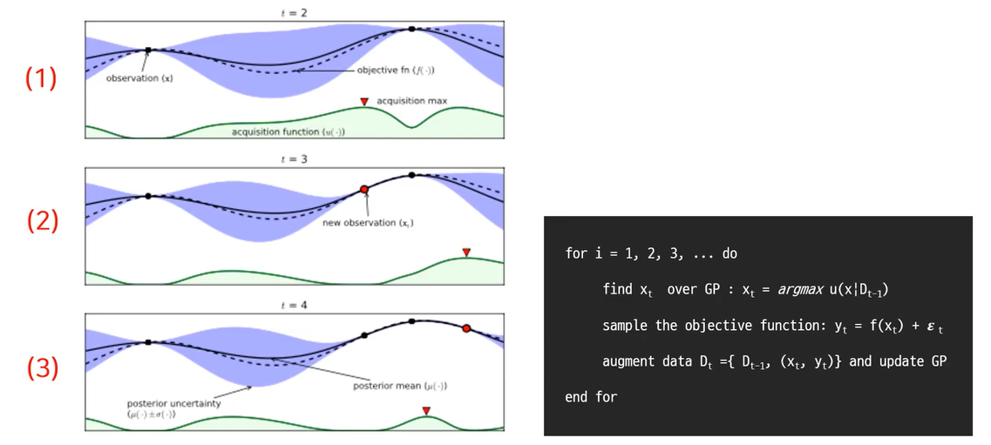
Unit 04 ㅣHyperparameter Optimization
Bayesian Optimization Algorithm

Slide 44
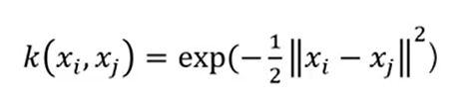
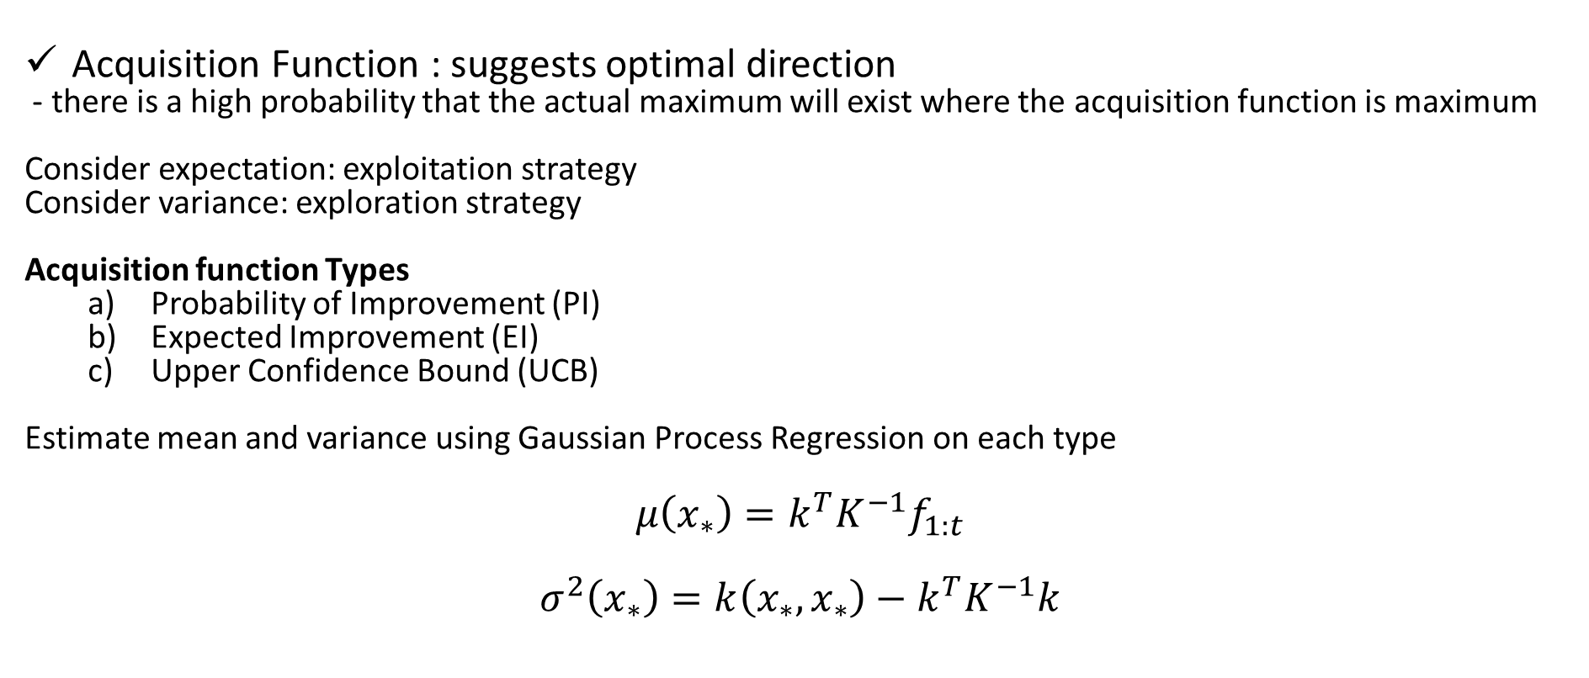
Unit 04 ㅣHyperparameter Optimization
Acquisition Function : suggests optimal direction
- there is a high probability that the actual maximum will exist where the acquisition function is maximum
Consider expectation: exploitation strategy
Consider variance: exploration strategy
Acquisition function Types
Probability of Improvement (PI)
Expected Improvement (EI)
Upper Confidence Bound (UCB)
Estimate mean and variance using Gaussian Process Regression on each type
$$μ\left(x_{∗}\right)=k^{T}K^{−1}f_{1:t}$$
$$σ^{2}\left(x_{∗}\right)=k\left(x_{∗},x_{∗}\right)−k^{T}K^{−1}k$$

Slide 45

Unit 04 ㅣHyperparameter Optimization
Bayesian Optimization
Bayesian Optimization is sequential structure
Acquisition function : Thompson Sampling
-> able to learn on parallel structure

Slide 46
Assignment
Complete ‘wk2_optimization_assignment.ipynb’
빈칸을 채워주세요! (마크다운, 코드)
완성된 함수로 주어진 데이터에 대해 gradient descent를 진행해주세요!
Hyperparameter를 수업 때 배웠던 방법 중 하나를 골라 최적화 시켜주세요!
완성된 코드에 대해 상세하게 주석을 달아주세요!
*과제에 대해 이해가 안되거나 잘 안된다면 연락 부탁드립니다.

Slide 47
Reference
Tobig’s 15기 오주영님 자료
https://daeson.tistory.com/167
https://www.analyticsvidhya.com/blog/2020/10/how-does-the-gradient-descent-algorithm-work-in-machine-learning/
https://serokell.io/blog/ml-optimization https://hyeongminlee.github.io/post/bnn002_mle_map/
https://www.khanacademy.org/math/multivariable-calculus/multivariable-derivatives/partial-derivative-and-gradient-articles/a/introduction-to-partial-derivatives
https://ybigta-data science.readthedocs.io/en/latest/6_Data_Science_from_Scratch/02_Gradient%20Descent%20&%20Linear%20Regression/
https://thinkingneuron.com/how-to-find-the-best-hyperparameters-using-manual-search-in-python/
https://brunch.co.kr/@tristanmhhd/19
https://www.youtube.com/watch?v=PTxqPfG_lXY
https://wooono.tistory.com/102https://blog.naver.com/PostView.naver?blogId=cjh226&logNo=221408767297&categoryNo=16&parentCategoryNo=0&viewDate=&currentPage=1&postListTopCurrentPage=1&from=postView
https://thinkingneuron.com/how-to-find-the-best-hyperparameters-using-manual-search-in-python/
http://sanghyukchun.github.io/99/#hyperparameter-tuning-as-optimization-problem
https://www.youtube.com/watch?v=PTxqPfG_lXY&t=1667s

Slide 48
Q & A
들어주셔서 감사합니다.

