Slide 1
Futures Project
What does the future hold for my project and why should I care?

Slide 2

by Brother Felt

Slide 3
Read the Instructions!
Paper Copy
I-Learn
Warning for Males!

Slide 4
Beep?
Creative!
“Next Slide”

Slide 5
Get Organized!
Research
Data
Facts
Expert Opinion
PowerPoint
First!
Record second!

Slide 6

Structure
Time
5-6 Minutes
Logical order
Who’s responsible?

Slide 7


Slide 8
This is wrong….
As a group, create a 5- to 6-minute audio podcast in which you answer the above question.
Excellent podcasts will draw on reliable sources of information and research.
You may wish to review the CFR Crisis Guide: Pakistan website (linked on our Futures Discussion Boards) as you research for your project.
Each member of the group must participate equally and introduce herself or himself at the beginning of the podcast. (Your pictures in the PowerPoint would be a nice touch!)
You may wish to organize the podcast as a news report, an editorial, an on-the-scenes report - however you'd like to do this. Be creative! The rest of the class will view your submission either in class or on our website.
If you are familiar with recording and editing .mp3 files, you may submit an .mp3.
If you are not familiar with audio recording, read the "How-to-use-Audacity.pdf" (xxxxxx) document (also linked on I-Learn) for details on using this great (and free!) audio recording program.
You MUST include a "beep" or "Next Slide Please" in your podcast to indicate to the audience when to advance to the next slide in your PowerPoint presentation.
Save your podcast as either an .ogg file (an Audacity format) or an .mp3 file.

Slide 9
This is better!
5-6 Minute Podcast
CFR Crisis Guide – Pakistan
Futures Discussion Boards
Equal Participation & Contribution
Divvy it up!
Format
Be creative!
.mp3 or Audacity (.ogg)

Slide 10
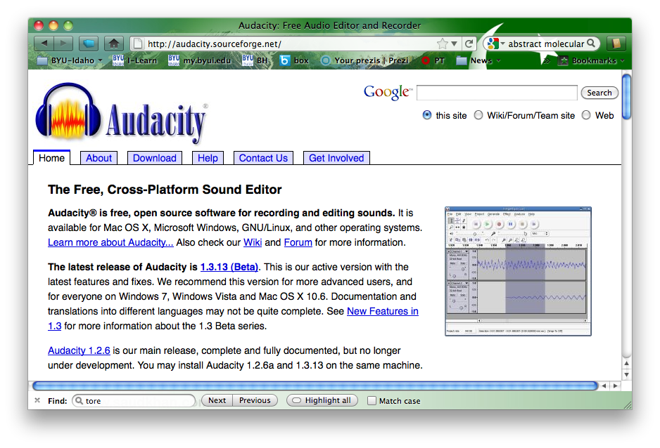
http://audacity.sourceforge.net/

Slide 11
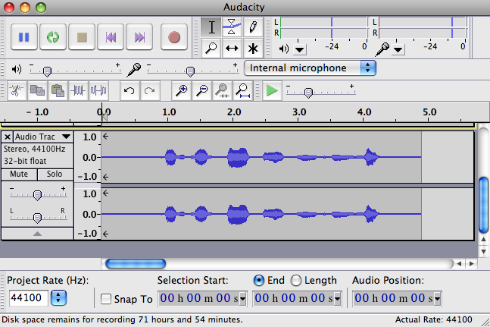
Audacity

Slide 12
Steps
Create PowerPoint
Edit the Podcast
Export as .mp3 or .ogg
Submit
.ppt(x) & .mp3/.ogg via I-Learn to your instructor
Record the Podcast

Slide 13
Good luck!
Email your instructor with any questions….

