Slide 1






Create a GUI Paint Application using Tkinter in Python
Kaira Milani Fitria
IoT Engineer
Program Magang dan Studi Independen Bersertifikat (MSIB) Bisa AI Academy 2022

Slide 2

Overview
Today we will learn how to create a paint application in python using Tkinter module we will be also using the pillow module for placing images on the Tkinter frame, the pillow module which have tools like a pen, pencil, eraser, and fill.
Tkinter is the standard GUI library for Python. Python when combined with Tkinter provides a fast and easy way to create GUI applications. Tkinter provides a powerful object-oriented interface to the Tk GUI toolkit.. It’s a very good tool for GUI programming in Python.

Slide 3
Overview
Graphical user interfaces (GUI) would become the standard of user-centered design in software application programming, providing users the capability to intuitively operate computers and other electronic devices through the direct manipulation of graphical icons such as buttons, scroll bars, windows, tabs, menus, cursors, and the mouse pointing device. Many modern graphical user interfaces feature touchscreen and voice-command interaction capabilities.

Slide 4
Step
Import the required modules
Creating GUI
Setting Up The Canvas And Paint Tools
Run the app

Slide 5
Import modules
from tkinter import *
from tkinter.colorchooser import askcolor
from PIL import ImageTk, Image

Slide 6
Create GUI
class Paint(object):
DEFAULT_PEN_SIZE = 5.0
DEFAULT_COLOR = 'black'
def __init__(self):
self.root = Tk()
self.root.title('Paint')
self.root.geometry('500x300')
self.root.maxsize(500,300)
self.root.minsize(500,300)
self.paint_tools = Frame(self.root,width=100,height=300,relief=RIDGE,borderwidth=2)
self.paint_tools.place(x=0,y=0)
self.pen_logo = ImageTk.PhotoImage(Image.open('pen.png'))
self.p = Label(self.paint_tools, text="pen",borderwidth=0,font=('verdana',10,'bold'))
self.p.place(x=5,y=11)
self.pen_button = Button(self.paint_tools,padx=6,image=self.pen_logo,borderwidth=2,command=self.use_pen)
self.pen_button.place(x=60,y=10)
self.brush_logo = ImageTk.PhotoImage(Image.open('brush.png'))
self.b = Label(self.paint_tools,borderwidth=0,text='brush',font=('verdana',10,'bold'))
self.b.place(x=5,y=40)
self.brush_button = Button(self.paint_tools,image = self.brush_logo,borderwidth=2,command=self.use_brush)

Slide 7
Create GUI
self.brush_button = Button(self.paint_tools,image = self.brush_logo,borderwidth=2,command=self.use_brush)
self.brush_button.place(x=60,y=40)
self.color_logo = ImageTk.PhotoImage(Image.open('color.png'))
self.cl = Label(self.paint_tools, text='color',font=('verdana',10,'bold'))
self.cl.place(x=5,y=70)
self.color_button = Button(self.paint_tools,image = self.color_logo,borderwidth=2,command=self.choose_color)
self.color_button.place(x=60,y=70)
self.eraser_logo = ImageTk.PhotoImage(Image.open('eraser.png'))
self.e = Label(self.paint_tools, text='eraser',font=('verdana',10,'bold'))
self.e.place(x=5,y=100)
self.eraser_button = Button(self.paint_tools,image = self.eraser_logo,borderwidth=2,command=self.use_eraser)
self.eraser_button.place(x=60,y=100)
self.pen_size = Label(self.paint_tools,text="Pen Size",font=('verdana',10,'bold'))
self.pen_size.place(x=15,y=250)
self.choose_size_button = Scale(self.paint_tools, from_=1, to=10, orient=VERTICAL)
self.choose_size_button.place(x=20,y=150)

Slide 8
Create GUI
self.c = Canvas(self.root, bg='white', width=600, height=600,relief=RIDGE,borderwidth=0)
self.c.place(x=100,y=0)
self.setup()
self.root.mainloop()
def setup(self):
self.old_x = None
self.old_y = None
self.line_width = self.choose_size_button.get()
self.color = self.DEFAULT_COLOR
self.eraser_on = False
self.active_button = self.pen_button
self.c.bind('<B1-Motion>', self.paint)
self.c.bind('<ButtonRelease-1>', self.reset)

Slide 9
Setting Canvas and Paint Tools
def use_pen(self):
self.activate_button(self.pen_button)
def use_brush(self):
self.activate_button(self.brush_button)
def choose_color(self):
self.eraser_on = False
self.color = askcolor(color=self.color)[1]
def use_eraser(self):
self.activate_button(self.eraser_button, eraser_mode=True)
def activate_button(self, some_button, eraser_mode=False):
self.active_button.config(relief=RAISED)
some_button.config(relief=SUNKEN)
self.active_button = some_button
self.eraser_on = eraser_mode

Slide 10
Setting Canvas and Paint Tools
def paint(self, event):
self.line_width = self.choose_size_button.get()
paint_color = 'white' if self.eraser_on else self.color
if self.old_x and self.old_y:
self.c.create_line(self.old_x, self.old_y, event.x, event.y,
width=self.line_width, fill=paint_color,
capstyle=ROUND, smooth=TRUE, splinesteps=36)
self.old_x = event.x
self.old_y = event.y
def reset(self, event):
self.old_x, self.old_y = None, None
if __name__ == '__main__':
Paint()

Slide 11
Code Explanation
from tkinter import *
from tkinter.colorchooser import askcolor
from PIL import ImageTk, Image
from tkinter import is for importing all the required packages like Tkinter,
from tkinter.colorchooser import askcolor is for import ask color from Tkinter,
from PIL import ImageTk, Image for import ImageTk along with an image from pillow module, PIL is Python Imaging Library.

Slide 12
Code Explanation
class Paint(object):
DEFAULT_PEN_SIZE = 5.0
DEFAULT_COLOR = 'black'
def __init__(self):
self.root = Tk()
self.root.title('Paint')
self.root.geometry('500x300')
self.root.maxsize(500,300)
self.root.minsize(500,300)
self.paint_tools = Frame(self.root,width=100,height=300,relief=RIDGE,borderwidth=2)
self.paint_tools.place(x=0,y=0)
class Paint() for setting the GUI. The default pen size is 5.0, with black as the default color.
def __init__ is called when an object is created from a Paint class and it allows the class to initialize the attributes of the class Paint. The self are instance variables for Paint class, and define the app title is ‘Paint’, also define the exact size geometry, the maxsize and minsize.
self.paint_tools is for setting the exact width and height of frame, and relief=RIDGE for setting the relief style of a widget refers to certain simulated 3-D effects around the outside of the widget and set the width. self.paint_tools.place for setting the exact place of the tools in the frame.

Slide 13
Code Explanation
self.pen_logo = ImageTk.PhotoImage(Image.open('pen.png’))
self.p = Label(self.paint_tools, text="pen",borderwidth=0,font=('verdana',10,'bold'))
self.p.place(x=5,y=11)
self.pen_button = Button(self.paint_tools,padx=6,image=self.pen_logo,borderwidth=2,command=self.use_pen)
self.pen_button.place(x=60,y=10)
self.pen_logo is for set the logo of pen tools, and connect with icon file ('pen.png') as the resource. self.p = Label for make the label “pen” beside the pen icon, also set the border, and font. self.p.place to set the place of pen tools.
self.pen_button = Button() for make the button of pen tools, it also set the pad, border, and the button place.
command=self.use_pen is for set the button can be used when it clicked.

Slide 14
Code Explanation
self.brush_logo = ImageTk.PhotoImage(Image.open('brush.png'))
self.b = Label(self.paint_tools,borderwidth=0,text='brush',font=('verdana',10,'bold'))
self.b.place(x=5,y=40)
self.brush_button = Button(self.paint_tools,image = self.brush_logo,borderwidth=2,command=self.use_brush)
self.brush_button = Button(self.paint_tools,image = self.brush_logo,borderwidth=2,command=self.use_brush)
self.brush_button.place(x=60,y=40)
self.brush_logo is for set the logo of brush tools, and connect with icon file (‘brush.png') as the resource.
self.b = Label for make the label “brush” beside the brush icon, also set the border, and font. self.b.place to set the place of brush tools.
self.brush_button = Button() for make the button of brush tools, it also set the pad, border, and the button place.
command=self.use_brush is for set the button can be used when it clicked.

Slide 15
Code Explanation
self.color_logo = ImageTk.PhotoImage(Image.open('color.png'))
self.cl = Label(self.paint_tools, text='color',font=('verdana',10,'bold'))
self.cl.place(x=5,y=70)
self.color_button = Button(self.paint_tools,image = self.color_logo,borderwidth=2,command=self.choose_color)
self.color_button.place(x=60,y=70)
self.color_logo is for set the logo of color picking tools, and connect with icon file (‘color.png') as the resource.
self.cl = Label for make the label “color” beside the color icon, also set the border, and font. self.cl.place to set the place of color tools.
self.color_button = Button() for make the button of color tools, it also set the color logo, border, and the button place by button.place() function.
command=self.choose_color is for set the button can be used when it clicked.

Slide 16
Code Explanation
self.eraser_logo = ImageTk.PhotoImage(Image.open('eraser.png’))
self.e = Label(self.paint_tools, text='eraser',font=('verdana',10,'bold'))
self.e.place(x=5,y=100)
self.eraser_button = Button(self.paint_tools,image = self.eraser_logo,borderwidth=2,command=self.use_eraser)
self.eraser_button.place(x=60,y=100)
self.eraser_logo is for set the logo of eraser tools, and connect with icon file (‘eraser.png') as the resource.
self.e = Label for make the label “eraser” beside the eraser icon, also set the font style and font size.
self.e.place to set the place of eraser tools.
self.eraser_button = Button() for make the button of eraser tools, it also set the border, and the button place by button.place() function.
command=self.use_eraser is for set the button can be used when it clicked.

Slide 17
Code Explanation
self.pen_size = Label(self.paint_tools,text="Pen Size",font=('verdana',10,'bold'))
self.pen_size.place(x=15,y=250)
self.choose_size_button = Scale(self.paint_tools, from_=1, to=10, orient=VERTICAL)
self.choose_size_button.place(x=20,y=150)
self.c = Canvas(self.root, bg='white', width=600, height=600,relief=RIDGE,borderwidth=0)
self.c.place(x=100,y=0)
self.setup()
self.root.mainloop()
self.pen_size = Label for make the label “Pen size”, also set the font style and font size. self.pen_size.place to set the place of eraser tools. self.choose_size_button = Scale() for make the scalling of pen tools, it set the orientation too, and set the pen size button place by button.place() function.
self.c = Canvas for make the canvas, with white background, and set the size and border. relief=RIDGE for setting the canvas relief style. self.c.place() for set the canvas place. self.setup() will run that method prior to each test. self.root.mainloop() for main window which we execute when we want to run our application

Slide 18
Code Explanation
def setup(self):
self.old_x = None
self.old_y = None
self.line_width = self.choose_size_button.get()
self.color = self.DEFAULT_COLOR
self.eraser_on = False
self.active_button = self.pen_button
self.c.bind('<B1-Motion>', self.paint)
self.c.bind('<ButtonRelease-1>', self.reset)
This for define the setup function, setting the old_x and old_y coordinate values to none. line_width = self.choose_size_button.get() for assign the line varies with the choice size button. To get method to color variable should be set to default color which is black. When the app start running we will set the eraser on a variable to false so that we don't select the eraser initially. We can set the pen button to active. We can bind the coarser motion with the paint method.

Slide 19
Code Explanation
Define the pen function, calling the active button method, and forward the self.pen button as parameters.
Defining the use brush function, calling the active button method where will be passing self dot brush button as parameter.
Define the choose color function where we can ask the user to choose a particular color this task can be achieved by calling ask color method.
Function for eraser, to use eraser where will be calling the active button method and passing two parameters like eraser button and eraser mode, we change the eraser mode value to true in order to erase something using the eraser button.
Define active button function which will configure eraser and the canvas, by defining paint function.
def use_pen(self):
self.activate_button(self.pen_button)
def use_brush(self):
self.activate_button(self.brush_button)
def choose_color(self):
self.eraser_on = False
self.color = askcolor(color=self.color)[1]
def use_eraser(self):
self.activate_button(self.eraser_button, eraser_mode=True)
def activate_button(self, some_button, eraser_mode=False):
self.active_button.config(relief=RAISED)
some_button.config(relief=SUNKEN)
self.active_button = some_button
self.eraser_on = eraser_mode

Slide 20
Code Explanation
def paint() for initiate the painting of the canvas by get the line width using get method from choosing size button, we also have tho change the old_x and old_y coordinate.
def reset() for defining the reset function we can reset the whole canvas, this can be achieved by setting the old_x and old_y coordinate to none
Now we can end up the whole class by calling paint function
def paint(self, event):
self.line_width = self.choose_size_button.get()
paint_color = 'white' if self.eraser_on else self.color
if self.old_x and self.old_y:
self.c.create_line(self.old_x, self.old_y, event.x, event.y,
width=self.line_width, fill=paint_color,
capstyle=ROUND, smooth=TRUE, splinesteps=36)
self.old_x = event.x
self.old_y = event.y
def reset(self, event):
self.old_x, self.old_y = None, None
if __name__ == '__main__':
Paint()

Slide 21
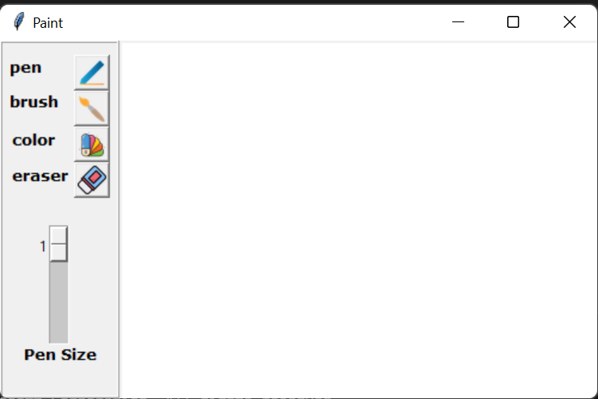
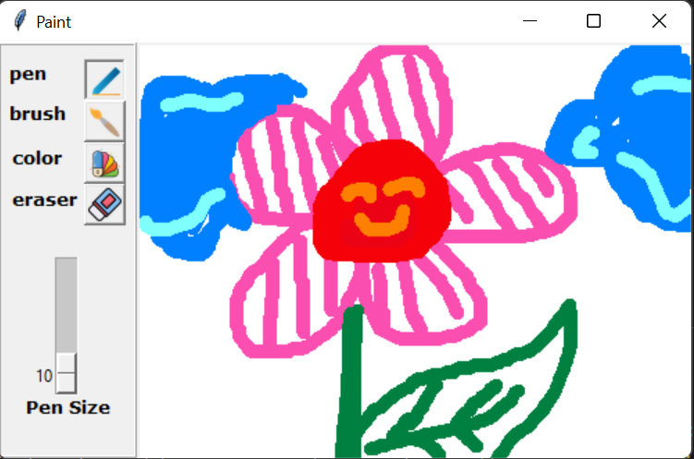
Result

Slide 22
Terima Kasih
Sesi Diskusi
Program Magang dan Studi Independen Bersertifikat (MSIB) Bisa AI Academy 2022

