Slide 1
Analysis and Prediction of Customer Rating

Slide 2
Project Overview
Goal: Analyse and categorise customer feedback to derive insights for business improvement
Why this project?
Businesses require structured and analysed customer feedback to improve
To increase customer retention, targeted marketing and quality improvements
Project Work Flow
Model Selection and Training
Prepare Dataframe
Feature Engineering
EDA
Data Preprocessing
Model Evaluation

Slide 3
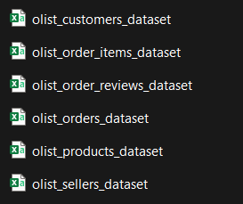
Dataset – What and Where?
Dataset: Brazilian E-Commerce Public Dataset by Olist (Kaggle)
Chosen datasets:

Slide 4
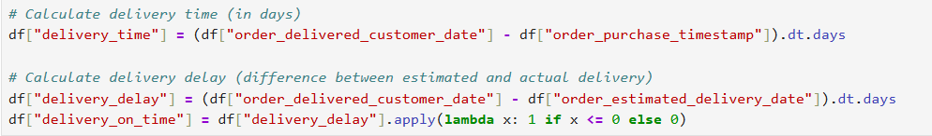
Data Cleaning and Feature Engineering
Merged all the datasets and kept only necessary columns
Created features
Handled missing values: since very less, deleted the rows

Slide 5
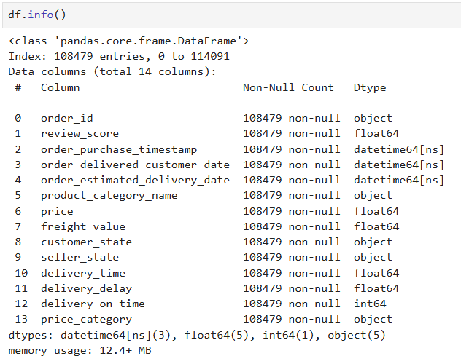
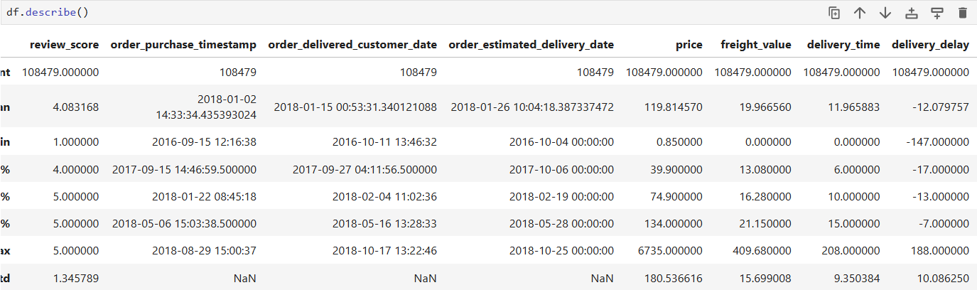
Dataset for EDA

Slide 6
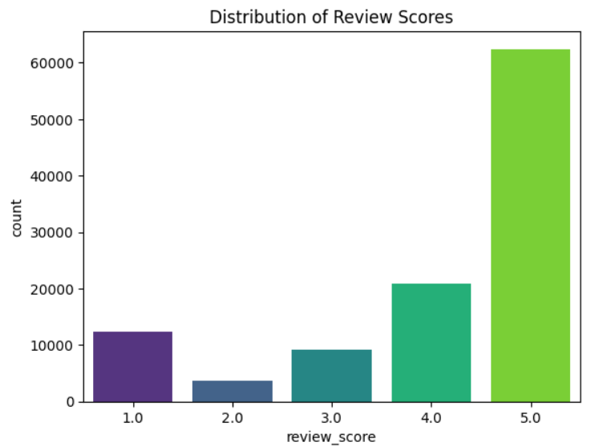
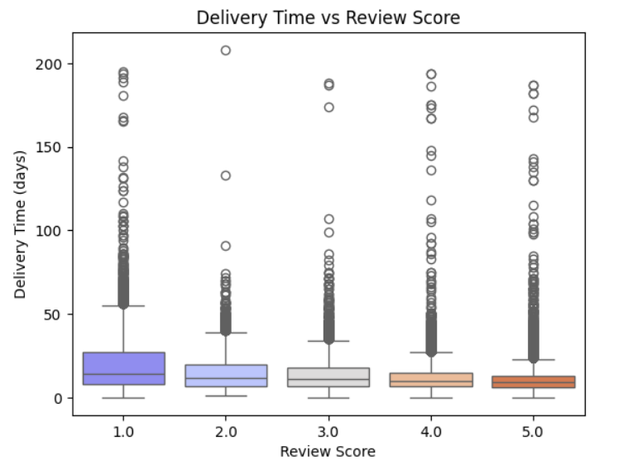
Exploratory Data Analysis
Bar graph to show distribution of review scores
Box plot to understand the relation between Delivery time and review score

Slide 7
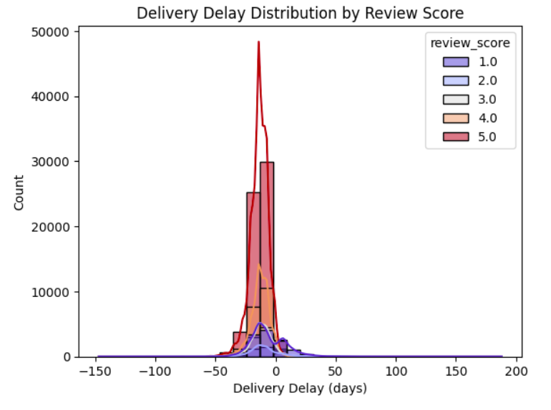
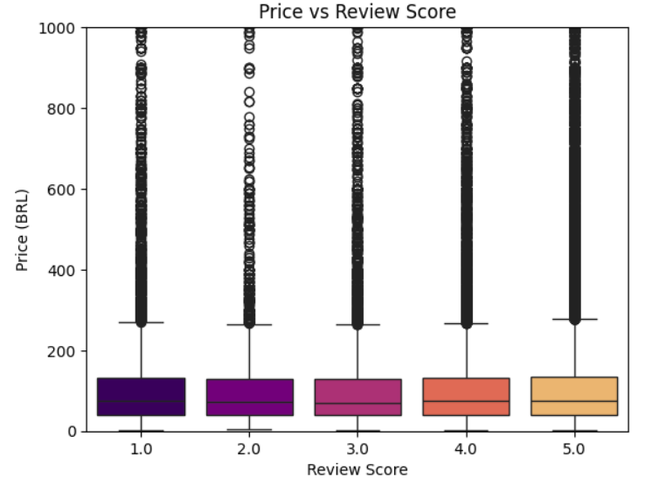
Exploratory Data Analysis
Histogram to show the impact of delivery delays on review score
Box plot to show the relationship between price and review score

Slide 8
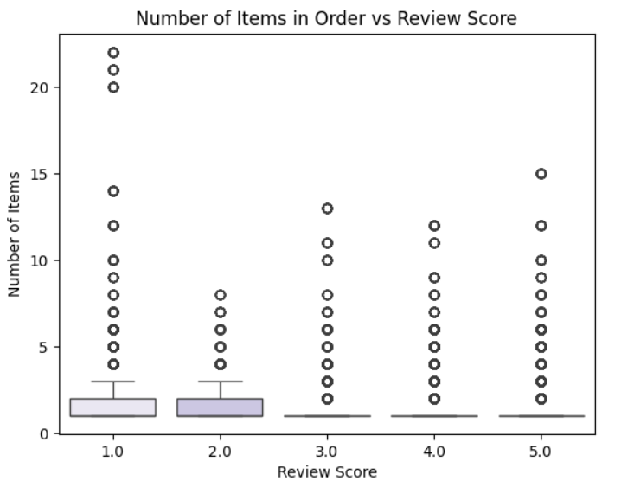
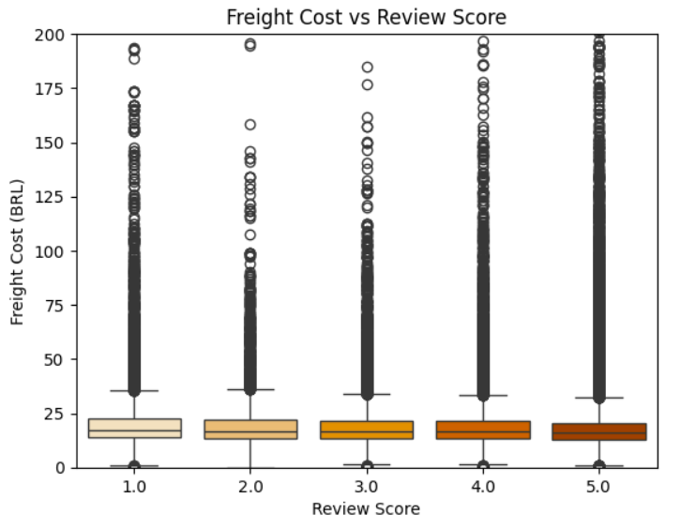
Exploratory Data Analysis
Box plot to show the relationship between number of items in order and review score
Box plot to show the relationship between shipping costs and review score

Slide 9
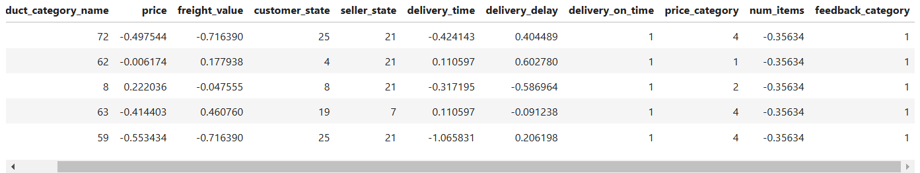
Data Preprocessing
Created feedback categories (1-2: Bad, 3: Neutral, 4-5: Good)
Dropped columns like order_id, timestamps and review score
Label encoded Categorical columns as well as the target column (feedback category)
Used Standard Scaler to scale columns like price, freight value, delivery time and delay

Slide 10
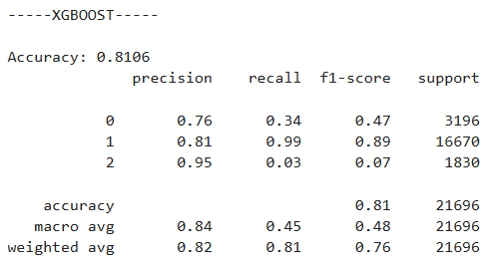
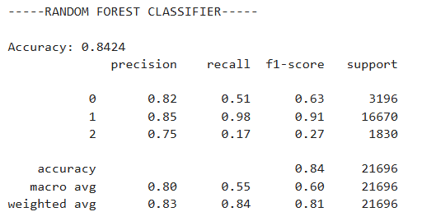
Machine Learning – Predicting Feedback
2 models used – XGBoost and Random Forest Classifier
Evaluation of both the models are given below

Slide 11
Key Findings
Delivery Time & Feedback: Longer delivery times were generally associated with lower feedback scores
Freight Value Impact: Higher shipping costs did not strongly correlate with negative feedback, suggesting customers might prioritize delivery reliability over cost
Items Ordered: Orders with a greater number of items showed lower ratings, possibly due to missing or damaged products
Regional Variations: Certain states showed consistently lower ratings, possibly due to regional delivery challenges.
Feature Importance: Delivery time and delay were the most significant features influencing customer feedback classification.

Slide 12
Learnings and Future Improvements
Limitations:
Text based reviews were not analysed – sentiment analysis could provide deeper insights
Some categories had low data representation, affecting reliability
Next Steps:
NLP techniques to analyse customer comments to find sentiment pattern
Apply SMOTE or other resampling techniques for better balance in the dataset

Slide 13
Thank you

