Slide 1
Hypothyroidism Analysis and Prediction
Kairavi Dave

Slide 2
Introduction
Hypothyroidism is a condition where the thyroid gland does not produce enough thyroid hormones, leading to various health issues.
Understanding the patterns and factors associated with hypothyroidism is crucial for early diagnosis and effective treatment.
The objective of this project is to analyze the dataset on thyroid disease and provide insights that can help healthcare professionals better manage and predict hypothyroidism cases.

Slide 3
Data Preparation
Data sourced from Kaggle
Data Cleaning and Preprocessing using SQL
The cleaned data was then exported for further analysis in Python.

Slide 4
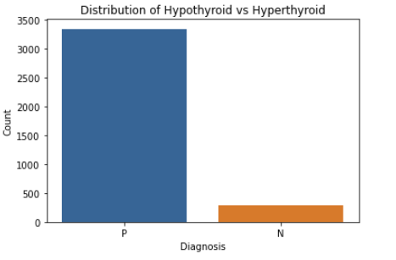
Exploratory Data Analysis (EDA)
Distribution of Hypothyroid vs. Non-Hypothyroid : The data shows a significant number of hypothyroid cases (3480) compared to non-hypothyroid cases (526).

Slide 5
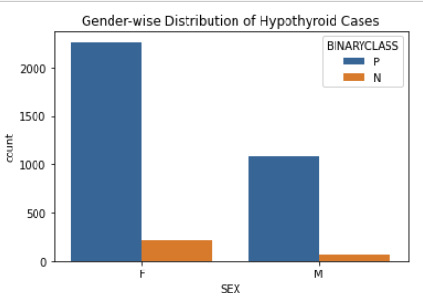
Exploratory Data Analysis (EDA)
Gender-wise Distribution of Hypothyroid Cases: The majority of hypothyroid cases are in females (2,008) compared to males (990).

Slide 6
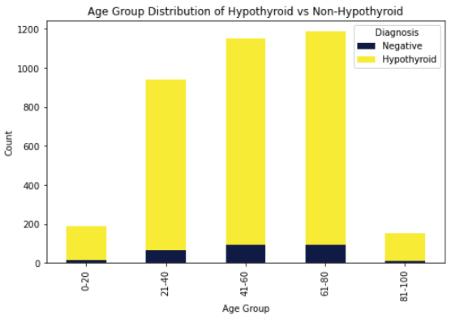
Exploratory Data Analysis (EDA)
Age-Group Distribution of Hypothyroid and Non-Hypothyroid Cases: The age group with the highest number of hypothyroid cases is 61-80 years old.
The non-hypothyroid cases are more evenly distributed across age groups.

Slide 7
Exploratory Data Analysis (EDA)
Age-Group Distribution of Hypothyroid and Non-Hypothyroid Cases: The age group with the highest number of hypothyroid cases is 61-80 years old.
The non-hypothyroid cases are more evenly distributed across age groups.

Slide 8
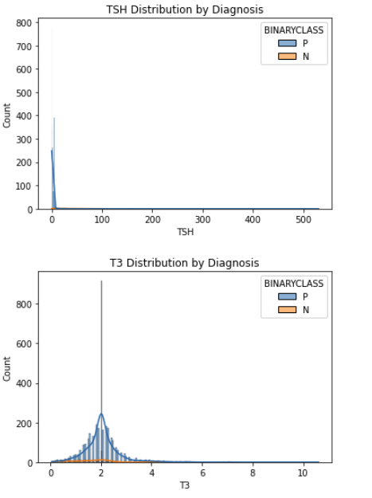

Slide 9
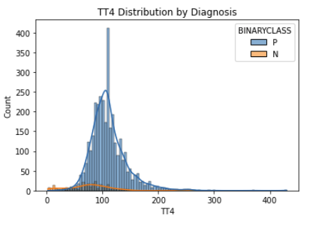

Slide 10
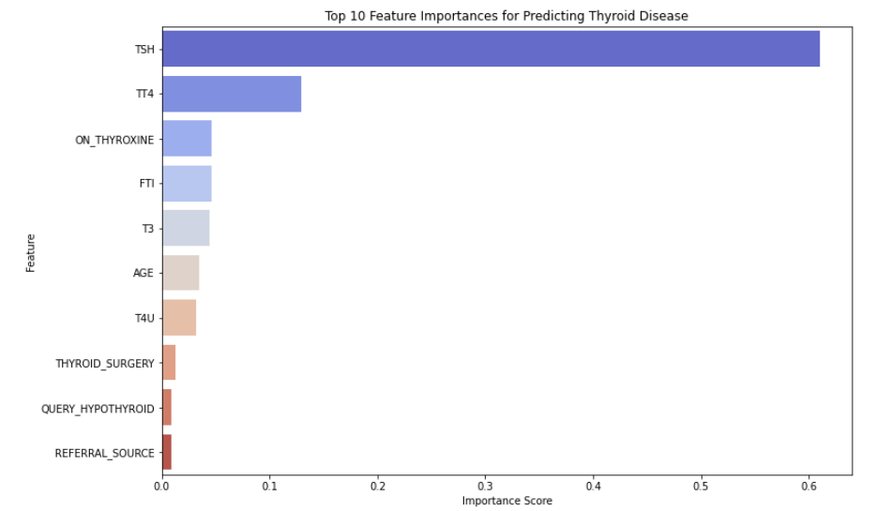

Slide 11
Conclusion
Key Findings:
1. Thyroid diseases vary by gender, age, and medical history
2. Hypothyroidism is more common in females, with a significant number of cases in the 41-60 age group
Implications:
The insights from this analysis can help healthcare professionals better understand the patterns and risk factors associated with hypothyroidism.
Early screening and targeted interventions for high-risk groups (e.g., females, middle-aged individuals, pregnant women) can lead to earlier diagnosis and improved management of hypothyroidism.
Future Scope:
1. Extend analysis with machine learning models
2. Incorporate external datasets for broader insights

Slide 12
Q&A
Questions and Discussions

