Slide 1
Identifying Aircraft from Above
Kai Roper-Blackman

Slide 2
Introduction
Computer vision is the study of how computers can interpret and obtain information from images.
Images are stored on computers as complex multi-dimensional arrays of data.
Computer vision seeks to automate tasks the human visual system undertakes every day.
There are several applications of computer vision, some more obvious than others. Image enhancement is the most readily available and used repeatedly by the general population.

Slide 3
Aims and Objectives
To create a data set suitable of training a machine learning model
To classify small images of aircraft and ground
To search large images such as an aerial view of an airport, for aircraft
To show results clearly and accurately using heat maps and drawing boxes around areas of interest.

Slide 4
Methods

Slide 5
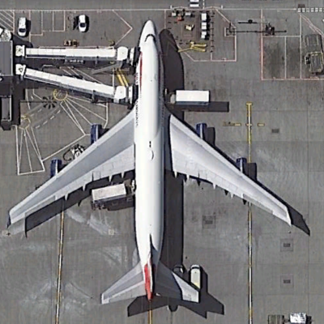
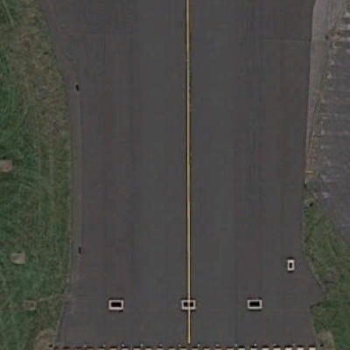
Data collection
To allow a computer to understand the difference between aircraft and ground, we must collate a training set containing both types.
The data source for this project was Google Earth
Images of aircraft and ground are cropped and given an appropriate label upon program execution.
Images containing more than one aircraft or complex structures are not included in the data set as they will confuse the machine learning model

Slide 6
Data sets
There are two data sets to used for the identification of aircraft. The uses of the data sets will be explored later in this presentation
Standalone
100 images of aircraft, 100 images of ground
Realistic
200 images of aircraft, 200 images of ground
All aircraft face north
Aircraft appear at random orientations and sizes
Images are further rotated before training

Slide 7
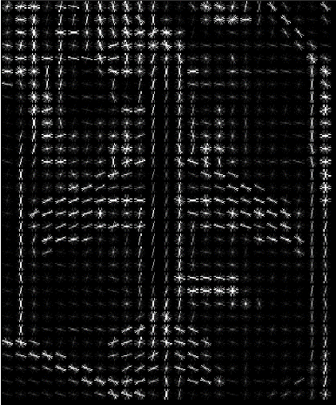
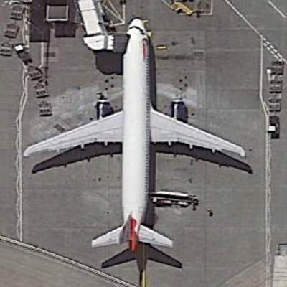
Pre- Processing (HOG)
Histogram of oriented gradients (HOG) is the image pre-processing method used to obtain key pieces of information from an image.
HOG works by calculating gradient orientation in all segmented areas of an image.
Gradient is normalised across multiple segments to ensure uniform results
The result returned takes two forms. A feature vector or visual representation of the image illustrating gradient direction
[0.124, 0.623, 0.234 …… 0.739]

Slide 8
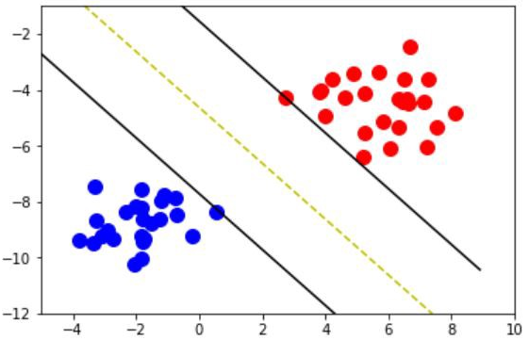
Support Vector Machine
To classify images, feature vectors are passed to a support vector machine after pre-processing for training
The SVM’s kernel determines how the feature vector is plotted after mathematical transformation.
The kernel used for both classification types is the Radial Basis function.
C and gamma remain the same during both types of classification.
After training is completed, test images are evaluated against the training data after they are also pre-processed.

Slide 9
Standalone classification
Standalone classification is the classification method used to classify individual images containing either aircraft or ground.
Uses the standalone data set for training
Classifies images randomly selected and removed temporarily removed from the data set upon execution ensuring the images remain unseen before training.

Slide 10
Image search
Large image search searches for aircraft in a large image.
Uses the realistic data set for training so the SVM can gain an understanding of aircraft in a real life setting.
Breaks a large image into several smaller segments
Image search dimensions are defined by users before the start of classification.
Amount of iterations over image are set by user. X and Y step are calculated from this information.

Slide 11
Results

Slide 12
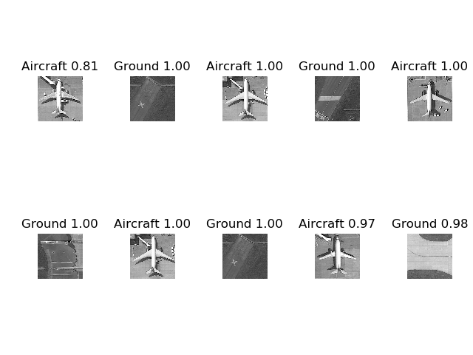
Standalone Classification results
Standalone classification has an accuracy of 100%
The prediction and prediction probability is displayed above the classified image

Slide 13
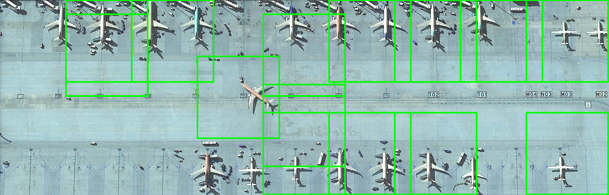
Image search results
Search accuracy achieved on average a score of 50%-60%
Some aircraft are overlooked as the search area doesn’t fit all aircraft precisely.
Some aircraft in large images are smaller than other thus confusing the machine learning model
Some false positives occur when areas of the airport have similar characteristics to an aircraft. For example, taxiway markings, vehicles and airport terminals that are a similar shape to an aircraft often create false positives.
Boxes show the SVM predicts an aircraft exists in the location selected

Slide 14
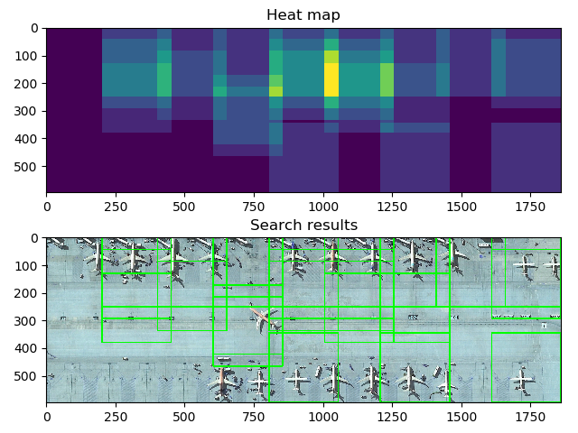
Image search results cont.

Slide 15
Conclusion
Cross validation score of standalone data set is 99%
Cross validation score of realistic data set across multiple image sizes is 69%
Accuracy of standalone image classification is 100%
Accuracy of large image search is 50-60%
A more extensive data set can be used to classify a wider variety of aircraft and ground objects
The type of data classified can be altered to classify different objects all together
Computational complexity of image classification is extremely high
Accurate classification is highly dependent on accuracy of data set

Slide 16
Questions?

