Slide 1

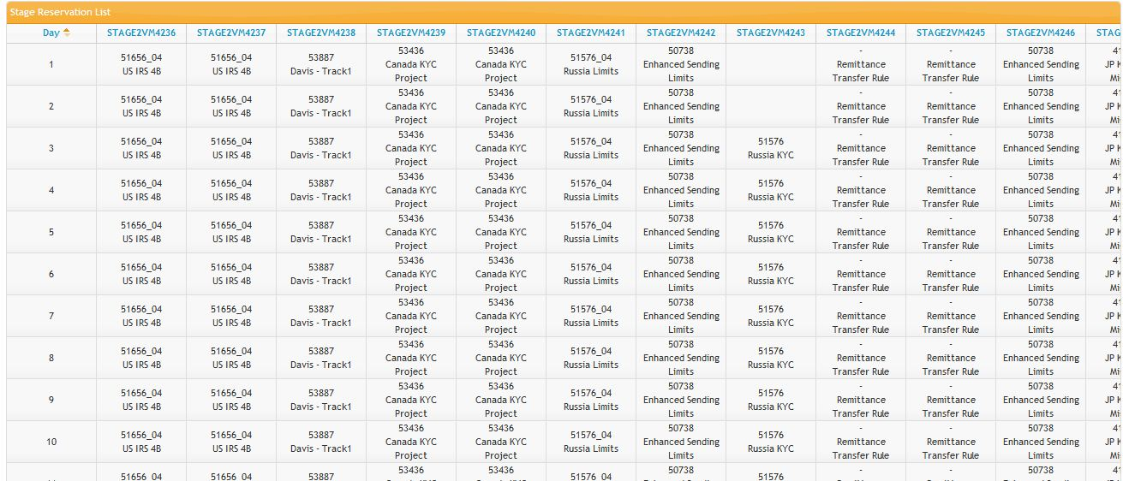
Select…
Date From
Date To
Spec ID
Spec Name
Submit
Guidelines
Reserve a stage for 5 workdays max
If you want to share a stage, contact the spec lead of the spec for which the stage is reserved.
Maintain the reservation table below; after 31 days, move the past dates from the top of the table to the bottom, and increment the month
STAGE2VM4229 is reserved for Compliance PD BAU. Owner Karthick
By default, these following people have "owner" rights of all the stages: Karthick Sundararajan [ksundarajan]. Contact them to get access.
Best viewed in Firefox, Chrome and IE 9.

