Slide 1
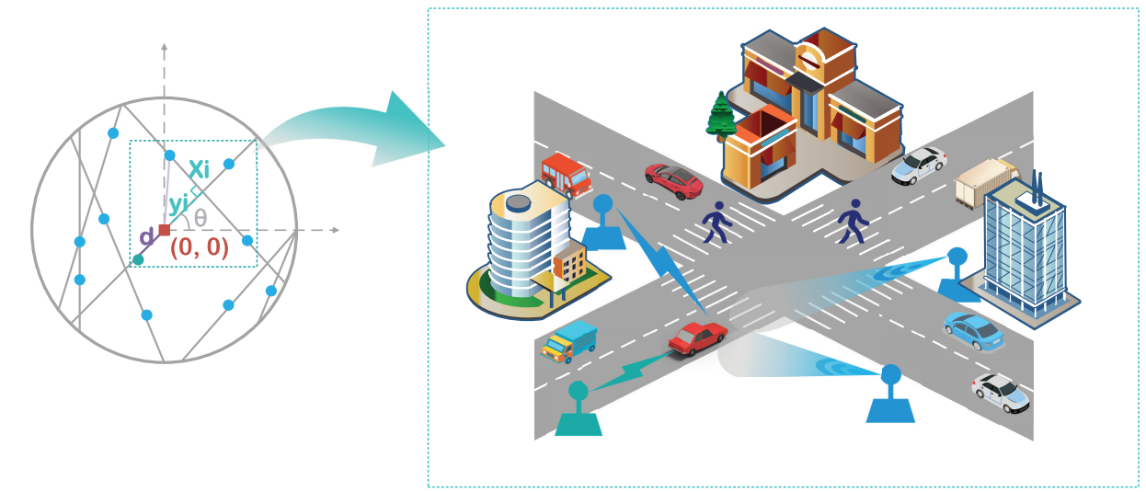
Joint Sensing-Communication Performance Analysis in ISAC-enabled Vehicular Networks
Name : Ankit Kumar Kero Roll no : 2302CM07 Course : EC3205: Introduction of Wireless Communications

Slide 2
Problem Statement
Objective of this Work:
To simulate an ISAC-enabled vehicular network and evaluate:
Probability of Successful Sensing (PSP)
Communication Coverage Probability (CCP)
Joint Sensing-Communication Performance (JPISAC)
To analyze the trade-off between sensing and communication caused by:
shared resources and interference
In modern vehicular networks, Road Side Units (RSUs) are required to perform:
Sensing (environment detection)
Communication (data transmission)
Due to random spatial distribution of:
Roads (modeled as Poisson Line Process)
RSUs (modeled as Poisson Point Process)
the network becomes highly stochastic
This randomness introduces:
Aggregate interference from multiple RSUs
Uncertainty in signal strength
Coupling between sensing and communication operations

Slide 3
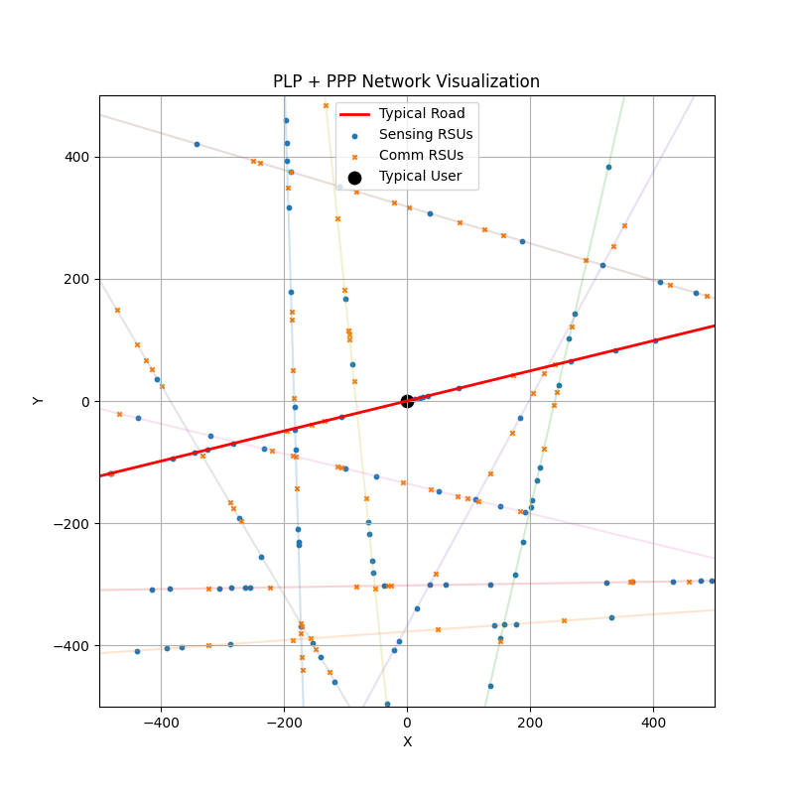
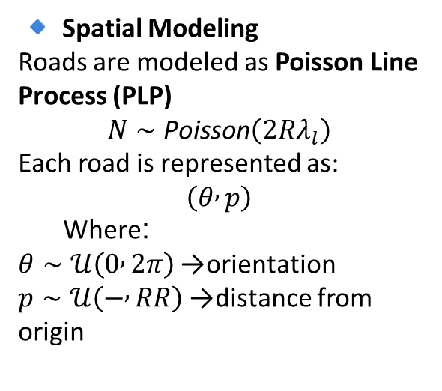



System Model
🔹 Spatial Modeling
Roads are modeled as Poisson Line Process (PLP)
$$N∼\text{Poisson}\left(2Rλ_{l}\right)$$
Each road is represented as:
$$\left(θ , p\right)$$
Where:
$θ∼𝒰\left(0 , 2π\right)$→ orientation
$p∼𝒰\left(− , RR\right)$→ distance from origin
🔹 Density Splitting (ISAC)
$$λ_{s}=βλ_{r},$$
$$λ_{c}=\left(1−β\right)λ_{r}$$
Typical User Model
User at: $\left(0 , 0\right)$
Serving RSU is nearest:
$$d=\underset{i}{\min{}}\sqrt{x_{i}^{2}+y_{i}^{2}}$$
🔹 RSU Distribution (PPP on Roads)
$$N_{r}∼\text{Poisson}\left(λ_{r}L\right)$$
RSU position on a line:
$$\left(x , y\right)=\left(x_{0} , +t\cos{θ} y_{0}+t\sin{θ}\right)$$
where:
$t∼𝒰\left(− , RR\right)$→ position along road

Slide 4


SIGNAL MODEL
🔷 Signal Model (Sensing & Communication)
🔹 Sensing Signal (Radar Mode)
$$P_{e}=\frac{P_{t} G_{T} G_{R} λ^{2} σ}{{\left(4π\right)}^{3} d^{2α}}$$
Signal travels forward + backward path loss = $d^{2α}$
✔ distance ↑ → signal very fast ↓
🔹 Communication Signal
$$S=P_{t} G_{T} h d^{−α}$$
Variable | Distribution | Meaning
( h ) | Gamma / Rayleigh | channel fading
( G_T ) | Random | antenna gain
Variable | Distribution | Meaning
( \sigma ) | Exponential | target reflectivity (RCS)
( G_T, G_R ) | Random (antenna) | directional gain
Sensing experiences double path loss due to round-trip propagation, while communication undergoes single path loss. Hence, sensing is more sensitive to distance variations.

Slide 5

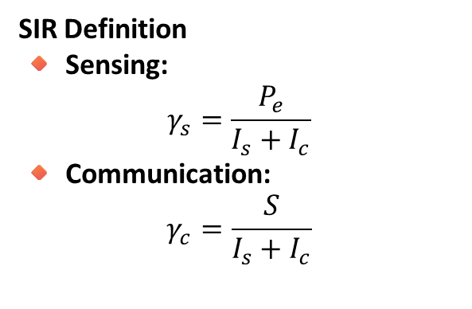

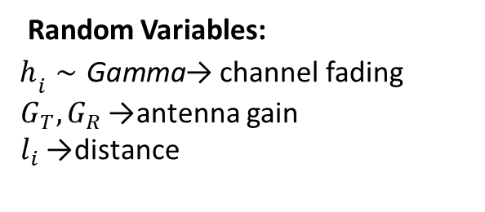
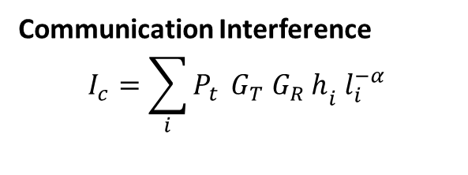
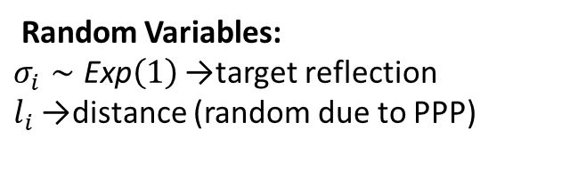
Interference & SIR Analysis
Total Interference
$$I=I_{s}+I_{c}$$
Communication Interference
$$I_{c}=\sum_{i}{P_{t}} G_{T} G_{R} h_{i} l_{i}^{−α}$$
Sensing Interference
$$I_{s}=\sum_{i}{A_{s}} P_{d} σ_{i} l_{i}^{−α}$$
Random Variables:
$h_{i}∼\text{Gamma}$→ channel fading
$G_{T},G_{R}$→ antenna gain
$l_{i}$→ distance
Random Variables:
$σ_{i}∼\text{Exp}\left(1\right)$→ target reflection
$l_{i}$→ distance (random due to PPP)
SIR Definition
🔸 Sensing:
$$γ_{s}=\frac{P_{e}}{I_{s}+I_{c}}$$
🔸 Communication:
$$γ_{c}=\frac{S}{I_{s}+I_{c}}$$
System performance is interference-limited, not noise-limited
Higher interference → lower SIR → lower success probability
Both sensing and communication share the same interference pool, which creates coupling between them

Slide 6
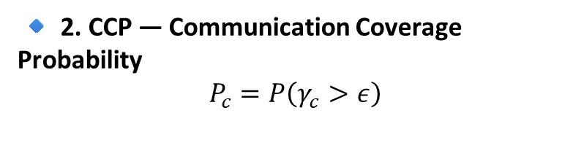
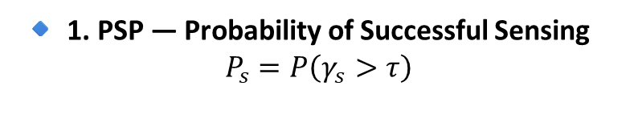

Performance Metrics
🔹 1. PSP — Probability of Successful Sensing
$$P_{s}=P\left(γ_{s}>τ\right)$$
🔹 3. JPISAC — Joint Probability
$$P_{j}=P_{s}×P_{c}$$
PSP measures how reliably the system can detect a target.
JPISAC captures the overall system reliability when both sensing and communication must succeed simultaneously
🔹 2. CCP — Communication Coverage Probability
$$P_{c}=P\left(γ_{c}>ε\right)$$
PSP and CCP are not independent — they are coupled through interference
Improving one often degrades the other (trade-off)
CCP measures how reliably data can be transmitted over the network.

Slide 7
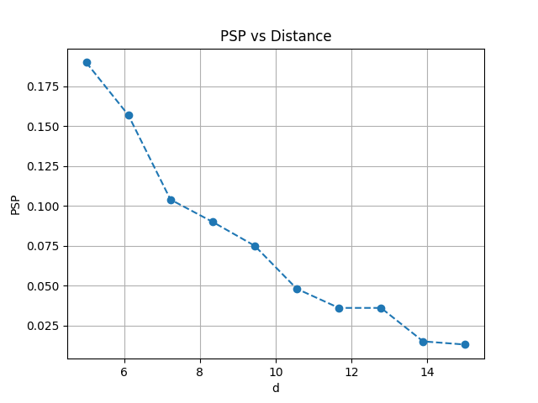
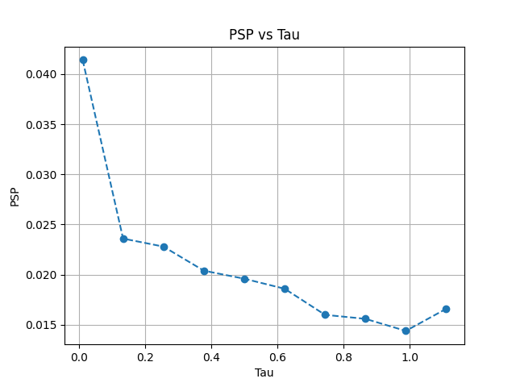
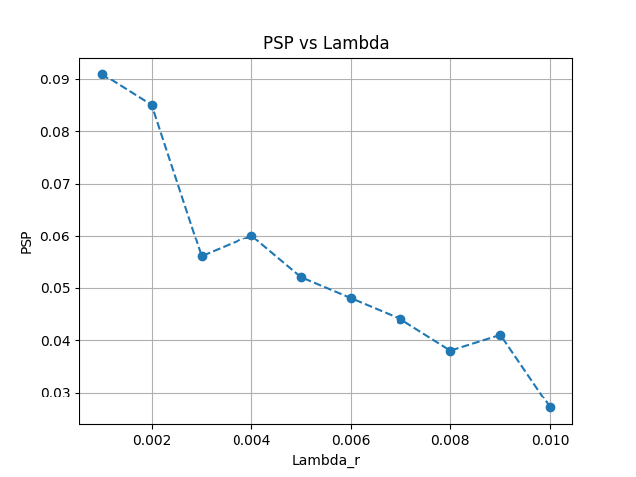
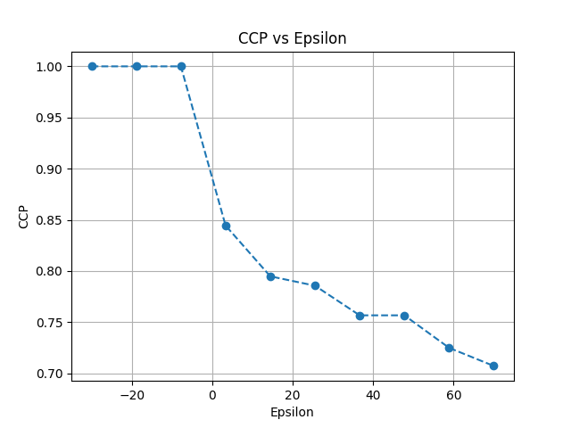
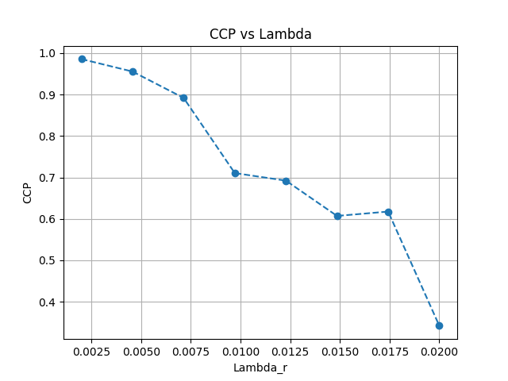
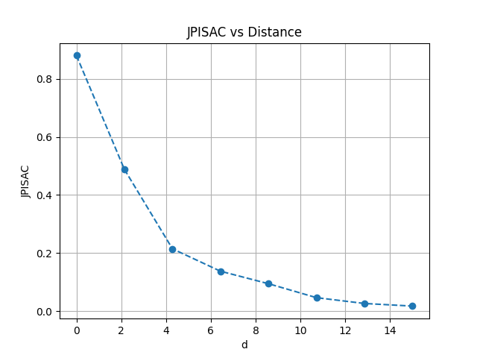
Simulation Results & Observations
Signal power ∝ d⁻²α → rapidly decays
Sensing becomes unreliable at larger distances due to severe path loss.
Only high SIR cases survive, lowering overall sensing probability.
More RSUs → more interference than useful gain.
Only strong links remain, reducing coverage probability.
Network becomes interference-limited at high density.
Joint success is more sensitive to distance than individual metrics.

Slide 8
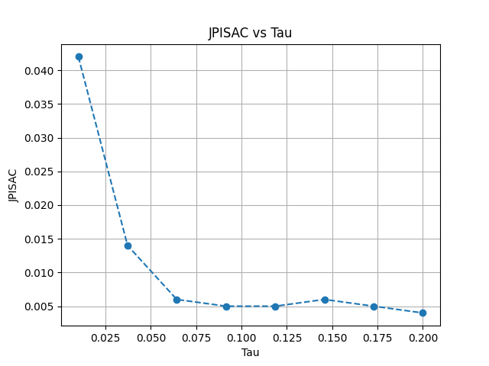
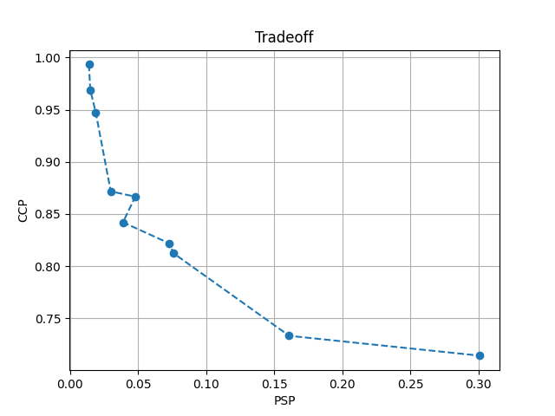
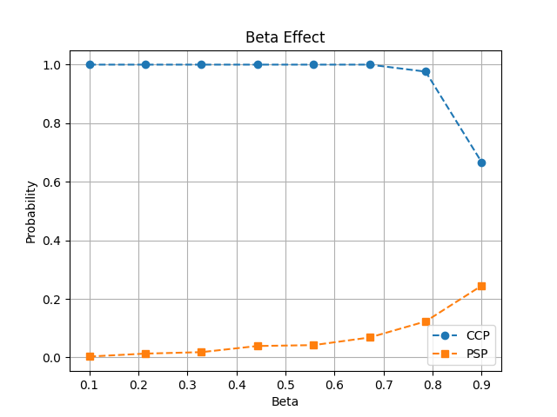
Joint metric drops faster since it depends on both links.
Improving sensing comes at the cost of communication performance.
Increasing sensing allocation reduces interference for communication
All trends are governed by the interplay of path loss and interference in a stochastic network.
Applications :
Autonomous Vehicles
Intelligent Transportation Systems (ITS)
Vehicle-to-Everything (V2X) Communication
Smart Cities
Radar-Communication Systems (ISAC)
Resources and my work

Slide 9
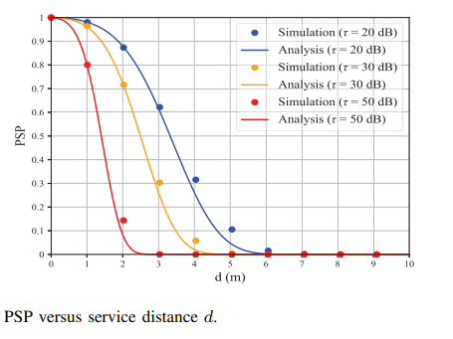
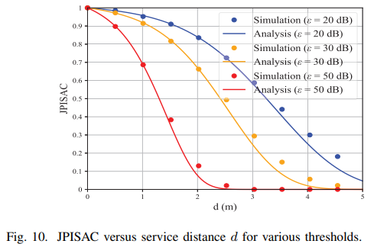
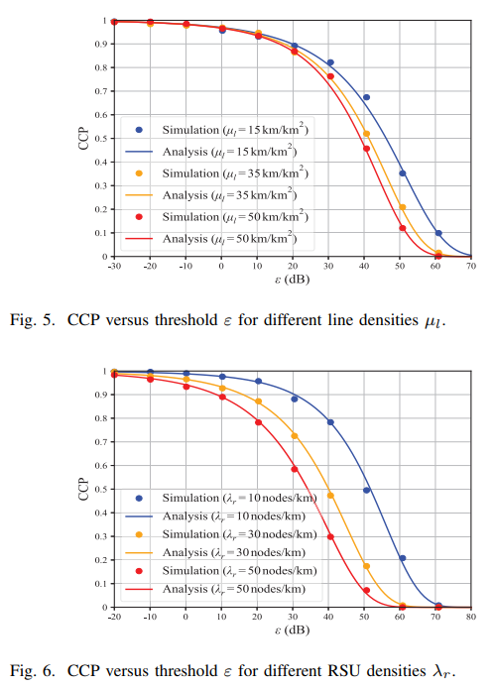
Observations
System performance is primarily limited by interference and path loss
Distance and threshold selection critically affect reliability
Joint performance degrades faster than individual metrics

Slide 10
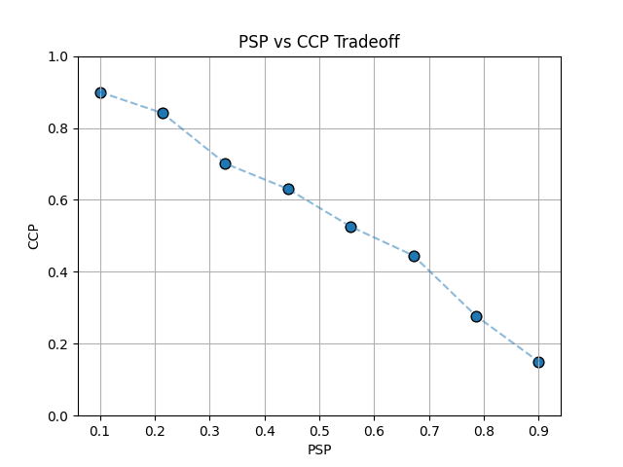
Trade-off Analysis :
PSP ↑ → CCP ↓
Sensing and communication compete for resources
Reason
Both share same interference environment
Increasing sensing activity:
↑ interference for sensing
↓ interference for communication
System is interference-limited
SIR determines success probability
Performance depends on:
distance
density
threshold
Proper tuning of β is essential
Hence, optimal system design requires balancing resource allocation between sensing and communication.

