Slide 1
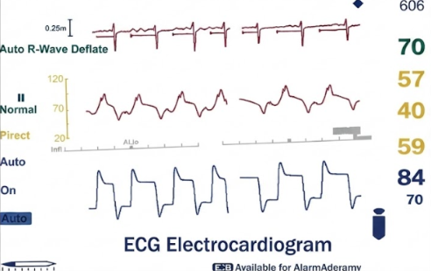
Fetal ECG Extraction under Alpha-Stable Noise
Improved Least Lncosh Based Fetal ECG Extraction in Alpha-Stable Noise (IEEE SPL 2025)
Extraction of Fetal ECG by Logarithmic Hyperbolic Secant Adaptive Algorithm in Alpha-Stable Noise
Name : Ankit Kumar Kero Roll no : 2302CM07 Course : EC4196 Summer internship

Slide 2
Problem Statement
Objective of this Work:
Why Fetal ECG Extraction?
Extract clean Fetal ECG (FECG) from Abdominal ECG (AECG).
Improve performance under Alpha-Stable Impulsive Noise.
Propose the Improved Logarithmic Hyperbolic Secant Adaptive Filter (ILHSAF).
Use AHTT for automatic parameter optimization.
Compare ILHSAF with NLMS, IPNLMS, Llncosh, and LHSAF.
Fetal ECG (FECG) is hidden inside the abdominal ECG.
Maternal ECG has much larger amplitude.
Alpha-stable impulsive noise further degrades the signal.
Conventional adaptive filters lose performance in impulsive environments.

Slide 3
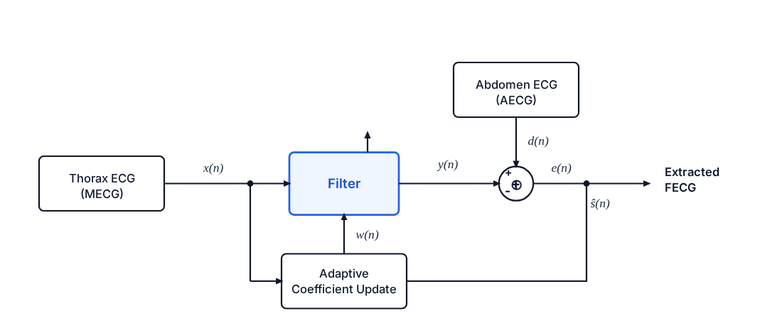
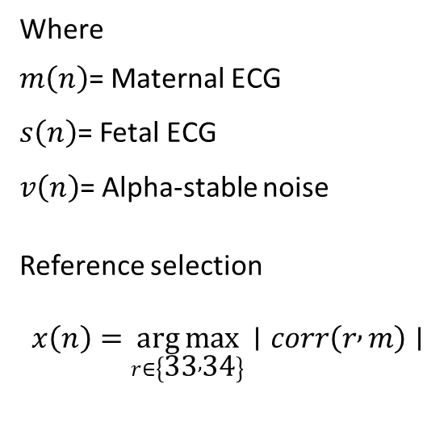
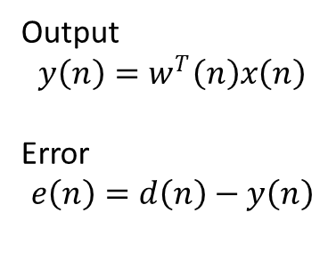
System Model
d(n)=m(n)+s(n)+v(n)
Where
$m\left(n\right)$= Maternal ECG
$s\left(n\right)$= Fetal ECG
$v\left(n\right)$= Alpha-stable noise
Reference selection
$$x\left(n\right)=\underset{r∈\left\{33 , 34\right\}}{arg max}∣corr\left(r , m\right)∣$$
Output
$$y\left(n\right)=w^{T}\left(n\right)x\left(n\right)$$
Error
$$e\left(n\right)=d\left(n\right)−y\left(n\right)$$
Block diagram of FECG extraction using adaptive filters.
Dataset
FECGSYN simulated fetal ECG database
Subjects used: Sub01, Sub03, Sub05, Sub07
Four abdominal channels averaged for evaluation
Maternal reference selected automatically from
channels 33 or 34 using maximum correlation.

Slide 4
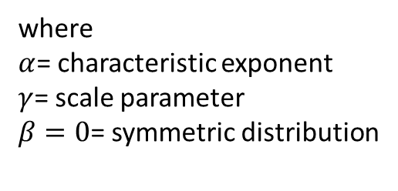
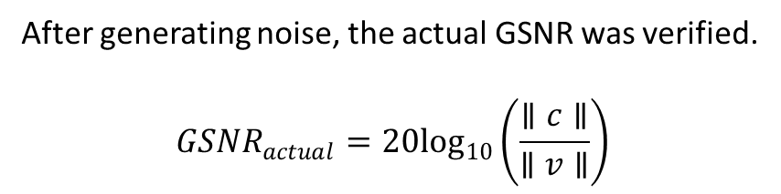

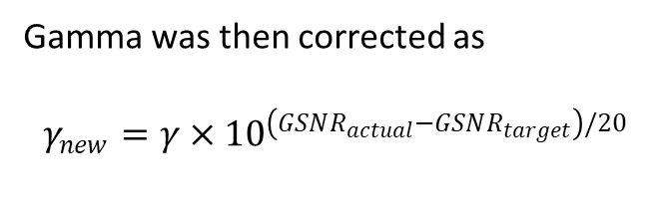

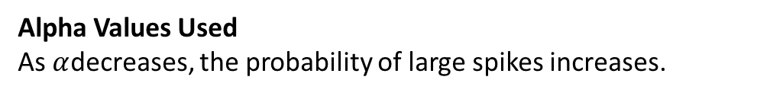
Alpha-Stable Noise Model
We used the Symmetric Alpha-Stable (SαS) distribution to generate impulsive noise
Noise Generation Equation
$$v\left(n\right)∼S_{α}\left(γ , β , =0,loc=0\right)$$
Alpha Values Used
As $α$decreases, the probability of large spikes increases.
Alpha | Noise Type
2.0 | Gaussian
1.8 | Mild impulsive
1.6 | Moderate impulsive
1.4 | Strong impulsive
where
$α$= characteristic exponent
$γ$= scale parameter
$β=0$= symmetric distribution
Target: GSNR = 15 dB
Initial gamma:
$$γ=\frac{RMS\left(c\right)}{{10}^{GSNR/20}}$$
After generating noise, the actual GSNR was verified.
$$GSNR_{actual}=20\log_{10}\left(\frac{∥c∥}{∥v∥}\right)$$
Gamma was then corrected as
$$γ_{new}=γ×{10}^{\left(GSNR_{actual}−GSNR_{target}\right)/20}$$

Slide 5
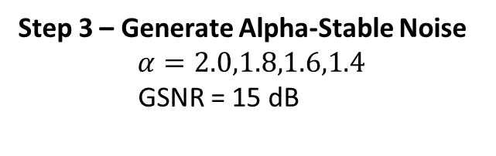
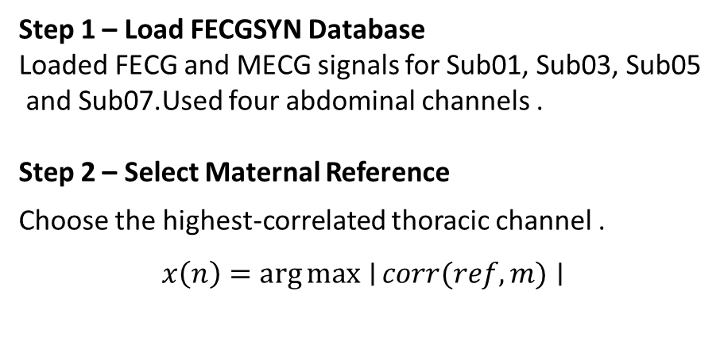
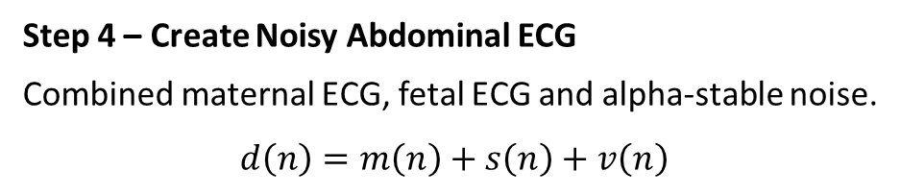
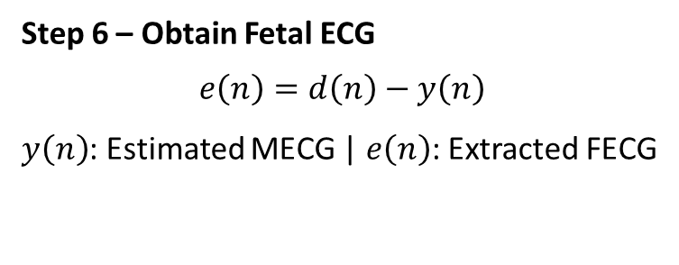
Adaptive Filtering Workflow
Step 1 – Load FECGSYN Database
Loaded FECG and MECG signals for Sub01, Sub03, Sub05
and Sub07.Used four abdominal channels .
Step 2 – Select Maternal Reference
Choose the highest-correlated thoracic channel .
$$x\left(n\right)=\arg{max}{∣}corr(ref,m)∣$$
Step 4 – Create Noisy Abdominal ECG
Combined maternal ECG, fetal ECG and alpha-stable noise.
$$d\left(n\right)=m\left(n\right)+s\left(n\right)+v\left(n\right)$$
Step 5 – Apply Adaptive Filters
NLMS
IPNLMS
ILL
LHSAF
ILHSAF
Step 3 – Generate Alpha-Stable Noise
$$α=2.0,1.8,1.6,1.4$$
GSNR = 15 dB
Step 7 - Evaluate Performance
RMSE, PRD, SNR, AMSE
Step 6 – Obtain Fetal ECG
$$e\left(n\right)=d\left(n\right)−y\left(n\right)$$
$y\left(n\right)$: Estimated MECG | $e\left(n\right)$: Extracted FECG

Slide 6
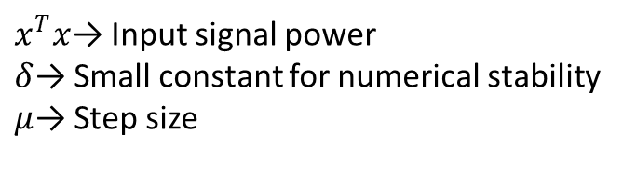
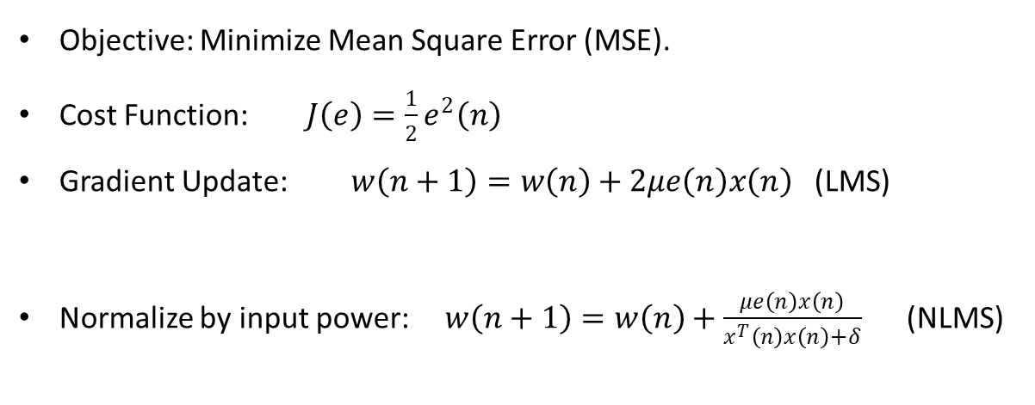
Normalized LMS (NLMS) Algorithm
Uses input-power normalization for stable updates.
Simulation Parameters
Objective: Minimize Mean Square Error (MSE).
Cost Function: $J\left(e\right)=\frac{1}{2}e^{2}\left(n\right)$
Gradient Update: $w\left(n+1\right)=w\left(n\right)+2μe\left(n\right)x\left(n\right)$ (LMS)
Normalize by input power: $w\left(n+1\right)=w\left(n\right)+\frac{μe\left(n\right)x\left(n\right)}{x^{T}\left(n\right)x\left(n\right)+δ}$ (NLMS)
Parameter | Value
Filter Length (M) | 180
Step Size (μ) | 0.1
$x^{T}x$→ Input signal power
$δ$→ Small constant for numerical stability
$μ$→ Step size

Slide 7
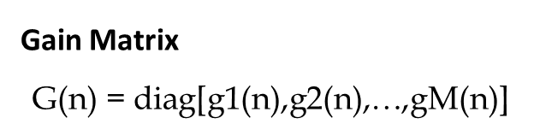
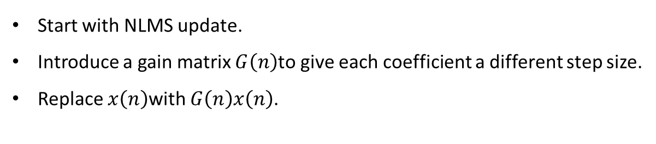
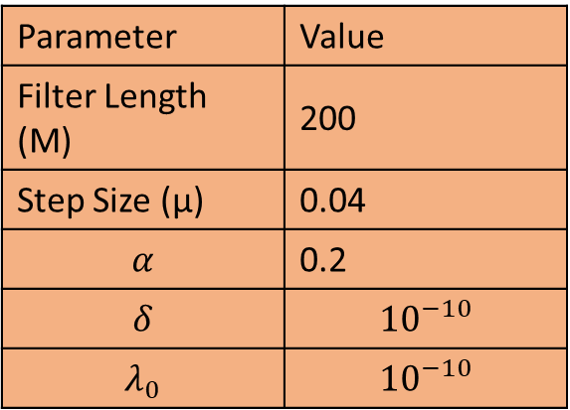
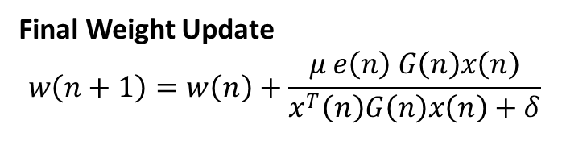

Improved Proportionate NLMS (IPNLMS)
Start with NLMS update.
Introduce a gain matrix $G\left(n\right)$to give each coefficient a different step size.
Replace $x\left(n\right)$with $G\left(n\right)x\left(n\right)$.
Simulation Parameters
Gain Matrix
$$\text{G(n)} \text{=} \text{diag[g1​(n),g2​(n),…,gM​(n)]}$$
Parameter | Value
Filter Length (M) | 200
Step Size (μ) | 0.04
$$α$$ | 0.2
$$δ$$ | $${10}^{−10}$$
$$λ_{0}$$ | $${10}^{−10}$$
where
$$g_{m}\left(n\right)=\frac{1−α}{2M}+\frac{\left(1+α\right)∣w_{m}\left(n\right)∣}{2M∥w\left(n\right)∥+λ_{0}}$$
Final Weight Update
$$w\left(n+1\right)=w\left(n\right)+\frac{μ e\left(n\right) G\left(n\right)x\left(n\right)}{x^{T}\left(n\right)G\left(n\right)x\left(n\right)+δ}$$

Slide 8

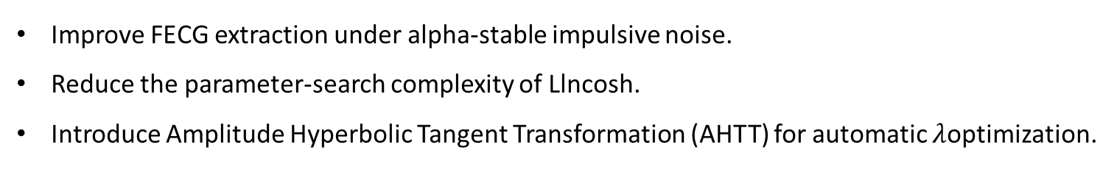
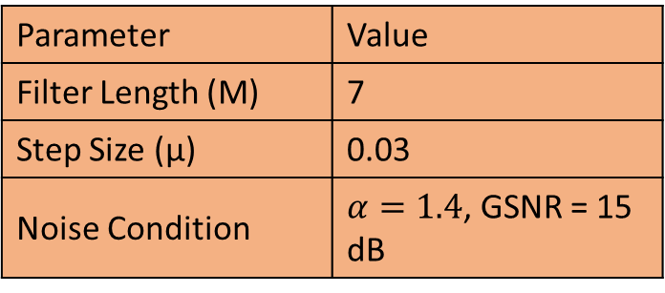
Improved Least Lncosh (ILL) Algorithm
Improve FECG extraction under alpha-stable impulsive noise.
Reduce the parameter-search complexity of Llncosh.
Introduce Amplitude Hyperbolic Tangent Transformation (AHTT) for automatic $λ$optimization.
Cost Function: $J_{ILL}=E\left[\frac{Hln⁡\left(cosh⁡\left(0.84e/H\right)\right)}{0.84}\right]$
Gradient: $\frac{∂J_{ILL}}{∂w}=−\tanh\left(\frac{0.84e}{H}\right)x\left(n\right)$
Final Update: $w\left(n+1\right)=w\left(n\right)+μH\tanh\left(\frac{0.84e\left(n\right)}{H}\right)x\left(n\right)$
Simulation Parameters
Parameter | Value
Filter Length (M) | 7
Step Size (μ) | 0.03
Noise Condition | $α=1.4$, GSNR = 15 dB

Slide 9
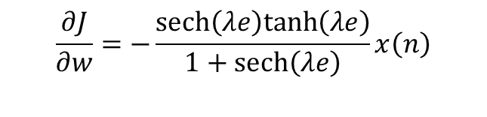
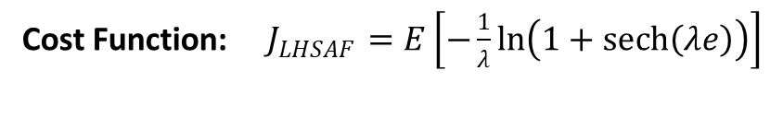
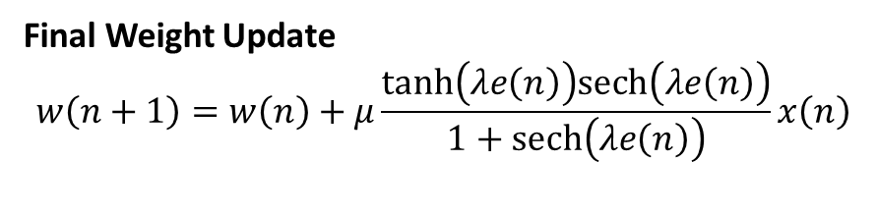
Logarithmic Hyperbolic Secant Algorithms
Improve FECG extraction under alpha-stable impulsive noise.
Reduce the influence of large errors using a Logarithmic Hyperbolic Secant cost function
Cost Function: $J_{LHSAF}=E\left[−\frac{1}{λ}\ln\left(1+sech⁡\left(λe\right)\right)\right]$
$$\frac{∂J}{∂w}=−\frac{sech⁡\left(λe\right)tanh⁡\left(λe\right)}{1+sech⁡\left(λe\right)}x\left(n\right)$$
Gradient
Final Weight Update
$$w\left(n+1\right)=w\left(n\right)+μ\frac{tanh⁡\left(λe\left(n\right)\right)sech⁡\left(λe\left(n\right)\right)}{1+sech⁡\left(λe\left(n\right)\right)}x\left(n\right)$$

Slide 10

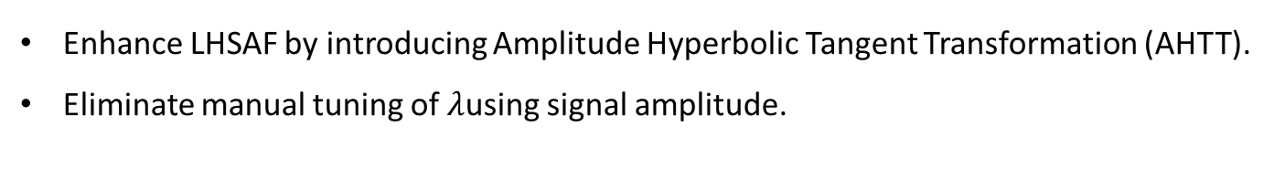
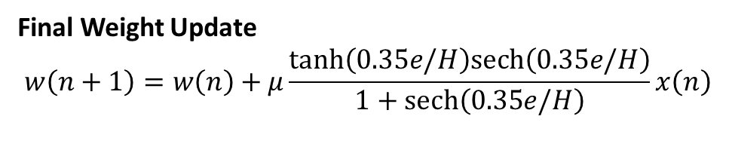
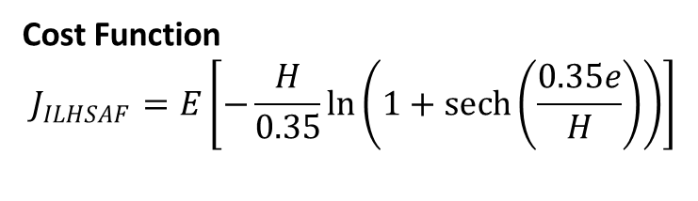
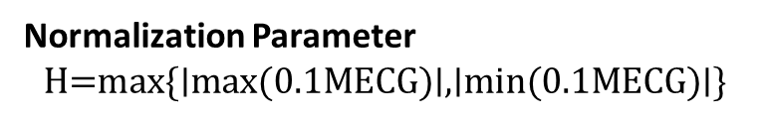
ILHSAF Algorithm
Enhance LHSAF by introducing Amplitude Hyperbolic Tangent Transformation (AHTT).
Eliminate manual tuning of $λ$using signal amplitude.
AHTT Transformation
$$κ\left(x\right)=\frac{H}{0.35}\tanh\left(\frac{0.35x}{H}\right)$$
Cost Function
$$J_{ILHSAF}=E\left[−\frac{H}{0.35}\ln\left(1+\operatorname{sech}\left(\frac{0.35e}{H}\right)\right)\right]$$
Normalization Parameter
$$\text{H=max\{∣max(0.1MECG)∣,∣min(0.1MECG)∣\}}$$
Final Weight Update
$$w\left(n+1\right)=w\left(n\right)+μ\frac{tanh⁡\left(0.35e/H\right)sech⁡\left(0.35e/H\right)}{1+sech⁡\left(0.35e/H\right)}x\left(n\right)$$

Slide 11
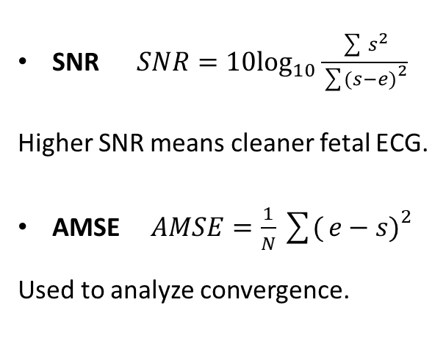

Performance Metrics
RMSE $RMSE=\sqrt{\frac{1}{N}\sum{(}\left.e−s{\left.)\right.}^{2}\right.}$
Measures reconstruction error.
PRD $PRD=100\sqrt{\frac{\sum{(}\left.e−s{\left.)\right.}^{2}\right.}{\sum{s^{2}}}}$
Lower PRD indicates better reconstruction.
SNR $SNR=10\log_{10}\frac{\sum{s^{2}}}{\sum{(}\left.s−e{\left.)\right.}^{2}\right.}$
Higher SNR means cleaner fetal ECG.
AMSE $AMSE=\frac{1}{N}\sum{(}\left.e−s{\left.)\right.}^{2}\right.$
Used to analyze convergence.

Slide 12
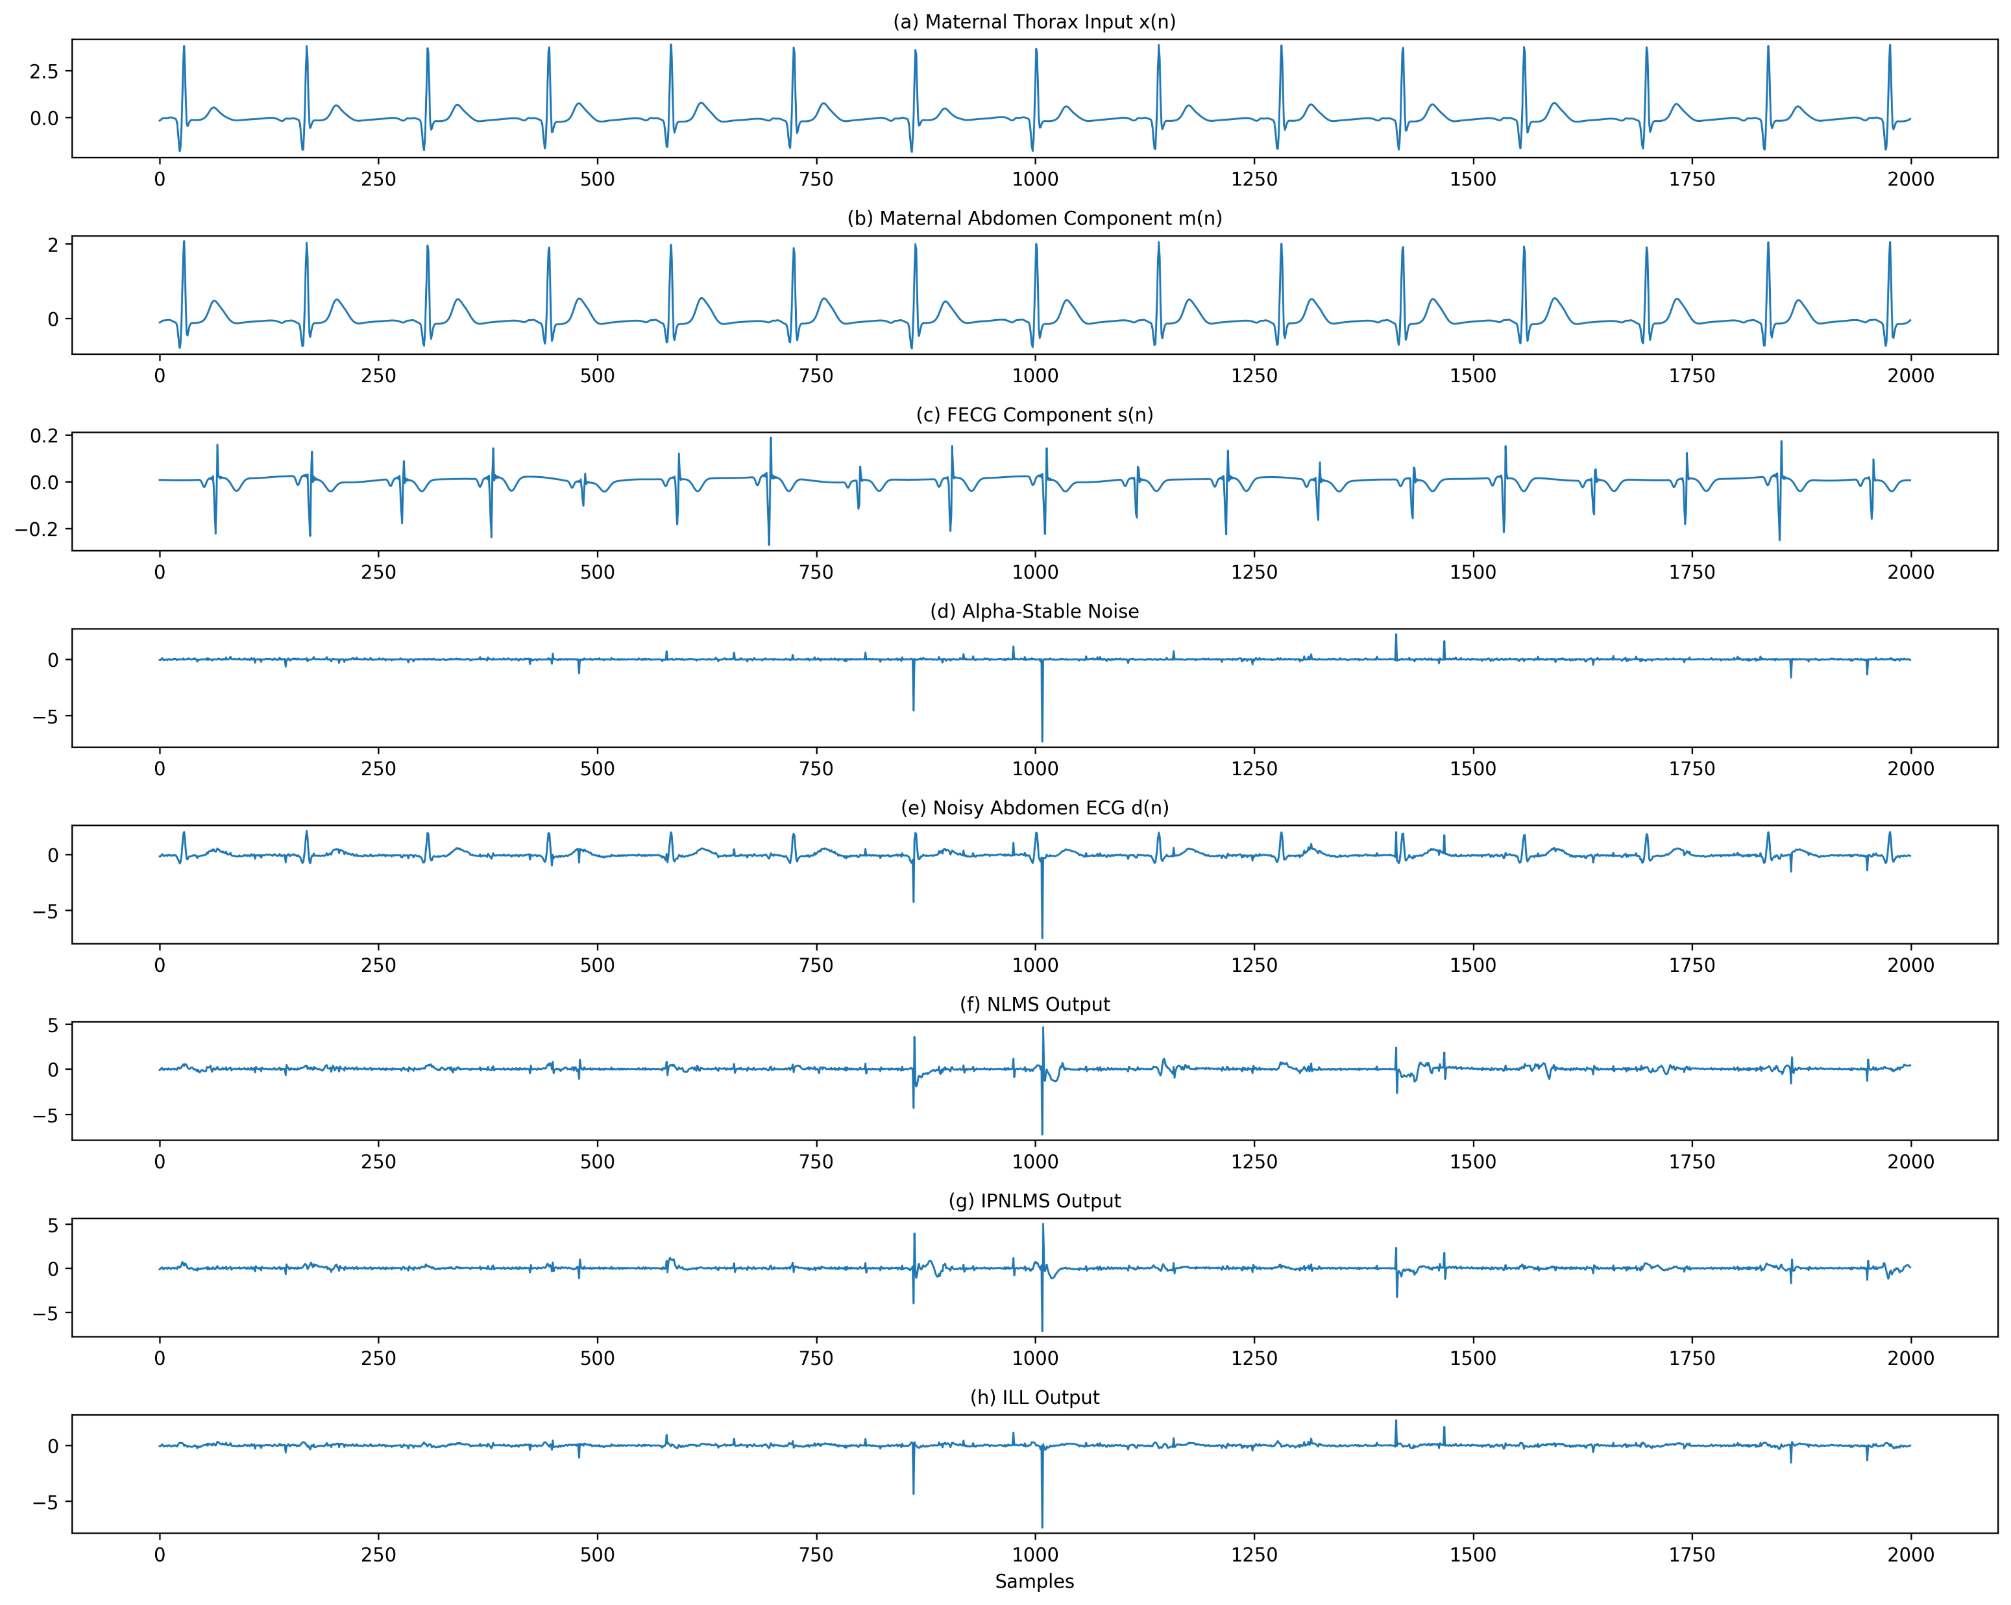
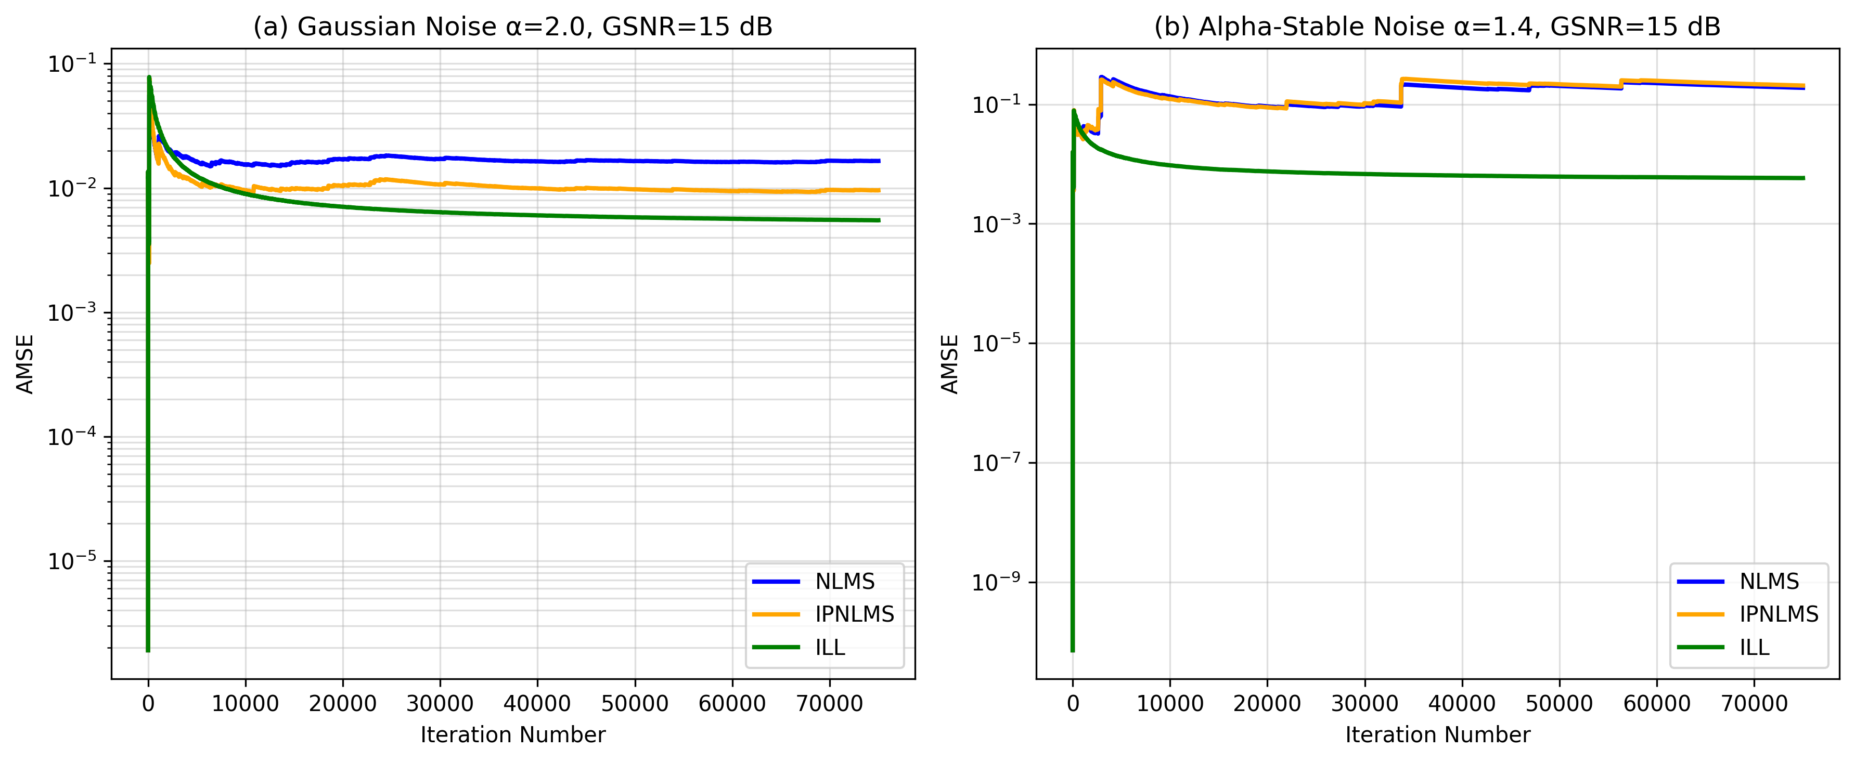
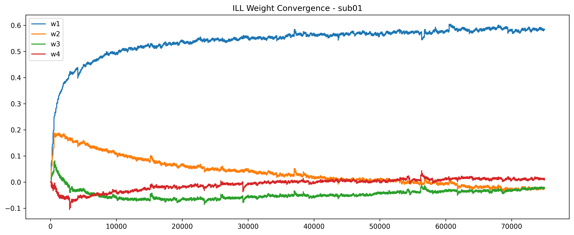
Signal Reconstruction Results
Paper-1
Fig : AMSE of the three algorithms in different noise backgrounds.
(a) Gaussian noise with α =2.0, GSNR = 15 dB. (b) non-Gaussian noise with α =1.4, GSNR = 15 dB.
Fig : Graphical response of each algorithm with Sub01 under S(1.4, 0,γ, 0).
Fig : ILL Weight Convergence – Sub01

Slide 13
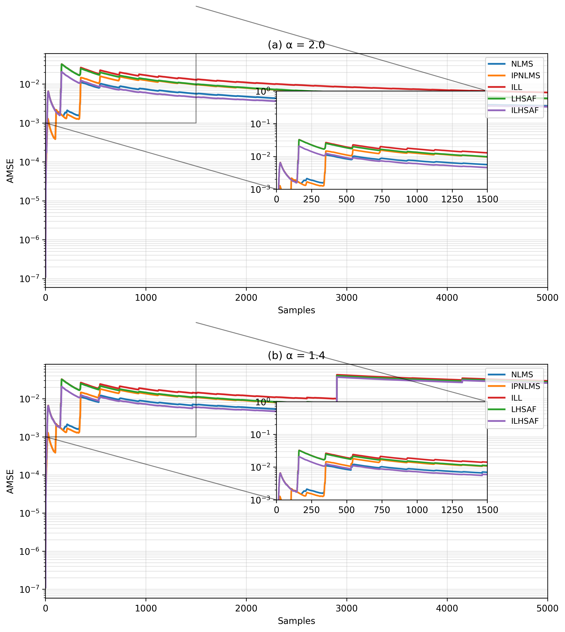
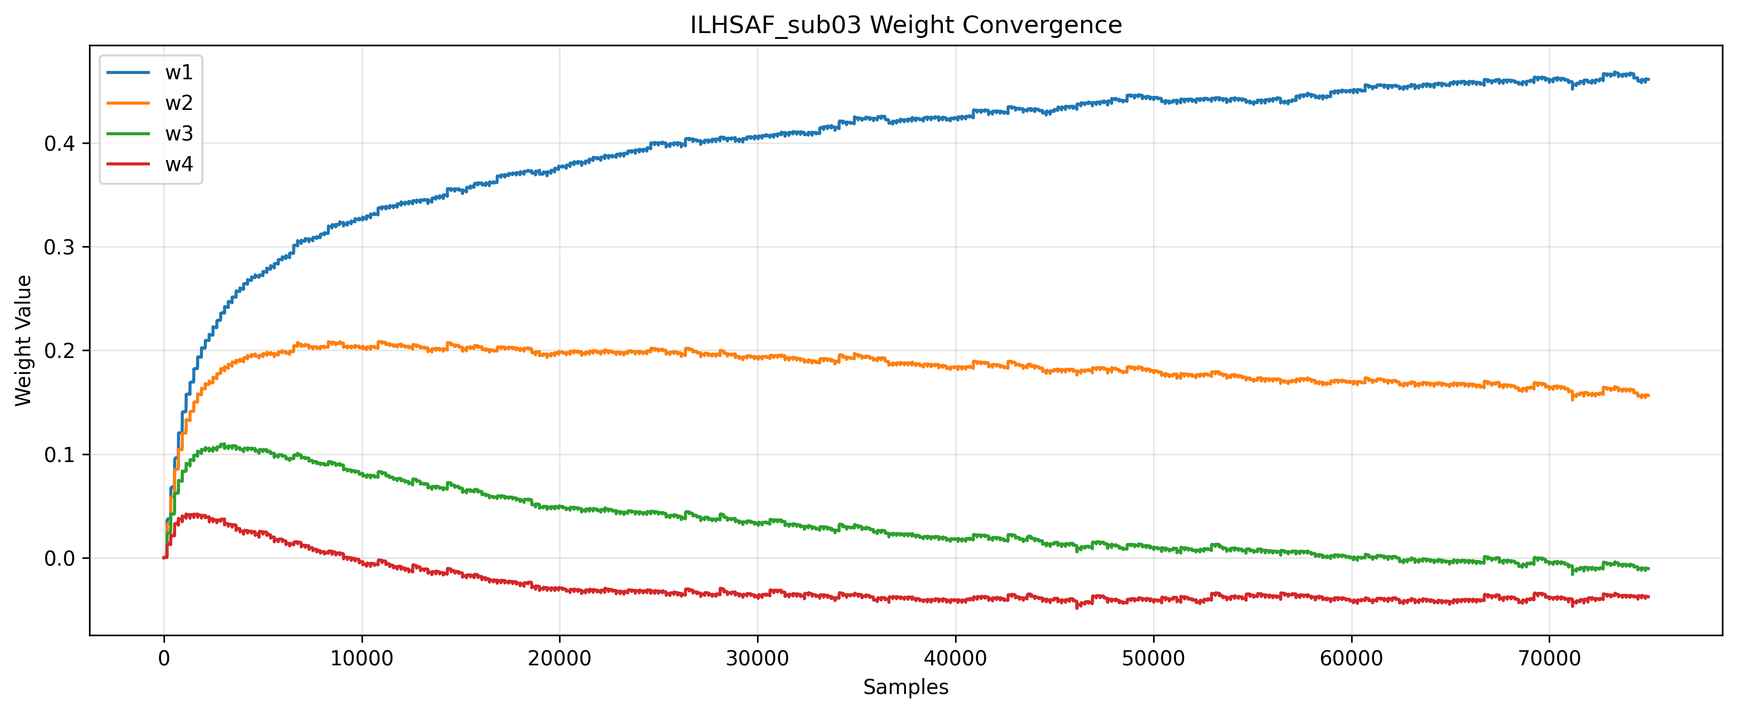
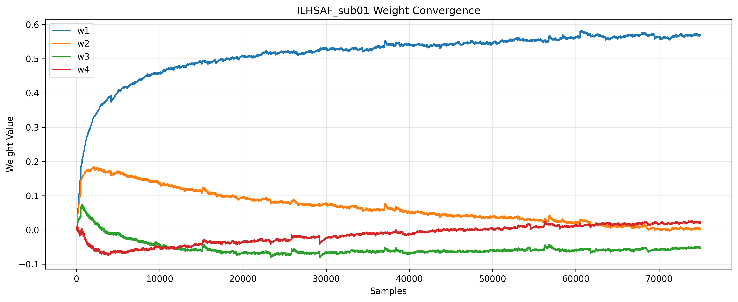
Table : OPTIMAL EVALUATION RESPONSE FOR EACH ALGORITHM
 |  | AMSE |  |  |  |  | PRD |  |  |  |  | RMSE |  |  |  |  | SNR
 | Algorithm | ILHSAF | IPNLMS | LHSAF | Llncosh | NLMS | ILHSAF | IPNLMS | LHSAF | Llncosh | NLMS | ILHSAF | IPNLMS | LHSAF | Llncosh | NLMS | ILHSAF | IPNLMS | LHSAF | Llncosh | NLMS
Subject | Alpha
sub01 | 1.4 | 0.293982 | 0.293193 | 0.34878 | 0.299203 | 0.298571 | 1440.583 | 1439.264 | 1564.919 | 1452.529 | 1452.388 | 0.128349 | 0.124762 | 0.255241 | 0.145303 | 0.144868 | 12.45113 | 12.66002 | 6.630256 | 11.40859 | 11.26559
 | 1.6 | 0.062571 | 0.054105 | 0.118393 | 0.067665 | 0.054796 | 660.1586 | 613.3532 | 892.7421 | 684.818 | 618.237 | 0.128077 | 0.086745 | 0.256234 | 0.144836 | 0.092661 | 4.693564 | 8.609968 | -1.18494 | 3.662586 | 7.753434
 | 1.8 | 0.027647 | 0.018179 | 0.086829 | 0.03266 | 0.018029 | 433.0616 | 346.3321 | 744.7921 | 468.5823 | 346.8257 | 0.127947 | 0.080178 | 0.261239 | 0.144516 | 0.081247 | -1.37754 | 3.405089 | -7.42069 | -2.39682 | 3.065475
 | 2 | 0.020429 | 0.010741 | 0.078966 | 0.025353 | 0.010475 | 368.4057 | 255.6569 | 702.7263 | 408.5508 | 255.2128 | 0.12777 | 0.078413 | 0.259756 | 0.144154 | 0.078493 | -5.67616 | -0.66062 | -11.6896 | -6.68808 | -0.86012
sub03 | 1.4 | 0.02545 | 0.025614 | 0.040496 | 0.061031 | 0.026737 | 332.4818 | 332.4673 | 415.7151 | 502.7786 | 340.0304 | 0.03405 | 0.037411 | 0.118322 | 0.174531 | 0.04998 | 13.37128 | 12.53117 | 3.588923 | 0.852577 | 9.992714
 | 1.6 | 0.005105 | 0.004913 | 0.020466 | 0.040505 | 0.005324 | 151.1761 | 146.5285 | 288.5914 | 395.8839 | 153.0002 | 0.033616 | 0.031356 | 0.119428 | 0.174169 | 0.037234 | 7.269502 | 7.817978 | -2.70193 | -5.35868 | 6.293094
 | 1.8 | 0.002028 | 0.001792 | 0.017163 | 0.03741 | 0.002095 | 96.84977 | 89.40107 | 260.0439 | 374.3746 | 97.1095 | 0.03348 | 0.030238 | 0.118576 | 0.174139 | 0.03484 | 4.410405 | 5.235818 | -5.55126 | -8.25534 | 3.974179
 | 2 | 0.001389 | 0.001148 | 0.016029 | 0.036883 | 0.001431 | 80.29799 | 71.9505 | 250.27 | 369.9686 | 80.68497 | 0.033385 | 0.029893 | 0.116803 | 0.174389 | 0.034303 | 3.47638 | 4.372607 | -6.40175 | -9.22629 | 3.148966
sub05 | 1.4 | 0.041593 | 0.042135 | 0.055608 | 0.07428 | 0.043245 | 669.5998 | 666.1024 | 768.737 | 875.0497 | 675.42 | 0.034191 | 0.041105 | 0.114569 | 0.16839 | 0.051982 | 14.65633 | 13.31292 | 5.16758 | 2.462726 | 11.27109
 | 1.6 | 0.007728 | 0.007495 | 0.021602 | 0.040615 | 0.007727 | 304.5026 | 285.2517 | 473.6261 | 622.9493 | 289.4994 | 0.033346 | 0.030137 | 0.114386 | 0.168504 | 0.033354 | 7.535082 | 8.481223 | -2.19206 | -4.9075 | 7.623252
 | 1.8 | 0.0026 | 0.002275 | 0.016413 | 0.035469 | 0.002361 | 194.2883 | 162.9505 | 408.6859 | 568.5742 | 165.7056 | 0.033077 | 0.028145 | 0.113866 | 0.168329 | 0.029438 | 2.741474 | 4.17879 | -7.03211 | -9.77542 | 3.791805
 | 2 | 0.001534 | 0.001195 | 0.015579 | 0.03437 | 0.001254 | 159.9225 | 122.8669 | 394.2167 | 555.5532 | 125.4085 | 0.032959 | 0.027598 | 0.114728 | 0.168188 | 0.028545 | 0.311819 | 1.875888 | -9.55456 | -12.2355 | 1.583764
sub07 | 1.4 | 0.05443 | 0.055018 | 0.070572 | 0.089193 | 0.058092 | 446.2392 | 449.7113 | 485.287 | 522.6397 | 460.2067 | 0.058413 | 0.0642 | 0.121103 | 0.158902 | 0.084255 | 11.84314 | 10.9434 | 7.338399 | 6.223934 | 8.664367
 | 1.6 | 0.011747 | 0.011539 | 0.028464 | 0.046327 | 0.012976 | 208.7393 | 208.8217 | 277.1449 | 324.667 | 217.8512 | 0.057868 | 0.0567 | 0.121987 | 0.158446 | 0.067594 | 5.098503 | 5.212023 | 0.493572 | -0.55987 | 3.765582
 | 1.8 | 0.005268 | 0.004991 | 0.021455 | 0.039998 | 0.006154 | 141.0686 | 139.825 | 222.1863 | 273.798 | 150.2491 | 0.05759 | 0.055622 | 0.120514 | 0.158576 | 0.064607 | 1.376065 | 1.621775 | -3.1905 | -4.30937 | 0.399275
 | 2 | 0.003922 | 0.003636 | 0.019977 | 0.038516 | 0.004748 | 122.2415 | 120.452 | 207.5504 | 259.3957 | 131.9864 | 0.057523 | 0.055364 | 0.120036 | 0.158282 | 0.063962 | -0.09447 | 0.18308 | -4.6415 | -5.76828 | -0.99256
Fig : Convergence behaviour of algorithms in different noise backgrounds.
Paper-2
Fig : Weights of ILHSAF over Sub01

Slide 14
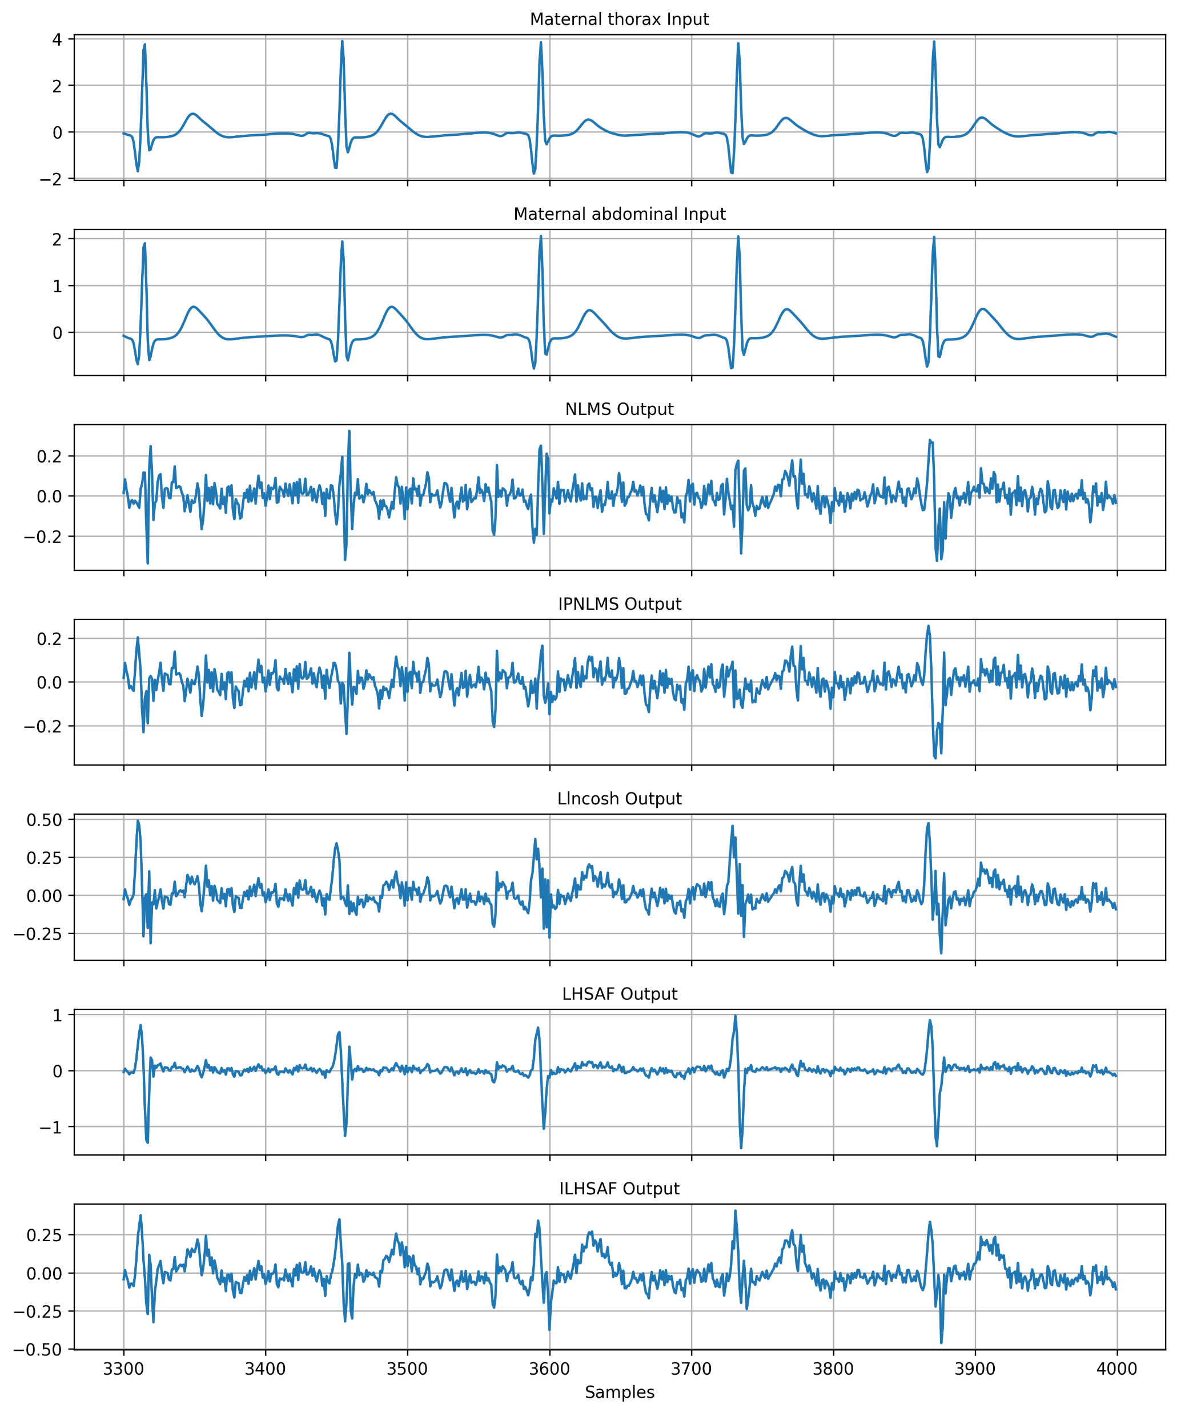
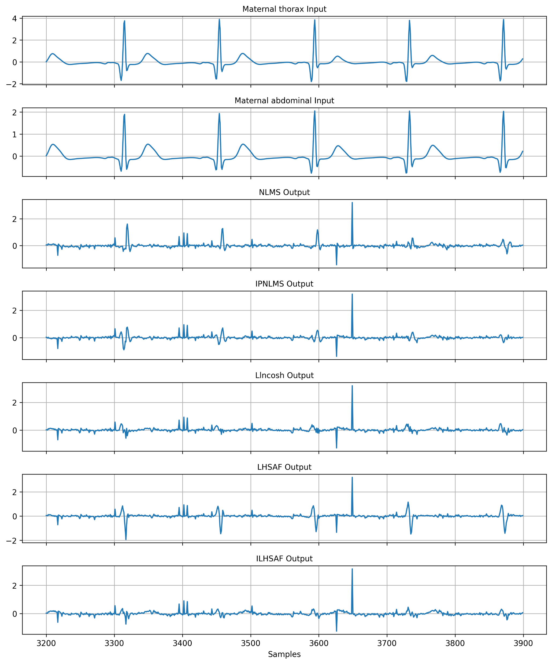
Observation
Maternal ECG is largely removed.
Fetal peaks become more visible.
ILHSAF preserves morphology better.
AMSE decreases with iterations.
Gaussian noise converges faster.
Alpha-stable noise slows convergence.
Amplitude
(a) α = 2.0
(b) α = 1.4
Fig. Graphical responses of FECG extraction with subject-01 under different noise background

Slide 15
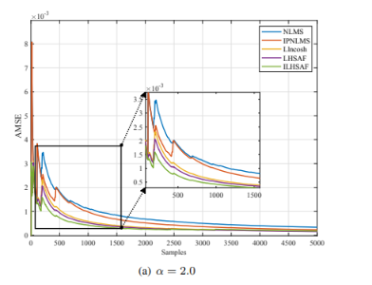
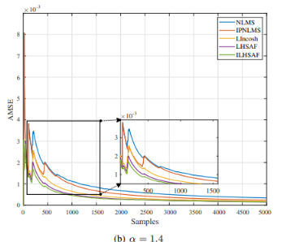
Observation
ILHSAF maintains stable learning under impulsive noise.
Llncosh converges faster than NLMS in our implementation.
Weights initially change rapidly.
Later stabilize after adaptation.
Stable weights indicate successful convergence.
Dominant coefficients capture maternal ECG characteristics.
Key Findings
Average results computed over four abdominal channels.
Tested on multiple subjects.
Evaluated across four alpha values.
ILHSAF consistently provides competitive RMSE, PRD and SNR.
Performance remains stable under heavy-tailed noise.
Highlight one or two best rows.
Convergence behaviour of algorithms in different noise backgrounds.

