Slide 1
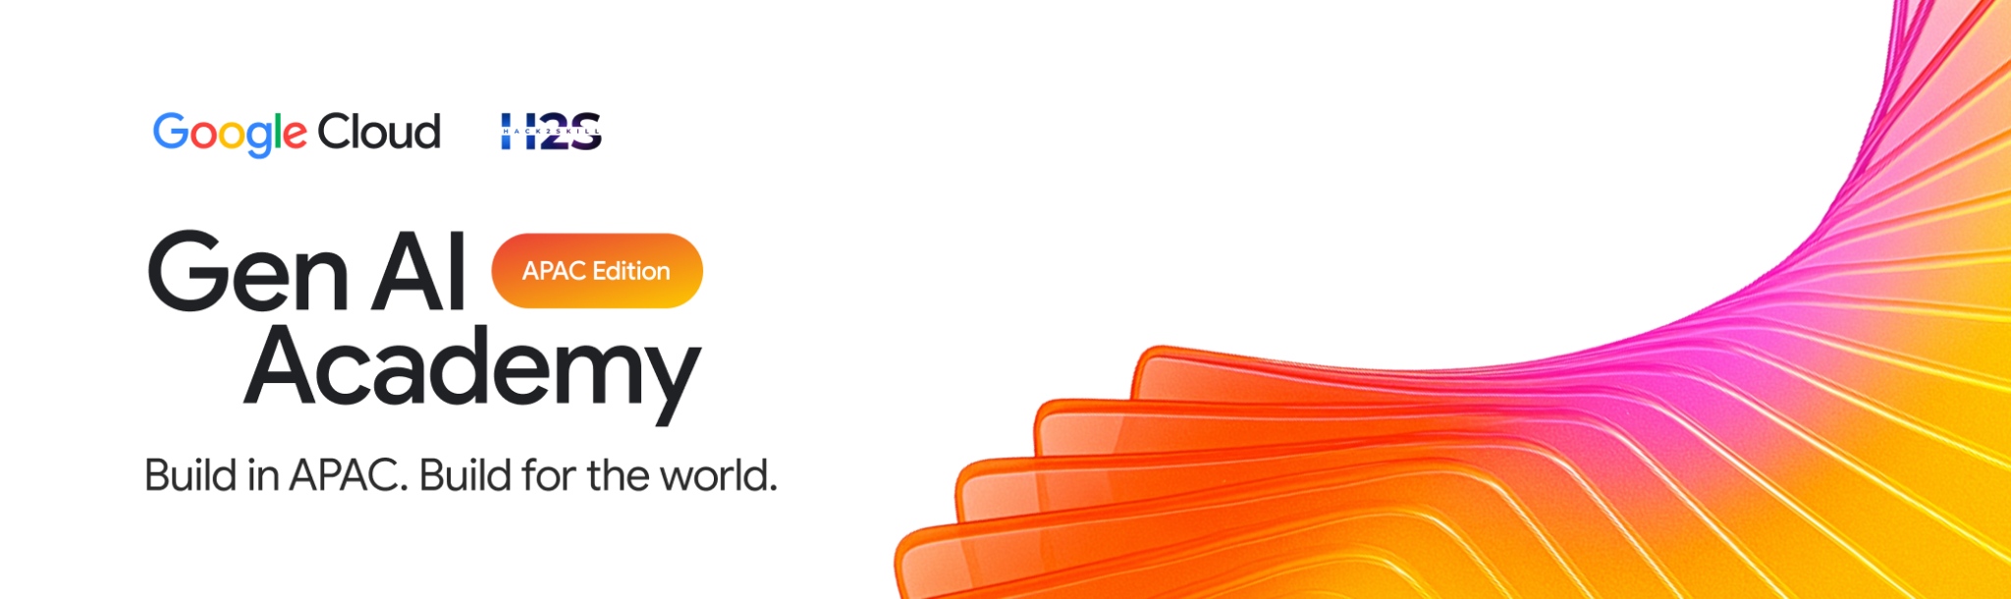
Participant Details
Participant Name: [Your Name]
Problem Statement: NVIDIA Track — Autonomous Multi-Agent Decision Intelligence for Smart Cities

Slide 2
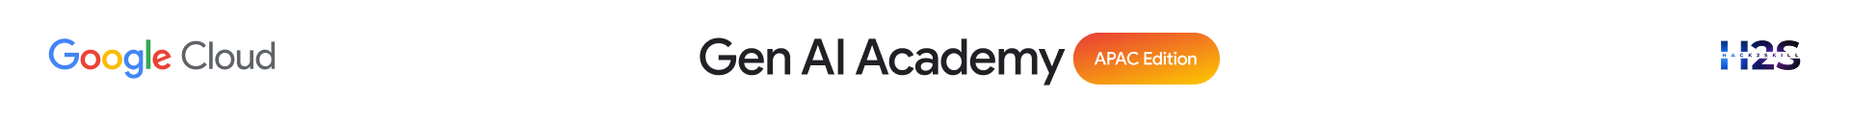
Brief about the idea
CityOS is an autonomous multi-agent decision-intelligence platform for smart cities. A goal-driven Planner breaks an incoming situation (e.g. a flash flood warning) into a dependency-aware task graph, dispatches specialized Traffic, Environment, Emergency, Citizen, and Knowledge agents in parallel, reflects on their confidence, and produces an explainable, human-approved recommendation.
It is grounded by a real knowledge graph — OpenStreetMap, Wikipedia, Wikidata, GeoJSON boundaries, and government PDFs indexed into Neo4j + Qdrant — and reasons using NVIDIA Nemotron models served through OpenRouter, behind a single AI Gateway that can swap providers without touching a single agent.

Slide 3
Your solution should be able to explain the following:
How did you approach the common problem statement and translate it into a working solution using Google Cloud technologies (e.g., BigQuery, ADK, Vertex AI, Gemini, etc.) while ensuring the hackathon's core requirements are met? If you selected the NVIDIA problem statement, also explain how NVIDIA technologies were integrated into your solution.
What real-world problem does your solution address, and what practical impact does it create for users, organizations, or communities??
What is the core architecture or workflow behind your solution, and how does it transform data into actionable insights or intelligent decisions?
Approach & NVIDIA integration: We selected the NVIDIA problem statement. All reasoning — planning, embedding, reranking, and content-safety — runs on NVIDIA Nemotron models (Nemotron 3 Ultra, Llama-Nemotron-Embed-VL, Llama-Nemotron-Rerank-VL, Nemotron 3.5 Content-Safety) via OpenRouter, unified behind one AI Gateway (src/ai/gateway.py) so no agent talks to a model API directly. Google Gemini remains as an automatic fallback for resilience.
Real-world problem & impact: City operators juggle isolated dashboards that show data but cannot reason, coordinate, or recall institutional knowledge during fast-moving events (floods, hazardous AQI, mass events). CityOS turns raw sensor + knowledge data into a single explainable recommendation an operator can approve in seconds — cutting response time and keeping a human in the loop for every high-risk decision.
Core architecture: Goal → Planner (DAG) → parallel Agent Workers → Reflection (confidence check) → RAG retrieval (Qdrant top-20 → Nemotron rerank → top-5) → Decision → human approval → Workflow. Every step is broadcast live over WebSocket to Mission Control.

Slide 4
Opportunities
How different is it from any of the other existing ideas?
USP of the proposed solution
Most smart-city tools are read-only dashboards: they visualize data but cannot reason about it, coordinate across domains, or recall institutional knowledge.
CityOS's USP:
• True multi-agent reasoning, not another chart — a Planner + Reflection loop that adapts its own task graph mid-run
• A real knowledge graph (Neo4j + Qdrant), not a keyword search — 5 heterogeneous sources fused into one retrievable graph
• Provider-agnostic AI Gateway — swap NVIDIA → NIM → Vertex → Ollama by editing one file, zero agent changes
• Guardrails by design — content-safety pre/post-check plus mandatory human approval on every high-risk decision

Slide 5
List of features offered by the solution
• Goal-driven multi-agent runtime: Planner → parallel Workers → Reflection → Decision → human approval
• RAG knowledge layer over OSM, Wikipedia, Wikidata, GeoJSON, and government PDFs (Neo4j + Qdrant)
• NVIDIA Nemotron AI Gateway: planning, embedding, reranking, content-safety — with automatic Gemini fallback
• Live Mission Control dashboard: city map, agent DAG, AI Copilot chat, decision timeline
• What-If Simulator: heavy rain / air pollution / major event / heatwave scenarios with live AI predictions
• Real-time data ingestion: weather + AQI every 15 minutes across 12 Hanoi districts
• Human-in-the-loop safety gate on every low-confidence or high-risk decision

Slide 6
Process flow diagram or Use-case diagram
Example: Heavy rain detected in Hanoi
User Goal / Sensor Trigger
↓
Planner (builds task DAG)
↓
Traffic Agent Emergency Agent Knowledge Agent (parallel)
↓
Reflection (confidence check)
↓
Decision (recommendation + evidence)
↓
Human Approval (Mission Control)
↓
Workflow executed + logged to timeline

Slide 7
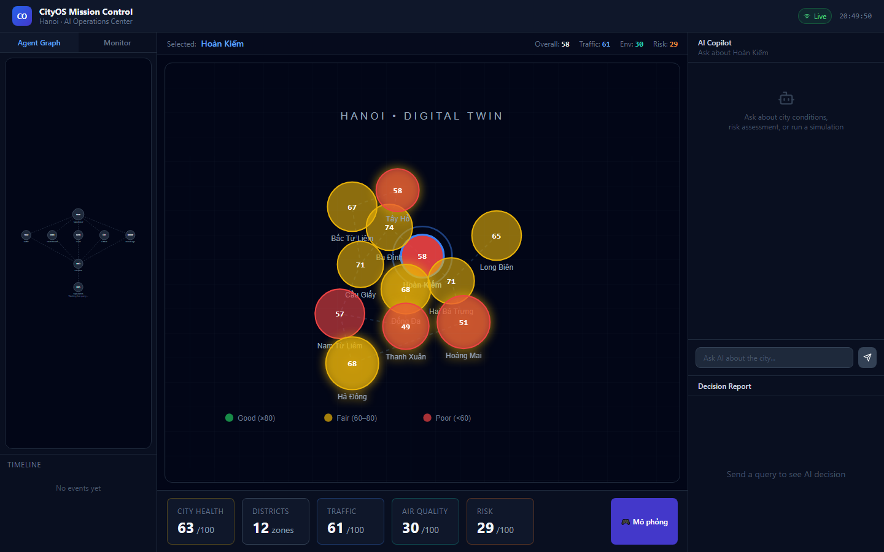
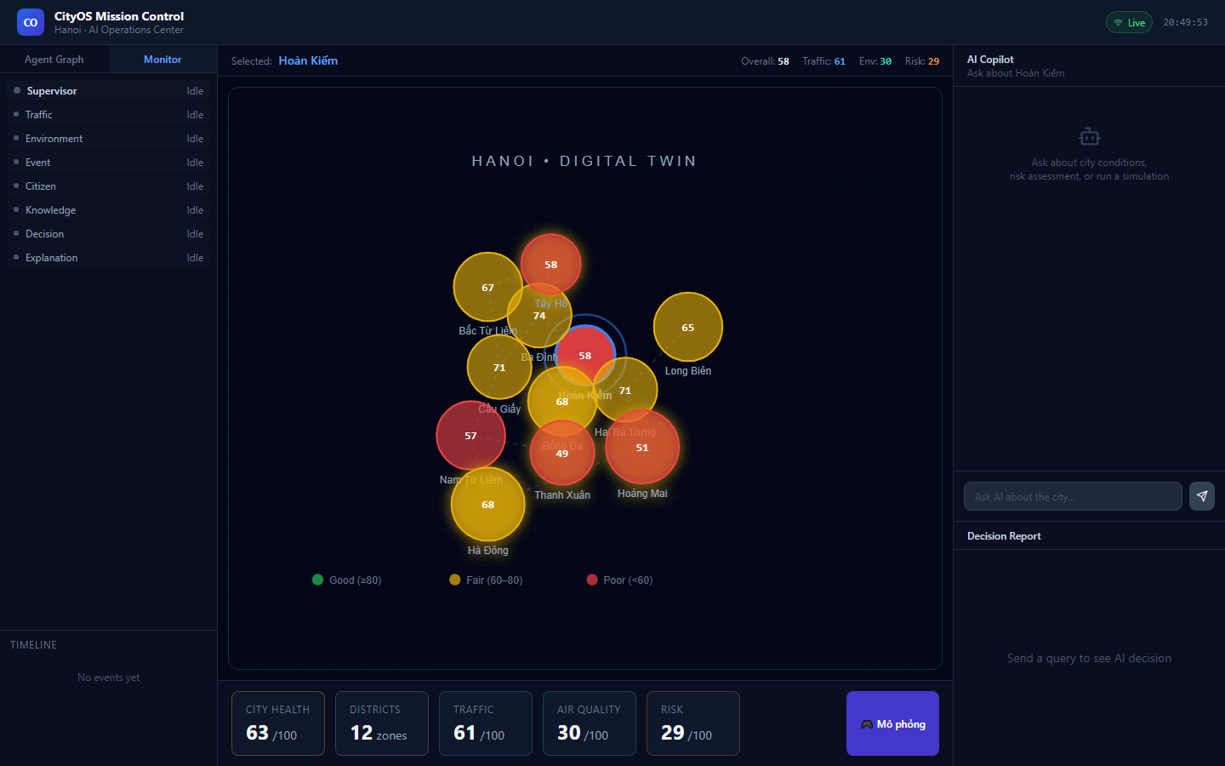
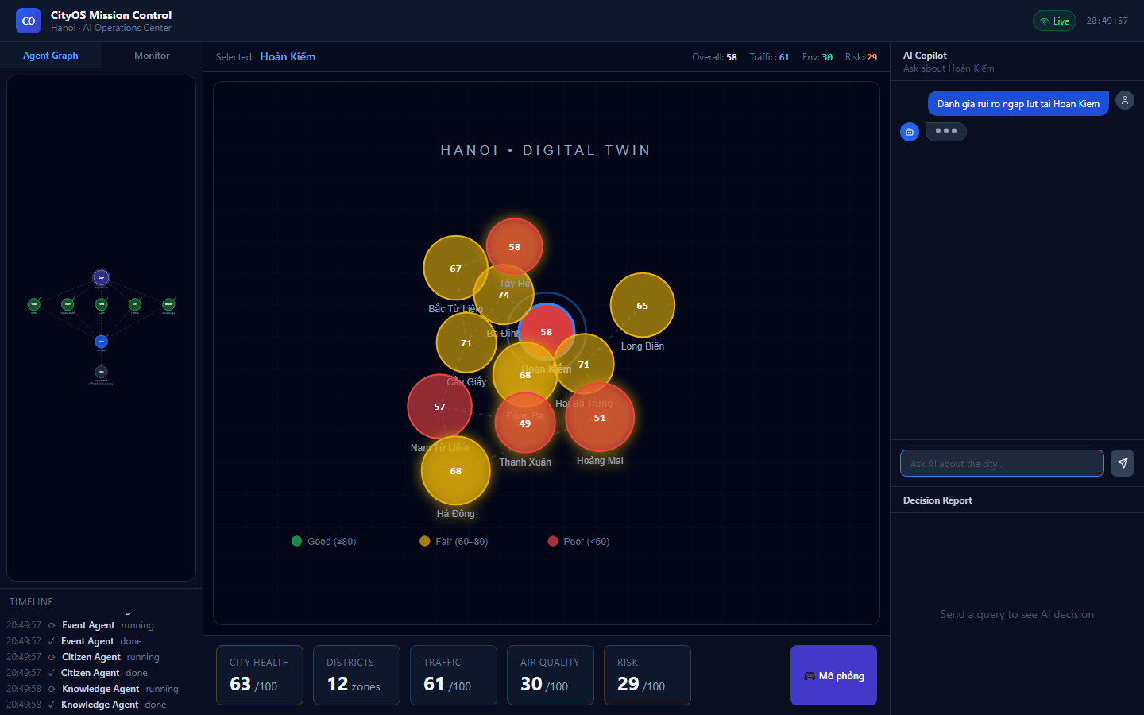
Wireframes/Mock diagrams of the proposed solution
Digital Twin
Agent Monitor
AI Copilot

Slide 8
Architecture diagram of the proposed solution:
React Mission Control (Map · DAG · Copilot · Timeline)
↓ REST + WebSocket
FastAPI Backend
↓
Multi-Agent Runtime (Planner → Scheduler → Workers → Reflection → Decision)
↓
Knowledge Layer: Neo4j (graph) + Qdrant (vectors)
↓
AI Gateway: Safety · Embedding · Reranker · Planner
↓
NVIDIA Nemotron (via OpenRouter) → fallback: Google Gemini
↓
Data Sources: OSM · Wikipedia · Wikidata · GeoJSON · Gov PDFs · Open-Meteo · OpenAQ

Slide 9
Technologies / Google / Nvidia Services used in the solution (Why did you choose your specific AI stack and system design, and how does it support scalability and real-world deployment?)
NVIDIA (via OpenRouter, free tier): Nemotron 3 Ultra (planning), Llama-Nemotron-Embed-VL-1B-V2 (embedding), Llama-Nemotron-Rerank-VL-1B-V2 (RAG reranking), Nemotron 3.5 Content-Safety (guardrails, pre + post-check)
Google: Gemini 2.0 Flash (v1 pipeline + automatic fallback when Nemotron/OpenRouter is unavailable)
Knowledge: Neo4j Aura (entity/relation graph), Qdrant Cloud (vector search)
Platform: FastAPI + PostgreSQL (Neon.tech), React + TypeScript, Render (backend), Vercel (frontend)
Why this stack: every model call is routed through one AI Gateway (src/ai/gateway.py) with a per-role fallback list — changing providers (NVIDIA NIM, Vertex AI, Ollama) means editing one file, not every agent. 100% free-tier components keep the whole stack deployable with zero GPU cost, while the gateway abstraction means production scale-up is a config change, not a rewrite.
Notes:
All solutions must leverage Google Cloud technologies. NVIDIA technologies should be included by teams that have selected the NVIDIA problem statement.

Slide 10
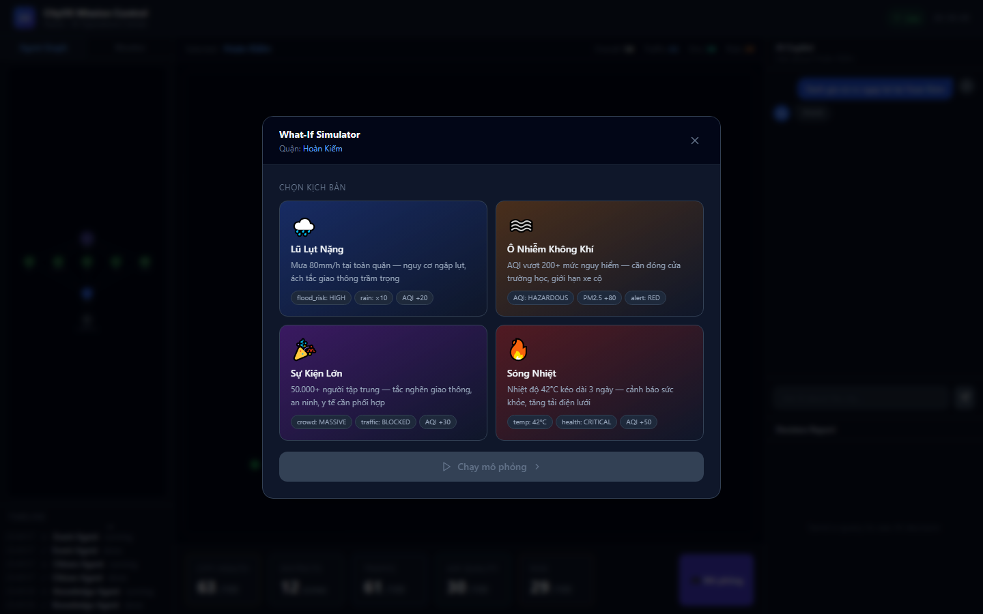
Snapshots of the prototype
What-If Simulator
Mission Control — live

Slide 11
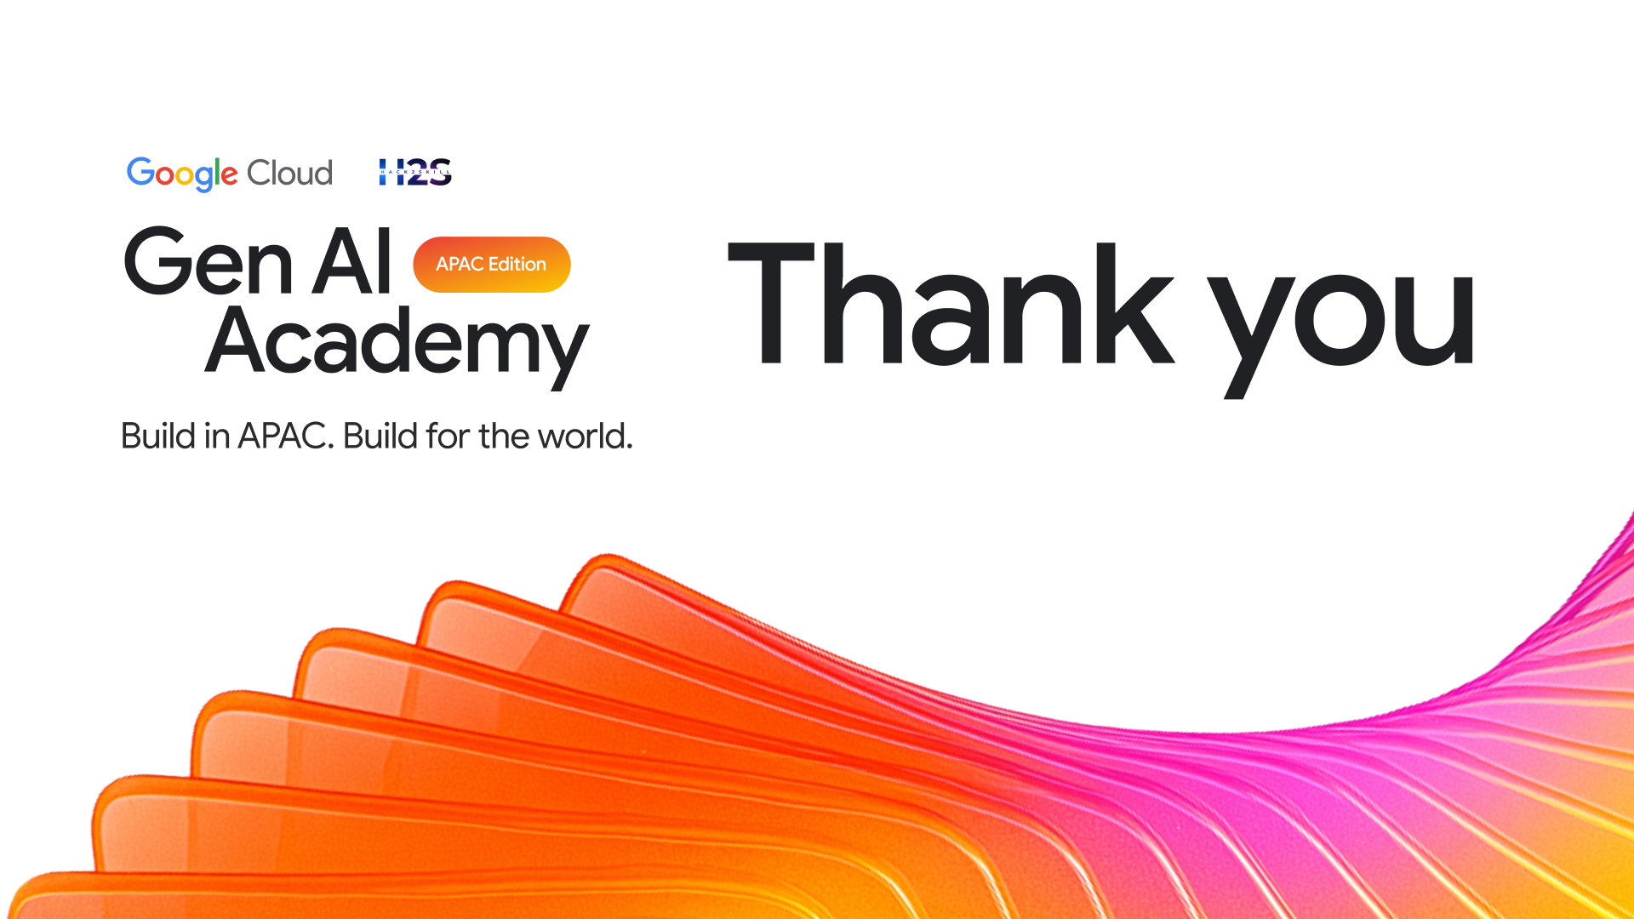
CityOS
An Autonomous Multi-Agent Operating System for Smart Cities

