Slide 1
第15章 JavaScript eXtension

Slide 2
本章学习目标
Web 前端开发工程师应掌握以下内容：
JavaScript回调函数
JavaScript作用域链
JavaScript闭包

Slide 3
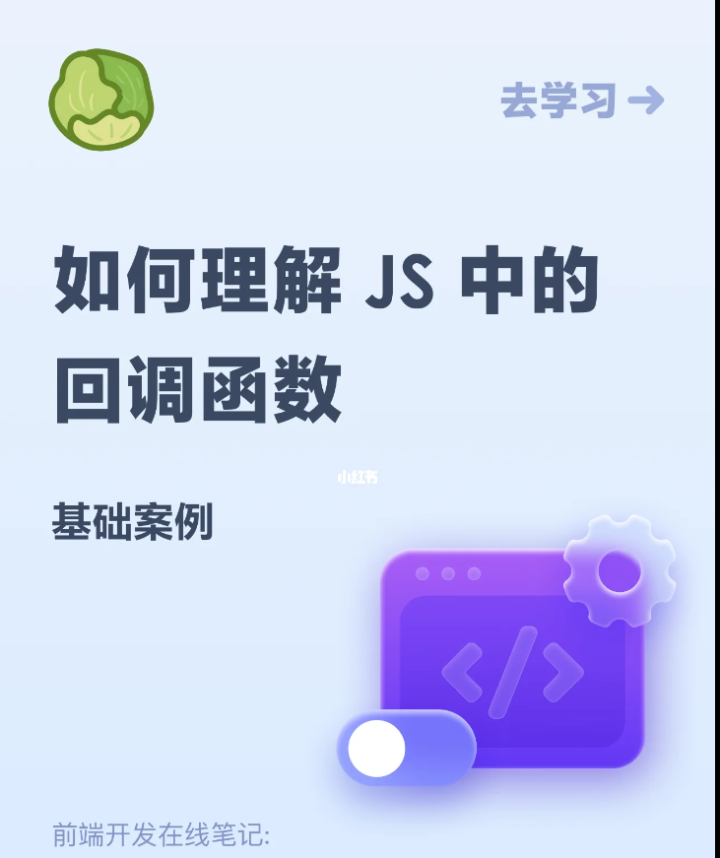
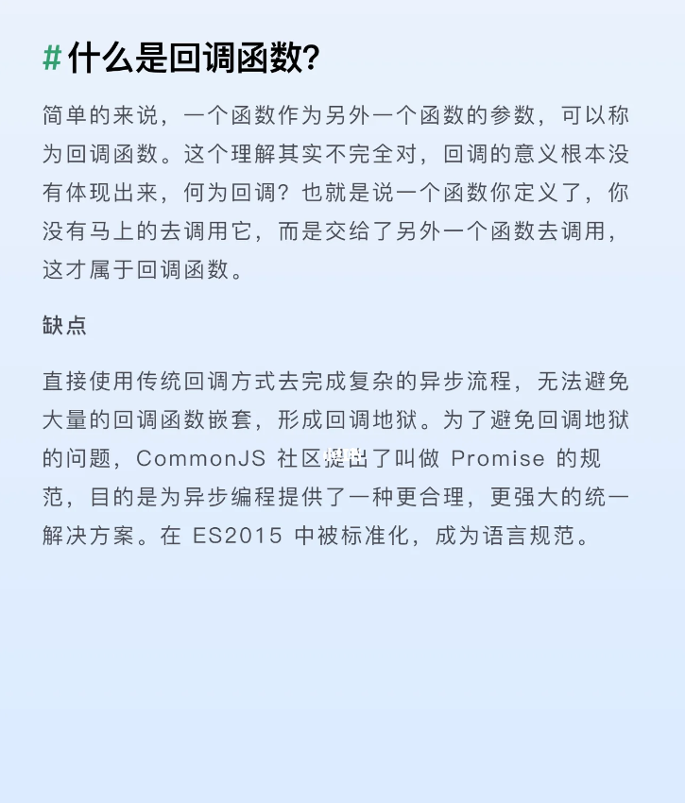
Callback-回调函数

Slide 4
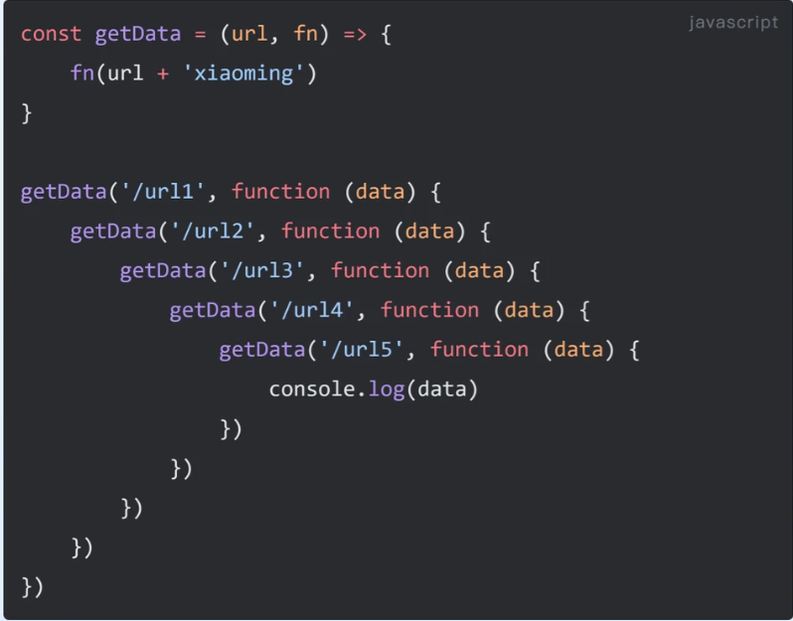
Callback 嵌套与地狱

Slide 5
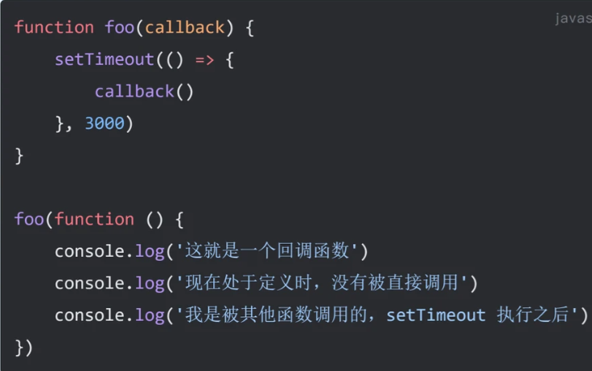
Callback – Promise规范

Slide 6
作用域 var let
In JavaScript, scope defines where variables can be accessed. The main difference between var and let lies in how they handle scope and hoisting.
var is function-scoped, meaning it is accessible anywhere inside the function where it’s declared, regardless of block boundaries. let is block-scoped, meaning it is only accessible within the {} block where it’s declared, such as inside loops or conditionals.

Slide 7
作用域 var let
function demoVarLet() {
if (true) {
var a = 10; // function-scoped
let b = 20; // block-scoped
}
console.log(a); // ✅ Works: 10
console.log(b); // ❌ ReferenceError
}
demoVarLet();
使用建议.
Use let (or const) for predictable block scoping and to avoid accidental variable leaks.
Avoid var in modern JavaScript unless maintaining legacy code.
Always declare variables before use to prevent hoisting-related bugs.

Slide 8

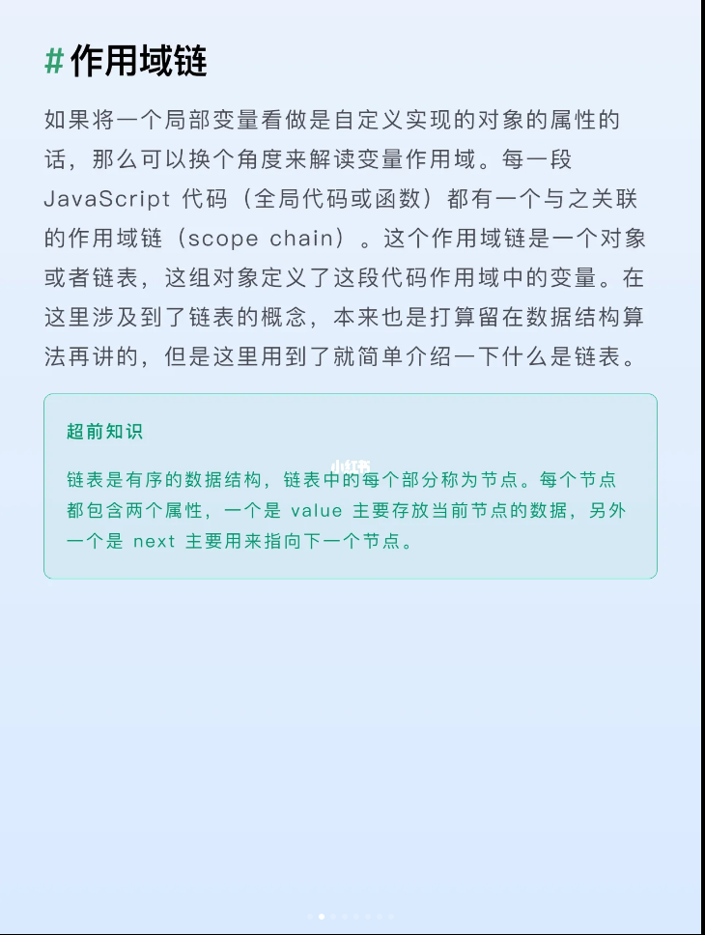
Scope Chain-作用域链

Slide 9
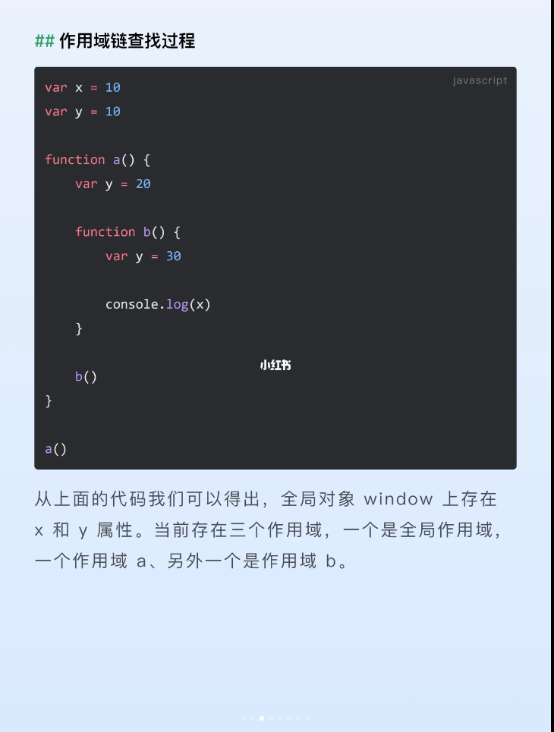
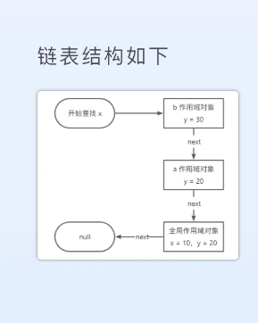
Scope Chain

Slide 10
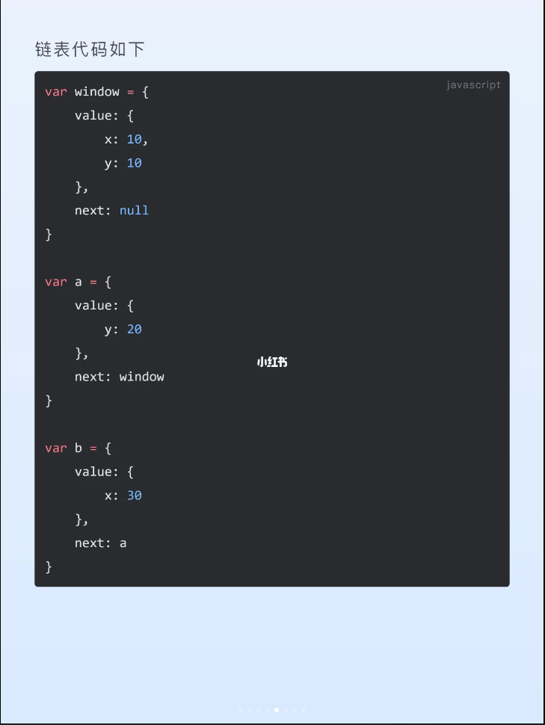
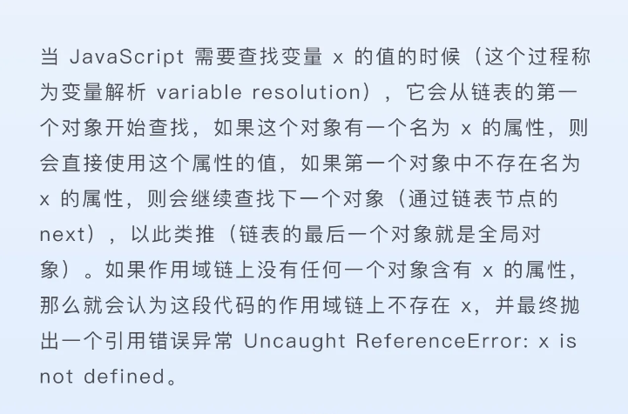
Scope Chain

Slide 11
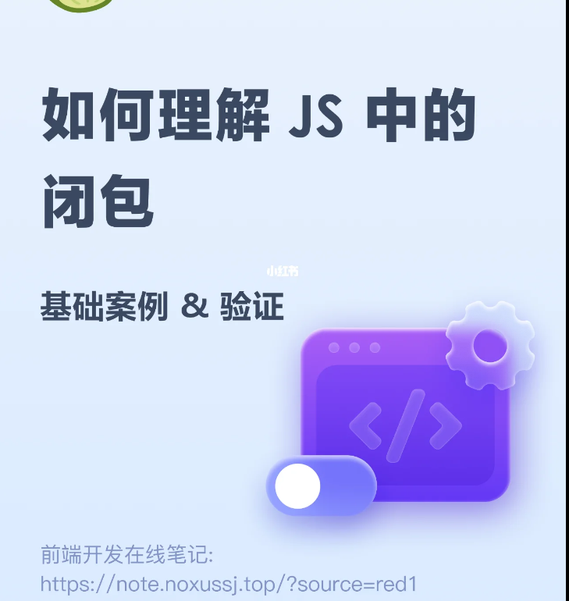
闭包(Closure)

Slide 12
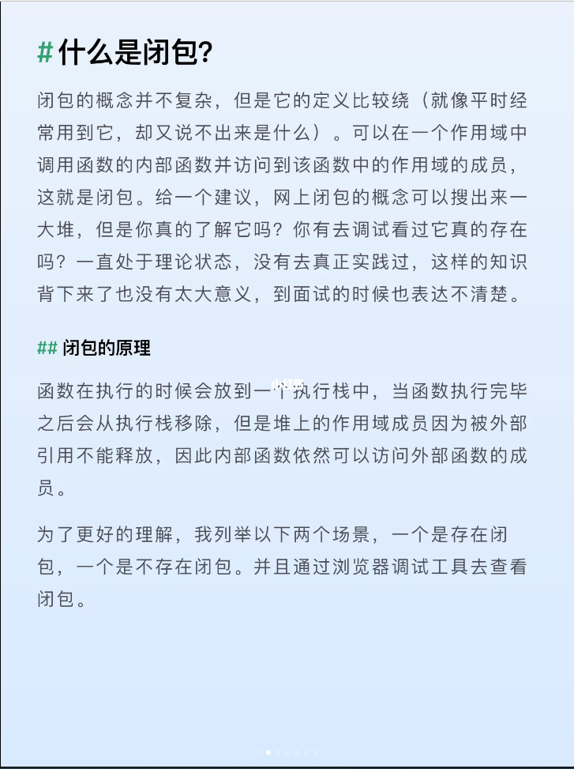
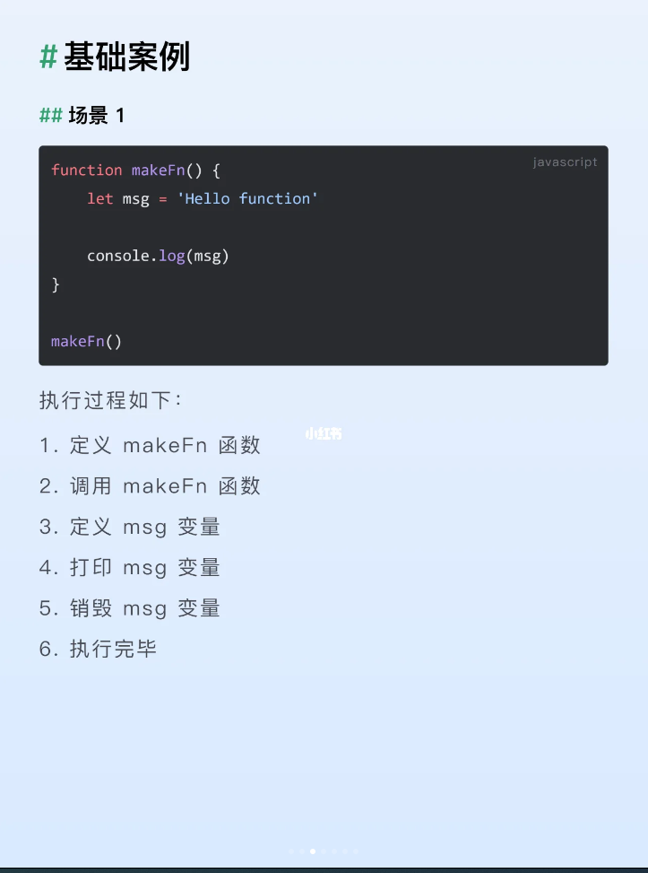
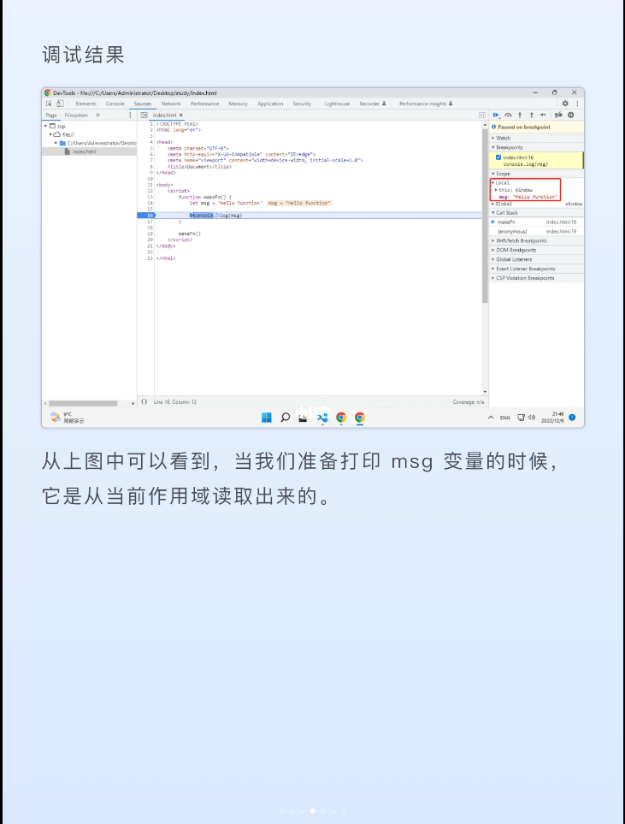
Closure

Slide 13
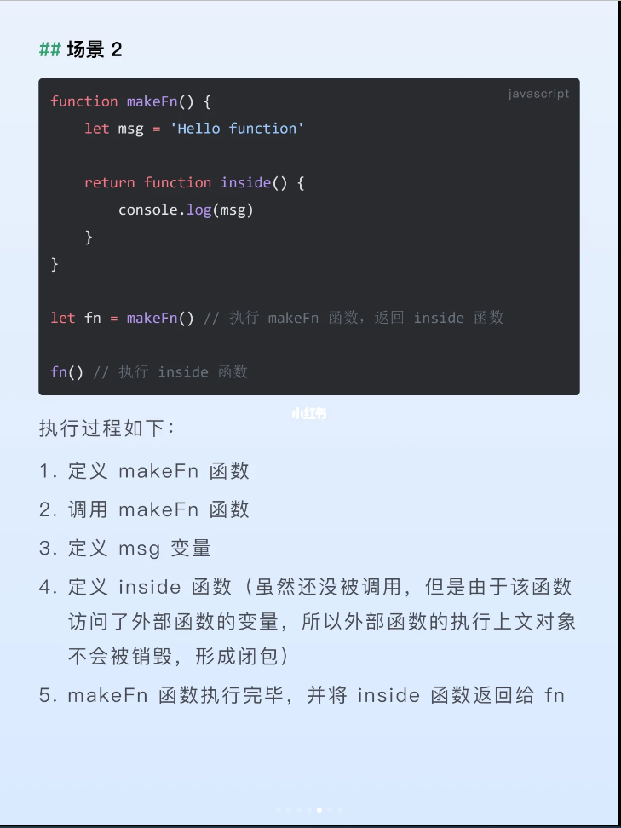
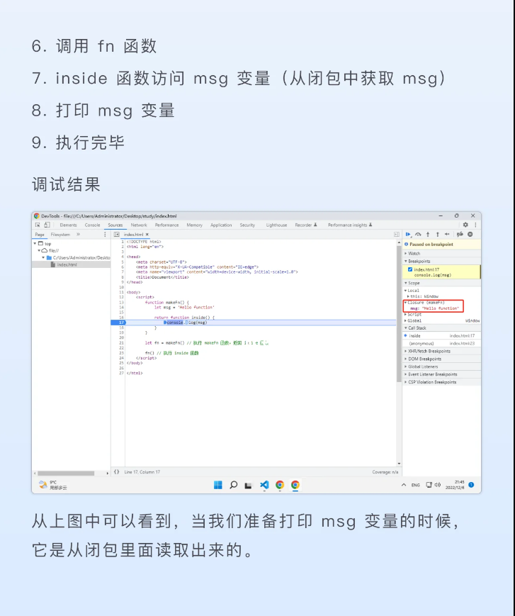
Closure

Slide 14
15.6 综合实例-代码
checkright=false;
}else //不为空，再判断用户名和密码的长度合法性
{
if(username.length<6) {
alert("用户名长度太短，至少6个字符！！");
checkright=false;
} else if(pwd.length<6) {
alert("密码长度太短，至少6个字符！！");
checkright=false;
} else if(pwd!=pwdConfirm) {
alert("两次输入的密码必须一致！！");
checkright=false;
} else{
checkright=true;}
}
return checkright;
}
function clearInfo()
{
var flag = confirm("确认要重置数据吗？");
if(flag==true)
{
$("myname").value = "";
$("mypwd1").value = "";
$("mypwd2").value = "";
}
}
</script>
</head>

Slide 15
练习与实验15
作业：
完成本章练习与实验

