Slide 1
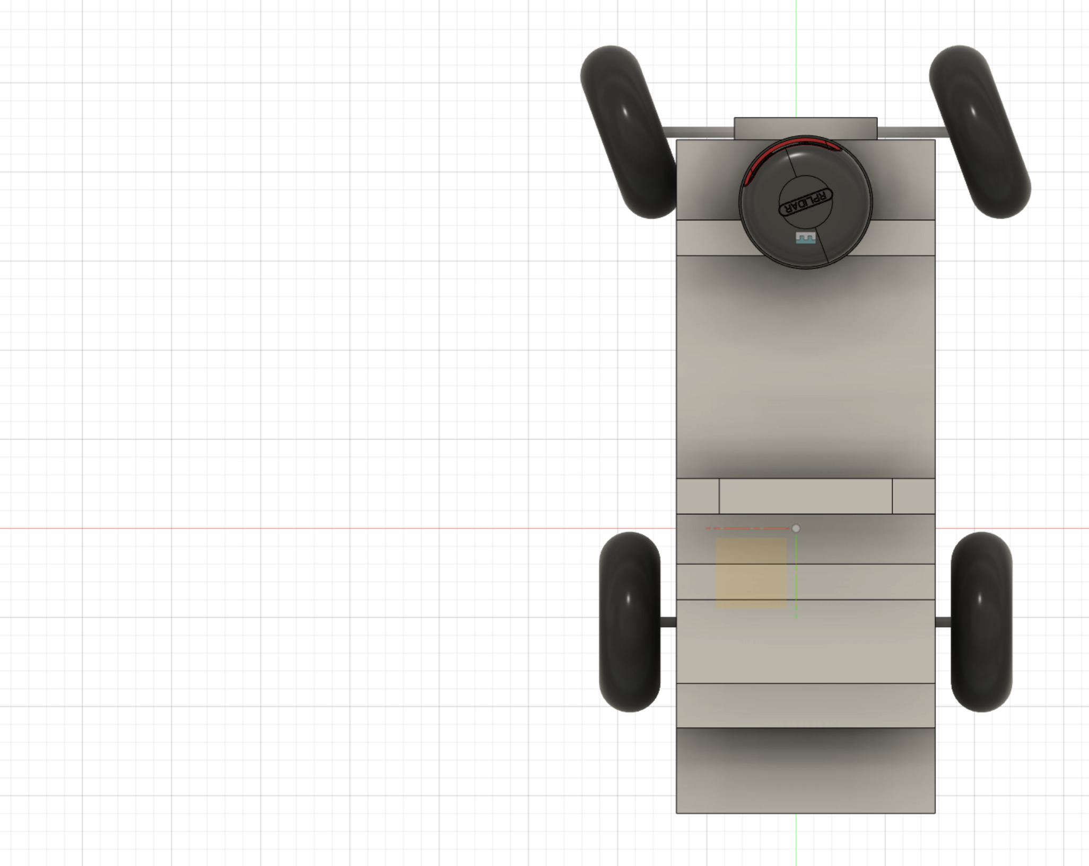
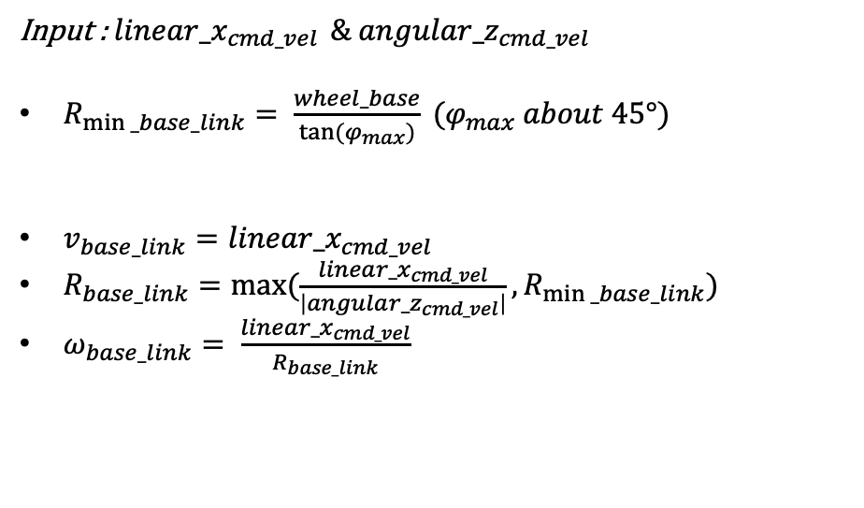



Input : $linear_x_{cmd_vel}$ $\& angular_z_{cmd_vel}$
$R_{min⁡_base_link}= \frac{wheel_base}{tan⁡(φ_{max})} (φ_{max} about 45°)$
$v_{base_link}=linear_x_{cmd_vel}$
$R_{base_link}=max⁡(\frac{linea{r_x}_{cmd_vel}}{\left|angula{r_z}_{cmd_vel}\right|},R_{min⁡_base_link})$
$ω_{base_link}= \frac{linea{r_x}_{cmd_vel}}{R_{base_link}}$
$$wheel_base$$
$$φ$$
$$R_{base_link}$$

Slide 2
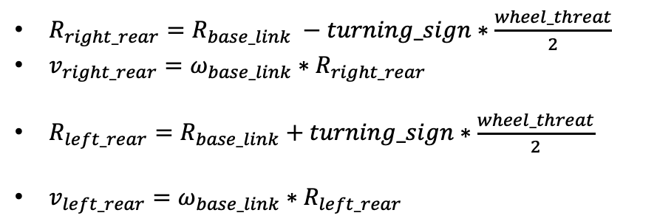



$R_{right_rear}=R_{base_link} −turning_sign∗\frac{wheel_threat}{2}$
$v_{right_rear}=ω_{base_link}∗R_{right_rear}$
$R_{left_rear}=R_{base_link}+turning_sign∗\frac{wheel_threat}{2}$
$v_{left_rear}=ω_{base_link}∗R_{left_rear}$
$$R_{left_rear}$$
$$R_{right_rear}$$
$$wheel_threat$$

Slide 3

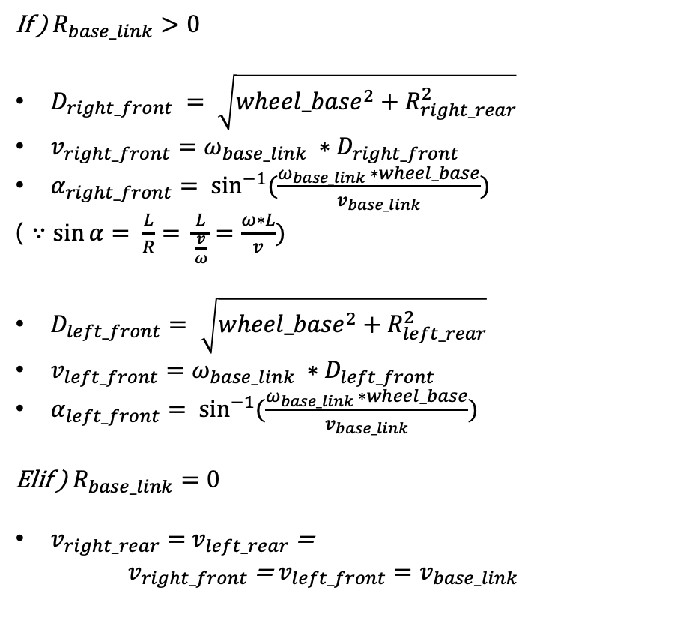





If ) $R_{base_link}>0$
$D_{right_front} = \sqrt{{wheel_base}^{2}+R_{right_rear}^{2}}$
$v_{right_front}=ω_{base_link} ∗D_{right_front}$
$α_{right_front}= \sin^{−1}{(\frac{ω_{base_link} ∗wheel_base}{v_{base_link}})}$
( $∵sin{α}= \frac{L}{R}= \frac{L}{\frac{v}{ω}}=\frac{ω∗L}{v})$
$D_{left_front}= \sqrt{{wheel_base}^{2}+R_{left_rear}^{2}}$
$v_{left_front}=ω_{base_link} ∗D_{left_front}$
$α_{left_front}= \sin^{−1}{(\frac{ω_{base_link} ∗wheel_base}{v_{base_link}})}$
Elif ) $R_{base_link}=0$
$v_{right_rear}=$ $v_{left_rear}$ =
$v_{right_front}$ = $v_{left_front}=v_{base_link}$
$$D_{left_front}$$
$$D_{right_front}$$
$$wheel_base$$
$$α_{right_front}$$
$$α_{left_front}$$
$$R_{left_rear}$$
$$R_{right_rear}$$

Slide 4
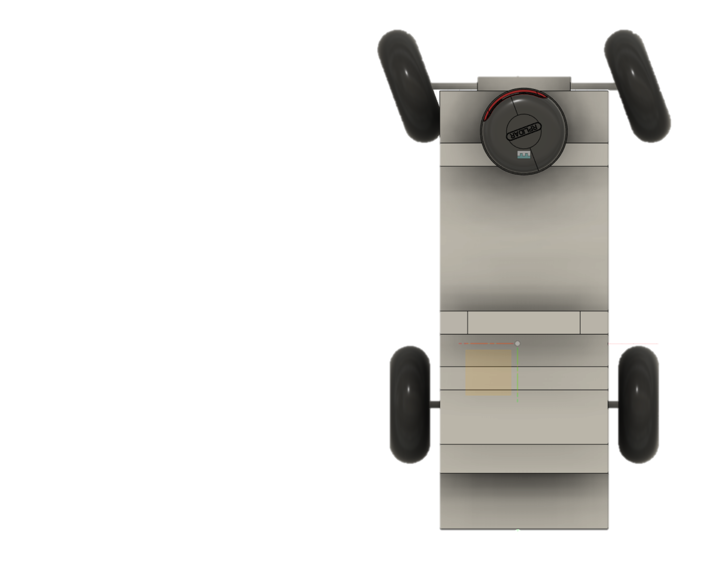
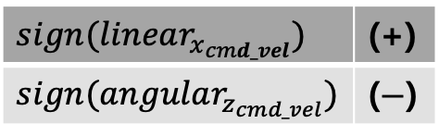
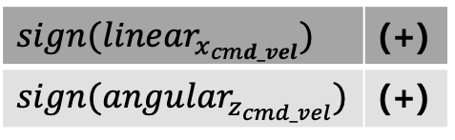
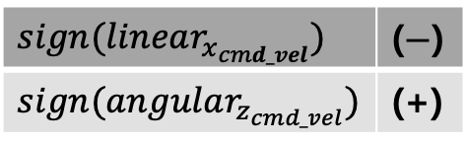
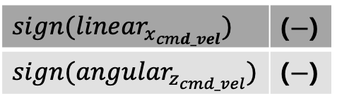
$$sign(linear_{x_{cmd_vel}})$$ | (+)
$$sign(angular_{z_{cmd_vel}})$$ | (+)
$$sign(linear_{x_{cmd_vel}})$$ | (+)
$$sign(angular_{z_{cmd_vel}})$$ | ($−$)
$$sign(linear_{x_{cmd_vel}})$$ | ($−$)
$$sign(angular_{z_{cmd_vel}})$$ | ($−$)
$$sign(linear_{x_{cmd_vel}})$$ | ($−$)
$$sign(angular_{z_{cmd_vel}})$$ | (+)

