Slide 1
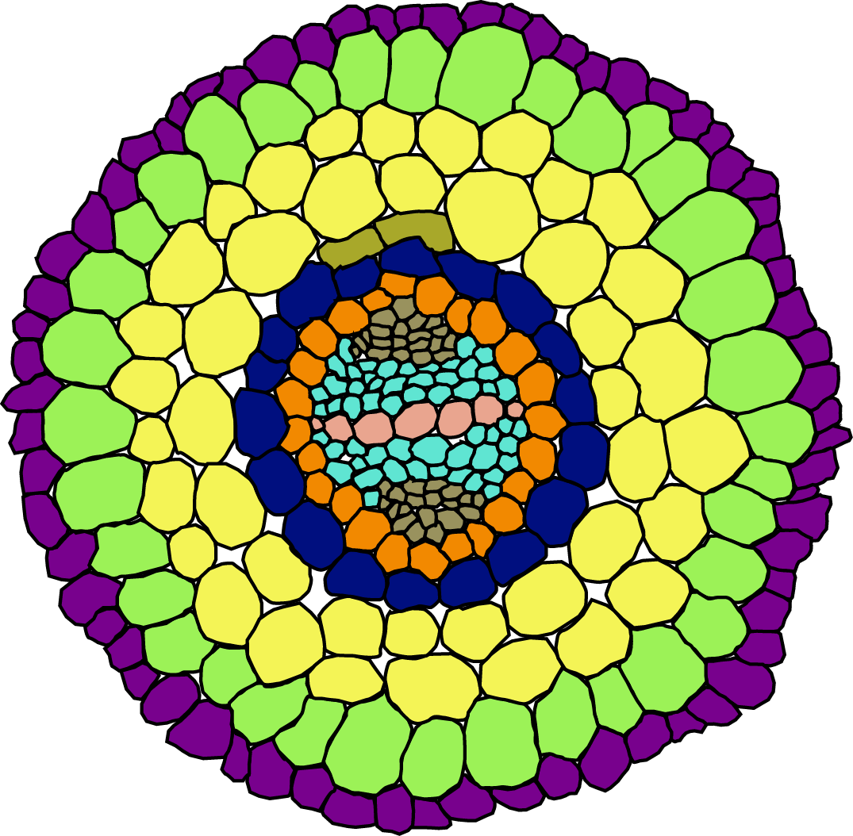
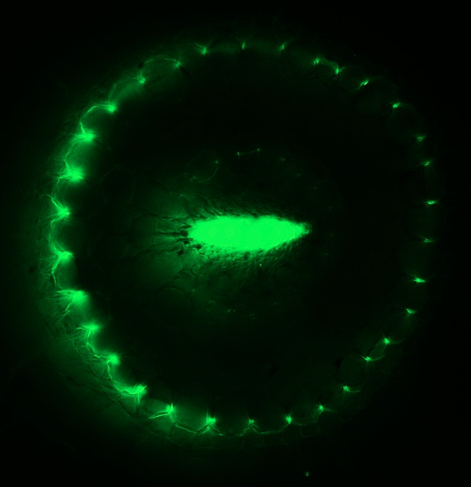
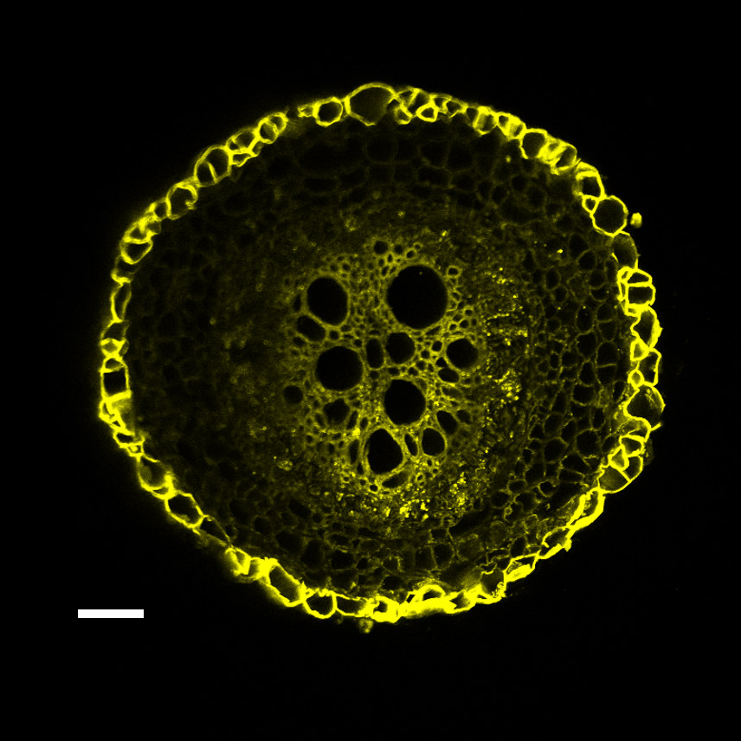
Epidermis
Pericycle
Exodermis (EX)
Phloem
Cortex
Procambium
Middle Cortex
Xylem (X)
Endodermis (EN)
EX
Lignin staining
EN
X
Suberin staining
EX
Suberin staining
Control

Slide 2
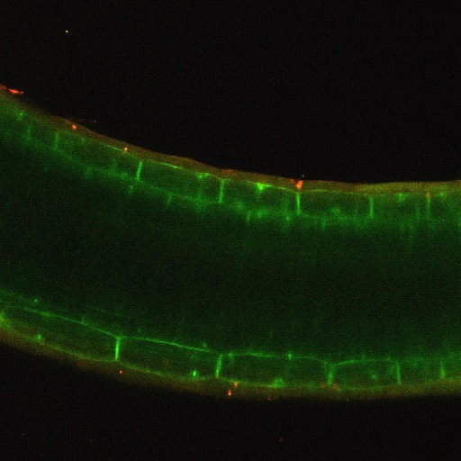
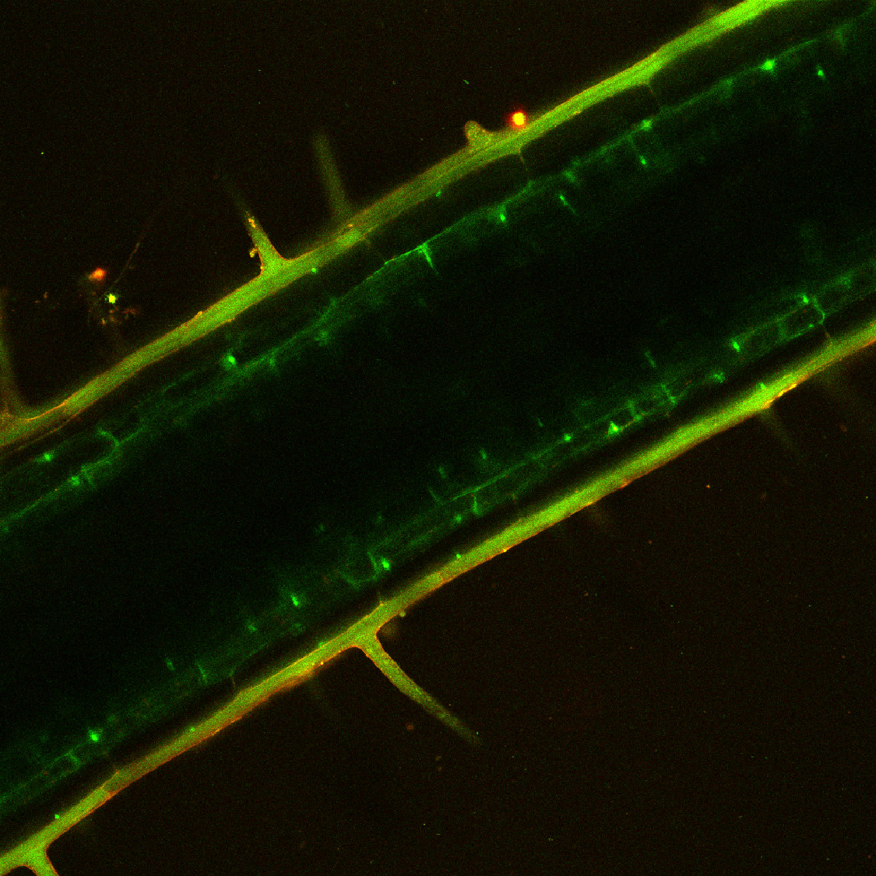
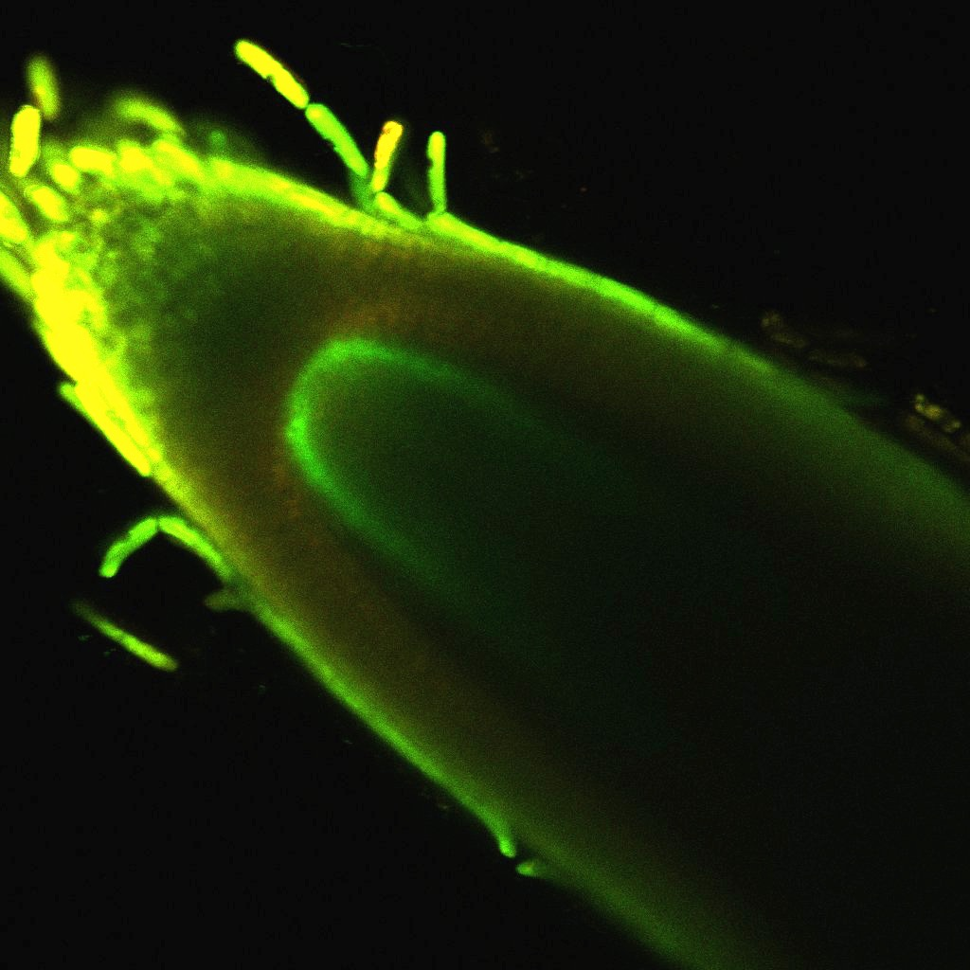
A SlPEPpro:TRAP
B AtPEPpro:TRAP
C SlSCRpro:TRAP
EX
COR
EN
COR
QC

Slide 3
Exodermis & epidermis
(SlPEPpro:TRAP)
Epidermis (AtWERpro:TRAP)
Non-exodermal cortex
(AtPEPpro:TRAP)
Genes highly expressed in exodermis
Endodermis & QC
(SlSCRpro:TRAP)
Genes that are highly expressed uniquely in exodermis and not in other cortex layers
Genes that are highly expressed uniquely in exodermis and not in endodermis
Genes that are highly expressed in
both exodermis and endodermis
Candidate genes unique for exodermis
If there are orthologs highly expressed in endodermis, then these genes were co-opted after duplication
Candidate genes for shared characteristics
These genes were co-opted to exodermal role directly and have a role in both endodermis and exodermis

