Slide 1
Project 2: Improving Parallel Sparse Matrix-vector
Multiplication
Prepared by:
Kaisar Barlybay, 211107009
Olzhas Sanatbek, 211107032

Slide 2
Introduction & Summary
Sparse Matrix-vector Multiplication (SMvM) is a mathematical method heavily used in many programs and computations. In SMvM, values from an input vector are multiplied with values from a matrix and added into an output vector.
The aim of this thesis is to develop new ideas and algorithms to speed-up parallel SMvM on a shared memory computer.

Slide 3
Fundamentals
In the paper the author discussed parallel programming, OpenMP, sparse matrix, coordinate representation (COO), Compressed row storage (CRS), Compressed column storage (CCS) and Parallel SMvM with various techniques.
The coordinate representation (COO) of sparse matrices consists of three arrays to store row indices, column indices and values of non-zero elements. The elements are easy to sort, restructure and allocate to a thread because the elements save its coordinate. CRS and CCS also save only the non zero elements, but they reduced the space used to store the coordinates. CRS reduced on row, and CCS reduced on column indices. For each row or column, the algorithms iterates over the elements of that row or column and multiplies it with the corresponding value from the input vector and adds the result into its correct place in the output vector.
After introduction part Mr. Tessem briefs about challenges for SMvM and discusses different existing solutions and their weaknesses.

Slide 4
Even work load
The author researches matrix vector multiplication efficiency using various matrix storage representations and work distribution techniques (static, dynamic, guided, binary search). Inspired by min-makespan problem, the author reports some performance improvement of matrix-vector multiplication of CRS representation with binary search distribution. On arrowhead matrices with COO representation the work load distributes perfectly even.Therefore for parallel SMvM algorithms to have an even work load the COO-algorithm may be the better choice than CRS or CCS, even though it uses more memory.

Slide 5
Efficient cache use
For the efficient cache using a good idea can be to use CRS-CCS-hybrid algorithm. But in some cases
it can slow down the performance because there is a higher amount of data movement. Therefore
efficiency of the hybrid- and CRS-algorithms depends on the structure of the matrix. The author poses poses that hybrid algorithms can be very efficient (more cache-efficient) on very sparse matrices or on random matrices.

Slide 6
Improving CSS with colouring
The problem of colouring algorithms for efficient parallel steps is in turn lead to write conflicts and use of the locks, potentially reducing efficiency and speed-up. For solving this problem author suggested to make the colouring random with the binary search. However the algorithm is using longer running time with larger distance between columns that gets the same colour. When the number of columns using each colour is high, a random colouring algorithm shows some speed-up because it makes each parallel step equally efficient, but is impractical due colouring time consumption.

Slide 7
Experiments of SMvM
COO-representation:
Delaynay_n24 (arrowhead matrix)
CRS-representation:
HV15R
af_shell10
nlpkkt240
Work-load distribution:
static
dynamic
guided

Slide 8
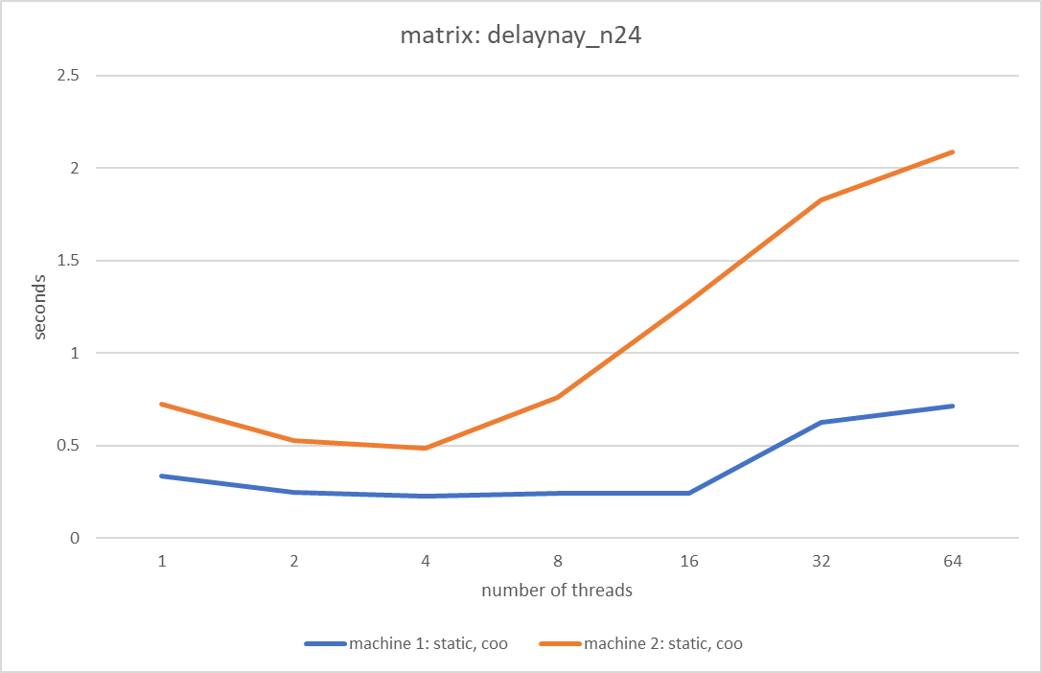
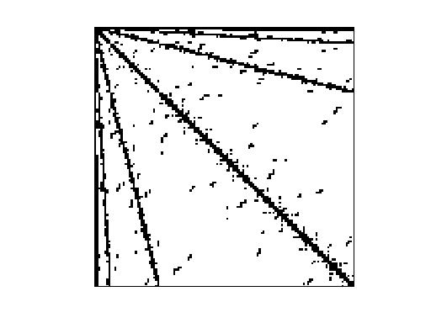
SMvM of arrowhead matrices
The work distribution is perfectly even in COO representation
Do not converge in CRS representation due difference in work load between heaviest and lightest loaded thread

Slide 9
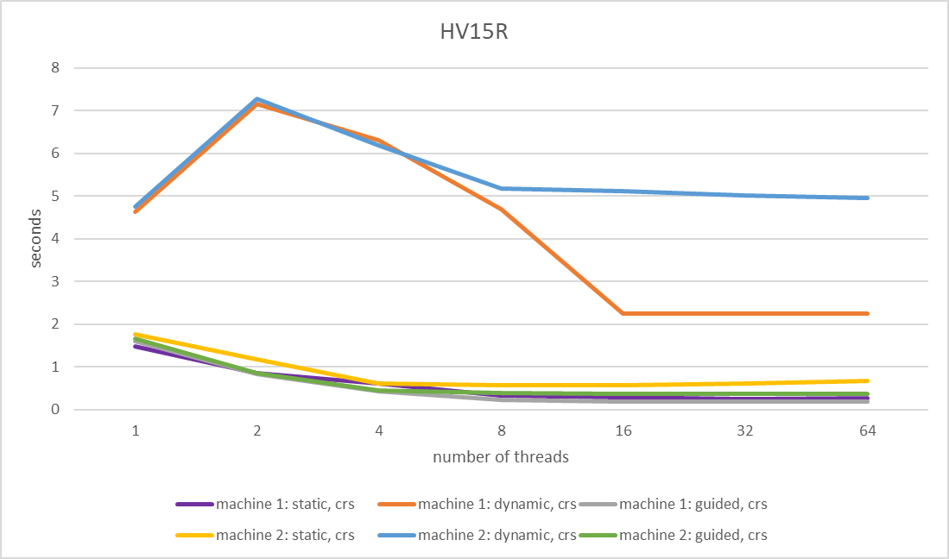
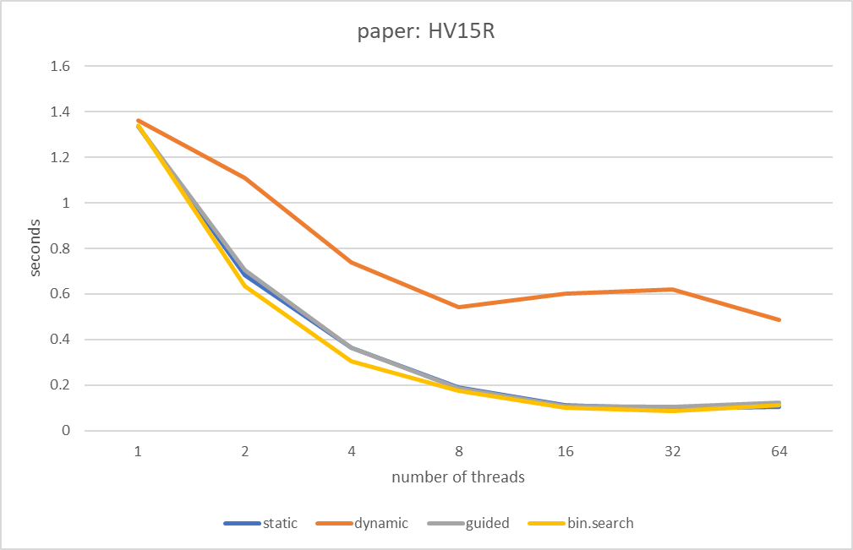
HV15R SMvM

Slide 10
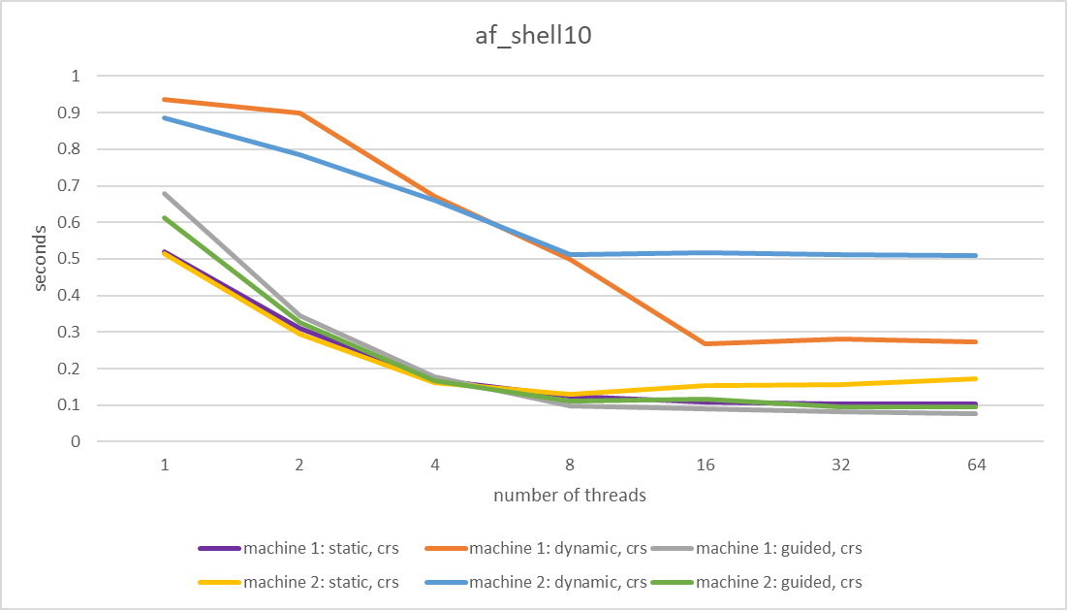
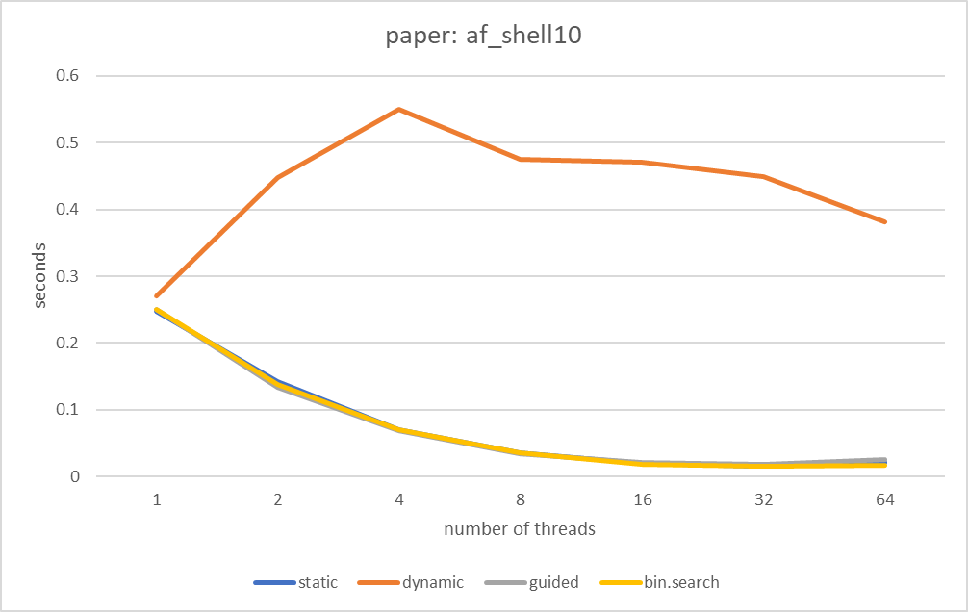
af_shell10 SMvM

Slide 11
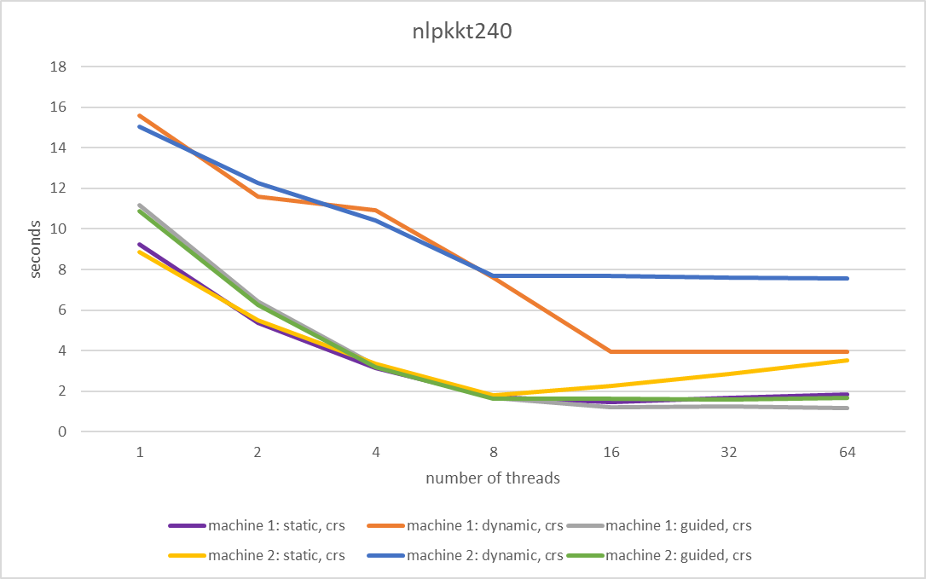
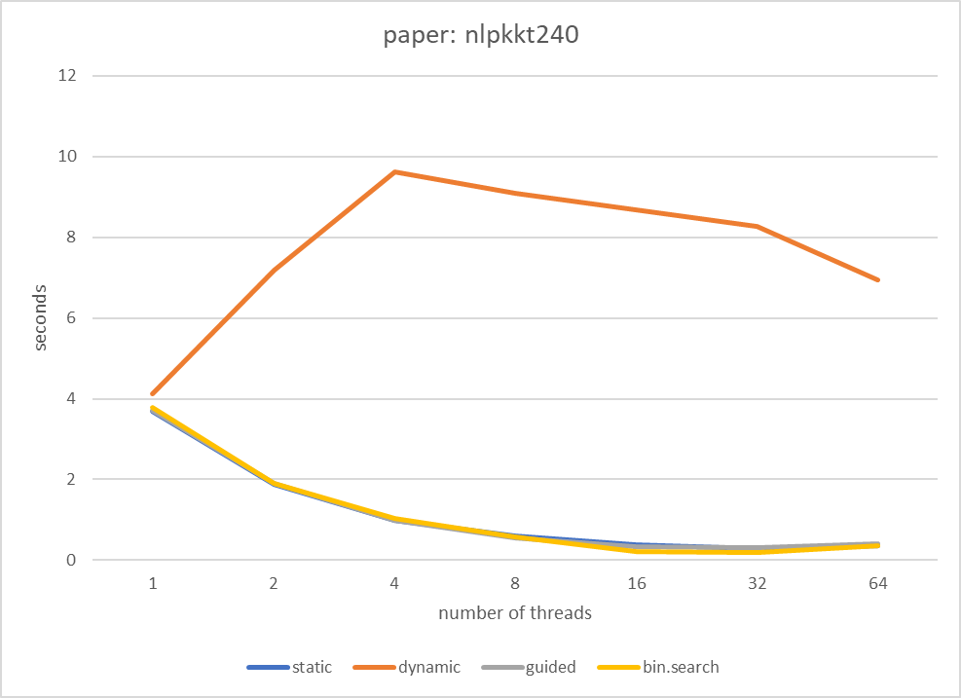
nlpkkt240 SMvM

Slide 12
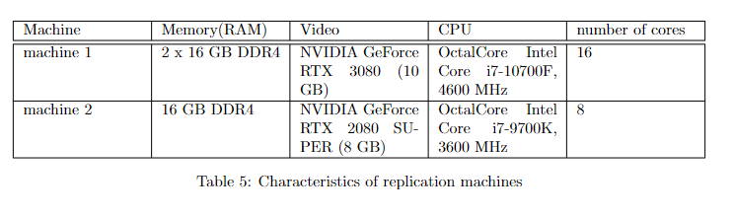
Characteristics of machines

Slide 13
Thank you for your attention!

