Slide 1
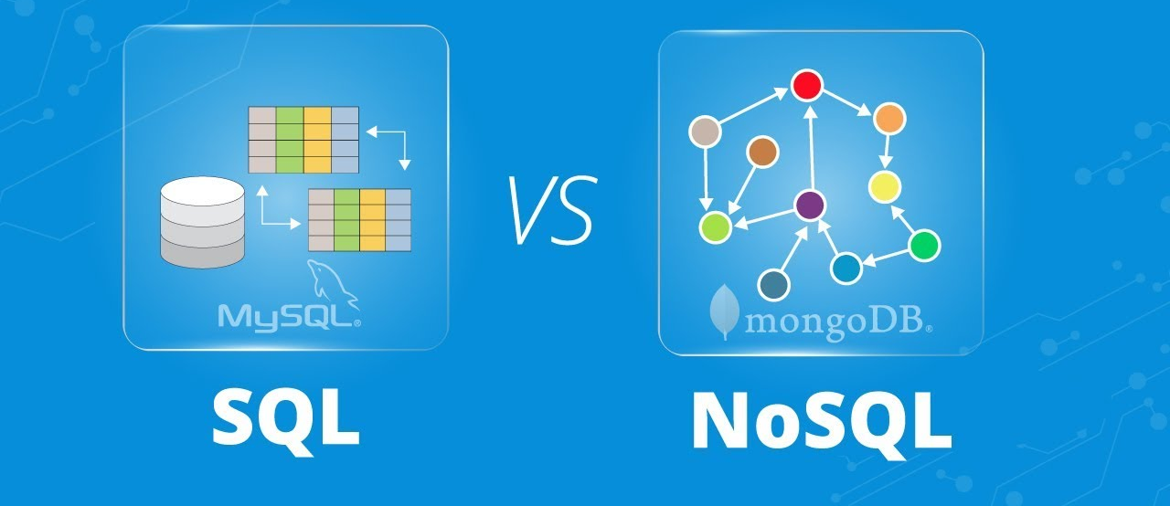
Differences between SQL and NoSQL

Slide 2
SQL: The Foundation of Structured Data Handling
A well-organized table with clearly labeled rows and columns, representing the structured nature of SQL databases.

Slide 3

NoSQL databases
Document-oriented model using JSON-like structures
Flexible schema that can evolve with application needs
Horizontal scaling for large datasets
High performance for real-time data access
Well-suited for applications with evolving data structures, large volumes of data, and a focus on agility

Slide 4
MongoDB vs SQL
 | MongoDB | SQL
Data Model | Document Store | Relational DBMS
Schema | Flexible | Fixed
Query Language | C++, Go, Python, JavaScript | C++
Licensing | Open-source | Commercial
Server OP | Windows, Linux, Solaris, OSX | Windows

Slide 5
