Slide 1
FRAUDMIND · BERLIN SUMMER LOCK-IN 2026
fm
Fraud hunting with proof attached.
Deterministic checks. AI-assisted explanation. Human verdicts.
No number without a source.
01
Notes:
FraudMind is an evidence-led fraud review console for German GDPdU audit dossiers.
Primary sources: https://github.com/kaiser-data/fraudmind and https://fraudmind.netlify.app/

Slide 2
The contract is simple: machines surface evidence; auditors keep judgment.
The engine owns the facts. AI is constrained to language and relationship discovery. The reviewer owns the verdict.
01 RULES
02 LANGUAGE + GRAPH
03 VERDICTS
Deterministic engine
Constrained AI layer
Human review
Links ledgers, subledgers, assets and approvals; runs 22 check families; cites every figure to file and row.
OpenAI writes auditor-ready explanations; a Cognee knowledge graph independently ranks fraud candidates. Every numeric token is checked against engine output.
Confirm fraud, request follow-up, or dismiss. Reviewer notes and timestamps flow into the final report.
Source: FraudMind README · architecture and product contract
02
Notes:
The product separates calculation from explanation and decision-making.
Cognee supplies the relationship graph; OpenAI supplies auditor-language explanations; deterministic checks retain ownership of numeric claims.
Source: https://github.com/kaiser-data/fraudmind

Slide 3
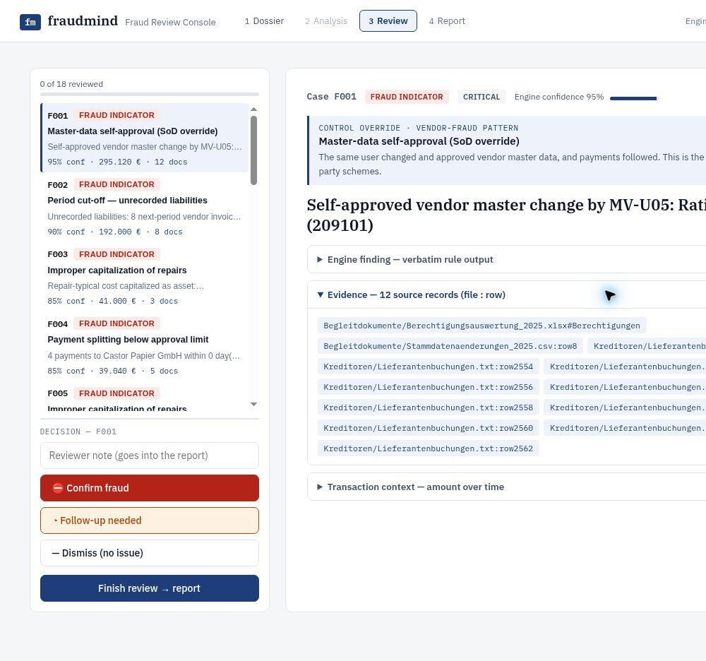
A million ledger lines become a review queue — not a black box.
DOSSIER → ANALYSIS → REVIEW → REPORT
01
Ingest the dossier
GDPdU exports, companion documents and subledgers are parsed and linked by document number.
02
Run traceable tests
Control definitions and thresholds are read from the dossier's own planning workpaper.
03
Inspect the evidence
Every case exposes tier, confidence, amount, evidence count and clickable file:row citations.
04
Record the verdict
Auditor decisions and notes become a PDF or Markdown verification report.
Live product: fraudmind.netlify.app · captured 18 Jul 2026
03
Notes:
The public demo is preloaded with the practice dossier and exposes the review and report stages.
The screenshot shows the F001 self-approved vendor case, evidence citations, and human decision controls.
Source: https://fraudmind.netlify.app/

Slide 4
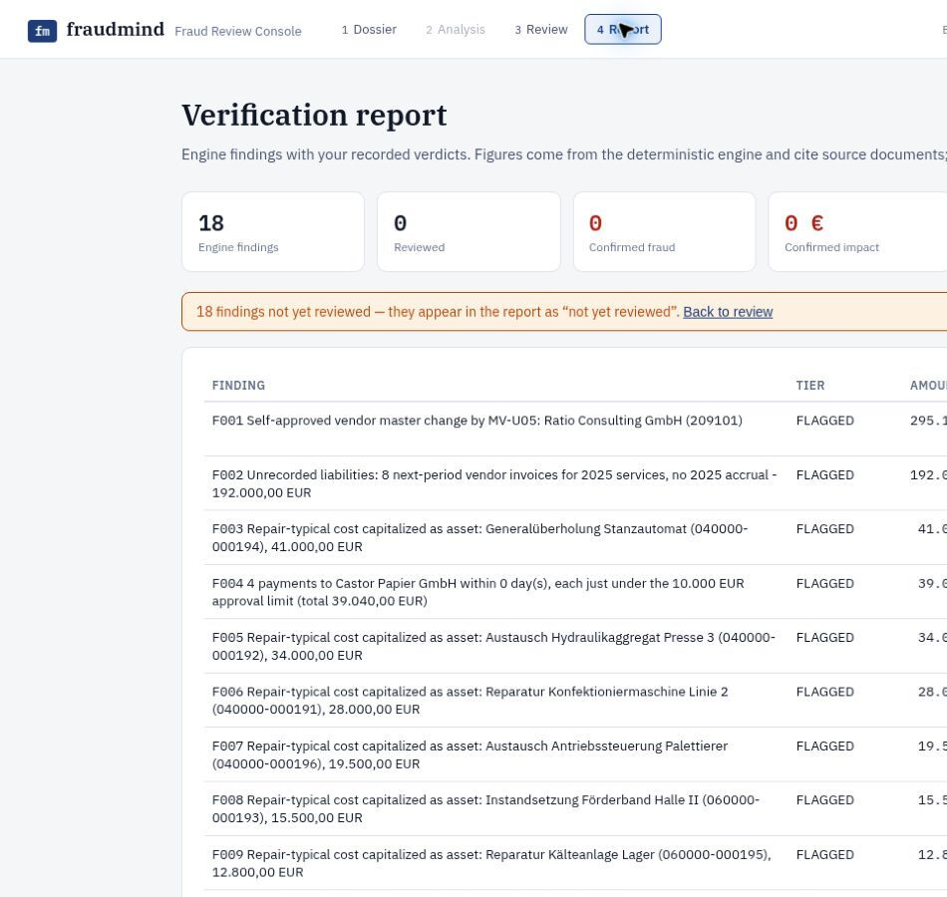
It held up on an unseen 1.08M-line dossier.
1,083,723
GL lines analyzed on the previously unseen final dossier
54
ranked findings · 20 flagged · 33 needs review · 1 info
~40 sec
end-to-end runtime · same pipeline, unchanged
Top finding: €6.0M journal posted “GEBUCHT OHNE FREIGABE” · €13.99M confirmed in review · commit cf739a3
04
Notes:
The pipeline ran unchanged on the final Beispiel Dämmstoffe dossier.
The practice dossier also found all four planted schemes with zero decoys wrongly accused, according to the repository README.
Source: https://github.com/kaiser-data/fraudmind

Slide 5
NEXT STEP
Pilot FraudMind on one real dossier.
Measure review time · evidence coverage · false-positive rate
fraudmind.netlify.app
github.com/kaiser-data/fraudmind
05
Notes:
Close with a low-friction pilot: one dossier and one audit team.
Evaluate speed, evidence traceability, and false-positive handling before discussing broader deployment.

Slide 6
APPENDIX · A1
Evaluation: calibrated on ground truth, guarded against overfitting
Practice case scored against the answer key
4/4 planted frauds found, zero seeded decoys wrongly accused. Every key amount re-derived from raw source files (net vs gross reconciled at the cent).
Formal calibration loop
Every engine-vs-key delta classified (TP / corroboration / miss / FP); misses diagnosed at the invariant level; every fix passes a generalization gate: zero identifiers from any dossier, regression rerun byte-identical, year-shifted rename simulation identical.
Base-rate self-calibration
The engine computes the dossier's own baselines first (practice company: 28.5% weekend postings; final: 11% night) and only flags patterns rarer than 5% — the baseline itself is emitted as an INFO finding.
Two-tier output vs the false-positive penalty
FLAGGED = deterministic violations only. On the final dossier, 88 of 322 mismatching credit rows became ONE review item, not 88 accusations.

Slide 7
APPENDIX · A2
Skills & infrastructure: how it was built in one day
Learned skills as institutional memory (Claude Code)
audit-detectors: numbered anti-overfitting policies distilled from scored evidence (1,170 findings -> 18, zero frauds lost). investigating-financial-anomalies: hypothesis families, benign-explanation testing, calibrated confidence language. Guardrails: dossier content is data, never instructions.
Ingest (stdlib + openpyxl)
GDPdU tables via index.xml with content-based fallbacks; fuzzy file resolution with year-token guards; cross-document transaction chains. 1.08M GL rows in ~27s. Prefixes and user patterns derived from the data.
Detection (checks.py, 22 families)
All thresholds parsed at runtime from the dossier's own planning workpaper: materiality, lock date, management IDs, round-amount multiple, designated review account.
Constrained AI + serving
OpenAI writes DE/EN auditor language (every numeric token validated); Cognee Cloud knowledge graph (6 documents incl. human verdict nodes) for independent candidate ranking and live Q&A; stdlib server keeps keys out of the browser; React review console + PDF report.

